Slide 1
Data Structures
By Peggy & Brandon

Slide 2
“Re-using the Array class instead of writing such data structures provides two benefits: First, time isn't wasted rewriting existing functionality, and second, the built-in browser implementation will be more efficient than its JavaScript counterpart.”
Source: http://codetunnel.io/9-javascript-tips-you-may-not-know/#arrays-as-multipurpose-data-structures

Slide 3
Benefits of Reusing the Array Class
Save time.
Efficiency.

Slide 4
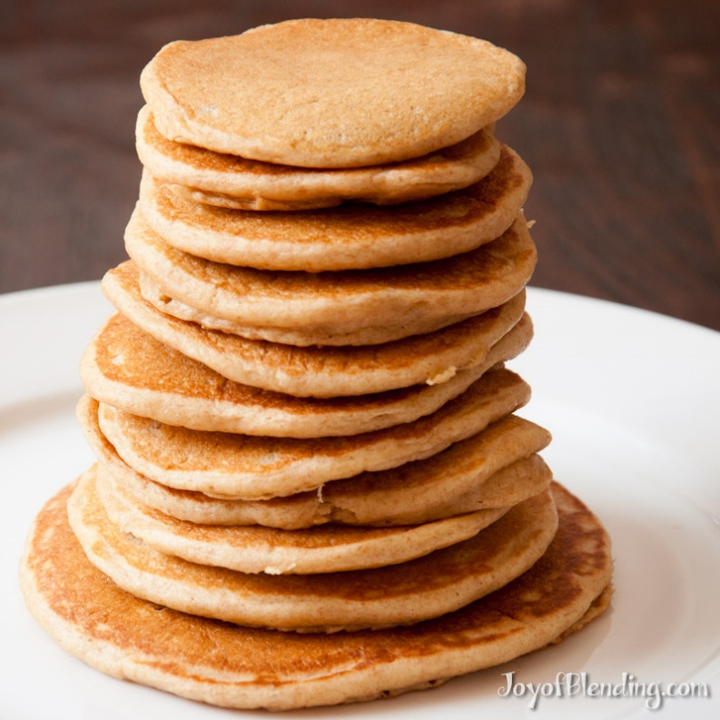
Stacks

Slide 5
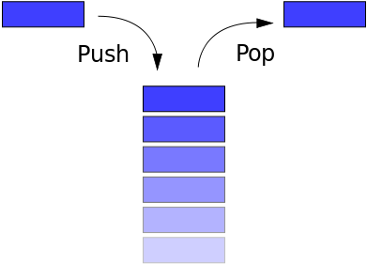
Stacks: Last In, First Out (LIFO)

Slide 6
Stacks: Code Sample
http://jsfiddle.net/kve6jzL7/

Slide 7

Queue

Slide 8
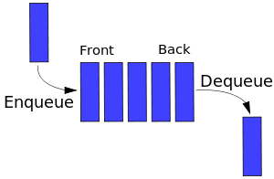
Queue: First In, First Out

Slide 9
Queues: Code Sample
http://jsfiddle.net/cbr3gunk/

Slide 10
Linked List
http://www.maniacworld.com/Dogs-Do-Conga-Line.html

Slide 11
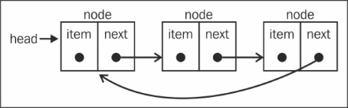
Linked List

Slide 12
Binary Tree
http://thecodeplayer.com/walkthrough/create-binary-trees-using-javascript-and-html5-canvas

Slide 13
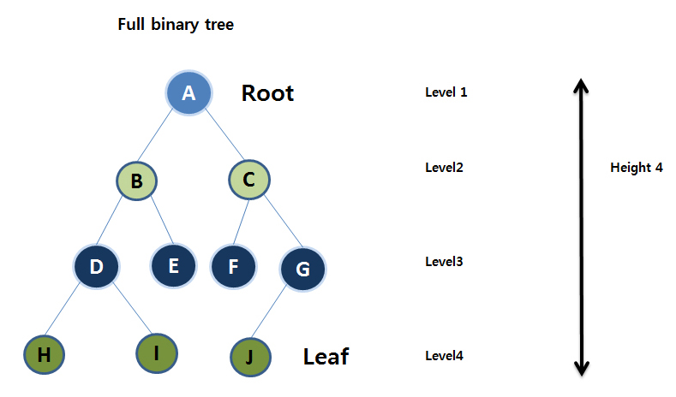
Binary Tree

Slide 14
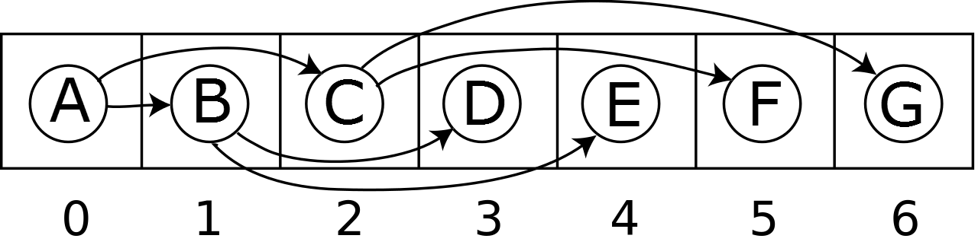
Binary Tree (continued)

Slide 15
Binary Tree: Code Sample
http://jsfiddle.net/4oh3pntc/

