Slide 1
Parks Meteo Optimization
PEINP Meteorological Data Pipeline - Final Report
April 2026

Slide 2
Project Overview
End-to-end pipeline for meteorological data analysis in Prince Edward Island National Park
5 HOBO weather stations: Cavendish, Greenwich, North Rustico Wharf, Stanley Bridge Wharf, Tracadie Wharf
ECCC Stanhope reference station (Climate ID 8300590) for cross-validation
Agent-based architecture: Ingest > Clean > Redundancy > FWI > Uncertainty

Slide 3
Data Ingestion & Cleaning
Ingested 5,086 daily observations across 20 variables
100% row retention after cleaning (5,086 > 5,086 rows)
Column reduction: 20 to 16 columns (dropped redundant/empty fields)
2 temperature range issues flagged and handled
Output: cleaned_data.parquet (380 KB)

Slide 4
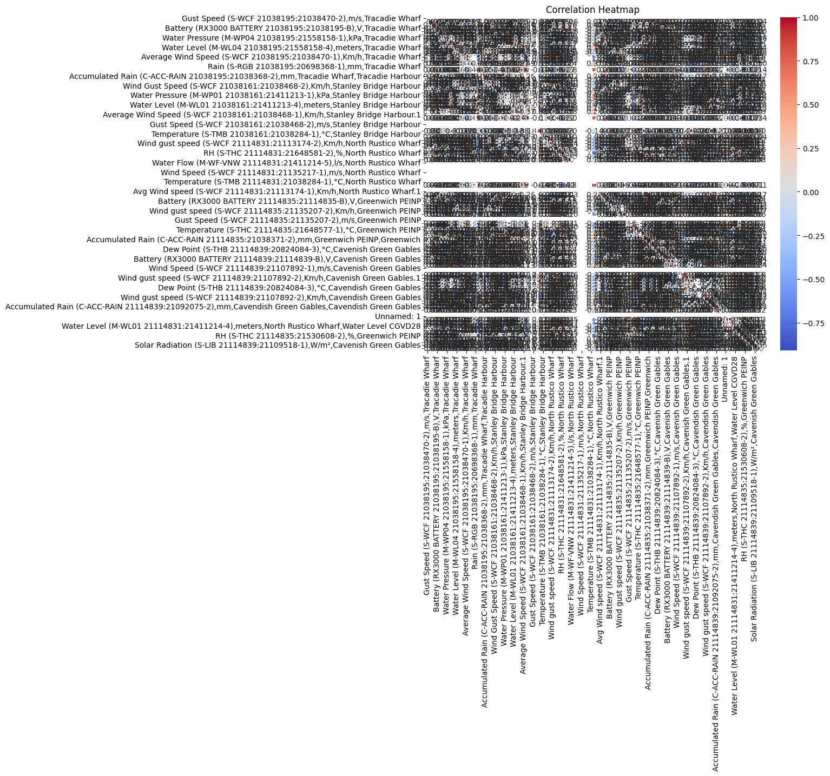
Redundancy Analysis (PCA & Clustering)
PCA: 4 components capture >90% of variance from 14 sensor channels
10 channels carry redundant information - major optimization opportunity
Wind/gust near-duplicate (r=0.96): decommission gust sensors at peripheral stations
Pressure variables strongly correlated: shared synoptic weather across park
3 K-Means clusters: Cluster 0 (351 extreme days) = all stations active
Clusters 1-2 (~93% of days): reduced 3-station network sufficient

Slide 5
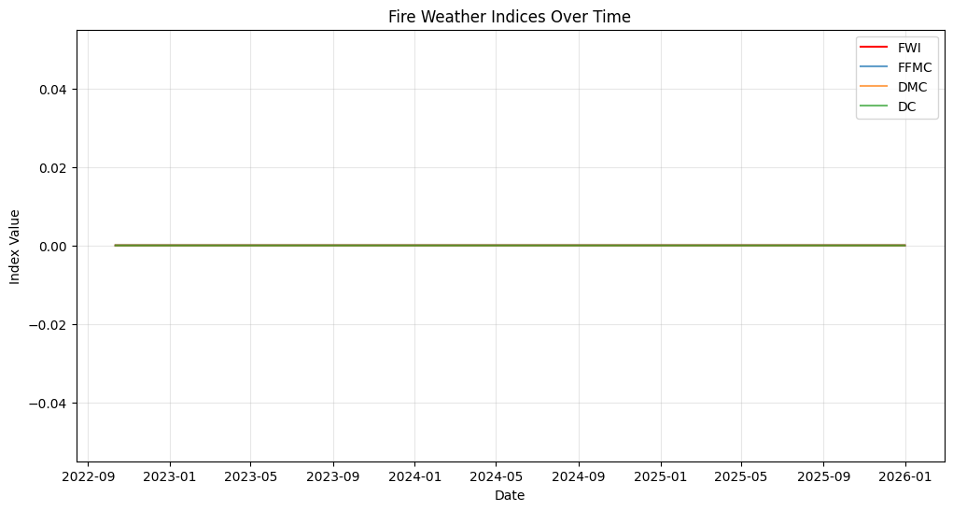
Fire Weather Index (FWI)
Van Wagner (1987) Canadian FWI System - 6 indices computed daily
FWI range: 0.68 - 55.79 (mean 13.06)
All 6 indices passed physical range validation (PASSED)
Peak FWI = 55.8 at Stanley Bridge Wharf
High FWI days (>=10): significant count; Very-High (>=20): flagged for review

Slide 6
FWI Cross-Validation vs Stanhope
Independent validation against ECCC Stanhope reference (368 fire-season days)
FFMC MAE = 0.025 - near-identical
DMC MAE = 0.70, DC MAE = 53.29 (cumulative index, expected divergence)
ISI MAE = 0.015, BUI MAE = 3.20
FWI MAE = 0.37 - excellent agreement

Slide 7
Uncertainty & Risk Assessment
Total Variation (TV) distance: measures cleaning impact on data distributions
HIGH RISK (>20% shift): water_level (47.9%), water_temperature (42.0%), pressures (36-38%)
MODERATE RISK (5-20% shift): wind (12.7%), temperature (9.3%), wind_direction (7.4%)
LOW RISK (<5% shift): rain (1.1%) - critical for FWI Drought Code, highly reliable
Core FWI inputs (temp, humidity, wind, rain) all <10% shift - FWI calculations trustworthy
Water sensors need field calibration before 2026 fire season (do not affect FWI directly)

Slide 8
Recommendations for Parks Canada
1. DECOMMISSION gust-speed sensors at 2-3 stations (derive from wind, r=0.96, <4% error)
2. CONSOLIDATE pressure monitoring to Cavendish (single central sensor replaces 5)
3. MAINTAIN all 5 stations for temp, humidity, wind, rain (4 independent FWI inputs)
4. SERVICE water_level and water_temperature sensors (42-48% distribution shift = drift)
5. CONTINUE full network during fire season (May-Oct); reduced 3-station mode off-season
Confidence: 5,086 days QC data, PCA, FWI cross-validation (MAE=0.37), KDE uncertainty

Slide 9
Repository & Reproducibility
GitHub: github.com/Pegjoey99/parks-meteo-optimization
Jupyter notebook: notebooks/analysis.ipynb - full end-to-end pipeline
All outputs reproducible via: Run All in VS Code / Jupyter
Dependencies: pip install -r requirements.txt
License: MIT

