Slide 1
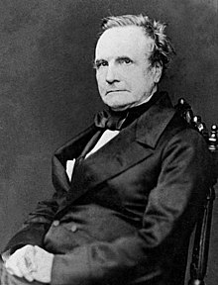
Charles Babbage
Haution Ilan

Slide 2
His Life
26 December 1791
mathematician, philosopher, inventor and mechanical engineer
Forty hill -> cambrige
Gratuated and married (Georgiana Whithmore) in 1814
Fellow of royal society 1816
1827 death of his father and his wife
Died on 18 October 1871

Slide 3
Difference engine
Limit boating accident
Idea 1812
Start by Blaise Pascal and Gottfried Leibniz
Ada Lovelace first algorithm
Royal Astronomical Society 1821
Start in 1823
Stop in 1833

Slide 4
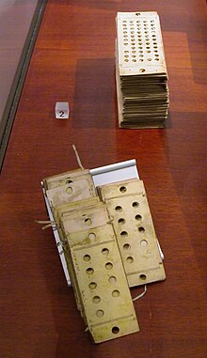
Analytique table
1834 -> 1836
Work with punched card
Can’t make his machine -> lake of technique

Slide 5
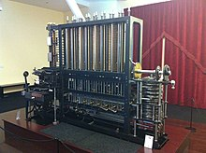
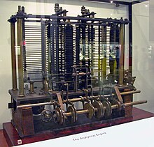
Difference machine n°2
The difference engine but simplified and realisable
Charles babbage never do it
Build by the London Science Museum in 1985 -> 2002

Slide 6
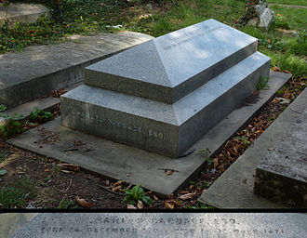
Thanks for listening

