Slide 1
BERT 改善
2021/7/30
吳佩芩

Slide 2
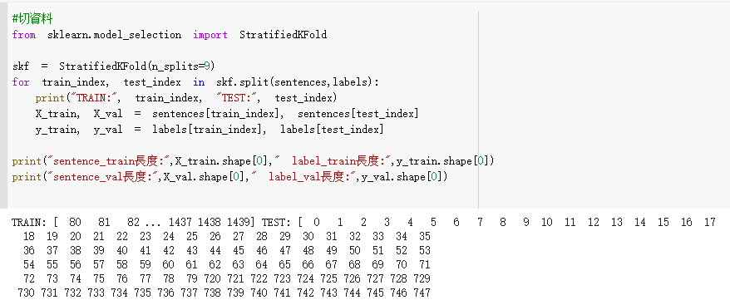
StratifiedKFold
The folds are made by preserving the percentage of samples for each class

Slide 3
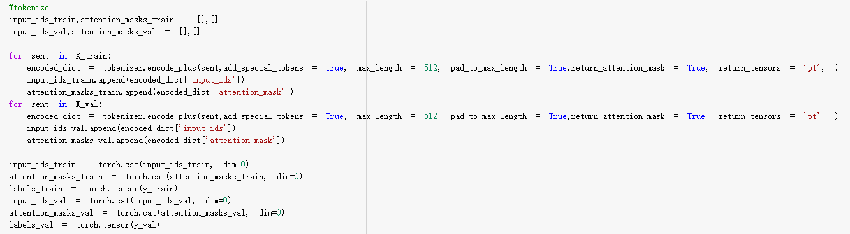
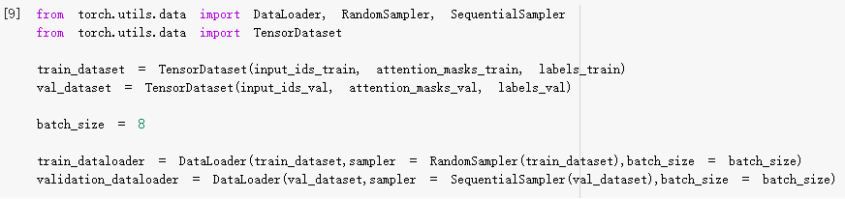

Slide 4
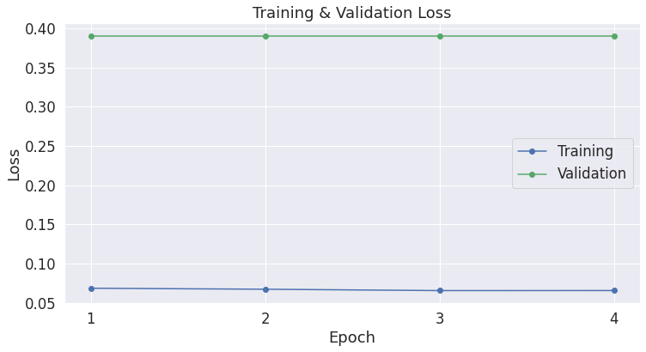

Slide 5
錯誤
沒存到每一筆train,val
需逐筆train,val都跑過

