Slide 1
HW10_Stock-Prediction-Models(1)
吳佩芩

Slide 2
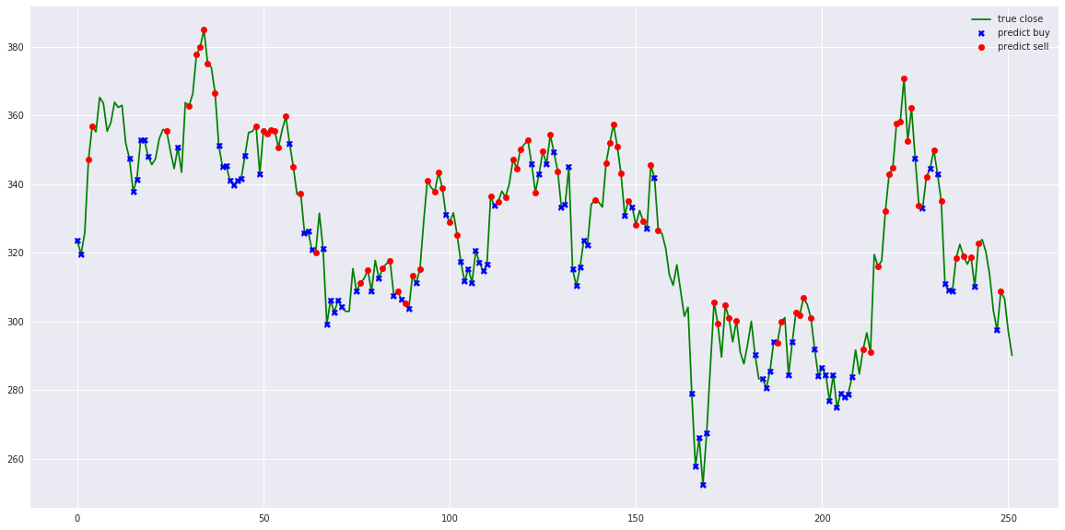
Stock-Prediction-Models
包含許多機器學習、深度學習模型與交易策略
可做到交易機器人和模擬

Slide 3
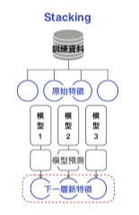
Models
Deep-learning models
LSTM
LSTM Bidirectional
LSTM 2-Path
GRU
GRU Bidirectional
GRU 2-Path
Vanilla
Vanilla Bidirectional
Vanilla 2-Path
Bonus
How to use one of the model to forecast t + N, how-to-forecast.ipynb
Consensus, how to use sentiment data to forecast t + N, sentiment-consensus.ipynb
Stacking models
Deep Feed-forward Auto-Encoder Neural Network to reduce dimension + Deep Recurrent Neural Network + ARIMA + Extreme Boosting Gradient Regressor
Adaboost + Bagging + Extra Trees + Gradient Boosting + Random Forest + XGB
LSTM Seq2seq
LSTM Bidirectional Seq2seq
LSTM Seq2seq VAE
GRU Seq2seq
GRU Bidirectional Seq2seq
GRU Seq2seq VAE
Attention-is-all-you-Need
CNN-Seq2seq
Dilated-CNN-Seq2seq
Notes:
Stacking堆疊

Slide 4
Agents (策略)
Double Recurrent Q-learning agent
Duel Q-learning agent
Double Duel Q-learning agent
Duel Recurrent Q-learning agent
Double Duel Recurrent Q-learning agent
Actor-critic agent
Actor-critic Duel agent
Actor-critic Recurrent agent
Actor-critic Duel Recurrent agent
Curiosity Q-learning agent
Recurrent Curiosity Q-learning agent
Duel Curiosity Q-learning agent
Neuro-evolution agent
Neuro-evolution with Novelty search agent
ABCD strategy agent
Turtle-trading agent
Moving-average agent
Signal rolling agent
Policy-gradient agent
Q-learning agent
Evolution-strategy agent
Double Q-learning agent
Recurrent Q-learning agent
Notes:
Turtle-trading agent:海龜交易法則，六大基本原則:Markets - What to buy or sell(標的物的選擇)Position Sizing - How much to buy or sell(哪個價位應該買進或賣出多少)Entries - When to buy or sell(進場或出場時機)Stops - When to get out of a losing position(何時止損)Exits - When to get out of a winning position(何時獲利了結)Tactics - How to buy or sell(買進或賣出策略)
Moving-average agent:指數移動平均

Slide 5
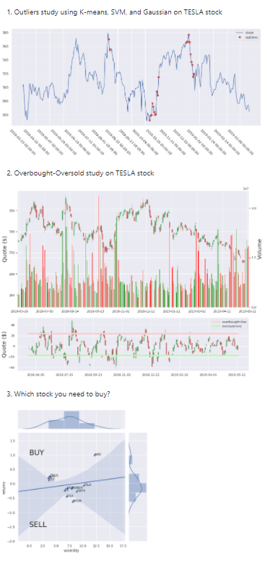
Data Explorations
stock market study on TESLA stock, tesla-study.ipynb
Outliers study using K-means, SVM, and Gaussian on TESLA stock, outliers.ipynb
Overbought-Oversold study on TESLA stock, overbought-oversold.ipynb
Which stock you need to buy? which-stock.ipynb

Slide 6
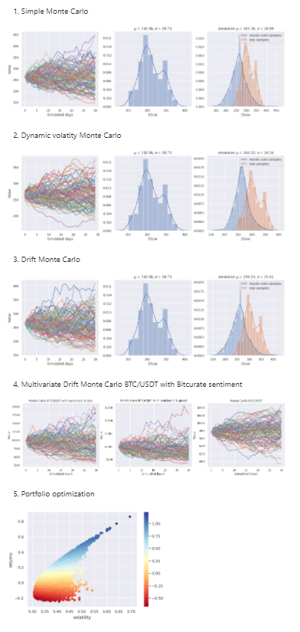
Simulations (模擬)
Simple Monte Carlo, monte-carlo-drift.ipynb
Dynamic volatility Monte Carlo, monte-carlo-dynamic-volatility.ipynb
Drift Monte Carlo, monte-carlo-drift.ipynb
Multivariate Drift Monte Carlo BTC/USDT with Bitcurate sentiment, multivariate-drift-monte-carlo.ipynb
Portfolio optimization, portfolio-optimization.ipynb, inspired from https://pythonforfinance.net/2017/01/21/investment-portfolio-optimisation-with-python/

Slide 7
Tensorflow-js
LSTM Recurrent Neural Network and Simple signal rolling agent inside Tensorflow JS
Misc
fashion trending prediction with cross-validation, fashion-forecasting.ipynb
Bitcoin analysis with LSTM prediction, bitcoin-analysis-lstm.ipynb
Kijang Emas Bank Negara, kijang-emas-bank-negara.ipynb

Slide 8
環境要求
conda install tensorflow=1.12.0 (python 3.6以下)

Slide 9
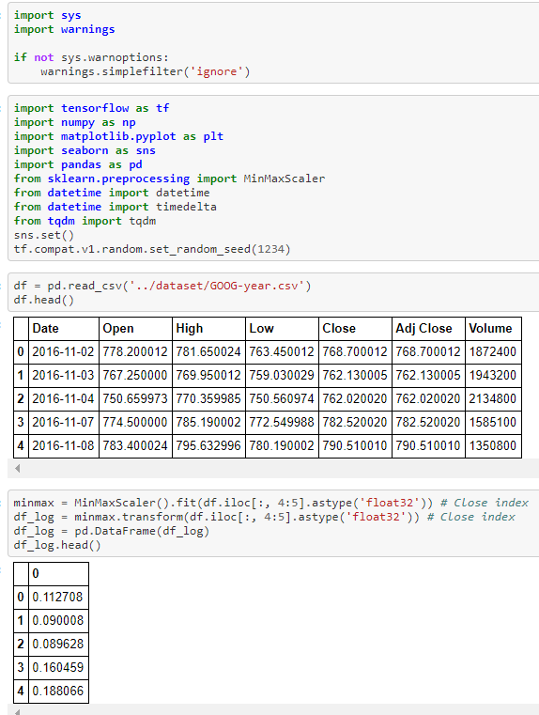
DL model:
匯入資料

Slide 10
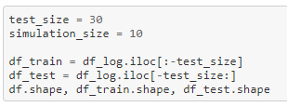
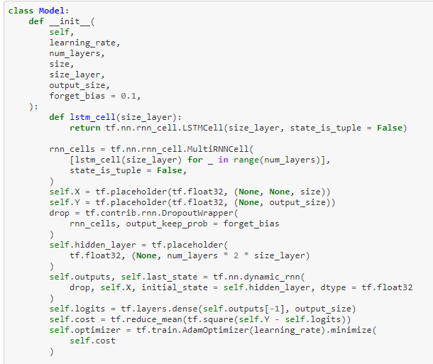
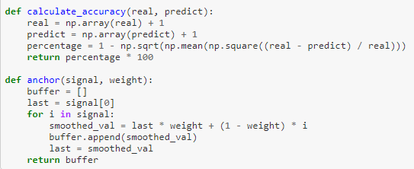
Split train and test
cut the dataset to train and test datasets
class Model
train至數據集結束前30天
Test從數據集錢30天到結束
讓模型根據最近30天進行預測，然後將重複進行10次實驗

Slide 11
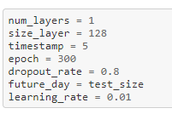

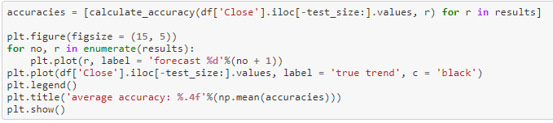
輸入參數:
def forecast
執行
輸出結果

