Slide 1
Apply machine learning on Investing stocks
Peicheng Wen

Slide 2
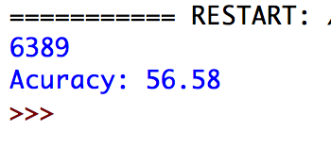
Original result
SVM
35 features
Data size:6389
Test times:100

Slide 3
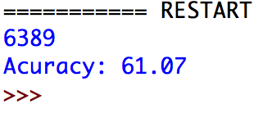
Rbf SVM
Linear SVM Result = 56.58
clf = svm.SVC(kernel="rbf",C=1.0)

Slide 4
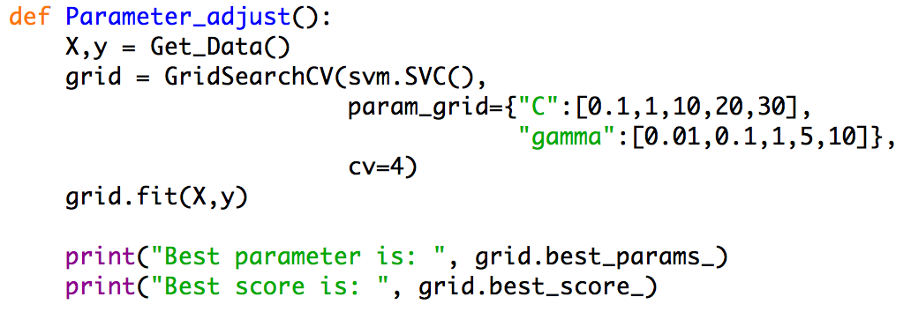
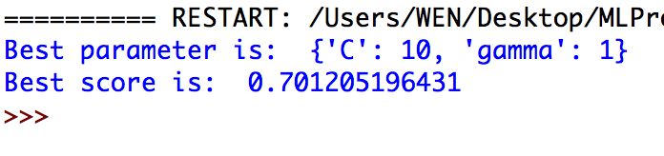
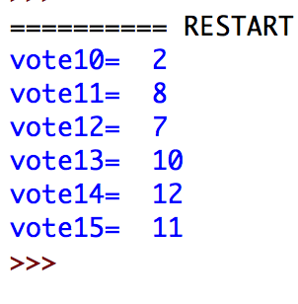
RBF Parameter adjustment
C = 14
Gamma = 1

Slide 5
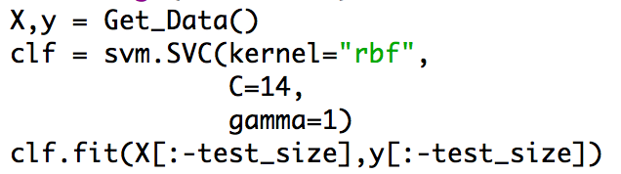
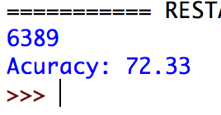
RBF with appropriate hyper-parameter
RBF with default parameter: 61.07

Slide 6
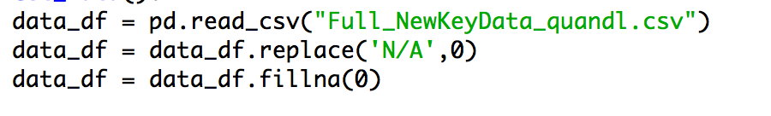
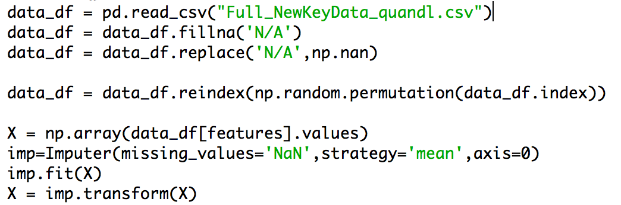
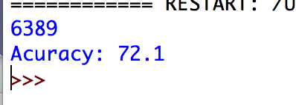
Missing data processing

Slide 7
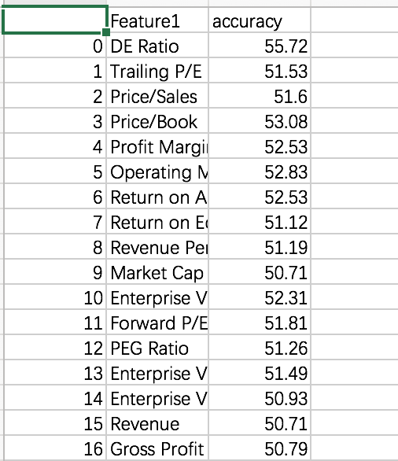
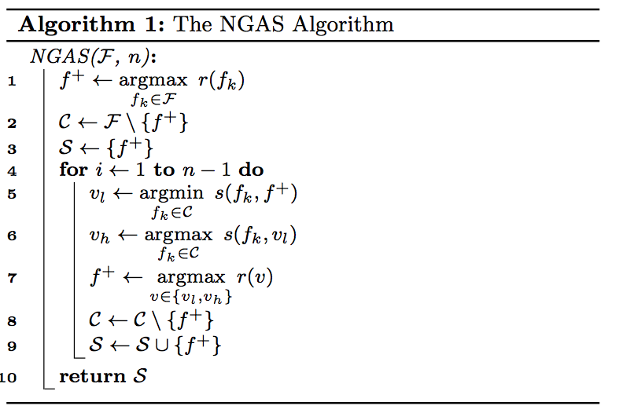
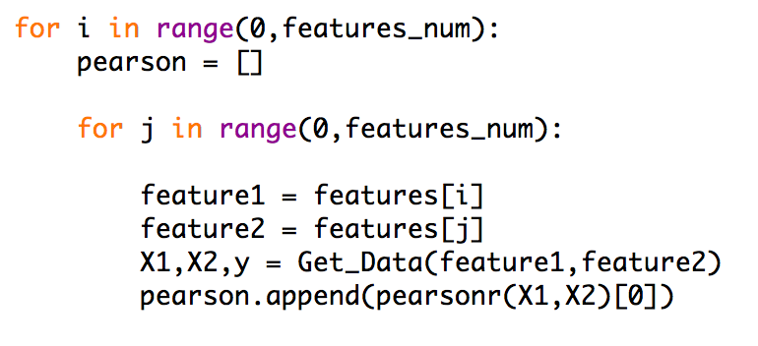
Feature selection-Naïve greedy search

Slide 8
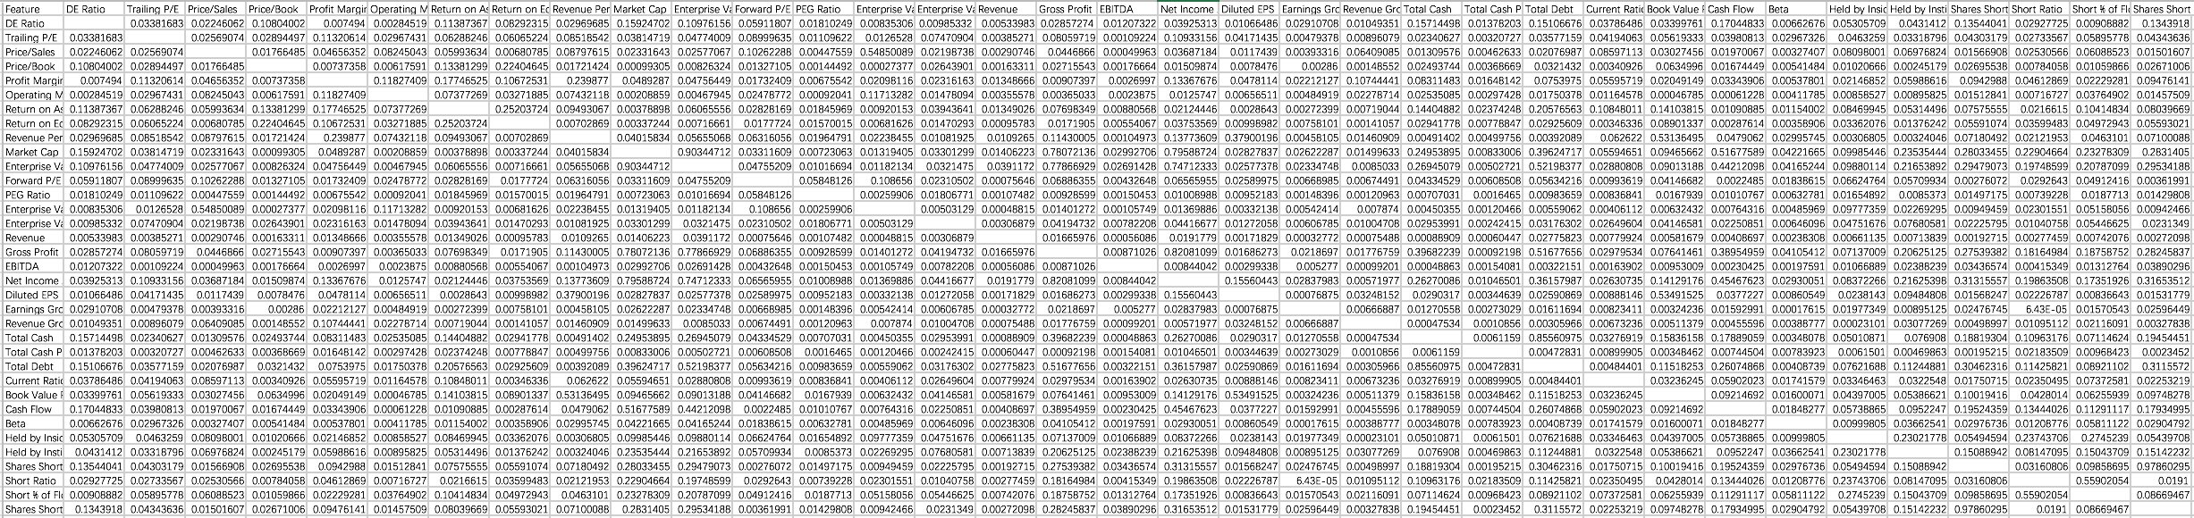
Feature selection-Naïve greedy search

Slide 9
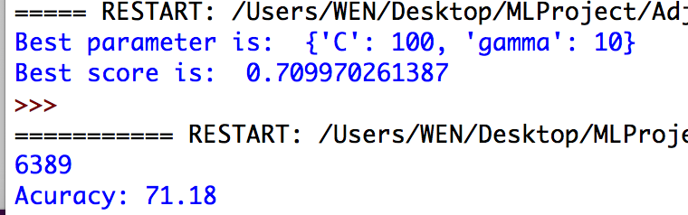
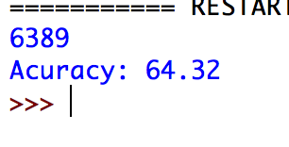
Feature selection – 10 selected features
Complete time (10 selected features & adjusted parameters): 9’51’’
Complete time (10 selected features): 3’50’’
Complete time (without feature selection):7’02’’

Slide 10
conclusion
Method | Accuracy
Linear | 56.58
RBF & default parameter | 61.07
RBF & adjusted parameter | 72.33
Missing data processing – mean value | 72.10
Naïve Greedy Search Algorithm Feature Selection | 71.18

Slide 11
Demo & code explanation

