Slide 1
Team rzz
AED Final Project

Slide 2
1、PROBLEM
Contents
PPT模板：www.1ppt.com/moban/ PPT素材：www.1ppt.com/sucai/
PPT背景：www.1ppt.com/beijing/ PPT图表：www.1ppt.com/tubiao/
PPT下载：www.1ppt.com/xiazai/ PPT教程： www.1ppt.com/powerpoint/
资料下载：www.1ppt.com/ziliao/ 范文下载：www.1ppt.com/fanwen/
试卷下载：www.1ppt.com/shiti/ 教案下载：www.1ppt.com/jiaoan/
PPT论坛：www.1ppt.cn PPT课件：www.1ppt.com/kejian/
语文课件：www.1ppt.com/kejian/yuwen/ 数学课件：www.1ppt.com/kejian/shuxue/
英语课件：www.1ppt.com/kejian/yingyu/ 美术课件：www.1ppt.com/kejian/meishu/
科学课件：www.1ppt.com/kejian/kexue/ 物理课件：www.1ppt.com/kejian/wuli/
化学课件：www.1ppt.com/kejian/huaxue/ 生物课件：www.1ppt.com/kejian/shengwu/
地理课件：www.1ppt.com/kejian/dili/ 历史课件：www.1ppt.com/kejian/lishi/
2、APPROACH
3、OBJECT MODEL
4、USE CASE

Slide 3
1
PROLEM STATEMENT

Slide 4
+
Large cost on the process of retail
No stable Collaborator
+
Transport
company
Manufacturing company
Lack of the sale market
+
Can’t easily buy product overseas
+
Have no idea about the price change
+
Customer

Slide 5
2
APPROACH

Slide 6
Link together
Sell large amount products directly
stable Collaborator
Transport
company
Manufacturing company
Routes
Expand sale market to other countries
products
Export
company
products
Can easily buy product overseas
Compare price easily
Customer

Slide 7
Value to export company: Overseas Retail
A Comprehensive view of business
Handle all work flows in operation process
Separately roles’ work area
Detailed order & revenue information for business decision
Export
company

Slide 8
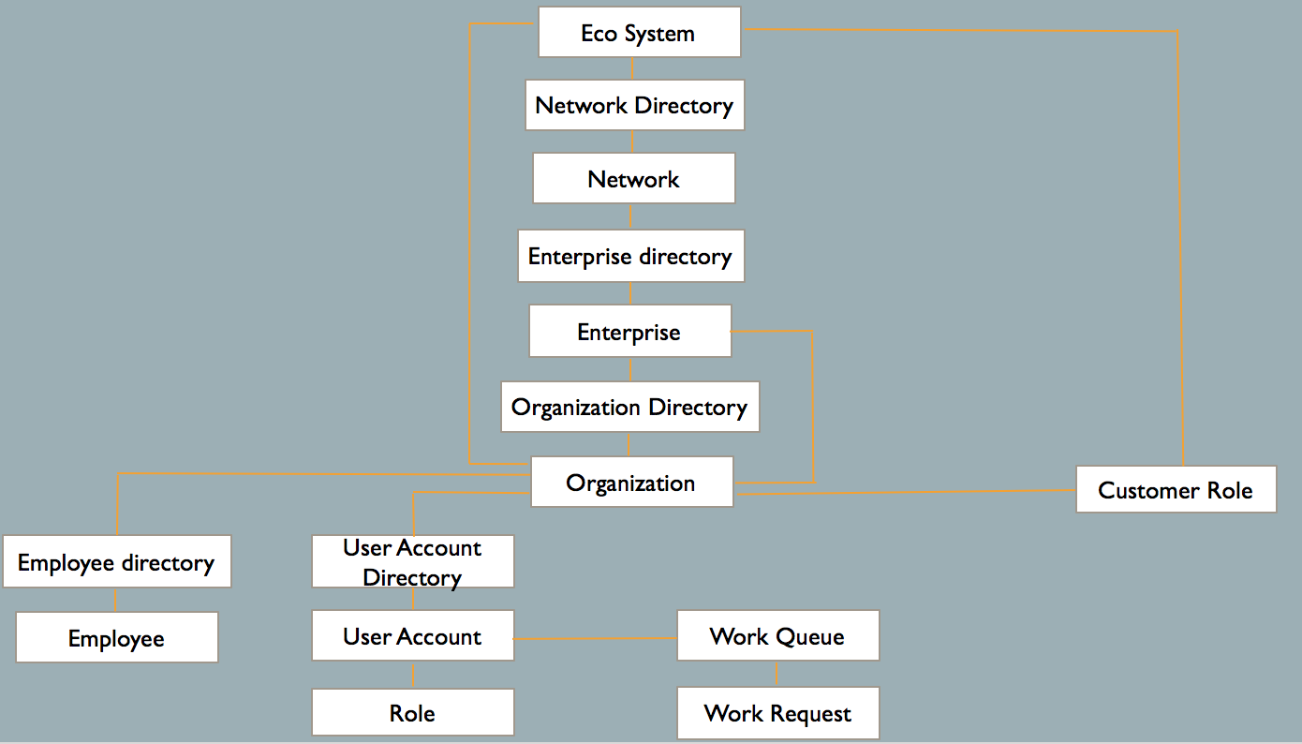
ECO SYSTEM ARCHITECTURE

Slide 9
3
Object Model

Slide 10
ECO SYSTEM ARCHITECTURE

Slide 11
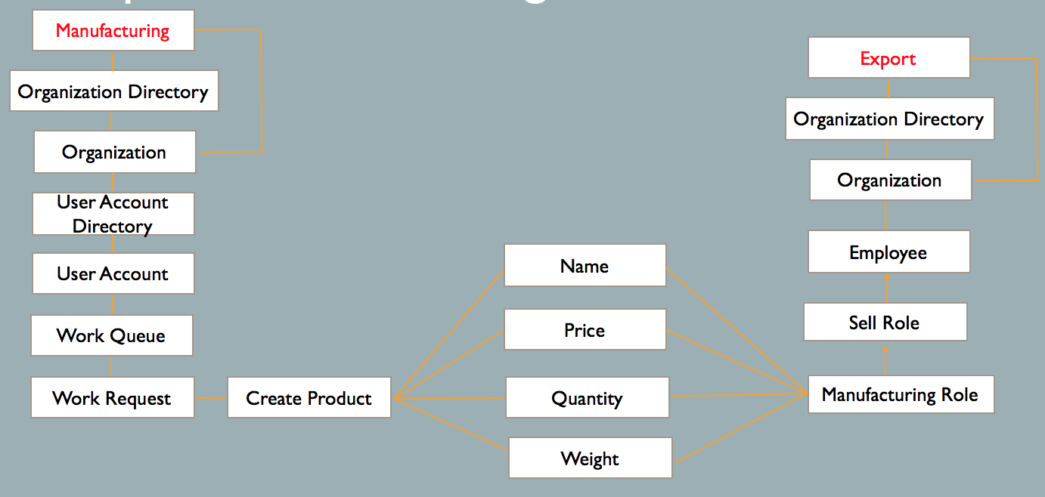
Enterprise Manufacturing Architecture

Slide 12
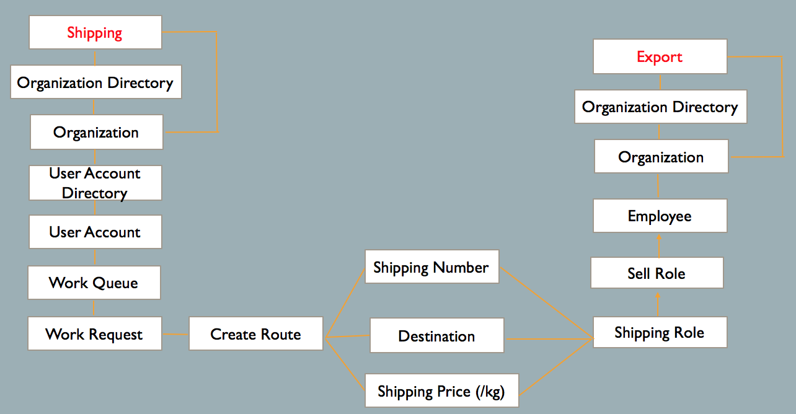
Enterprise Shipping Architecture

Slide 13
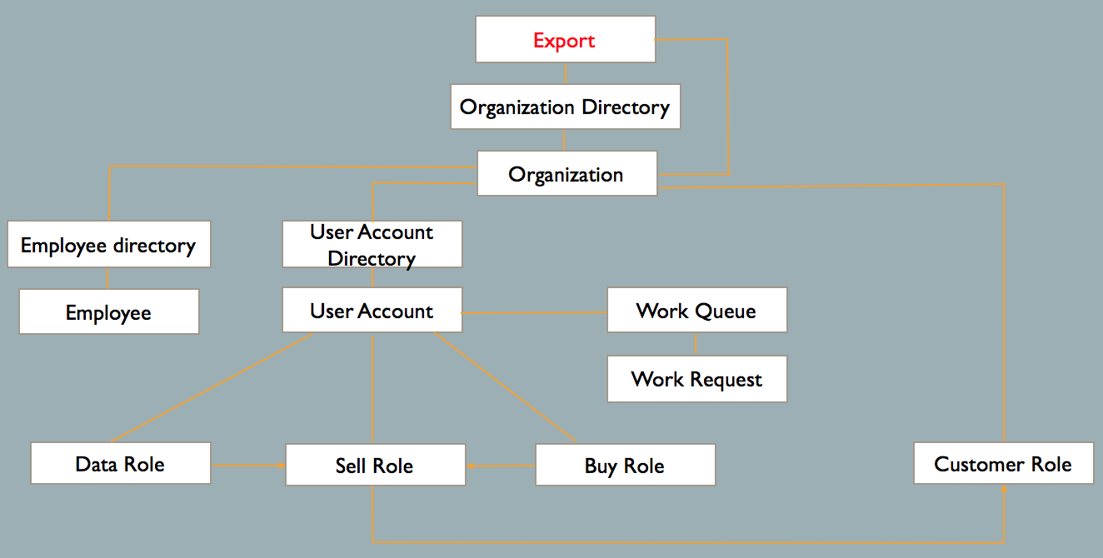
Enterprise Export Architecture

Slide 14
4
Use cases

Slide 15
Use Cases
01
02
03
04
05
Administrator
Manufacturing
Company
Transport
Company
Export
Company
Customer
Manage whole System
Manufacture and list products to be sold
Set and list routes to transport products
Manage three departments
Buy products from the export company directly

Slide 16
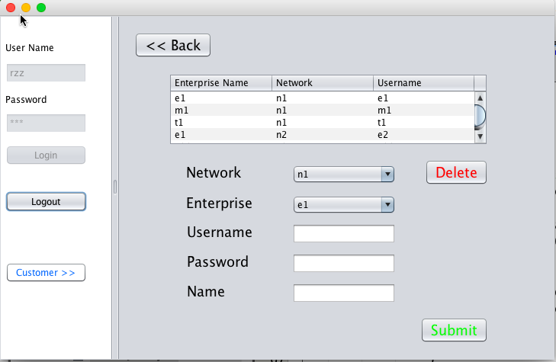
SystemAdmin: Create Admin for enterprises

Slide 17
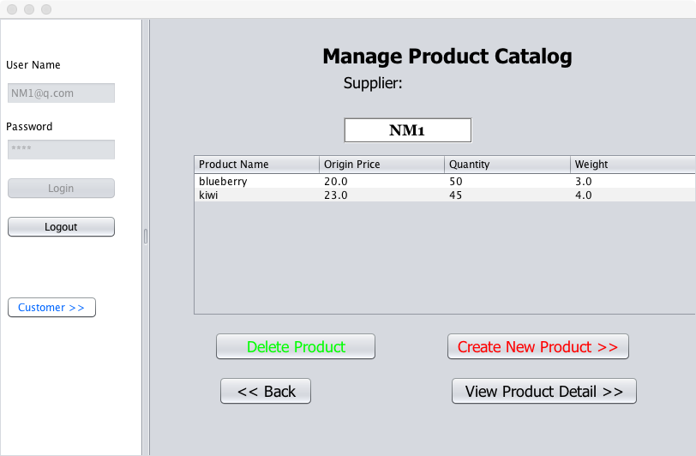
Manufacturing company

Slide 18
Export - Department
01
02
03
Shipping
Department
Purchasing
Department
Sales
Department
Collect the shipping information from the transport company
Collect the products information from the manufacturing company
Assign salesmen to sell products to different countries

Slide 19
Export - Employee
01
02
03
Of Shipping
Department
Of Purchasing
Department
Of Sales
Department
Select the routes through that export company sells products
Buy products from the manufacturing company
Select where and what to sell from the information provided by other two departments

Slide 20
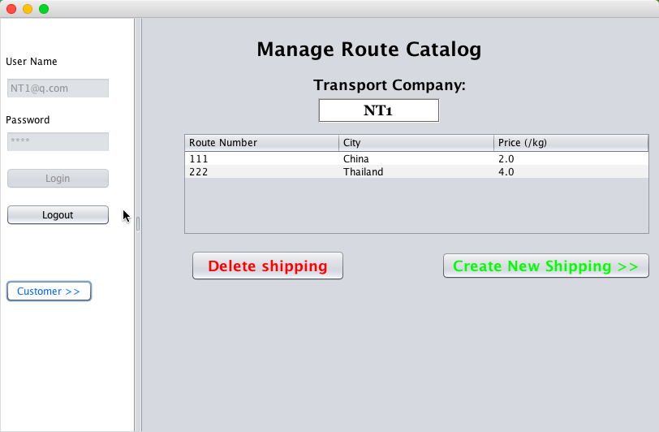
Export :Shipping department

Slide 21
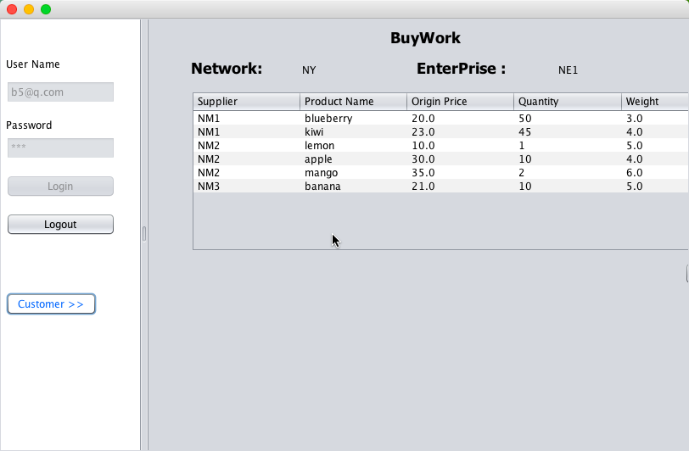
Export :Buying department

Slide 22
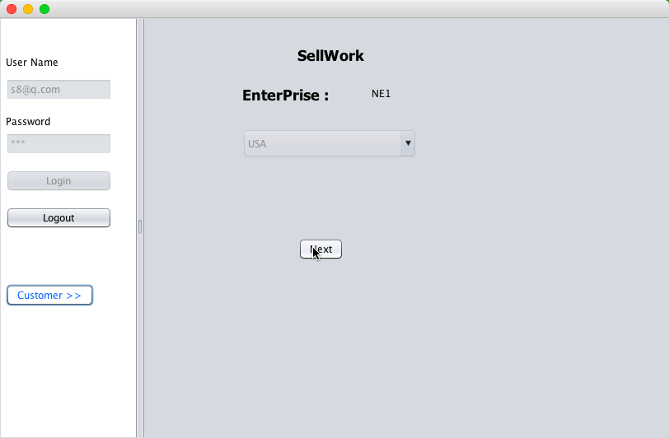
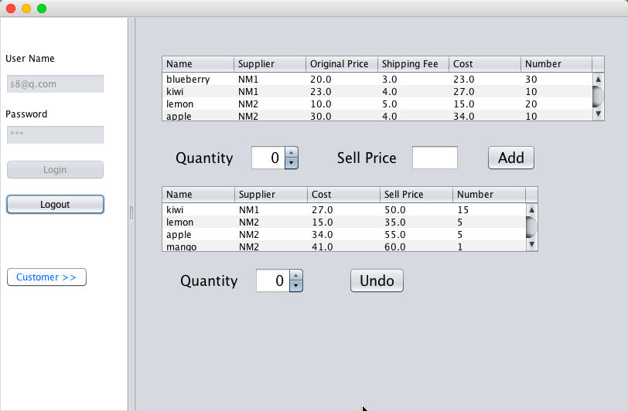
Export :Sale department

Slide 23
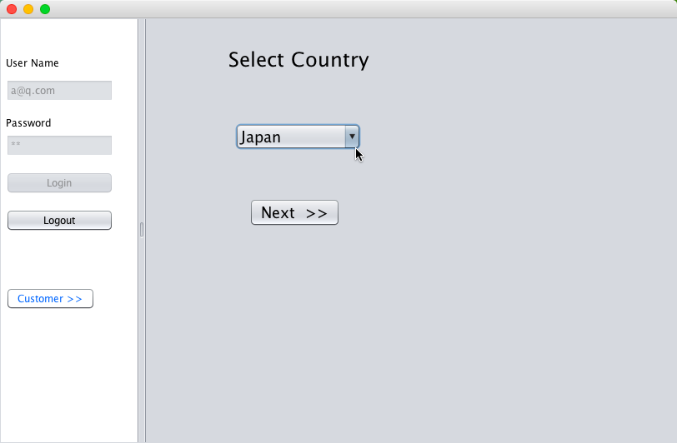
Customer: select country

Slide 24
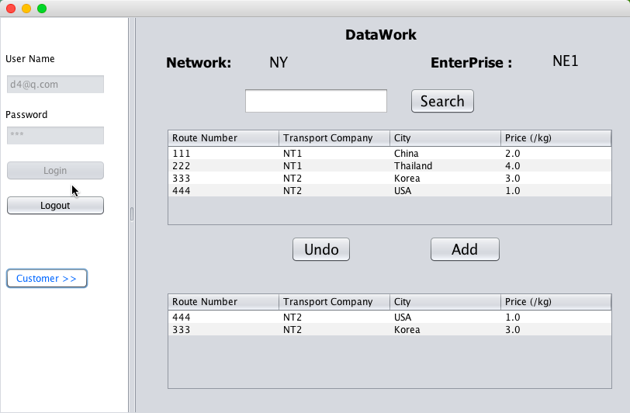
Customer: select enterprise

Slide 25
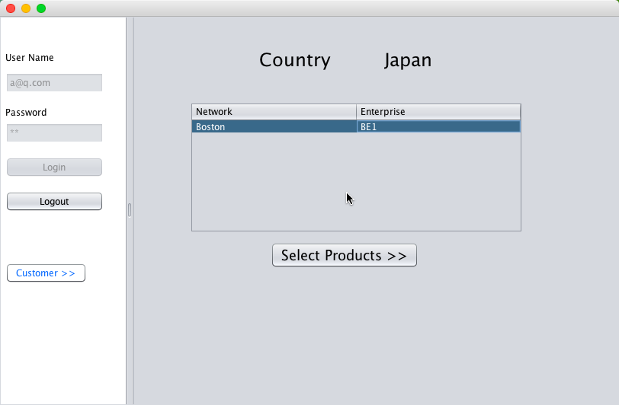
Customer: select enterprise

Slide 26
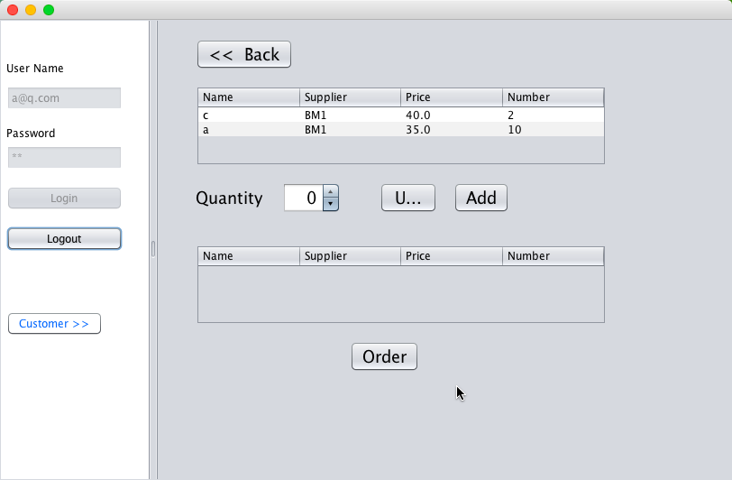
Customer: Order

Slide 27
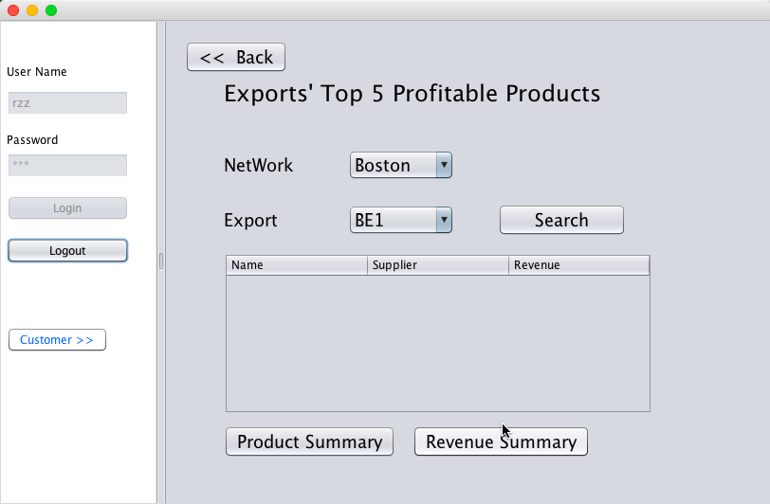
Detailed data: Profitable product of each export

Slide 28
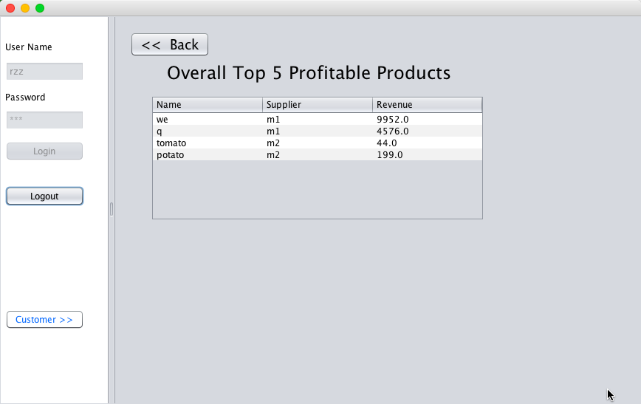
Detailed data:Overall Profitable product

Slide 29
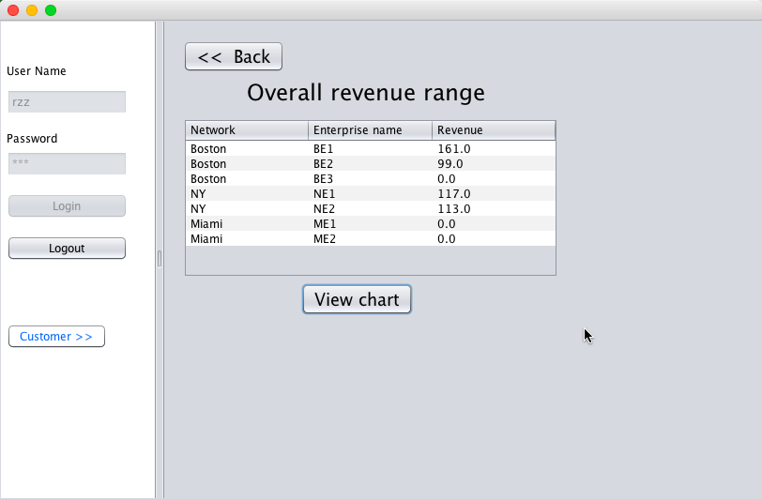
Detailed data: Overall revenue

Slide 30
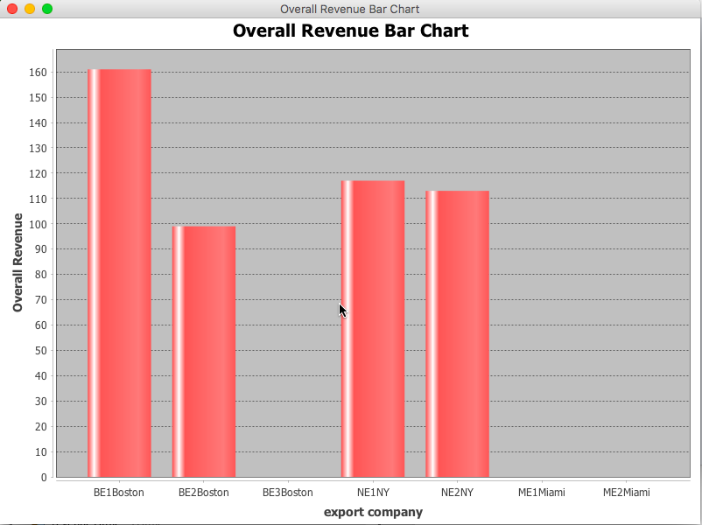
Detailed data : Overall revenue chart

Slide 31
RZZ
THANK YOU

