Slide 1
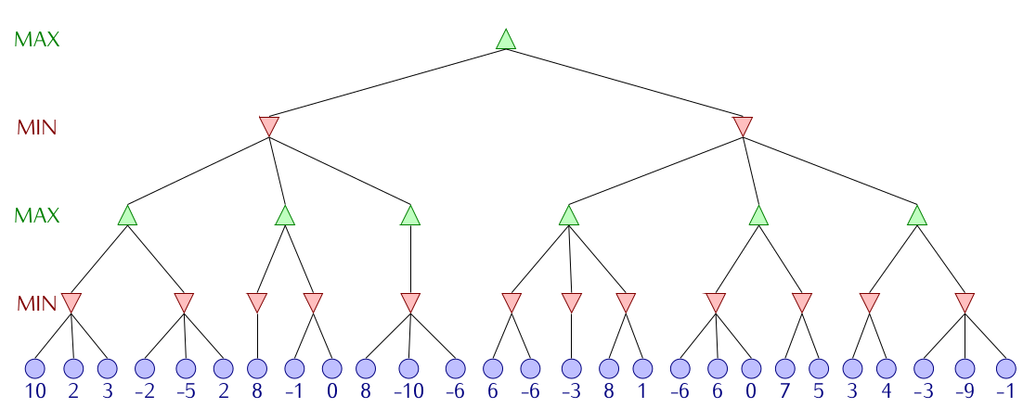
1
-10
1
2
8
-10
1
5
3
2
-2
8
-1
-10
-6
-3
1
-6
5
3
-9

Slide 2
α = - ∞, -10, 1
β = + ∞
1
α = - ∞
β = + ∞, 2, -10
α = -10
β = + ∞, 1
-10
1
α = - ∞, 2
β = + ∞
α = - ∞
β = 2
α = - ∞, -10
β = 2
α = -10, -6, -3, 1
β = + ∞
α = -10, -6
β = 1
α = -10
β = 1
2
8
-10
1
5
3
α = - ∞
β = 2
α = - ∞
β = 2, -10
α = -10
β = + ∞, 6, -6
α = -6
β = + ∞, -3
α = -3
β = + ∞, 8, 1
α = -10
β = 1, -6
α = -6
β = 1
α = -10
β = 1
α = - ∞
β = + ∞, 10, 2
α = 2
β = + ∞, -2
2
-2
8
-10
-6
-3
1
-6
5
3

Slide 3
α = - ∞, 1
β = + ∞
1
α = 1
β = + ∞
α = - ∞
β = + ∞, 3, 1
-6
1
α = 1
β = + ∞
α = - ∞, 1
β = 3
α = - ∞
β = 3
α = - ∞, -9, 3
β = + ∞
-6
1
5
3
α = 1
β = 3
α = 1
β = 3
α = - ∞
β = 3, 1
α = - ∞
β = 3
α = -9
β = + ∞, 4, 3
α = - ∞
β = + ∞, -1, -9
α = 1
β = + ∞
-6
-6
-3
1
5
3
-9

Slide 4
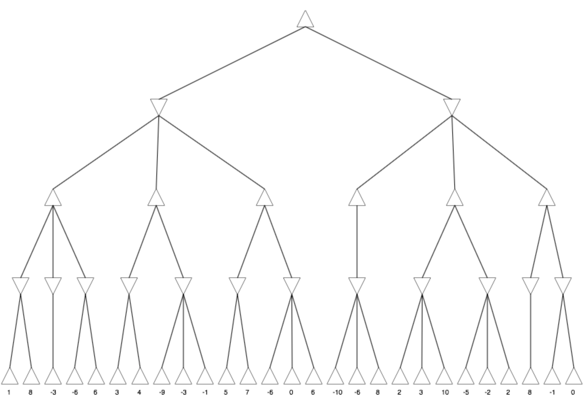
1
α = - ∞, 1
β = + ∞
α = - ∞
β = + ∞, 1
1
-10
α = 1
β = + ∞
α = - ∞, 1
β = + ∞
α = - ∞
β = 1
α = - ∞
β = 1
α = 1
β = + ∞
1
3
5
-10
α = - ∞
β = + ∞, 1
α = 1
β = + ∞
α = 1
β = + ∞
α = 1
β = + ∞
α = - ∞
β = 1
α = - ∞
β = 1
1
-3
-6
3
5
-10

