Slide 1
Detect China Online Censorship ——
The impact of major political events on Weibo posts
Presenters: Hazel Chui, Yulun Han, Peihan Gao, Xin Tang
Notes:
welcome to Interner censorship final project presentation. Our final project is to investigate The impact of major political events on Weibo posts by Detecting China Online Censorship. Our team members are

Slide 2
Motivation & Problem
Motivation
Our study aims to provide insight into the effectiveness of censorship measures in controlling public opinion during major political events in China.
Examine the atmosphere that the government desires to create before and after symbolic political events
Evaluate users' self-censorship or platforms' filtering effects.
Problem
The Chinese government reinforces censorship measures before major political events to ensure their success.
It is essential to investigate how these measures affect the public's posts on social media platforms such as Sina Weibo (Weibo).
Notes:
With the increasing use of social media platforms in China, there is a growing need to understand the impact of censorship on online public opinion. Our study focuses on a specific major political event, which is the Twentieth National Congress of the Communist Party of China (the 20th CPC National Congress), and we focus on investigating how censorship measures affect the public's posts on Weibo.
The Chinese government reinforces censorship measures before major political events to ensure their success, and it is essential to investigate how these measures impact public opinion. Our study aims to provide insight into the effectiveness of censorship measures in controlling public opinion during major political events in China. By analyzing the public's posts on Weibo before and after the 20th CPC National Congress, we can examine the atmosphere that the government desires to create before and after symbolic political events, as well as to evaluate users' self-censorship or platforms' filtering effects.

Slide 3

Data Collection
Data source:
Time periods
Before the 20th CPC National Congress
During the Congress
After the Congress
Keywords
“疫情“ - “covid”
“隔离” - “quarantine”
“抗疫” - “prevention and control of covid-19”
Notes:
Weibo is China’s most often-used social media platform for people to share their thoughts and emotions towards a specific topic.
We splitted the data into 3 time periods one month Before the 20th CPC National Congress, the week during the congress, and one month after the congress
We used the following 3 keywords to scrape the weibo posts. The meaning for keywords are “疫情“ (“covid”), ”隔离“ (”quarantine”), and “抗疫“ (”prevention and control of covid-19”)
And in the next stage, we conducted computational methods to analyze the large dataset of weibo posts.

Slide 4
Methods
Sentiment analysis
A type of text analysis that involves using natural language processing, computational linguistics, and machine learning to identify and extract subjective information from written or spoken language. It can be used to determine the emotional tone or attitude expressed in a text, such as positive, negative, or neutral.
Topic modeling
A type of statistical modeling that identifies patterns in a collection of documents or texts. It allows the identification of topics or themes that are present in the data, without prior knowledge or manual labeling.
Word cloud
A visual representation of text data, where words are displayed in varying sizes and colors based on their frequency or importance in the text.

Slide 5
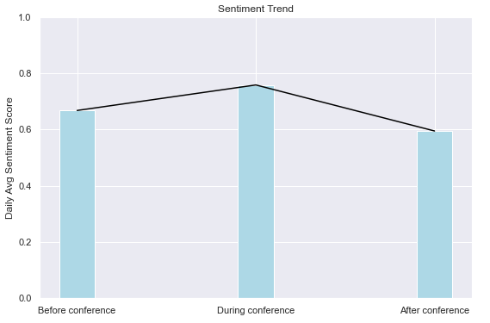
Sentiment Analysis
⬆13.4%
0.76
⬇21.1%
0.67
0.6
Notes:
The daily average sentiment scores for the three time periods—before, during, and after the Congress—are 0.67, 0.76, and 0.6, respectively, as shown in the graph above. It is consistent with the hypothesis that posts' sentiment would increase in the days leading up to the 20th CPC National Congress and peak during that time. When the Congress is over, the attitudes resurface and are considerably more unfavorable than in the month leading up to the event. The average emotion trends point to the likely censoring of unfavorable posts before and during the significant event. Instead, when the emphasis is not on maintaining the atmosphere of stable public opinion, censorship vanishes after the event.

Slide 6
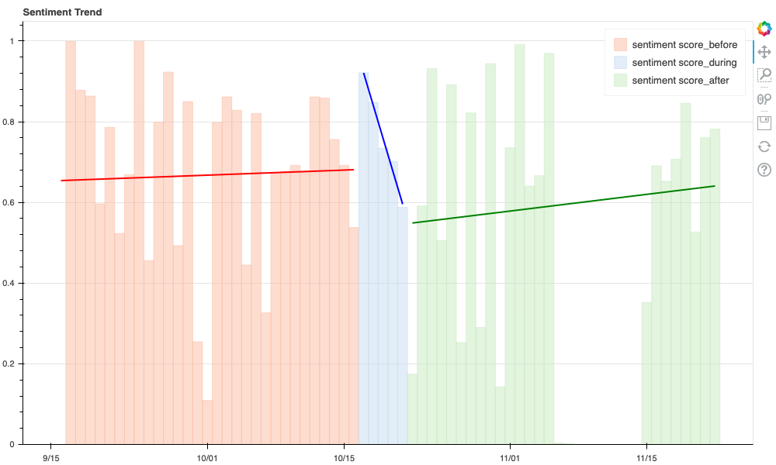
Sentiment Analysis
Notes:
The daily time-series shift of sentiment is clearly visible in the graph below. We use linear regression to fit lines for the three eras by plotting the daily sentiment average by day. The level of the line after the 20th CPC National Congress is lower than the fitted line of the sentiment score prior to the Congress. Also, when the Congress's opening day draws near, the mood improves and peaks on that day before suffering a sharp decrease until the event's conclusion.

Slide 7
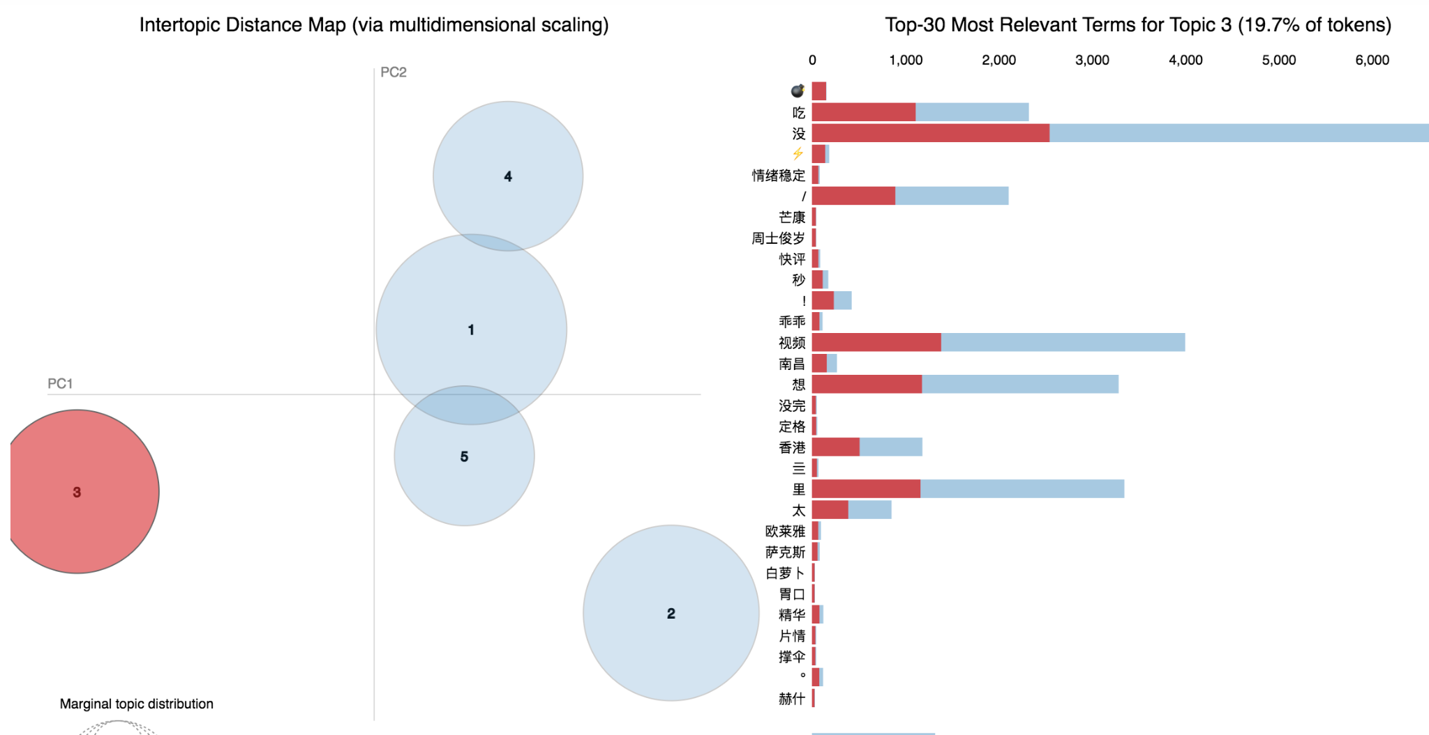
Topic Modeling
Before
positive words: “情绪稳定”(being calm)

Slide 8
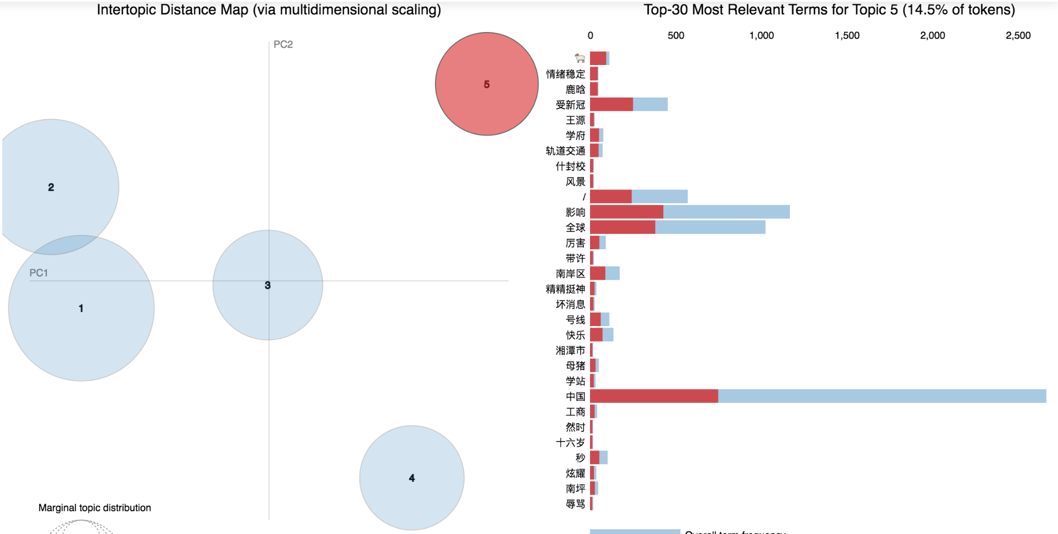
Topic Modeling
During
positive words: “快乐”(happy)

Slide 9
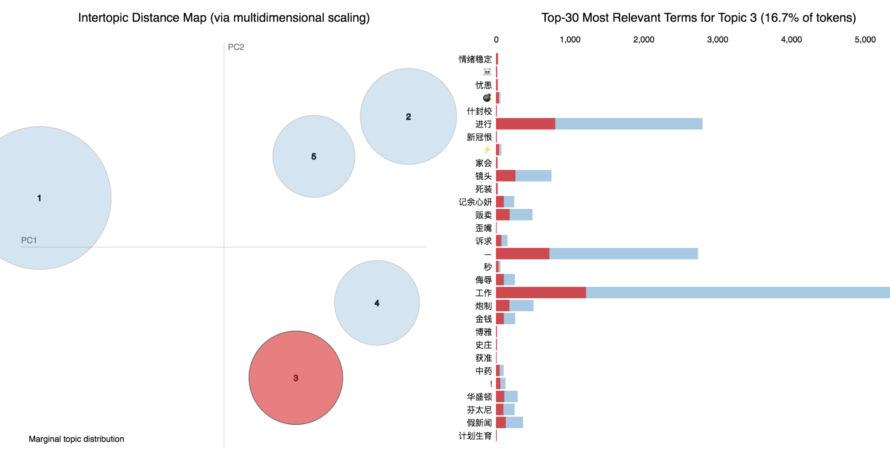
Topic Modeling
After
Negative words: “新冠恨”(Covid hate), “假新闻”(fake news)

Slide 10
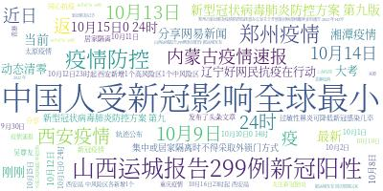
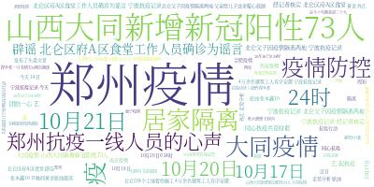
Word Cloud
Word cloud (druing the 20th CPC National Congress)
"郑州疫情”: epidemic in Zhengzhou, a city in China
“大同疫情": epidemic in Datong, another city in China
"居家隔离": home quarantine
Word cloud (before the 20th CPC National Congress)
"中国人受新冠影响全球最小": Chinese were least affected by Covid in the world
"辽宁好网民抗疫在行动": Good Liaoning netizens are fighting against Covid
→ The appraising attitude towards the government and people's proactive reactions to the pandemic in Weibo posts may have been the result of information censorship

Slide 11
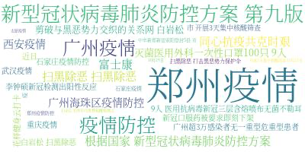
Word Cloud
Word cloud (after the 20th CPC National Congress)
"新冠口服药被要求即刻下架": Covid oral medication was immediately taken down
"扫黑除恶": crackdown on crimes
"剪破与黑恶势力交织的关系网": cutting off the network of mafia-like relationships
→Might imply loosening of censorship by the Chinese government, allowing for the expression of negative opinions and concerns on Weibo

Slide 12
Conclusion
Sentiment change:
Before 0.67 ➡ During 0.76 (increased 13.4%)
During 0.76 ➡ After 0.6 (decreased 21.1%)
Topic Modeling
Topics are relatively more positive before and during the Congress
Topics are relatively more negative after the Congress
Word cloud
More encouraging news before the Congress
More unfavorable reports and harsh language after the Congress
Conclusions: Government Censorship for public opinions might exist

Slide 13
Thank you!

