Slide 1

Wumpus world
Peihang Xu, Micky Kumar, Elham Saeedy Seyedeh

Slide 2
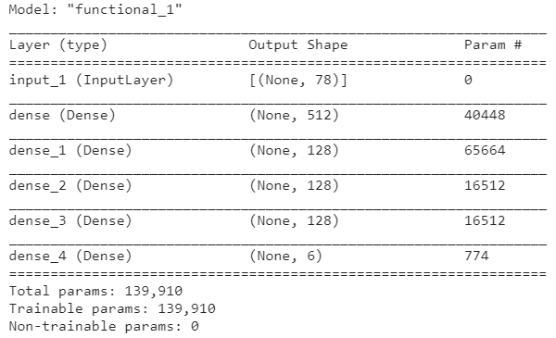
The best model so far
Input:
78 features with 6 extra features
3 Booleans recording if the previous 5, 10 and 50 moves are the same
3 Booleans recording if the previous 4, 10 and 50 locations are the same
Network:
Input - 512 - 128 – 128 – 128 – output

Slide 3
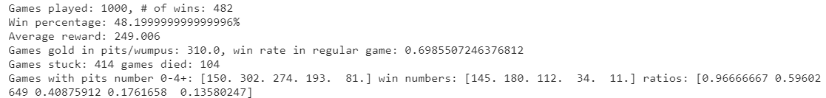
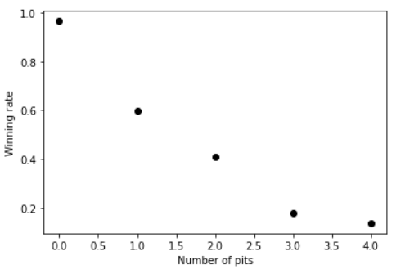
Results
Win ~48% of the game in 10000 game testing
Average reward ~+250 with a limit of max_moves=250
The agent still gets stuck sometimes, with a rate of 40%
The agent will die sometimes ~10%
The agent usually gets stuck when gold is in the same location as Wumpus or pits
For “easy” games, winning rate ~65%
Epsilon included in testing games
Wining rate ~55%, with average reward ~+95
20% stuck rate, 25% games died
Add intelligence to the agent during testing:
Wining rate ~50%, with average reward ~+45
5% stuck rate, 45% games died

Slide 4
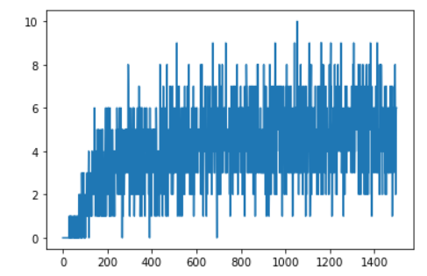
Hyperparameters tuning
Learning rate: 10^(-3)
Gamma: 0.85 ⬅ helpful to get reduced from 1, increased the winning rate to ~30%
Batch size: 128
Max move limit: 250
Sync frequency: 500 ⬅ There might be some correlation between max move limit and sync frequency
Epsilon: exponentially decay, *0.999 per epoch, with a lower limit of 0.03 ⬅ This helps a little bit, especially the lower limit of 0.03 is better than 0.01 and 0.05
Memory size: 10^7 ⬅ very helpful to be large, increase the winning rate from ~40% to ~50% with its value changed from 1e6 to 1e7
Epoch number: 15000 ⬅ does not seem to be the more the better
Win # in latest 10 games
# of epochs/10

Slide 5
Issues to think more about
Agent still get stuck
My naïve thought earlier was to have a higher max move limit, together with the feature engineering, and train the model many episodes
Maybe give the agent some intelligence during training
Agent does not really seem to learn to climb out without the gold if the game is hard
It never did this in testing
For my probabilistic agent, I let it leave with a safe path if it has explored 12 locations

Slide 6
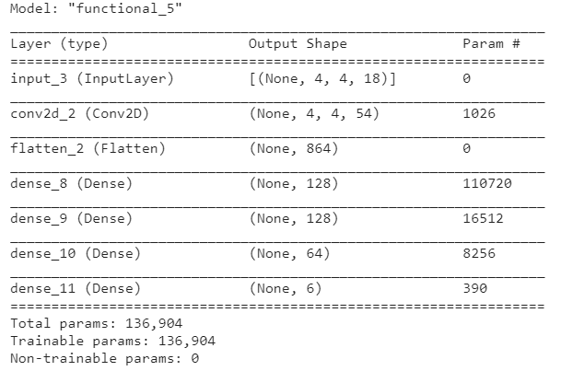
CNN layers
Input dimension: 4x4x18 (18 feature planes)
Boolean and orientation variables ➔ make a whole plane 4x4 to be 1 or 0
Only one conv 2D layer (54x(1x1)), and then 4 dense layers 128 x 128 x 64 x 6
Similar total params to train compared to the previous model

Slide 7
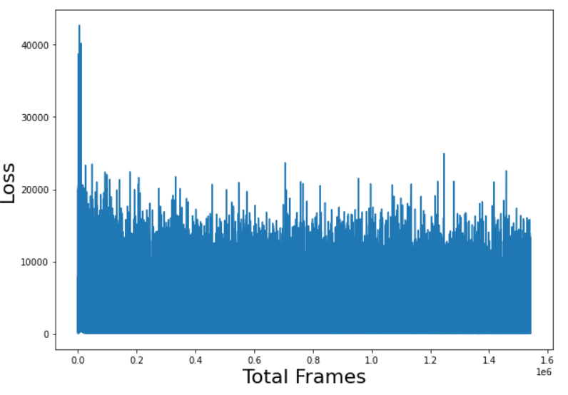
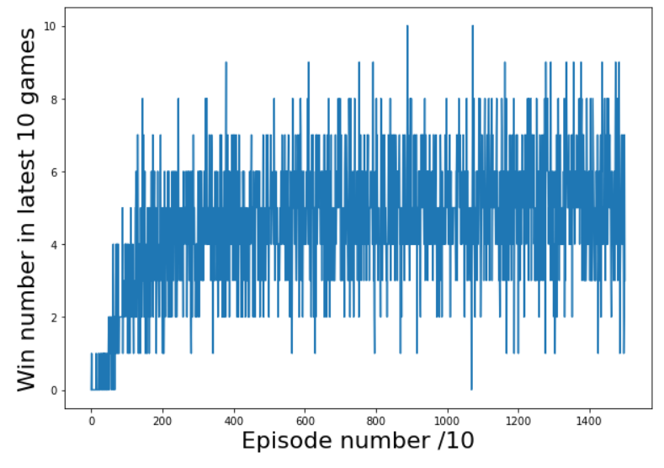
Hyperparameters
Learning rate: 5x10^(-4)
Gamma: 0.85
Batch size: 128
Max move limit: 250
Sync frequency: 500
Epsilon: exponentially decay, *0.999 per epoch, with a lower limit of 0.03
Memory size: 10^7
Epoch number: 15000

Slide 8
Results

Slide 9
Results, compared to the all-Dense-layer model
CNN model
All dense model
Win ~53% of the game in 1000 game testing ➔ BETTER
Average reward ~+370 with a limit of max_moves = 250
The agent still gets stuck sometimes, with a rate of 43%
The agent will die sometimes ~4% ➔ reduced
The agent usually gets stuck when gold is in the same location as Wumpus or pits
For “easy” games, winning rate ~73% ➔ BETTER
Win ~48% of the game in 1000 game testing
Average reward ~+250 with a limit of max_moves=250
The agent still gets stuck sometimes, with a rate of 40%
The agent will die sometimes ~10%
The agent usually gets stuck when gold is in the same location as Wumpus or pits
For “easy” games, winning rate ~65%

Slide 10
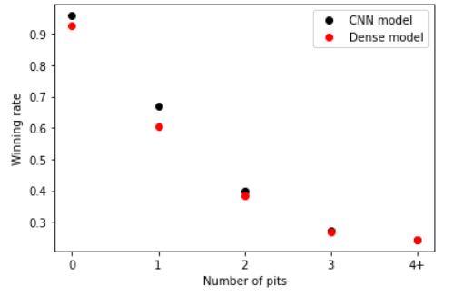

Slide 11
Gomoku Study
Peihang Xu, Micky Kumar, Elham Saeedy Seyedeh

Slide 12
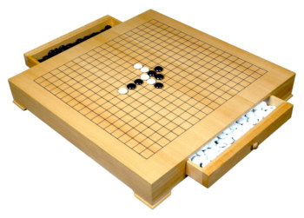
About GomoKu
It is also called five in a row
It is played with Go board and pieces on 15*15 board or 19*19 board
The winner is the first person to have 5 pieces in a row, a column, or a diagonal.
Github repository: https://github.com/junxiaosong/AlphaZero_Gomoku
https://gevin-ent.com/20-inch-beech-wood-go-gomoku-game-table-with-double-drawers/

Slide 13
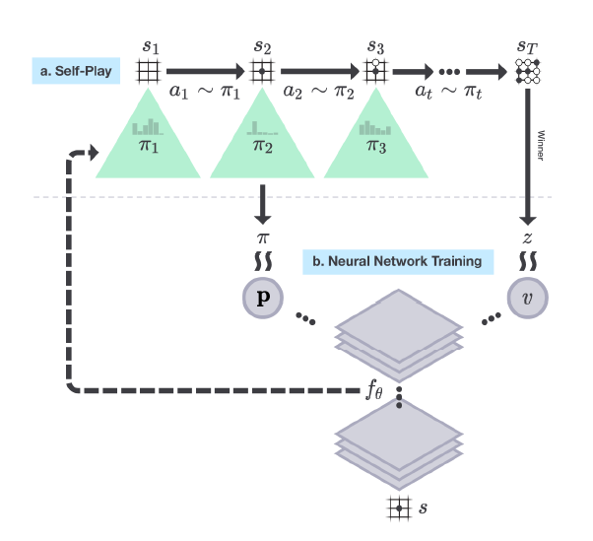
AlphaZero
No human data or guidance beyond the basic rules of the game
Input to deep NN:
Raw representations of board positions
Output of deep NN:
Scalar value v: probability that the current player will win from the current board position
Vector p: move probabilities, one for each possible placement on board
What are targets for NN to train?
Sutton, RL

Slide 14
Self-play
“MCTS may therefore be viewed as a powerful policy improvement operator.” Silver et al. (2017)
Self-play
Not selecting self-play actions according to the probabilities p
p is still used! ➔ Direct each execution of MCTS
MCTS generates new move probabilities as policies π
The output policies are used as targets to train the DNN model!
The winner in each self play game will be used as a label for training the scalar output of the DNN model
MCTS generates π
p direct MCTS
Sutton, RL

Slide 15
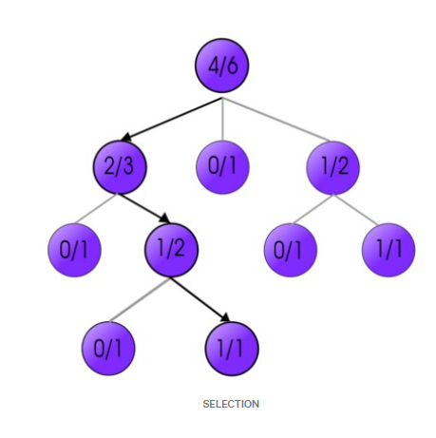
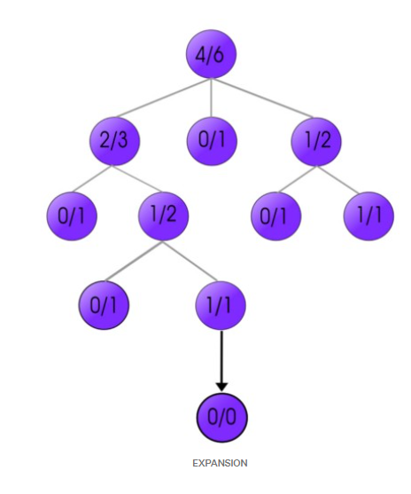
MCTS -- Monte carlo tree search
Selection:
start from a node (e.g. current board configuration)
select a node on the tree that has the highest possibility of winning
Expansion:
increase the options further in the game
expand the selected node and creating many children nodes
https://towardsdatascience.com/monte-carlo-tree-search-158a917a8baa

Slide 16
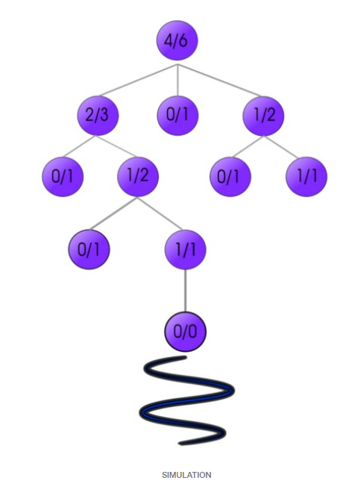
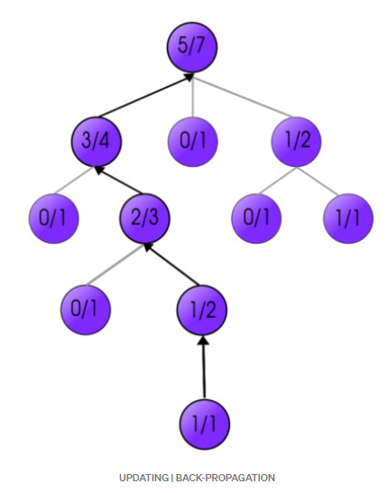
MCTS -- Monte carlo tree search
Simulating/rollout:
Find the best children which will lead us to the correct solution
Make random decisions in the game further down
The simulation is done for every children node
Updating:
New nodes get their positive or negative scores in the environment
Total scores of their parent nodes must be updated by going back up the tree one-by-one
https://towardsdatascience.com/monte-carlo-tree-search-158a917a8baa

Slide 17
Guided MCTS
X
Simpler version of MCTS
Each iteration of MCTS ran a simulation that ended at a leaf node of the current search tree instead of at the terminal position of a complete game simulation ➔ No rollout stage
The rollout stage is replaced by the prediction from the NN ➔ Guided MCTS
We do ~400 MCTS per move

Slide 18
Input to the NN
8x8 grid board
4 binary feature planes:
First for the representations of the positions of the current player’s stones
Second for the representations of the positions of the opponent’s stones
Third for the opponent’s latest move ➔ where the current player made the move is going to be close to where the opponent’s latest move was
Fourth: the whole plane will be 1 if the player made the first move

Slide 19
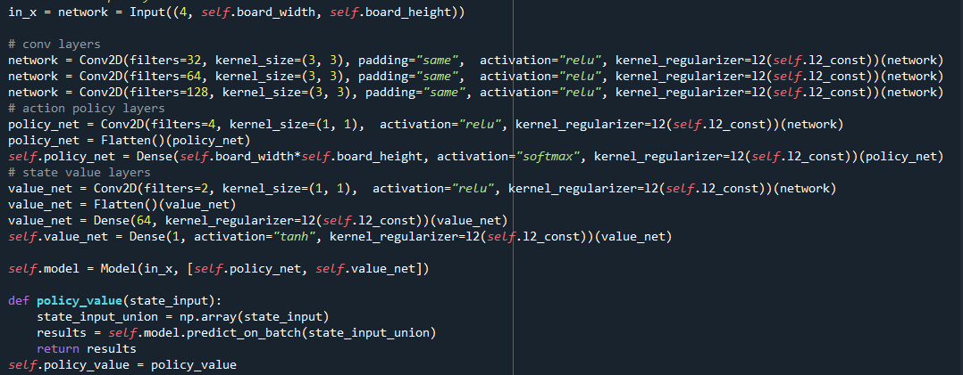
Neural Net structure
Three CNN layers: 32, 64, and 128 (3x3) filters
Output to value v: 2 (1x1) filter ➔ Dense layer 64 ➔ Dense layer output (tanh)
Output to value p: 4 (1x1) filter ➔ Dense layer output (softmax)

Slide 20

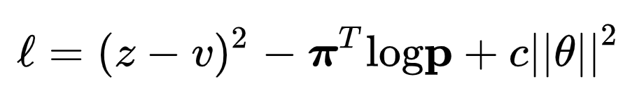
Training Targets
p from NN close to π from MCTS
v from NN close to z from MCTS
Loss function: sum of MSE and cross-entropy losses
MCTS generates π
p direct MCTS
Silver, D., Hubert, T., Schrittwieser, J., Antonoglou, I., Lai, M., Guez, A., ... & Lillicrap, T. (2017). Mastering chess and shogi by self-play with a general reinforcement learning algorithm. arXiv preprint arXiv:1712.01815.

