Slide 1
N-DAMO process package
Pei-Hsin Wang

Slide 2
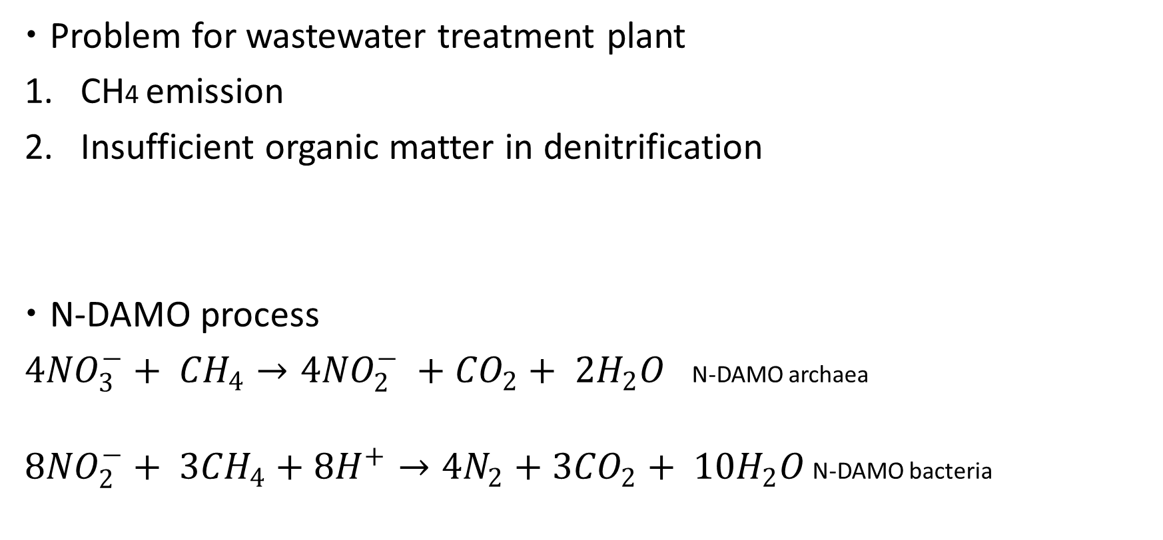
Background
Problem for wastewater treatment plant
CH4 emission
Insufficient organic matter in denitrification
N-DAMO process
${4NO}_{3}^{−}+ {CH}_{4}→{4NO}_{2}^{−} +{CO}_{2}+ 2H_{2}O$N-DAMO archaea
${8NO}_{2}^{−}+ {3CH}_{4}+{8H}^{+}→4N_{2}+{3CO}_{2}+ 10H_{2}O$ N-DAMO bacteria
Organic matter
NO3, NO2
N2
denitrification

Slide 3
Use case
Engineer works in the wastewater treatment plant
Evaluating if we can apply anaerobic wastewater (CH4) to remove NO3, NO2
Get preliminary result to see NO3, NO2 and reaction time
Anaerobic wastewater
NO3, NO2
CH4
Preliminary decide if N-DAMO process exists
Determine the ratio of wastewater input
N-DAMO process reaction
NO3, NO2 visualization

Slide 4
Design
First goal: Evaluate if N-DAMO process exists
Data input: excel file
Functions:
1. extracting BOD, temperature, salinity data for calculating dissolved CH4
2. select minimum dissolved CH4 to compare with methane affinity value for determining existence of N-DAMO process
Second goal: Have preliminary understanding about NO3, NO2 concentration by N-DAMO process
Data input: the minimum dissolved CH4
Functions:
1. Tellurium model to see concentration change of NO3, NO2
→ How long it takes for NO3, NO2 converting to N2

Slide 5
Lessons learned and future work
Lessons learned: be cautious to data type
Future work: add a stop function if N-DAMO process does not exist
Anaerobic wastewater
NO3, NO2
CH4
Preliminary decide if N-DAMO process exists
Determine the ratio of wastewater input
N-DAMO process reaction
NO3, NO2 visualization

Slide 6
Thank you!

