Slide 1
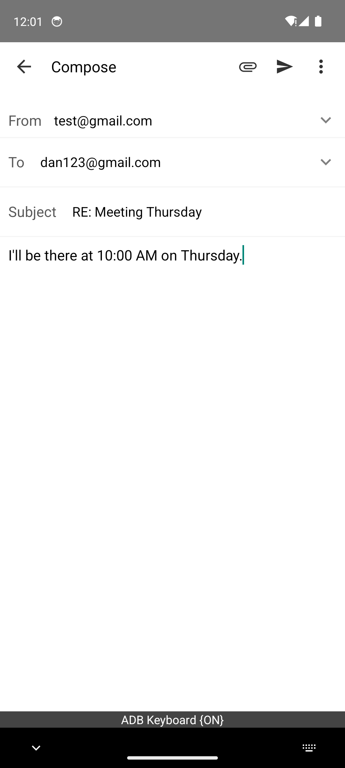
<think> I need to tap the send bottom, which is in the upper right corner of the page. </think>
Language Reasoning
image
MLLM
Compute SFT Loss
Send a email to dan123.
subject: ***
content: ***
<action>
Tap (10, 980)
</action>
GOAL
Action

Slide 2
<think> I need to tap the send bottom, which is in the upper right corner of the page. </think>
Language Reasoning
image
<action>
Tap (10, 980)
</action>
Action
MLLM
<imagine>
HTML
</imagine>
World Prediction
Send a email to dan123.
subject: ***
content: ***
GOAL
Compute Loss

Slide 3
s(1)
at(1)
v(1)
s(2)
World Model
at(2)
v(2)
VLA
St
Value Model
s(3)
at(3)
v(3)
s(4)
at(4)
v(4)

Slide 4

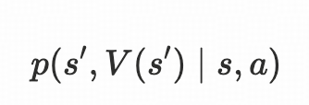

8 estimated (h,v) pairs to compare with GT (h,v)
h(1)
v(1)
VLA
Model
World Model
St
at
v(2)
Value Model
h(2)
We have finished this model checkpoint (probably right)
v(3)
v(4)

Slide 5
4 estimated (a,h,v) samples
LLM Judge
a(1)
h(1)
v(1)
score1
a(2)
ht(2)
v(2)
score2
Joint WAM Model
GRPO
St
a(3)
h(3)
v(3)
score3
a(4)
h(4)
v(4)
score4
proceed only in one step

