Slide 1

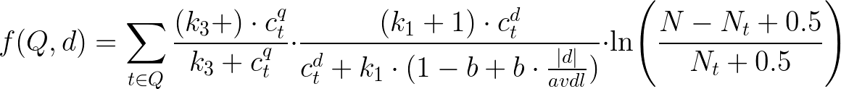
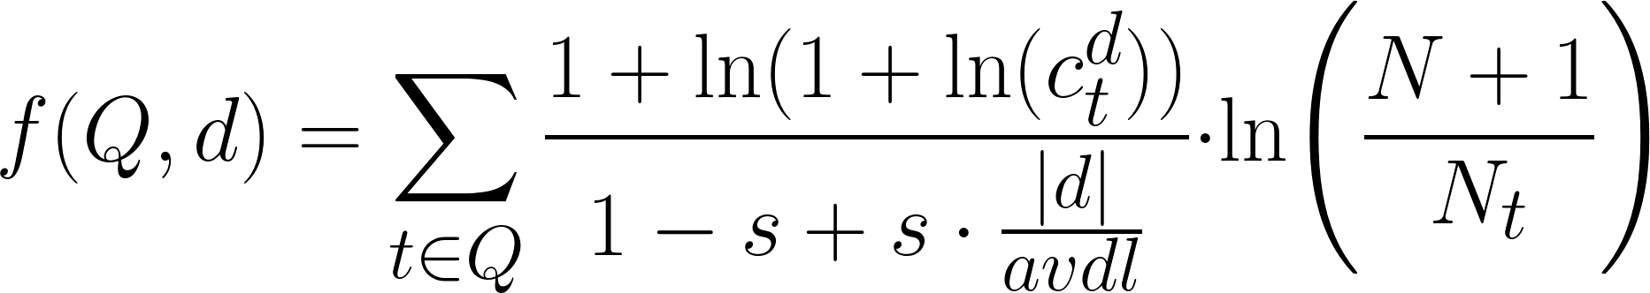
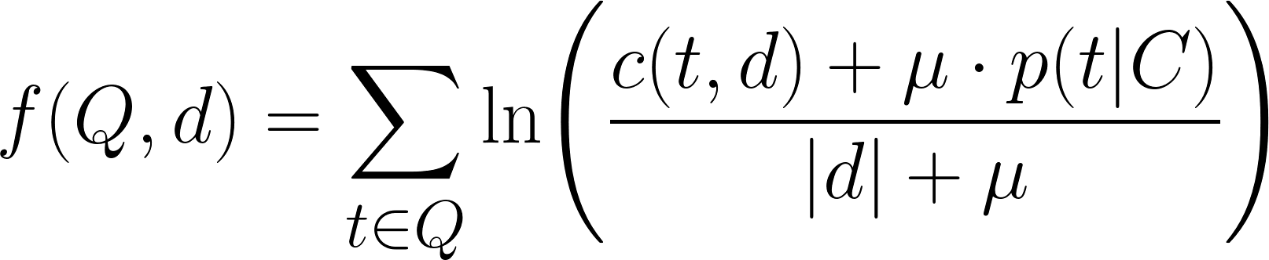
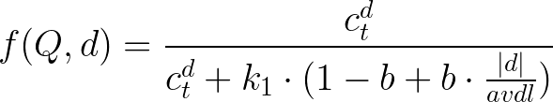
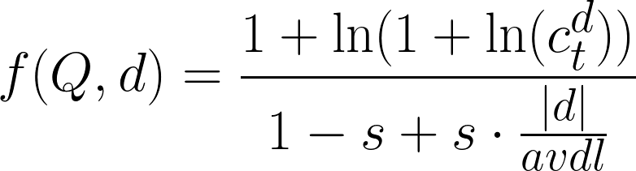
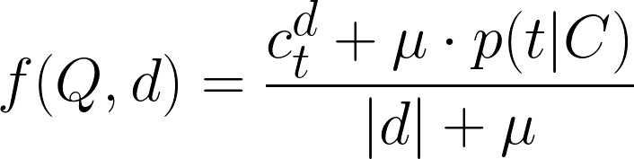
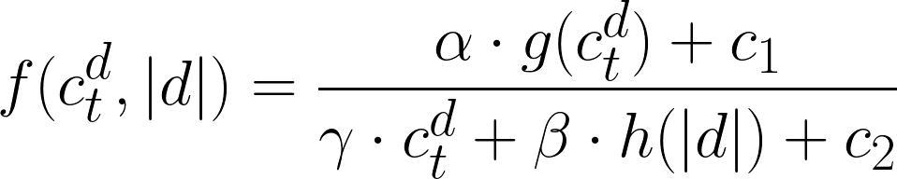
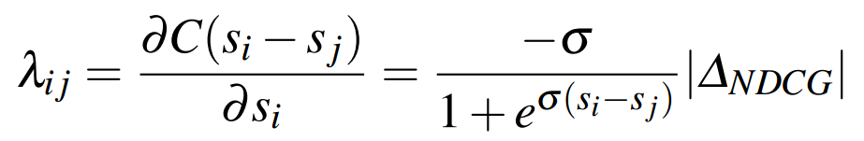
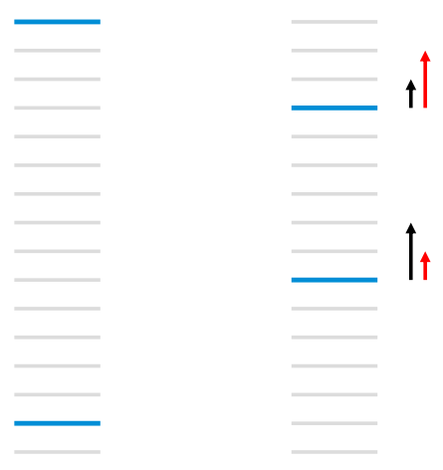
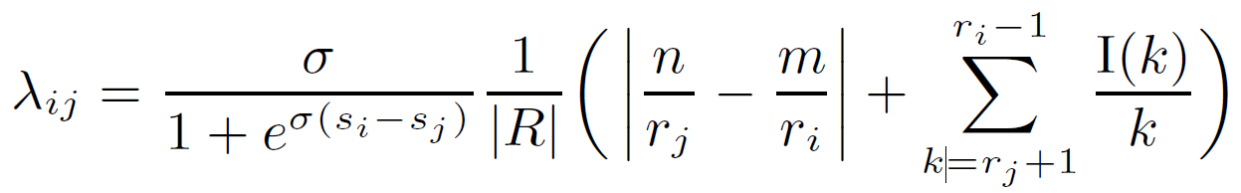
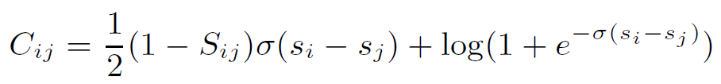

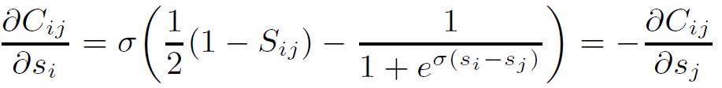

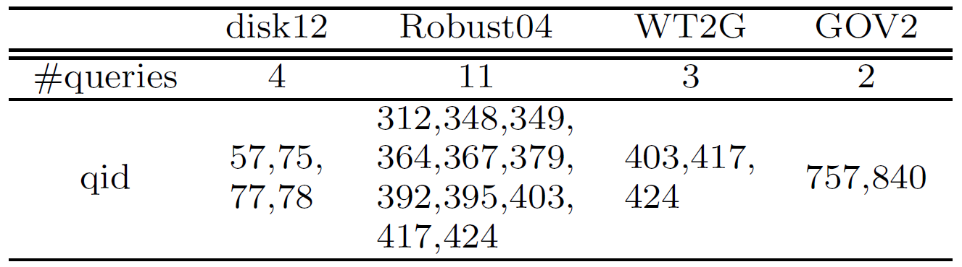
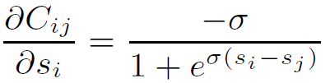

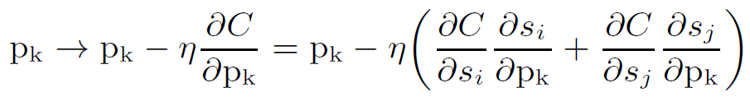
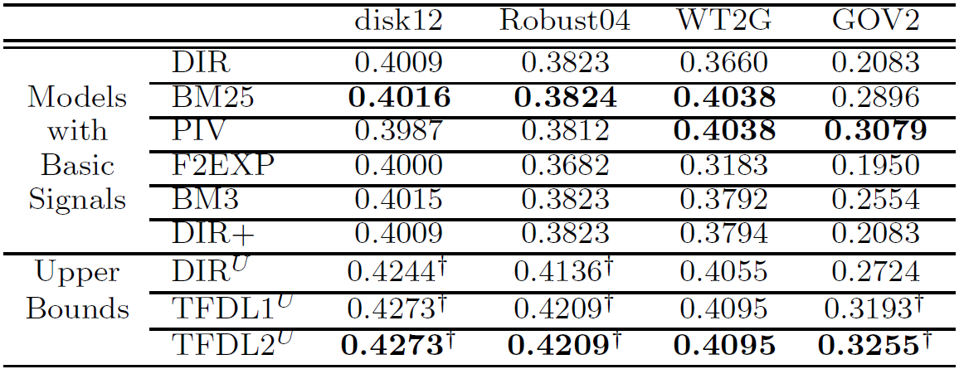
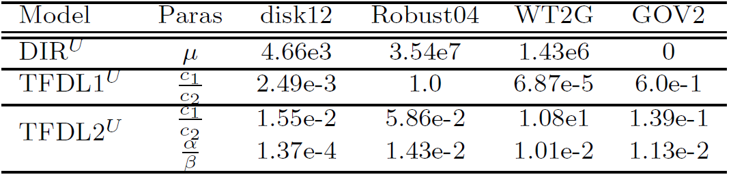

Retrieval Performance Bound Analysis
for Single Term Queries
Peilin Yang, Hui Fang
Motivation
Quite a lot of ranking models contain components Term Frequency, Inverted Document Frequency, Document Length and Collection Statistics.
Most ranking models are based on Bag-of-Terms assumption.
Term Frequency
Inverted Document Frequency
BM25
Bag-of-Terms
Pivoted Document Length Normalization
Document Length
Collection Statistics
Language with Dirichlet Prior
TF
DL
IDF
Collection Stats
Is there any performance upper bound for these ranking models?
When the query has only one term…
BM25
Pivoted Document Length Normalization
Summarization is omitted
Language with Dirichlet Prior
IDF is omitted
Ranking invariants are omitted
Generalization of Ranking Models
Using Cost Analysis to Find the Maximum
Inspired by Lambda Rank
+
MAP
g(·) and h(·) are arbitrary non-linear functions
$α$, $β$, $γ$,$c_{1}$,$c_{2}$ are constants which may related to collection statistics
Using Cost Analysis to Find the Maximum
Minimize the cost
Experiments & Results
Cost: pairwise cross-entropy cost applied to the logistic of the difference of the model scores.
Tested Models
${DIR}^{U}$
${TFDL1}^{U}$
${TFDL2}^{U}$
Tested Collections
Use gradient boost
Simplified as
Reduce the cost via stochastic gradient
Unfortunately this is the “optimization” cost NOT the actual cost
Model Paras.

