Slide 1



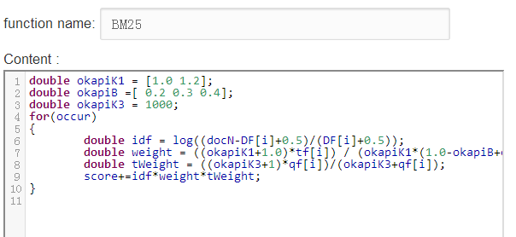
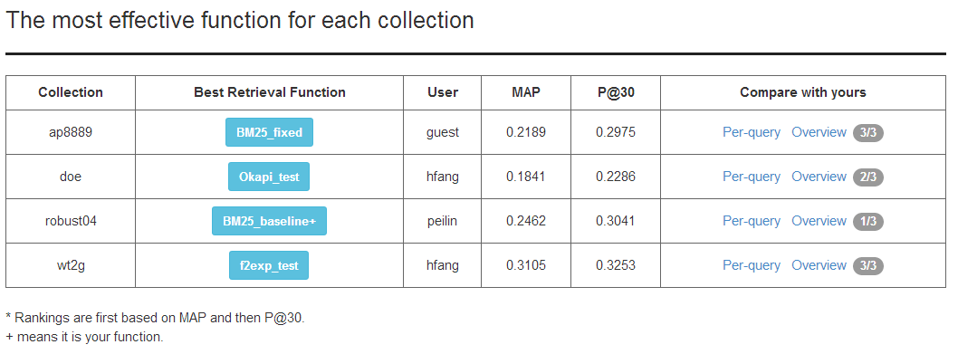
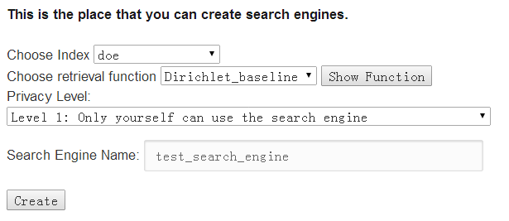
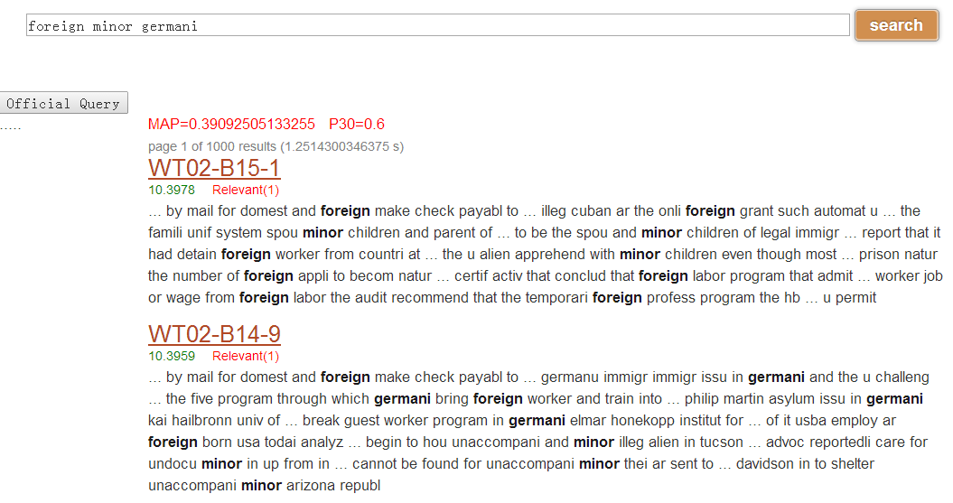
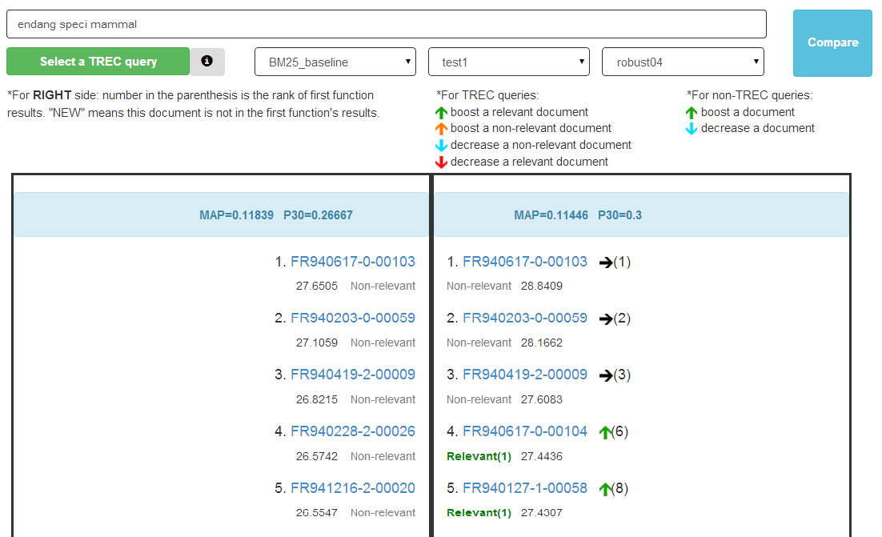
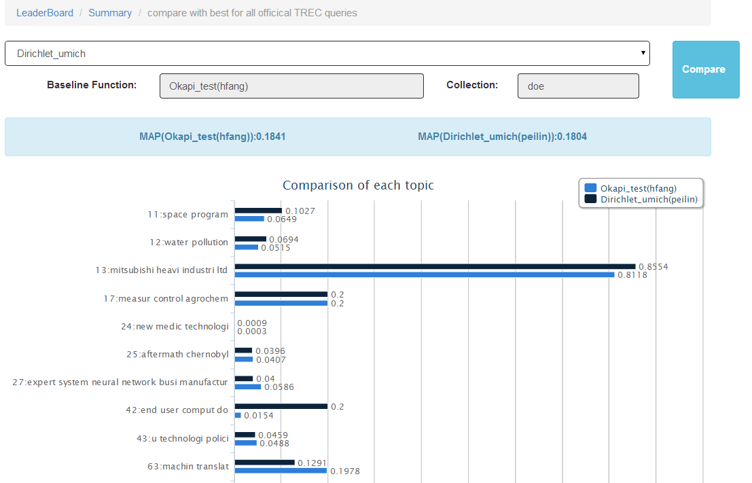
VIRLab: A Web-based Virtual Lab for Learning and
Studying Information Retrieval Models
Hui Fang, Hao Wu, Peilin Yang
University of Delaware
Newark, DE, USA
ChengXiang Zhai
University of Illinois at Urbana-Champaign
Urbana, IL, USA
Go and try our toolkit at http://infolab.ece.udel.edu:8008/
Motivation
Developing optimal IR models is one of the most important research problems in information retrieval.
Unfortunately, experimenting with any new retrieval model is inevitably time consuming and requires significant amount of resources available.
Lots of things need to be done: implementation, evaluation and analysis of new retrieval models.
Our proposed web-based interactive toolkit facilitates the procedures.
System Components Explanation and Workflow
For Teaching
For Research
Start
Users only need to write a few lines of code through a Web form to combine statistics retrieved from the indexes without worrying about how to access the indexes. The code will be automatically checked for syntax errors and translated to an executable, which will be used for ranking documents, by a dynamic code generator.
Implementation of retrieval functions
Screenshot of implementing a retrieval function
Configuration of search engines
Performance comparison through leader-boards
Users can configure a search engine by selecting a retrieval function and a test collection. Multiple search engines can be easily created at the same time. The users can either submit their own queries or select queries from a set of topics associated with the corresponding document collection. Moreover, the users can also compare the search results of two search engines side by side to figure out their ranking differences.
A leader board is created for each collection so that the most effective 10 retrieval functions are displayed. Users can see how their retrieval functions are compared with others, and they can also leverage the comparison functionality described earlier to figure out how to revise their retrieval functions to improve the performance.
Not as good as expected?
Inspect the details of the not-so-good queries
Summary, Future work, Acknowledgement

