Slide 1
Options Valuation: solutions (all using gbsm)
Peilin Luo

Slide 2
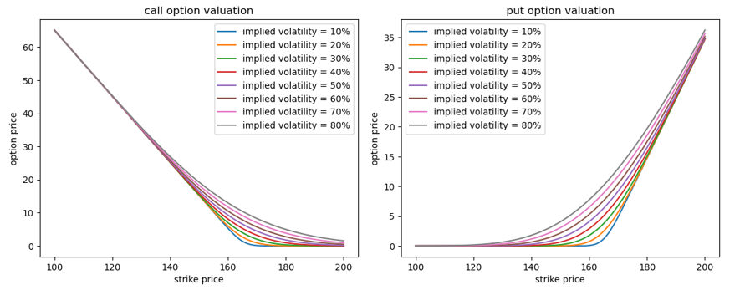
Problem 1
time to maturity: 0.0384 years
when there are higher demand and lower supply, the price of options will increase, and the implied volatility will also increase

Slide 3
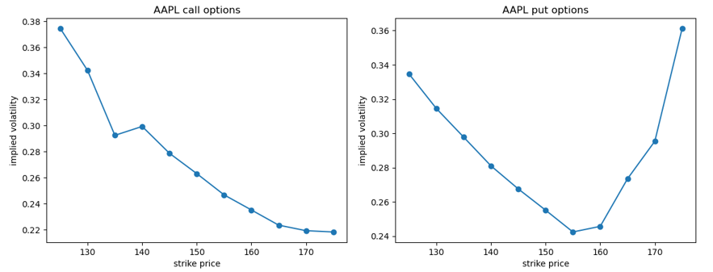
Problem 2
call: volatility “smirk”; put: volatility “smile”
not all options on the same underlying and expiration have the same implied volatility
call: demand is greater when options are ITM, increasing the implied volatility
put: extreme events → significant shifts in stock prices & making options finish ITM

Slide 4
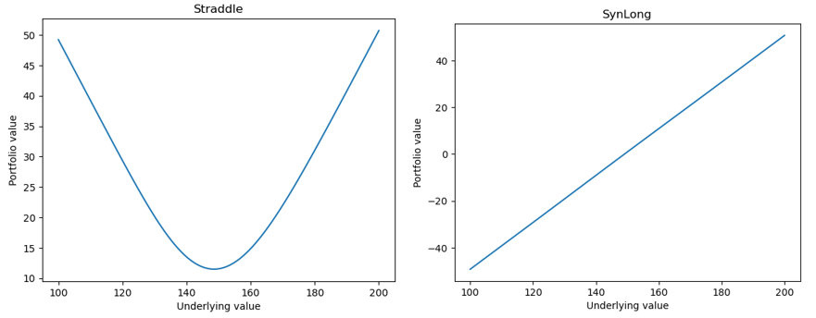
Problem 3
Straddle: underlying price < $150, the put option is ITM; underlying price > $150, the call option is ITM → Straddle decreases the risk
SynLong: make a profit ONLY when the underlying price > $150 → SynLong increases the risk

Slide 5
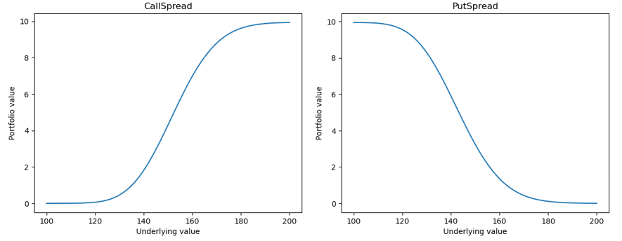
Problem 3
CallSpread: underlying price < $150, both →OTM; underlying price > $160, both →ITM; $150 < underlying price < $160 →profit ➔ profit will have a limit of $10
PutSpread: underlying price < $140, both →ITM; underlying price > $150, both →OTM; $140 < underlying price < $150 →profit ➔ profit will have a limit of $10

Slide 6
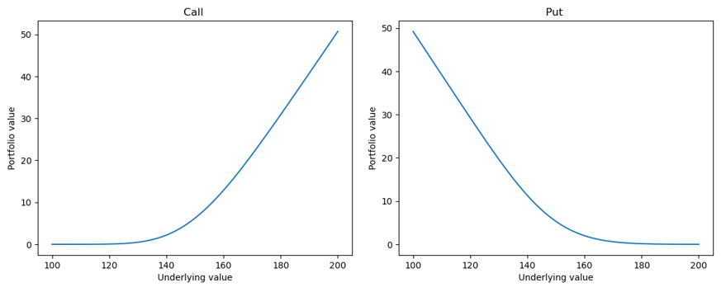
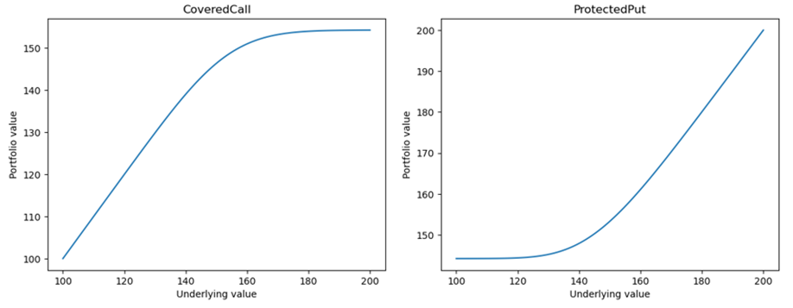
Problem 3
Put Call Parity (C+K=P+S)
value of CoveredCall is the reverse of Put (S-C=-P+K)
sum of CoveredCall and Put: PV of the strike price
value of ProtectedPut has the same shape as Call
difference between ProtectedPut and Call: PV of the strike price

Slide 7
Problem 3
Straddle: VaR and ES are small → small risk.
SynLong: VaR and ES are large → greater risk
PL mean of CoveredCall is approximately the opposite of that of Put, since buying a CoveredCall equals selling a Put
PL mean of ProtectedPut is similar to that of Call, because buying a ProtectedPut equals buying a Call
Portfolio | PL mean | VaR | ES
Straddle | 1.5399 | 1.3797 | 1.3877
SynLong | -0.0292 | 16.1957 | 20.0312
CallSpread | -0.1029 | 3.8852 | 4.1873
PutSpread | 0.3060 | 2.6282 | 2.8017
Stock | 0.1742 | 15.9536 | 19.7661
Call | 0.7554 | 6.0319 | 6.3690
Put | 0.7845 | 4.3645 | 4.5891
CoveredCall | -0.7139 | 12.1403 | 15.8338
ProtectedPut | 0.8338 | 8.0618 | 8.6943

Slide 8
Thank you!

