Slide 1
Week 5 Project
Peilin Luo

Slide 2
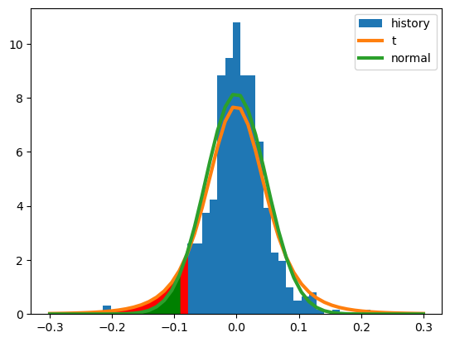
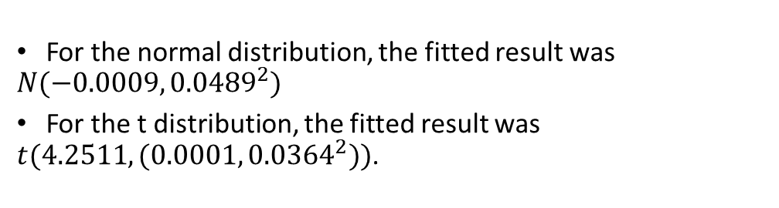
Problem 1
For the normal distribution, the fitted result was $N(−0.0009, {0.0489}^{2})$
For the t distribution, the fitted result was $t(4.2511, (0.0001, {0.0364}^{2}))$.
 | Normal distribution | T distribution
VaR | 0.0820 | 0.0764
Expected shortfall | 0.1020 | 0.1130

Slide 3
the value at risk in the normal distribution is larger than that in the t distribution
the expected shortfall in the normal distribution is smaller than that in the t distribution
the difference could be perfectly explained by the fat tail of the t distribution
 | Normal distribution | T distribution
VaR | 0.0820 | 0.0764
Expected shortfall | 0.1020 | 0.1130

Slide 4
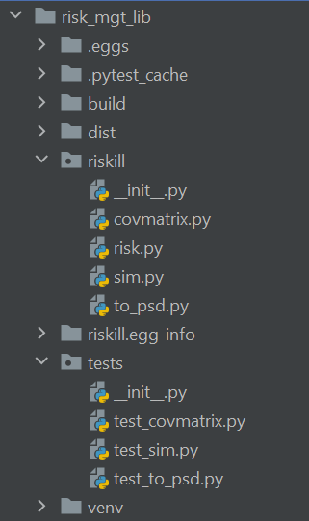
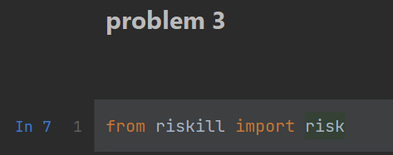
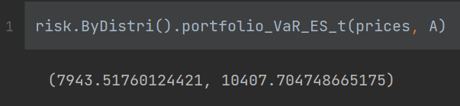
Problem 2
my structure of risk management library

Slide 5
Problem 3
much higher than the results from week 4
for the expected shortfall, influenced by fat tails, the expected shortfalls for portfolios were much larger
VaR for portfolios
portfolio | A | B | C | Total
Monte Carlo with discrete return | 5620.37$ | 4357.73$ | 3753.22$ | 13470.81$
Monte Carlo with log return | 5539.85$ | 4382.22$ | 3736.56$ | 13450.62$
Historic sim with discrete return | 3452.11$ | 3631.77$ | 2754.59$ | 11064.37$
Historic sim with log return | 4558.32$ | 3631.77$ | 2754.59$ | 11064.37$
Fitted t distribution | 7944$ | 6693$ | 5565$ | 19961$
ES for portfolios
portfolio | A | B | C | Total
Fitted t distribution | 10408$ | 8882$ | 7361$ | 26446$

