Slide 1
Genova University
IOT
Smart Parking
Peiman Ataei
Sahel Riazi

Slide 2
Project Goal
To define requirements, architecture and prototype of an IoT system for Smart Parking to be used to monitor the different parking lots of VP-Dibris.

Slide 3
Project Aim
Empty Places
Status of each place in parking and the license number of the parked cars
Publish Information
Publish these information for staff members
Project Result
Save data
Storing information of each car in data base
Statistic
Providing statistics on the result
Smart Parking

Slide 4
Proposal of the architecture of the IoT system with a particular attention on the following points:
types of sensors and edge devices to be used to acquire data
Raspberry Pi
Ultrasonic Sensor HRC-04
IP Webcam/Webcam/RPi Camera (In Node red simulation project we get image from internet instead of camera)
You can simply impress your audience and add a unique zing and appeal to your Presentations. Get a modern PowerPoint Presentation that is beautifully designed. I hope and I believe that this Template will your Time, Money and Reputation.
Raspberry
Ultrasonic
Camera

Slide 5
software components for data acquisition, storage and processing, dashboard and visualisation and main functionalities of the different components
Node-Red
HTML
CSS
JS
Firebase Realtime Database
You can simply impress your audience and add a unique zing and appeal to your Presentations. Get a modern PowerPoint Presentation that is beautifully designed. I hope and I believe that this Template will your Time, Money and Reputation.
Node-red
JS
HTML
Firebase

Slide 6
Node-Red Palettes used
node-red-contrib-firebase
node-red-contrib-realtime-database
node-red-contrib-image-output
node-red-contrib-plate-recognizer
You can simply impress your audience and add a unique zing and appeal to your Presentations. Get a modern PowerPoint Presentation that is beautifully designed. I hope and I believe that this Template will your Time, Money and Reputation.
Database
Image
Recognizer
Firebase

Slide 7
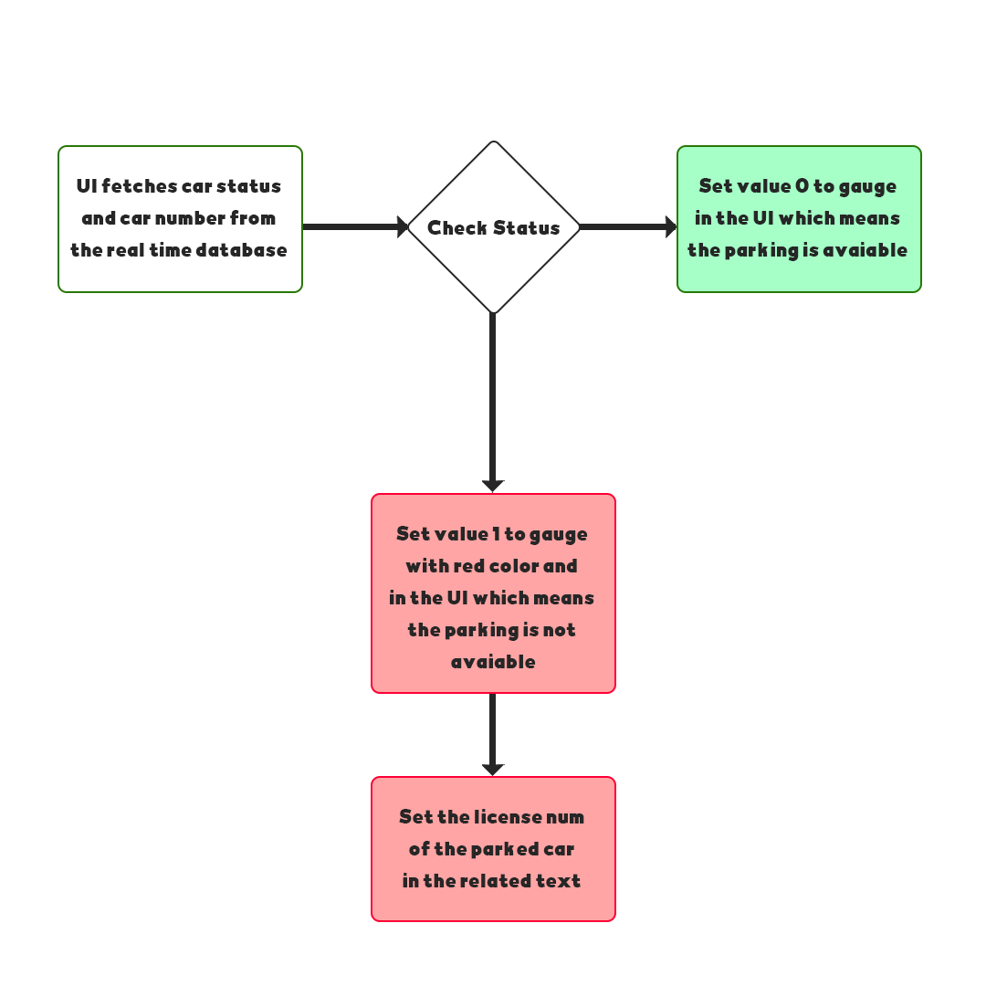
Interaction schemes (main protocols needed in the system)
You can simply impress your audience and add a unique zing and appeal to your Presentations. Get a modern PowerPoint Presentation that is beautifully designed. I hope and I believe that this Template will your Time, Money and Reputation.

Slide 8
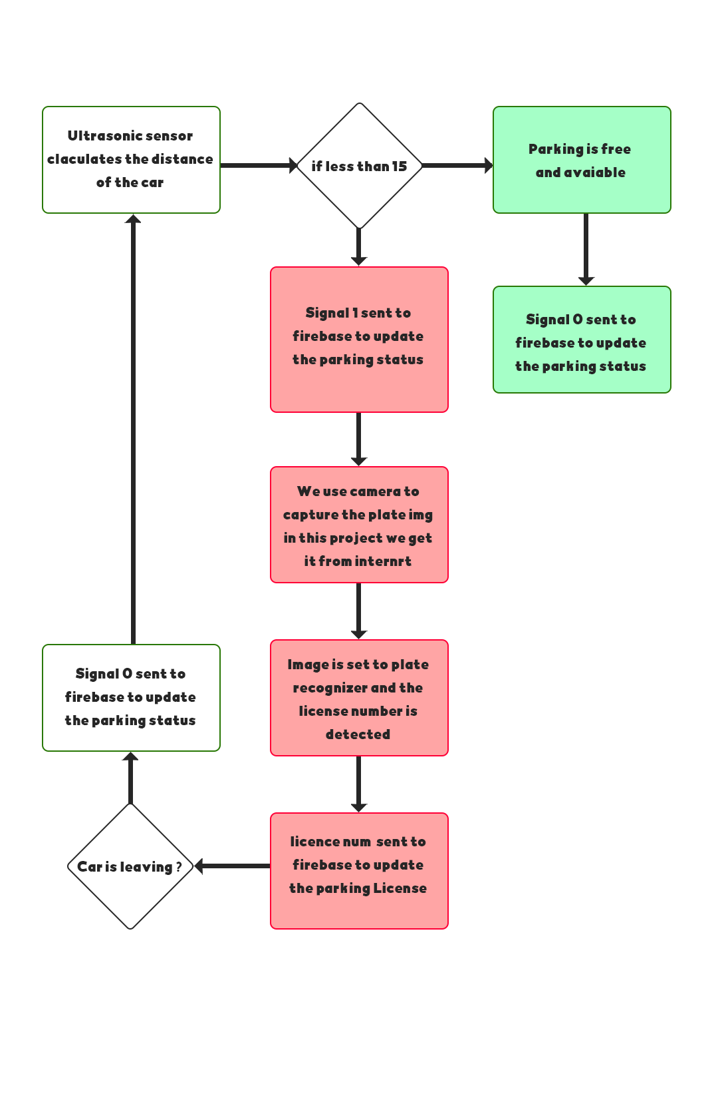
Interaction schemes (main protocols needed in the system)
You can simply impress your audience and add a unique zing and appeal to your Presentations. Get a modern PowerPoint Presentation that is beautifully designed. I hope and I believe that this Template will your Time, Money and Reputation.

Slide 9
Implement a prototype of the architecture in Node-Red consisting of the following components:
software components for simulating the chosen set of sensors
middleware for data acquisition
processing component and dashboard
You can simply impress your audience and add a unique zing and appeal to your Presentations. Get a modern PowerPoint Presentation that is beautifully designed. I hope and I believe that this Template will your Time, Money and Reputation.
Raspberry
Ultrasonic
Camera

Slide 10
software components for simulating the chosen set of sensors
Raspberry Pi
Ultrasonic Sensor HRC-04
IP Webcam/Webcam/RPi Camera (Not implemented in Node-red simulation)
You can simply impress your audience and add a unique zing and appeal to your Presentations. Get a modern PowerPoint Presentation that is beautifully designed. I hope and I believe that this Template will your Time, Money and Reputation.
Raspberry
Ultrasonic
Camera

Slide 11
middleware for data acquisition
Firebase Realtime Database
Fire base
You can simply impress your audience and add a unique zing and appeal to your Presentations. Get a modern PowerPoint Presentation that is beautifully designed. I hope and I believe that this Template will your Time, Money and Reputation.

Slide 12
Working Mechanism (Vehicle Detection)
Ultrasonic Sensor is present at each parking slots which continuously detects the distance of the parking slot from the top.
If a car enters the parking slot the distance will be less than 15 cm and the message “1” will be sent to the database of that slot. (1 means car parked)
As soon as the signal is sent, an image of plate will be captured(in simulation we get image from internet) which works over the Internet
It uses OCR to detect the License Plate Number of the car
It then sends the data to the database of that slot.
After detecting the license plate of the car the license number will be sent to the Realtime database
UI continuously fetches data from the database
When Ui receive the status 1, it set the gauge value to 1 and change the color to red which means the slut is full

Slide 13
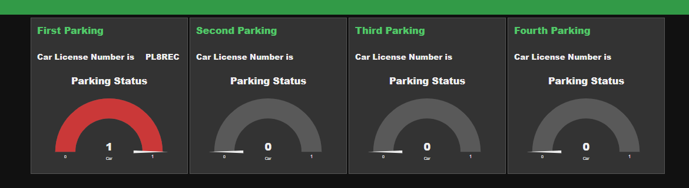
Working Mechanism (Vehicle Detection)
You can simply impress your audience and add a unique zing and appeal to your Presentations. Get a modern PowerPoint Presentation that is beautifully designed. I hope and I believe that this Template will your Time, Money and Reputation.

Slide 14
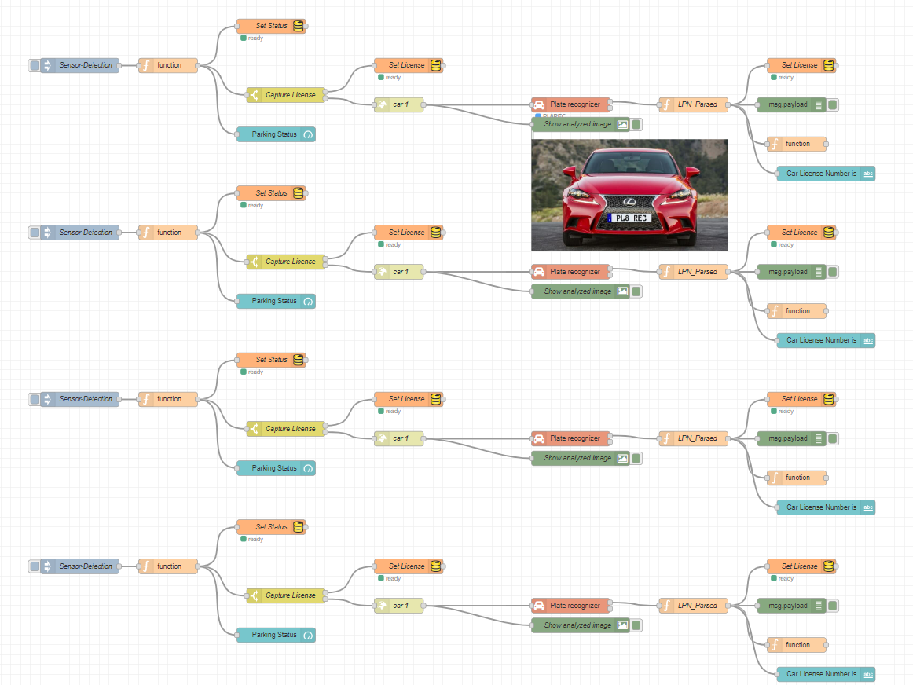
Node-Red Flow
You can simply impress your audience and add a unique zing and appeal to your Presentations. Get a modern PowerPoint Presentation that is beautifully designed. I hope and I believe that this Template will your Time, Money and Reputation.

Slide 15
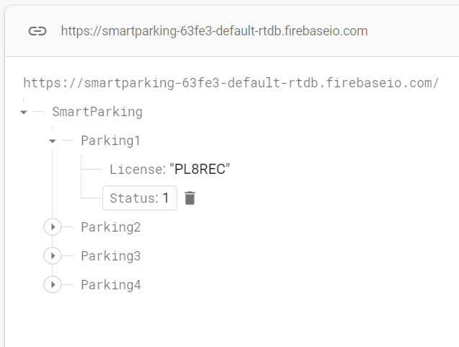
Firebase – Google
You can simply impress your audience and add a unique zing and appeal to your Presentations. Get a modern PowerPoint Presentation that is beautifully designed. I hope and I believe that this Template will your Time, Money and Reputation.

Slide 16
SMART PARKING
Thank You
Peiman Ataei
Sahel Riazi

