Slide 1
simple merge
Team 4
김명규, 김민조, 김성연, 김현빈, 우정현, 조성주

Slide 2
Table of contents
1. Requirements Analysis
2. Design
3. Implementation
4. Verification
5. Maintenance

Slide 3
1. Requirements Analysis

Slide 4
Functions
Load
Edit
Diff
Copy
Save

Slide 5
usecase
UC1 Load
UC2 Edit
UC3 Save
UC4 Diff
UC5 Merge
UC6 CopytoRight
UC7 CopytoLeft

Slide 6
2. Software Design

Slide 7
Key Concepts
MVC pattern
Diff Algorithm (LCS)

Slide 8
MVC Pattern
Model : SM_Model
View : SM_View
+ View_textFrame
Controller : SM_Controller

Slide 9
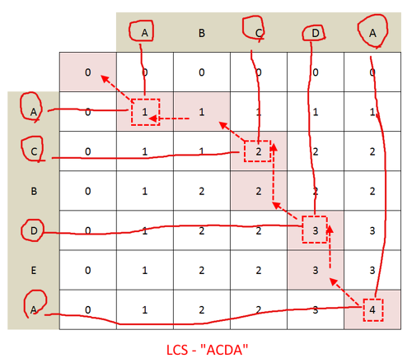
Diff Algorithm
Source : mygumi.tistory.com/126
Using LCS(Longest Common Subsequence) Algorithm

Slide 10
3. Software Implementation

Slide 11
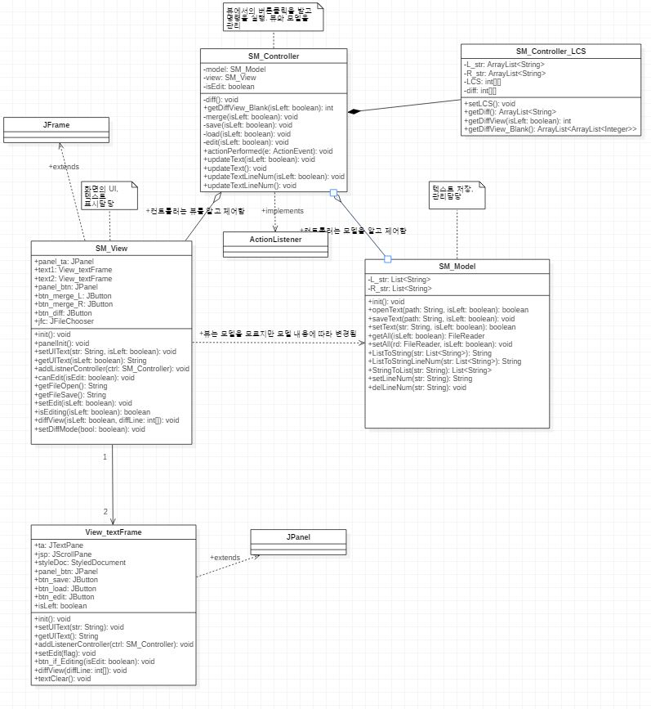
Class diagram

Slide 12
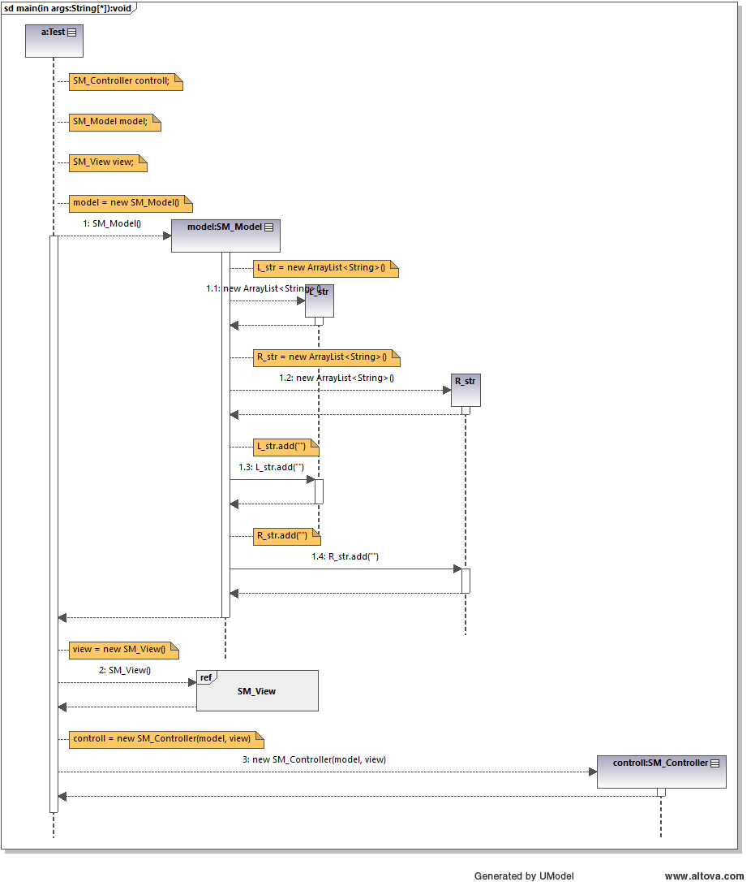
Sequence diagram

Slide 13
4. Software Verification

Slide 14
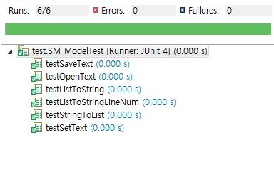
Junit
testSaveText
testOpenText
testListToString
testListToStringLineNum
testStringToList
testSetText

Slide 15
5. Maintenance

Slide 16
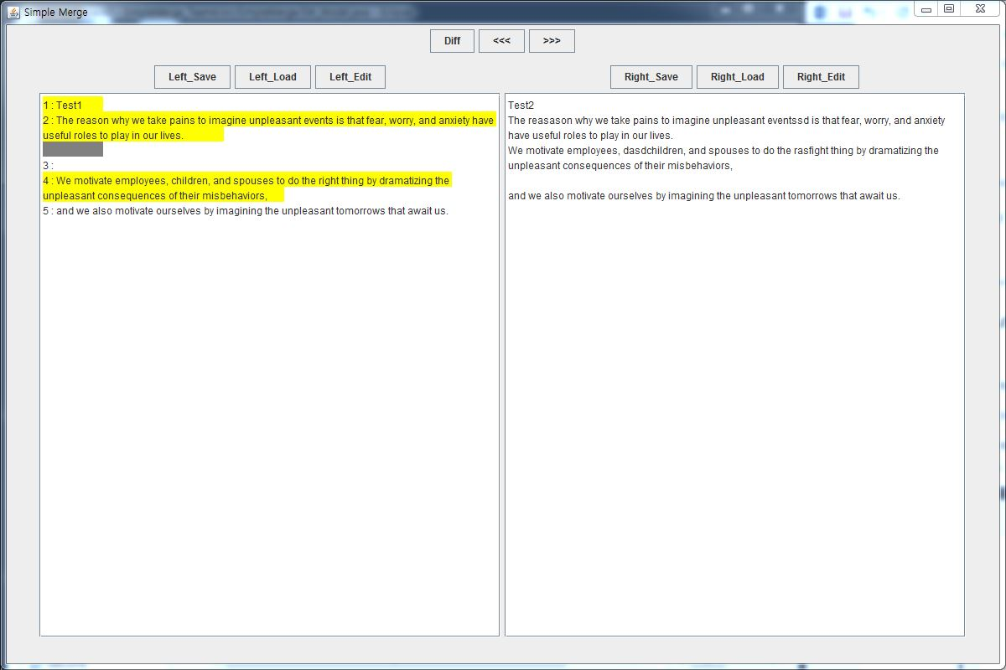
To do lists
In Diff States, We found a bug that rarely when saving one texture, that side becomes non-colored and the other side is still colored.

Slide 17

Q&A

