Slide 1
Coursera Assignment
The Battle of Neighborhoods
————University Tour

Slide 2
INTRODUCTION
the government want to build a new university in your hometown, but the government has no experience on this, so Professor Li are assigned to do a research about the layout of a campus.
five major cities are chosen, namely New York, Chicago, Jersey City, Boston and San Francisco
there should be as many universities as possible in the city, and the distances between them should be as neglectable as possible, so that he can save his time on the way.

Slide 3
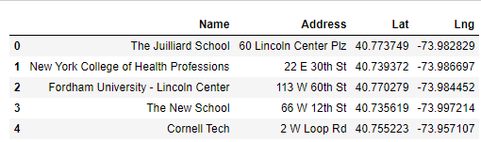
Dataset
Foursquare API is used in this case, and the data of the 5 cities will be directly collected from the database, here is on simple example of New York City

Slide 4
Number of Universities or colleges in the Cities
From the Diagram below can we see that New York City has the greatest number of campus

Slide 5
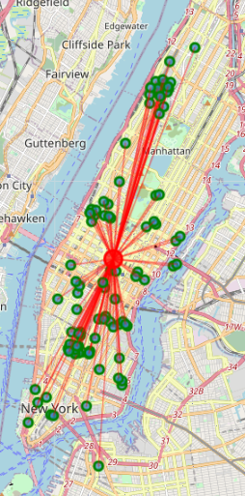
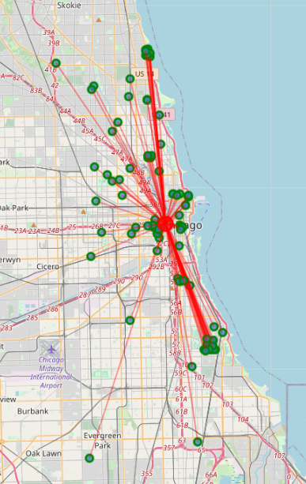
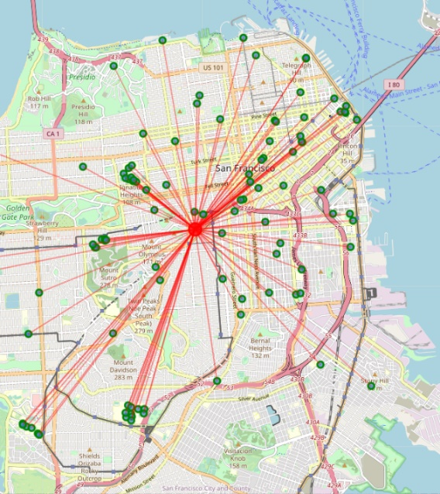
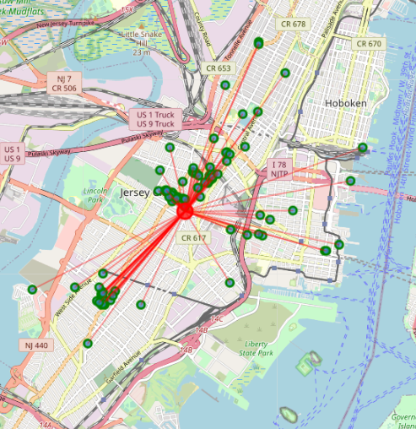
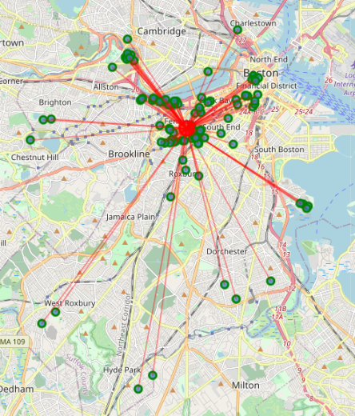
Density of the Universities or Colleges in the cities

Slide 6
Conclusion
although New York doesn’t have the smallest number of Mean Distance from Mean coordinates, the value of this factor remains acceptable, while the value for Chicago is too big.
Although San Francisco has the smallest value of Mean Distance from Mean coordinates, the total number of campus is too small to be reckoned with
Therefore, New York should be the best city for Professor Li to visit

