Slide 1
Millicharged particle (mCP) at BDX experiment
2024/7/19

Slide 2
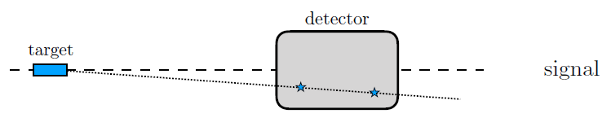
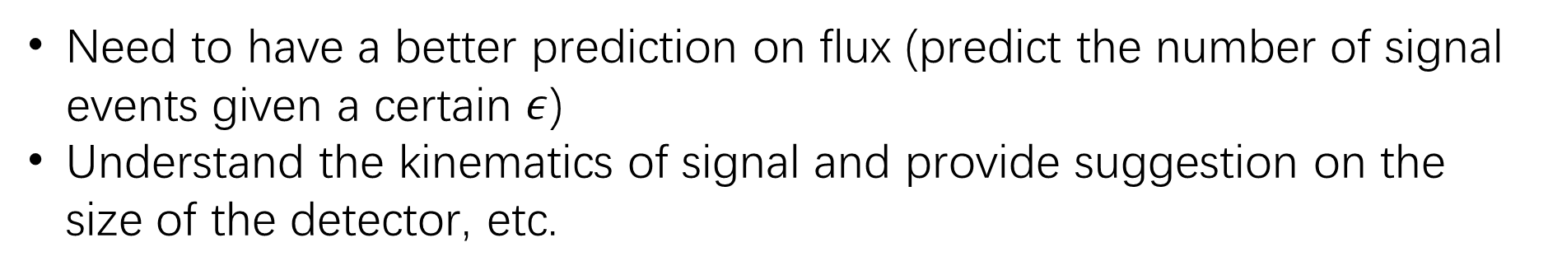

Millicharge particle at Beamdump experiment
Millicharge interact with electrons by tiny EM force
$e′\overline{χ}γ^{μ}χA_{μ}$ where $e^{′}=ε∗e, ε\sim 0.01$
Need to have a better prediction on flux (predict the number of signal events given a certain $ε$)
Understand the kinematics of signal and provide suggestion on the size of the detector, etc.

Slide 3
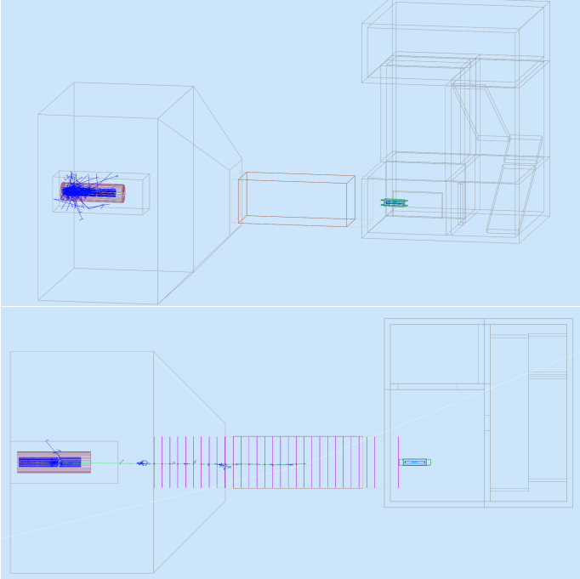
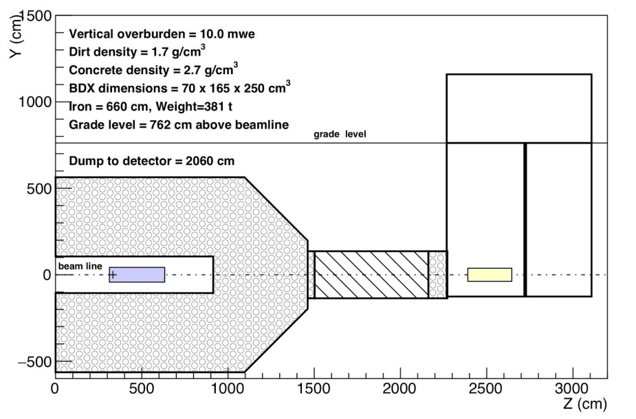
BDX: Beam-Dump eXperiment at Jefferson Lab (JLab)
Virginia state
1607.01390 (arxiv.org) Page 26, the dump is Aluminum
Beam energy=11 GeV
CsI
Al with 3m thickness

Slide 4
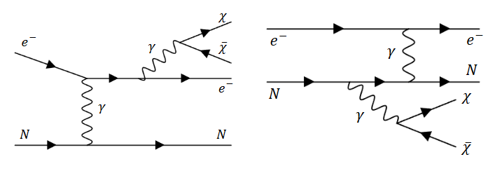
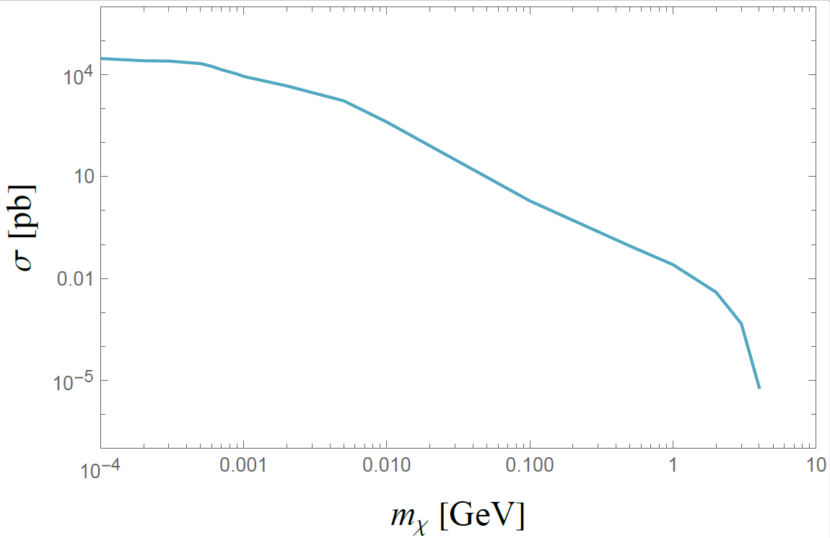

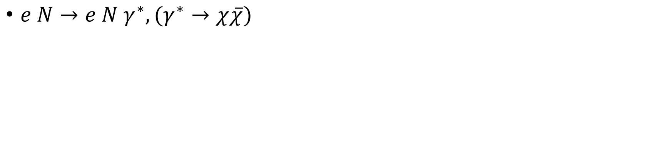
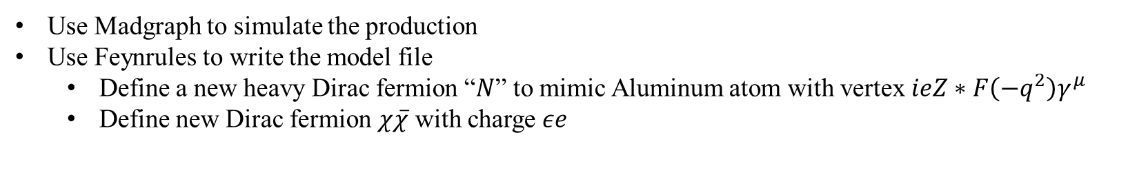
Production of pair millicharged particle (mCP)
$e N→e N γ^{∗}, (γ^{∗}→χ\overline{χ})$
$$p_{e}=\left(11,0,0,11\right) GeV$$
$$p_{Al}=\left(25.2, 0, 0, 0\right) GeV$$
$$\sqrt{s}=33 GeV$$
Use Madgraph to simulate the production
Use Feynrules to write the model file
Define a new heavy Dirac fermion “$N$” to mimic Aluminum atom with vertex $ieZ∗F\left(−q^{2}\right)γ^{μ}$
Define new Dirac fermion $χ\overline{χ}$ with charge $εe$

Slide 5
Total production cross section:
Finding cross-checks:
Massive dark photon (Yiming’s study)
Or other measured flux, e.g., muons.
NA64e (Ref.[5] in overleaf)
Maybe start with 0.01MeV

Slide 6
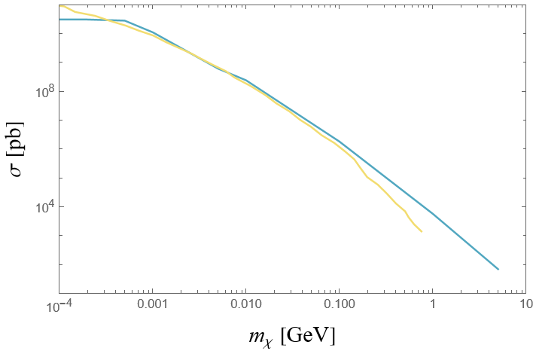
Cross section check with other paper
NA64e (Ref.[5] in overleaf)
100 GeV electron beam, with Pb target
Blue is our result using Madgraph
Yellow is the other paper’s result using CalcHEP

Slide 7
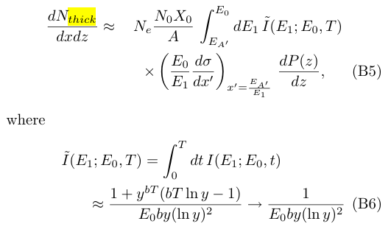
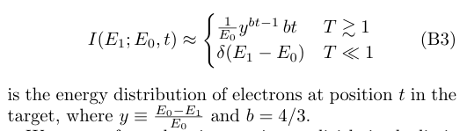
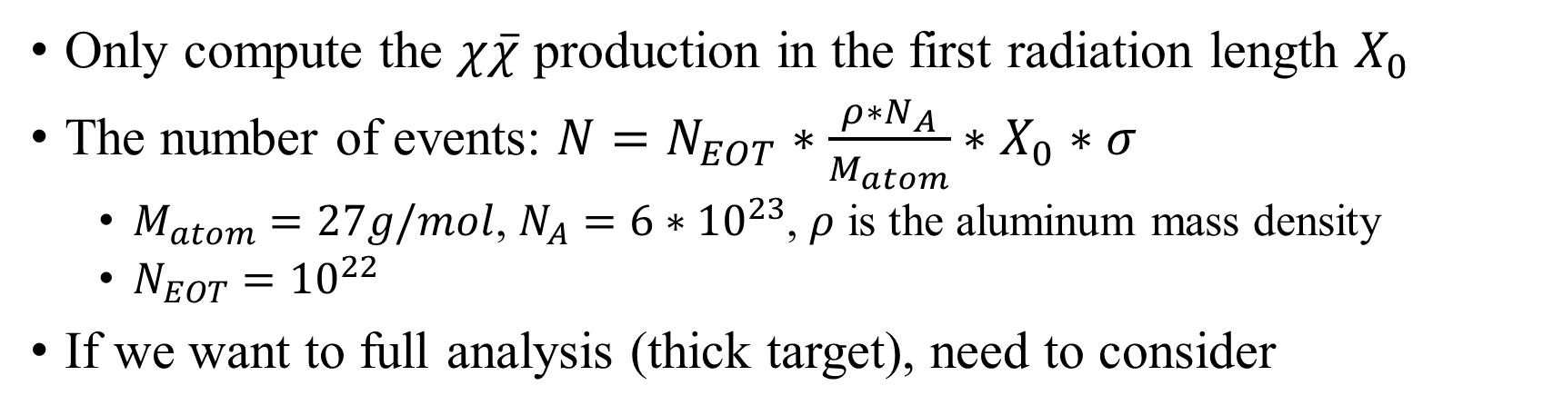
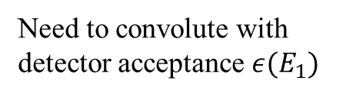
Number of events
https://cds.cern.ch/record/1279627/files/PH-EP-Tech-Note-2010-013.pdf
Only compute the $χ\overline{χ}$ production in the first radiation length $X_{0}$
The number of events: $N=N_{EOT}∗\frac{ρ∗N_{A}}{M_{atom}}∗X_{0}∗σ$
$M_{atom}=27g/mol$, $N_{A}=6∗{10}^{23}$, $ρ$ is the aluminum mass density
$N_{EOT}={10}^{22}$
If we want to full analysis (thick target), need to consider
https://arxiv.org/pdf/2204.03984
Need to convolute with detector acceptance $ε(E_{1})$
https://arxiv.org/pdf/0906.0580

Slide 8
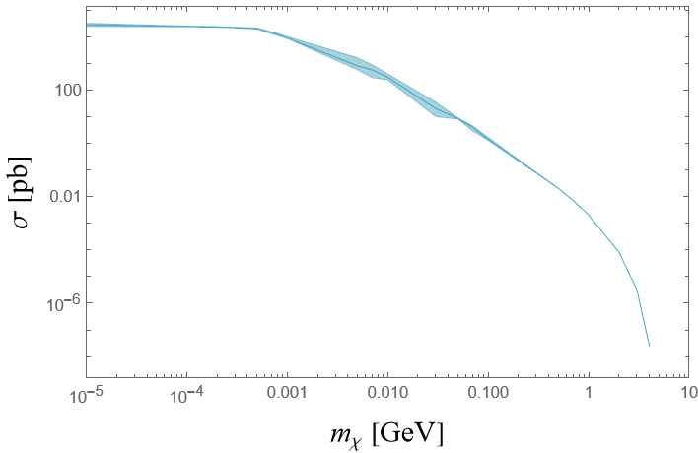
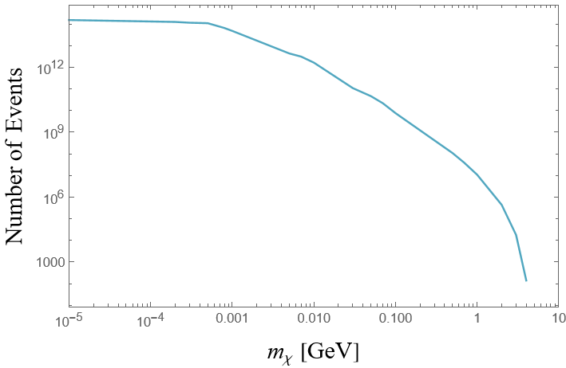
Total cross section and total number of events

Slide 9
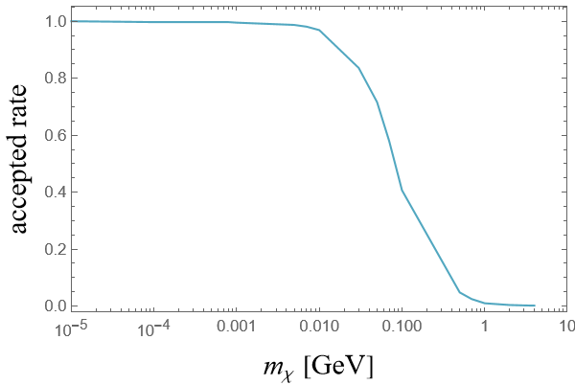
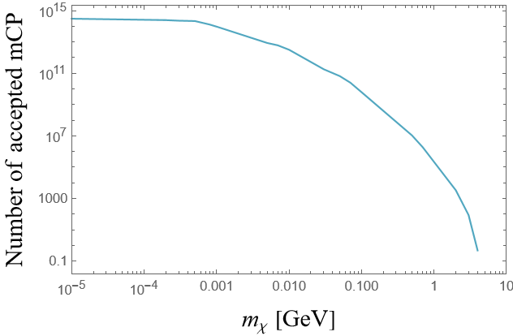
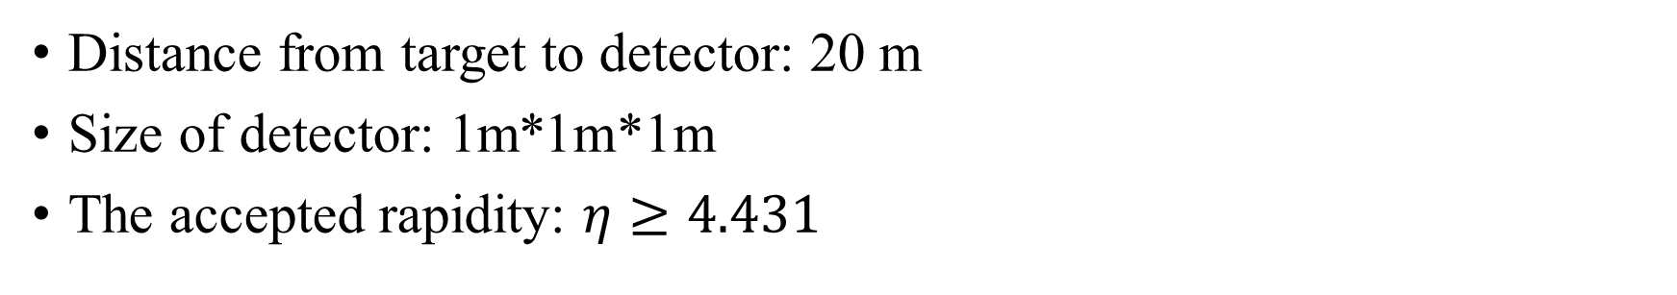
Accepted rate by BDX detector
Distance from target to detector: 20 m
Size of detector: 1m*1m*1m
The accepted rapidity: $η≥4.431$

Slide 10
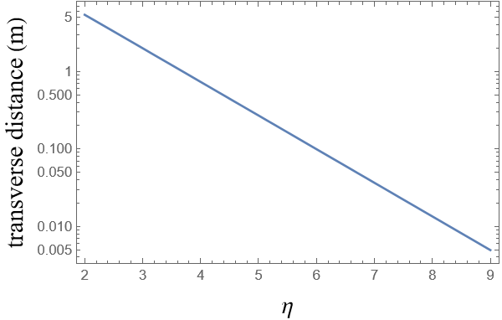
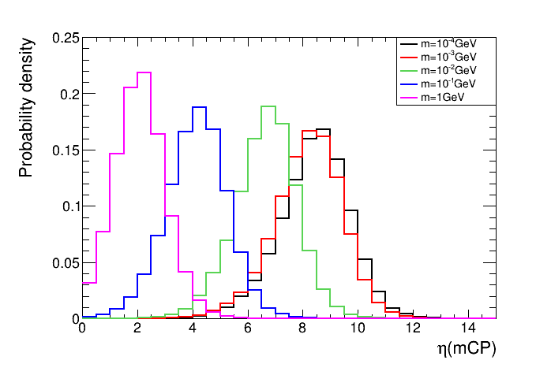
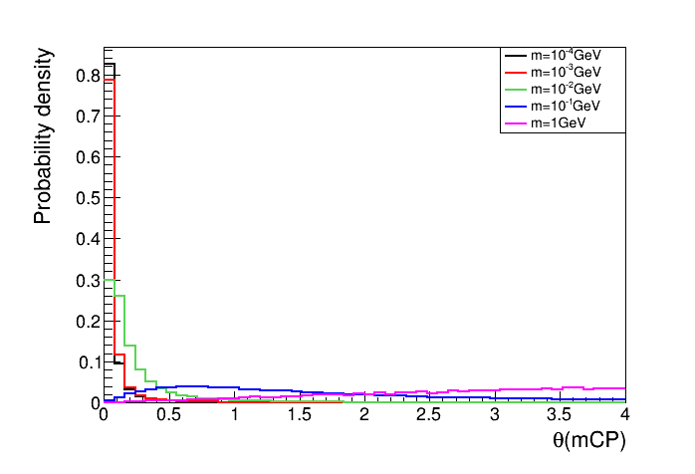
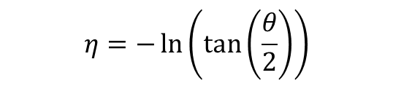
Rapidity distribution
$$η=−\ln\left(\tan\left(\frac{θ}{2}\right)\right)$$

Slide 12
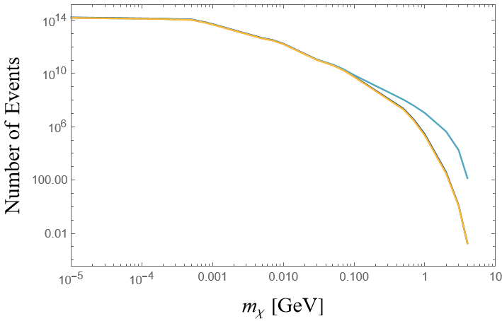
Update on the production
Blue: previous result (didn’t successfully apply nuclear formfactor)
Yellow: applied formfactor
Dark green: updated formfactor

Slide 13
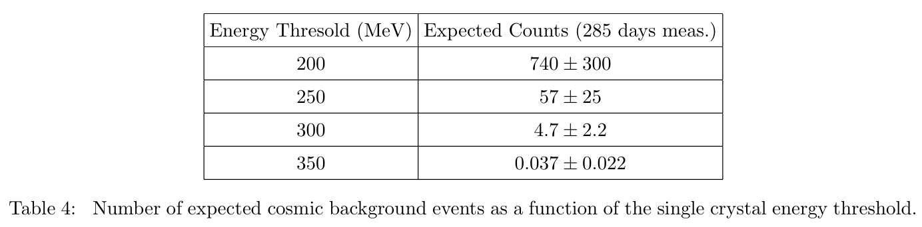
Contribution from CsI detector
The energy threshold is 300 MeV

Slide 14
Back up

Slide 15
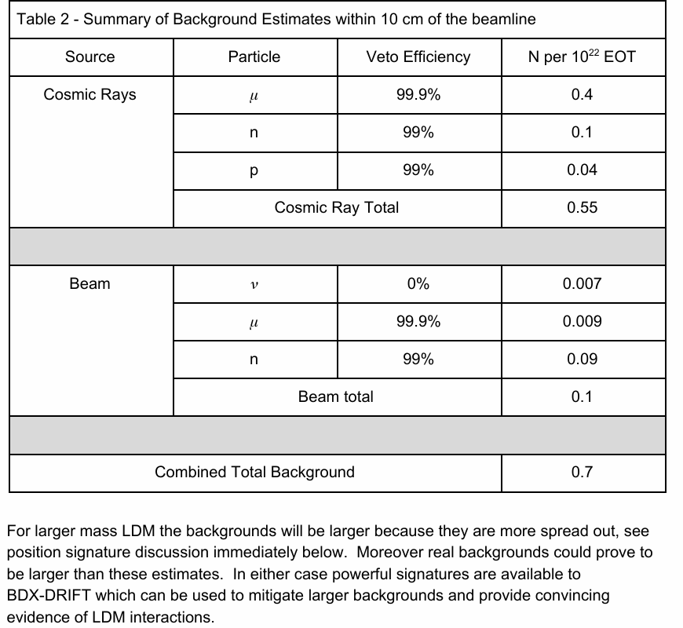
Background
Share Data with Megan and Hailin.
Signal distributions:
Angular distribution dependence on mass.
Energy distribution dependence on mass.

Slide 16
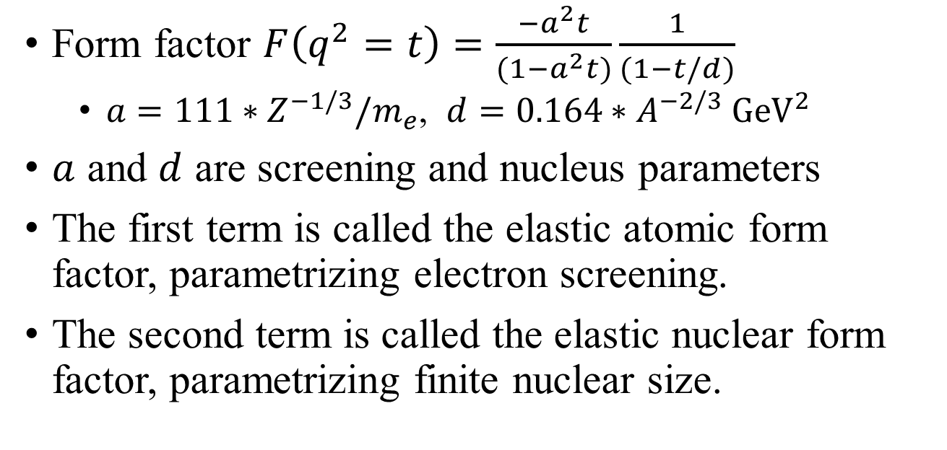
Form factor
Form factor $F\left(q^{2}=t\right)=\frac{−a^{2}t}{(1−a^{2}t)}\frac{1}{(1−t/d)}$
$a=111∗Z^{−1/3}/m_{e}$, $d=0.164∗A^{−2/3} {GeV}^{2}$
$a$ and $d$ are screening and nucleus parameters
The first term is called the elastic atomic form factor, parametrizing electron screening.
The second term is called the elastic nuclear form factor, parametrizing finite nuclear size.
https://arxiv.org/pdf/0906.0580

Slide 17
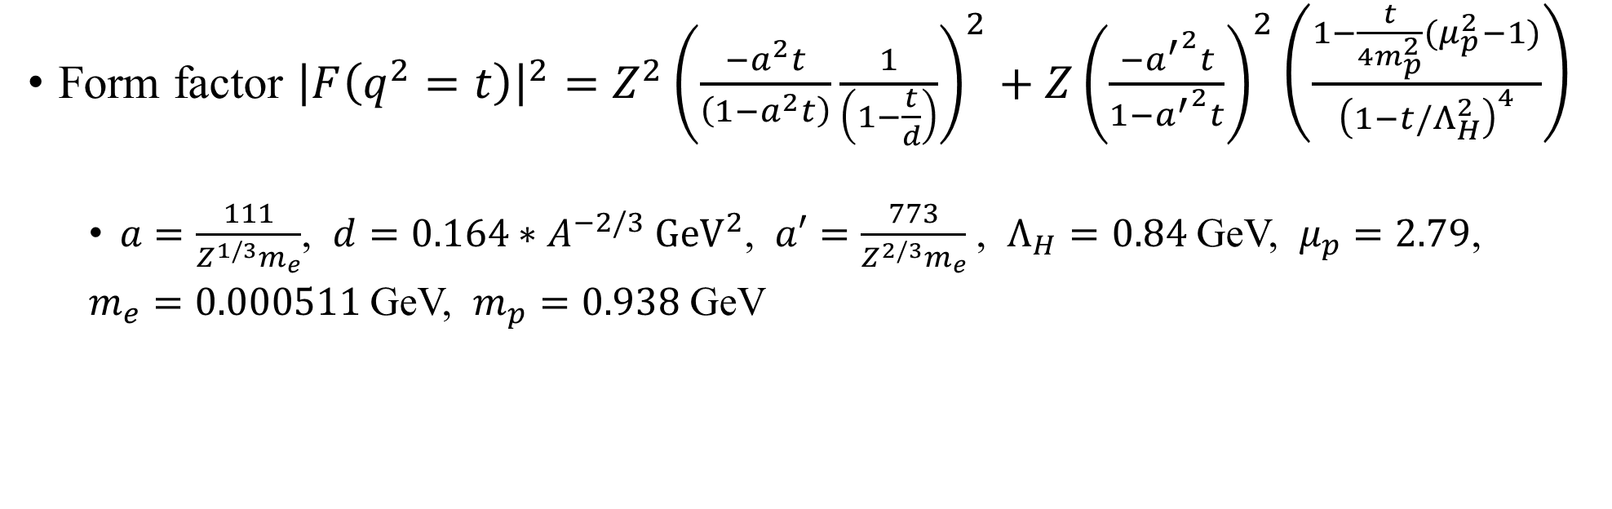
Form factor (updated)
Form factor ${\left|F\left(q^{2}=t\right)\right|}^{2}=Z^{2}{\left(\frac{−a^{2}t}{\left(1−a^{2}t\right)}\frac{1}{\left(1−\frac{t}{d}\right)}\right)}^{2}+Z{\left(\frac{−{a^{′}}^{2}t}{1−{a^{′}}^{2}t}\right)}^{2}\left(\frac{1−\frac{t}{4m_{p}^{2}}(μ_{p}^{2}−1)}{{\left(1−t/Λ_{H}^{2}\right)}^{4}}\right)$
$a=\frac{111}{Z^{1/3}m_{e}}$, $d=0.164∗A^{−2/3} {GeV}^{2}$, $a′=\frac{773}{Z^{2/3}m_{e}}$ , $Λ_{H}=0.84$ GeV, $μ_{p}=2.79$,
$m_{e}=0.000511$ GeV, $m_{p}=0.938$ GeV
https://arxiv.org/pdf/2401.06843

Slide 18
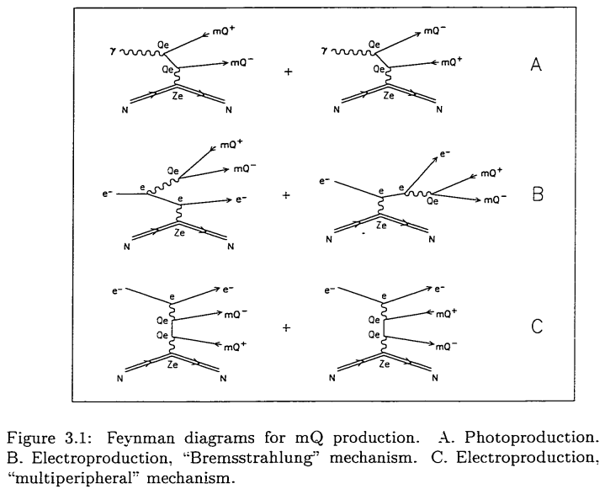
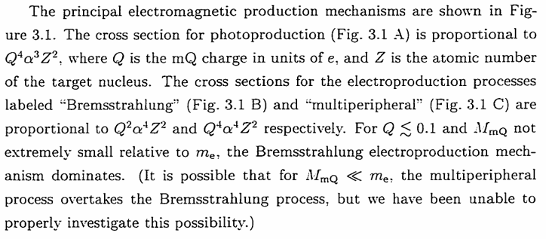
SLAC production
https://inspirehep.net/files/08e5ea6b54eb1a30bb4fdd1319841f9d

Slide 19
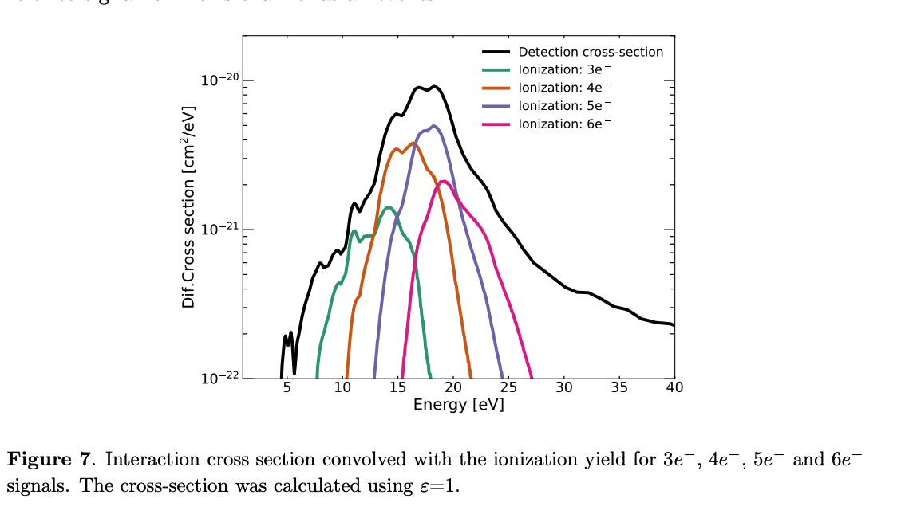


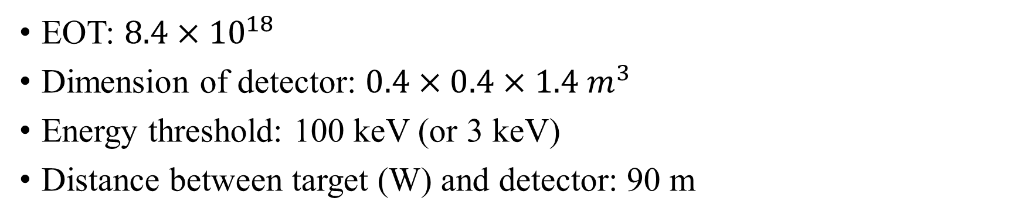
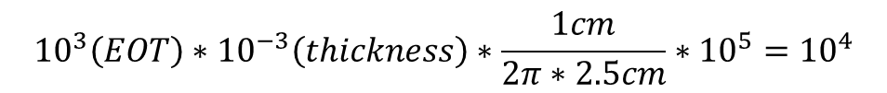
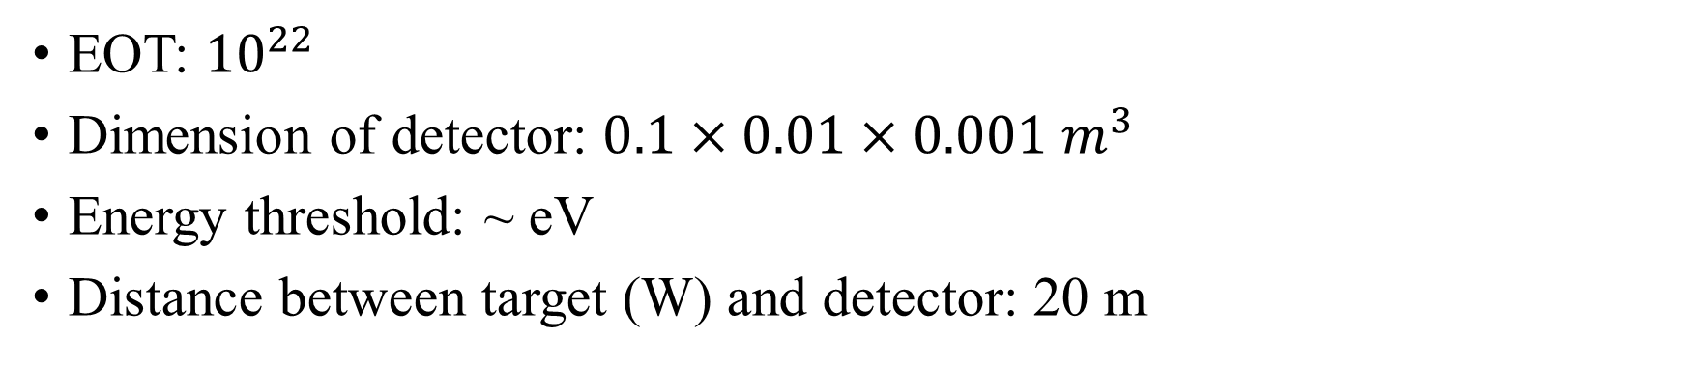
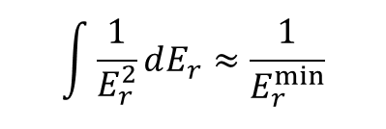
SLAC detection
https://arxiv.org/pdf/1307.6861 PhysRevLett.81.1175 (aps.org)
EOT: $8.4×{10}^{18}$
Dimension of detector: $0.4×0.4×1.4 m^{3}$
Energy threshold: 100 keV (or 3 keV)
Distance between target (W) and detector: 90 m
BDX detection
EOT: ${10}^{22}$
Dimension of detector: $0.1×0.01×0.001 m^{3}$
Energy threshold: ~ eV
Distance between target (W) and detector: 20 m
$${10}^{3}\left(EOT\right)∗{10}^{−3}\left(thickness\right)∗\frac{1cm}{2π∗2.5cm}∗{10}^{5}={10}^{4}$$
For $m_{χ}<{10}^{−3}$ GeV:
$$\int{\frac{1}{E_{r}^{2}}dE_{r}≈\frac{1}{E_{r}^{min}}}$$

Slide 21
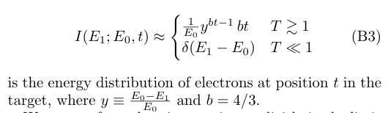
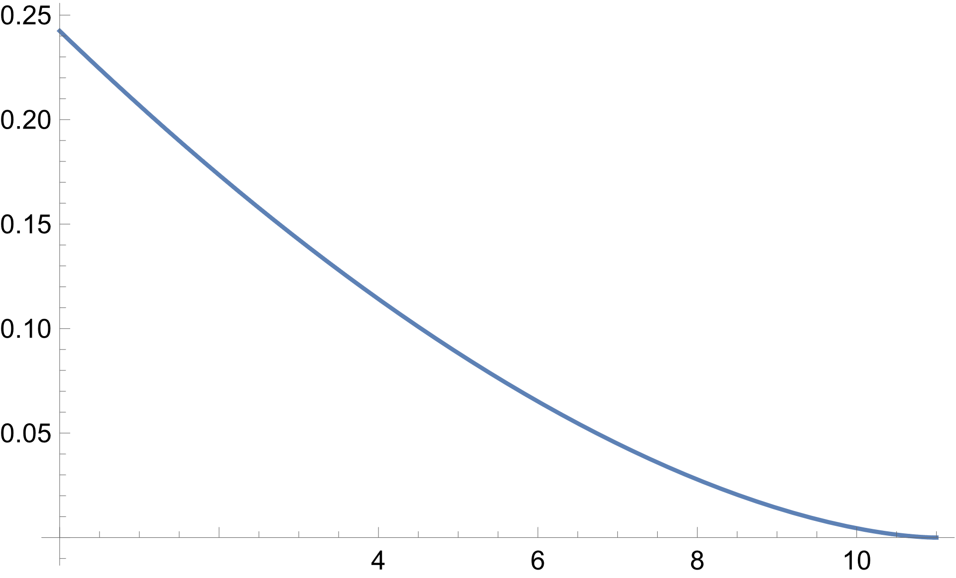

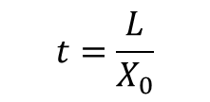


Beam Energy distribution at given position t
https://arxiv.org/pdf/0906.0580
$$t=\frac{L}{X_{0}}$$
$$P(E_{1})$$
$$t=2$$
$$E_{1}(GeV)$$

Slide 22
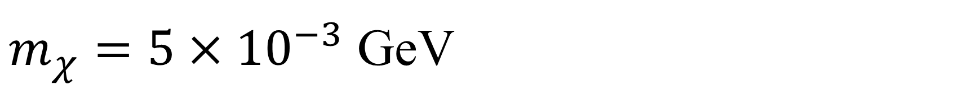
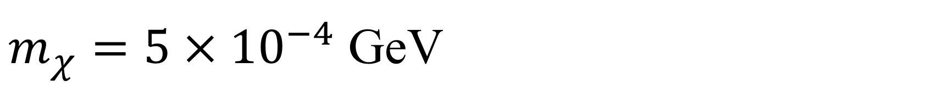
$m_{χ}=5×{10}^{−4}$ GeV
1st radiation length (11 GeV): xs=20000 pb (99%)
2nd radiation length (4 GeV): xs=28000 pb (90%)
3rd radiation length (1 GeV): xs=67000 pb (70%)
$m_{χ}=5×{10}^{−3}$ GeV
1st radiation length (11 GeV): xs=800 pb (99%)
2nd radiation length (4 GeV): xs=700 pb (60%)
3rd radiation length (1 GeV): xs=800 pb (20%)

Slide 23
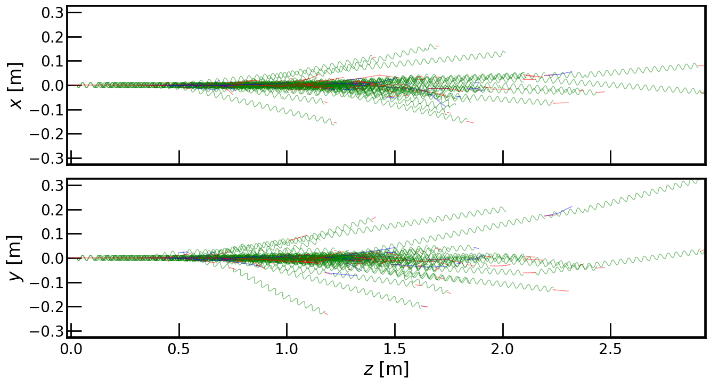
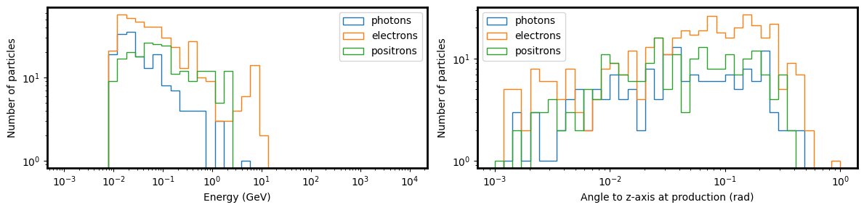
shower
min particle energy: 10 MeV
Material: graphite (need to change)
11 GeV beam energy

Slide 24



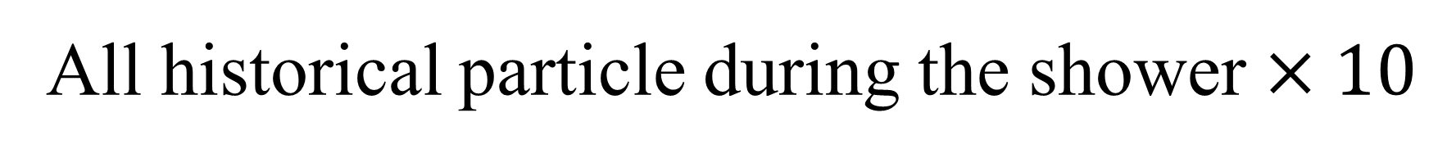
All historical particle during the shower $×10$
$E_{min}=100$ MeV
Forwarded electron (within the accepted angle: 0.1m/20m)
$E_{min}=10$ MeV
$E_{min}=1$ MeV

Slide 25

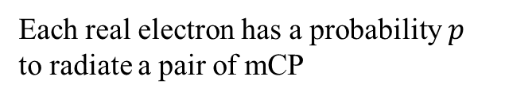
Conditional probability
Each real electron has a probability $p$ to radiate a pair of mCP
1 electron $→$ 30 electron
But $p$ is very small $\left(1−p\right)∗p≈1∗p$
Ignore conditional probability
cross sections can be just added

Slide 26


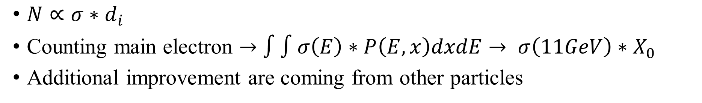



Shower
Shower process
$$d_{4}$$
1 main electron $→$ 30 main electrons
$$d_{3}$$
$$d_{2}$$
$$d_{1}$$
$N∝σ∗d_{i}$
Counting main electron $→$ $∫∫σ\left(E\right)∗P\left(E,x\right)dxdE→ σ\left(11GeV\right)∗X_{0}$
Additional improvement are coming from other particles

Slide 27
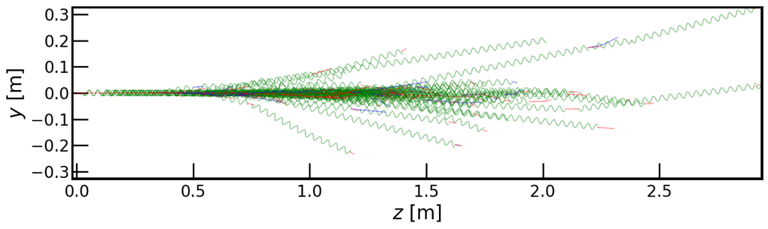
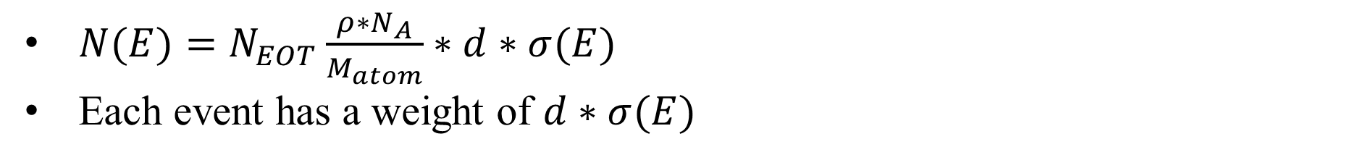
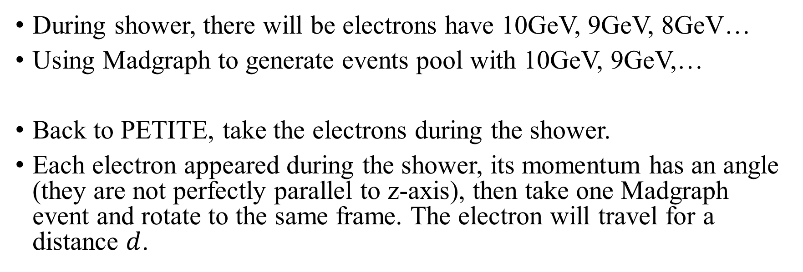
Sampling from Shower
During shower, there will be electrons have 10GeV, 9GeV, 8GeV…
Using Madgraph to generate events pool with 10GeV, 9GeV,…
Back to PETITE, take the electrons during the shower.
Each electron appeared during the shower, its momentum has an angle (they are not perfectly parallel to z-axis), then take one Madgraph event and rotate to the same frame. The electron will travel for a distance $d$.
$N(E)=N_{EOT}\frac{ρ∗N_{A}}{M_{atom}}∗d∗σ(E)$
Each event has a weight of $d∗σ(E)$
Final sample, for each mass benchmark, will be a list of $χ:$ $\{p_{x},p_{y},p_{z},E,weight\}$

Slide 28
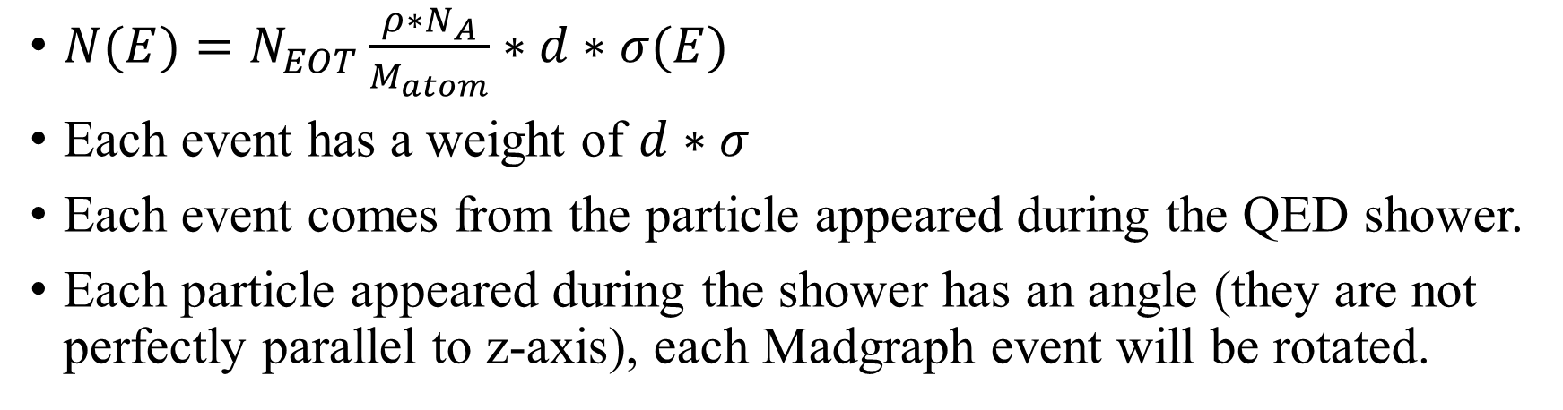
Number of event
$N(E)=N_{EOT}\frac{ρ∗N_{A}}{M_{atom}}∗d∗σ(E)$
Each event has a weight of $d∗σ$
Each event comes from the particle appeared during the QED shower.
Each particle appeared during the shower has an angle (they are not perfectly parallel to z-axis), each Madgraph event will be rotated.

Slide 29
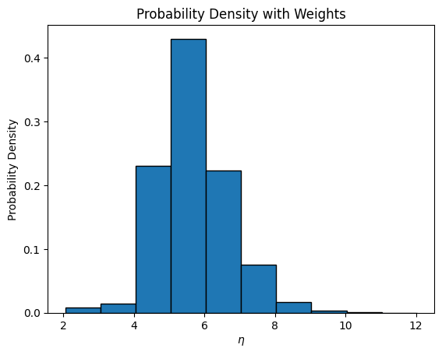





$η=6.5→5$cm / 20 m
$m_{χ}={10}^{−4}$ GeV
Shower
$N_{total}=3.9×{10}^{15}$
Acceptance ($η>6.5$): 19%
$N=7.3×{10}^{14}$
$m_{χ}={10}^{−4}$ GeV
Shower (include positron)
$N_{total}=5.6×{10}^{15}$
Acceptance ($η>6.5$): 17%
$N=9.7×{10}^{14}$
$m_{χ}={10}^{−4}$ GeV

Slide 30


$η=6.5→5$cm / 20 m
$m_{χ}={10}^{−4}$ GeV
Shower (include positron)
$N_{total}=5.6×{10}^{15}$
Acceptance ($η>6.5$): 17%
$N=9.7×{10}^{14}$
$m_{χ}={10}^{−4}$ GeV
1st radiation length approximation
$N_{total}=2.6×{10}^{14}$
Acceptance ($η>6.5$): ~90%
$N=2.4×{10}^{14}$
$m_{χ}={10}^{−4}$ GeV

Slide 31



$η=6.5→5$cm / 20 m
$m_{χ}={10}^{−4}$ GeV
Shower (include positron)
$N_{total}=5.6×{10}^{15}$
Acceptance ($η>6.5$): 17%
$N=9.7×{10}^{14}$
$m_{χ}={10}^{−4}$ GeV
Shower (include positron)
$N_{total}=5.6×{10}^{15}$
Acceptance ($η>6.5$): 17%
$N=9.7×{10}^{14}$
$m_{χ}={10}^{−4}$ GeV
Weight=1/r

Slide 32




$η=6.5→5$cm / 20 m
$m_{χ}={10}^{−1}$ GeV
Shower
$N_{total}=1.7×{10}^{10}$
Acceptance ($η>6.5$): 1.4%
$N=2.4×{10}^{8}$
$m_{χ}={10}^{−1}$ GeV
1st radiation length approximation
$N_{total}=8.8×{10}^{9}$
Acceptance ($η>6.5$): ~1%
$N \sim 1×{10}^{8}$
$m_{χ}=0.1$GeV

Slide 33
2024/10/1

Slide 34
$η=6.5→5$cm / 20 m
$m_{χ}={10}^{−4}$ GeV
Shower (include positron)
$N_{total}=5.6×{10}^{15}$
Acceptance ($η>6.5$): 17%
$N=9.7×{10}^{14}$
$m_{χ}={10}^{−4}$ GeV
1st radiation length approximation
$N_{total}=2.6×{10}^{14}$
Acceptance ($η>6.5$): ~90%
$N=2.4×{10}^{14}$
$m_{χ}={10}^{−4}$ GeV

Slide 35





$η=6.5→5$cm / 20 m
$$χ$$
$$e$$
$m_{χ}={10}^{−4}$ GeV
Shower
$N_{total}=3.9×{10}^{15}$
Acceptance ($η>6.5$): 19%
$N=7.3×{10}^{14}$
$m_{χ}={10}^{−4}$ GeV
Shower (Compton scattering)
$N_{total}=6.4×{10}^{14}$
Acceptance ($η>6.5$): 0.36%
$N=2.3×{10}^{12}$
$m_{χ}={10}^{−4}$ GeV

Slide 36






$η=6.5→5$cm / 20 m
$$e$$
$$χ$$
$$e$$
$$χ$$
$m_{χ}={10}^{−4}$ GeV
Shower (include positron)
$N_{total}=5.6×{10}^{15}$
Acceptance ($η>6.5$): 17%
$N=9.7×{10}^{14}$
$m_{χ}={10}^{−4}$ GeV
Shower (annihilation, 1GeV)
$N_{total}=1.4×{10}^{15}$
Acceptance ($η>6.5$): 1.4%
$N=1.9×{10}^{13}$
$m_{χ}={10}^{−4}$ GeV

Slide 37



$η=6.5→5$cm / 20 m
$$e$$
$$χ$$
$$e$$
$$χ$$
$m_{χ}={10}^{−4}$ GeV
Shower (include positron, 1GeV)
$N_{total}=5.6×{10}^{15}$
Acceptance ($η>6.5$): 17%
$N=9.7×{10}^{14}$
$m_{χ}={10}^{−4}$ GeV
Shower ($E(e+)>100$MeV)
$N_{total}=1.1×{10}^{17}$
Acceptance ($η>6.5$): 0.1%
$N=1.013×{10}^{14}$
$m_{χ}={10}^{−4}$ GeV

Slide 38





$η=6.5→5$cm / 20 m
$$e$$
$$χ$$
$$e$$
$$χ$$
$m_{χ}={10}^{−4}$ GeV
Shower (include positron, 100MeV)
$N_{total}=1.2×{10}^{17}$
Acceptance ($η>6.5$): 1.4%
$N=1.575×{10}^{15}$
$m_{χ}={10}^{−4}$ GeV
Shower ($E(e+)>100$MeV)
$N_{total}=1.1×{10}^{17}$
Acceptance ($η>6.5$): 0.08%
$N=8.8×{10}^{13}$
$m_{χ}={10}^{−4}$ GeV

Slide 39





$η=6.5→5$cm / 20 m
$$e$$
$$χ$$
$$e$$
$$χ$$
$m_{χ}={10}^{−4}$ GeV
Shower (include positron, 10MeV)
$N_{total}=3.4×{10}^{17}$
Acceptance ($η>6.5$): 0.5%
$N=1.614×{10}^{15}$
$m_{χ}={10}^{−4}$ GeV
Shower ($E(e+)>10$MeV)
$N_{total}=9.9×{10}^{17}$
Acceptance ($η>6.5$): 0.01%
$N=1.07×{10}^{14}$
$m_{χ}={10}^{−4}$ GeV

Slide 40

$m_{χ}=1×{10}^{−4}$ GeV, $η>6.5$ (5cm)
Annihilation
$$e$$
$$χ$$
$$e$$
$$χ$$
Threshold | 1GeV | 900MeV | 800MeV | 700MeV | 600MeV | 500MeV | 400MeV | 300MeV | 200MeV | 100MeV
Accepted number | 2e13 | 2.2e13 | 2.4e13 | 2.6e13 | 3.5e13 | 4e13 | 4.6e13 | 5.3e13 | 7.4e13 | 8.8e13
 |  | 90MeV | 80MeV | 70MeV | 60MeV | 50MeV | 40MeV | 30MeV | 20MeV | 10MeV
 |  | 9.0e13 | 9.0e13 | 1.0e14 | 1.03e14 | 1.07e14 | 1.07e14 | 1.07e14 | 1.07e14 | 1.07e14

Slide 41



$η=6.5→5$cm / 20 m
$$χ$$
$$e$$
$m_{χ}={10}^{−4}$ GeV
Shower (include positron, 10MeV)
$N_{total}=3.4×{10}^{17}$
Acceptance ($η>6.5$): 0.5%
$N=1.614×{10}^{15}$
$m_{χ}={10}^{−4}$ GeV
Shower ($E(γ)>10$MeV)
$N_{total}=4.2×{10}^{17}$
Acceptance ($η>6.5$): 0.02%
$N=7.6×{10}^{13}$
$m_{χ}={10}^{−4}$ GeV

Slide 42





Weighted by $1/r$
$$r$$
$$η=−ln⁡(tan⁡(θ/2))$$
$$e$$
$$χ$$
$$e$$
$$χ$$

Slide 43



Weighted by $1/r$
$$r$$
$$e$$
$$χ$$
${10}^{−4}$ GeV
$$e$$
$$χ$$

Slide 44



Weighted by $1/r$
$$r$$
$$e$$
$$χ$$
${10}^{−3}$ GeV
$$e$$
$$χ$$

Slide 45




Trident process
${10}^{−4}$ GeV
${10}^{−3}$ GeV

Slide 47
To Do
Fill the overleaf draft

