Slide 1
Millicharged particle (mCP) at BDX experiment
2024/7/19

Slide 2
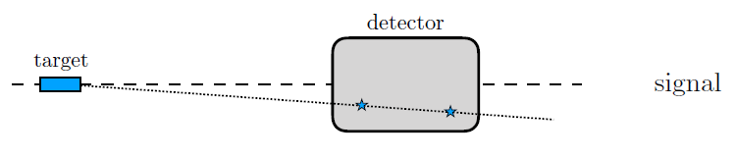
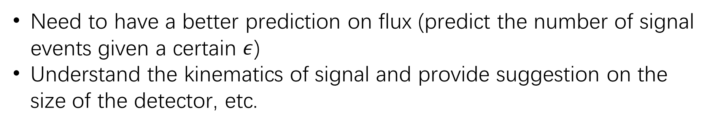

Millicharge particle at Beamdump experiment
Millicharge interact with electrons by tiny EM force
$e′\overline{χ}γ^{μ}χA_{μ}$ where $e^{′}=ε∗e, ε\sim 0.01$
Need to have a better prediction on flux (predict the number of signal events given a certain $ε$)
Understand the kinematics of signal and provide suggestion on the size of the detector, etc.

Slide 3
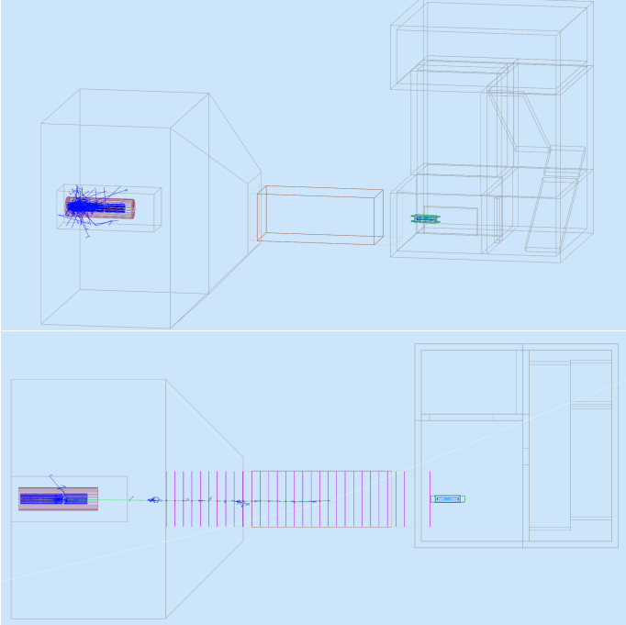
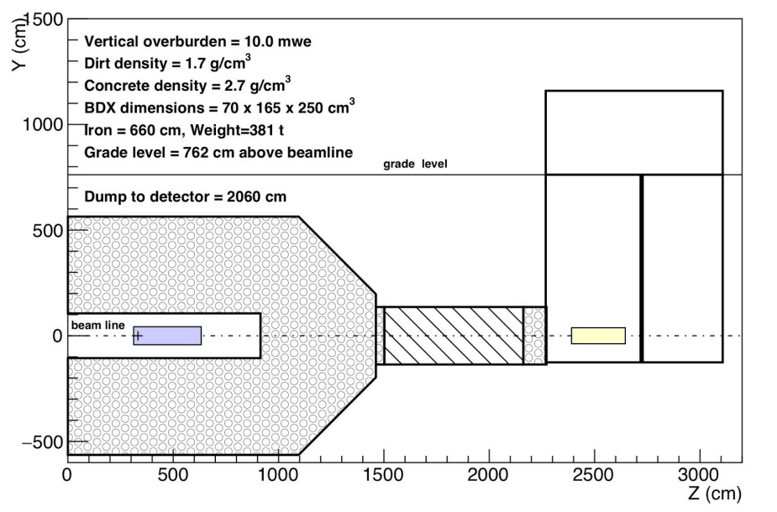
BDX: Beam-Dump eXperiment at Jefferson Lab (JLab)
Virginia state
1607.01390 (arxiv.org) Page 26, the dump is Aluminum
Beam energy=11 GeV
CsI
Al

Slide 4
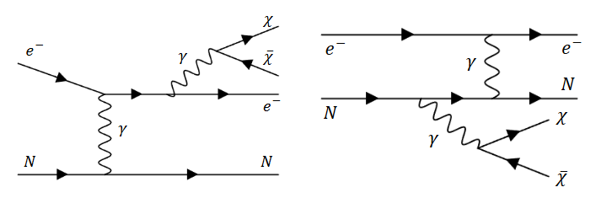
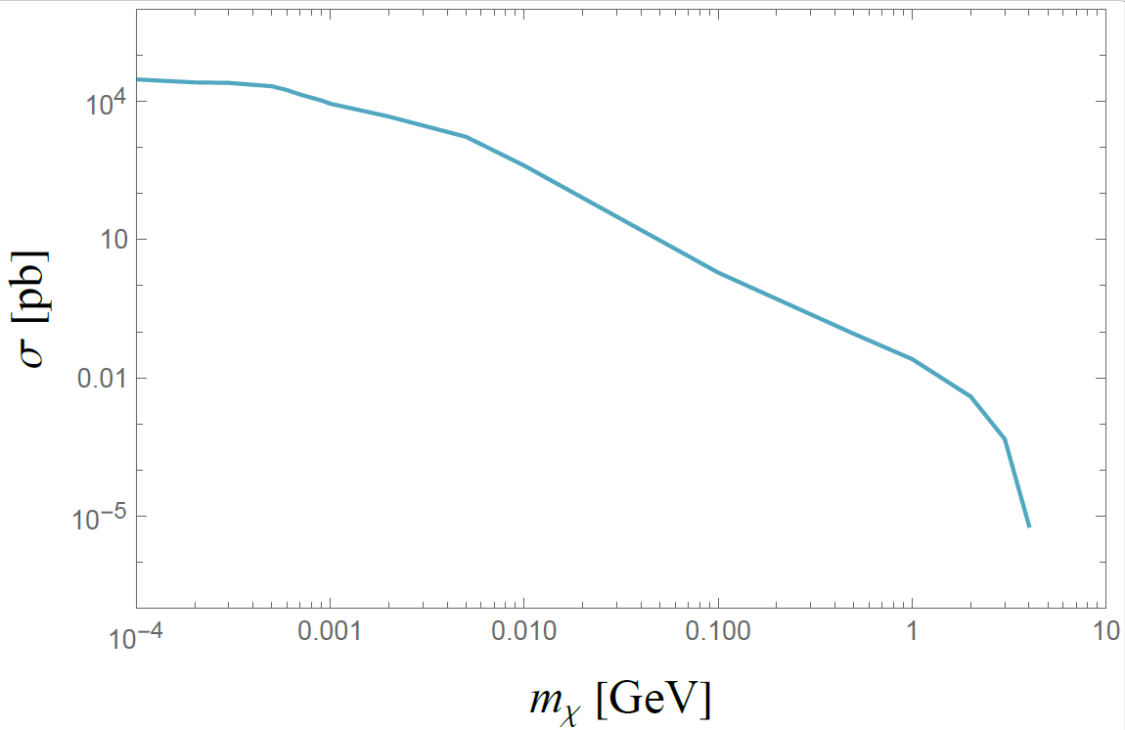

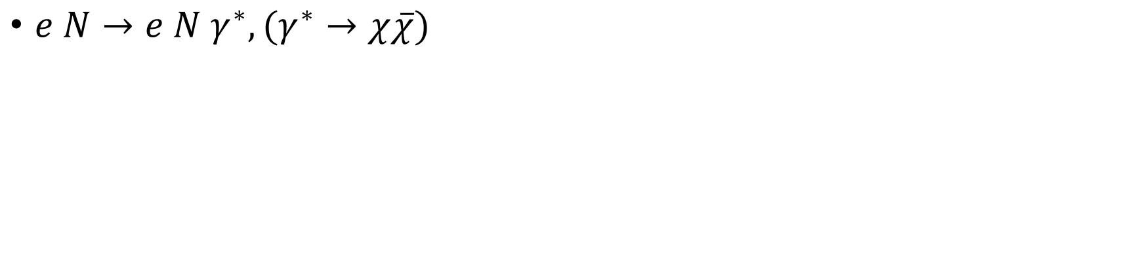
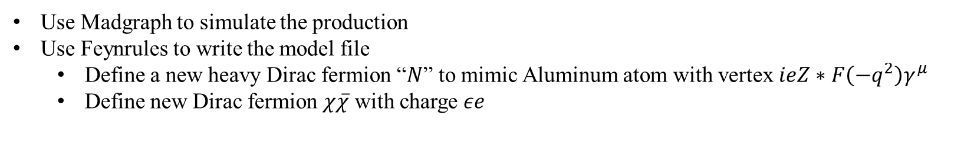
Production of pair millicharged particle (mCP)
$e N→e N γ^{∗}, (γ^{∗}→χ\overline{χ})$
$$p_{e}=\left(10,0,0,10\right) GeV$$
$$p_{Al}=\left(25.2, 0, 0, 0\right) GeV$$
$$\sqrt{s}=33 GeV$$
Use Madgraph to simulate the production
Use Feynrules to write the model file
Define a new heavy Dirac fermion “$N$” to mimic Aluminum atom with vertex $ieZ∗F\left(−q^{2}\right)γ^{μ}$
Define new Dirac fermion $χ\overline{χ}$ with charge $εe$

Slide 5
Total production cross section:
Finding cross-checks:
Massive dark photon (Yiming’s study)
Or other measured flux, e.g., muons.
NA64e (Ref.[5] in overleaf)
Maybe start with 0.01MeV

Slide 6
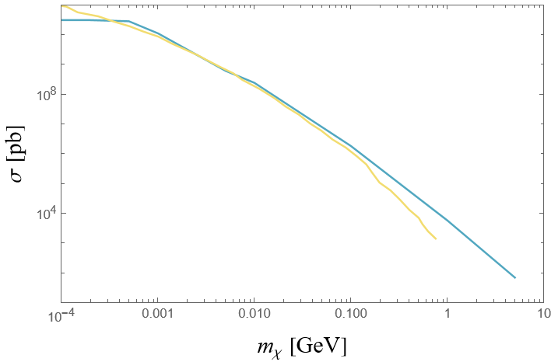
Cross section check with other paper
NA64e (Ref.[5] in overleaf)
100 GeV electron beam, with Pb target
Blue is our result using Madgraph
Yellow is the other paper’s result using CalcHEP

Slide 7
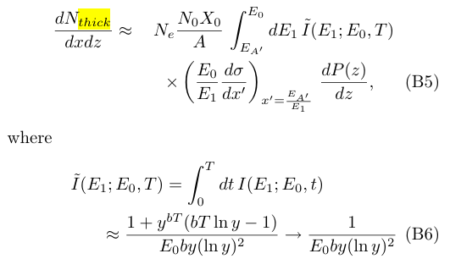
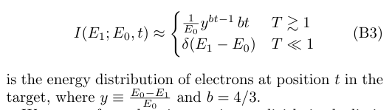
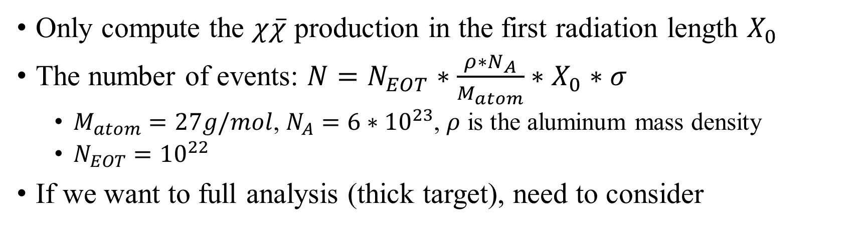
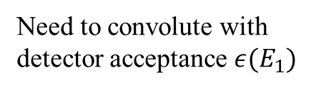
Number of events
https://cds.cern.ch/record/1279627/files/PH-EP-Tech-Note-2010-013.pdf
Only compute the $χ\overline{χ}$ production in the first radiation length $X_{0}$
The number of events: $N=N_{EOT}∗\frac{ρ∗N_{A}}{M_{atom}}∗X_{0}∗σ$
$M_{atom}=27g/mol$, $N_{A}=6∗{10}^{23}$, $ρ$ is the aluminum mass density
$N_{EOT}={10}^{22}$
If we want to full analysis (thick target), need to consider
https://arxiv.org/pdf/2204.03984
Need to convolute with detector acceptance $ε(E_{1})$
https://arxiv.org/pdf/0906.0580

Slide 8
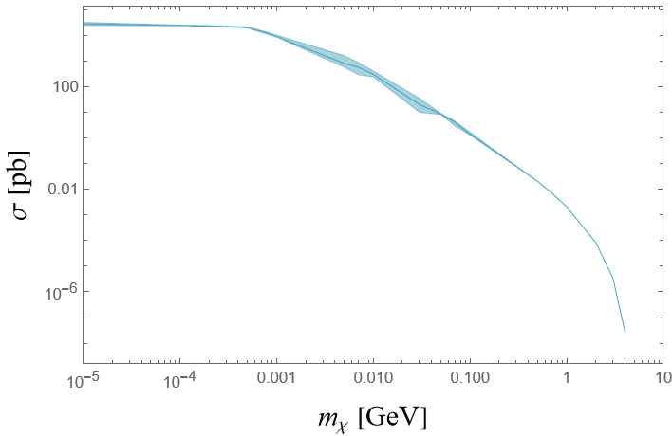
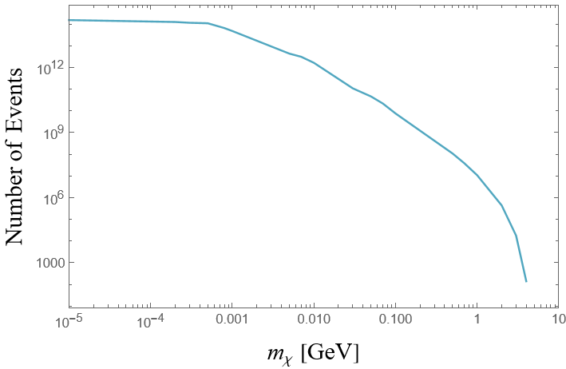
Total cross section and total number of events

Slide 9
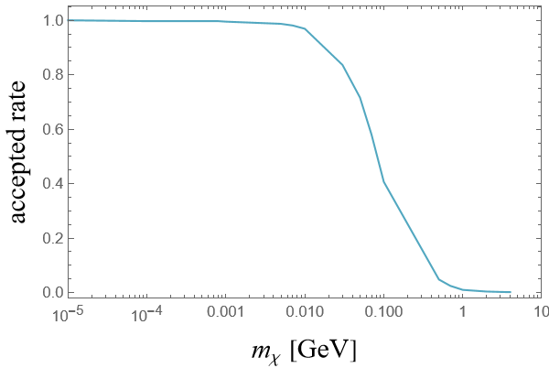
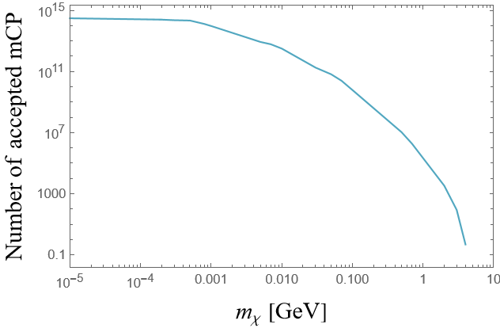
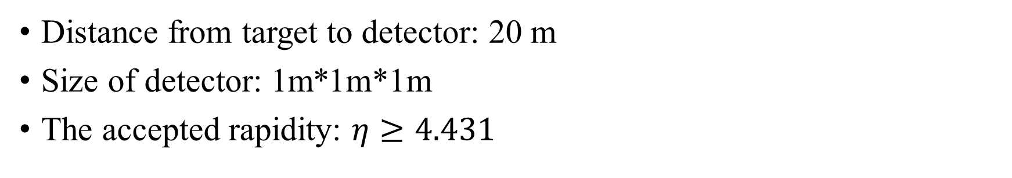
Accepted rate by BDX detector
Distance from target to detector: 20 m
Size of detector: 1m*1m*1m
The accepted rapidity: $η≥4.431$

Slide 10
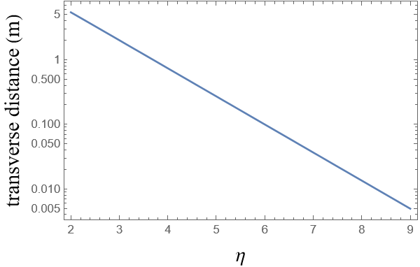
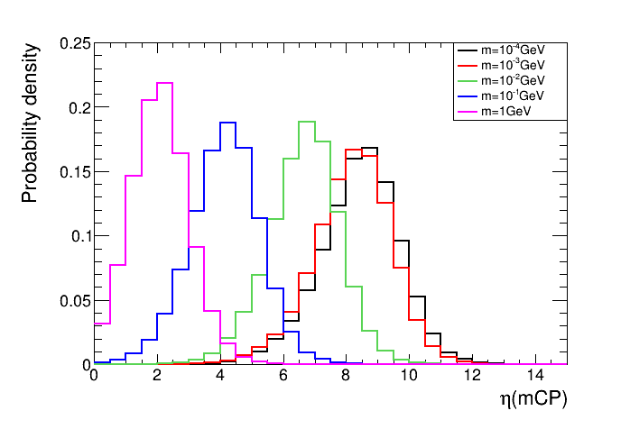
Rapidity distribution
Bin width: 0.5

Slide 12
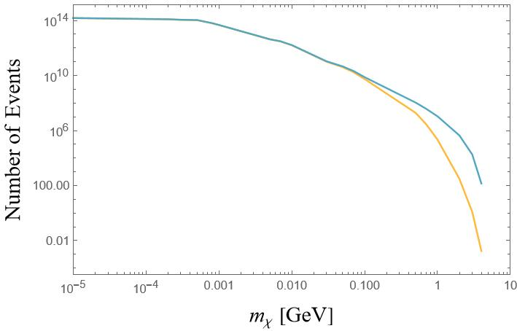
Update on the production
Blue: previous result (didn’t successfully apply nuclear formfactor)
Yellow: updated result (applied)

Slide 13
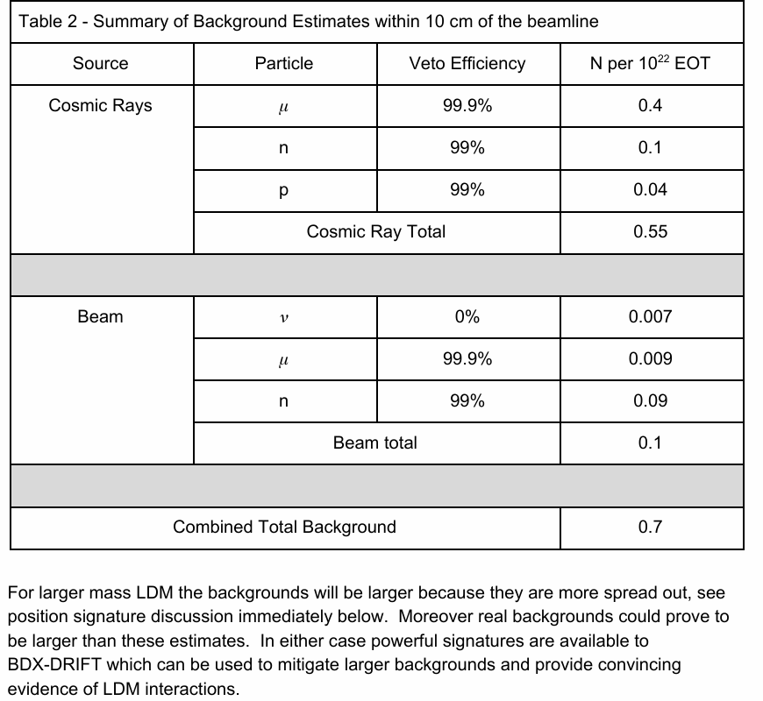
Background
Share Data with Megan and Hailin.
Signal distributions:
Angular distribution dependence on mass.
Energy distribution dependence on mass.

Slide 14
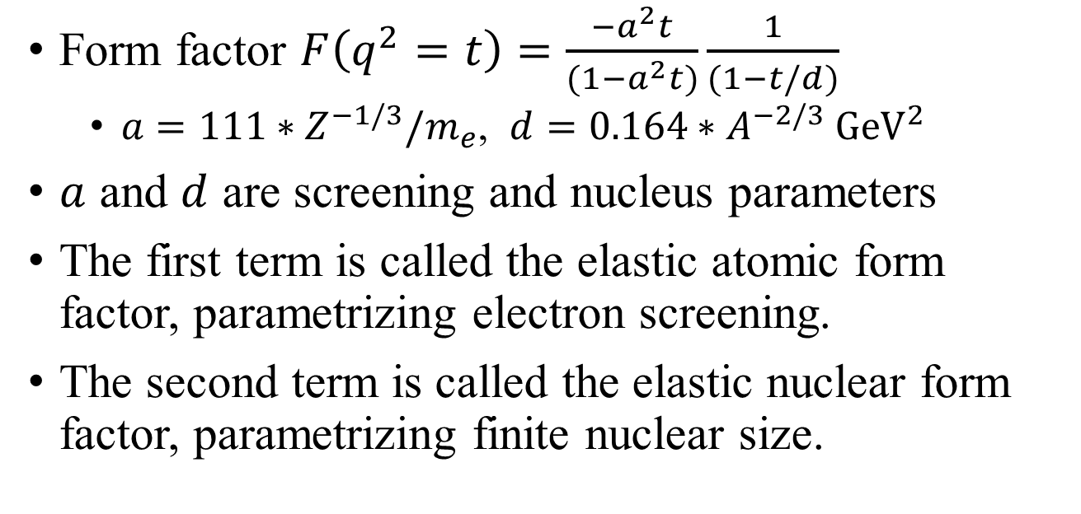
Form factor
Form factor $F\left(q^{2}=t\right)=\frac{−a^{2}t}{(1−a^{2}t)}\frac{1}{(1−t/d)}$
$a=111∗Z^{−1/3}/m_{e}$, $d=0.164∗A^{−2/3} {GeV}^{2}$
$a$ and $d$ are screening and nucleus parameters
The first term is called the elastic atomic form factor, parametrizing electron screening.
The second term is called the elastic nuclear form factor, parametrizing finite nuclear size.
https://arxiv.org/pdf/0906.0580

Slide 15
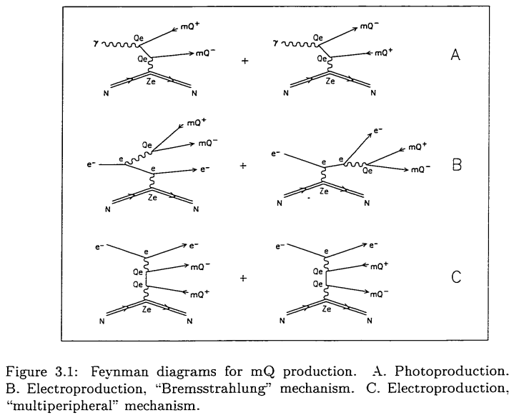
SLAC
https://inspirehep.net/files/08e5ea6b54eb1a30bb4fdd1319841f9d

