Slide 1
Gravitational Radiation: Maxwell-Heaviside Formulation
Author: Cole Prather
Mentor: Dr. Weldon Wilson

Slide 2
Outline
Introduction
Methodology
Results
Field Equations, Potentials, and Wave Equations
Retarded Potentials and Fields
Liénard–Wiechert Potentials and Fields
*Lorentz Force
Poynting Vector
Gravitational Fields
Gravitational Radiation
Conclusion and Future Work

Slide 3
Introduction
Why reformulate gravity?

Slide 4
Introduction
Why reformulate gravity?
Why not?

Slide 5


Introduction (continued)
Coulomb’s Force Law
$$F=k\frac{q_{1}q_{2}}{R^{2}}\hat{R}$$
Newton’s Force Law
$F=−G\frac{m_{1}m_{2}}{R^{2}}$ $\hat{R}$
$$q_{1}$$
$$q_{2}$$
$$m_{1}$$
$$m_{2}$$
+
+
+
+

Slide 6
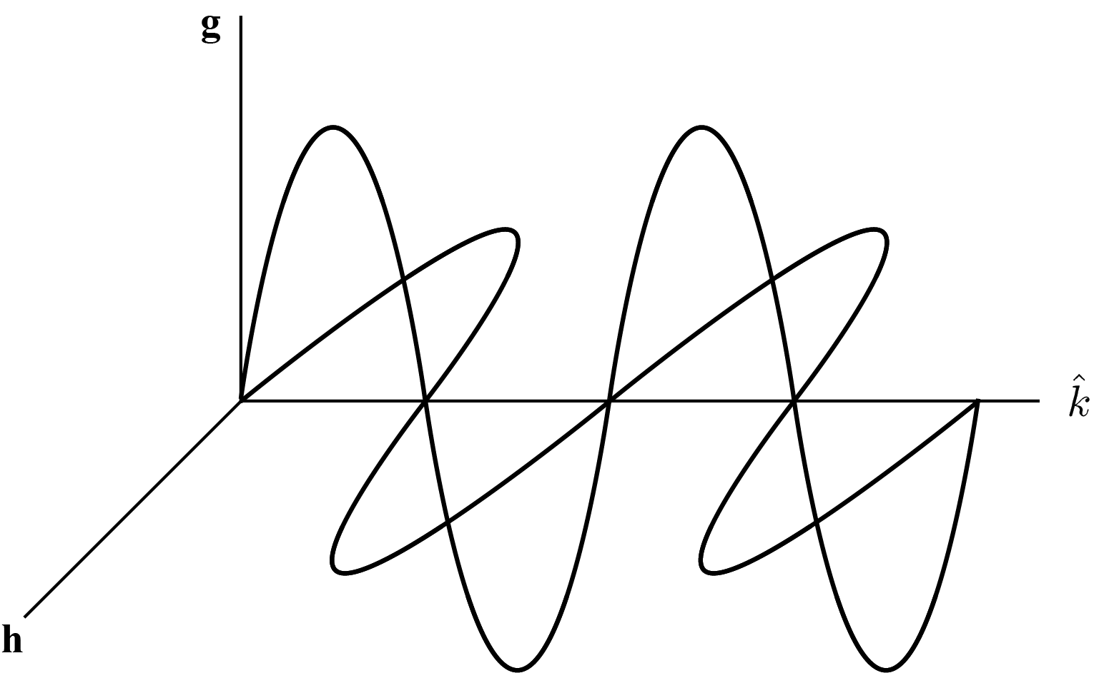

Introduction (continued)
Gravity as an analogy to electromagnetism
James Maxwell
Oliver Heaviside
Gravitational fields and waves
Negative field energy
Radiation
What about general relativity?
Cannot localize gravity
$$\hat{k}$$
Figure 1: A gravitational wave.

Slide 7
Introduction (continued)
Aristotelian (gravity)
Ptolemaic (geocentrism)
Copernican (heliocentrism w/ nested circles)
Keplerian (eccentric orbits)
Galilean (tides and phase cycles)
Newtonian (forces)
Einsteinian (spacetime curvature)

Slide 8
Introduction (continued)
Aristotelian (gravity)
Ptolemaic (geocentrism)
Copernican (heliocentrism w/ nested circles)
Keplerian (eccentric orbits)
Galilean (tides and phase cycles)
Newtonian (forces)
Maxwell-Heaviside? (fields)
Einsteinian (spacetime curvature)

Slide 9
Methodology
... By analogy!
Field equations → Scalar and vector potentials → Wave equations
Retarded wave propagation → Retarded potentials and fields
Retarded potentials → Liénard–Wiechert potentials and fields
Poynting Vector + Liénard–Wiechert Fields → Radiation
Larmor formula for power radiated

Slide 10
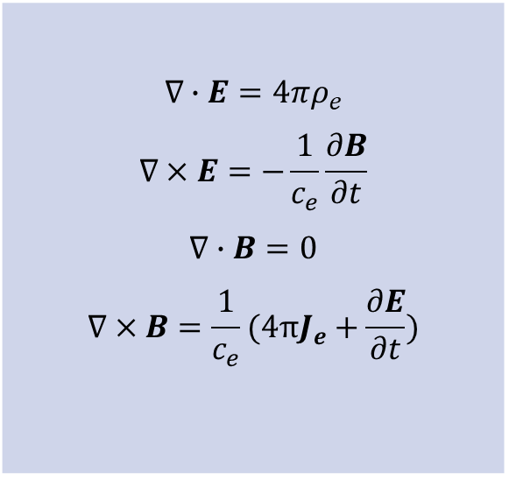
Methodology (continued)
Field equations → Scalar and vector potentials
$$∇∙E=4πρ_{e}$$ $$∇×E=−\frac{1}{c_{e}}\frac{∂B}{∂t}$$ $$∇∙B=0$$ $$∇×B=\frac{1}{c_{e}}(4πJ_{e}+\frac{∂E}{∂t})$$

Slide 11
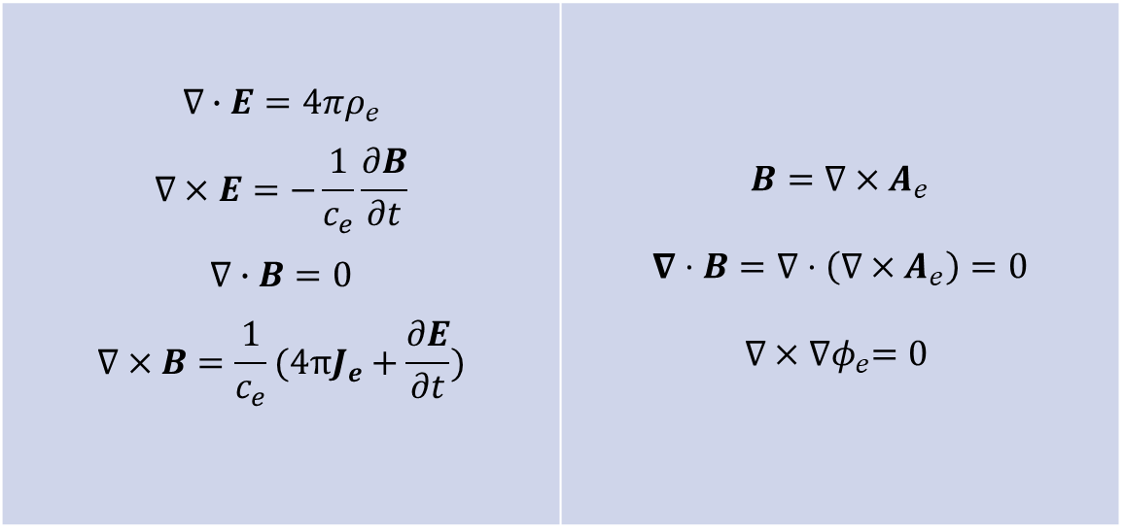
Methodology (continued)
Field equations → Scalar and vector potentials
$$∇∙E=4πρ_{e}$$ $$∇×E=−\frac{1}{c_{e}}\frac{∂B}{∂t}$$ $$∇∙B=0$$ $$∇×B=\frac{1}{c_{e}}(4πJ_{e}+\frac{∂E}{∂t})$$ | $$B=∇×A_{e}$$ $$∇⋅B=∇⋅\left(∇×A_{e}\right)=0$$ $$∇×{∇φ}_{e}=0$$
Define:
→

Slide 12
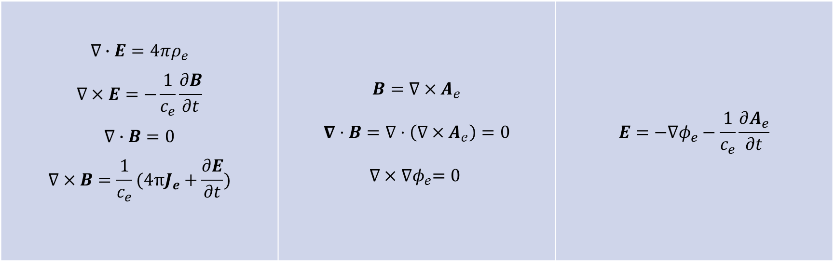
Methodology (continued)
Field equations → Scalar and vector potentials
$$∇∙E=4πρ_{e}$$ $$∇×E=−\frac{1}{c_{e}}\frac{∂B}{∂t}$$ $$∇∙B=0$$ $$∇×B=\frac{1}{c_{e}}(4πJ_{e}+\frac{∂E}{∂t})$$ | $$B=∇×A_{e}$$ $$∇⋅B=∇⋅\left(∇×A_{e}\right)=0$$ $$∇×{∇φ}_{e}=0$$ | $$E=−∇φ_{e}−\frac{1}{c_{e}}\frac{∂A_{e}}{∂t}$$
Define:
→
→

Slide 13
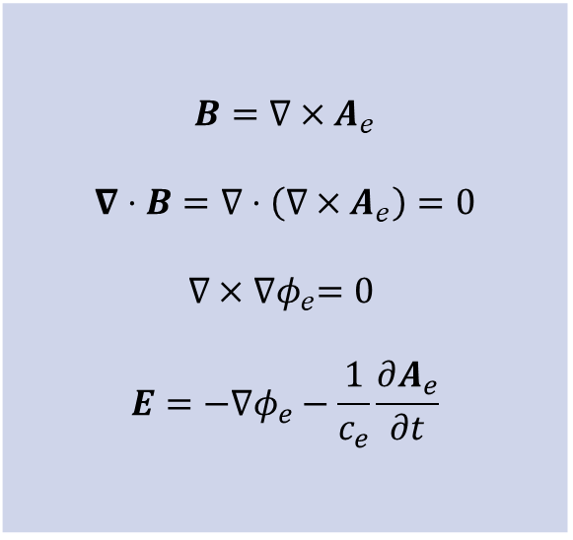
Methodology (continued)
Scalar and vector potentials → Wave equations
$$B=∇×A_{e}$$ $$∇⋅B=∇⋅\left(∇×A_{e}\right)=0$$ $$∇×{∇φ}_{e}=0$$ $$E=−∇φ_{e}−\frac{1}{c_{e}}\frac{∂A_{e}}{∂t}$$

Slide 14
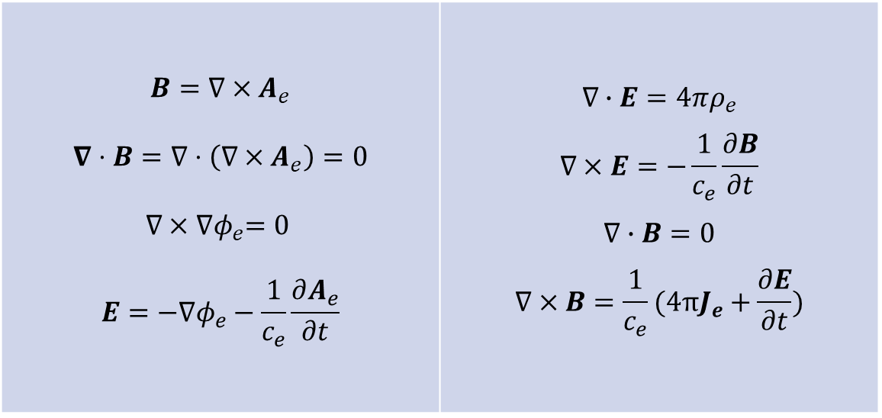
Methodology (continued)
Scalar and vector potentials → Wave equations
$$B=∇×A_{e}$$ $$∇⋅B=∇⋅\left(∇×A_{e}\right)=0$$ $$∇×{∇φ}_{e}=0$$ $$E=−∇φ_{e}−\frac{1}{c_{e}}\frac{∂A_{e}}{∂t}$$ | $$∇∙E=4πρ_{e}$$ $$∇×E=−\frac{1}{c_{e}}\frac{∂B}{∂t}$$ $$∇∙B=0$$ $$∇×B=\frac{1}{c_{e}}(4πJ_{e}+\frac{∂E}{∂t})$$
Back into:
→

Slide 15
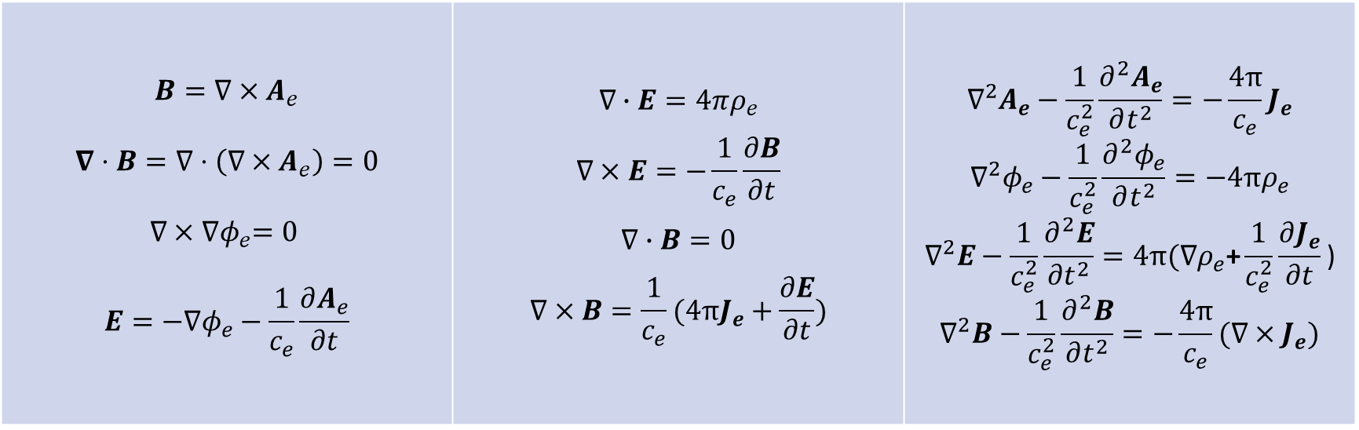
Methodology (continued)
Scalar and vector potentials → Wave equations
$$B=∇×A_{e}$$ $$∇⋅B=∇⋅\left(∇×A_{e}\right)=0$$ $$∇×{∇φ}_{e}=0$$ $$E=−∇φ_{e}−\frac{1}{c_{e}}\frac{∂A_{e}}{∂t}$$ | $$∇∙E=4πρ_{e}$$ $$∇×E=−\frac{1}{c_{e}}\frac{∂B}{∂t}$$ $$∇∙B=0$$ $$∇×B=\frac{1}{c_{e}}(4πJ_{e}+\frac{∂E}{∂t})$$ | $$∇^{2}A_{e}−\frac{1}{c_{e}^{2}}\frac{∂^{2}A_{e}}{∂t^{2}}=−\frac{4π}{c_{e}}J_{e}$$ $$∇^{2}φ_{e}−\frac{1}{c_{e}^{2}}\frac{∂^{2}φ_{e}}{∂t^{2}}=−4πρ_{e}$$ $$∇^{2}E−\frac{1}{c_{e}^{2}}\frac{∂^{2}E}{∂t^{2}}=4π(∇ρ_{e}\text{+}\frac{1}{c_{e}^{2}}\frac{∂J_{e}}{∂t}\text{)}$$ $$∇^{2}B−\frac{1}{c_{e}^{2}}\frac{∂^{2}B}{∂t^{2}}=−\frac{4π}{c_{e}}{(∇×J}_{e})$$
Back into:
→
→

Slide 16
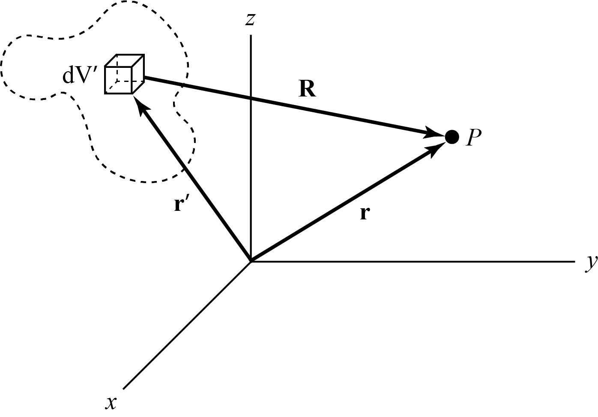


Methodology (continued)
Retarded wave propagation → retarded potentials and fields
$$A_{e}\left(r,t\right)=\frac{1}{c_{e}}\iiint{\frac{J_{e}(r^{′},t−\frac{R}{c_{e}})}{R}dV′}$$
$$φ_{e}\left(r,t\right)=\iiint{\frac{ρ_{e}(r^{′},t−\frac{R}{c_{e}})}{R}dV′}$$
$$E\left(r,t\right)=\iiint{\left(\frac{{[ρ}_{e}]{\hat{e}}_{R} }{R^{2}}+\frac{\left[\frac{{∂ρ}_{e}}{∂t}\right]{\hat{e}}_{R}}{c_{e}R}−\frac{\left[\frac{{∂J}_{e}}{∂t}\right]}{c_{e}^{2}R}\right)dV′}$$
$$B\left(r,t\right)=\frac{1}{c_{e}}\iiint{\left(\frac{\left[J_{e}\right]×{\hat{e}}_{R}}{R^{2}}+\frac{\left[\frac{{∂J}_{e}}{∂t}\right]×{\hat{e}}_{R}}{c_{e}R}\right)dV′}$$
$$R=r−r^{′}$$
$$t^{′}=t−\frac{R}{c_{e}}$$
Figure 2: Delay from Retardation.

Slide 17
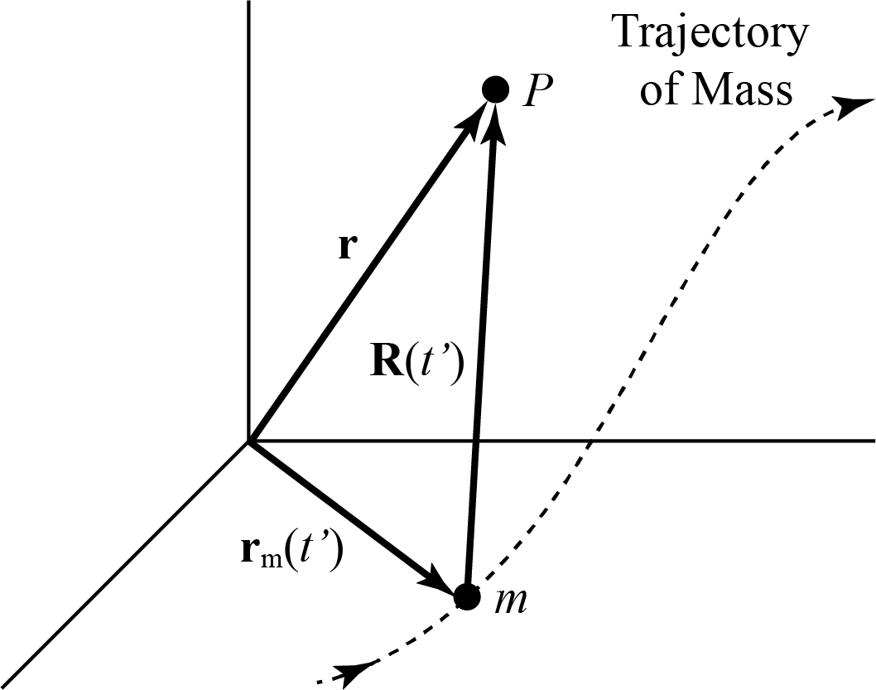


Methodology (continued)
Retarded potentials → Liénard–Wiechert potentials and fields
$$φ_{e}\left(r,t\right)=\left[\frac{e}{R(1−\hat{R}∙β)}\right]{\left.​\right|}_{t^{′}=t− \frac{R}{c_{e}}}$$
$$A_{e}\left(r,t\right)=\left[\frac{eβ}{R(1−\hat{R}∙β)}\right]{\left.​\right|}_{t^{′}=t− \frac{R}{c_{e}}}$$
$$E\left(r,t\right)=e\left[\frac{(\hat{R}−β)(1−β^{2})}{K^{3}R^{2}}+\frac{\hat{R}×\left(\left(\hat{R}−β\right)×\dot{β}\right)}{c_{e}K^{3}R}\right]$$
$$E\left(r,t\right)=E_{v}+E_{a}$$
$$B\left(r,t\right)=e\left[\frac{\left(β×\hat{R}\right)\left(1−β^{2}\right)}{K^{3}R^{2}}+\frac{(\dot{β}∙\hat{R})\left(β×\hat{R}\right)}{c_{e}K^{3}R}+\frac{\dot{β}×\hat{R}}{c_{e}K^{2}R}\right]$$
$$B\left(r,t\right)=B_{v}+B_{a}$$
$$B_{v}=β×E_{v} \& B_{a}=\hat{R}×E_{a}$$
$$β=\frac{v}{c_{e}}$$
$$A_{e}\left(r,t\right)=βφ_{e}\left(r,t\right)$$
$$K=(1−\hat{R}∙β)$$
Figure 3: Geometry of a Moving Point Mass.

Slide 18

Methodology (continued)
The Poynting vector represents energy flux and is given by:
$$S=\frac{c_{e}}{4π}E×B$$
From the Poynting theorem:
$$\frac{∂W}{∂t}+∇⋅S+g⋅J=0$$
The velocity fields vary as an inverse-square of distance,
$$E_{v},B_{v}∝\frac{1}{\left[R^{2}\right]}$$
The acceleration fields vary as an inverse-first-power of distance,
$$E_{a},B_{a}∝\frac{1}{[R]}$$
So, from the following Poynting vector arrangements,
$$S_{vv}∝\frac{1}{[R^{4}]}$$
$$S_{aa}∝\frac{1}{[R^{2}]}$$
only accelerated charges can radiate!

Slide 19

Methodology (continued)
Total radiated power can be evaluated as using the Larmor formulae:
$$\frac{dP}{dΩ}=\left(S_{a}⋅\hat{R}\right)R^{2}$$
$$P=\int_{4π}{\frac{dP}{dΩ}}dΩ$$

Slide 20
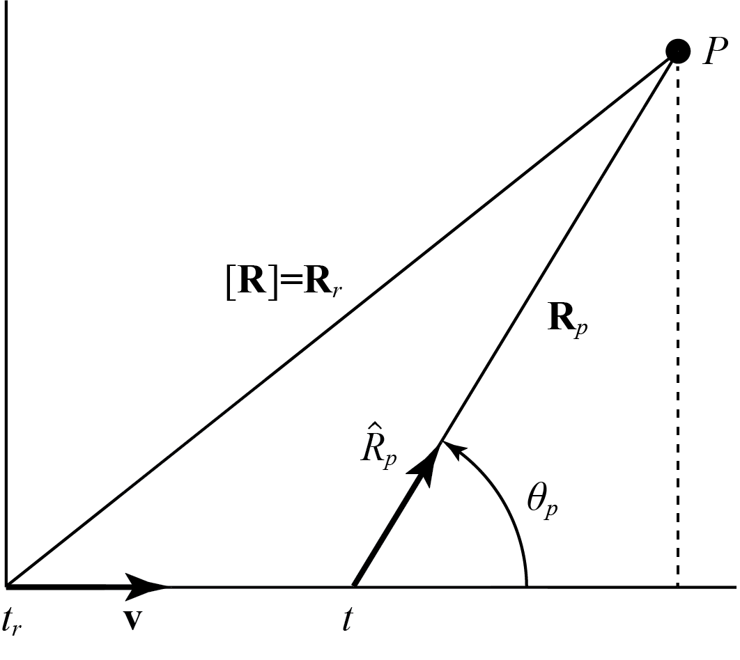

Methodology (continued)
Retarded fields → Present fields
From the figure,
$R_{r}=R_{p}+\left(t−t_{r}\right)v$
where,
$R_{r}=$ $\left(t−t_{r}\right)c_{e}$
Leads to
$R_{p}=$ $R_{r}({\hat{R}}_{r}−β)$
Figure 4: Retarded Position Diagram.

Slide 21
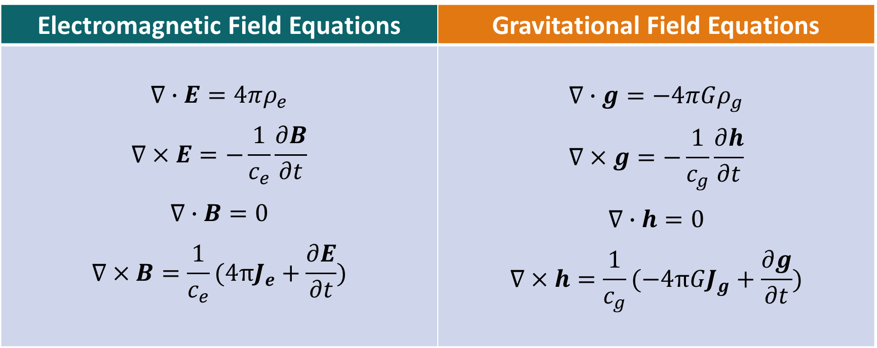
Field Equations
Electromagnetic Field Equations | Gravitational Field Equations
$$∇∙E=4πρ_{e}$$ $$∇×E=−\frac{1}{c_{e}}\frac{∂B}{∂t}$$ $$∇∙B=0$$ $$∇×B=\frac{1}{c_{e}}(4πJ_{e}+\frac{∂E}{∂t})$$ | $$∇∙g=−4πGρ_{g}$$ $$∇×g=−\frac{1}{c_{g}}\frac{∂h}{∂t}$$ $$∇∙h=0$$ $$∇×h=\frac{1}{c_{g}}(−4πGJ_{g}+\frac{∂g}{∂t})$$

Slide 22
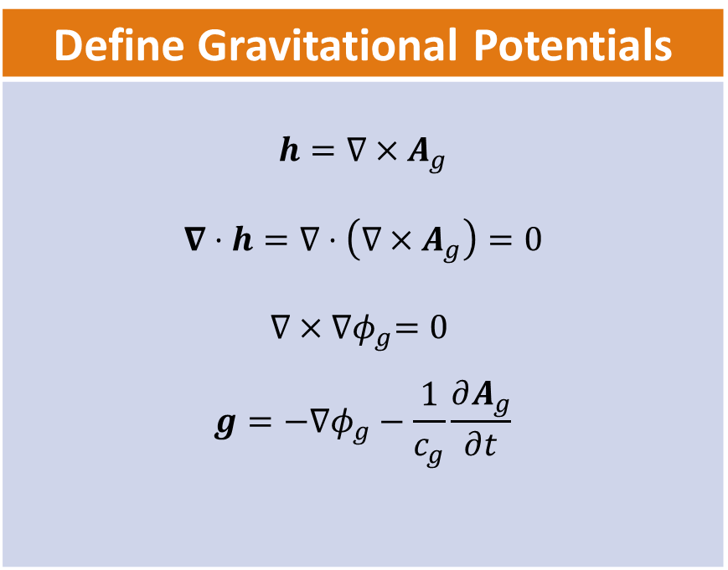
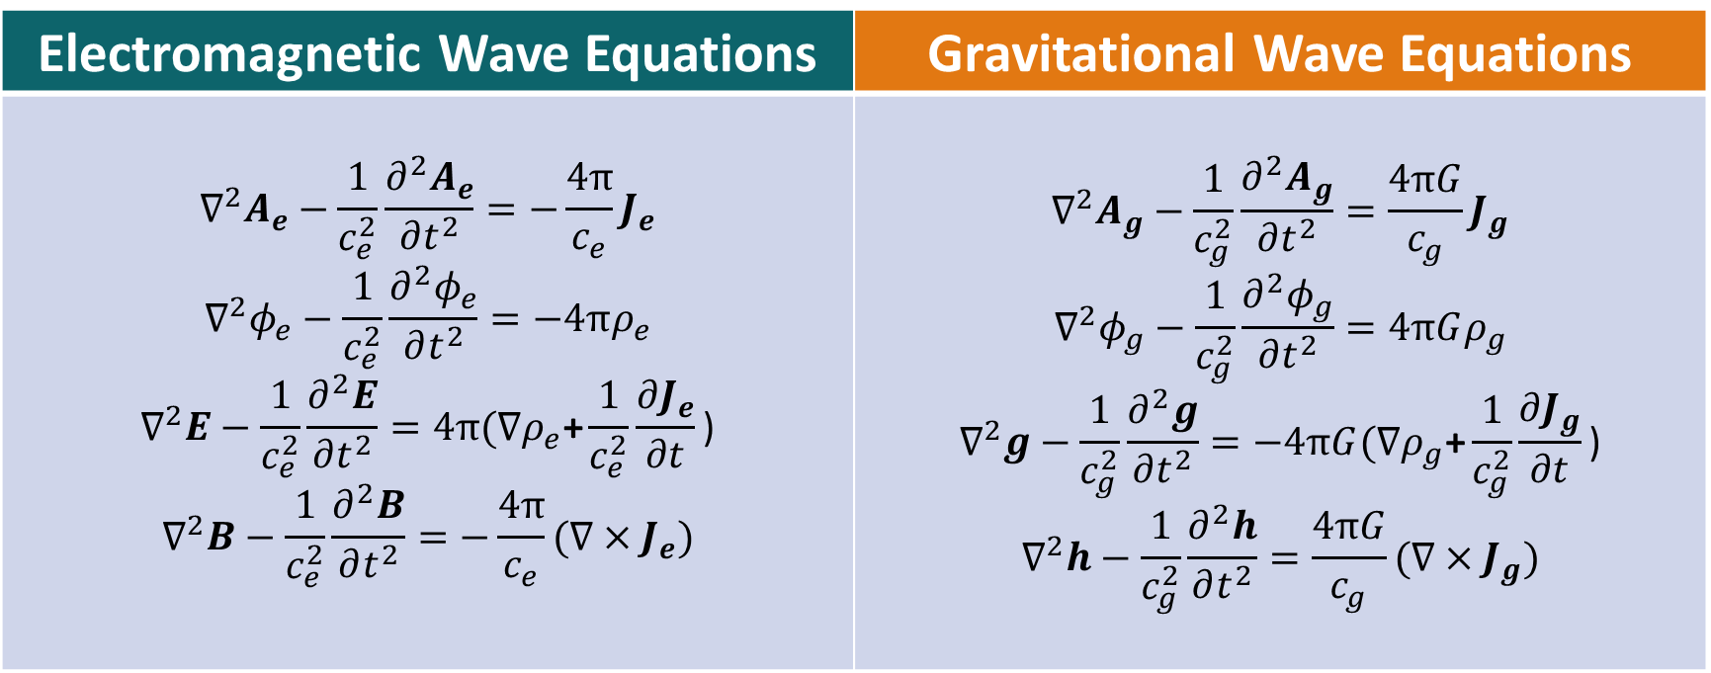
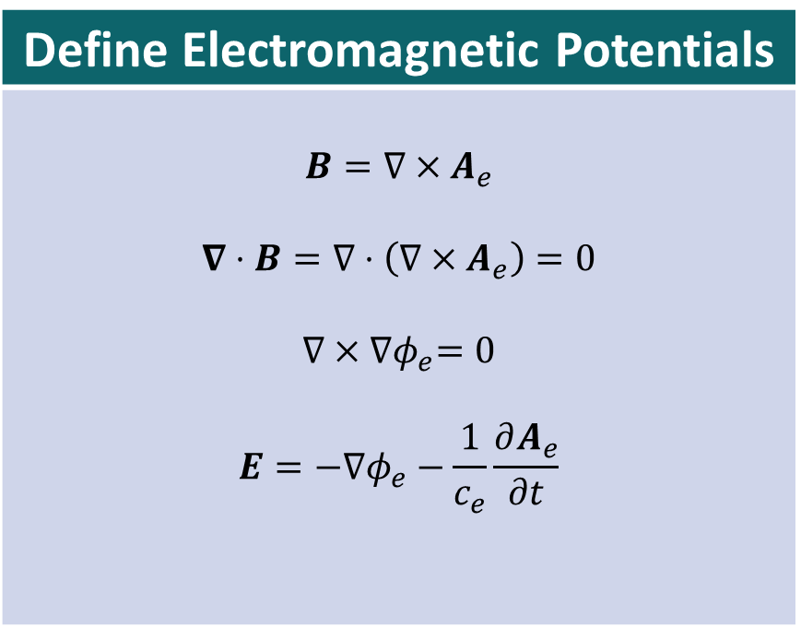
Vector and Scalar Potentials
Define Gravitational Potentials
$$h=∇×A_{g}$$ $$∇⋅h=∇⋅\left(∇×A_{g}\right)=0$$ $$∇×{∇φ}_{g}=0$$ $$g=−∇φ_{g}−\frac{1}{c_{g}}\frac{∂A_{g}}{∂t}$$
Electromagnetic Wave Equations | Gravitational Wave Equations
$$∇^{2}A_{e}−\frac{1}{c_{e}^{2}}\frac{∂^{2}A_{e}}{∂t^{2}}=−\frac{4π}{c_{e}}J_{e}$$ $$∇^{2}φ_{e}−\frac{1}{c_{e}^{2}}\frac{∂^{2}φ_{e}}{∂t^{2}}=−4πρ_{e}$$ $$∇^{2}E−\frac{1}{c_{e}^{2}}\frac{∂^{2}E}{∂t^{2}}=4π(∇ρ_{e}\text{+}\frac{1}{c_{e}^{2}}\frac{∂J_{e}}{∂t}\text{)}$$ $$∇^{2}B−\frac{1}{c_{e}^{2}}\frac{∂^{2}B}{∂t^{2}}=−\frac{4π}{c_{e}}{(∇×J}_{e})$$ | $$∇^{2}A_{g}−\frac{1}{c_{g}^{2}}\frac{∂^{2}A_{g}}{∂t^{2}}=\frac{4πG}{c_{g}}J_{g}$$ $$∇^{2}φ_{g}−\frac{1}{c_{g}^{2}}\frac{∂^{2}φ_{g}}{∂t^{2}}=4πGρ_{g}$$ $$∇^{2}g−\frac{1}{c_{g}^{2}}\frac{∂^{2}g}{∂t^{2}}=−4πG(∇ρ_{g}\text{+}\frac{1}{c_{g}^{2}}\frac{∂J_{g}}{∂t}\text{)}$$ $$∇^{2}h−\frac{1}{c_{g}^{2}}\frac{∂^{2}h}{∂t^{2}}=\frac{4πG}{c_{g}}{(∇×J}_{g})$$
Define Electromagnetic Potentials
$$B=∇×A_{e}$$ $$∇⋅B=∇⋅\left(∇×A_{e}\right)=0$$ $$∇×{∇φ}_{e}=0$$ $$E=−∇φ_{e}−\frac{1}{c_{e}}\frac{∂A_{e}}{∂t}$$

Slide 23
Wave Equations
Electromagnetic Wave Equations | Gravitational Wave Equations
$$∇^{2}A_{e}−\frac{1}{c_{e}^{2}}\frac{∂^{2}A_{e}}{∂t^{2}}=−\frac{4π}{c_{e}}J_{e}$$ $$∇^{2}φ_{e}−\frac{1}{c_{e}^{2}}\frac{∂^{2}φ_{e}}{∂t^{2}}=−4πρ_{e}$$ $$∇^{2}E−\frac{1}{c_{e}^{2}}\frac{∂^{2}E}{∂t^{2}}=4π(∇ρ_{e}\text{+}\frac{1}{c_{e}^{2}}\frac{∂J_{e}}{∂t}\text{)}$$ $$∇^{2}B−\frac{1}{c_{e}^{2}}\frac{∂^{2}B}{∂t^{2}}=−\frac{4π}{c_{e}}{(∇×J}_{e})$$ | $$∇^{2}A_{g}−\frac{1}{c_{g}^{2}}\frac{∂^{2}A_{g}}{∂t^{2}}=\frac{4πG}{c_{g}}J_{g}$$ $$∇^{2}φ_{g}−\frac{1}{c_{g}^{2}}\frac{∂^{2}φ_{g}}{∂t^{2}}=4πGρ_{g}$$ $$∇^{2}g−\frac{1}{c_{g}^{2}}\frac{∂^{2}g}{∂t^{2}}=−4πG(∇ρ_{g}\text{+}\frac{1}{c_{g}^{2}}\frac{∂J_{g}}{∂t}\text{)}$$ $$∇^{2}h−\frac{1}{c_{g}^{2}}\frac{∂^{2}h}{∂t^{2}}=\frac{4πG}{c_{g}}{(∇×J}_{g})$$

Slide 24
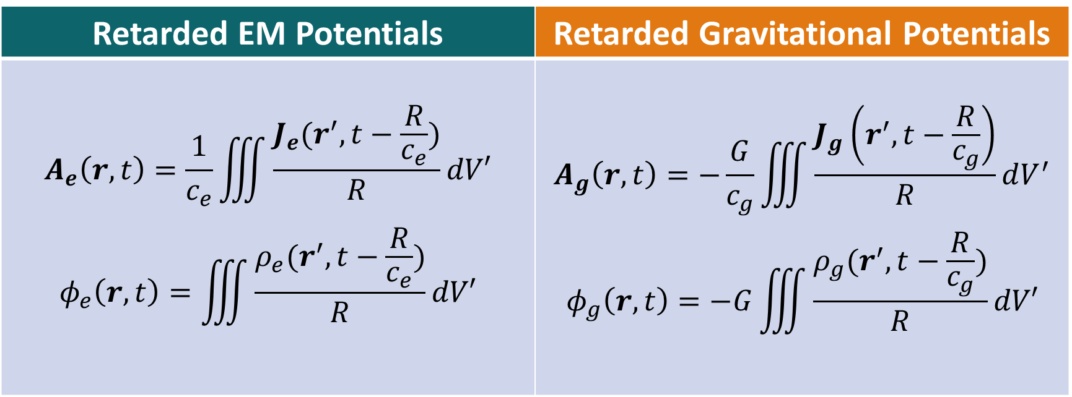
Retarded Potentials
Retarded EM Potentials | Retarded Gravitational Potentials
$$A_{e}\left(r,t\right)=\frac{1}{c_{e}}\iiint{\frac{J_{e}(r^{′},t−\frac{R}{c_{e}})}{R}dV′}$$ $$φ_{e}\left(r,t\right)=\iiint{\frac{ρ_{e}(r^{′},t−\frac{R}{c_{e}})}{R}dV′}$$ | $$A_{g}\left(r,t\right)=−\frac{G}{c_{g}}\iiint{\frac{J_{g}\left(r^{′},t−\frac{R}{c_{g}}\right)}{R}dV^{′}}$$ $$φ_{g}\left(r,t\right)=−G\iiint{\frac{ρ_{g}(r^{′},t−\frac{R}{c_{g}})}{R}dV′}$$

Slide 25
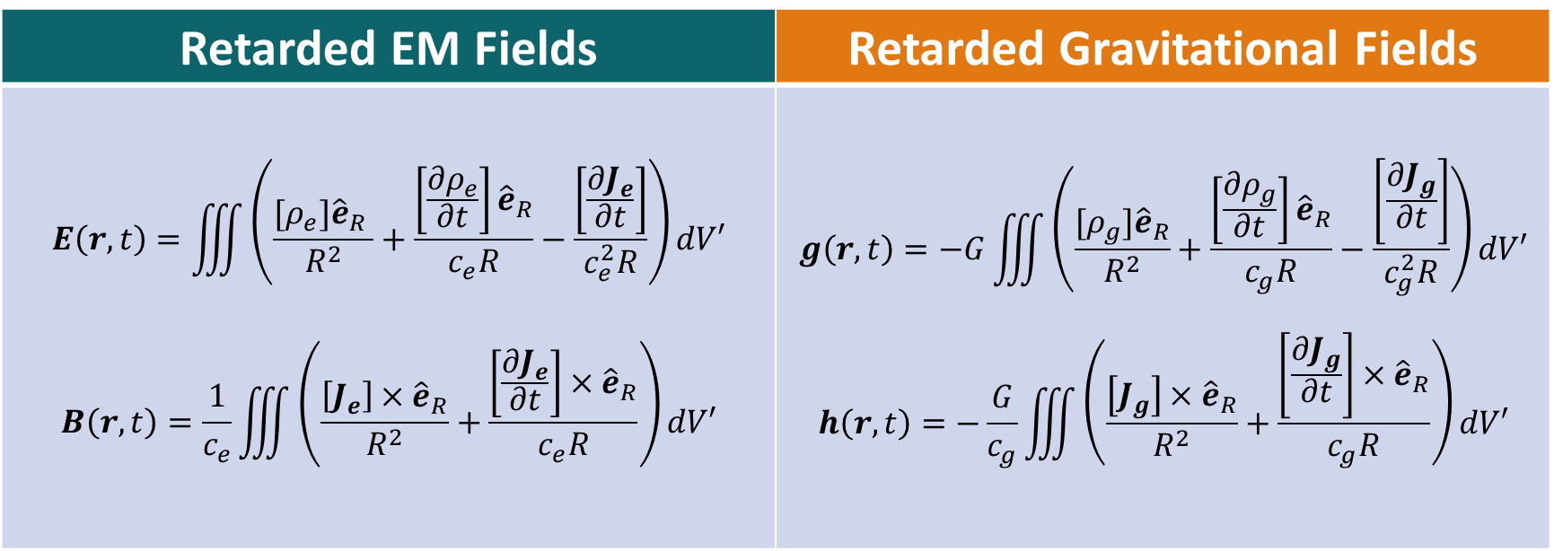
Retarded Fields
Retarded EM Fields | Retarded Gravitational Fields
$$E\left(r,t\right)=\iiint{\left(\frac{{[ρ}_{e}]{\hat{e}}_{R} }{R^{2}}+\frac{\left[\frac{{∂ρ}_{e}}{∂t}\right]{\hat{e}}_{R}}{c_{e}R}−\frac{\left[\frac{{∂J}_{e}}{∂t}\right]}{c_{e}^{2}R}\right)dV′}$$ $$B\left(r,t\right)=\frac{1}{c_{e}}\iiint{\left(\frac{\left[J_{e}\right]×{\hat{e}}_{R}}{R^{2}}+\frac{\left[\frac{{∂J}_{e}}{∂t}\right]×{\hat{e}}_{R}}{c_{e}R}\right)dV′}$$ | $$g\left(r,t\right)=−G\iiint{\left(\frac{{[ρ}_{g}]{\hat{e}}_{R}}{R^{2}}+\frac{\left[\frac{{∂ρ}_{g}}{∂t}\right]{\hat{e}}_{R}}{c_{g}R}−\frac{\left[\frac{{∂J}_{g}}{∂t}\right]}{c_{g}^{2}R}\right)dV′}$$ $$h\left(r,t\right)=−\frac{G}{c_{g}}\iiint{\left(\frac{\left[J_{g}\right]×{\hat{e}}_{R}}{R^{2}}+\frac{\left[\frac{{∂J}_{g}}{∂t}\right]×{\hat{e}}_{R}}{c_{g}R}\right)dV′}$$
Oleg Jefimenko (~ 1960s) & Jose Heras (1994, 2007)

Slide 26

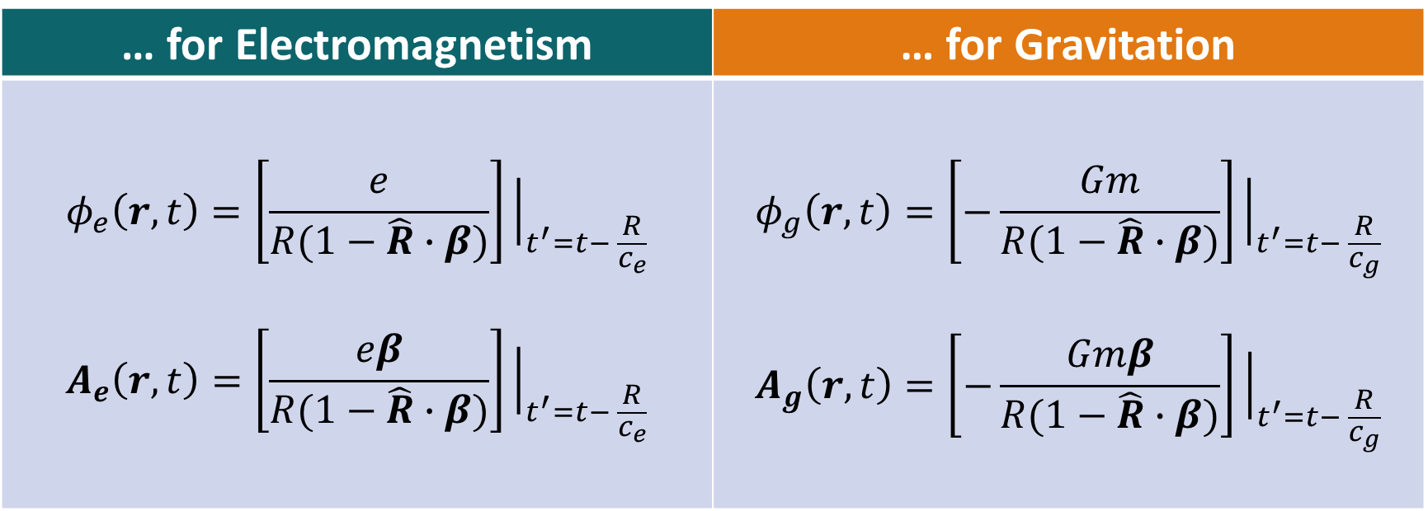
Liénard–Wiechert Potentials
… for Electromagnetism | … for Gravitation
$$φ_{e}\left(r,t\right)=\left[\frac{e}{R(1−\hat{R}∙β)}\right]{\left.​\right|}_{t^{′}=t− \frac{R}{c_{e}}}$$ $$A_{e}\left(r,t\right)=\left[\frac{eβ}{R(1−\hat{R}∙β)}\right]{\left.​\right|}_{t^{′}=t− \frac{R}{c_{e}}}$$ | $$φ_{g}\left(r,t\right)=\left[−\frac{Gm}{R(1−\hat{R}∙β)}\right]{\left.​\right|}_{t^{′}=t− \frac{R}{c_{g}}}$$ $$A_{g}\left(r,t\right)=\left[−\frac{Gmβ}{R(1−\hat{R}∙β)}\right]{\left.​\right|}_{t^{′}=t− \frac{R}{c_{g}}}$$
$$A_{i}\left(r,t\right)=βφ_{i}\left(r,t\right)$$

Slide 27

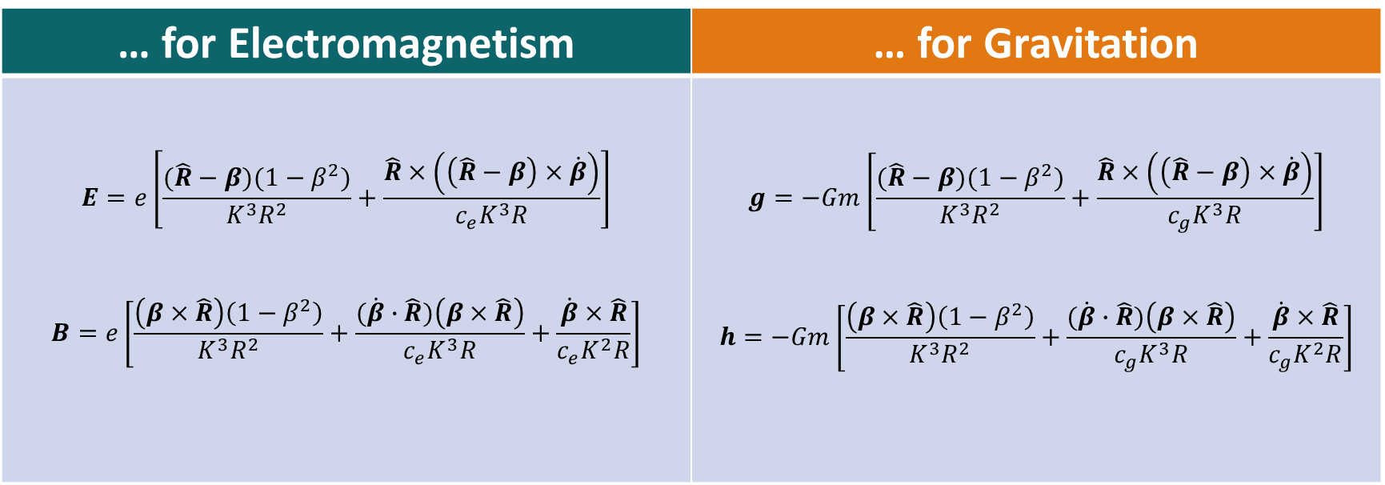
Liénard–Wiechert Fields
… for Electromagnetism | … for Gravitation
$$E=e\left[\frac{(\hat{R}−β)(1−β^{2})}{K^{3}R^{2}}+\frac{\hat{R}×\left(\left(\hat{R}−β\right)×\dot{β}\right)}{c_{e}K^{3}R}\right]$$ $$B=e\left[\frac{\left(β×\hat{R}\right)\left(1−β^{2}\right)}{K^{3}R^{2}}+\frac{(\dot{β}∙\hat{R})\left(β×\hat{R}\right)}{c_{e}K^{3}R}+\frac{\dot{β}×\hat{R}}{c_{e}K^{2}R}\right]$$ | $$g=−Gm\left[\frac{(\hat{R}−β)(1−β^{2})}{K^{3}R^{2}}+\frac{\hat{R}×\left(\left(\hat{R}−β\right)×\dot{β}\right)}{c_{g}K^{3}R}\right]$$ $$h=−Gm\left[\frac{\left(β×\hat{R}\right)\left(1−β^{2}\right)}{K^{3}R^{2}}+\frac{(\dot{β}∙\hat{R})\left(β×\hat{R}\right)}{c_{g}K^{3}R}+\frac{\dot{β}×\hat{R}}{c_{g}K^{2}R}\right]$$
$$K=(1−\hat{R}∙β)$$

Slide 28

*Lorentz Force
… for Electromagnetism | … for Gravitation
$$F=q\left(E+\frac{v}{c_{e}}×B\right)$$ | $$F=m\left(g+\frac{v}{c_{g}}×h\right)$$

Slide 29
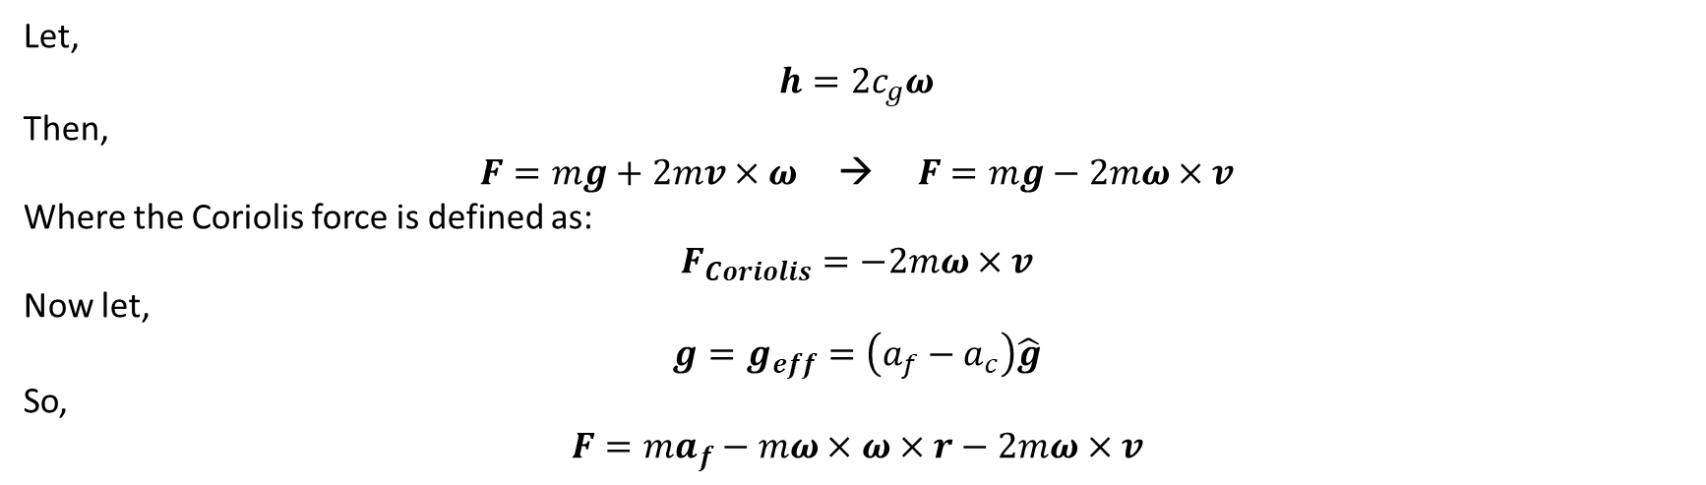
*Lorentz Force
… for Electromagnetism | … for Gravitation
$$F=q\left(E+\frac{v}{c_{e}}×B\right)$$ | $$F=m\left(g+\frac{v}{c_{g}}×h\right)$$
Let,
$$h=2c_{g}ω$$
Then,
$$F=mg+2mv×ω \text{→} F=mg−2mω×v$$
Where the Coriolis force is defined as:
$$F_{Coriolis}=−2mω×v$$
Now let,
$$g=g_{eff}=\left(a_{f}−a_{c}\right)\hat{g}$$
So,
$$F=ma_{f}−mω×ω×r−2mω×v$$

Slide 30

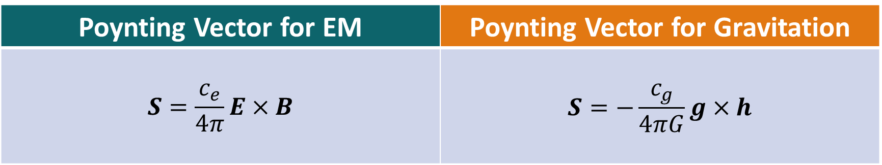
Poynting Theorem
$$\frac{∂W}{∂t}+∇⋅S+g⋅J=0$$
$$P_{field}=\frac{∂W}{∂t}+∇⋅S=−g⋅J$$
Poynting Vector for EM | Poynting Vector for Gravitation
$$S=\frac{c_{e}}{4π}E×B$$ | $$S=−\frac{c_{g}}{4πG}g×h$$

Slide 31
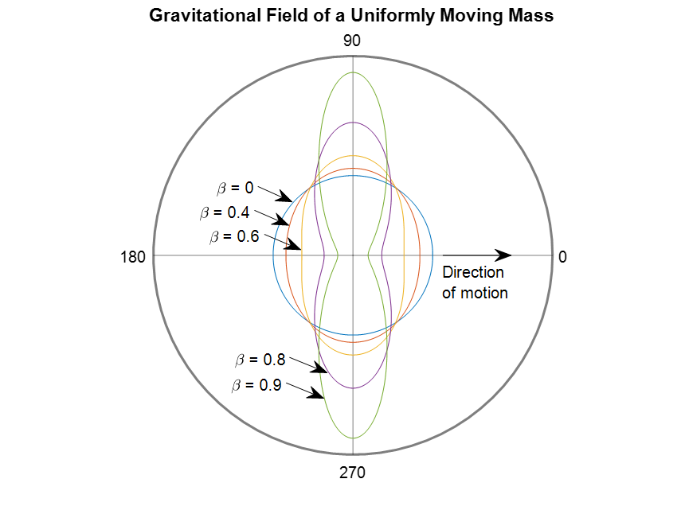
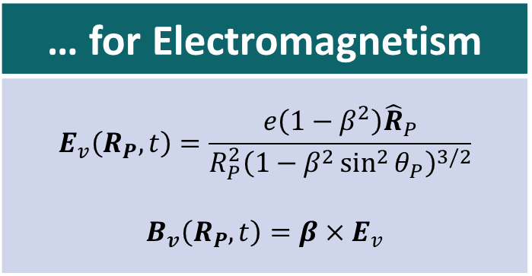
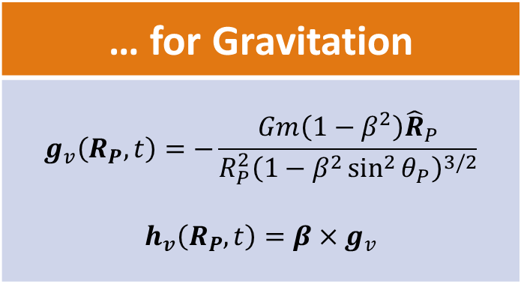
Fields for Uniform Motion
… for Electromagnetism
$$E_{v}\left(R_{P},t\right)=\frac{e\left(1−β^{2}\right){\hat{R}}_{P}}{R_{P}^{2}{\left(1−β^{2}\sin^{2}{θ_{P}}\right)}^{3/2}}$$ $$B_{v}\left(R_{P},t\right)=β×E_{v}$$
… for Gravitation
$$g_{v}\left(R_{P},t\right)=−\frac{Gm\left(1−β^{2}\right){\hat{R}}_{P}}{R_{P}^{2}{\left(1−β^{2}\sin^{2}{θ_{P}}\right)}^{3/2}}$$ $$h_{v}\left(R_{P},t\right)=β×g_{v}$$
Figure 5

Slide 32
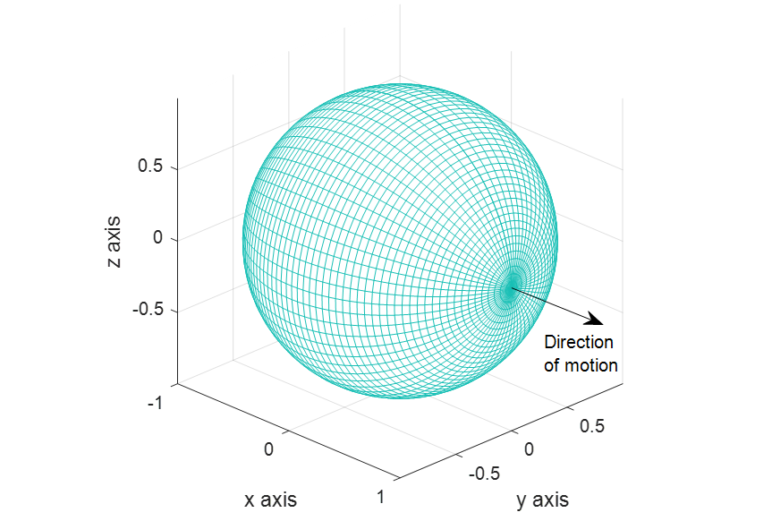
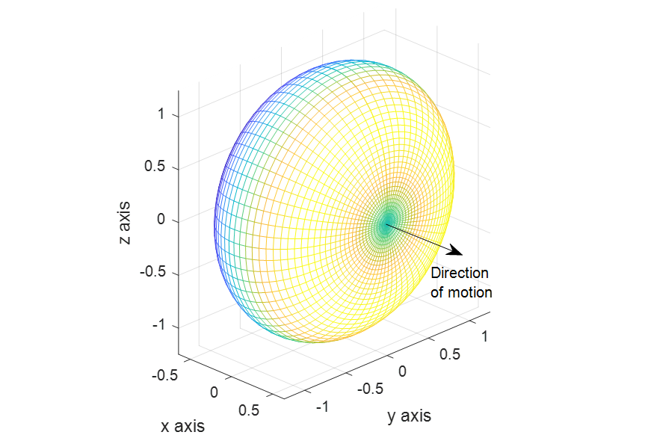


Fields for Uniform Motion (continued)
$$β≪1$$
$$β=0.6$$
Figure 6
Figure 7

Slide 33
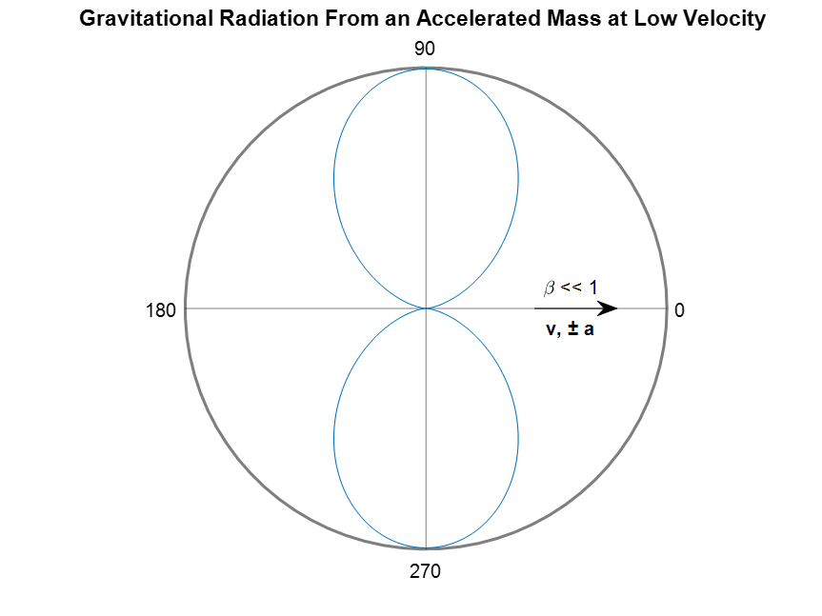
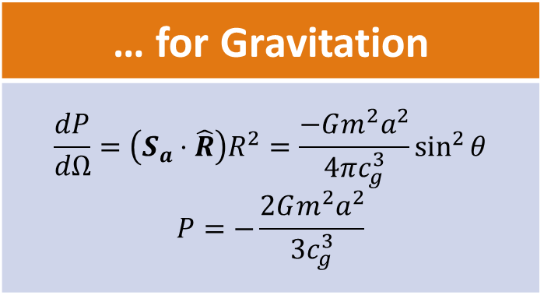
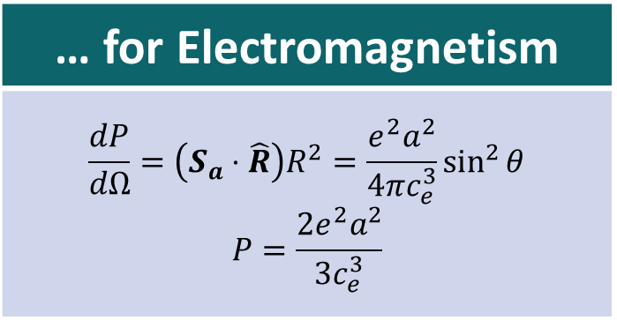
Radiation from Acceleration at Low Velocities
… for Electromagnetism
$$\frac{dP}{dΩ}=\left(S_{a}⋅\hat{R}\right)R^{2}=\frac{e^{2}a^{2}}{4πc_{e}^{3}}\sin^{2}{θ}$$ $$P=\frac{2e^{2}a^{2}}{3c_{e}^{3}}$$
… for Gravitation
$$\frac{dP}{dΩ}=\left(S_{a}⋅\hat{R}\right)R^{2}=\frac{−Gm^{2}a^{2}}{4πc_{g}^{3}}\sin^{2}{θ}$$ $$P=−\frac{2Gm^{2}a^{2}}{3c_{g}^{3}}$$
Figure 8

Slide 34
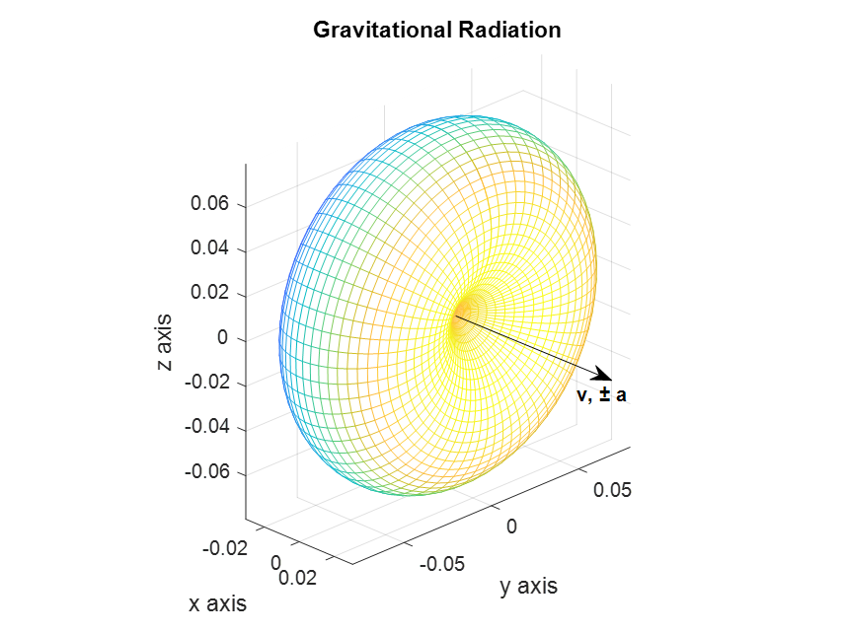

Radiation from Acceleration at Low Velocities
$$β≪1$$
… for Electromagnetism
$$\frac{dP}{dΩ}=\left(S_{a}⋅\hat{R}\right)R^{2}=\frac{e^{2}a^{2}}{4πc_{e}^{3}}\sin^{2}{θ}$$ $$P=\frac{2e^{2}a^{2}}{3c_{e}^{3}}$$
… for Gravitation
$$\frac{dP}{dΩ}=\left(S_{a}⋅\hat{R}\right)R^{2}=\frac{−Gm^{2}a^{2}}{4πc_{g}^{3}}\sin^{2}{θ}$$ $$P=−\frac{2Gm^{2}a^{2}}{3c_{g}^{3}}$$
Figure 9

Slide 35
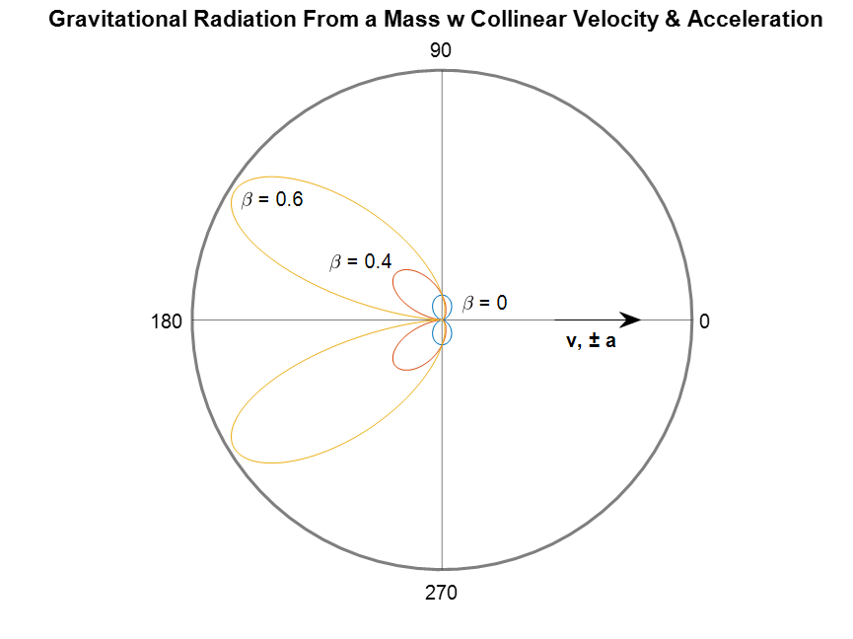

Gravitational Radiation from a Mass With Collinear Velocity and Acceleration
$$\frac{dP}{dΩ}=\frac{−Gm^{2}a^{2}\sin^{2}{θ}}{4πc_{g}^{3}{\left(1−βcosθ\right)}^{5}}$$
$$P=−\frac{2Gm^{2}a^{2}}{3c_{g}^{3}{\left(1−β^{2}\right)}^{3}}$$
$$h\left(R_{P},t\right)=−\frac{Gm\left(1−β^{2}\right){\hat{R}}_{P}}{R_{P}^{2}{\left(1−β^{2}\sin^{2}{θ_{P}}\right)}^{\frac{3}{2}}}β×{\hat{R}}_{P}$$
Figure 10

Slide 36
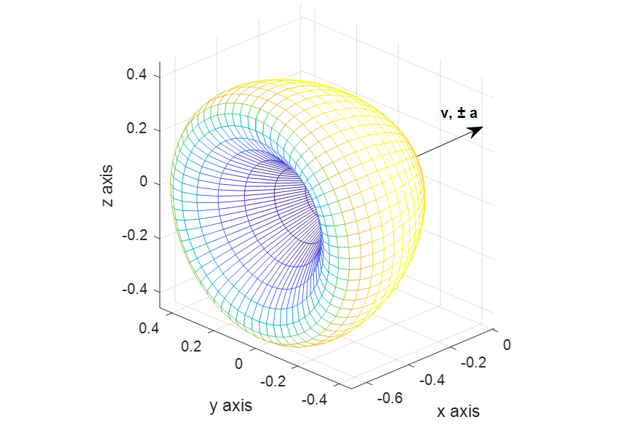
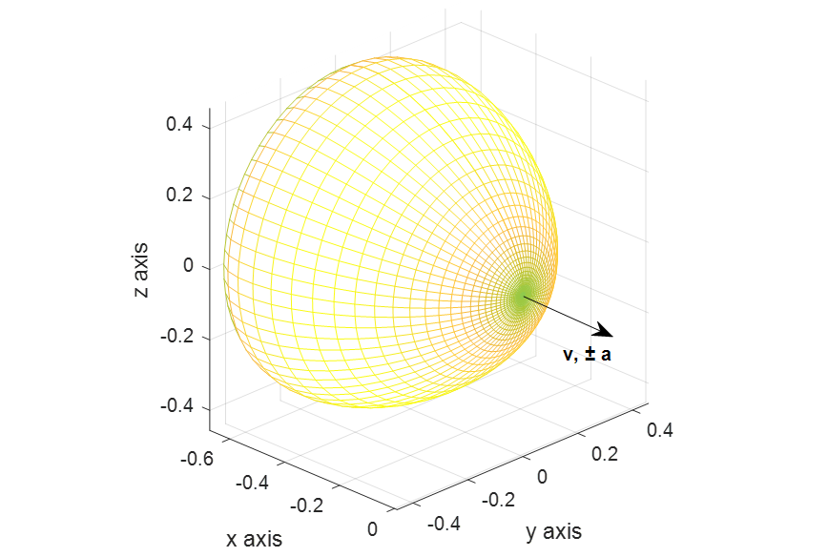

Gravitational Radiation from a Mass With Collinear Velocity and Acceleration (cont.)
$$β=0.6$$
Figure 11
Figure 12

Slide 37
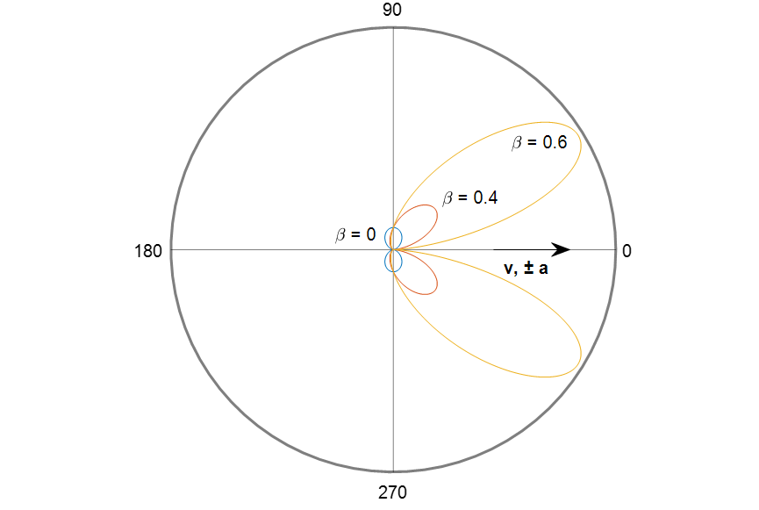
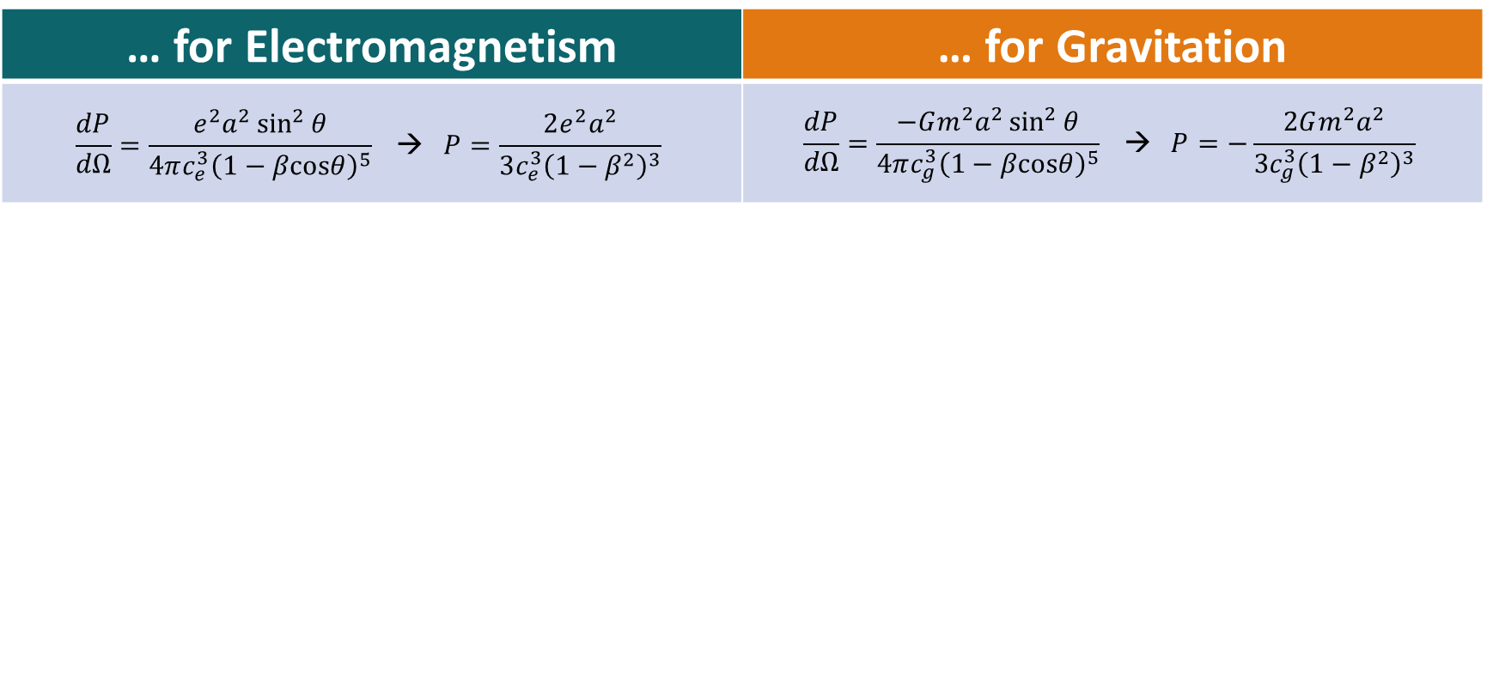
Radiation by Collinear Velocity & Acceleration
Figure 13
Figure 14
… for Electromagnetism | … for Gravitation
$$\frac{dP}{dΩ}=\frac{e^{2}a^{2}\sin^{2}{θ}}{4πc_{e}^{3}{\left(1−βcosθ\right)}^{5}} \text{→ }P=\frac{2e^{2}a^{2}}{3c_{e}^{3}{\left(1−β^{2}\right)}^{3}}$$ | $$\frac{dP}{dΩ}=\frac{−Gm^{2}a^{2}\sin^{2}{θ}}{4πc_{g}^{3}{\left(1−βcosθ\right)}^{5}} \text{→ }P=−\frac{2Gm^{2}a^{2}}{3c_{g}^{3}{\left(1−β^{2}\right)}^{3}}$$

Slide 38
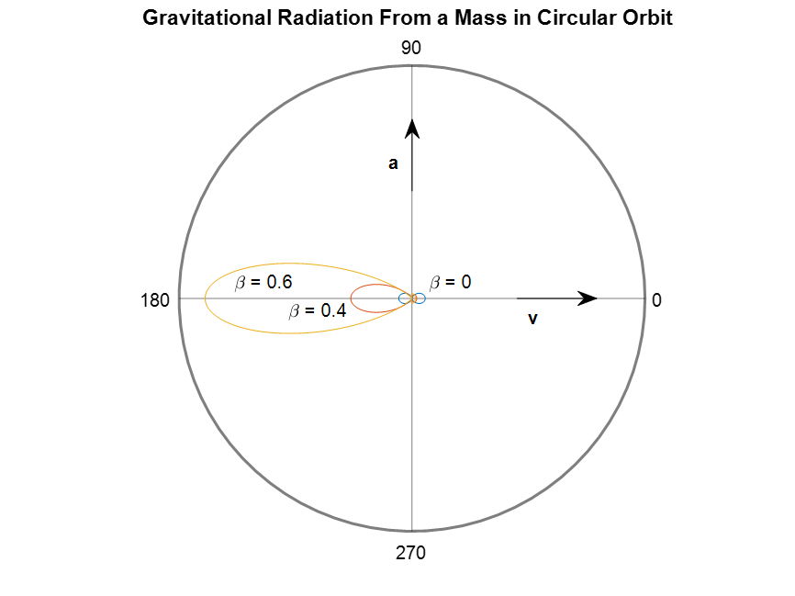

Gravitational Radiation Produced by a Mass in a Circular Orbit
$$\frac{dP}{dΩ}=\frac{−Gm^{2}a^{2}{[\left(1−βcosθ\right)}^{2}{−\left(1−β^{2}\right)sin}^{2}θ\cos^{2}φ]}{4πc_{g}^{3}{\left(1−βcosθ\right)}^{5}}$$
$$P=−\frac{2Gm^{2}a^{2}}{3c_{g}^{3}{\left(1−β^{2}\right)}^{2}}$$
$$h\left(R_{P},t\right)=−\frac{Gm\left(1−β^{2}\right){\hat{R}}_{P}}{R_{P}^{2}{\left(1−β^{2}\sin^{2}{θ_{P}}\right)}^{\frac{3}{2}}}β×{\hat{R}}_{P}$$
Figure 15

Slide 39
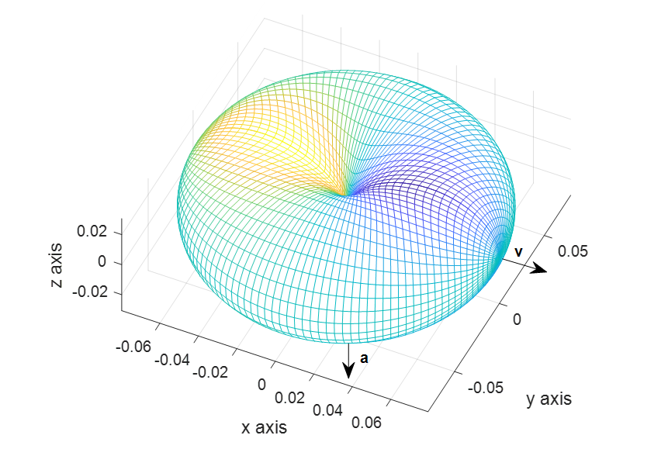
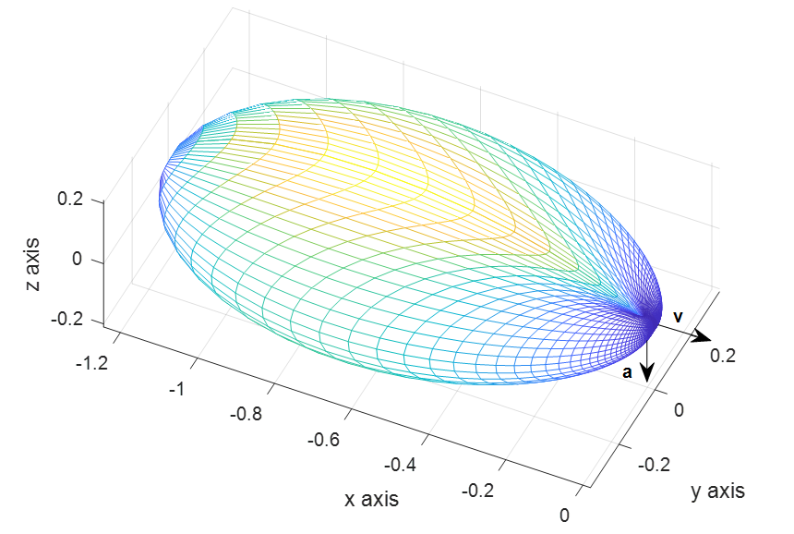


Gravitational Radiation Produced by a Mass in a Circular Orbit (continued)
$$β≪1$$
$$β=0.6$$
Figure 16
Figure 17

Slide 40
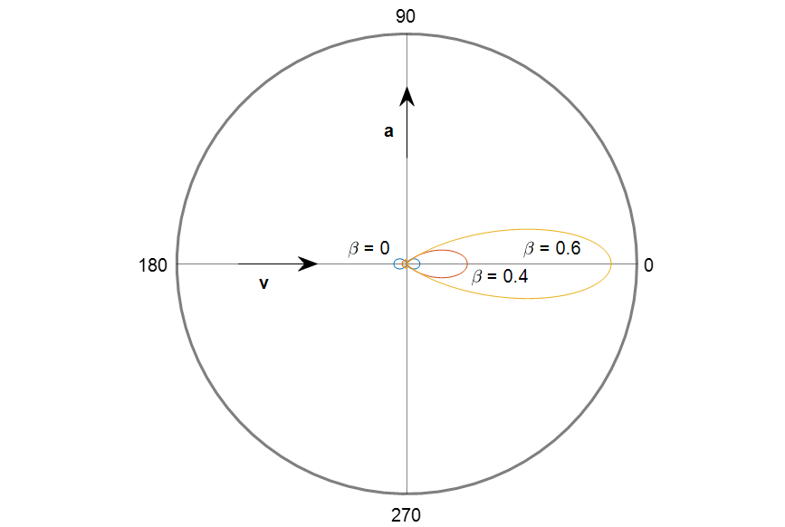
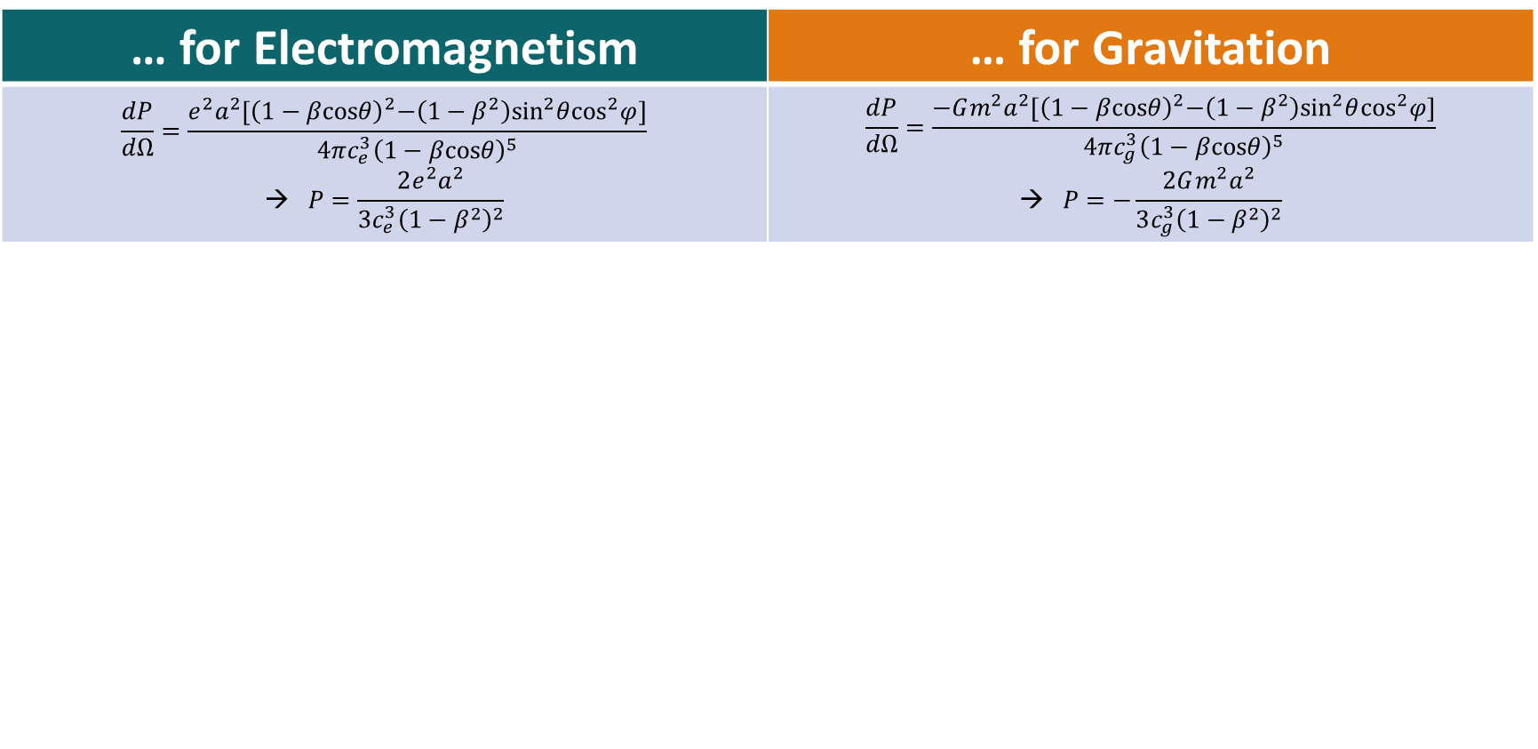
Radiation in a Circular Orbit
Figure 18
Figure 19
… for Electromagnetism | … for Gravitation
$$\frac{dP}{dΩ}=\frac{e^{2}a^{2}{[\left(1−βcosθ\right)}^{2}{−\left(1−β^{2}\right)sin}^{2}θ\cos^{2}φ]}{4πc_{e}^{3}{\left(1−βcosθ\right)}^{5}}$$ $$\text{→ }P=\frac{2e^{2}a^{2}}{3c_{e}^{3}{\left(1−β^{2}\right)}^{2}}$$ | $$\frac{dP}{dΩ}=\frac{−Gm^{2}a^{2}{[\left(1−βcosθ\right)}^{2}{−\left(1−β^{2}\right)sin}^{2}θ\cos^{2}φ]}{4πc_{g}^{3}{\left(1−βcosθ\right)}^{5}}$$ $$\text{→ }P=−\frac{2Gm^{2}a^{2}}{3c_{g}^{3}{\left(1−β^{2}\right)}^{2}}$$

Slide 41
Gravitational Radiation Animation
https://gravityvisualizer.vercel.app/

Slide 42
Conclusions
Sources of gravitational fields are mass and momentum
Field energy is negative
Gravitational fields and radiation behave relativistically
Gravitational radiation is produced by accelerated masses
Gravitational radiation patterns mirror dipole patterns for electromagnetic radiation

Slide 43
Future Work
Immediate Future
Determine precession for planetary orbits and compare to observation
Lense-Thirring precession
Develop a radiation instructional tool
Foreseeable Future
Quantum gravity

Slide 44
References
Heald, M,. and Marion, J,. “Classical Electromagnetic Radiation,” Dover, 2012
Heaviside, O., “Electromagnetic Theory,” The Electrician, 1893, 31, pp. 281-282 & 359
Hills, B,. “Gravito-electromagnetism and Mass Induction,” 2020
Jefimenko, O., “Causality, Electromagnetic Induction, and Gravitation,” Electret Scientific, 2000

Slide 45
Acknowledgements
Thesis Committee
Engineering & Physics Department
Jackson College of Graduate Studies
RCSA Research Grant
Kegan Johnson & Maddy Clark

Slide 46
Questions?

