Slide 1


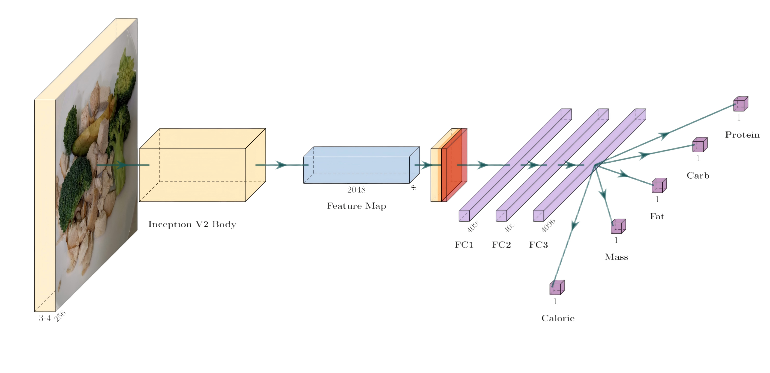





STAGE 4: LLMS & LMMS
STAGE 3: Deep Learning
STAGE 2: Traditional Machine Learning
Features:
Semantic Reasoning Engine
Context Understanding
Multimodal Integration
Personalized Inference
STAGE 1: Memory-based
Methods:
CNNs
ResNet
YOLO
Pain Points:
Lack of semantic reasoning
Difficulty in handling hidden ingredients
Methods:
24HR Recall
FFQ
Food Dairies
Pain Points:
High Cognitive Load
Recall Errors
Methods:
Hand-crafted Features
Pain Points:
Low Generalization
Dependency on Reference Objects

Slide 2
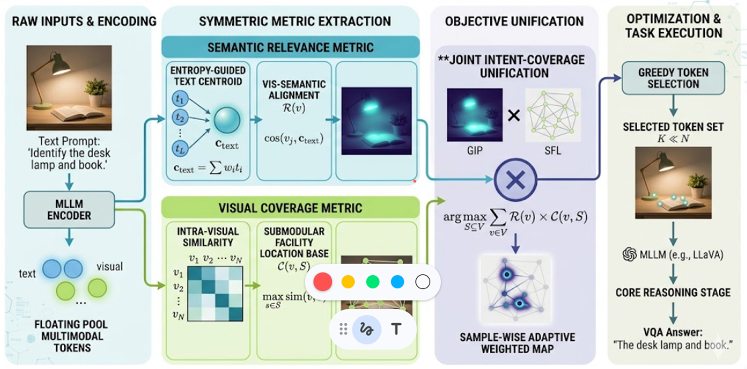
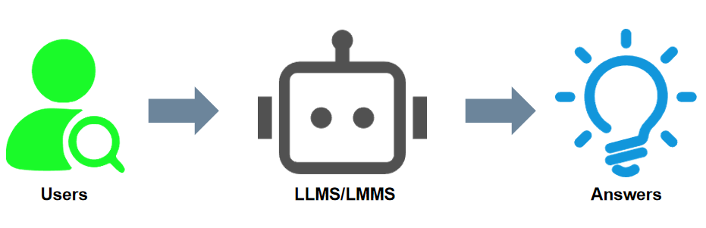

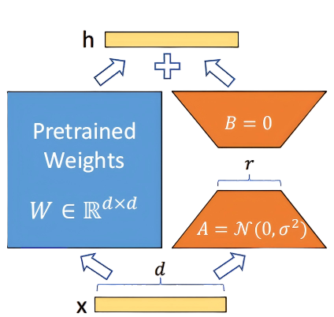



LLMS/LMMS
First step: ...
Second step: ...
...
Vector
DB
RAG
LoRA
COT
Answers
Users
Enhanced LLMS/LMMS

Slide 3
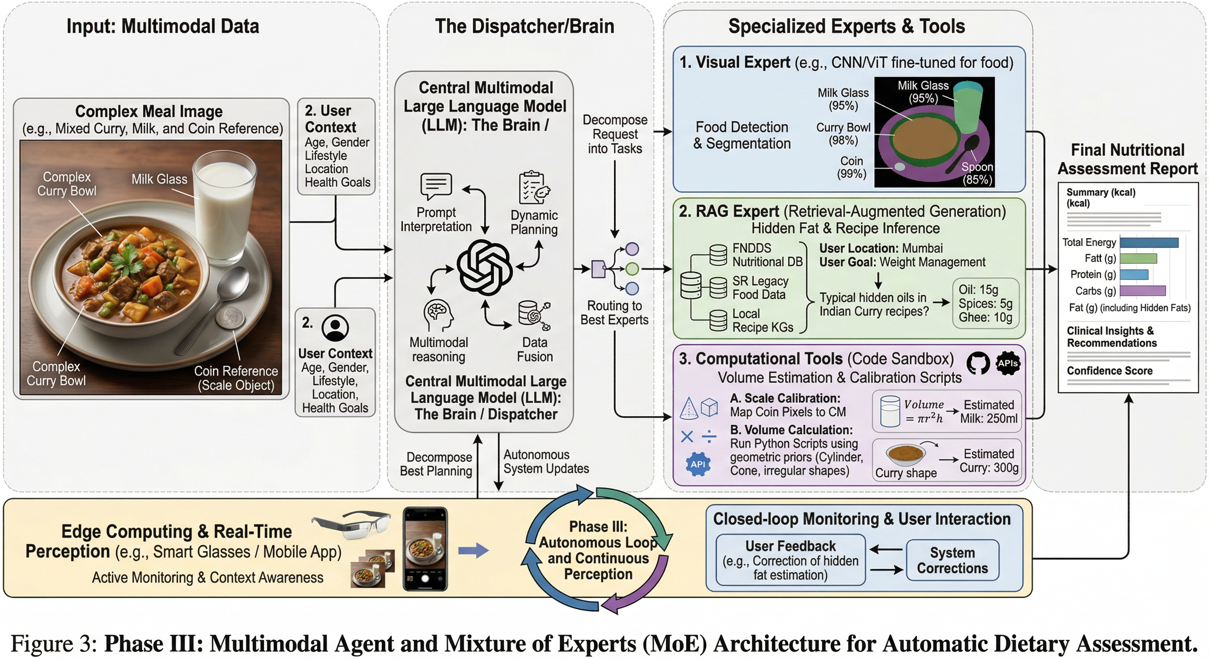

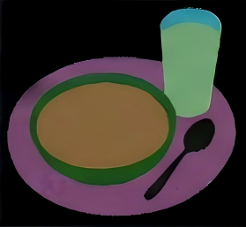


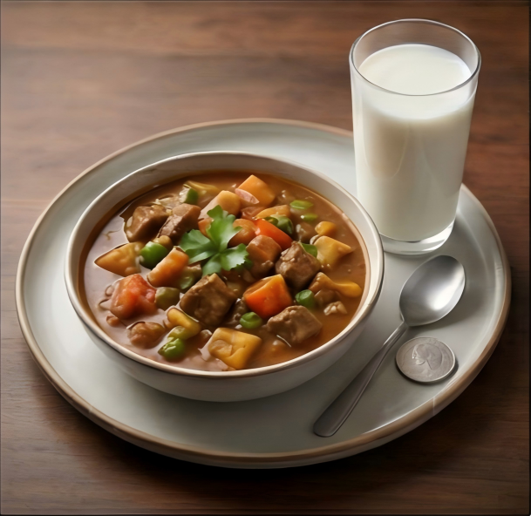

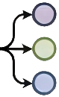



Input: Multimodal Data
The Dispatcher
Specialized Experts & Tools
Central Multimodal
1. Visual Expert
User Context
Food Detection & Segmentation
Complex Meal Image
Age, Gender,
Lifestyle,
Location,
Health Goals
...
Prompt
Interpretation
Dynamic
Planning
2. RAG Expert
Food Detection & Segmentation
Routing to
Best Experts
Multimodal
Reasoning
Description Context
Data
Fusion
3. Computational Tools

