Slide 1



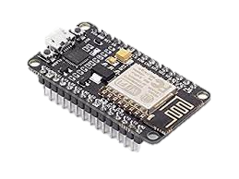
Getting Started
with
Blynk 2.0

