Slide 1
Single Cell Transcriptomics scRNAseq
Matthew L. Settles
Genome Center Bioinformatics Core
University of California, Davis
settles@ucdavis.edu; bioinformatics.core@ucdavis.edu

Slide 2
Purpose
The sequencing of the transcriptomes of single-cells, or single-cell RNA-sequencing, has now become the dominant technology for the identification of novel cell types and for the study of stochastic gene expression.
Single-cell transcriptomics determines what genes (and in what relative quantity) are being expressed in each cell.
Notes:
stochastic gene expression - Clonal populations of cells exhibit substantial phenotypic variation. Such heterogeneity can be essential for many biological processes and is conjectured to arise from stochasticity, or noise, in gene expression.
Bulk RNAseq – averages that expression

Slide 3
Major reasons to conduct single cell analysis
Bulk RNAseq, where you measure the ’average’ expression of all constituent cells, is sometimes insufficient for some experimental questions.
Gene dynamics - what changes in gene expression effect different cell characteristics, such as during differentiation
RNA splicing – cell to cell variation in alternative splicing
Cell typing - genes expressed in a cell are used to identify types of cells. The main goal in cell typing is to find a way to determine the identity of cells that don't have known genetic markers.
Spatial Transcriptomics – isolation of cells with known spatial location.

Slide 4
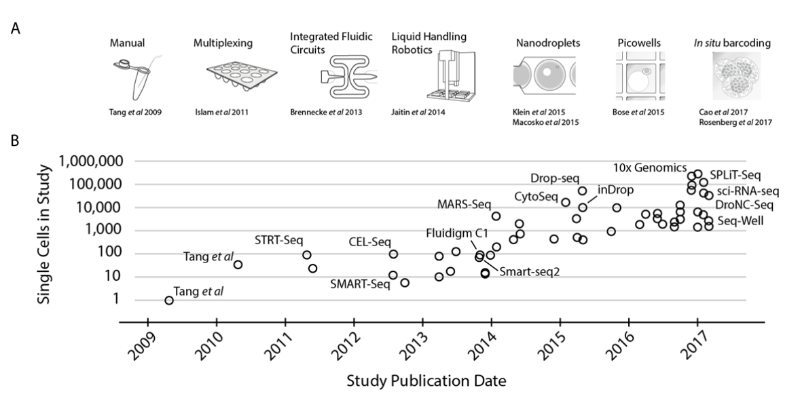
Exponential scaling of single-cell RNAseq in the last decade
https://arxiv.org/abs/1704.01379

Slide 5
Designing Experiments
Beginning with the question of interest ( and working backwards )
The final step of a DE analysis is the application of a linear model to each gene in your dataset.
Traditional statistical considerations and basic principals of statistical design of experiments apply.
Control for effects of outside variables, avoid/consider possible biases, avoid confounding variables in sample preparation.
Randomization of samples, plots, etc.
Replication is essential (triplicates are THE minimum)
You should know your final (DE) model and comparison contrasts before beginning your experiment.

Slide 6
General rules for preparing samples
Prepare more samples then you are going to need, i.e. expect some will be of poor quality, or fail
Preparation stages should occur across all samples at the same time (or as close as possible) and by the same person
Spend time practicing a new technique to produce the highest quality product you can, reliably
Quality should be established using Fragment analysis traces (pseudo-gel images, RNA RIN > 7.0)
DNA/RNA should not be degraded
260/280 ratios for RNA should be approximately 2.0 and 260/230 should be between 2.0 and 2.2. Values over 1.8 are acceptable
Quantity should be determined with a Fluorometer, such as a Qubit.

Slide 7
Comparison to RNA-seq libraries
Considerations
QA/QC of RNA samples Cells [Consistency across samples is most important.]
‘Cleanliness’ of cells and accurate cell counts
What is the RNA of interest [polyA extraction is pretty universal]
Library Preparation
Stranded Vs. Unstranded [Standard is pretty universal]
Size Selection/Cleanup [Target kit recommendations]
Final QA [Consistency across samples remains most important.]

Slide 8
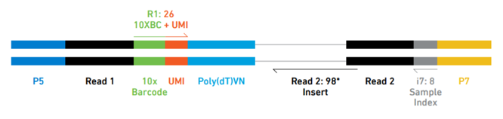
Elements of a Library
Library Barcode (Sample Index) - Used to pool multiple samples on one sequencing lane
Cell Barcode (10x Barcode) – Used to identify the cell the read came from
Unique Molecular Index (UMI) – Used to identify reads that arise during PCR replication
Sequencing Reads – Used to identify the gene a read came from

Slide 9
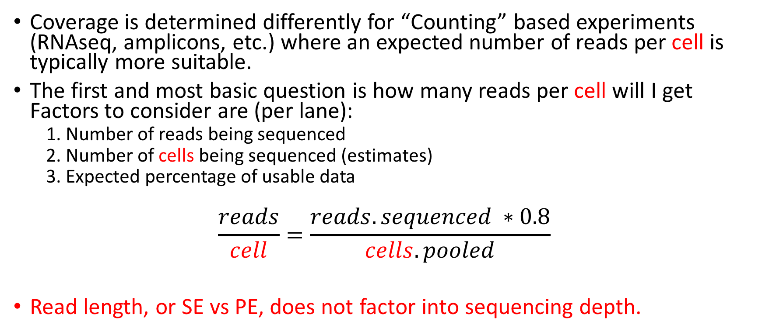
Sequencing Depth
Coverage is determined differently for “Counting” based experiments (RNAseq, amplicons, etc.) where an expected number of reads per cell is typically more suitable.
The first and most basic question is how many reads per cell will I get Factors to consider are (per lane):
1. Number of reads being sequenced
2. Number of cells being sequenced (estimates)
3. Expected percentage of usable data
$$\frac{reads}{cell}=\frac{reads.sequenced ∗0.8}{cells.pooled}$$
Read length, or SE vs PE, does not factor into sequencing depth.

Slide 10
Sequencing - Characterization of transcripts, or differential gene expression
Factors to consider are:
Read length needed depends on likelihood of mapping uniqueness, but generally longer is better and paired-end is better than single-end (except when its not) ( 75bp or greater is best ).
Complexity of sample, >> complexity -> the >> depth.
Interest in measuring genes expressed at low levels, << level -> the >> depth.
The fold change you want to be able to detect ( < fold change more replicates and more depth).
Detection of novel transcripts, or quantification of isoforms (full-length libraries) requires >> sequencing depth.
The amount of sequencing needed for a given experiment is best determined by the goals of the experiment and the nature of the sample.

Slide 11
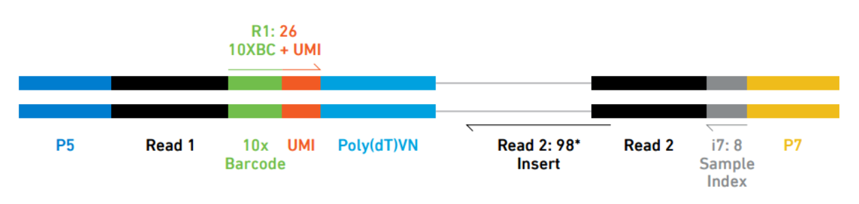
Sequencing, V2
Recommendation
50,000 raw reads per cell is the recommended sequencing depth for ‘typical’ samples.
30,000 raw reads per cell is sufficient for RNA-poor cell types such as PBMCs.
Given variability in cell counting/loading, extra sequencing may be required if the cell count is higher than anticipated.
Validated on
Novaseq
HiSeq 4000
HiSeq 2500 Rapid Run
NextSeq
MiSeq
Typical sequencing run, with 3 reads, V2 kits
Sequence Read | Recommended Length | Read Description
Read 1 | 100bp (16bp bc, 10bp UMI) | 10 barcode and UMI
I7 Index | 8bp | Sample Index Read
Read2 | 100bp | Transcript Tag
@ full capacity 10,000 cells per sample and 50K reads per cell = 500M reads or ~1.25 lane/sample

Slide 12
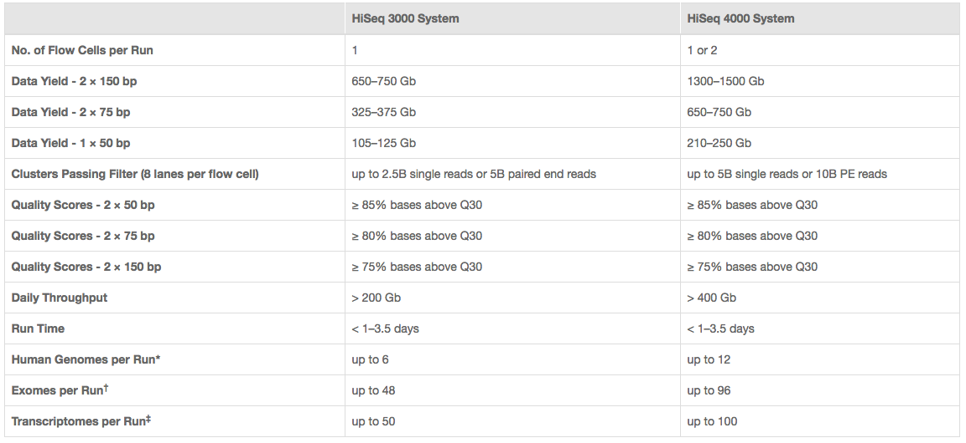
Illumina sequencing
http://www.illumina.com/systems/hiseq-3000-4000/specifications.html

Slide 13
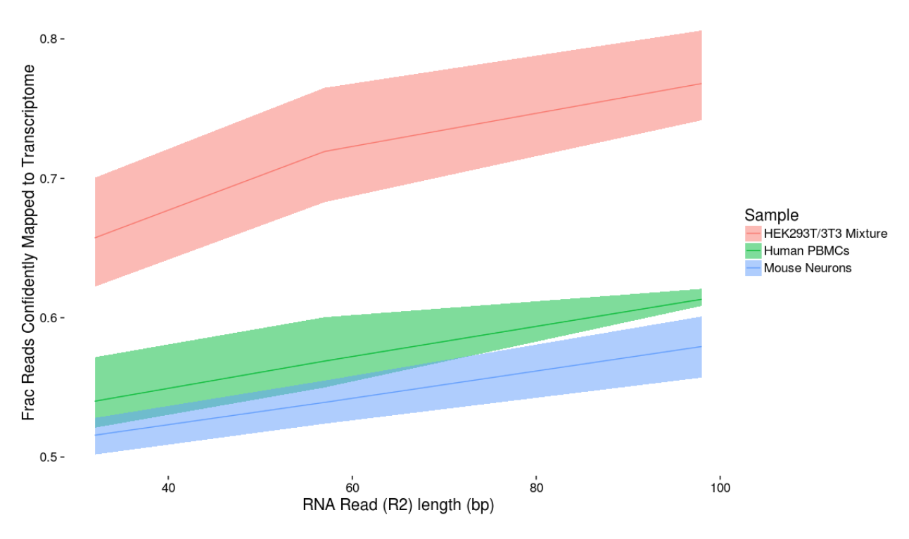
Read length matters (10x slide)

Slide 14
Cost Estimation
Cell Isolation
Library preparation (Per sample/cell)
Sequencing (Number of lanes)
Bioinformatics
General rule is to estimate the same dollar amount as data generation, i.e. double your budget
http://dnatech.genomecenter.ucdavis.edu/prices/
http://bioinformatics.ucdavis.edu/services-2/

Slide 15
Be Consistent
BE CONSISTENT ACROSS ALL SAMPLES!!!

