Slide 1
Quick Introduction and Introduction to the UC Davis Bioinformatics Core

Slide 2
The mission of the Bioinformatics Core facility is to facilitate outstanding omics- scale research through these activities:
Data Analysis
The Bioinformatics Core promotes experimental design, advanced computation and informatics analysis of ‘omics’ scale datasets that drives research forward.
Research Computing
Maintain and make available high-performance computing hardware and software necessary for todays data-intensive bioinformatic analyses.
Training
The Core helps to educate the next generation of bioinformaticians through highly acclaimed training workshops, seminars and through direct participation in research activities.
Data Analysis
Research Computing
Training
Data Analysis
Research Computing
Training
Data Analysis
Research Computing
Training
Data Analysis
Research Computing
Training
Intelligently analyzing data from genomics, and other projects, to help drive research forward
Helping build high-performance software and hardware bioinformatics solutions
Providing acclaimed training workshops that will equip people with in-demand bioinformatics skills
Intelligently analyzing data from genomics, and other projects, to help drive research forward
Helping build high-performance software and hardware bioinformatics solutions
Providing acclaimed training workshops that will equip people with in-demand bioinformatics skills
Intelligently analyzing data from genomics, and other projects, to help drive research forward
Helping build high-performance software and hardware bioinformatics solutions
Providing acclaimed training workshops that will equip people with in-demand bioinformatics skills
Intelligently analyzing data from genomics, and other projects, to help drive research forward
Helping build high-performance software and hardware bioinformatics solutions
Providing acclaimed training workshops that will equip people with in-demand bioinformatics skills

Slide 3
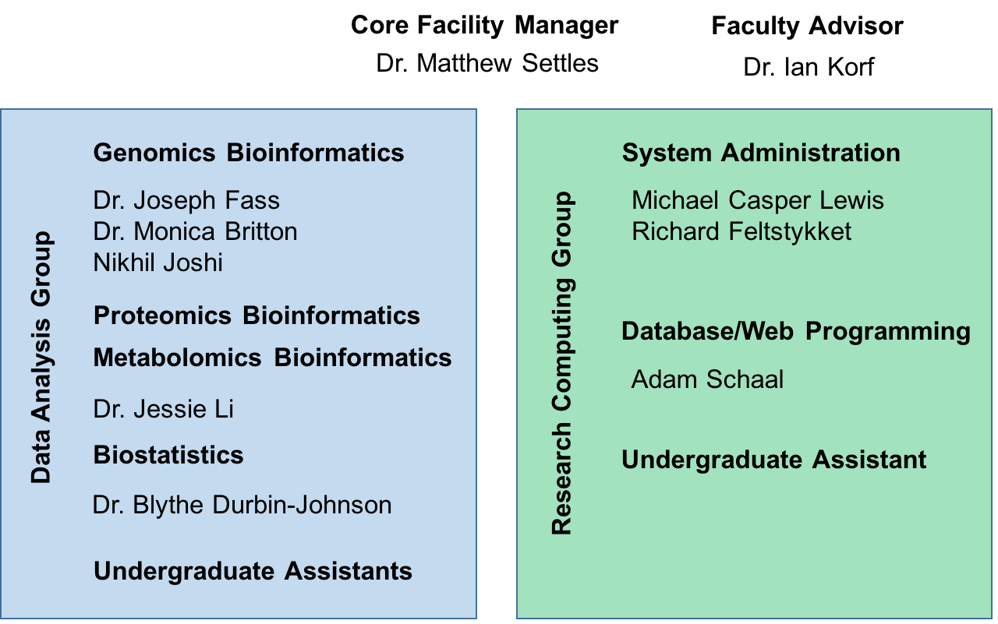
UC Davis Bioinformatics Core in the Genome Center

Slide 4
Contacts
Website: http://bioinformatics.ucdavis.edu/
Computing Issues, including but not limited to
User account questions, equipment failure/malfunction, software install, software failures (not related to use)
helpdesk@genomecenter.ucdavis.edu
Bioinformatics related questions, including but not limited to
bioinformatic methods questions, software use, data questions
bioinformatics.core@ucdavis.edu
Bioinformatics training and workshop related questions
training.bioinformatics@ucdavis.edu
Mailing lists: http://bioinformatics.ucdavis.edu/contact-us/

Slide 5
Goals
End to End understanding of single cell RNA sequending
Experimental design
Technologies
Cost estimation
Analysis Workflow
To work through a complete experiment, starting from raw data to completion, including making a few figures.
Goal is 30-40% lecture/discussion 60-70% hands-on

Slide 6
Workshop Info
Internet
If your home institution is on eduroam, you should be on already
http://itcatalog.ucdavis.edu/service/eduroam
UCD Guest Wireless
http://itcatalog.ucdavis.edu/service/wireless-guest-access
Schedule is loose, we will try and have short breaks, lunch is ~12-1pm then a technology talk
Monday – Takara
Tuesday – Illumina
Wednesday - 10X Genomics

Slide 7
Workshop Info
Workshop materials posted on github
https://ucdavis-bioinformatics-training.github.io/2017-September-Microbial-Community-Analysis-Workshop/
Course will be conducted on our server and cluster
ganesh.genomecenter.ucdavis.edu
Cluster usage will be under a workshop reservation
Everyone should have a username/password combo in their badge.

Slide 8
Schedule at a glance
Wednesday Tuesday 5th
Introductions
Morning Hands on: Intro to Command Line (Joe)
Morning Talk: “What is Bioinformatics?” (Matt)
Early Afternoon Hands on: Running Jobs on the Cluster (Joe)
Late Afternoon Hands On: Installing workshop software and setting the environment
Afternoon Talk: “Intro to Microbial Sequencing” (Matt)
Thursday August 6th
dbcAmplions: Processing Sequence Reads Through abundance Tables
Afternoon Talk: “Host Microbe Systems Biology Core” (Matt)

Slide 9
Schedule
Friday September 8th
Morning Hands on: Intro to R (Jessie)
Morning Talk: “Oligotyping” (Peter Henry)
Afternoon Hands on: Microbial Community Analysis with R (Matt)
Closing

