Slide 1
Actual step by Nesterov momentum
Gradient step
Momentum step
Gradient step ahead (correction)
Step ahead by standard momentum
1. Gradient step
2. Momentum step
3. Step ahead by standard momentum
4. Gradient step ahead (for correction)
5. Actual step by Nesterov momentum

Slide 2
Step ahead by standard momentum
Actual step by Nesterov momentum
Gradient step
Momentum step
Gradient step ahead (correction)
Step ahead by standard momentum
Momentum step
Gradient step ahead
(correction)
Gradient step
Gradient step
Gradient step

Slide 3
f(x) = X*W + b
X
f(X)
Softmax
Loss
Update Parameters
W, b
Gradient Descent for a smaller loss
X (N, D)
W (D, K)
b (1, K)
Scores (N, K)

Slide 4
Backpropagate and update parameters W, b
ReLU
Scores =
ReLU(f(x)) * W₂ + b₂
X
f(X)
Scores
Softmax
Loss
Update Parameters W₂, b₂
f(X) =
X*W + b
Gradient Descent for a smaller loss
X (N, D)
W (D, h)
b (h, )
f(X) (N, h)
W₂ (h, K)
b₂ (K, )
Scores (N, K)

Slide 5
Weight | .shape[0] | .shape[1]
W₁ | input_dim | H₁
W₂ | H₁ | H₂
… | H… | H_{…+1}
W_{k} | H_{k} | num_classes
index | i | j
0 | input_dim | H₁
1 | H₁ | H₂
… | H… | H_{…+1}
k | H_{k} | num_classes

Slide 6
hidden_dims = [H₁, H₂, …, H_{k}]
Input Data | .shape[0] | .shape[1]
X | N | D
Weight | .shape[0] | .shape[1]
W₁ | D | H₁
W₂ | H₁ | H₂
… | H… | H_{…+1}
W_{k} | H_{k} | num_classes
Bias | .shape
b₁ | (H₁, )
b₂ | (H₂, )
… | (H_{…+1}, )
b_{k} | (H_{k}, )
*
+

Slide 7
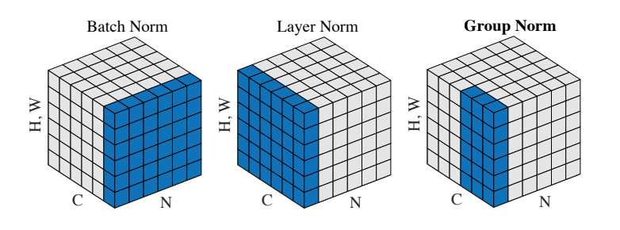
ReLU
Dropout
Normalization
Dropout
Normalization
X
f(X₁)
f(X₂)

Slide 8
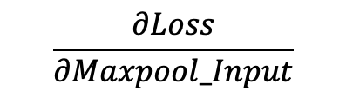
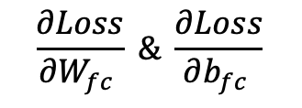
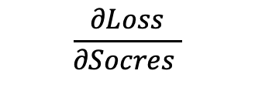

A simplified convolutional neural network looks like:
CONV
Pool
ReLU
FC
X
Scores
Softmax
Loss
Backwards

Slide 9
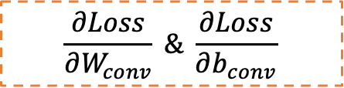
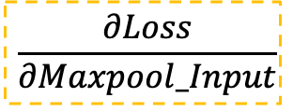
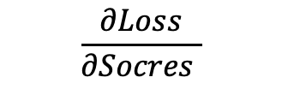
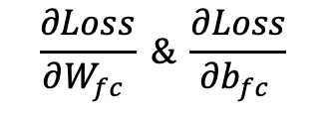
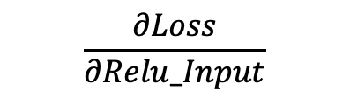
CONV
Pool
ReLU
FC
X
Scores
Softmax
Loss

Slide 10
CONV
Pool
ReLU
FC
Flatten
X
Scores
Softmax
Loss

Slide 11
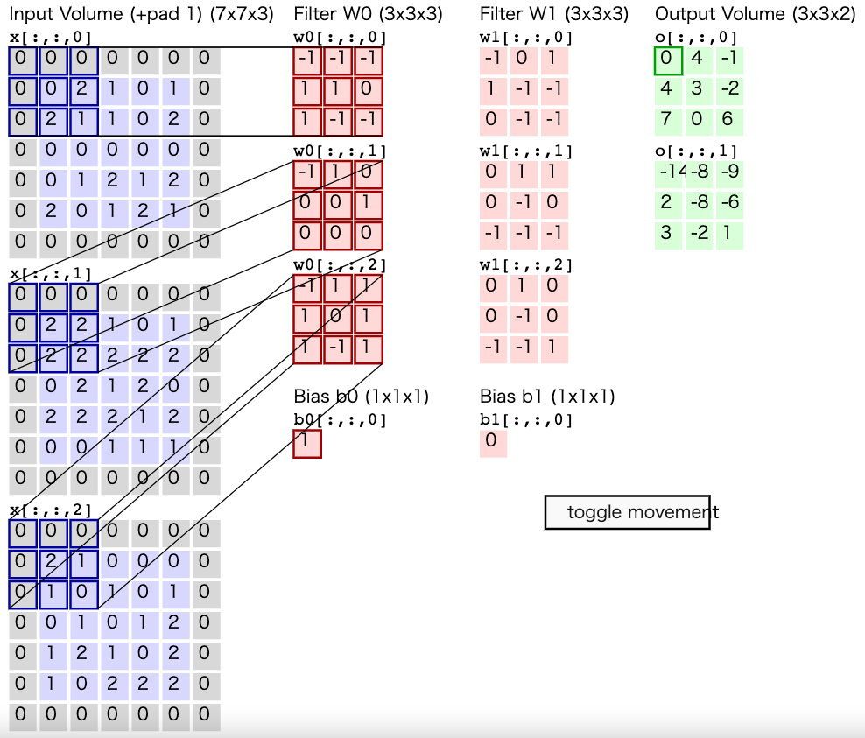
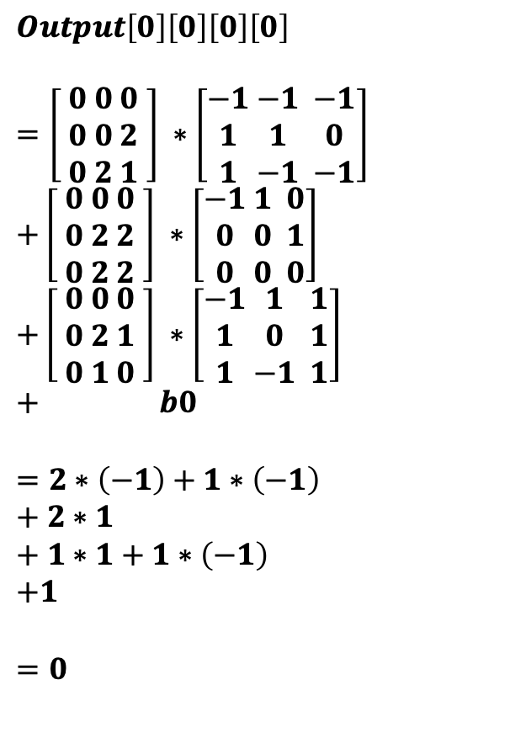

Slide 12
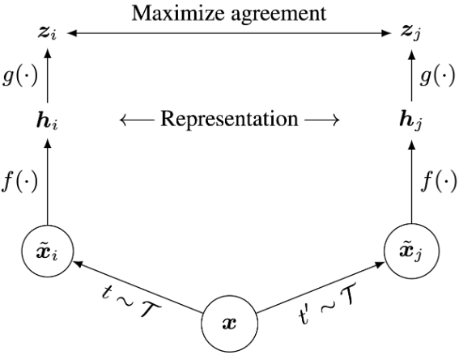
Training
Test
h
f(x)
x
𝓣: A randomly augmented function.
f(): A base Encoder such as ResNet. Extracts representation vectors of the augmented images.
g(): A neural network projection. Maps representation vectors to the space where the contrastive loss is applied.

Slide 13


Error
O(h²)
Error
O(h)

