Slide 1
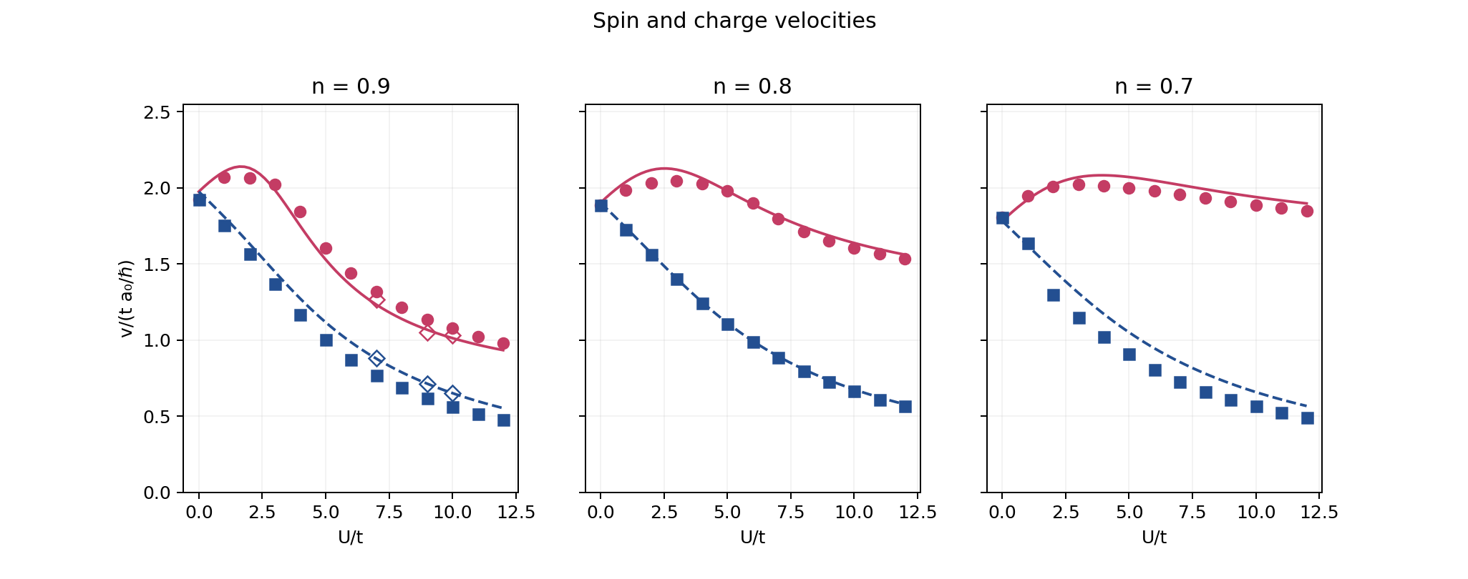
Spin and charge velocities
Charge: red Spin: blue dashed BA: lines MMHK: markers
10 orbitals · 50 density twists · η/t = 0.1
1
Notes:
BA curves solve thermodynamic Hubbard integral equations at nominal density. MMHK markers are dominant positive-frequency peak divided by q_min=2*pi/L: a finite-q, broadening-dependent estimator, not an extrapolated sound velocity. Diamonds show BA at the actual density when different. No intensity normalization.

Slide 2
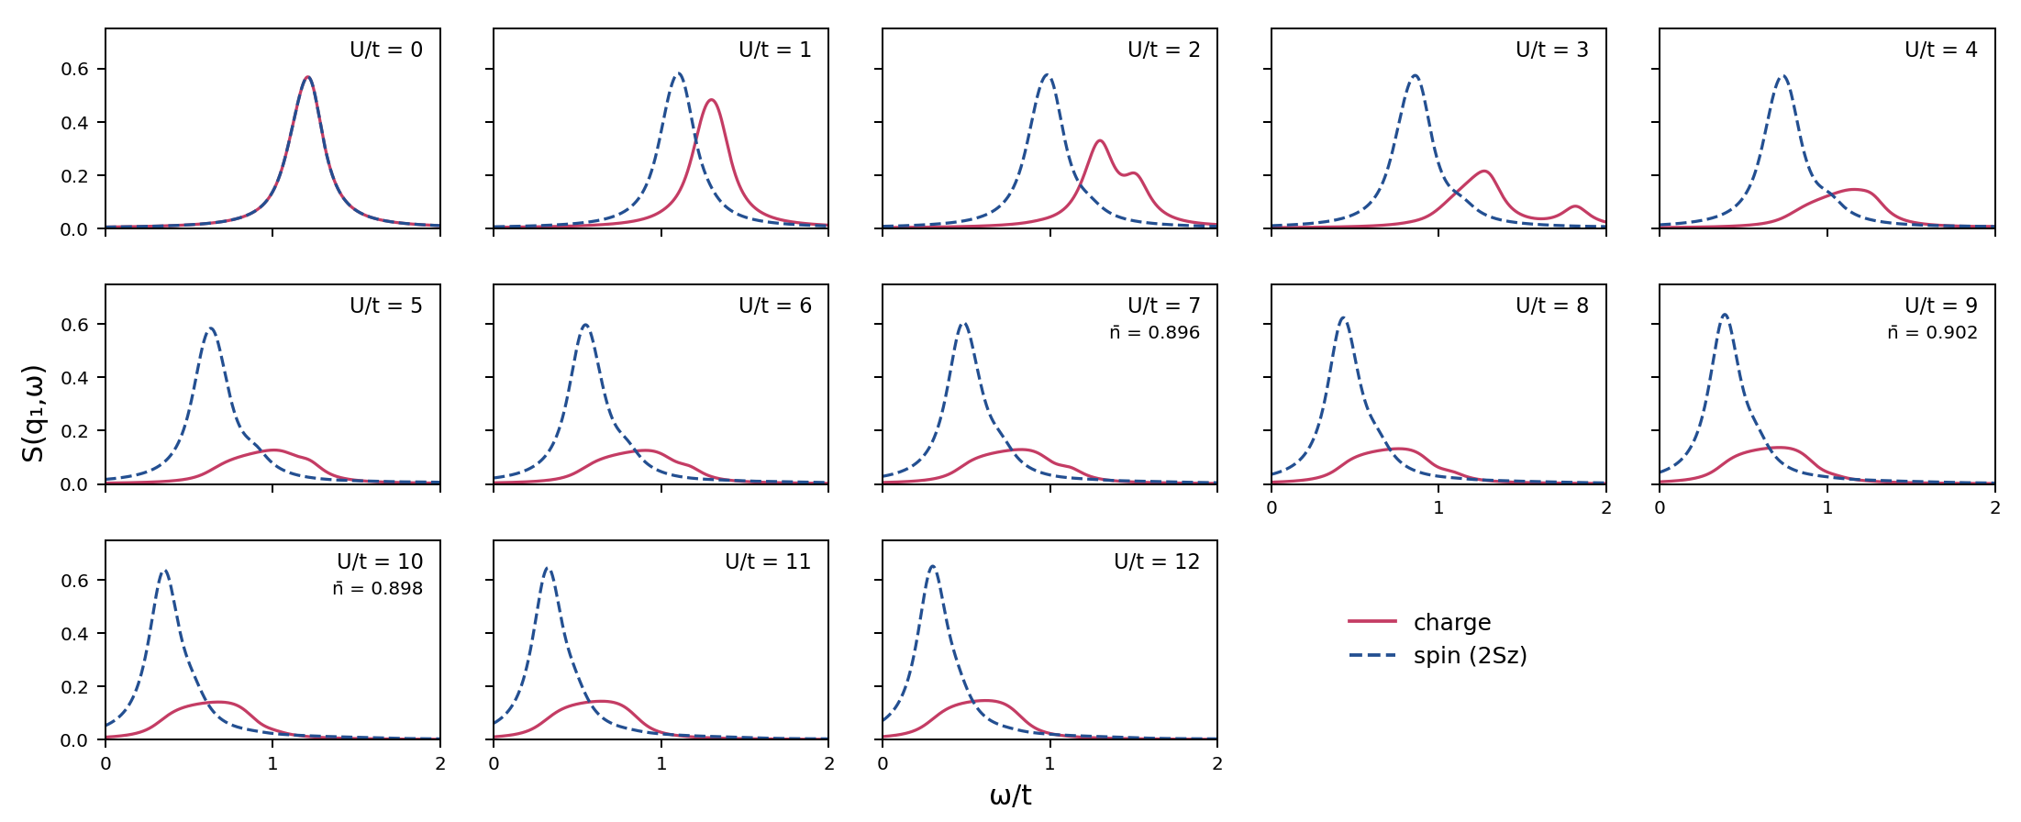
Spin and charge response · target n = 0.9
10 orbitals · 50 density twists · η/t = 0.1
2
Notes:
Coherent charge and longitudinal spin (2Sz) positive inelastic Lehmann spectra. One common chemical potential, complete ground-state trace per twist, not a fixed number or Sz. Elastic weight is excluded. The CSV files report actual densities and peak diagnostics; broadening eta/t=0.1.

Slide 3
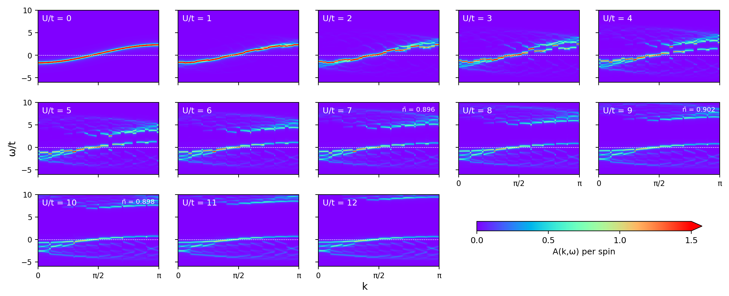
Single-particle spectrum · target n = 0.9
10 orbitals · 50 density twists · η/t = 0.1
3
Notes:
Per-spin A(k,omega)=-Im(Gup+Gdn)/(2*pi). 101 directly calculated k points from 0 to pi, no interpolation. Common mu fixed by the density twist grid. The display is clipped to [-6,10], not the stored frequency range. Colormap saturation is 1.5.

Slide 4
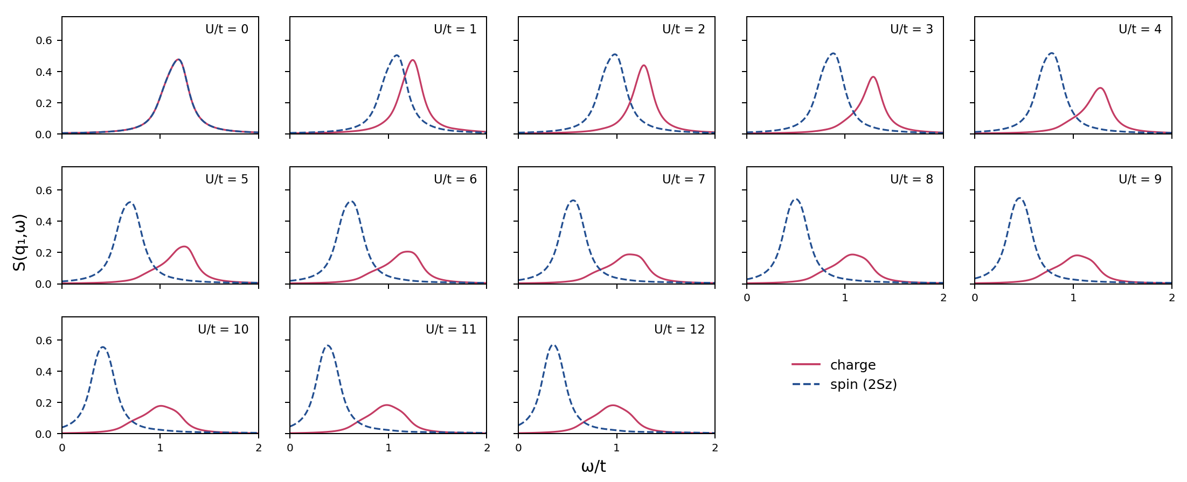
Spin and charge response · target n = 0.8
10 orbitals · 50 density twists · η/t = 0.1
4
Notes:
Coherent charge and longitudinal spin (2Sz) positive inelastic Lehmann spectra. One common chemical potential, complete ground-state trace per twist, not a fixed number or Sz. Elastic weight is excluded. The CSV files report actual densities and peak diagnostics; broadening eta/t=0.1.

Slide 5

Single-particle spectrum · target n = 0.8
10 orbitals · 50 density twists · η/t = 0.1
5
Notes:
Per-spin A(k,omega)=-Im(Gup+Gdn)/(2*pi). 101 directly calculated k points from 0 to pi, no interpolation. Common mu fixed by the density twist grid. The display is clipped to [-6,10], not the stored frequency range. Colormap saturation is 1.5.

Slide 6
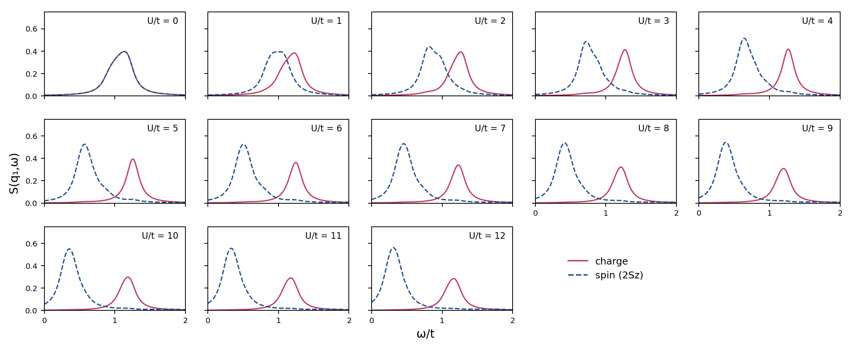
Spin and charge response · target n = 0.7
10 orbitals · 50 density twists · η/t = 0.1
6
Notes:
Coherent charge and longitudinal spin (2Sz) positive inelastic Lehmann spectra. One common chemical potential, complete ground-state trace per twist, not a fixed number or Sz. Elastic weight is excluded. The CSV files report actual densities and peak diagnostics; broadening eta/t=0.1.

Slide 7

Single-particle spectrum · target n = 0.7
10 orbitals · 50 density twists · η/t = 0.1
7
Notes:
Per-spin A(k,omega)=-Im(Gup+Gdn)/(2*pi). 101 directly calculated k points from 0 to pi, no interpolation. Common mu fixed by the density twist grid. The display is clipped to [-6,10], not the stored frequency range. Colormap saturation is 1.5.

