Slide 1
Spin and charge velocities
10-MMHK, 50 twists, η/t = 0.1, q₁ = π/5
Charge: red Spin: blue dashed BA: lines MMHK: markers
U/t
Velocity unit: t a₀/ℏ
BA grid: Δ(U/t) = 0.2.
Notes:
BA source: Essler et al., The One-Dimensional Hubbard Model (Cambridge, 2005), Eqs.5.102–5.105 and6.44–6.47. BA uses fixed physical n=Ne/L, T=B=0. Actual near-n0.9 densities: U7 .896, U9 .902, U10 .898. Neutral source pole data: /Users/cosdis/Desktop/projects/HK_orbital_cluster/1d/response/results/twist50_common_mu_U0to12_n0p7_0p8_0p9/analysis_ba_step0p2_eta0p1/velocity_comparison.csv. No chemical-potential shift in neutral frequencies.
The MMHK markers are dominant-peak omega(q₁)/q₁ values at q₁=π/5 and eta/t=0.1. They are finite-q, broadening-dependent estimators, rather than a q→0 extrapolation.

Slide 2
Spin and charge response at n ≈ 0.9
10-MMHK, 50 twists, η/t = 0.1, q₁ = π/5
Charge: red solid Spin (2Sᶻ): blue dashed Common absolute intensity scale
Frequency axis: ω/t Intensity: S(q₁,ω). This slide shows ω/t = 0–2.
Notes:
13 panels cover U/t=0..12. Physical n=Ne/L. Coherent densities rho_c/s=sum_j exp(iqj)(nup +/- ndn)/sqrt(L); spin is 2Sz, divide spin intensity by4 for Sz. Same common chemical potentials and complete spin/translation ground ensembles as original50-twist campaign. Eta0.1 rebroadened original poles and re-extracted peak positions. Full range figures (omega/t0..65) accompany the deck. Literal source values: /Users/cosdis/Desktop/projects/HK_orbital_cluster/1d/response/results/twist50_common_mu_U0to12_n0p7_0p8_0p9/analysis_ba_step0p2_eta0p1/presentation_data.json

Slide 3
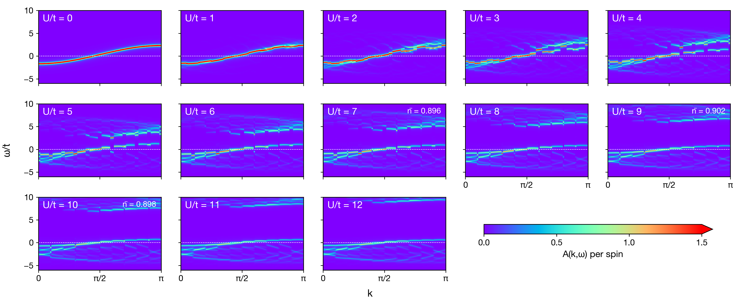
Single-particle spectra at n ≈ 0.9
10-MMHK, η/t = 0.1, 101 momenta from 0 to π
U/t = 0–12 A(k,ω) per spin Common color scale
Chemical potentials from the 50-twist density calculation
Notes:
Sources: /Users/cosdis/Desktop/projects/HK_orbital_cluster/1d/response/results/twist50_common_mu_U0to12_n0p7_0p8_0p9/single_particle_eta0p1_k101_depth600/U*/n0p9/Akw.npz and metadata.json. The 13 panels show U/t=0..12, eta/t=0.1 and exactly 101 directly calculated physical momenta k_j=j*pi/100 without momentum interpolation. The 101-point grid selects20 folded phases, with11 inversion representatives. The common mu and reference density are those of the original50-twist campaign and are not retuned for this coarser spectral sampling. Per-spin A=-Im(Gup+Gdn)/(2*pi), with unit full-frequency weight. The display clips to omega/t=-6..10, while stored NPZ arrays cover -6..16. Addition Em(N+1)-E0-mu; removal E0-Em(N-1)-mu. Color range0..1.5, with an upper saturation arrow. Reference densities: U7 .896, U9 .902, U10 .898, otherwise .9.

Slide 4
Spin and charge response at n = 0.8
10-MMHK, 50 twists, η/t = 0.1, q₁ = π/5
Charge: red solid Spin (2Sᶻ): blue dashed Common absolute intensity scale
Frequency axis: ω/t Intensity: S(q₁,ω). This slide shows ω/t = 0–2.
Notes:
13 panels cover U/t=0..12. Physical n=Ne/L. Coherent densities rho_c/s=sum_j exp(iqj)(nup +/- ndn)/sqrt(L); spin is 2Sz, divide spin intensity by4 for Sz. Same common chemical potentials and complete spin/translation ground ensembles as original50-twist campaign. Eta0.1 rebroadened original poles and re-extracted peak positions. Full range figures (omega/t0..65) accompany the deck. Literal source values: /Users/cosdis/Desktop/projects/HK_orbital_cluster/1d/response/results/twist50_common_mu_U0to12_n0p7_0p8_0p9/analysis_ba_step0p2_eta0p1/presentation_data.json

Slide 5

Single-particle spectra at n = 0.8
10-MMHK, η/t = 0.1, 101 momenta from 0 to π
U/t = 0–12 A(k,ω) per spin Common color scale
Chemical potentials from the 50-twist density calculation
Notes:
Sources: /Users/cosdis/Desktop/projects/HK_orbital_cluster/1d/response/results/twist50_common_mu_U0to12_n0p7_0p8_0p9/single_particle_eta0p1_k101_depth600/U*/n0p8/Akw.npz and metadata.json. The 13 panels show U/t=0..12, eta/t=0.1 and exactly 101 directly calculated physical momenta k_j=j*pi/100 without momentum interpolation. The 101-point grid selects20 folded phases, with11 inversion representatives. The common mu and reference density are those of the original50-twist campaign and are not retuned for this coarser spectral sampling. Per-spin A=-Im(Gup+Gdn)/(2*pi), with unit full-frequency weight. The display clips to omega/t=-6..10, while stored NPZ arrays cover -6..16. Addition Em(N+1)-E0-mu; removal E0-Em(N-1)-mu. Color range0..1.5, with an upper saturation arrow.

Slide 6
Spin and charge response at n = 0.7
10-MMHK, 50 twists, η/t = 0.1, q₁ = π/5
Charge: red solid Spin (2Sᶻ): blue dashed Common absolute intensity scale
Frequency axis: ω/t Intensity: S(q₁,ω). This slide shows ω/t = 0–2.
Notes:
13 panels cover U/t=0..12. Physical n=Ne/L. Coherent densities rho_c/s=sum_j exp(iqj)(nup +/- ndn)/sqrt(L); spin is 2Sz, divide spin intensity by4 for Sz. Same common chemical potentials and complete spin/translation ground ensembles as original50-twist campaign. Eta0.1 rebroadened original poles and re-extracted peak positions. Full range figures (omega/t0..65) accompany the deck. Literal source values: /Users/cosdis/Desktop/projects/HK_orbital_cluster/1d/response/results/twist50_common_mu_U0to12_n0p7_0p8_0p9/analysis_ba_step0p2_eta0p1/presentation_data.json

Slide 7

Single-particle spectra at n = 0.7
10-MMHK, η/t = 0.1, 101 momenta from 0 to π
U/t = 0–12 A(k,ω) per spin Common color scale
Chemical potentials from the 50-twist density calculation
Notes:
Sources: /Users/cosdis/Desktop/projects/HK_orbital_cluster/1d/response/results/twist50_common_mu_U0to12_n0p7_0p8_0p9/single_particle_eta0p1_k101_depth600/U*/n0p7/Akw.npz and metadata.json. The 13 panels show U/t=0..12, eta/t=0.1 and exactly 101 directly calculated physical momenta k_j=j*pi/100 without momentum interpolation. The 101-point grid selects20 folded phases, with11 inversion representatives. The common mu and reference density are those of the original50-twist campaign and are not retuned for this coarser spectral sampling. Per-spin A=-Im(Gup+Gdn)/(2*pi), with unit full-frequency weight. The display clips to omega/t=-6..10, while stored NPZ arrays cover -6..16. Addition Em(N+1)-E0-mu; removal E0-Em(N-1)-mu. Color range0..1.5, with an upper saturation arrow.

