Slide 2
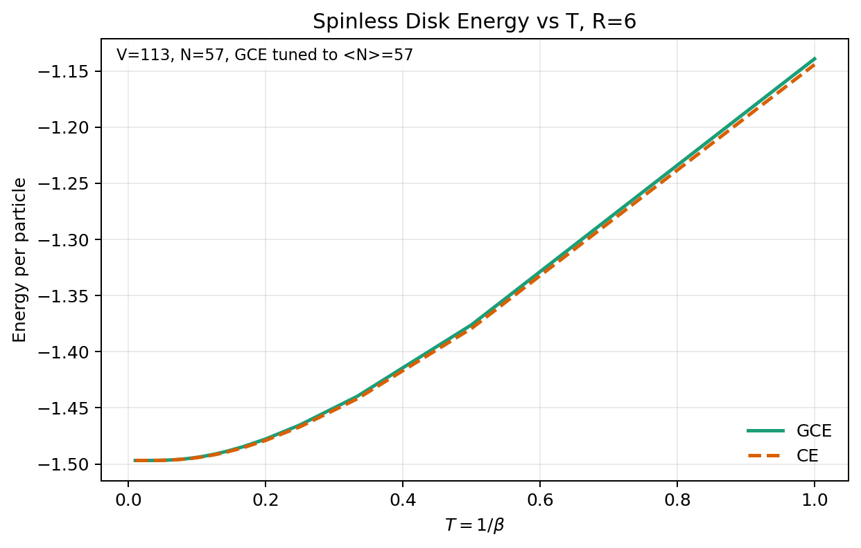
Energy per particle: E/N

Slide 3
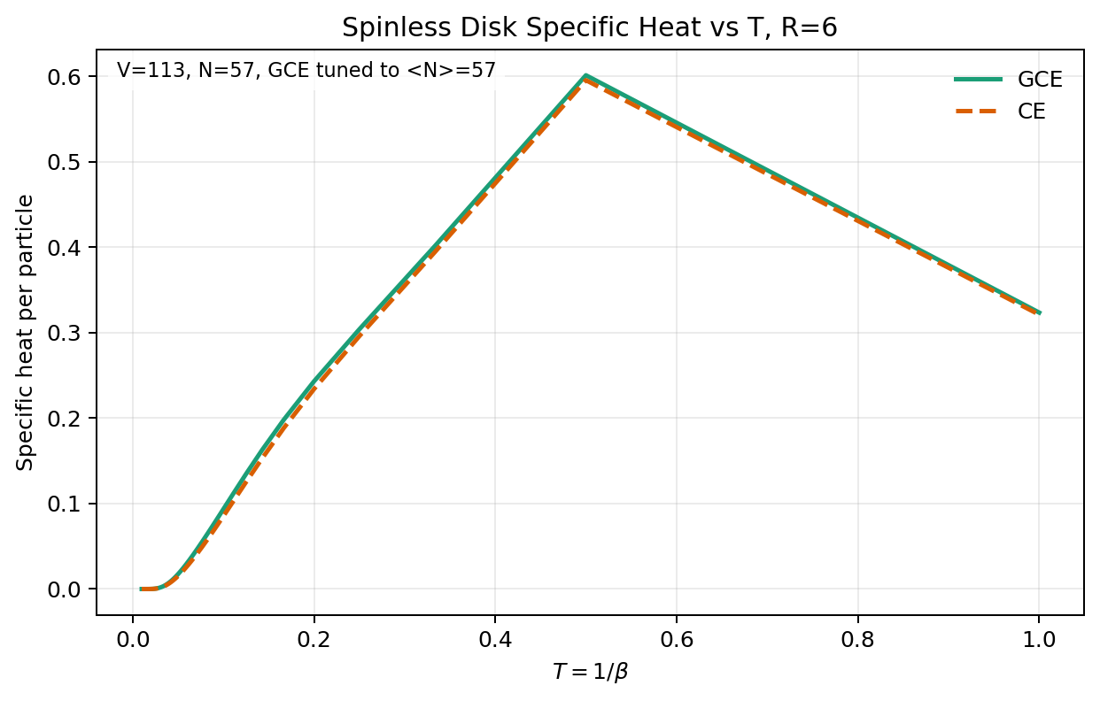
Specific heat: C/N = -beta^2 d(E/N)/d beta

Slide 4
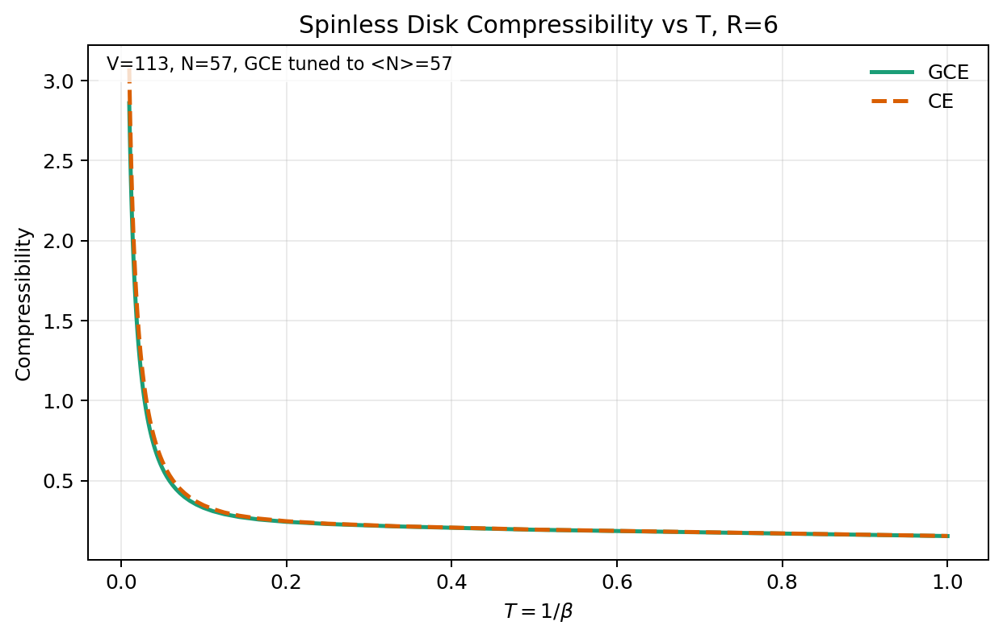
Compressibility: CE [V(F(N+1)-2F(N)+F(N-1))]^-1 ; GCE beta Var(N)/V

Slide 5
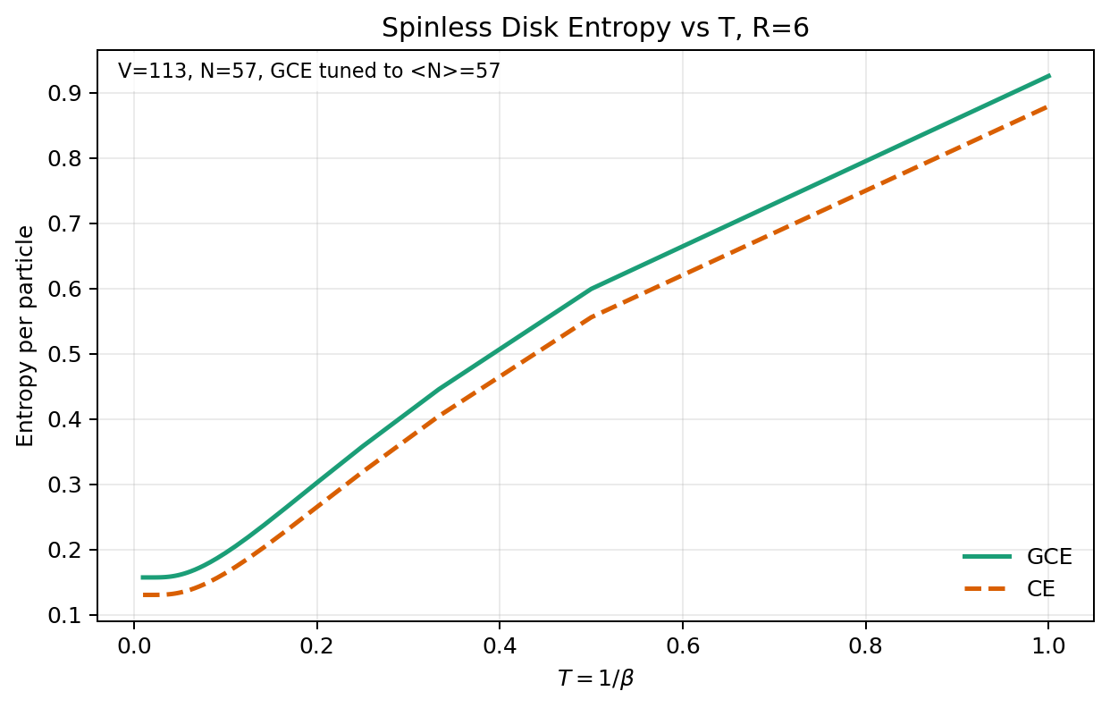
Entropy per particle: CE (E-F)/(T N) ; GCE (E-Omega-mu N)/(T N)

