Slide 1
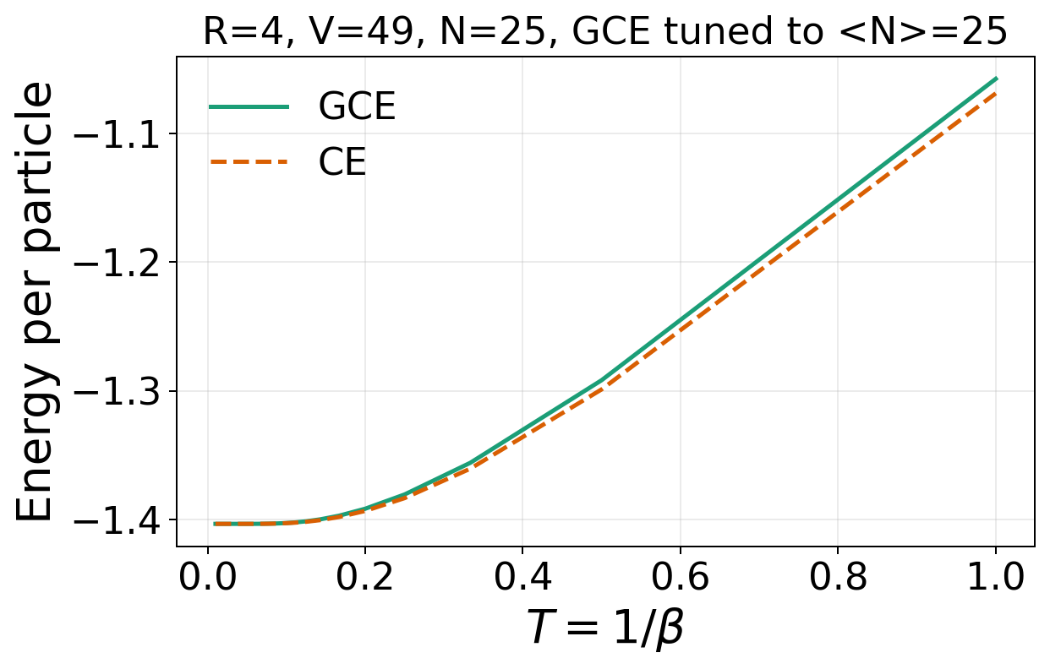
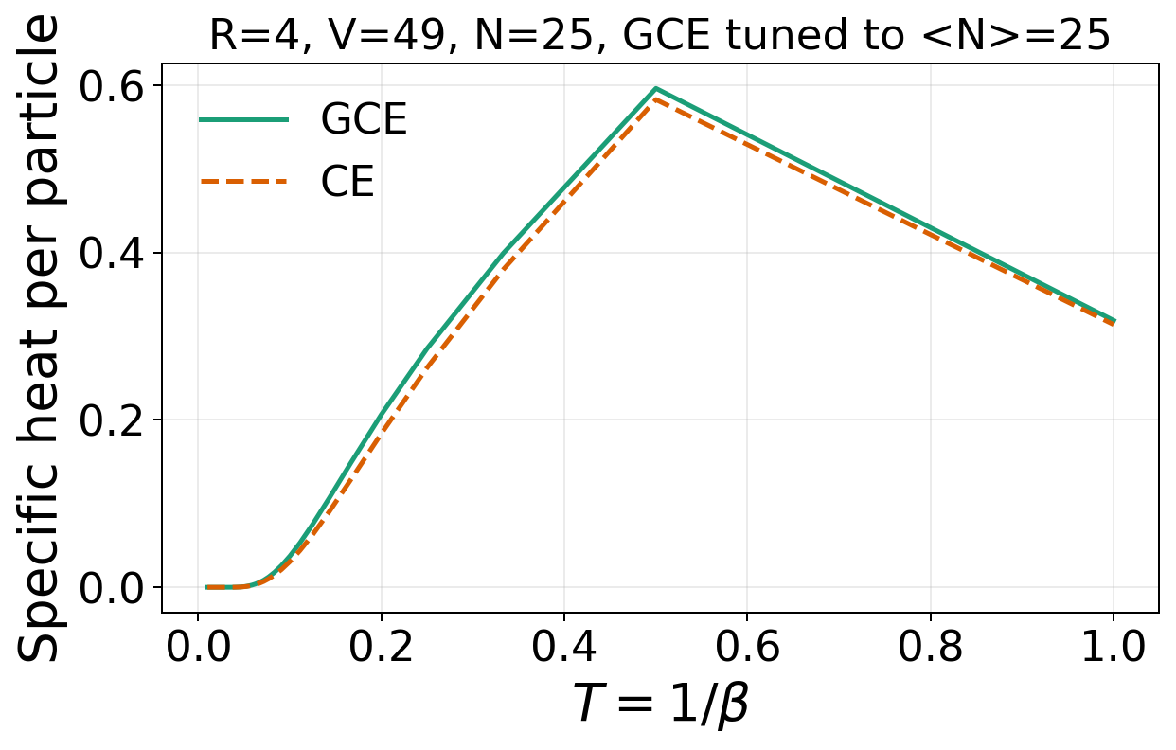
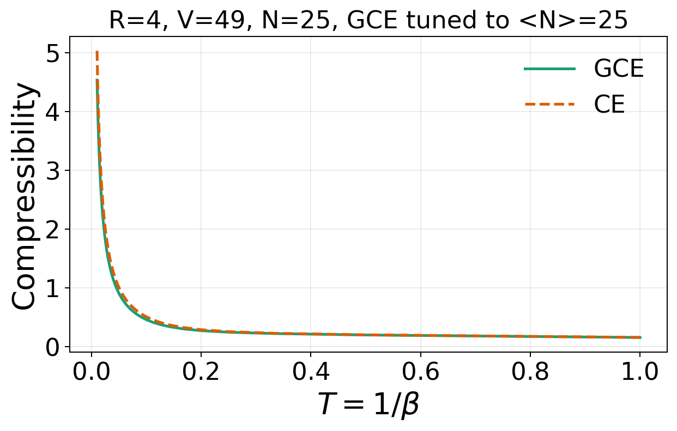
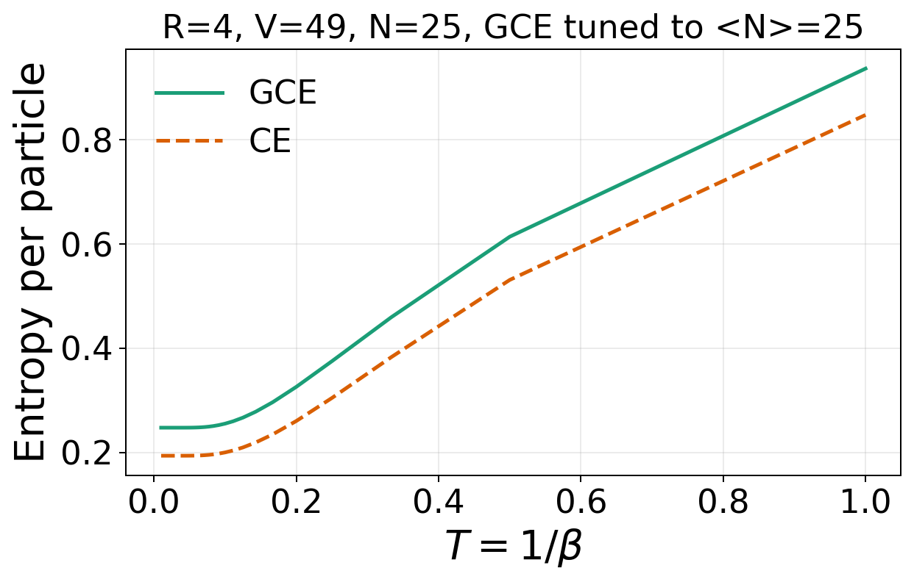
Disk, OBC, R=4, V=49, N=25, GCE tuned to <N>=25
Energy: E/N
Specific heat: C/N = -beta^2 d(E/N)/d beta
Compressibility: kappa_CE=[V(F(N+1)-2F(N)+F(N-1))]^-1 ; kappa_GCE=beta Var(N)/V
Entropy: S/N ; CE=(E-F)/(TN), GCE=(E-Omega-mu N)/(TN)

Slide 2
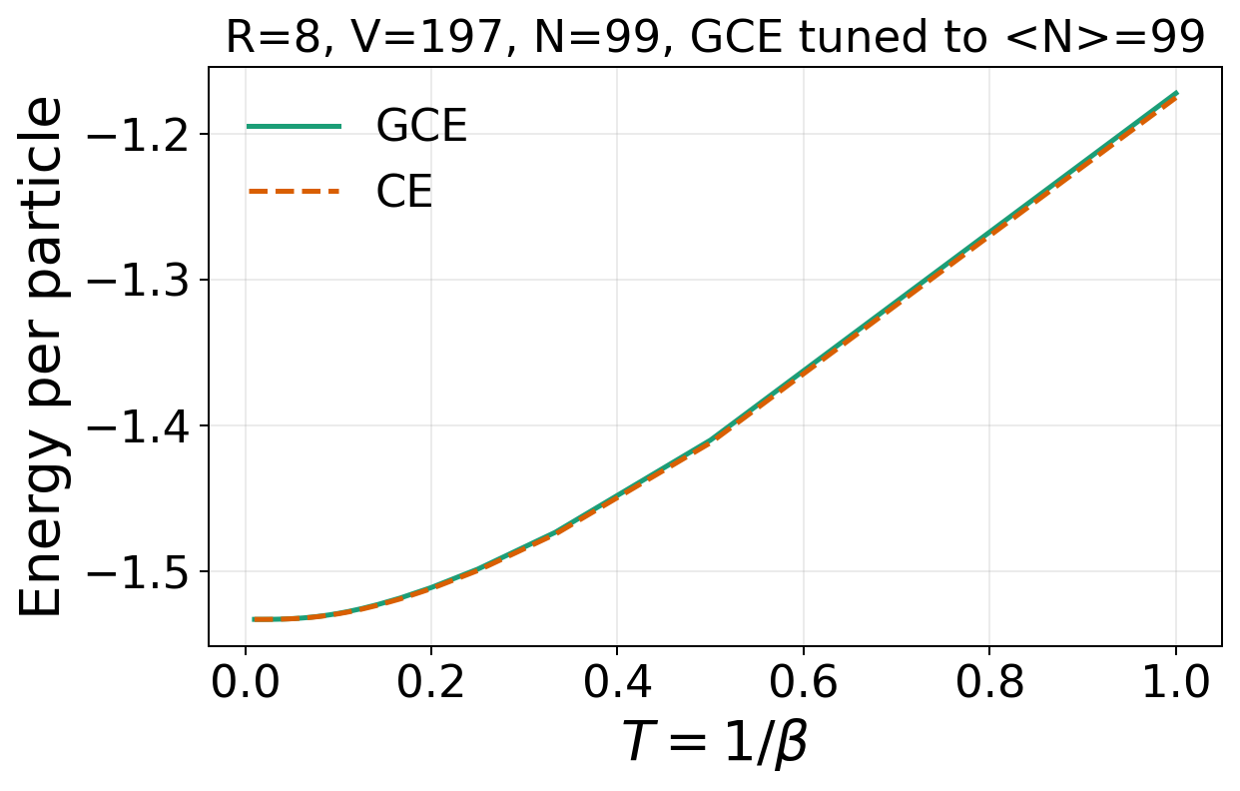
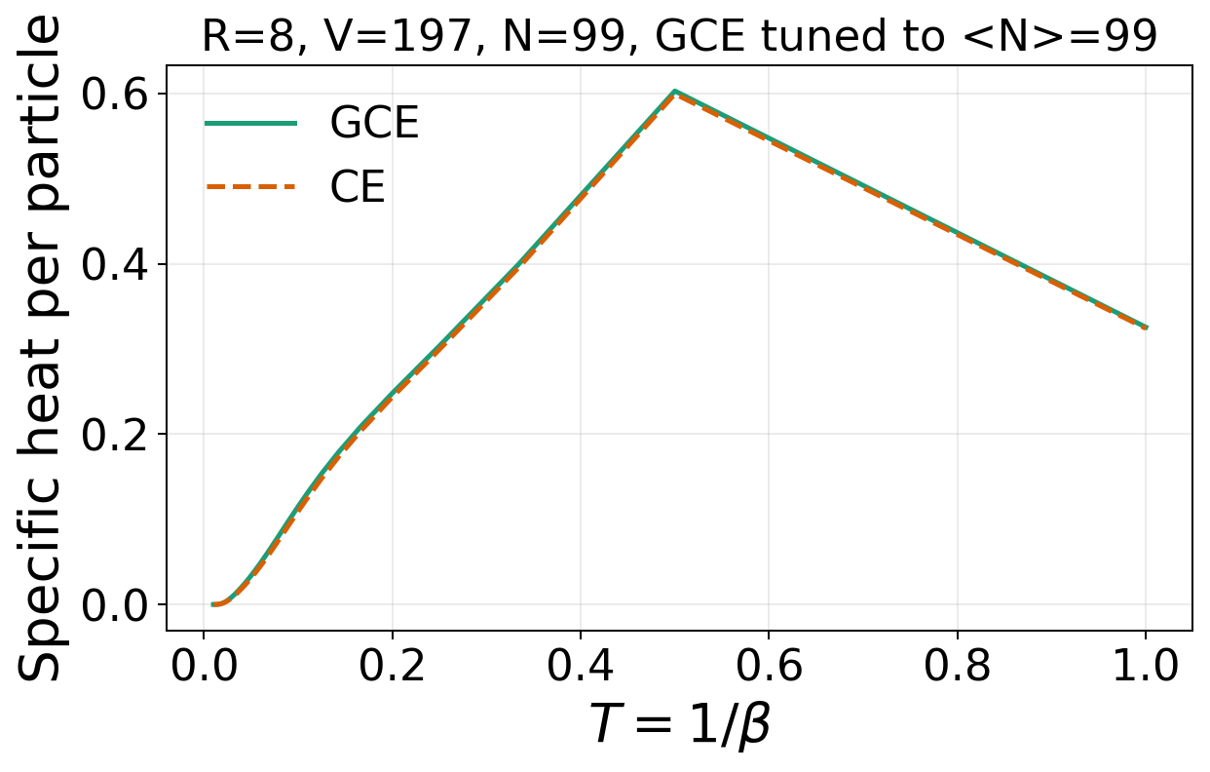
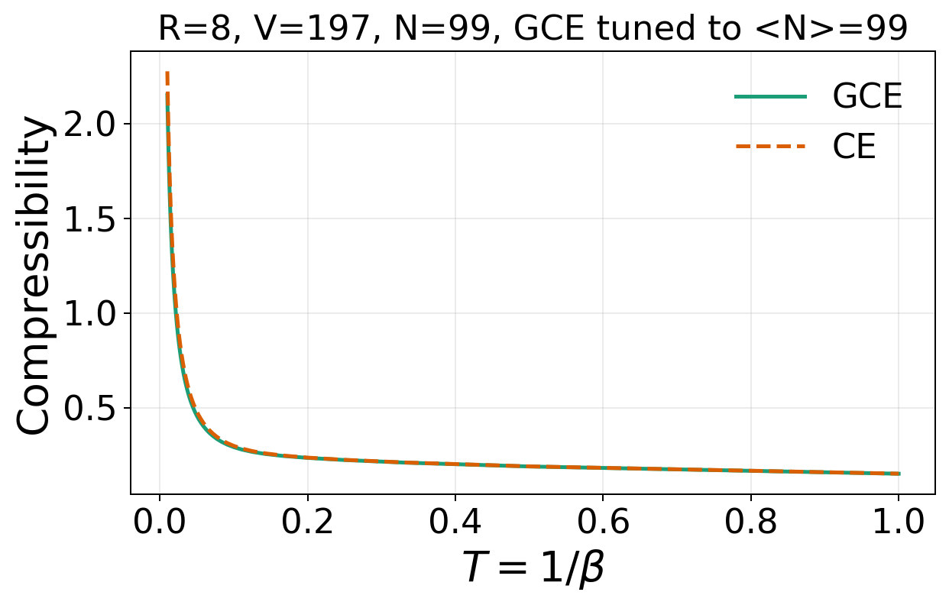
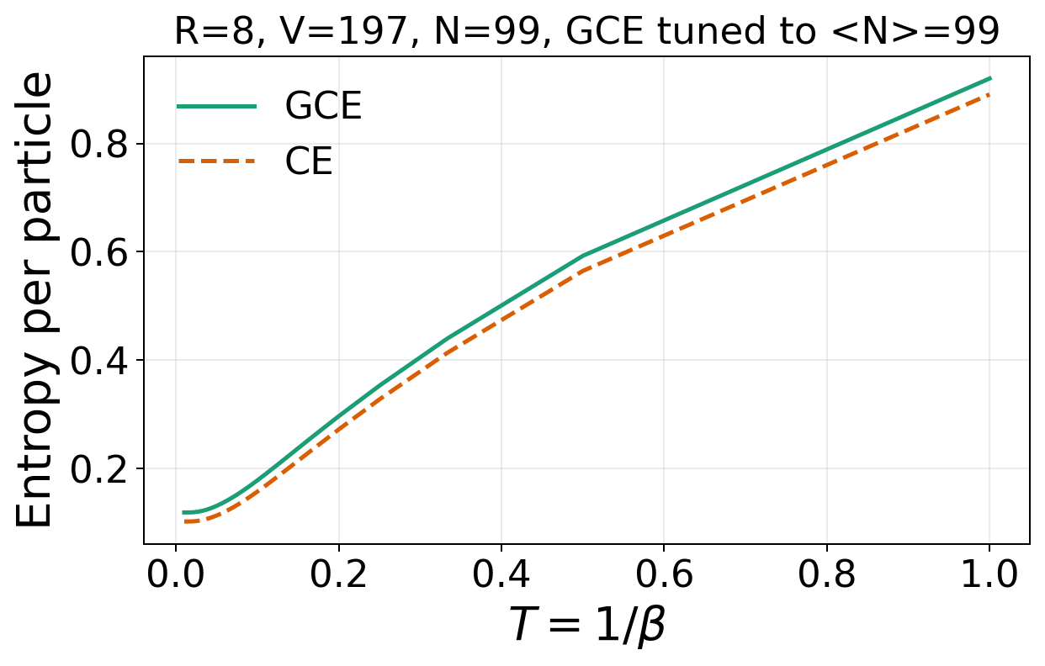
Disk, OBC, R=8, V=197, N=99, GCE tuned to <N>=99
Energy: E/N
Specific heat: C/N = -beta^2 d(E/N)/d beta
Compressibility: kappa_CE=[V(F(N+1)-2F(N)+F(N-1))]^-1 ; kappa_GCE=beta Var(N)/V
Entropy: S/N ; CE=(E-F)/(TN), GCE=(E-Omega-mu N)/(TN)

Slide 3
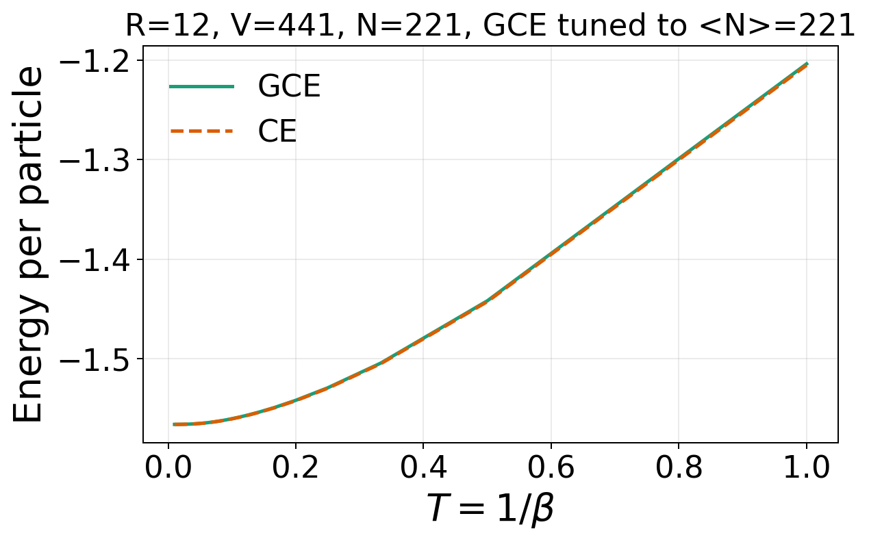
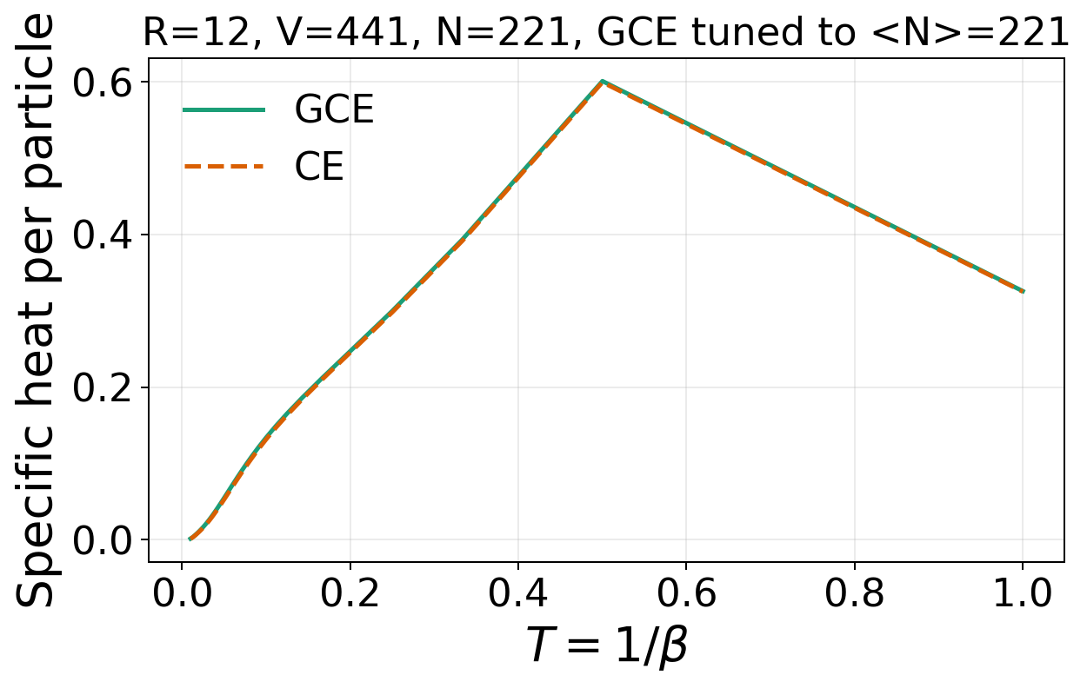
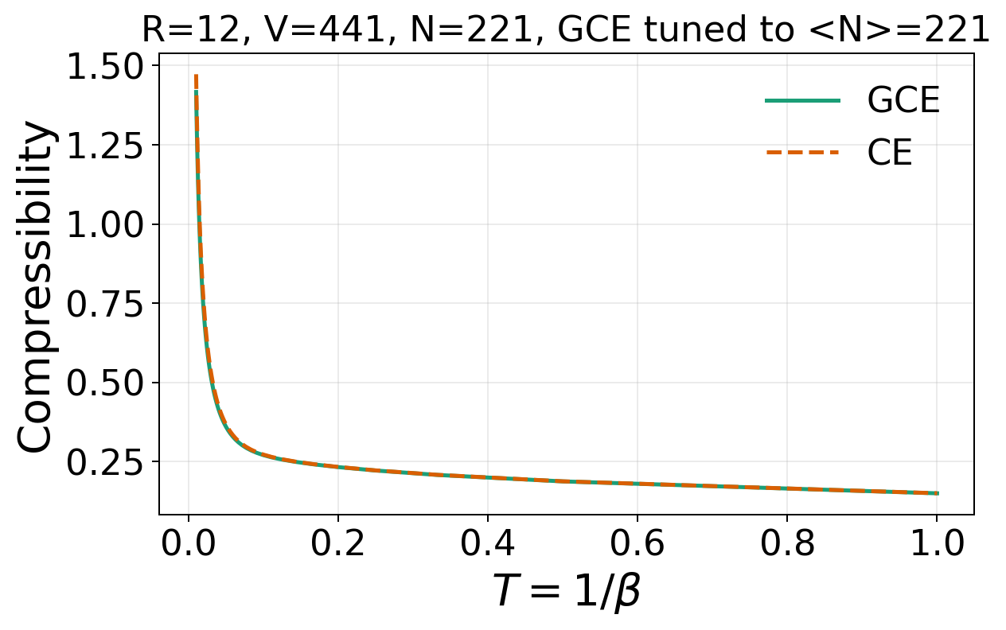
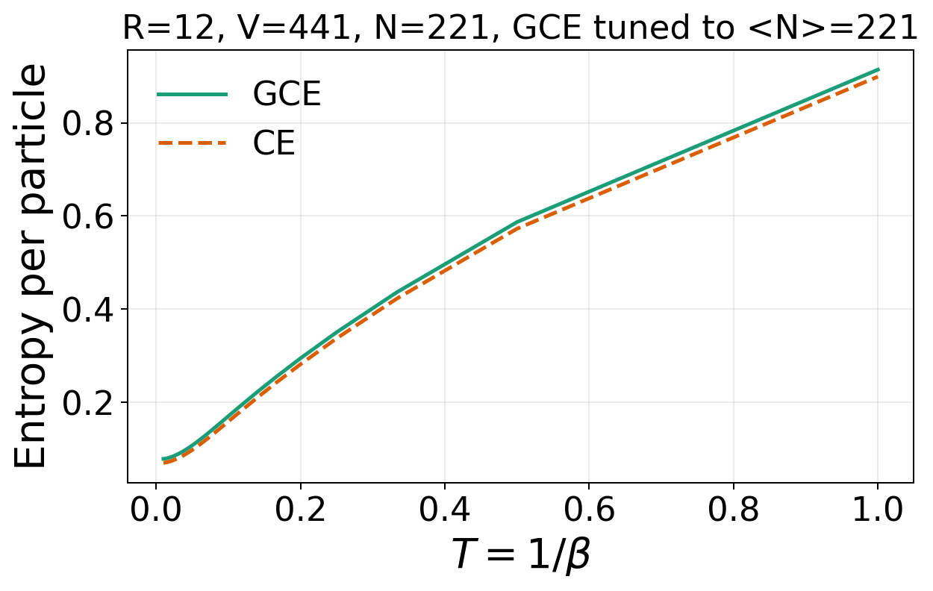
Disk, OBC, R=12, V=441, N=221, GCE tuned to <N>=221
Energy: E/N
Specific heat: C/N = -beta^2 d(E/N)/d beta
Compressibility: kappa_CE=[V(F(N+1)-2F(N)+F(N-1))]^-1 ; kappa_GCE=beta Var(N)/V
Entropy: S/N ; CE=(E-F)/(TN), GCE=(E-Omega-mu N)/(TN)

Slide 4
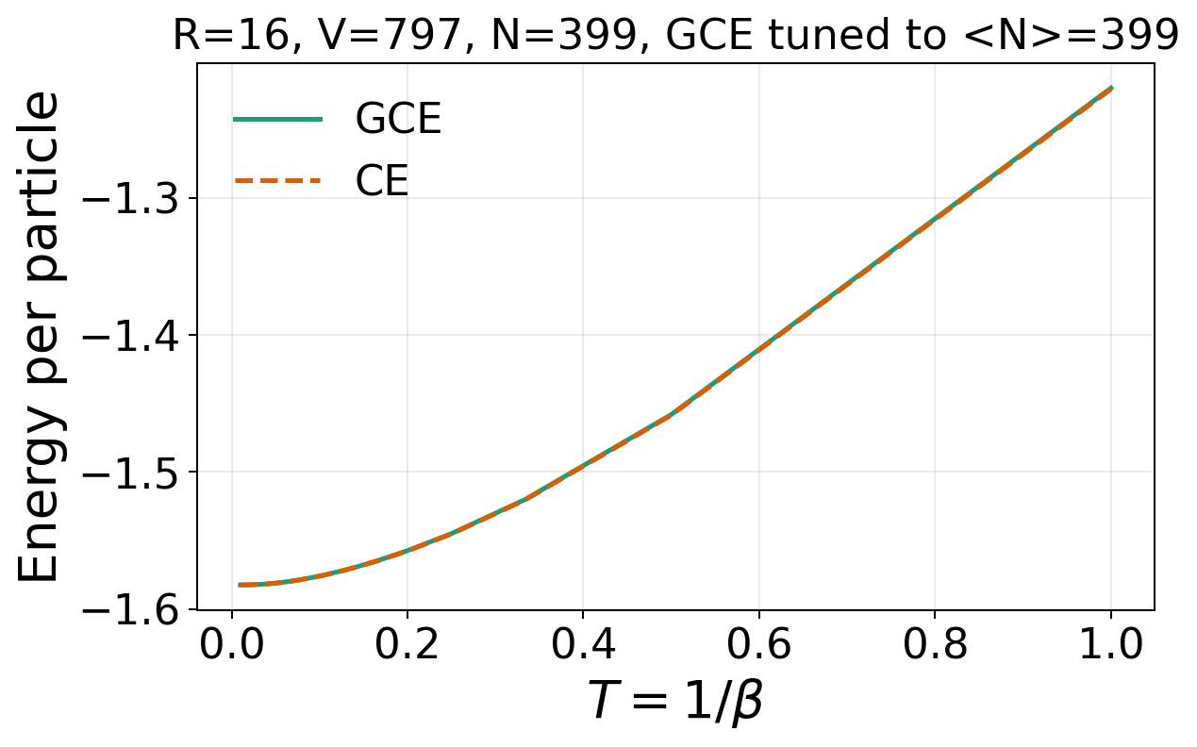
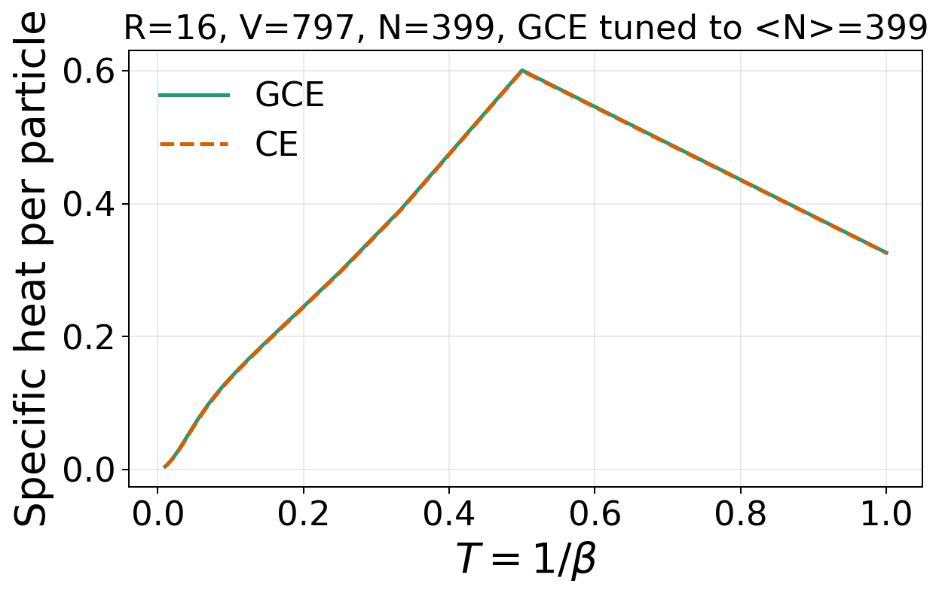
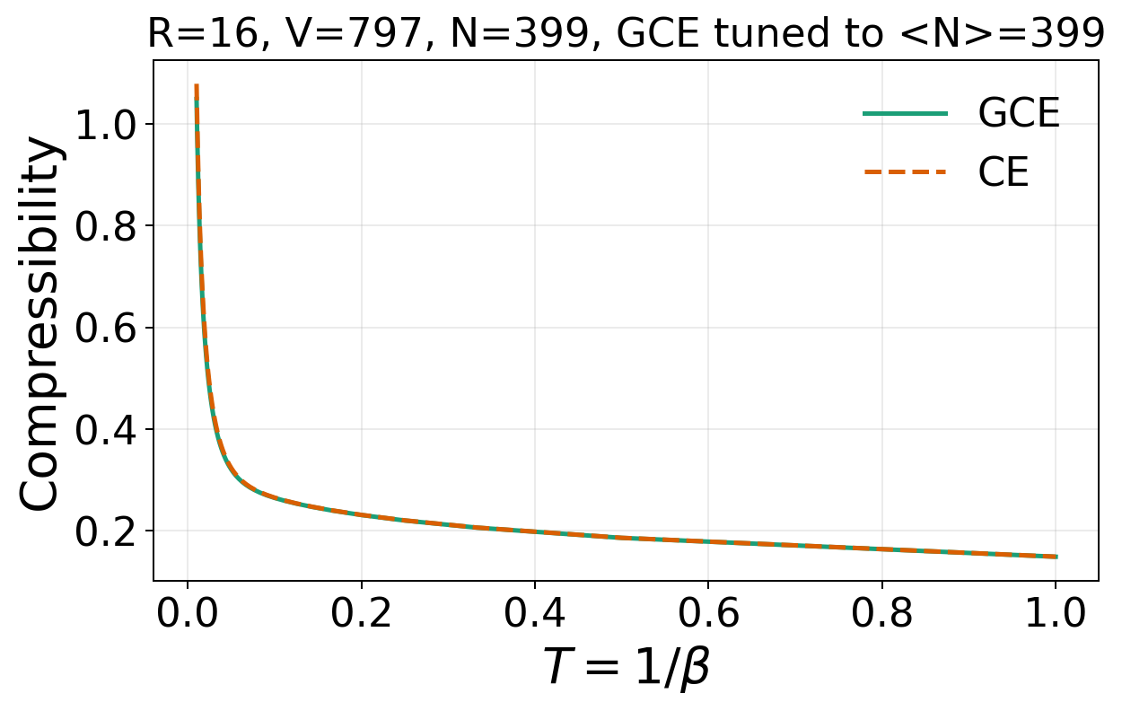
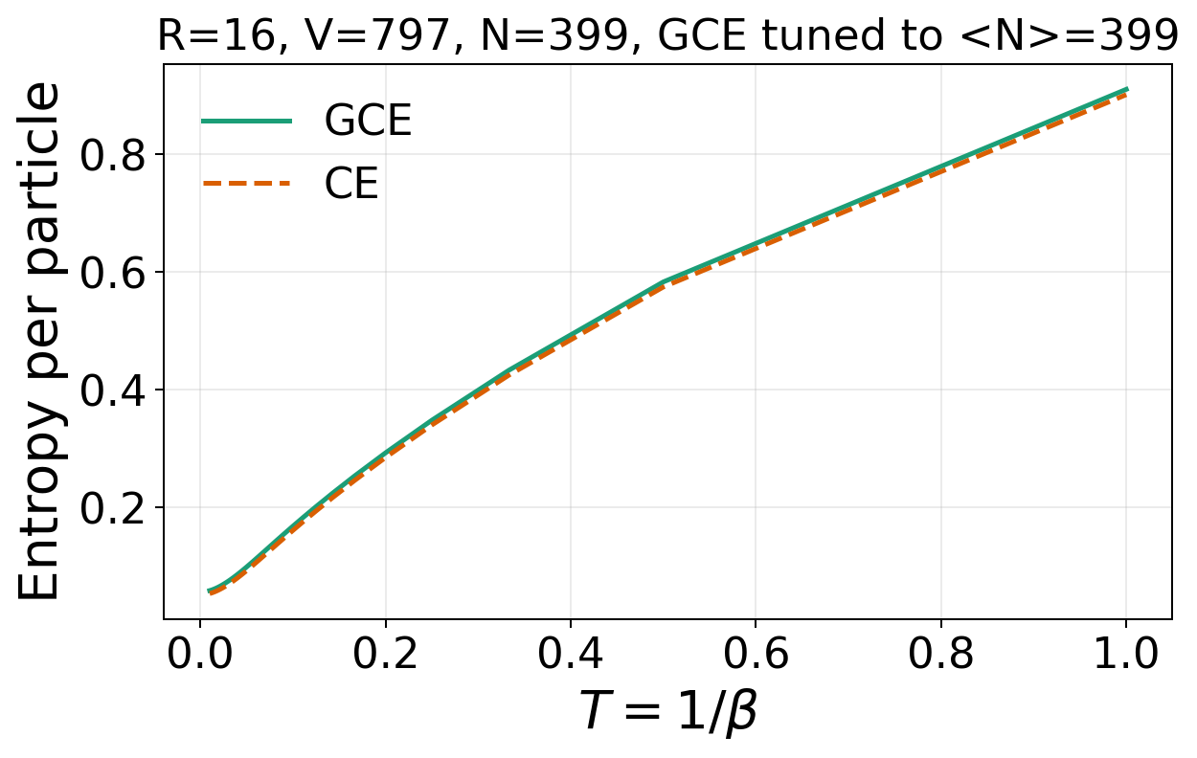
Disk, OBC, R=16, V=797, N=399, GCE tuned to <N>=399
Energy: E/N
Specific heat: C/N = -beta^2 d(E/N)/d beta
Compressibility: kappa_CE=[V(F(N+1)-2F(N)+F(N-1))]^-1 ; kappa_GCE=beta Var(N)/V
Entropy: S/N ; CE=(E-F)/(TN), GCE=(E-Omega-mu N)/(TN)

Slide 5

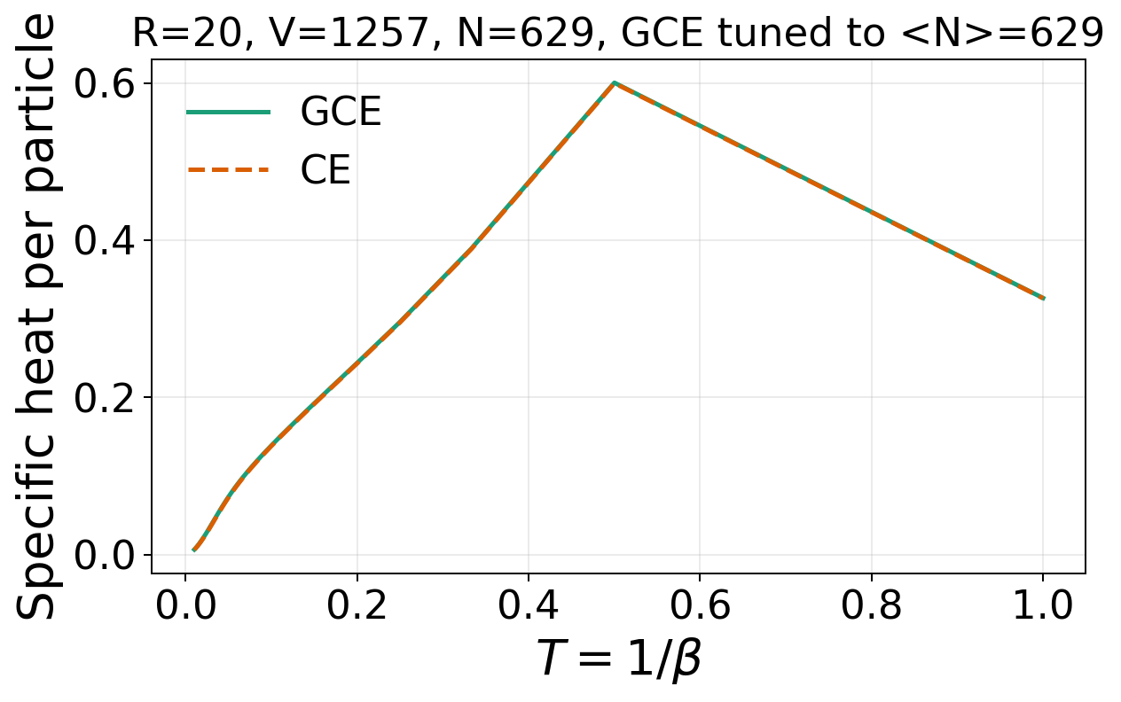
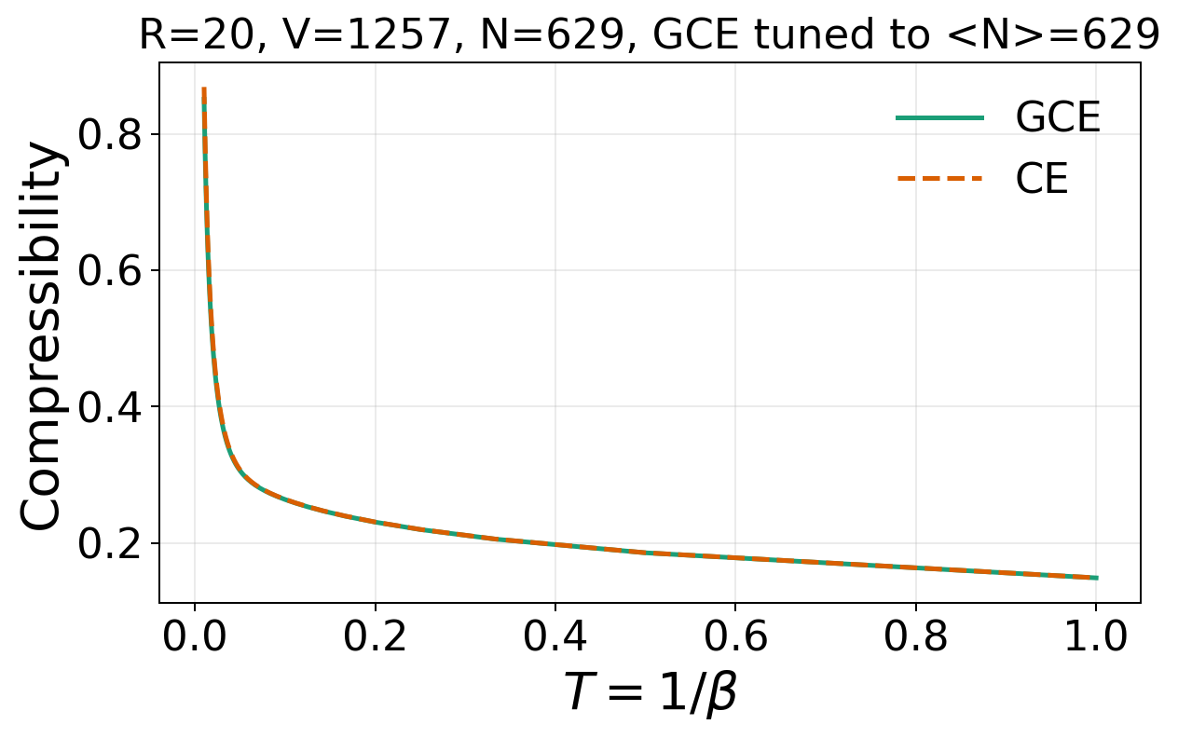
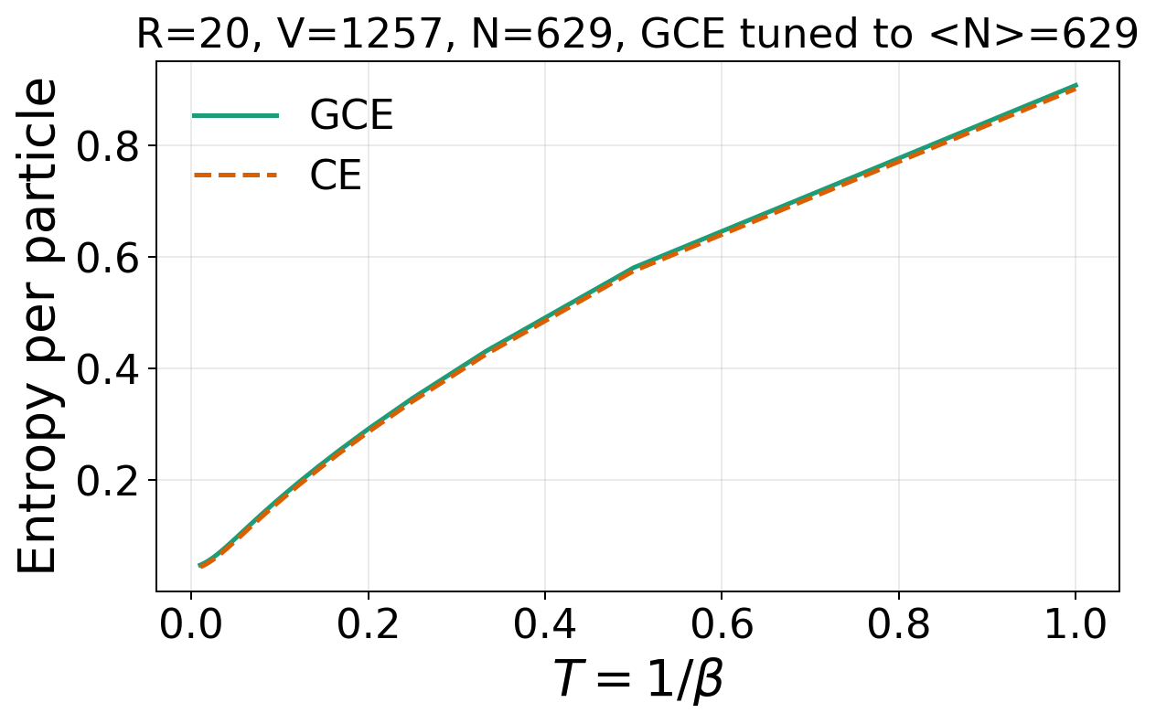
Disk, OBC, R=20, V=1257, N=629, GCE tuned to <N>=629
Energy: E/N
Specific heat: C/N = -beta^2 d(E/N)/d beta
Compressibility: kappa_CE=[V(F(N+1)-2F(N)+F(N-1))]^-1 ; kappa_GCE=beta Var(N)/V
Entropy: S/N ; CE=(E-F)/(TN), GCE=(E-Omega-mu N)/(TN)

Slide 6
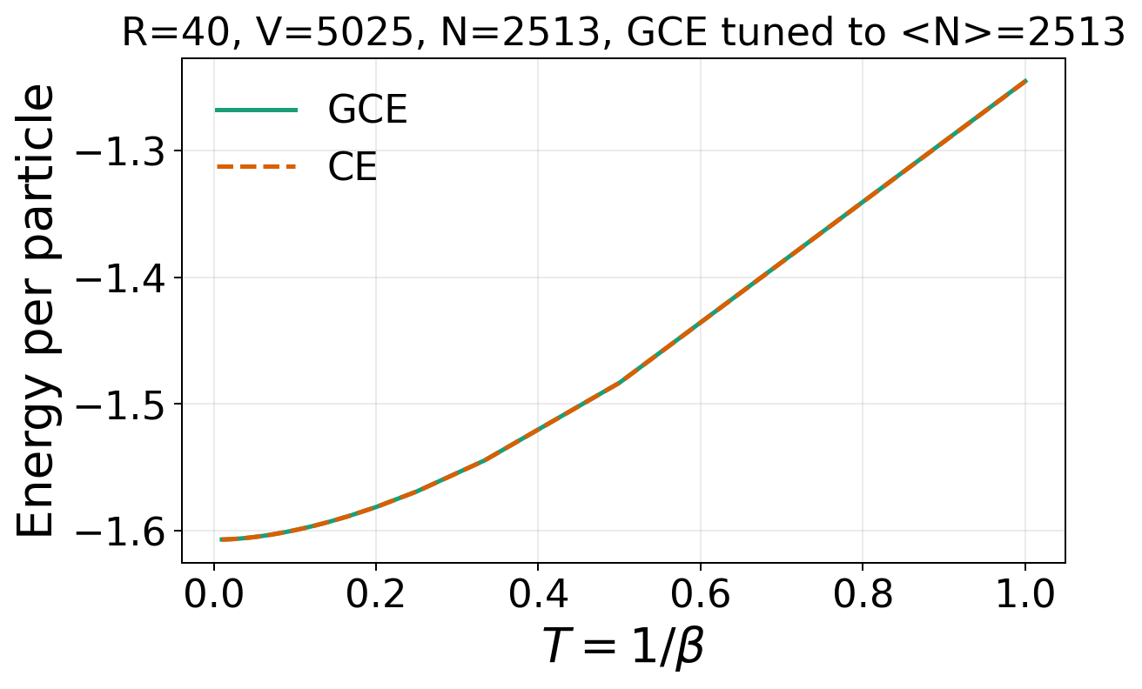
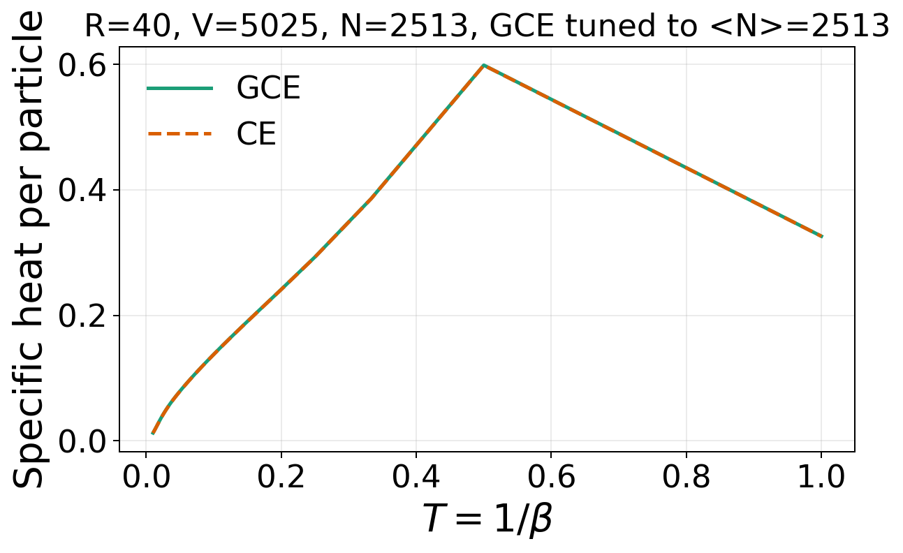
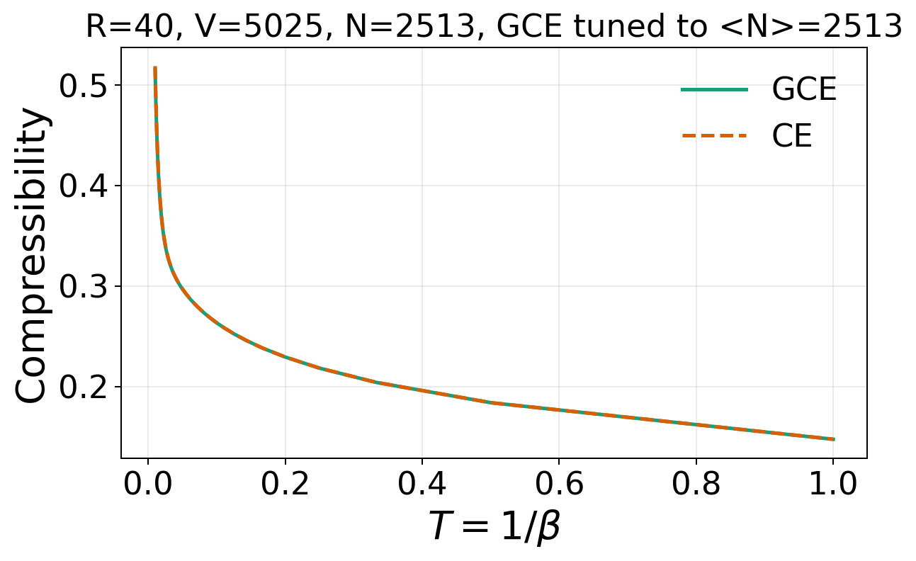
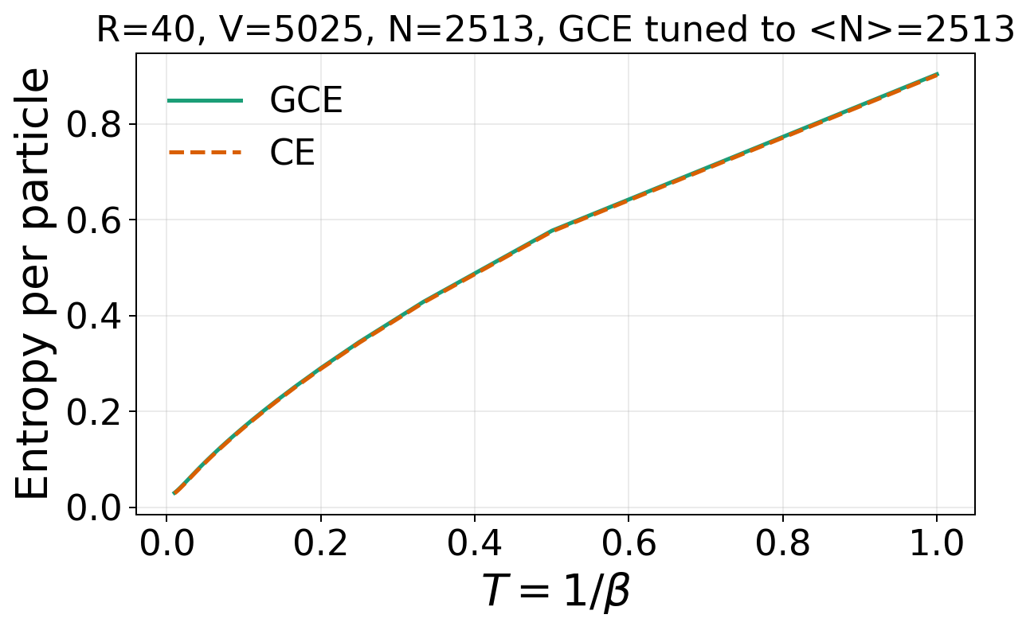
Disk, OBC, R=40, V=5025, N=2513, GCE tuned to <N>=2513
Energy: E/N
Specific heat: C/N = -beta^2 d(E/N)/d beta
Compressibility: kappa_CE=[V(F(N+1)-2F(N)+F(N-1))]^-1 ; kappa_GCE=beta Var(N)/V
Entropy: S/N ; CE=(E-F)/(TN), GCE=(E-Omega-mu N)/(TN)

