Slide 1
Disk lattice

Slide 2
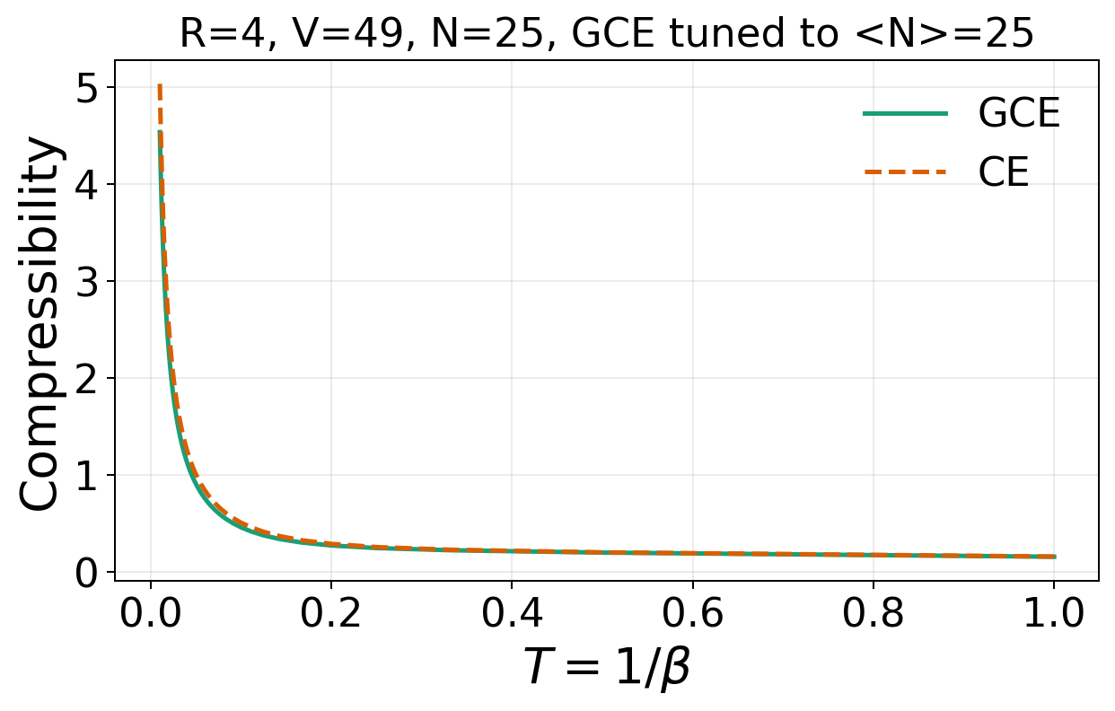
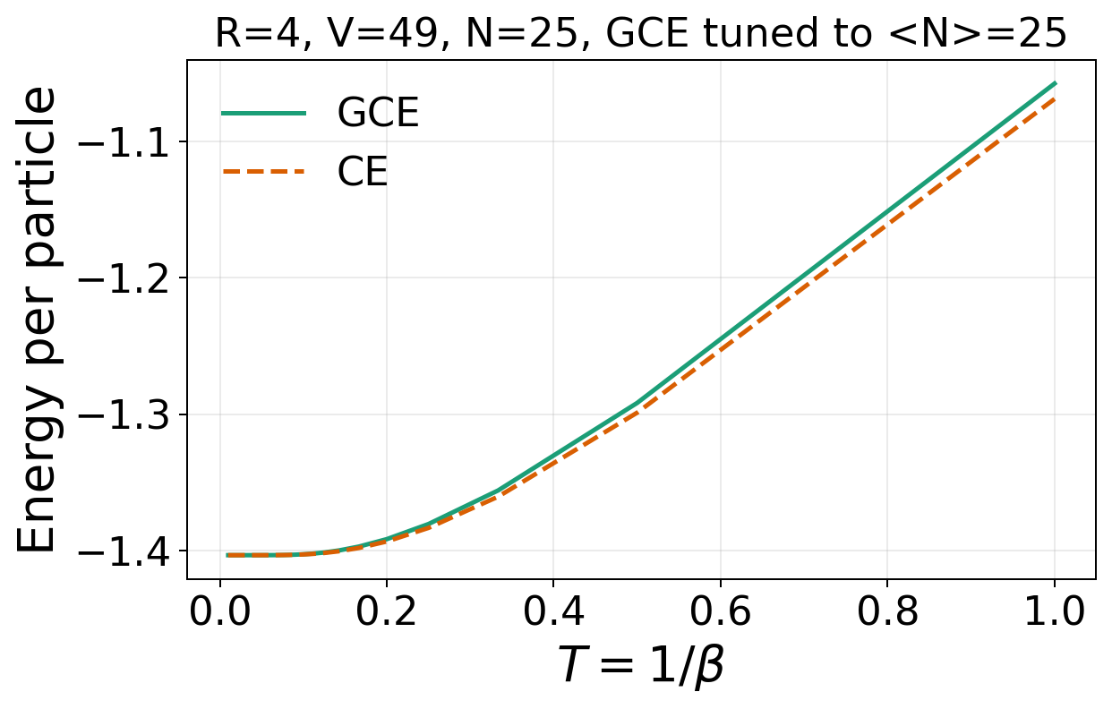
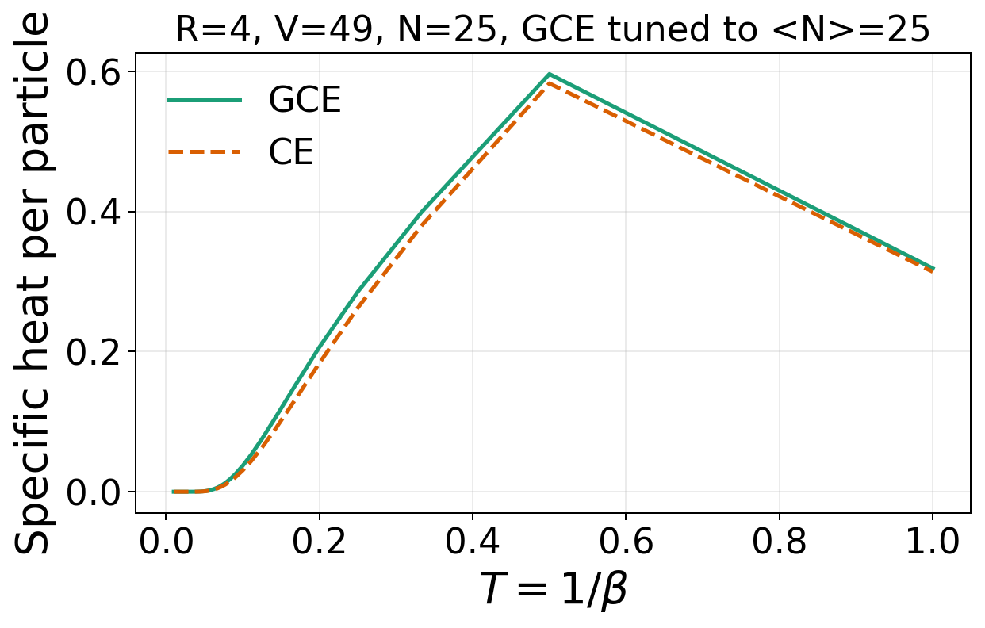
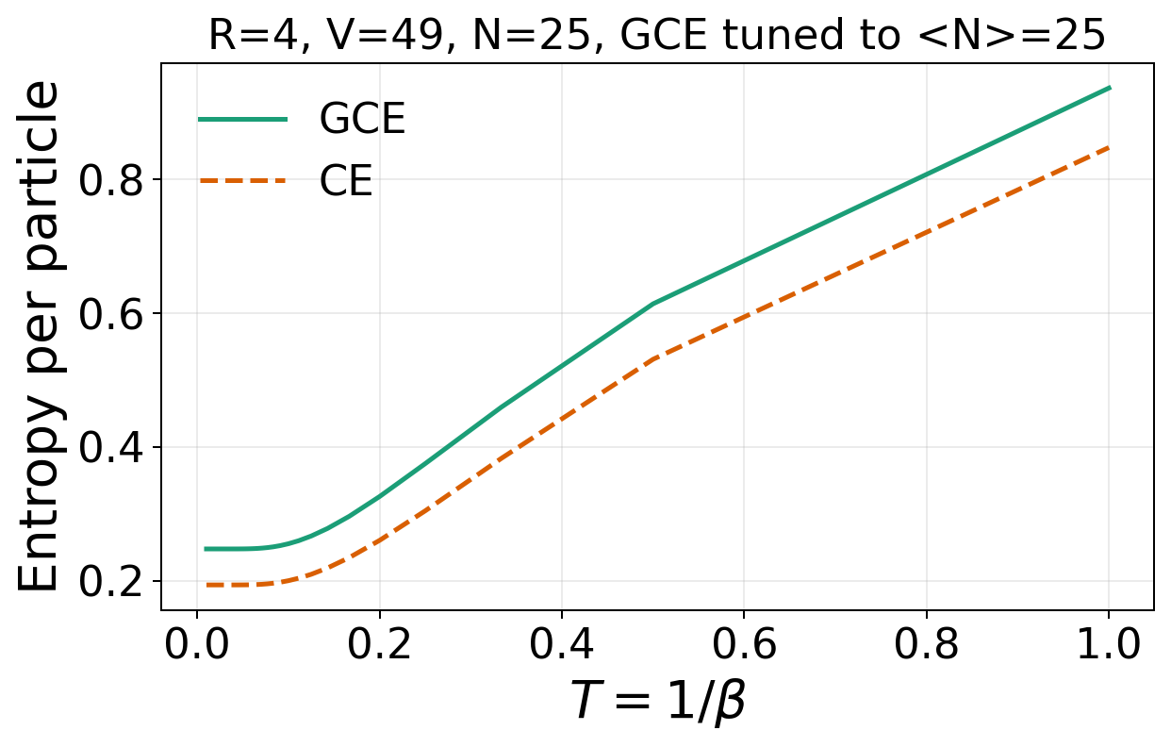
Disk R=4, V=49, N=25, GCE tuned to <N>=25
Energy per particle: E/N
Compressibility
CE [V(F(N+1)-2F(N)+F(N-1))]^-1 ; GCE beta Var(N)/V
Entropy per particle:
CE (E-F)/(T N) ;
GCE (E-Omega-mu N)/(T N)
C/N = -beta^2 d(E/N)/d beta

Slide 3
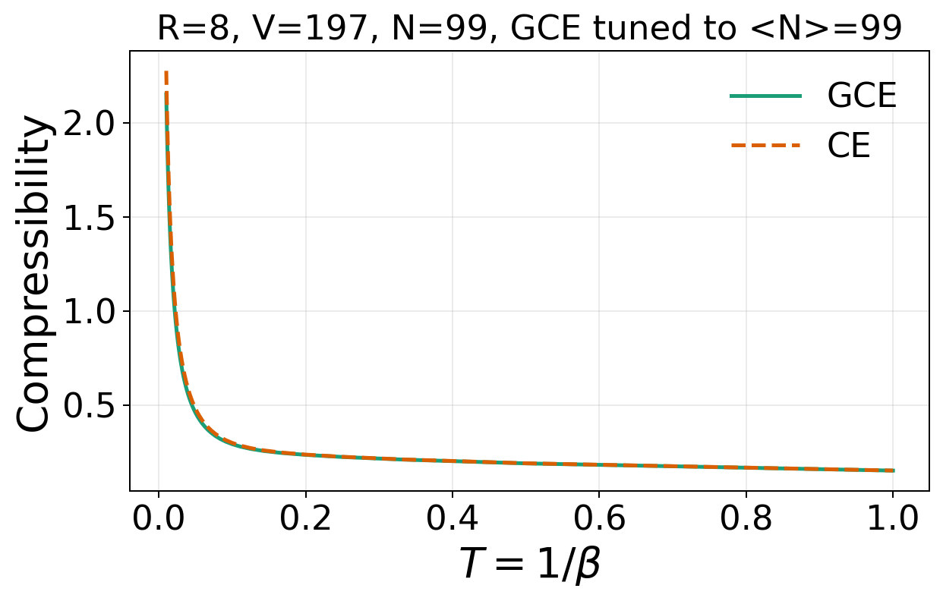
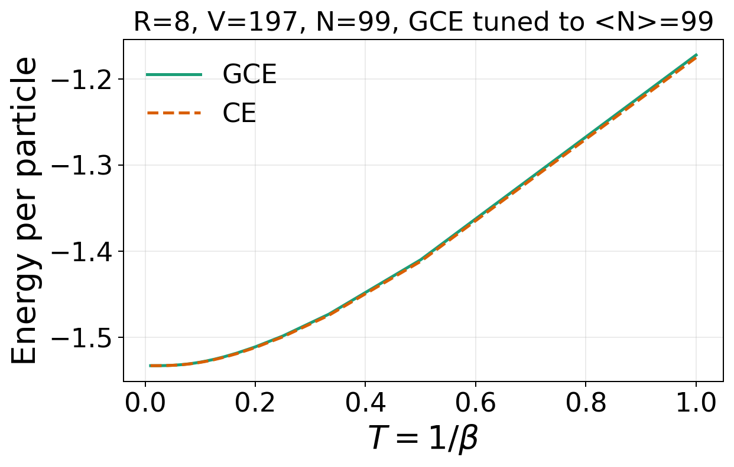
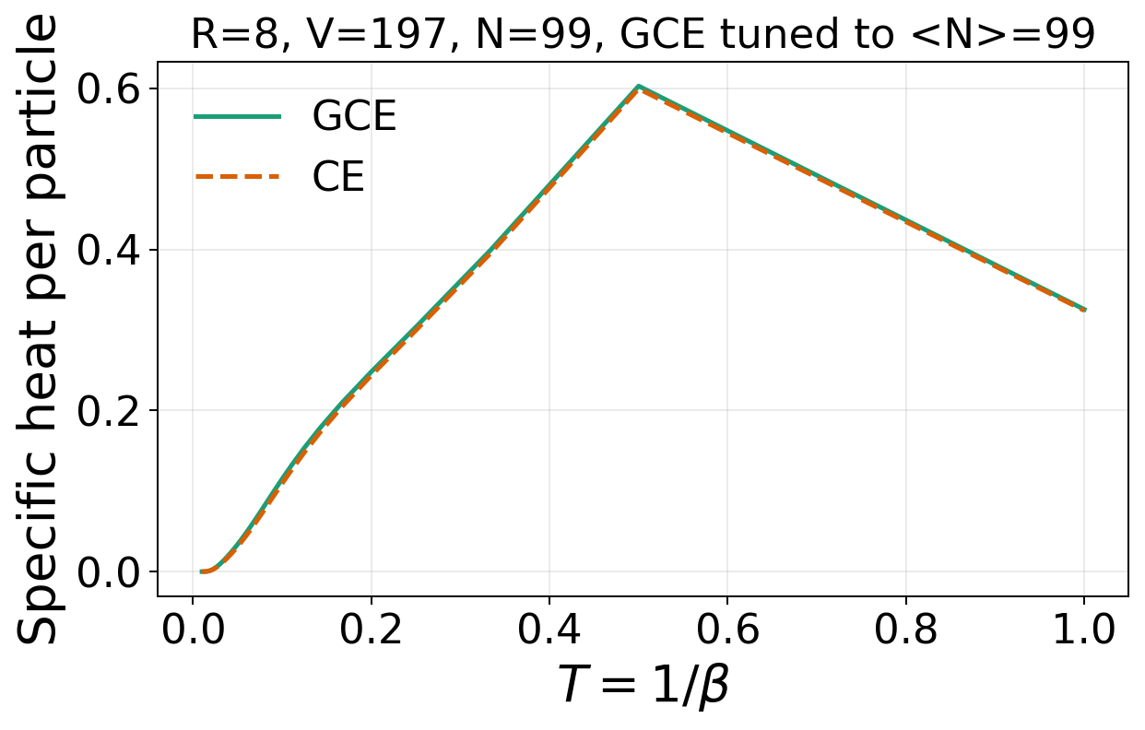
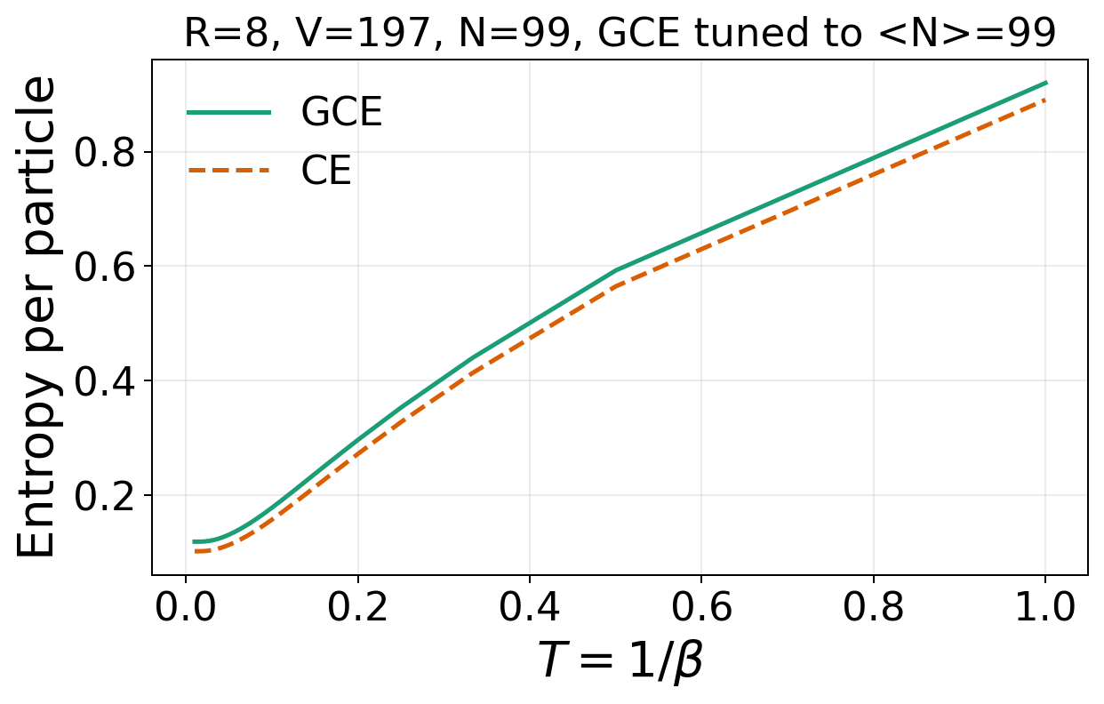
Disk R=8, V=197, N=99, GCE tuned to <N> =99

Slide 4
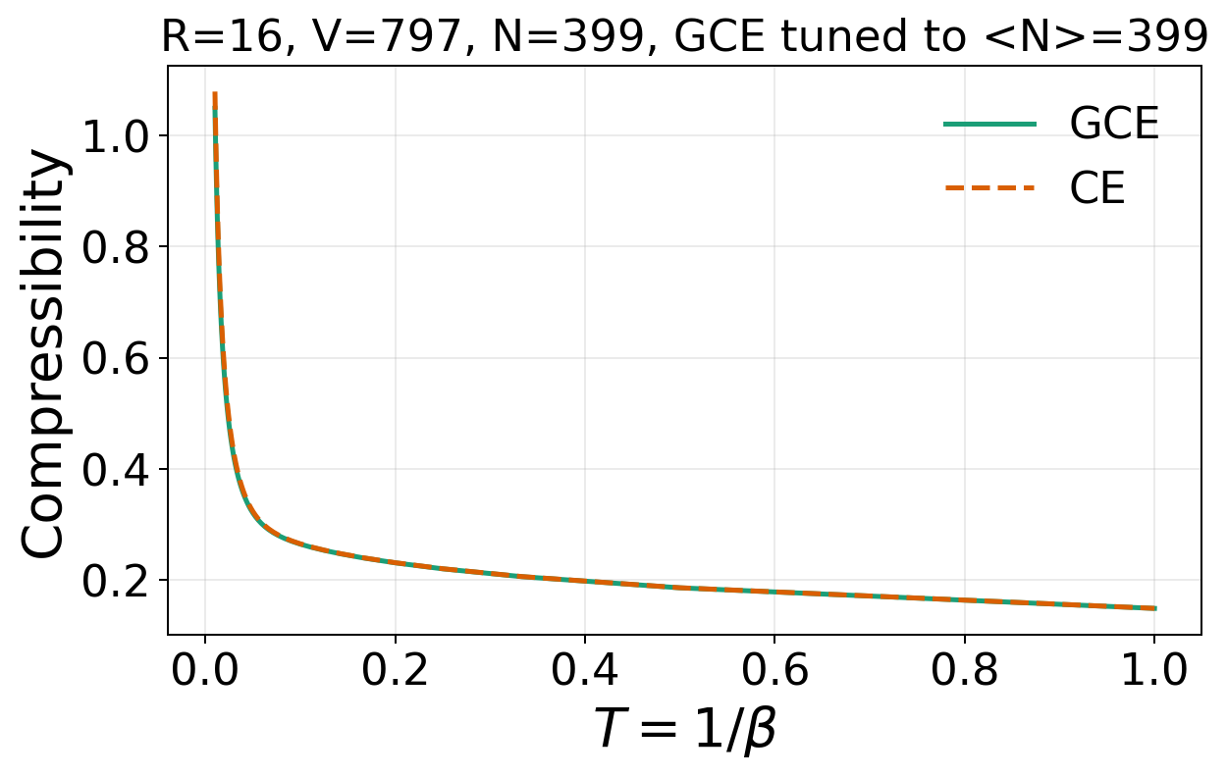
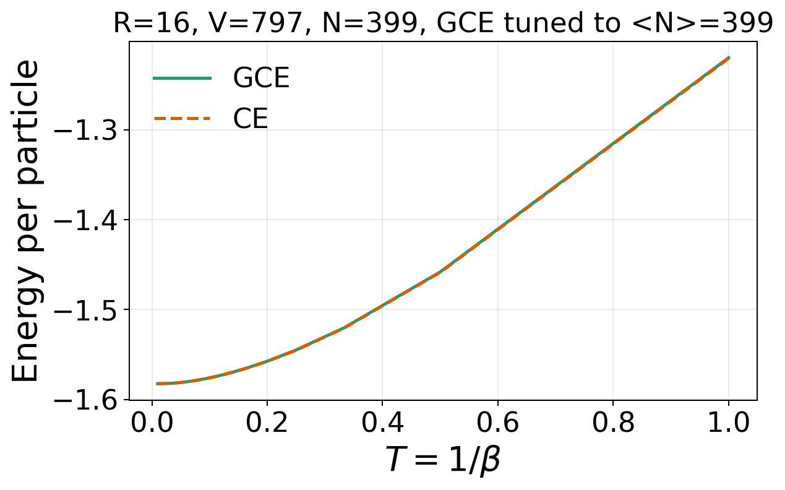
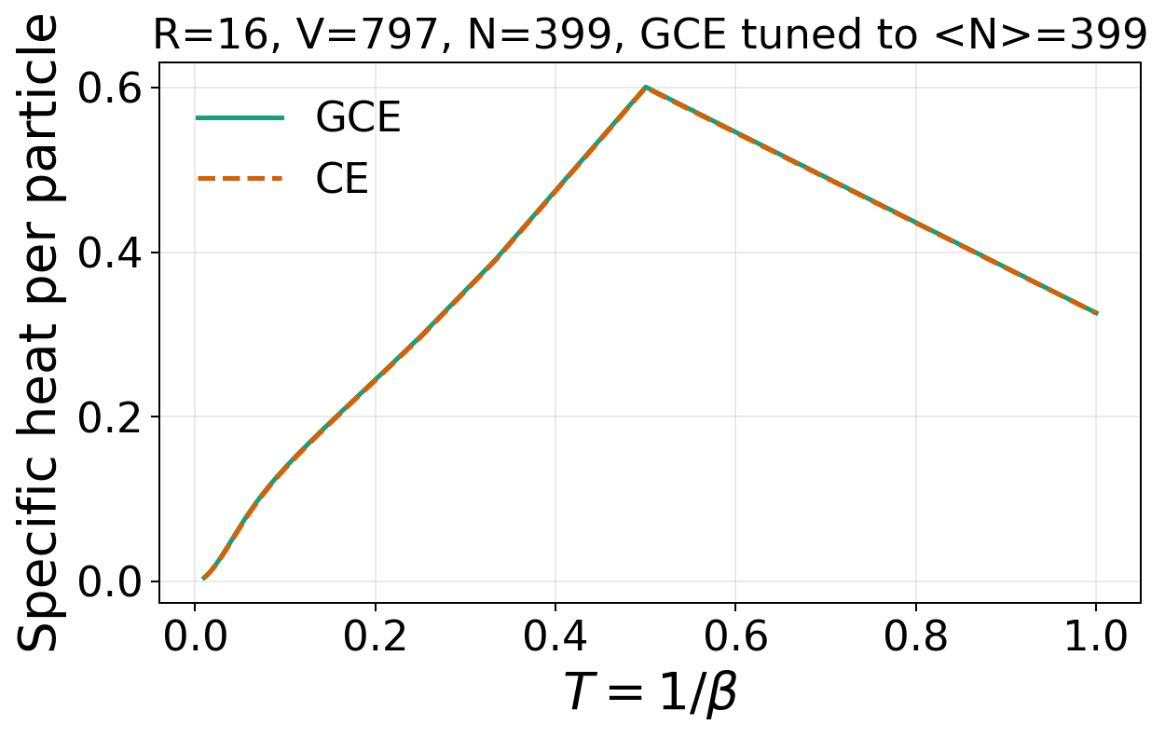
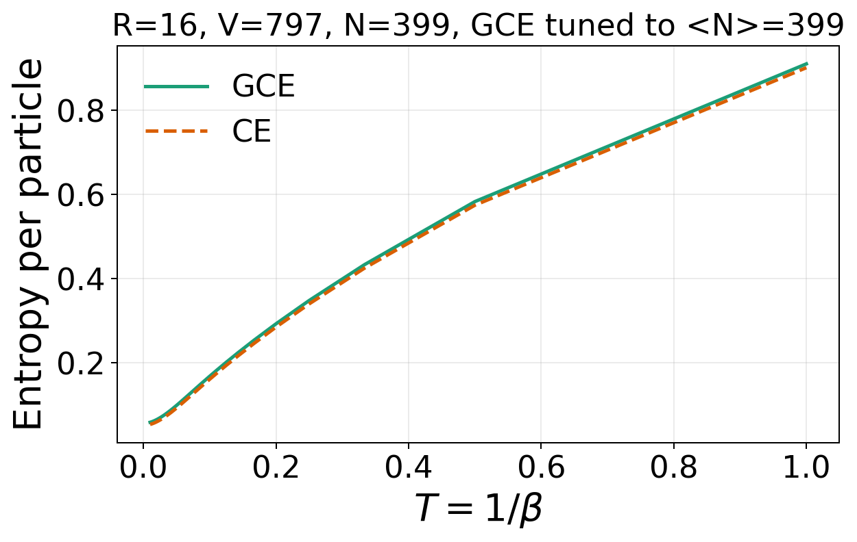
Disk R=16, V=797, N=399, GCE tuned to <N> =399

Slide 5
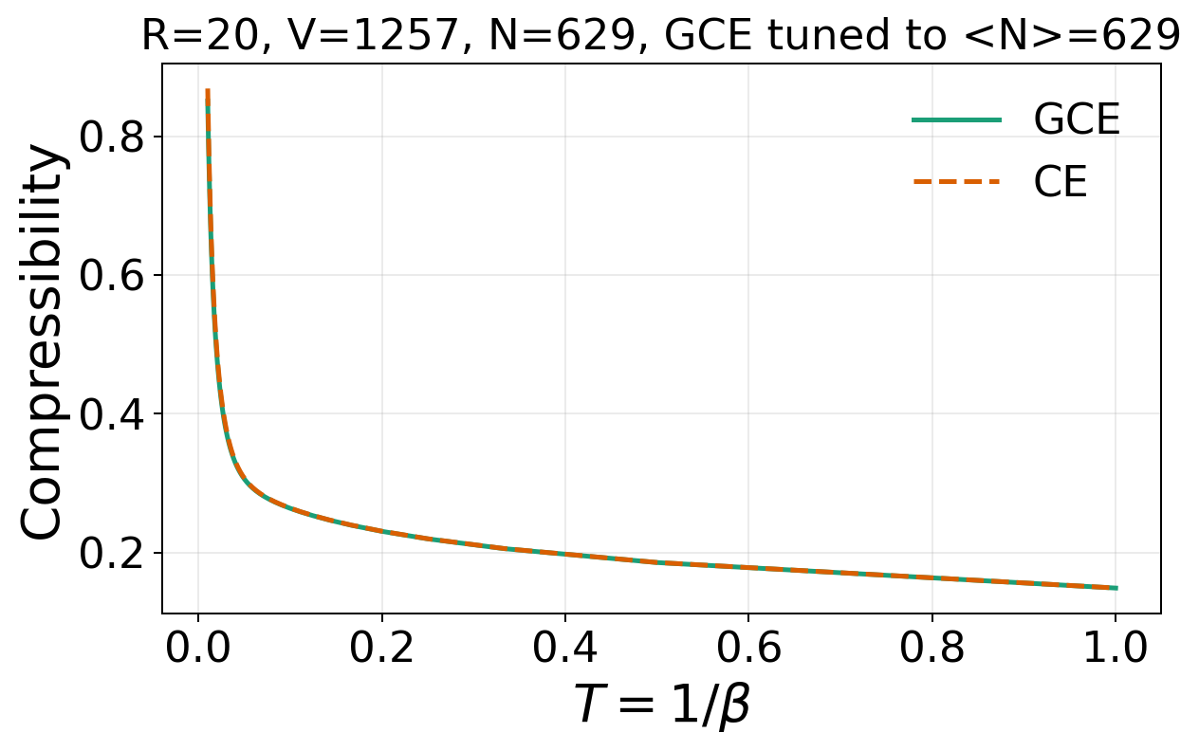

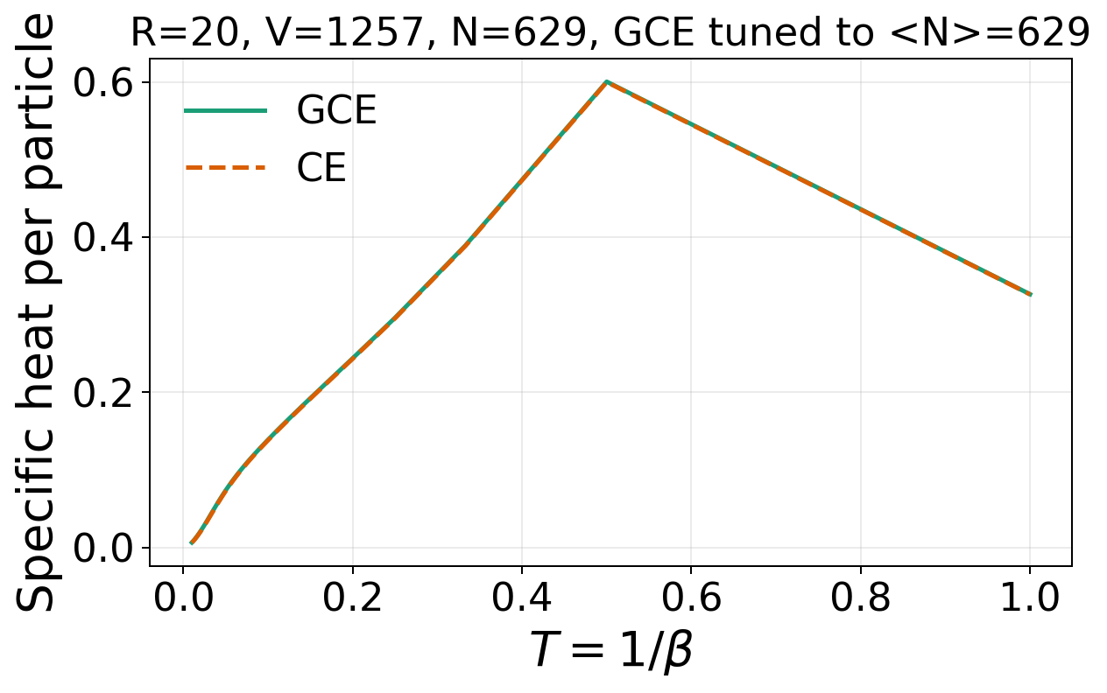
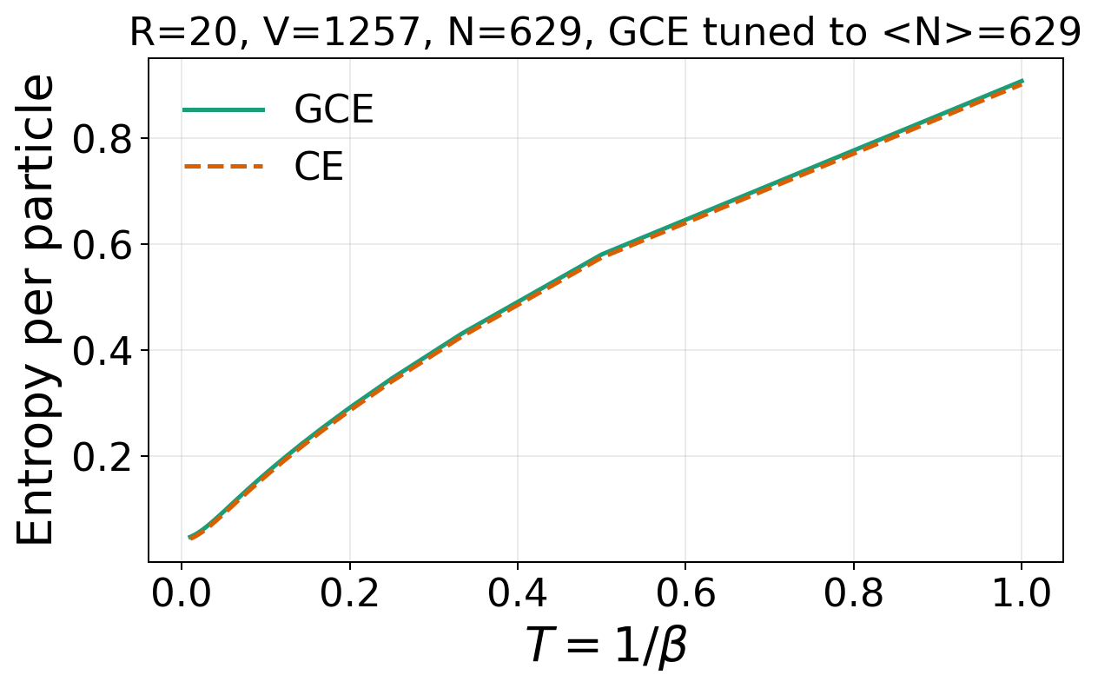
Disk R=20, V=1257, N=629, GCE tuned to <N>=629

Slide 6
Square lattice PBC

Slide 7
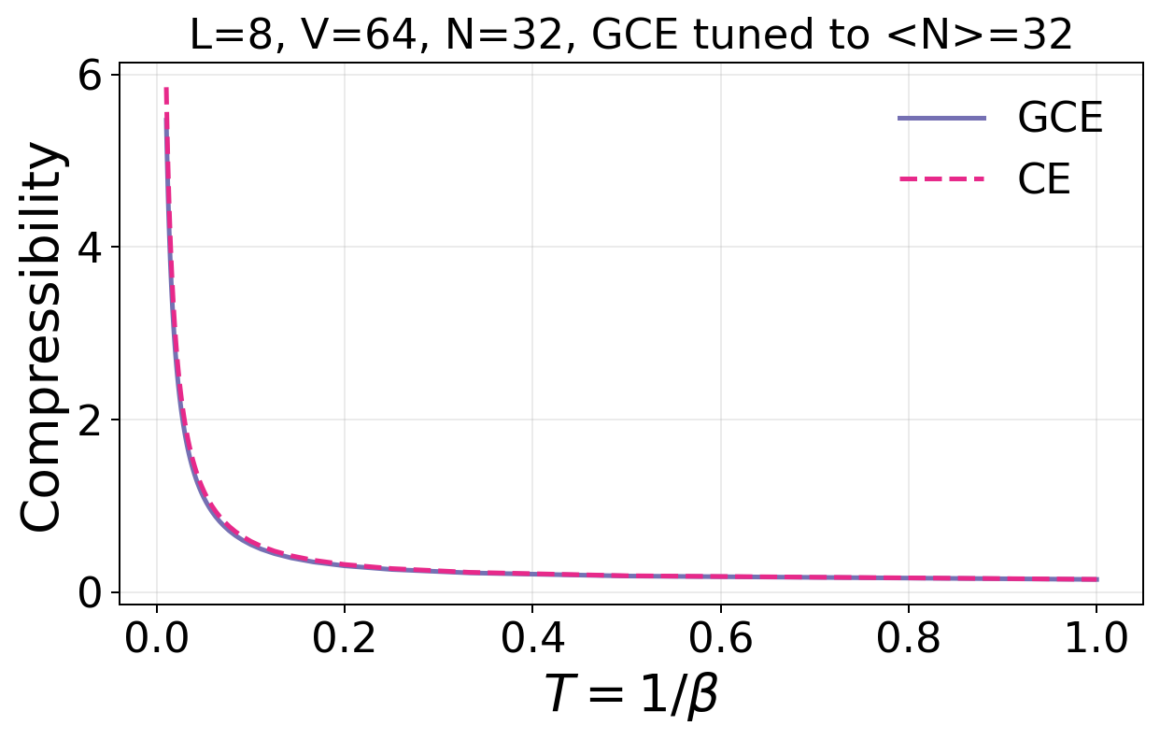
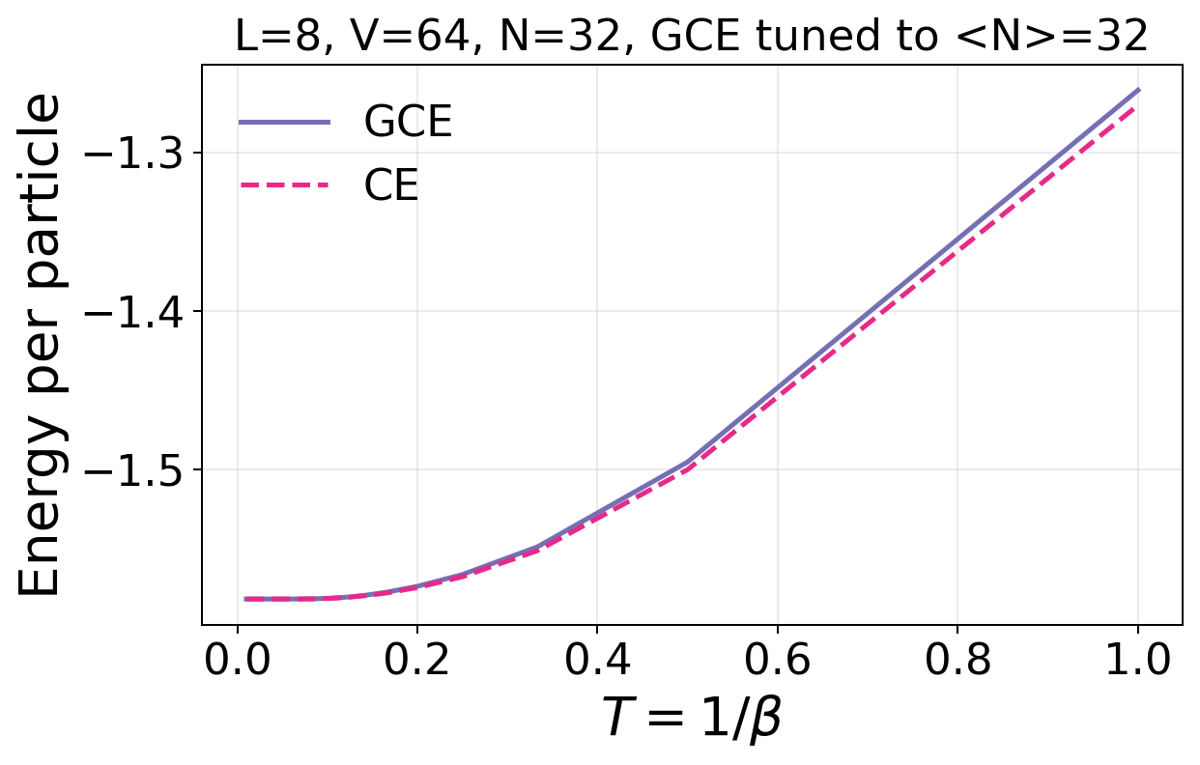
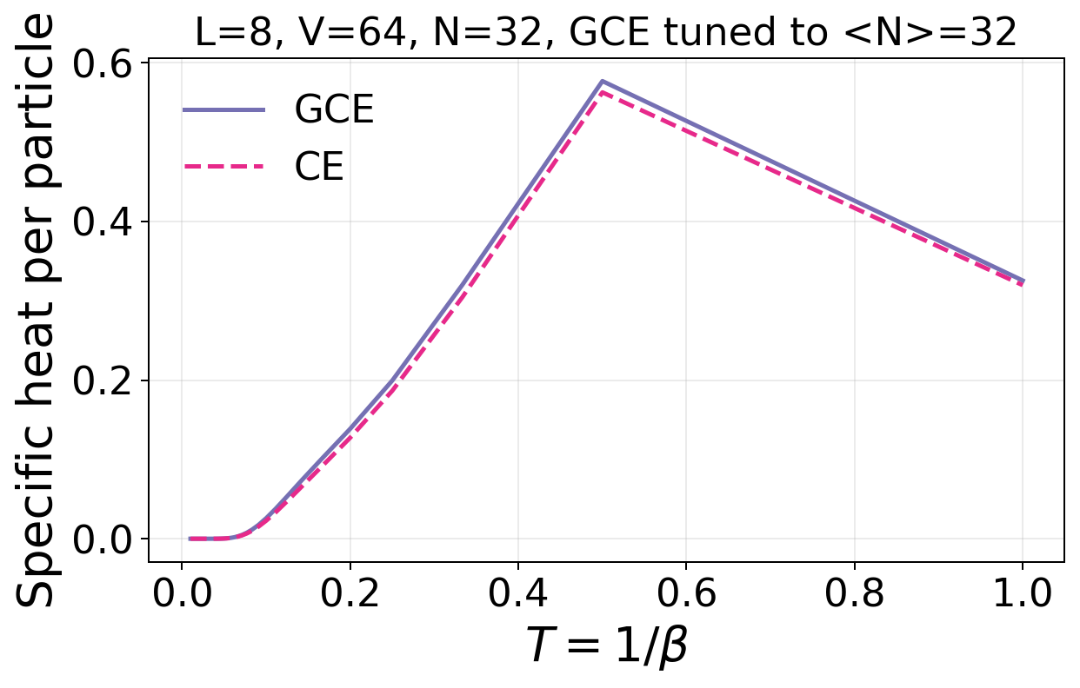
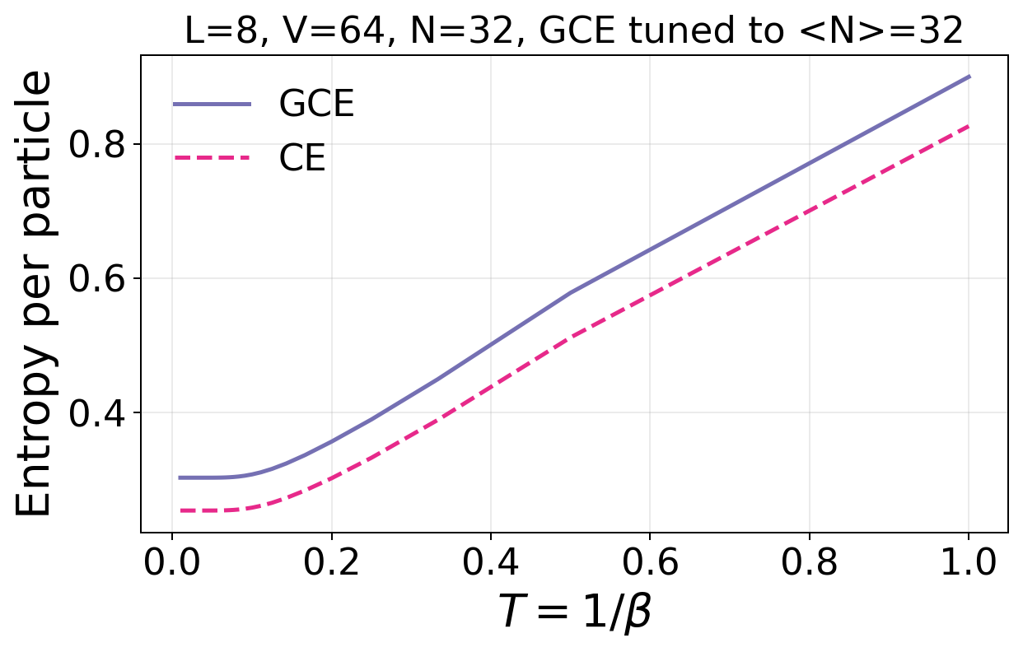
Square PBC L=8, V=64, N=32, GCE tuned to <N>=32

Slide 8
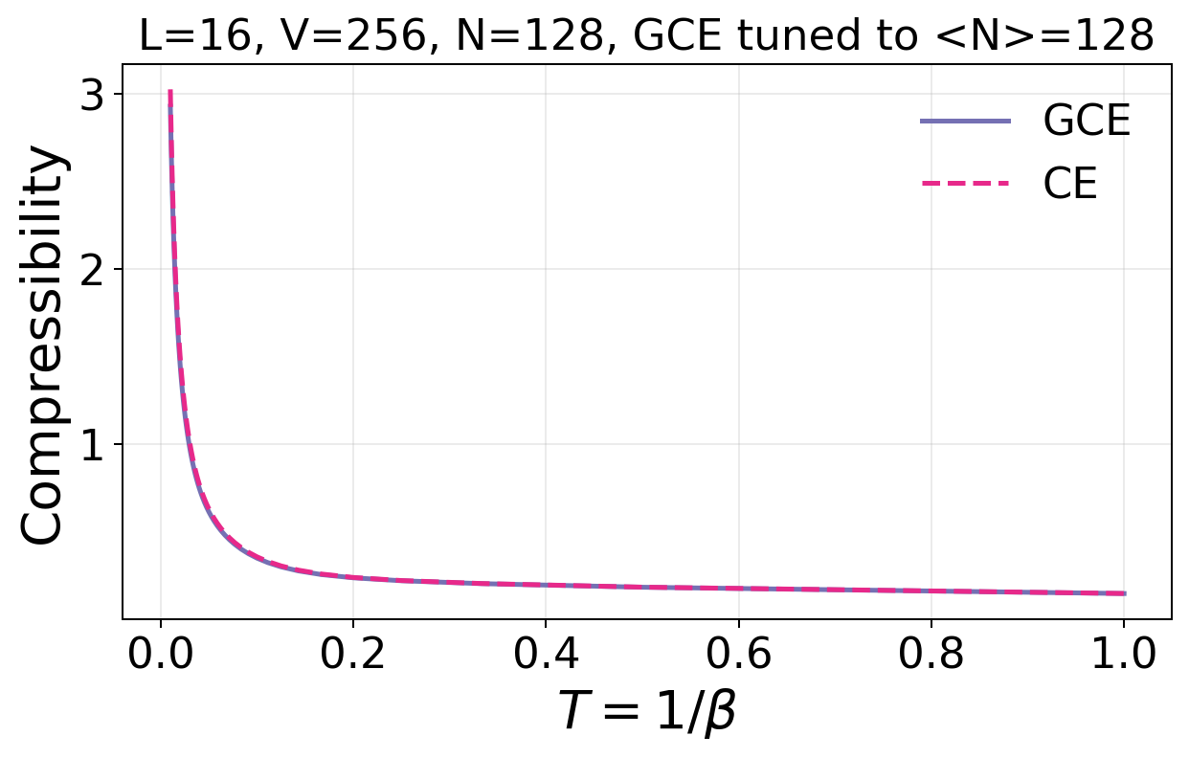
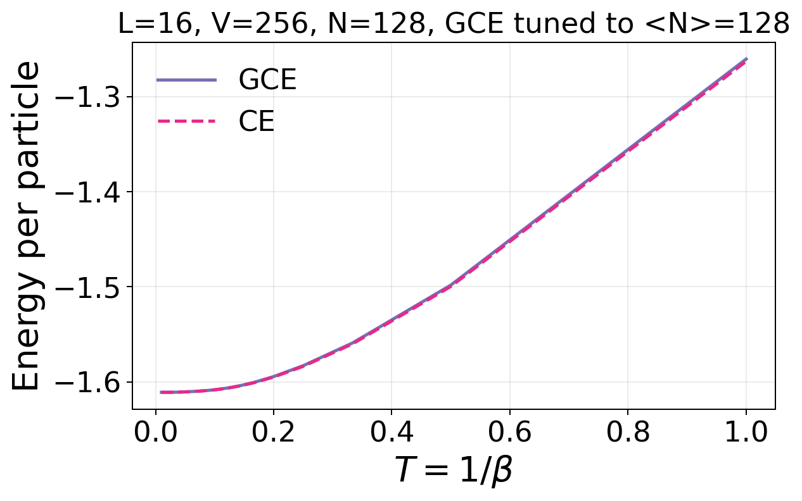
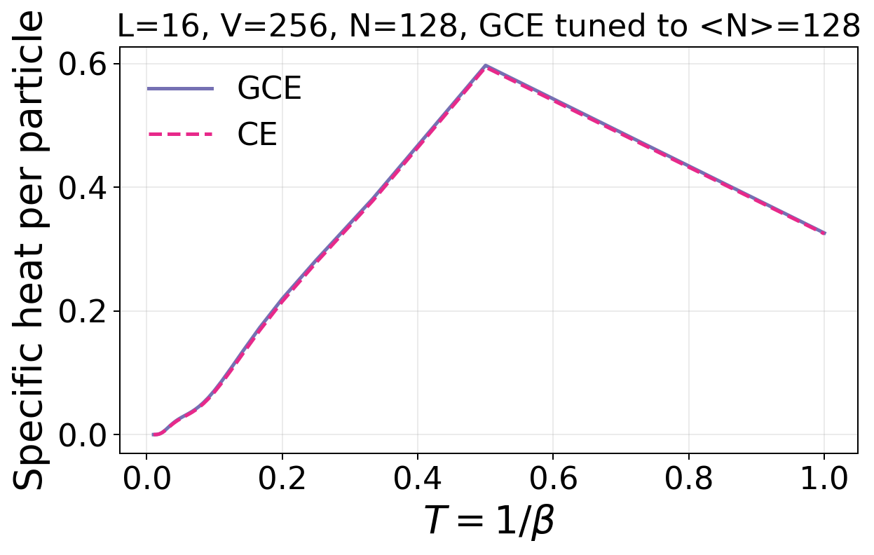
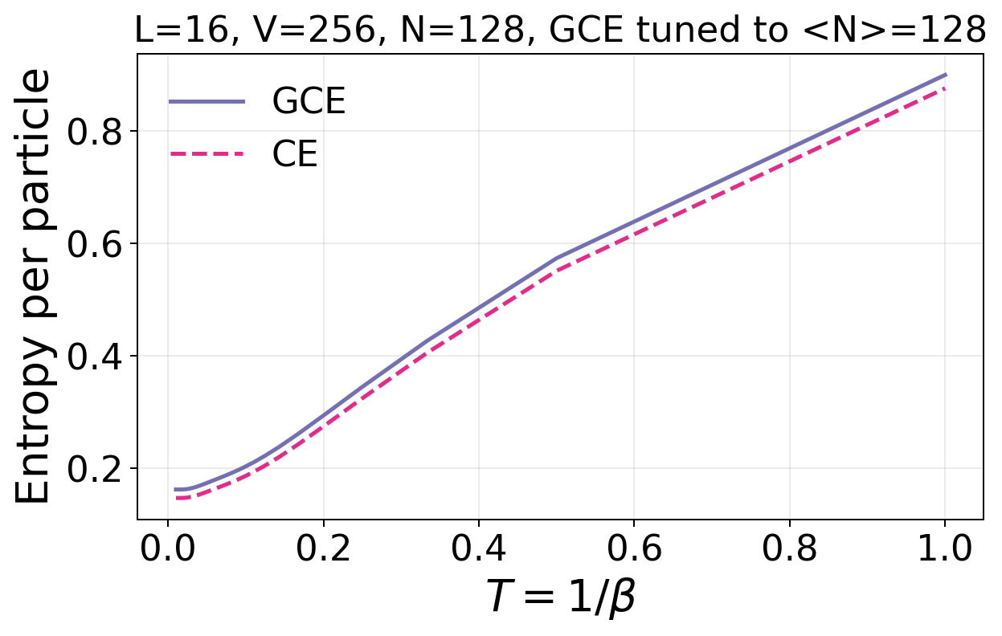
Square PBC L=16, V=256, N=128, GCE tuned to <N>=128

Slide 9
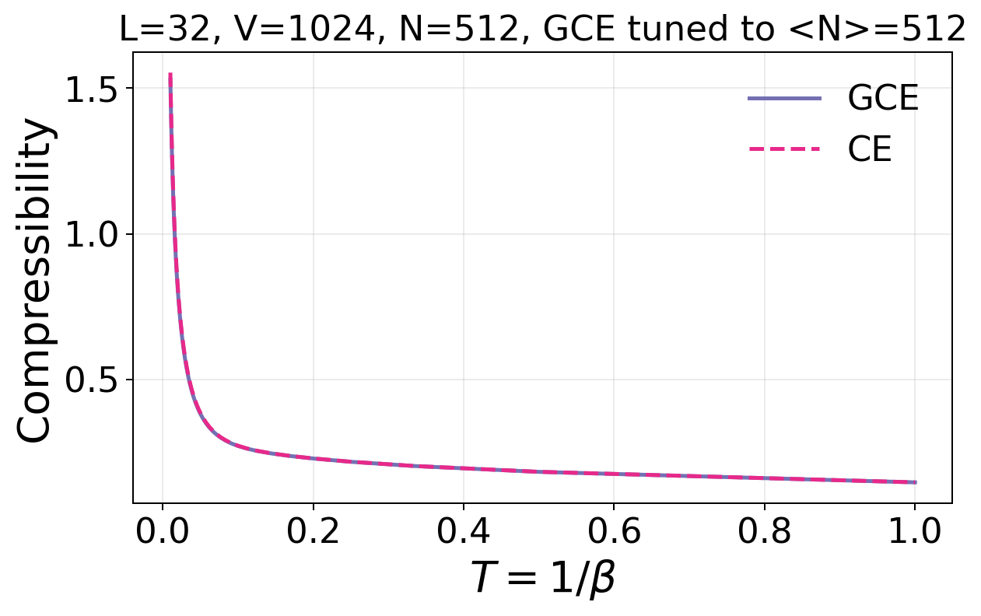
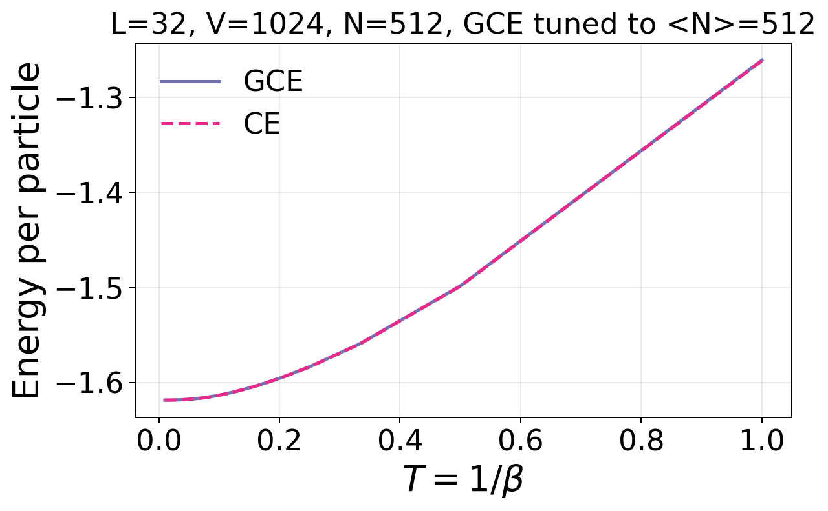
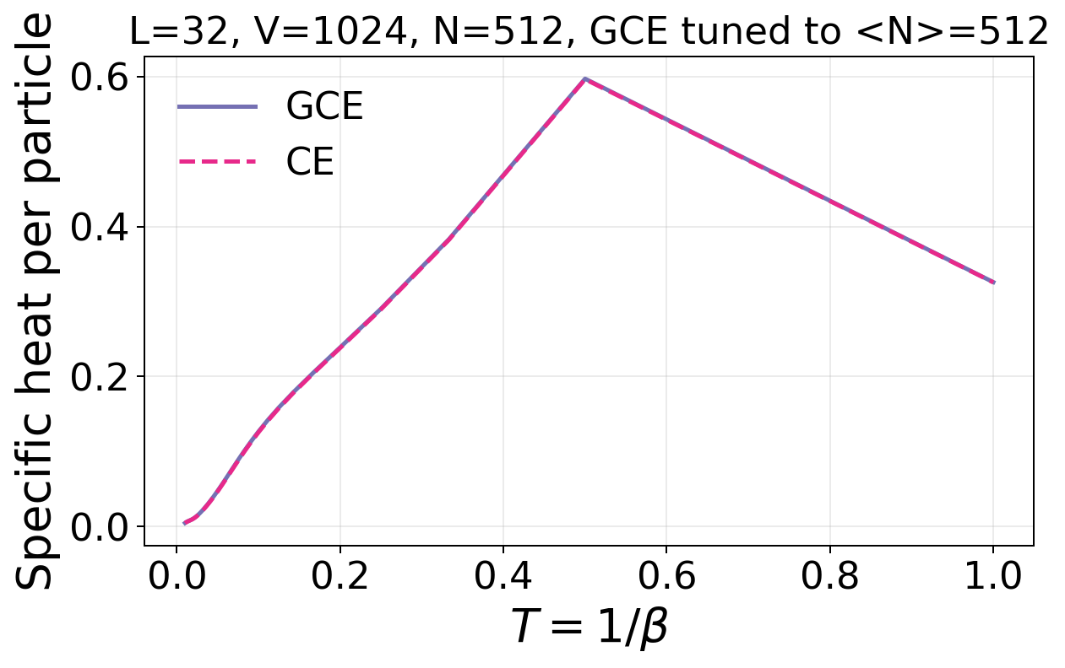
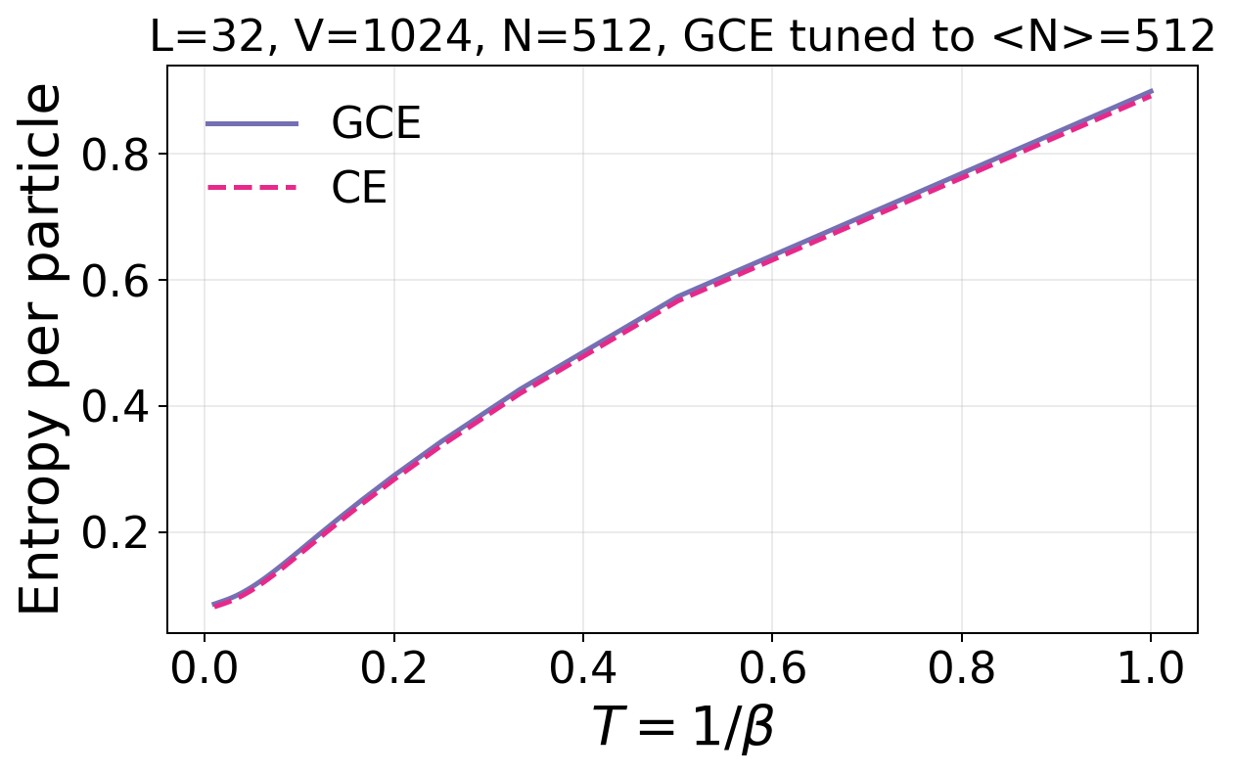
Square PBC L=32, V=1024, N=512, GCE tuned to <N>=512

Slide 10
Square lattice OBC

Slide 11
Comparison

Slide 12
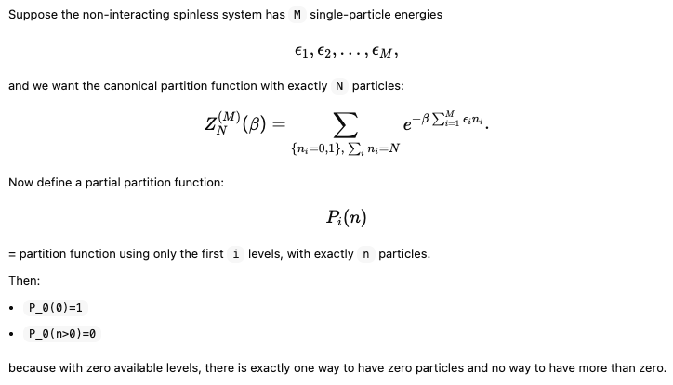
Partition function for Canonical ensemble

Slide 13
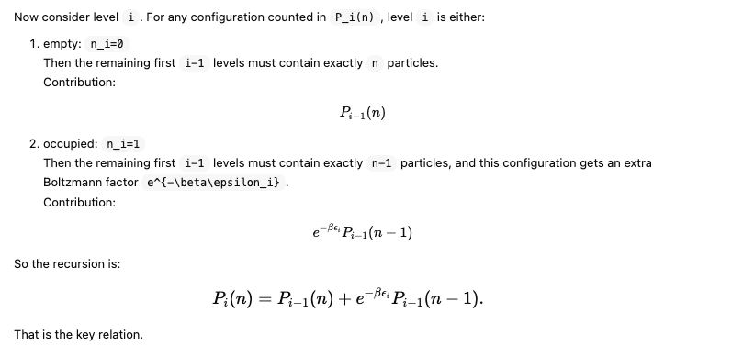
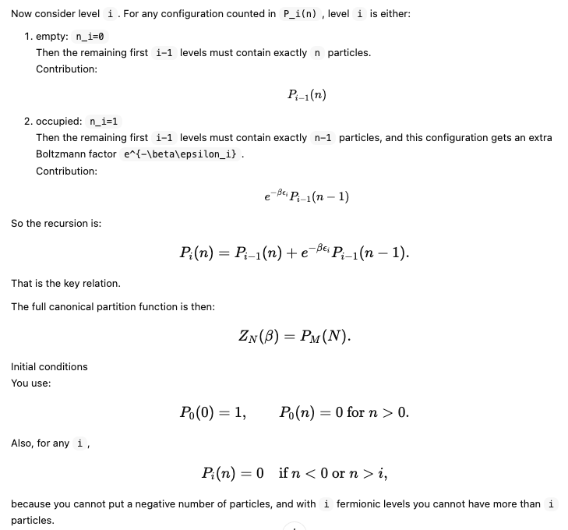
Partition function for Canonical ensemble

Slide 14
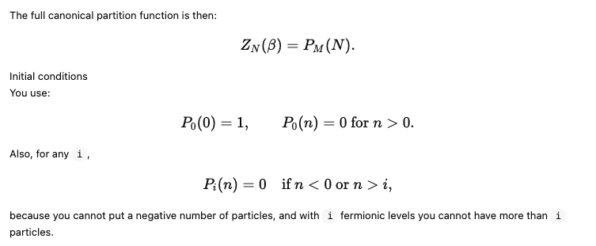
Partition function for Canonical ensemble

