Slide 1
Module Overview
Descriptive
Statistics
Probability
Distributions
Hypothesis
Testing 1
Probability
Sampling
Week
1
Week
2
Week
3
Week
4
Week
5
Week
6
Week
7
Week
8
Week
9
Week
10
Hypothesis
Testing 2
Testing
Relationship
Regression
Conditional
Probability
Factor
Analysis
Week
11
Revision

Slide 2
A tiny bit of housekeeping
If you struggle with something, grab me after lecture or seminar for question.
If you are shy just reach out to me via email.
Send your questions if possible so that I can redirect you to the right course material or extra-material if I need to search for it.
Don’t worry if you feel that your question might be “stupid”: it won’t be. Asking questions just show that you care.

Slide 3
Contents
Probability Basics
Ways to Assess
Basic definitions
Visualizing Probability
Venn diagrams
Contingency table
Combining Events
Mutually exclusive
Conditional Probability
Independence of events
Overlapping

Slide 4
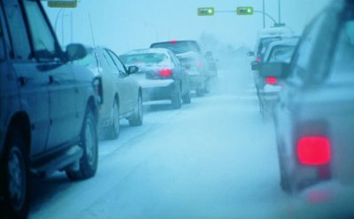
Probability
Probability is a measure of the likeliness that an event will occur
A measure of the likeliness

Slide 5

The probability scale
Absolute
certainty
1.0
e.g. Will it snow tomorrow? Definitely
$$0≤p\left(X\right)≤1$$
0.5
Absolute
impossibility
e.g. Will it snow tomorrow? Impossible
0.0
Notes:
Probability is a scientific way of expressing and dealing with uncertainty.
You might express probabilities in different ways; as a fraction, as a percentage or as a decimal. The basics hole whichever way you express them.
We say the probability of some event – like me getting heads with the coin – lies somewhere on the scale between absolute impossibility and absolute certainty

Slide 6






How to assess probabilities?
A priori
Empirical
25%
Subjective

Slide 7
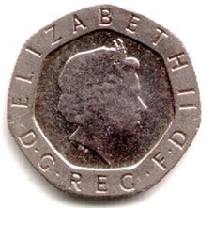

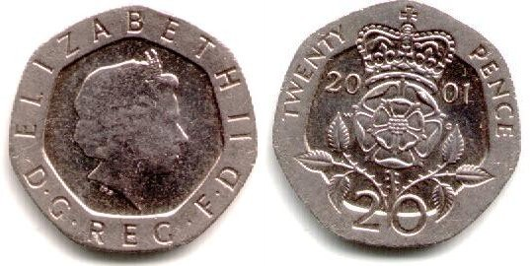
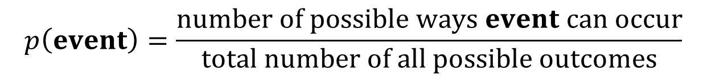
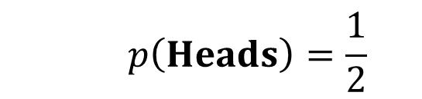
A Priori Probabilities
For situations where all outcomes are equally likely…
$$p\left(event\right)=\frac{number of possible ways event can occur}{total number of all possible outcomes}$$
E.g. tossing a coin
One way to
get a head
$$p\left(Heads\right)=\frac{1}{2}$$
Two possible outcomes

Slide 8







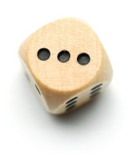

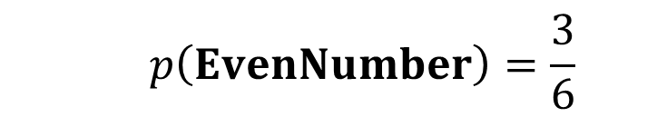
A Priori Probabilities
E.g. throwing an even number with a die
3 ways to get an even number
$$p\left(EvenNumber\right)=\frac{3}{6}$$
6 possible outcomes

Slide 9
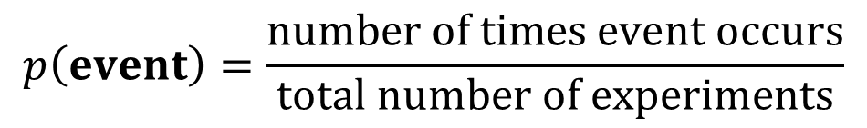
Empirical Probabilities
For majority of practical situations…
$$p\left(event\right)=\frac{number of times event occurs}{total number of experiments}$$
… based on observations
… also known as relative frequency
… used where outcomes are NOT equally likely
Notes:
This is the relative proportion
An experiment is any process of measurement or observation

Slide 10

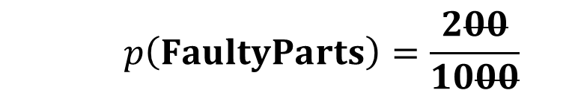
Empirical Probabilities
E.g. sampling parts purchased in September
Number of
faulty parts
$$p\left(FaultyParts\right)=\frac{200}{1000}$$
Total number of
samples taken
That’s
2 out of 10
20%
0.2
Notes:
this actually provides an estimate, bigger samples should be more accurate measures of the overall rate (providing nothing changes)

Slide 11
Empirical Probabilities
When the number of experiments go very large
Empirical
Theoretical

Slide 12


Subjective Probabilities
Also referred to as intuitive probabilities
E.g. there’s a 50-50 chance our competitor will enter this market
Subjective probabilities differ from person to person
MCFC Fans say:-
85-15 chance to win
LUFC Fans say:-
80-20 chance to win
Notes:
Sometimes in business these are the best estimates you have

Slide 13
Subjective Probabilities
There is no absolute mathematical proof but…
Fans may still reply in actual percentage terms.
Subjective
Subjective
A priori
Empirical
 | LUFC fans say… | MCFC fans Say…
Leeds United | .80 | .15
Manchester City | .20 | .85
Theoretically Equally likely | Relative Frequency
.50 | .28
.50 | .72

Slide 14

Subjective Probabilities – my colleague’s dog Toya
Subjective probabilities differ from person to person
(I’m not sure dogs do probabilities, but I sure hope it does before it run after the ball)
Toya says
100-0 chance to bring the ball, give me a treat first!
He says
80-20 chance she brings the ball back

Slide 15

Q1 – When tossing a coin, there is 50/50 chance of getting a head or a tail. Why do we believe this?
A – Because our parents have told us that there is 50% chance of getting head or tail. B – Because we assume that there are only two possible outcomes and they are both equally likely in a fair coin, so we use a prior probability.
C – Because when we flip it hundred times, we get heads in fifty of those trials and tail in other fifty of the trials. This is empirical probability. D – This is a universal truth, we just believe it. No need to justify. E – None of the above

Slide 16
#1 B
We use ‘priori’ by combining different facts i.e.
There are two mutually exclusive events: Head and Tail
There are no other events as we believe that coin will not stand in the middle. :-)
and all the events are equally likely
By combining these three facts, we say that the likely hood of each event is 1/2.

Slide 17
Q2 – When I flipped a coin 20 times, the head appeared 13 times while tail appeared only 7 times. Does it mean that my coin is unfair?
A – No, I guess this is just due to chance that the head appeared more often than the tail. B – Yes, there is some problem with the coin as we expect both events to occur exactly 10 times.
C – Yes, we can only expect a very little error due to chance, we cannot attribute this difference of 13/7 to chance only. There must be something going wrong. D – No, the coin is fair but the person who flipped the coin has not reported the outcomes truthfully.

Slide 18
#2 A
The theoretical (a priori) probabilities are different from empirical (experimental) probabilities. This is quite likely that the head appeared more often than the tail. We may need more trials to declare the coin unfair.

Slide 19
Q3 – Imagine you are working in a company as a business analyst. You are doing feasibility analysis for entering the Kenyan market. Your boss comes to you and tells you that there is a 50/50 chance our competitor will also enter this market
A – Your boss knows everything so she must be right. B – 50/50 appears to be a subjective probability.
C – It could be that your boss is using empirical probability.
D – Your boss does not know more than a business analyst so she must listen to the analyst who will gain evidence from data E – None of the above

Slide 20
#3 BC
B and C are both possible i.e. it can either be subjective or empirical.
It could be a subjective probability as the term 50/50 gives an indication that your boss is uncertain.
Or alternatively, it could be that she is aware of dozens of such cases, and in half of those cases, competitors did enter.

Slide 21
Basic definitions
Sample Space:
List of all possible outcomes in a situation
Sample Point:
Each possible outcome in a situation
Event:
A subset of the sample space
When throwing a die, the sample space is {1, 2, 3, 4, 5, 6}
Each element is a sample point
Outcome less than 4

Slide 22
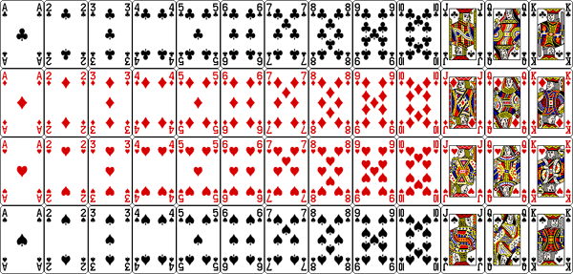
Basic definitions
Sample Space:
List of all possible outcomes in a situation
Sample Point:
Each possible outcome in a situation
Event:
A subset of the sample space
Events may not be mutually exclusive
Events may not be mutually exclusive
All outcomes are mutually exclusive
All outcomes are mutually exclusive

Slide 23
Basic definitions
Two events are mutually exclusive if both the events cannot occur simultaneously.

Slide 24
Basic definitions
A set of events is collectively exhaustive if one of the events must occur.

Slide 25
Q4 – An event is a subset of the sample space
A – Events in a sample space are always mutually exclusive. B – Events in a sample space are always collectively exhaustive. C – Events in a sample space do not need to be mutually exclusive. D – Events in a sample space do not need to be collectively exhaustive.

Slide 26
#4 CD
Events in a sample space do not need to be mutually exclusive
Events in a sample space do not need to be collectively exhaustive

Slide 27


Contents
Probability Basics
Ways to Assess
Basic definitions
Visualizing Probability
Venn diagrams
Contingency table
Combining Events
Mutually exclusive
Conditional Probability
Independence of events
Overlapping

Slide 28
Venn diagrams
A graphical representation
Useful when solving more complex problems
a point represents an outcome
U
A
a loop or circle represents an event
Help you visualise the relationships between events

Slide 29

Venn diagrams
A graphical representation
Useful when solving more complex problems
The part of the sample space which is not part of
event A is called the complement of A ($\overline{A},\acute{A}, or A^{c}$)
U
A
Not A
A’ or A^{c}

Slide 30


Complement
The bar shows the event NOT occurring (a complement)
$$p\left(\overline{X}\right)$$
The probability of the event NOT occurring is 1 minus the probability of the event occurring
$$p\left(\overline{X}\right)=1−p\left(X\right)$$
RECALL
 | Leeds United fans say… | Manc. City fans Say…
Leeds United | .80 | .15
Manchester City | .20 | .85
Notes:
Bit of notation again
It’s also worth remembering that the probability something won’t happen is 1 minus the probability it does. Thinking this way round can sometimes be the quickest way to solve problems.

Slide 31

Venn diagrams
Example: Suppose we toss a coin twice
The sample space is…
{(H,H),(H,T),(T,H),(T,T)}
H
H
H
T
T
H
T
T
If event A is “exactly one head occurs”, then
{(H,T),(T,H)}
and event A^{c} is…
{(H,H),(T,T)}

Slide 32
Venn diagrams
U
A
B
A & B are mutually
exclusive events

Slide 33
Venn diagrams
U
A
B
A & B are NOT mutually
exclusive events

Slide 34

Venn diagrams
U
$$A∪B$$
Either A or B happens
The UNION set

Slide 35
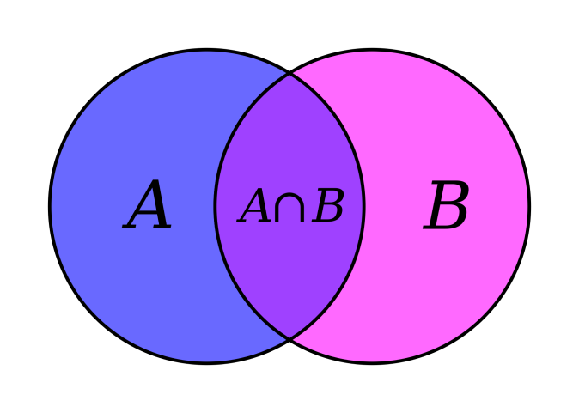
Venn diagrams
U
Both A and B happen
The INTERSECTION set

Slide 36
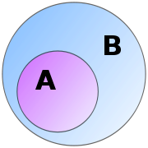
Venn diagrams
U
A is contained in B
A is a SUBSET of B

Slide 37
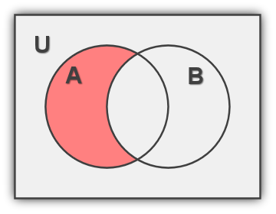
Venn diagrams
?
What does
this area
represent?

Slide 38
Venn diagrams
A but not B
i.e. A - B

Slide 39
Venn diagrams
U = all animals
lions
tigers
mammals
How would you represent
“animals with sharp pointy teeth”?

Slide 40
Venn diagrams
U = all animals
lions
tigers
animals with
sharp pointy teeth
mammals

Slide 41
Contingency Tables
Another tool…
for keeping a record of the counts or percentages
 | Mammals | Non mammals | Total
Sharp teeth | 20 | 25 | 45
No sharp teeth | 20 | 35 | 55
Total | 40 | 60 | 100
Especially helpful for figuring out whether events are dependent or independent.
[will discuss later]

Slide 42
Q5 – If the Met Office (UK’s national meteorological service) reports that there is a 5% chance that it will snow next month then…
A – There is a 95% chance that it will NOT snow next month. B – There is a no chance of snow next month. C – There is a 5% chance that it will NOT snow next month. D – This is not possible, we always have 50% chance of having snow.

Slide 43
#5 A
Using the simple calculation of complement, p(A_c) = 1 - p(A), we can deduce
p(NOT snow) = 1 - p(snow)
= 1 - 0.05
= 0.95
So there is 95% chance that it will NOT snow next month.

Slide 44
Q6 – Suppose RED is a colour for MAMMALS BLUE is a colour for MARINE ANIMALS PURPLE is a colour for the intersection of RED and BLUE
A – Dolphins should be placed in BLUE because they are marine. B – Turtles should be placed in PURPLE because they can live both on land and under water.
C – Bats should be placed in RED because they are mammals but not marine. D – Whales should be placed in purple because they are both mammals and marine.

Slide 45
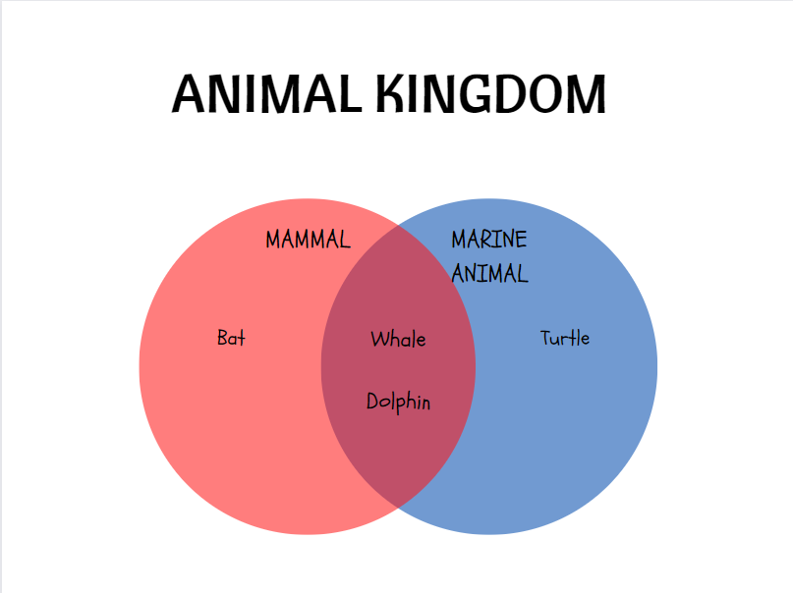
#6 CD

Slide 46
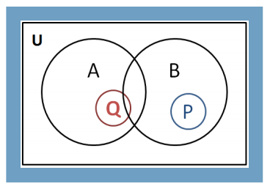
Q7 – Look at the Venn diagram showing four vents A, B, P and Q. Which of the following statements are true in this situation?
A – A and B are not mutually exclusive but P and Q are mutually exclusive
B – A and B are mutually exclusive but P and Q are not mutually exclusive
C – P and A are mutually exclusive
D – Q and B are mutually exclusive
E – All of the above are true

Slide 47
#7 A C
A and B are not mutually exclusive but P and Q are mutually exclusive.
P and A are indeed mutually exclusive

Slide 48
10 Minutes Break

Slide 49
Contents
Probability Basics
Ways to Assess
Basic definitions
Visualizing Probability
Venn diagrams
Contingency table
Combining Events
Mutually exclusive
Conditional Probability
Independence of events
Overlapping

Slide 50
Combining Events
Probability of A or B happening:
number of ways
A can happen
+
number of ways
B can happen
total number of possibilities
i.e. p(A U B) = p(A) + p(B)
U
A
B
If A and B are mutually
exclusive events

Slide 51
Combining Events
Example: Suppose we throw a die…
If event A is “getting an even number”
And event B is “getting a 5”
Then…
A = {2, 4, 6} p=3/6
B = {5} p=1/6
A U B = {2, 4, 5, 6}
p(A or B) = 4/6

Slide 52
Combining Events
Events which aren’t mutually exclusive
$$p\left(A∪B\right)=p\left(A\right)+p\left(B\right)−p\left(A∩B\right)$$
the overlap makes a difference: we don’t want to double count it
U

Slide 53
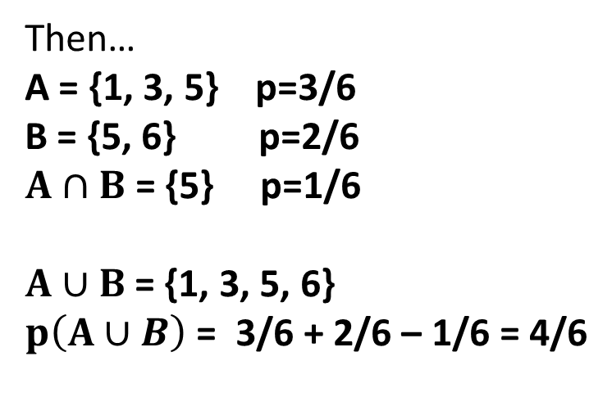
Combining Events
Example: Suppose we throw a die…
If event A is “getting an odd number”
And event B is “getting a number above 4”
Then…
A = {1, 3, 5} p=3/6
B = {5, 6} p=2/6
$A∩B$ = {5} p=1/6
$A∪B$= {1, 3, 5, 6}
$p\left(A∪B\right)$ = 3/6 + 2/6 – 1/6 = 4/6

Slide 54
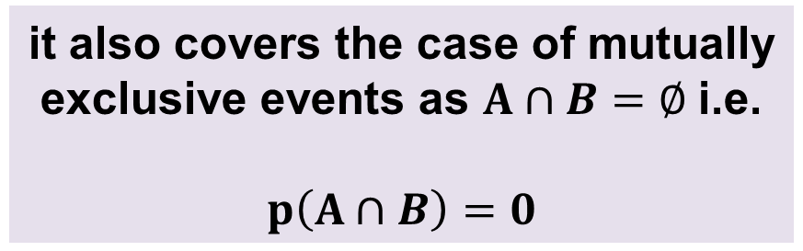
Combining Events
$$p\left(A∪B\right)=p\left(A\right)+p\left(B\right)−p\left(A∩B\right)$$
This formula is a general one…
it also covers the case of mutually
exclusive events as $A∩B=∅$i.e.
$$p\left(A∩B\right)=0$$

Slide 55
Combining Events
Probability of A and B happening simultaneously…
How we calculate this is affected by whether the
events are independent or dependent
Independent events if…
the outcome of one event does NOT affect
the probability of the other occurring
Dependent events if…
the outcome of one event does affect
the probability of the other occurring

Slide 56
Combining Events
INDEPENDENT: Two separate draws
Independent versus Dependent
INDEPENDENT:
the drawn card is inserted back in the deck
DEPENDENT:
the drawn card is taken away

Slide 57


Combining Events
Probability of A and B happening simultaneously…
For independent events:
number of ways
A can happen
number of ways
B can happen
$$×$$
total number
of possibilities
total number
of possibilities
$$p\left(A∩B\right)=p\left(A\right)×p\left(B\right)$$

Slide 58
Combining Events
Example: Suppose we throw two dice…
If event A is “getting an even number” on die 1
And event B is “getting a 5 or a 6” on die 2
Then…
A = {2, 4, 6} p=3/6
B = {5, 6} p=2/6
p(A and B) = 3/6 x 2/6 = 6/36 = 1/6

Slide 59
Q8 - Combining Events
Example: In a factory a sample was taken of 10,000 parts and 500 were found to be scrap.
Suppose three parts are selected at random from the shop floor and inspected in turn.
What is the probability that a scrap part is not discovered until the third part is inspected?
A – 0.95
B – 0.85
C – 0.05
D – 0.045
E – None of the above.

Slide 60
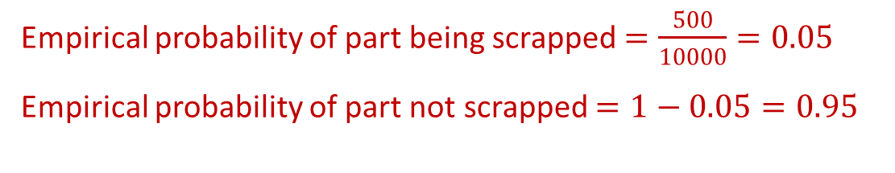
#8
Example: In a factory a sample was taken of 10,000 parts and 500 were found to be scrap.
Suppose three parts are selected at random from the shop floor and inspected in turn.
What is the probability that a scrap part is not discovered until the third part is inspected?
Empirical probability of part being scrapped $=\frac{500}{10000}=0.05$
Empirical probability of part not scrapped $=1−0.05=0.95$

Slide 61
#8
Example: In a factory a sample was taken of 10,000 parts and 500 were found to be scrap.
Suppose three parts are selected at random from the shop floor and inspected in turn.
What is the probability that a scrap part is not discovered until the third part is inspected?
Empirical probability of part being scrapped $=\frac{500}{10000}=0.05$
Empirical probability of part not scrapped $=1−0.05=0.95$
Three events: (let’s call them) $X_{1},X_{2},X_{3}$

Slide 62
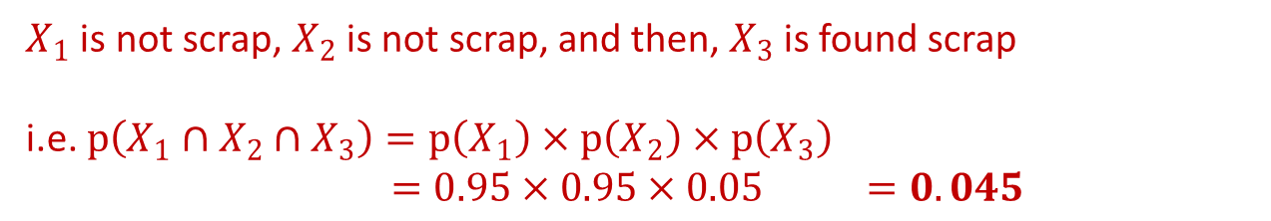
#8 D
Example: In a factory a sample was taken of 10,000 parts and 500 were found to be scrap.
Suppose three parts are selected at random from the shop floor and inspected in turn.
What is the probability that a scrap part is not discovered until the third part is inspected?
Empirical probability of part being scrapped $=\frac{500}{10000}=0.05$
Empirical probability of part not scrapped $=1−0.05=0.95$
Three events: (let’s call them) $X_{1},X_{2},X_{3}$
$X_{1}$ is not scrap, $X_{2}$ is not scrap, and then, $X_{3}$ is found scrap
i.e. $p\left(X_{1}∩X_{2}∩X_{3}\right)=p\left(X_{1}\right)×p\left(X_{2}\right)×p\left(X_{3}\right)$
$=0.95×0.95×0.05 =0.045$

Slide 63
Q9 – Bidding
Example: A firm has a 75% chance of getting any contract it bids for.
If the company bids for two contracts…
What are the chances it will get Contract 1 or
Contract 2 or both?
A – ¾
B – 9/16
C – 15/16
D – 4/4
E – None of the above

Slide 64

Q9
Example: A firm has a 75% chance of getting any contract it bids for.
If the company bids for two contracts…
What are the chances it will get Contract 1 or
Contract 2 or both?
Empirical/Subjective probability $=\frac{3}{4}$

Slide 65
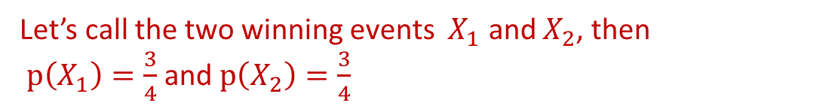
Q9
Example: A firm has a 75% chance of getting any contract it bids for.
If the company bids for two contracts…
What are the chances it will get Contract 1 or
Contract 2 or both?
Empirical/Subjective probability $=\frac{3}{4}$
Let’s call the two winning events $X_{1}$ and $X_{2}$, then
$p\left(X_{1}\right)=\frac{3}{4}$ and $p\left(X_{2}\right)=\frac{3}{4}$

Slide 66
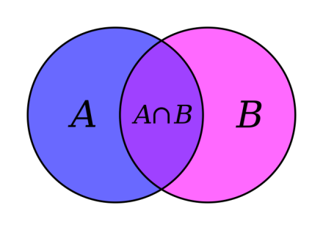
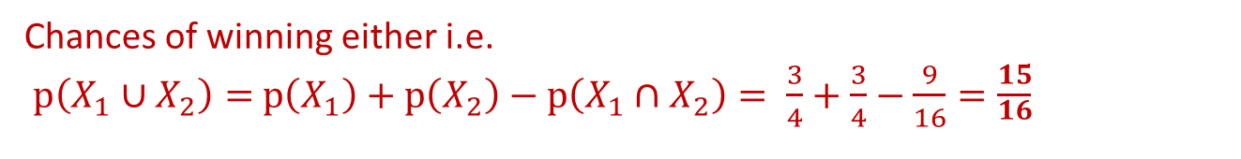
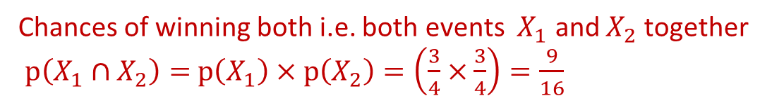
Q9 - C
Example: A firm has a 75% chance of getting any contract it bids for.
If the company bids for two contracts…
What are the chances it will get Contract 1 or
Contract 2 or both?
Empirical/Subjective probability $=\frac{3}{4}$
Recall!
Let’s call the two winning events $X_{1}$ and $X_{2}$, then
$p\left(X_{1}\right)=\frac{3}{4}$ and $p\left(X_{2}\right)=\frac{3}{4}$
U
Chances of winning both i.e. both events $X_{1}$ and $X_{2}$ together
$p\left(X_{1}∩X_{2}\right)=$ $p\left(X_{1}\right)×p\left(X_{2}\right)=\left(\frac{3}{4}×\frac{3}{4}\right)=\frac{9}{16}$
Chances of winning either i.e.
$p\left(X_{1}∪X_{2}\right)=$ $p\left(X_{1}\right)+p\left(X_{2}\right)−p\left(X_{1}∩X_{2}\right)= \frac{3}{4}+\frac{3}{4}−\frac{9}{16}=\frac{15}{\begin{aligned}16 \\ \end{aligned}}$

Slide 67
Contents
Probability Basics
Ways to Assess
Basic definitions
Visualizing Probability
Venn diagrams
Contingency table
Combining Events
Mutually exclusive
Conditional Probability
Independence of events
Overlapping

Slide 68

Combining Events
Probability of A and B happening simultaneously…
For events that are not independent:
$$p\left(A∩B\right)=p\left(A\right)×p\left(B|A\right)$$
Conditional Probability

Slide 69




Combining Events
Probability of A and B happening simultaneously…
For events that are not independent:
Consider a company where:-
20% of female employees smoke
50% of employees are female
30% of employees smoke
If an employee is chosen at random…
what is the chance it will be a woman who smokes?
Chances of both events $X_{smoke}$ and $X_{female}$ together:-
$p\left(X_{female}∩X_{smoke}\right)=p\left(X_{female}\right)×p\left(X_{smoke}\right)$
$p\left(X_{female}∩X_{smoke}\right)=0.50×0.30=0.15$

Slide 70

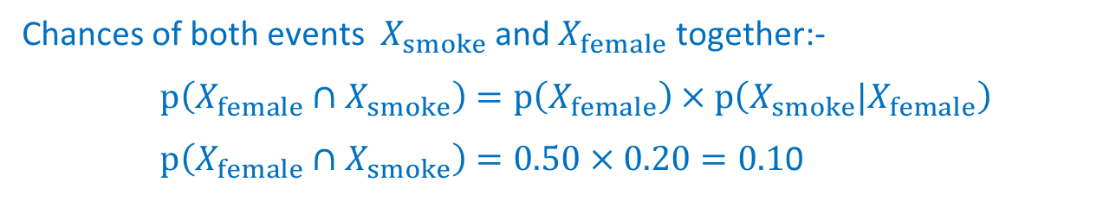
Combining Events
Probability of A and B happening simultaneously…
For events that are not independent:
Consider a company where:-
20% of female employees smoke
50% of employees are female
30% of employees smoke
If an employee is chosen at random…
what is the chance it will be a woman who smokes?
Chances of both events $X_{smoke}$ and $X_{female}$ together:-
$p\left(X_{female}∩X_{smoke}\right)=p\left(X_{female}\right)×p\left(X_{smoke}|X_{female}\right)$
$p\left(X_{female}∩X_{smoke}\right)=0.50×0.20=0.1$0

Slide 71
Conditional Probabilities
p(smoker if female) is the conditional probability i.e.
the worker smokes given that the worker is female
This can be written as…
p(smoker | female)
Conditional probabilities can be important:
They give information about subgroups with different propensities
e.g. different propensities to default on loans or purchase products
Notes:
example in book shows that purchasing a plasma TV indicates an increased chance of purchasing a DVDR

Slide 72

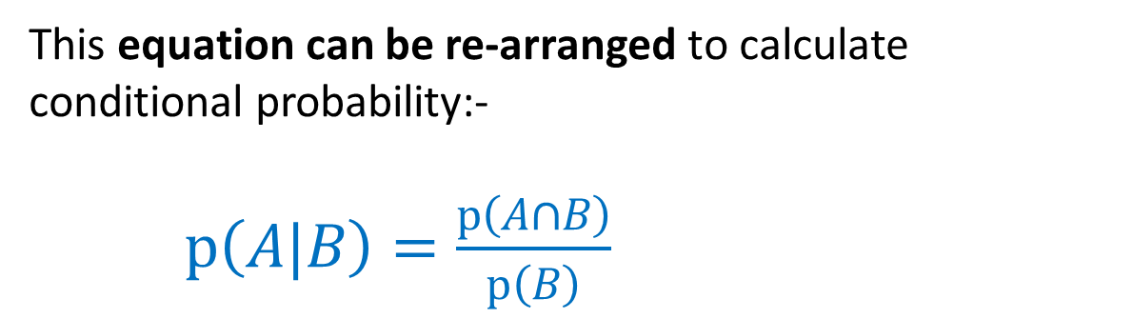
Conditional Probabilities
The formula for p(female who smokes) would be…
p(female who smokes) =
p(female) X p(smoker if female)
or, more generally
$p\left(A∩B\right)=p\left(B\right)×p\left(A|B\right)$
This equation can be re-arranged to calculate conditional probability:-
$p\left(A|B\right)=\frac{p\left(A∩B\right)}{p\left(B\right)}$

Slide 73
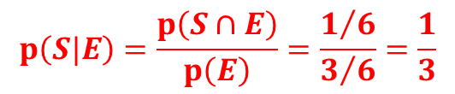
Conditional Probabilities
Example: A dice is thrown…
Event E is “an even number is thrown”
Event S is “a 6 is thrown”
{6}
p(S)= 1/6
S
We are told…
Event E has occurred
E
What is the probability of Event S
occurring given this information?
p(E)= 3/6
{2, 4, 6}
$$p\left(S|E\right)=\frac{p\left(S∩E\right)}{p\left(E\right)}=\frac{1/6}{3/6}=\frac{1}{3}$$

Slide 74
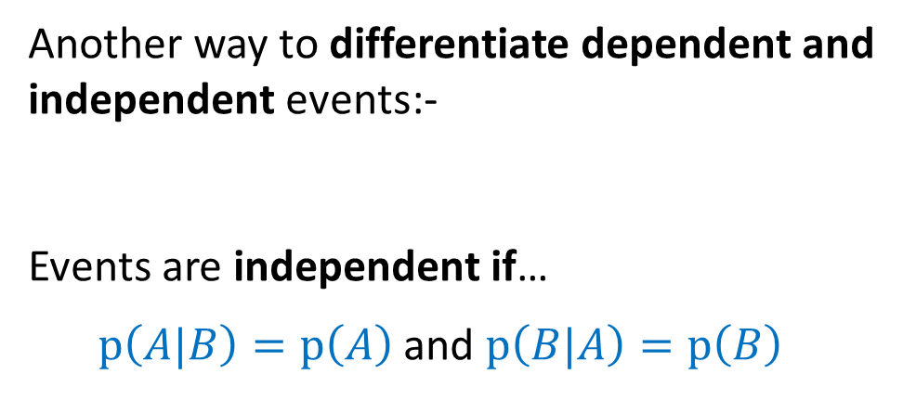
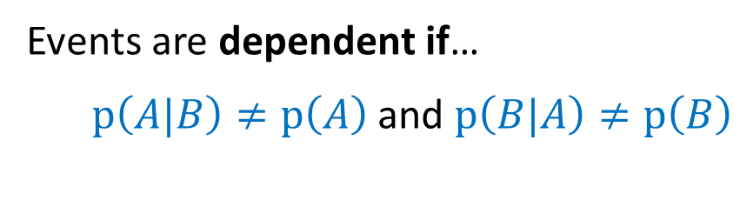
Conditional Probabilities
Another way to differentiate dependent and
independent events:-
Events are independent if…
$p\left(A|B\right)=p\left(A\right)$ and $p\left(B|A\right)=p\left(B\right)$
Events are dependent if…
$p\left(A|B\right)≠p\left(A\right)$ and $p\left(B|A\right)≠p\left(B\right)$

Slide 75
Contents
Probability Basics
Ways to Assess
Basic definitions
Visualizing Probability
Venn diagrams
Contingency table
Combining Events
Mutually exclusive
Conditional Probability
Independence of events
Overlapping

Slide 76
Summary
We’ve looked at…
Types of assessing probability
A visual way to represent events
Venn diagrams
Probability of combined events
Conditional probabilities

Slide 77
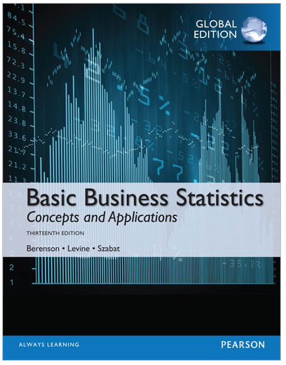
Reading…
Chapter 4
Basic Probability
Sections 4.1 and 4.2

Slide 78
Module Overview
Descriptive
Statistics
Probability
Distributions
Hypothesis
Testing 1
Probability
Sampling
Week
1
Week
2
Week
3
Week
4
Week
5
Week
6
Week
7
Week
8
Week
9
Week
10
Hypothesis
Testing 2
Testing
Relationship
Regression
Conditional
Probability
Factor
Analysis
Week
11
Revision

