Slide 1
Module Overview
Descriptive
Statistics
Probability
Distributions
Hypothesis
Testing 1
Probability
Sampling
Week
1
Week
2
Week
3
Week
4
Week
5
Week
6
Week
7
Week
8
Week
9
Week
10
Hypothesis
Testing 2
Testing
Relationship
Regression
Conditional
Probability
Factor
Analysis
Week
11
Revision

Slide 2

Contents
Random Variables & Probability Distributions
Discrete Probability Distribution
Continuous Probability Distribution
Normal Distribution
Standardized Normal Distribution
Notes:
Descriptive statistics is about summarizing and presenting data. This week we will look at presenting. Unless there are only a small number of values it can be hard to make sense of raw data.

Slide 3
Random variables
A random variable is a numeric variable that takes different values according to chance
By convention, random variables are labelled using capital letters
For example, X, Y, etc.
And particular values of the random variables are labelled with lower case letters
For example, X can take a particular value x
The probability of that particular value is denoted as p(X=x)
or simply p(x) if only one variable is discussed

Slide 4
Random variables
Discrete
can only take particular values
e.g. discrete values like the number of faulty parts
Continuous
can take any value in its range
e.g. temperature measurements
We can say; continuous variables measure
while discrete variables count
Notes:
It can be hard to distinguish discrete and continuous variables as discrete variables start to have continuous properties if they have a lot of values.

Slide 5

Probability distributions
List of all possible values that the variable can take (i.e. all possible outcomes) and their associated probabilities
For example, we get this probability distribution table for a roll of a die:
DISCRETE
UNIFORM

Slide 6
Probability distributions
The sum of the probabilities is always equal to 1
for discrete random variables
This is because the outcomes are
mutually exclusive (only one occurs at a time) and
collectively exhaustive (no other outcomes are possible)

Slide 7
Probability distributions
The concepts of frequency distributions for data and probability distributions are quite similar:-
Sample of data
Random variable, X
x’s: Actual items in the sample
x’s: Possible values which X can take
Relative frequencies f(x)
Probabilities P(x)
Distribution of data
Probability distribution of X

Slide 8
Contents
Random Variables & Probability Distributions
Discrete Probability Distribution
Continuous Probability Distribution
Normal Distribution
Standardized Normal Distribution
Notes:
Descriptive statistics is about summarizing and presenting data. This week we will look at presenting. Unless there are only a small number of values it can be hard to make sense of raw data.

Slide 9
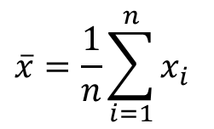

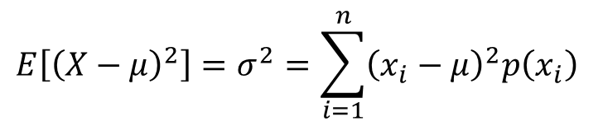
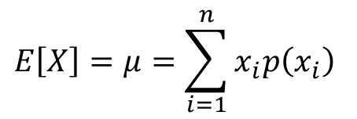
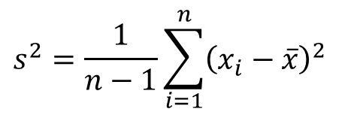
Discrete probability distributions
Just as we can calculate summary statistics for a dataset we can also find numerical summaries for probability distributions:-
$$\overline{x}=\frac{1}{n}\sum_{i=1}^{n}{x_{i}}$$
$$E\left[X\right]=μ=\sum_{i=1}^{n}{x_{i}p\left(x_{i}\right)}$$
$$s^{2}=\frac{1}{n−1}\sum_{i=1}^{n}{{\left(x_{i}−\overline{x}\right)}^{2}}$$
$$E\left[{\left(X−μ\right)}^{2}\right]=σ^{2}=\sum_{i=1}^{n}{{\left(x_{i}−μ\right)}^{2}p\left(x_{i}\right)}$$
$E\left[X\right]$ stands for “expected value”
Notes:
The use of P(x) performs the job of dividing by n in the data case.

Slide 10
Discrete probability distributions
The expected value is the average value X would take…
If the situation that produces X were repeated an infinite number of times
$$E\left[X\right]=μ=\sum_{i=1}^{n}{x_{i}p\left(x_{i}\right)}$$
The variance is the mean of the squared deviation of X from its expected value
$$E\left[{\left(X−μ\right)}^{2}\right]=σ^{2}=\sum_{i=1}^{n}{{\left(x_{i}−μ\right)}^{2}p\left(x_{i}\right)}$$
as with data, the standard deviation of the random variable is the square root of the variance

Slide 11


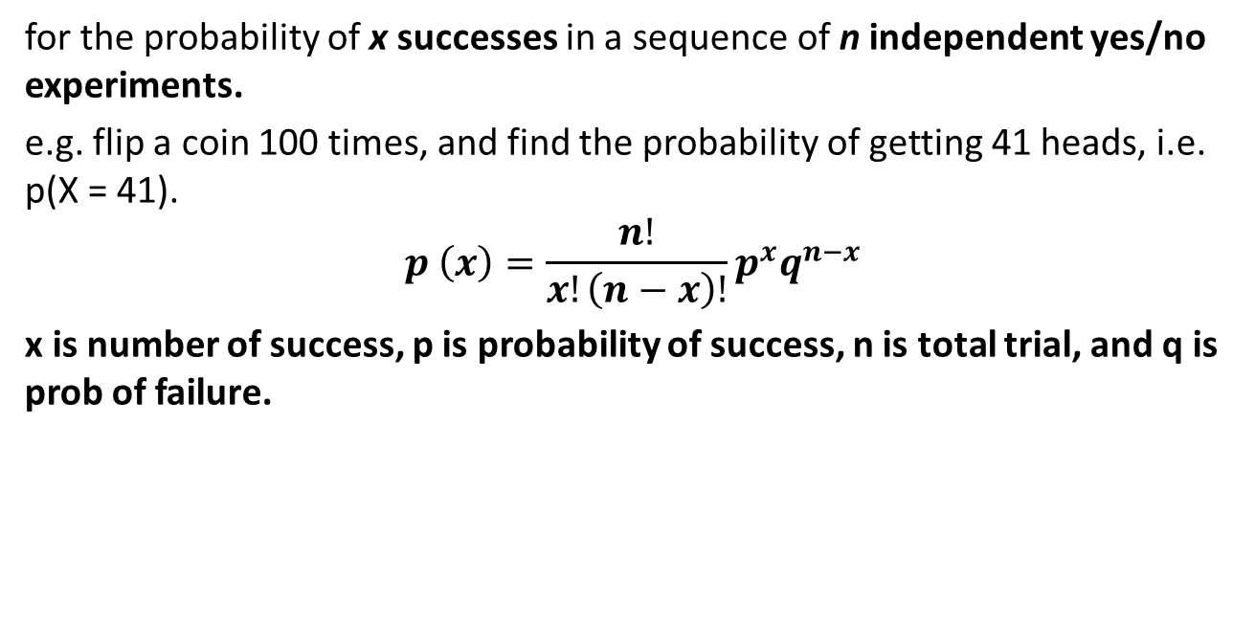


Discrete probability distributions
Binomial distribution
for the probability of x successes in a sequence of n independent yes/no experiments.
e.g. flip a coin 100 times, and find the probability of getting 41 heads, i.e. p(X = 41).
$$p \left(x\right)=\frac{n!}{x!\left(n−x\right)!}p^{x}q^{n−x}$$
x is number of success, p is probability of success, n is total trial, and q is prob of failure.
$$p\left(X=x\right)=\frac{n! π^{x}{\left(1−π\right)}^{n−x}}{x!\left(n−x\right)!}$$
$$p\left(X=x\right)=\frac{e^{−λ}λ^{x}}{x!}$$

Slide 12
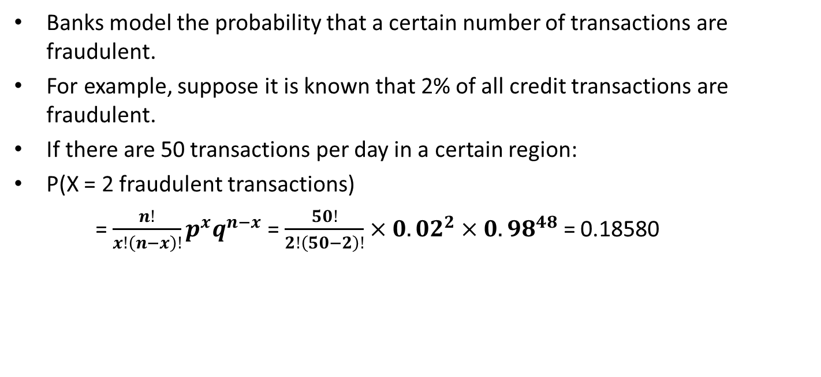
Example of Binomial Distribution
Example 1: Number of Fraudulent Transactions
Banks model the probability that a certain number of transactions are fraudulent.
For example, suppose it is known that 2% of all credit transactions are fraudulent.
If there are 50 transactions per day in a certain region:
P(X = 2 fraudulent transactions)
= $\frac{n!}{x!\left(n−x\right)!}p^{x}q^{n−x}$ = $\frac{50!}{2!\left(50−2\right)!}×{0.02}^{2}{×0.98}^{48}$ = 0.18580

Slide 13
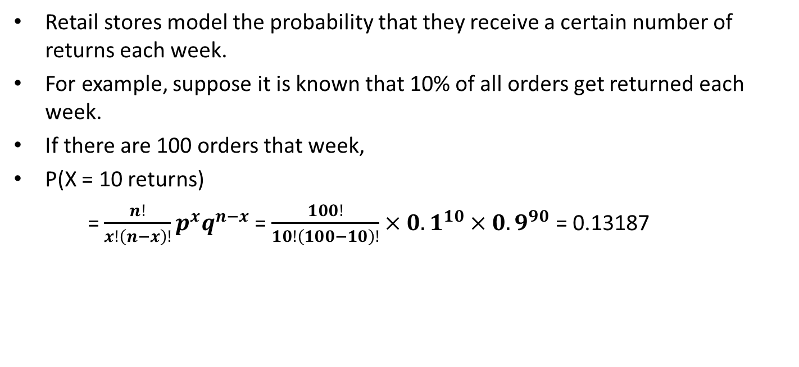
Example of Binomial Distribution
Example 2: Shopping Returns per Week
Retail stores model the probability that they receive a certain number of returns each week.
For example, suppose it is known that 10% of all orders get returned each week.
If there are 100 orders that week,
P(X = 10 returns)
= $\frac{n!}{x!\left(n−x\right)!}p^{x}q^{n−x}$ = $\frac{100!}{10!\left(100−10\right)!}×{0.1}^{10}{×0.9}^{90}$ = 0.13187

Slide 14


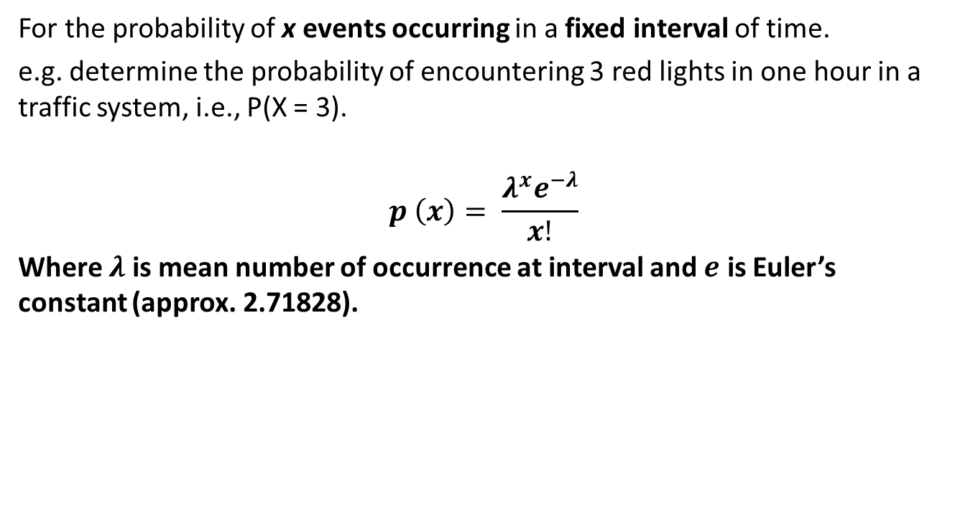
Discrete probability distributions
Poisson distribution
For the probability of x events occurring in a fixed interval of time.
e.g. determine the probability of encountering 3 red lights in one hour in a traffic system, i.e., P(X = 3).
$$p \left(x\right)= \frac{λ^{x}e^{−λ}}{x!}$$
Where $λ$ is mean number of occurrence at interval and $e$ is Euler’s constant (approx. 2.71828).
$$p\left(X=x\right)=\frac{n! π^{x}{\left(1−π\right)}^{n−x}}{x!\left(n−x\right)!}$$
$$p\left(X=x\right)=\frac{e^{−λ}λ^{x}}{x!}$$

Slide 15

Example of Poisson Distribution
Example 1: Calls per Hour at a Call Center
Call center use the Poisson distribution to model the number of expected calls per hour that they’ll receive.
For example, suppose a given call center receives 10 calls per hour.
P(X = 3 call) = $\frac{λ^{x}e^{−λ}}{x!}$ = $\frac{{10}^{3}e^{−10}}{3!}$ = 0.00757

Slide 16

Example of Poisson Distribution
Example 2: Number of system failure per Week
Technology companies use the Poisson distribution to model the number of expected failures per week.
For example, suppose a given company experiences an average of 1 failure per week.
P(X = 0 failures) = $\frac{λ^{x}e^{−λ}}{x!}$ = $\frac{1^{0}e^{−1}}{0!}$ = 0.36788

Slide 17
Contents
Random Variables & Probability Distributions
Discrete Probability Distribution
Continuous Probability Distribution
Normal Distribution
Standardized Normal Distribution
Notes:
Descriptive statistics is about summarizing and presenting data. This week we will look at presenting. Unless there are only a small number of values it can be hard to make sense of raw data.

Slide 18
Continuous probability distributions
We can’t itemise out every value of a continuous random variable
So we have to take a different approach to probability distributions
… we talk about a
probability density function
(pdf)

Slide 19
Probability density function
The probability density function of a continuous random variable X is a function of x, usually called f(x), and has the following properties:-
It is a curve that lies on or above the x axis
the area under the curve between any two values a and b on the x axis is the probability that X falls between these two values: p(a<X<b)
Notes:
this link between the area under the pdf and probability is a think we make use of in statistics to tell is how likely events are

Slide 20
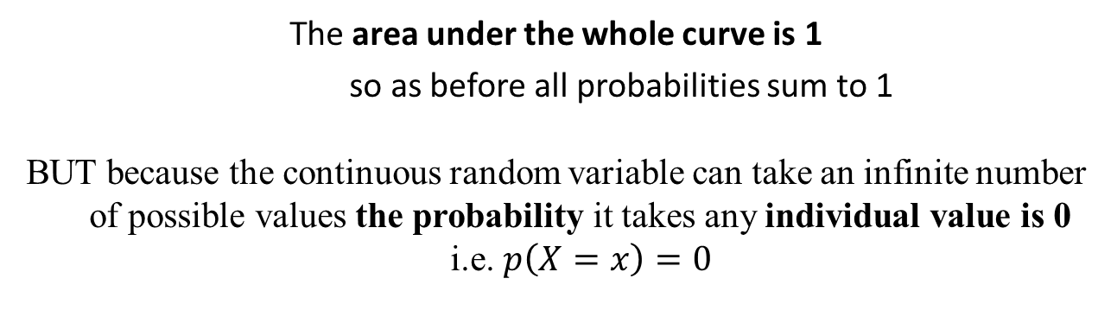
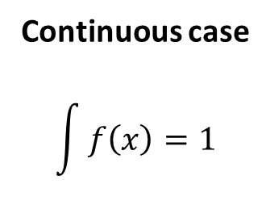
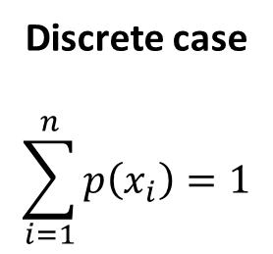
Probability density function
Discrete case
$$\sum_{i=1}^{n}{p\left(x_{i}\right)}=1$$
Continuous case
$$\int{f\left(x\right)}=1$$
The area under the whole curve is 1
so as before all probabilities sum to 1
BUT because the continuous random variable can take an infinite number of possible values the probability it takes any individual value is 0
i.e. $p\left(X=x\right)=0$

Slide 21
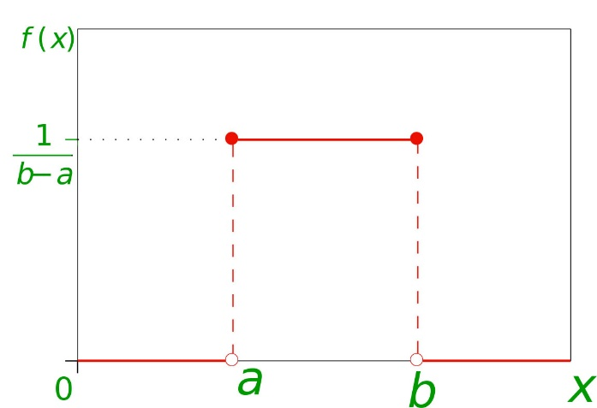
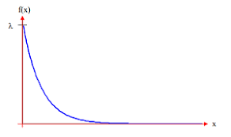


Continuous probability distributions
The two popular mathematical models…
Uniform distribution
Exponential distribution
The values are evenly distributed between the smallest and largest
The value may increase or decrease exponential based on the length of time between events.
$$f\left(x\right)=\frac{1}{b−a}$$
$$f\left(x\right)=\frac{e^{−λ}λ^{x}}{x!}$$

Slide 22
Continuous probability distributions
The two popular mathematical models…
Normal Distribution
Uniform distribution
Exponential distribution
The values are evenly distributed between the smallest and largest
For the length of time between events (widely used in queueing theory)
$$f\left(x\right)=\frac{1}{b−a}$$
$$f\left(x\right)=\frac{e^{−λ}λ^{x}}{x!}$$

Slide 23

1. Which two of the following random variables have discrete probabilities distributions?
The number of events occurring in a fixed interval of time
The length of time between consecutive events
Random number between 0 and 1, generated in Microsoft Excel (using RAND function)
The number of successes in a sequence of n independent yes/no experiments

Slide 24
#1 A,D
The discrete random variables should "count", length of time doesn't count and so is the case with random number between 0 and 1. A and D however are both correct answers.

Slide 25
2. The sum of the probabilities is always equal to
1 for discrete random variables
0 for discrete random variables
0.5 for discrete random variables
Infinity
None of the above

Slide 26
#2 A
Due to mutually exclusive and collectively exhaustive principles, all the outcomes of a random variable should add to 1. I mentioned this for discrete random variable because continuous variables have infinite possible values so adding is not possible.

Slide 27
3. If we throw a die a million times, the distribution will look close to
Normal distribution
Poisson distribution
What we expect a priori
None of the above

Slide 28
#3 C
We know a priori that there is 1/6 chance of each outcome on a die. The a priori distribution in this case is a discrete uniform distribution.

Slide 29
4. In a continuous probability distribution, the probability of any given range of values is
The sum of all values less than the given value
Equal to the area under the curve for its distribution
Always less than zero
Always greater than zero
None of the above

Slide 30
#4 B
We calculate "area under the curve" for continuous probability distribution as continuous variables have infinite possible values so adding is not possible. Also note that probability of any single value is zero in this case.

Slide 31
10 Minutes Break

Slide 32
Contents
Random Variables & Probability Distributions
Discrete Probability Distribution
Continuous Probability Distribution
Normal Distribution
Standardized Normal Distribution
Notes:
Descriptive statistics is about summarizing and presenting data. This week we will look at presenting. Unless there are only a small number of values it can be hard to make sense of raw data.

Slide 33
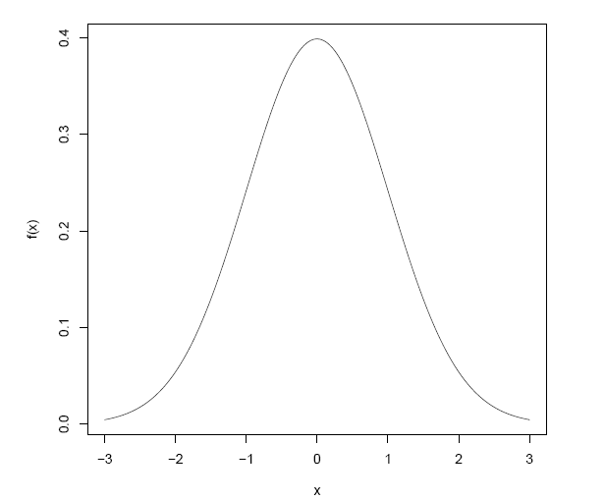


Normal Distribution
also known as the Gaussian Distribution
The mathematical model for normal distribution is:-
This equation has two parameters $μ$and $σ$
(other elements of the equation are constants)
When X approximates a normal distribution
We use notation as: $X \sim N\left(μ,σ^{2}\right)$
Notes:
This is the bell shaped distribution I talked of in an earlier lecture – this version is more accurately drawn. The distribution of many physical and psychological quantities is approximately normal, for example the heights of men, the weights of sacks of flour coming off a production line, download times for web pages. The normal distribution is important in the context if statistics because it provides the basis for statistical inference and some statistical tests.

Slide 34



Normal Distribution
also known as the Gaussian Distribution
A bell shaped continuous probability
Symmetrical about $μ$
Never touches the x axis
Defined over the range $−∞$ to $∞$
Values far from $μ$ are very unlikely
Notes:
This is the bell shaped distribution I talked of in an earlier lecture – this version is more accurately drawn. The distribution of many physical and psychological quantities is approximately normal, for example the heights of men, the weights of sacks of flour coming off a production line, download times for web pages. The normal distribution is important in the context if statistics because it provides the basis for statistical inference and some statistical tests.

Slide 35
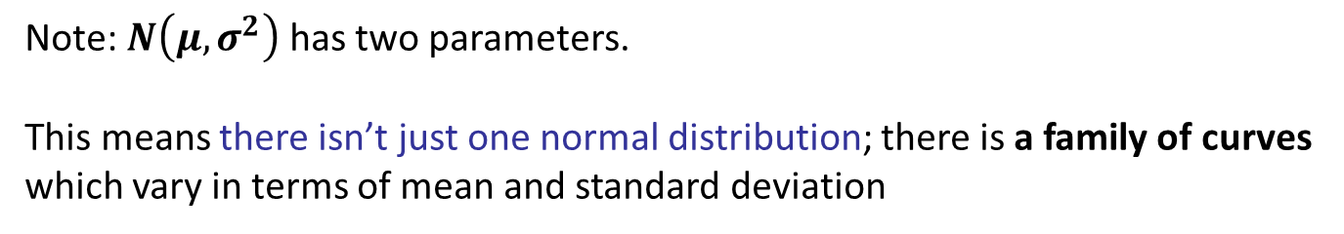
Normal Distribution
Note: $N\left(μ,σ^{2}\right)$has two parameters.
This means there isn’t just one normal distribution; there is a family of curves which vary in terms of mean and standard deviation
Notes:
This is the bell shaped distribution I talked of in an earlier lecture – this version is more accurately drawn. The distribution of many physical and psychological quantities is approximately normal, for example the heights of men, the weights of sacks of flour coming off a production line, download times for web pages. The normal distribution is important in the context if statistics because it provides the basis for statistical inference and some statistical tests.

Slide 36
Normal Distribution
Given the formula for the normal curve this isn’t straightforward working from scratch but we can use tables
Find curves with same mean?
Find curves with same sd?
Notes:
This is the bell shaped distribution I talked of in an earlier lecture – this version is more accurately drawn. The distribution of many physical and psychological quantities is approximately normal, for example the heights of men, the weights of sacks of flour coming off a production line, download times for web pages. The normal distribution is important in the context if statistics because it provides the basis for statistical inference and some statistical tests.

Slide 37
Normal Distribution
What can we do with it?
Recall that the area under a p.d.f. represents probability
Given we know its mathematical form
we can calculate probabilities such as the probability that x is not greater than some particular value
For example, we can calculate the probability that
- a passenger/customer is no more that 6 feet tall
- the time to load a web page is no more than 5 seconds
Notes:
This is the bell shaped distribution I talked of in an earlier lecture – this version is more accurately drawn. The distribution of many physical and psychological quantities is approximately normal, for example the heights of men, the weights of sacks of flour coming off a production line, download times for web pages. The normal distribution is important in the context if statistics because it provides the basis for statistical inference and some statistical tests.

Slide 38
Contents
Random Variables & Probability Distributions
Discrete Probability Distribution
Continuous Probability Distribution
Normal Distribution
Standardized Normal Distribution
Notes:
Useful

Slide 39
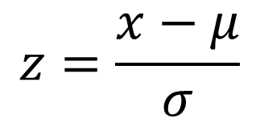
Standard normal distribution
It has a mean of 0 and a standard deviation of 1
Also known as Z distribution
Any normal distribution can be standardized by converting its values into z-scores. Z-scores tell you how many standard deviations from the mean each value lies.
$$z=\frac{x−μ}{σ}$$
How many standard deviations the value is from mean
This is the one which is used to produce statistical tables
Notes:
This is the bell shaped distribution I talked of in an earlier lecture – this version is more accurately drawn. The distribution of many physical and psychological quantities is approximately normal, for example the heights of men, the weights of sacks of flour coming off a production line, download times for web pages. The normal distribution is important in the context if statistics because it provides the basis for statistical inference and some statistical tests.

Slide 40
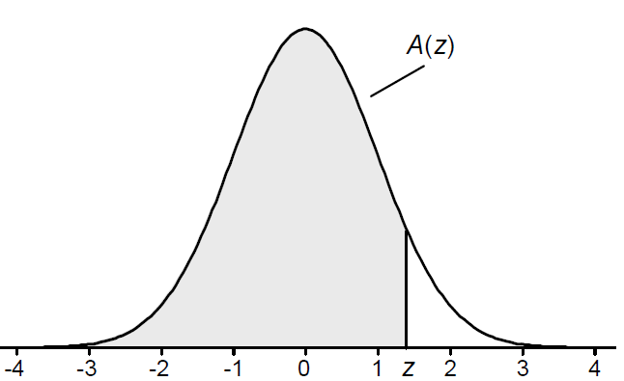
Standard normal distribution
Go to your Minerva and open
Lookup Table - Cumulative Standardized Normal Distribution
These are the same as those in the textbook
These give the probability that a normal random variable is not more than z standard deviations above its mean
Notes:
This is the bell shaped distribution I talked of in an earlier lecture – this version is more accurately drawn. The distribution of many physical and psychological quantities is approximately normal, for example the heights of men, the weights of sacks of flour coming off a production line, download times for web pages. The normal distribution is important in the context if statistics because it provides the basis for statistical inference and some statistical tests.

Slide 41
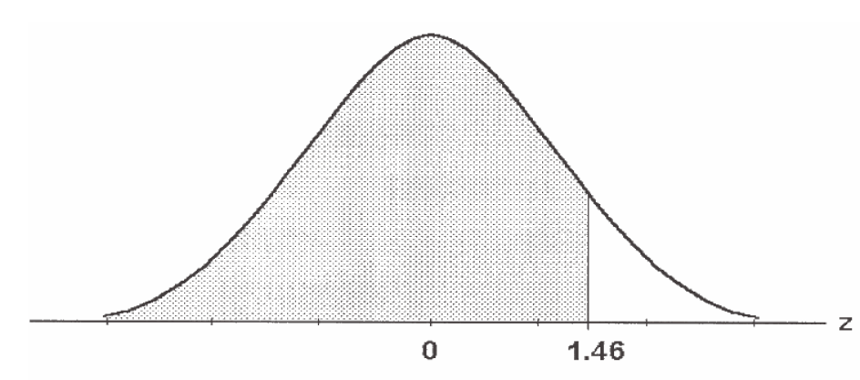
Calculating Normal Distribution Probabilities
Example 1: Lower tail probabilities…
e.g. probability of a value <1.46 sd above the mean i.e. p(z<1.46)
this can be read directly from the tables: = 0.9279

Slide 42
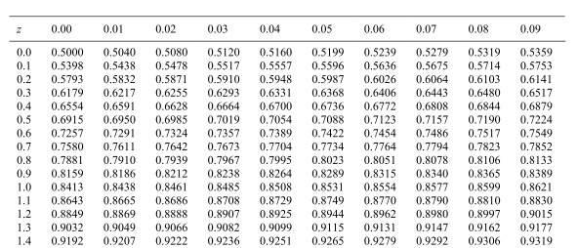

Slide 43
Calculating Normal Distribution Probabilities
Example 2: Probability of a range/interval
e.g. probability of a value between 1.46 and 2.05 i.e. p(1.46<z<2.05)
p(1.46<z<2.05)
= p(z<2.05) – p(z<1.46)

Slide 44
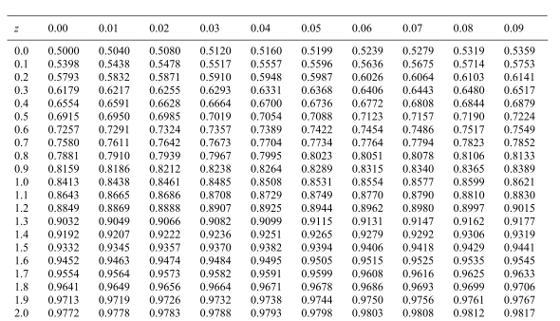

Slide 45
Calculating Normal Distribution Probabilities
Example 2: Probability of a range/interval
e.g. probability of a value between 1.46 and 2.05 i.e. p(1.46<z<2.05)
p(1.46<z<2.05)
= p(z<2.05) – p(z<1.46)
= 0.9798 – 0.9279
= 0.0519

Slide 46
Calculating Normal Distribution Probabilities
Example 3: Upper tail probabilities…
e.g. probability of a value > 2.05 sd above the mean i.e. p(z>2.05)
p(z>2.05) = 1 – p(z<2.05)

Slide 48
Calculating Normal Distribution Probabilities
Example 3: Upper tail probabilities…
e.g. probability of a value > 2.05 sd above the mean i.e. p(z>2.05)
p(z>2.05)
= 1 – p(z<2.05)
= 1 – 0.9798
= 0.0202

Slide 49
Calculating Normal Distribution Probabilities
Example 4: Values below the mean
e.g. probability of a value <-1.3 i.e. p(z<-1.3)
p(z<-1.3)
= p(z>1.3)
= 1 – p(z<1.3)

Slide 51
Calculating Normal Distribution Probabilities
Example 4: Values below the mean
e.g. probability of a value <-1.3 i.e. p(z<-1.3)
p(z<-1.3)
= p(z>1.3)
= 1 – p(z<1.3)
= 1 – 0.9032 = 0.0968

Slide 52
Calculating Normal Distribution Probabilities
Example 5: Values below the mean
e.g. probability of a value > -1.52 i.e. p(z>-1.52)
p(z>-1.52)
= p(z<1.52)

Slide 54
Calculating Normal Distribution Probabilities
Example 5: Values below the mean
e.g. probability of a value > -1.52 i.e. p(z>-1.52)
p(z>-1.52)
= p(z<1.52)
= 0.9357

Slide 55
Calculating Normal Distribution Probabilities
Example 6: Ranges spanning the mean
e.g. probability of a value between -1.96 and 1.25 i.e. p(-1.96<z<1.25 )
p(-1.96<z<1.25)
= p(z<1.25) - p(z<-1.96)
= p(z<1.25) – (1 - p(z<1.96))

Slide 57
Calculating Normal Distribution Probabilities
Example 6: Ranges spanning the mean
e.g. probability of a value between -1.96 and 1.25 i.e. p(-1.96<z<1.25 )
p(-1.96<z<1.25)
= p(z<1.25) - p(z<-1.96)
= p(z<1.25) – (1 - p(z<1.96))
= 0.8944 – (1 – 0.9750)
= 0.8694

Slide 58
Calculating Normal Distribution Probabilities
Example 7: Probability in two tails
e.g. probability of a value <-2 or > 2
p(z<-2 or z>2)
= 2 x p(z>2)
= 2 x (1-p(z<2))

Slide 60
Calculating Normal Distribution Probabilities
Example 7: Probability in two tails
e.g. probability of a value <-2 or > 2
p(z<-2 or z>2)
= 2 x p(z>2)
= 2 x (1-p(z<2))
= 2 x (1 – 0.9772)
= 0.0456

Slide 61

A manufacturer promises delivery in 7 weeks or less
Class Exercise
Records show an approximately normally distributed delivery times
with a mean of 42 days and a standard deviation of 14 days

Slide 62
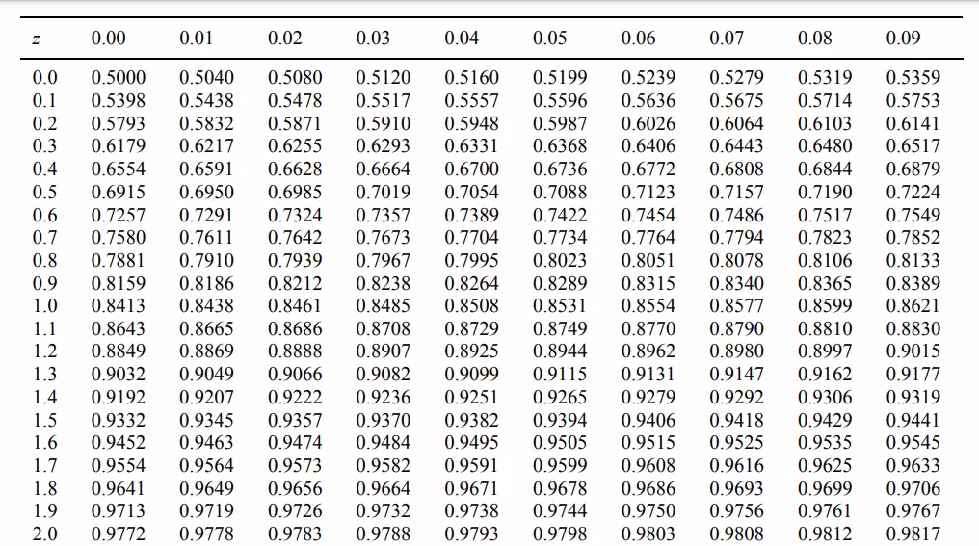
Question 1
Promise 7 weeks
Mean 42 days
SD 14 days
What proportion of customers receive their deliveries late?

Slide 63
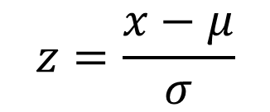
Question 1
Promise 7 weeks
Mean 42 days
SD 14 days
What proportion of customers receive their deliveries late?
$$z=\frac{x−μ}{σ}$$
how many sd above the mean
is this?
(49-42/14) = 0.5
what is the probability of a
value < 0.5 sd?
P(z<0.5) is 0.6915
value > 0.5 sd?
P(z>0.5) is 1 – 0.6915 = 0.3085
So 30.85% of customers receive their deliveries late
42
49

Slide 64
Question 2
Promise 7 weeks
Mean 42 days
SD 14 days
What proportion of customers receive delivery between
28 days and 49 days (inclusive)?

Slide 65
Question 2
Promise 7 weeks
Mean 42 days
SD 14 days
What proportion of customers receive delivery between
28 days and 49 days (inclusive)?
28 days is a value ((28-42)/14)= -1 sd below the mean
p(z<-1) = p(z>1)= 1-p(z<1)
p(z<1) = 0.8413
< 28 and < 50
(i.e includes 49)
So p(z<-1)= 1-0.8413 = 0.1587
i.e. p(days<28) = 0.1587
p(days<50) = p(z<0.57) = 0.7157
so p(days >28 and <50)
= 0.7157 - 0.1587
= 0.557
42
So 55.7% of customers receive deliveries in 28 to 49 days inclusive.
28
50

Slide 66
Calculating Normal Distribution Probabilities
Calculating z for given probabilities
p(z>a) = 0.05 can be found by using the tables “backwards”
In the cumulative table we are looking for p(z<a)= 1 – 0.05 = 0.95
Find the nearest match in the tables.
Nearest for 0.95 are 0.9495 and 0.9505
Usually take the closest, but if the problem says, for example, p(z>a) is no more than 0.05 then we would use the value which is greater than 0.95 rather than less

Slide 68
Question 3
80% Promise?
Mean 42 days
SD 14 days
To what figure should the delivery promise be amended if
it is required that at most 20% of deliveries should be late?

Slide 69
Question 3
80% Promise?
Mean 42 days
SD 14 days
To what figure should the delivery promise be amended if
it is required that at most 20% of deliveries should be late?
p(days > d) < 0.2 ==> p(days < d) > 0.8
This section involves using the tables "backwards". We need the probability to be as near to 0.80 as possible, but not below it.
From the tables p=0.8023 is nearest to 0.8.
This corresponds to a z value of 0.85
p < 0.20
𝑧=(𝑥−𝜇)/𝜎 could be rewritten as 𝑥=𝑧𝜎+𝜇
The delivery promise should therefore be amended to 0.85*14+42 = 53.9 days (round to 54 days)
42
d

Slide 71
Summary
Random Variables & Probability Distributions
Discrete Probability Distribution
Continuous Probability Distribution
Normal Distribution
Standardized Normal Distribution
Class Exercise
Notes:
Descriptive statistics is about summarizing and presenting data. This week we will look at presenting. Unless there are only a small number of values it can be hard to make sense of raw data.

Slide 72
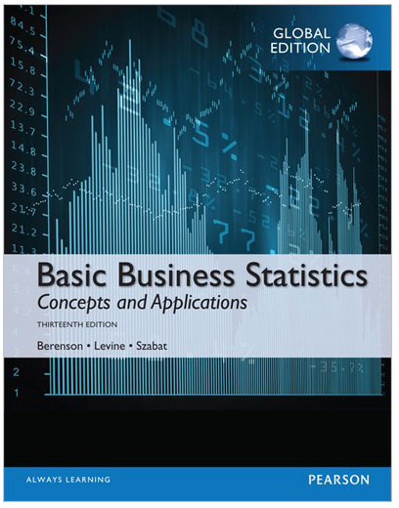
Reading…
Chapter 6
The Normal Distribution and…
Sections 6.1 to 6.3
Very important to read
Optional reading
Chapter 5
for Discrete probability distribution
Section 6.4 and 6.5
for Uniform and Exponential distribution

Slide 73
Module Overview
Descriptive
Statistics
Probability
Distributions
Hypothesis
Testing 1
Probability
Sampling
Week
1
Week
2
Week
3
Week
4
Week
5
Week
6
Week
7
Week
8
Week
9
Week
10
Hypothesis
Testing 2
Testing
Relationship
Regression
Conditional
Probability
Factor
Analysis
Week
11
Revision

