Slide 1
Module Overview
Descriptive
Statistics
Probability
Distributions
Hypothesis
Testing 1
Probability
Sampling
Week
1
Week
2
Week
3
Week
4
Week
5
Week
6
Week
7
Week
8
Week
9
Week
10
Hypothesis
Testing 2
Testing
Relationship
Regression
Conditional
Probability
Factor
Analysis
Week
11
Revision

Slide 2

What is Factor Analysis?
A technique to untangle the relationships of variables into their patterns, ending up in a smaller number of factors i.e.
    $\left[X_{1},X_{2},X_{3},X_{4},…,X_{m}\right]↔\left[F_{1},F_{2},…,F_{k}\right]$
Factor analysis assembles common variables into descriptive categories.
(Harman 1976)
Notes:
One of the primary goals of factor analysis is often to identify a measurement model for a latent variable
This includes
identifying the items to include in the model
identifying how many ‘factors’ there are in the latent variable
identifying which items are “associated” with which factors
Usually ends up in an exploratory finding

Slide 3
Why Factor Analysis?
Curse of dimensionality $→$ Parsimony
Large datasets that consist of several variables can be reduced by observing ‘groups’ of variables (i.e., factors)
Theory development
Consider for example: Personality assessment variables
Talkative | Disorganized | Shy
Does a thorough job | Worries | Efficient
Depressed | Quiet | Calm in tense situations
Reserved | Lazy | Outgoing
Careless | Emotionally stable | Sticks to plans
Relaxed | Assertive | Nervous
Reliable | Perseveres | Distractible
Tense

Slide 4
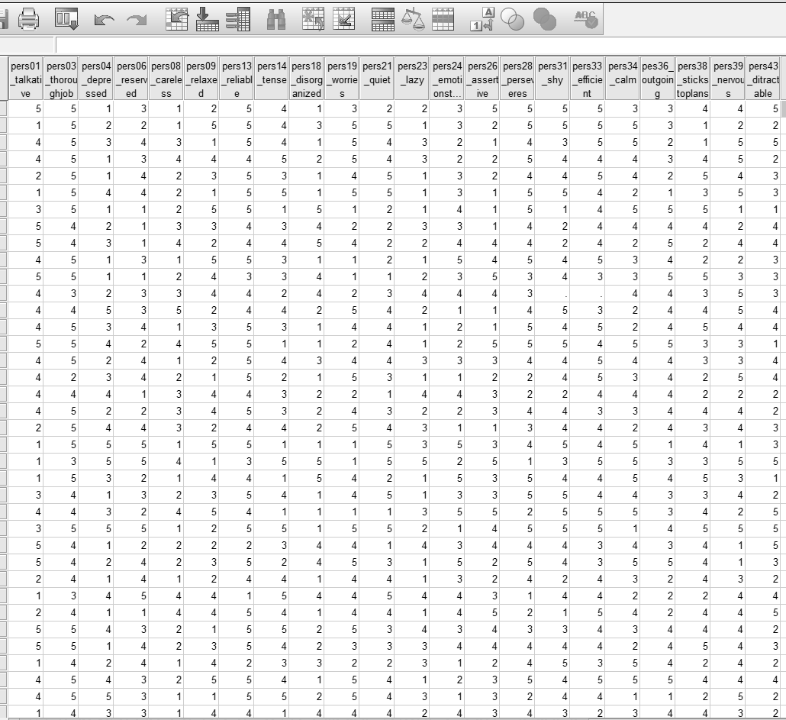
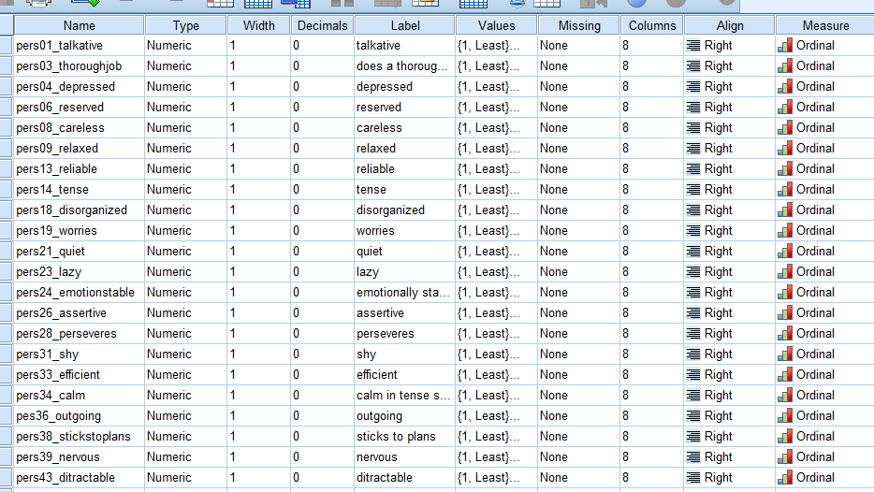
Example: Personality assessment

Slide 5
How to perform factor analysis
Four stages…
Correlation matrix
Factor extraction
Rotation
Computing factor scores
Notes:
So let’s move on to looking at the process of factor analysis.
There is quite a lot of choice in the factor analysis procedure. The outcome also depends on exactly which variables are included in some cases. The aim is always to get fewer factors than variables and for these to be meaningful. The choice involved though does mean that two people might get different outcomes from the same data, even if they choose the same variables as input. The aim of simplicity and meaningfulness mitigates this effect.
To walk through things it is useful to look at some SPSS output. Rather than put sections in the slides I’ve handed out copies of a set of output, as it is easier for you to see the details. I’ll go through this example (which is basically data reduction) and then discuss the options a bit more once you have some context. I’ll also discuss sample size, which can give rise to queries during projects.

Slide 6
Correlation Matrix
The starting point of factor analysis is a correlation matrix, in which the correlations between the studied variables are presented.
$X_{1}X_{2}X_{3}X_{4}$… $X_{m}$

Slide 7
Correlation Matrix
Computing correlations
… for all pairs
$X_{1}{ X}_{2} X_{3 }X_{4}$ … $X_{m}$
$X_{1} { X}_{2 }X_{3} X_{4}$ … $X_{m}$
Notes:
So let’s move on to looking at the process of factor analysis.
There is quite a lot of choice in the factor analysis procedure. The outcome also depends on exactly which variables are included in some cases. The aim is always to get fewer factors than variables and for these to be meaningful. The choice involved though does mean that two people might get different outcomes from the same data, even if they choose the same variables as input. The aim of simplicity and meaningfulness mitigates this effect.
To walk through things it is useful to look at some SPSS output. Rather than put sections in the slides I’ve handed out copies of a set of output, as it is easier for you to see the details. I’ll go through this example (which is basically data reduction) and then discuss the options a bit more once you have some context. I’ll also discuss sample size, which can give rise to queries during projects.

Slide 8
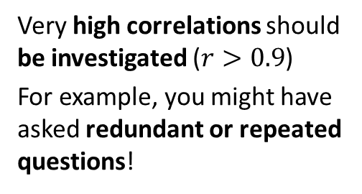
Correlation Matrix
-1
0
+1
Computing correlations for all pairs
Very high correlations should be investigated ($r>0.9$)
For example, you might have asked redundant or repeated questions!
$X_{1}{ X}_{2} X_{3 }X_{4}$ … $X_{m}$
$X_{1} { X}_{2 }X_{3} X_{4}$ … $X_{m}$
Notes:
So let’s move on to looking at the process of factor analysis.
There is quite a lot of choice in the factor analysis procedure. The outcome also depends on exactly which variables are included in some cases. The aim is always to get fewer factors than variables and for these to be meaningful. The choice involved though does mean that two people might get different outcomes from the same data, even if they choose the same variables as input. The aim of simplicity and meaningfulness mitigates this effect.
To walk through things it is useful to look at some SPSS output. Rather than put sections in the slides I’ve handed out copies of a set of output, as it is easier for you to see the details. I’ll go through this example (which is basically data reduction) and then discuss the options a bit more once you have some context. I’ll also discuss sample size, which can give rise to queries during projects.

Slide 9
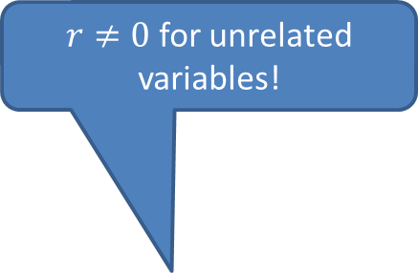
Correlation Matrix
-1
0
+1
Computing correlations for all pairs
$r≠0$ for unrelated variables!
$X_{1}{ X}_{2} X_{3 }X_{4}$ … $X_{m}$
Here, we have ordered the variables nicely, but in practice, this matrix is not so easy to read
$X_{1} { X}_{2 }X_{3} X_{4}$ … $X_{m}$
Notes:
So let’s move on to looking at the process of factor analysis.
There is quite a lot of choice in the factor analysis procedure. The outcome also depends on exactly which variables are included in some cases. The aim is always to get fewer factors than variables and for these to be meaningful. The choice involved though does mean that two people might get different outcomes from the same data, even if they choose the same variables as input. The aim of simplicity and meaningfulness mitigates this effect.
To walk through things it is useful to look at some SPSS output. Rather than put sections in the slides I’ve handed out copies of a set of output, as it is easier for you to see the details. I’ll go through this example (which is basically data reduction) and then discuss the options a bit more once you have some context. I’ll also discuss sample size, which can give rise to queries during projects.

Slide 10
Examining Correlations
-1
0
+1
Bartlett’s test of sphericity
H₀: the correlation matrix is an identity matrix
We want the correlation matrix significantly different
$X_{1}{ X}_{2} X_{3 }X_{4}$ … $X_{m}$
NOT VERY USEFUL
Field indicates an experienced colleague has never seen it non-significant!
$X_{1} { X}_{2 }X_{3} X_{4}$ … $X_{m}$
Notes:
If you felt happy after looking at the matrix then this will be ok almost by definition.
Bartlett’s test is very sensitive and affected by number of cases (so large samples would tend to be significant even if correlations are quite low).
So basically a non-significant test would be dynamite, but a significant one is not particularly supportive. The one for this data is significant.

Slide 11
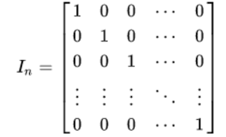
Note: This is an identity matrix

Slide 12

Examining Correlations
Kaiser-Meyer-Olkin (KMO) measure of sampling adequacy
tests the relationships between variables
This compares the magnitudes of the correlation coefficients and the partial correlation coefficients.
Indicate the suitability of your data for structure detection.
KMO returns values between 0 and 1.
KMO Values close to 1 generally indicate that a factor analysis may be useful with your data. If the value is less than 0.50, the results of the factor analysis probably won't be very useful.
$X_{1}{ X}_{2} X_{3 }X_{4}$ … $X_{m}$
K
 | K
 |  | K
 |  |  | K
 |  |  |  | K
 |  |  |  |  | K
 |  |  |  |  |  | K
 |  |  |  |  |  |  | K
 |  |  |  |  |  |  |  | K
 |  |  |  |  |  |  |  |  | K
 |  |  |  |  |  |  |  |  |  | K
 |  |  |  |  |  |  |  |  |  |  | K
 |  |  |  |  |  |  |  |  |  |  |  | K
 |  |  |  |  |  |  |  |  |  |  |  |  | K
 |  |  |  |  |  |  |  |  |  |  |  |  |  | K
$X_{1} { X}_{2 }X_{3} X_{4}$ … $X_{m}$
Notes:
If you felt happy after looking at the matrix then this will be ok almost by definition.
Bartlett’s test is very sensitive and affected by number of cases (so large samples would tend to be significant even if correlations are quite low).
So basically a non-significant test would be dynamite, but a significant one is not particularly supportive. The one for this data is significant.

Slide 13
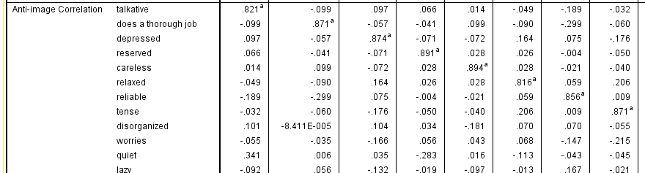
KMO-MSA in SPSS
A value of 0 indicates that the sum of partial correlations is large relative to the sum correlations, indicating factor analysis is likely to be inappropriate
Values below 0.5 indicate you shouldn’t proceed
A KMO value close to 1 indicates that the sum of partial correlations is not large relative to the sum of correlations and so factor analysis should yield distinct and reliable factors.

Slide 14
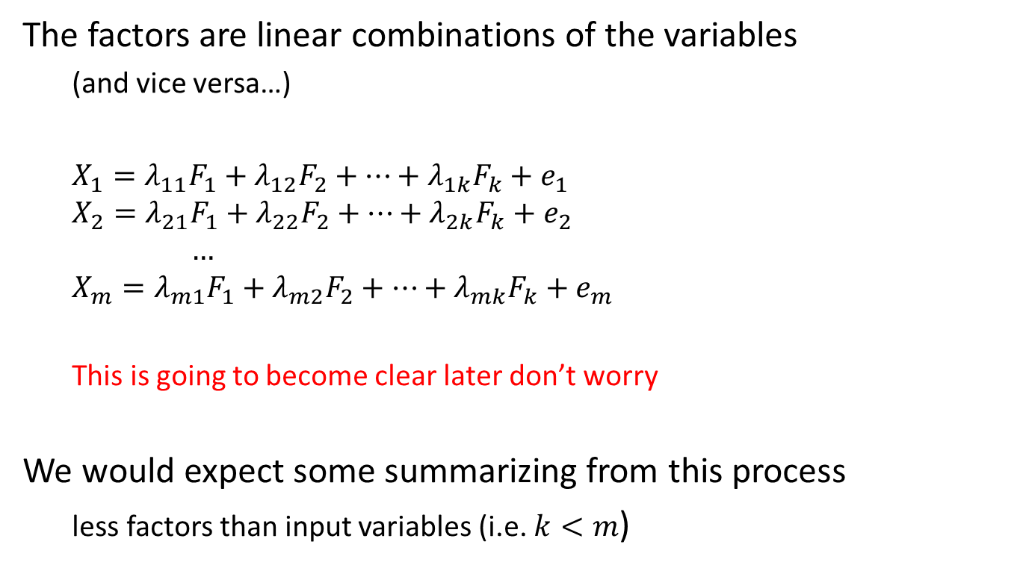
Factor Extraction
The factors are linear combinations of the variables
  (and vice versa…)
  $$X_{1}=λ_{11}F_{1}+λ_{12}F_{2}+…+λ_{1k}F_{k}+e_{1}$$
  $$X_{2}=λ_{21}F_{1}+λ_{22}F_{2}+…+λ_{2k}F_{k}+e_{2}$$
      $$…$$
  $$X_{m}=λ_{m1}F_{1}+λ_{m2}F_{2}+…+λ_{mk}F_{k}+e_{m}$$
  This is going to become clear later don’t worry
We would expect some summarizing from this process
  less factors than input variables (i.e. $k<m$)
In a theory building exercise, it’s very important that the factors are meaningful – if they aren’t, you need to rethink

Slide 15
Factor Extraction
A number of approaches exists, for example…
Principal Component Analysis
An exploratory technique that converts a set of correlated variables into a set of uncorrelated variables (the principal components)
The linear combination of variables that explains the most variation is the first principal component
The second principal component is the combination, uncorrelated with the first, that explains the next most variance
and so on, until all variance is explained

Slide 16
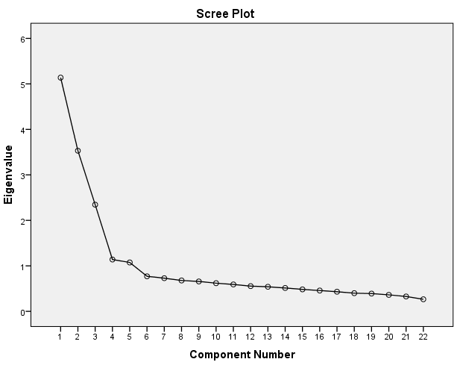
Factor Extraction
Eigenvalue is the amount of variation explained by one component. (Principal Eigenvalue is the maximal value)
As a default SPSS uses the eigenvalue as a basis for retaining factors; it extracts factors with eigenvalue > 1
  a rule put forward by Kaiser¹
Or, we look at the scree plot, and usually observe how many factors there are, before the point of inflection²
Kaiser, H.F. (1960). The application of electronic computers to factor analysis. Educational and Psychological Measurement, 20, 141–151.
Cattell, R.B. (1966). The scree test for the number of factors. Multivariate Behavioral Research, 1, 245–276.
Notes:
The values in this example are relatively high probably because they are physical characteristics of a machine. Things with individuals would be less so, maybe only 40% variation explained.
These proportions are on the diagonals of the Reproduced Correlations, which is the correlation matrix based on the factors extracted. If they are near this means the factors account for a lot of the original variance. Residuals are produced between observed and reproduced correlations. The % of nonredundant residuals with absolute values > 0.05 should be less than 50% and small is good.

Slide 17
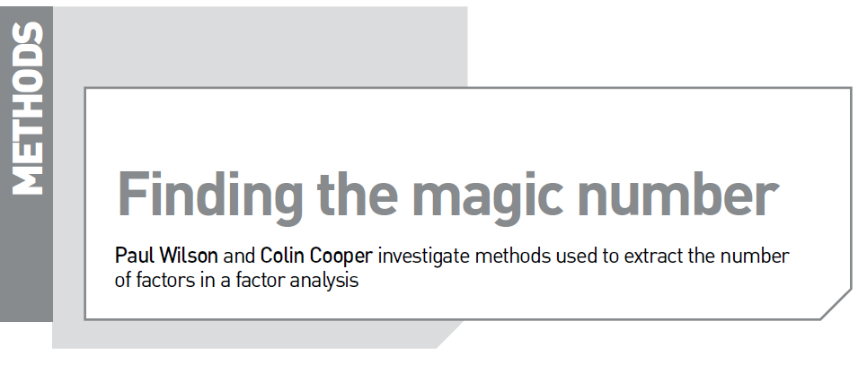
Factor Extraction
More appropriate approaches:-
  Minimum average partial³ (MAP)
    Velicer, W.F. (1976). Determining the number of components from the matrix of partial correlations.
  Parallel Analysis⁴
    Horn, J.L. (1965). A rationale and test for the number of factors in factor analysis. Psychometrika, 30, 179–185.
HOW MANY FACTORS IN FACTOR ANALYSIS?
READ THE 2-PAGE ARTICLE ON VLE

Slide 18
10 Minutes Break

Slide 19
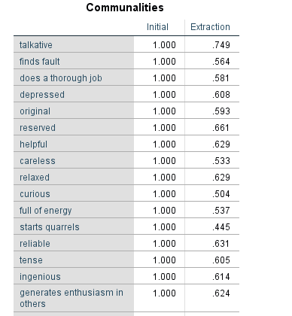
Communalities
Communalities – This is the proportion of each variable's variance that can be explained by the factors (e.g., the underlying latent continua)

Slide 20
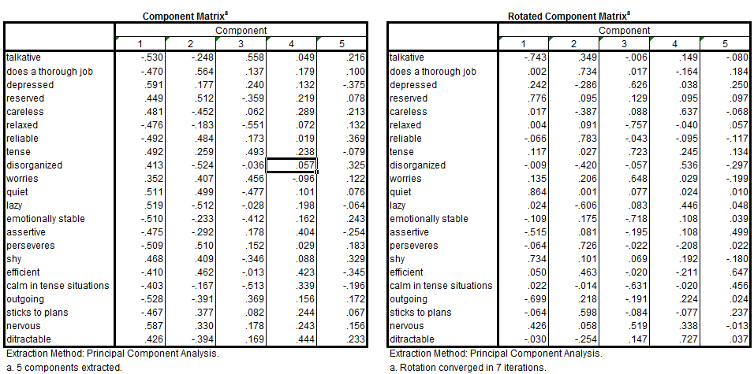
Factor Extraction
PC2
PC2
PC1
Notes:
The values in this example are relatively high probably because they are physical characteristics of a machine. Things with individuals would be less so, maybe only 40% variation explained.
These proportions are on the diagonals of the Reproduced Correlations, which is the correlation matrix based on the factors extracted. If they are near this means the factors account for a lot of the original variance. Residuals are produced between observed and reproduced correlations. The % of nonredundant residuals with absolute values > 0.05 should be less than 50% and small is good.

Slide 21
Factor Rotation
After extraction, typically variables have high loadings on the most important factor and less on each of the others
This doesn’t achieve what we want in terms of interpretability!
PC2
F2
PC2
Rotation can improve the situation
Think of the factor as an axis against which variables can be plotted
F1
PC1
Notes:
The values in this example are relatively high probably because they are physical characteristics of a machine. Things with individuals would be less so, maybe only 40% variation explained.
These proportions are on the diagonals of the Reproduced Correlations, which is the correlation matrix based on the factors extracted. If they are near this means the factors account for a lot of the original variance. Residuals are produced between observed and reproduced correlations. The % of nonredundant residuals with absolute values > 0.05 should be less than 50% and small is good.

Slide 22
Unrotated versus Rotated

Slide 23
Types of Rotation
Orthogonal
Oblique
factors are rotated, but kept uncorrelated (axes perpendicular)
factors can correlate, so angle between axes varies
PC2
F2
PC2
PC2
F1
F2
F1
PC1
PC1
PC1
Notes:
Here we used an orthogonal technique, so our rotated factors are still orthogonal
Going back to the “rotation sum of squared loadings”
You’ll see the amount of variation explained by the rotated factors is the same as before rotation, but the % variation explained has been spread more between the factors

Slide 24
Which type of rotation
Orthogonal
Oblique
factors are rotated, but kept uncorrelated (axes perpendicular)
factors can correlate, so angle between axes varies
Easier to report and commonly used, correlation between factors would be expected for data on humans¹
Experts² suggest trying an oblique rotation and examining the correlations between factors
F2
PC2
F1
F2
F1
PC1
PC1
PC1
varimax is a common orthogonal rotation option
oblimin and promax are widely-used oblique rotations
¹Field
²Tabachnick & Fidell
Notes:
Here we used an orthogonal technique, so our rotated factors are still orthogonal
Going back to the “rotation sum of squared loadings”
You’ll see the amount of variation explained by the rotated factors is the same as before rotation, but the % variation explained has been spread more between the factors

Slide 25
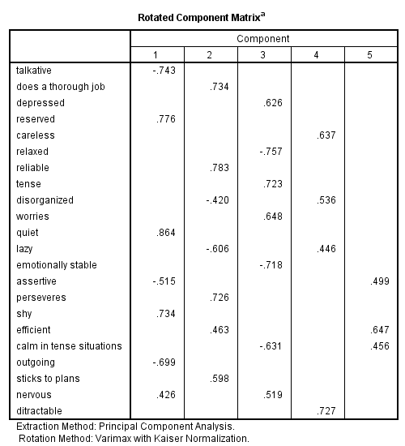
Factor Rotation Matrix
Shows the loading of each variable onto each factor after rotation
This is the output we interpret for the factors
Different people define different cut-off point. Most common cut-off points are 0.4 and 0.5
Notes:
in other words the correlation between the variable and the factor
if you get all loadings printed initially it lets you see how close others are to your cutoff.
the first three variables correlated with factor 1 seem performance related; engine size and horsepower, with price being paid to have this
the second factor seems to relate to physical size
the third related to fuel economy or possibly range
In the application of predicting sales these factors used as scores would put more information into the model than say, using the variable which is most correlated with the factor alone.
In applications where you are mainly focused on meaning interpretability would be the main focus. These variables could be seen as expressing aspect that influence consumer preferences. You might try running different models in this situation if you aren’t so happy with the outcome.
If the rotation hasn’t made much difference you can consider whether another method would be better

Slide 26
Personality assessment
 | F1 | F2 | F3 | F4 | F5
Talkative | -.743 | .349 | -.006 | .149 | -.080
Does a thorough job | .002 | .734 | .017 | -.164 | .184
Depressed | .242 | -.286 | .626 | .038 | .250
Reserved | .776 | .095 | .129 | .095 | .097
Careless | .017 | -.387 | .088 | .637 | -.068
Relaxed | .004 | .091 | -.757 | -.040 | .057
Reliable | -.066 | .783 | -.043 | -.095 | -.117
Tense | .117 | .027 | .723 | .245 | .134
Disorganized | -.009 | -.420 | -.057 | .536 | -.297
Worries | .135 | .206 | .648 | .029 | -.199
Quiet | .864 | .001 | .077 | .024 | .010
Lazy | .024 | -.606 | .083 | .446 | .048
Emotionally stable | -.109 | .175 | -.718 | .108 | .039
Assertive | -.515 | .081 | -.195 | .108 | .499
Perseveres | -.064 | .726 | -.022 | -.208 | .022
Shy | .734 | .101 | .069 | .192 | -.180
Efficient | .050 | .463 | -.020 | -.211 | .647
Calm in tense situations | .022 | -.014 | -.631 | -.020 | .456
Outgoing | -.699 | .218 | -.191 | .224 | .024
Sticks to plans | -.064 | .598 | -.084 | -.077 | .237
Nervous | .426 | .058 | .519 | .338 | -.013
Distractible | -.030 | -.254 | .147 | .727 | .037
Extraction Method: Principal Component Analysis. Rotation Method: Varimax with Kaiser Normalization.
Cut-off value
> 0.4

Slide 27
Limitations
Several…
Note that we are using correlation so…
Errors should roughly be normally distributed
Sample size is important to test the significance
Naming the factors can be problematic…
Factor names may not accurately reflect the variables within the factor…
Some variables may load onto multiple factors which is known as split loadings. Split loadings are sometimes difficult to interpret

Slide 28
Ways of using factor analysis
Exploratory Factor Analysis
Confirmatory Factor Analysis
We collect the data to explore the underlying dimensions or factors that underlie complex phenomena
We hypothesize the underlying factors along with their relationships and test our hypothesis by fitting the available data into this model.
How many factors are there?
Is data confirming the factors that my model suggests?
Which variables are mapped on these factors
Are the variables correctly loading on these factors?
Notes:
indicator variables can be referred to as manifest variables
they are almost always interval or ratio data – you need variation

Slide 29
Exercise
 | F1 | F2
To attract large customers | 0.74100 | 0.22288
As a final ‘clincher’ for a sale | 0.78508 | 0.17410
To promote slow moving products | 0.09721 | 0.90158
When customers insist | 0.68154 | -0.06330
To keep in line with competitors | 0.69488 | 0.13033
To reward loyal customers | 0.51613 | 0.46329
To promote declining products | 0.13069 | 0.91726
To promote new products | 0.27239 | 0.81636
To win customers from rivals | 0.73544 | 0.37578
To gain new customers | 0.68838 | 0.43811
(a) Please illustrate the groups of variables that load onto the two factors identified, using a threshold of 0.4.
(b) Please name each factor.
(c) Does split loading exist?

Slide 30
Exercise
Customers related
Products related
 | F1 | F2
To attract large customers | 0.74100
As a final ‘clincher’ for a sale | 0.78508
To promote slow moving products |  | 0.90158
When customers insist | 0.68154
To keep in line with competitors | 0.69488
To reward loyal customers | 0.51613 | 0.46329
To promote declining products |  | 0.91726
To promote new products |  | 0.81636
To win customers from rivals | 0.73544
To gain new customers | 0.68838 | 0.43811

Slide 31
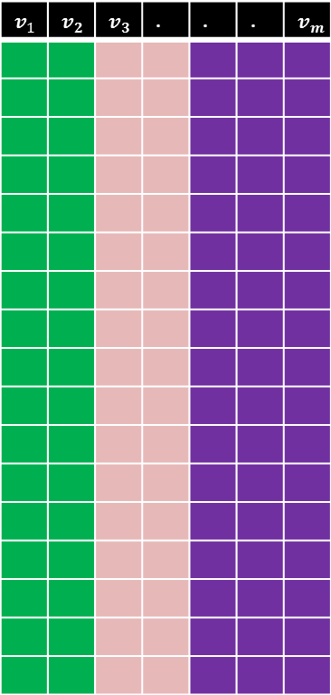

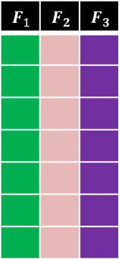

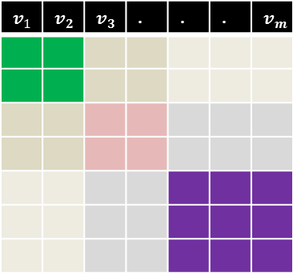
Summary
Sample1
Sample2
Sample3
.
.
.
.
.
.
.
.
.
.
.
.
.
Sample n
$$v_{1}$$ | $$v_{2}$$ | $$v_{3}$$ | . | . | . | $$v_{m}$$
$$v_{1}$$
$$v_{2}$$
$$v_{3}$$
.
.
.
$$v_{m}$$
$$v_{1}$$ | $$v_{2}$$ | $$v_{3}$$ | . | . | . | $$v_{m}$$
$$v_{1}$$
$$v_{2}$$
$$v_{3}$$
.
.
.
$$v_{m}$$
$$F_{1}$$ | $$F_{2}$$ | $$F_{3}$$

Slide 32
Examination!
The exam will be an 60 questions MCQ in-person
14 Jan 2026 from 2:00 PM to 4:00 PM
Location will be announced later.
Once you have started taking the exam you have 2 hours to complete it
You don’t lose points for no answer or wrong answers
A training (mock) exam is available online.
Try it after the seminar in computer cluster (the tutorial has been kept short on purpose to allow you to check the exam).

Slide 33
When preparing for the exam
Tips:
Understand the concepts covered in the lecture slides.
Practice 100+ questions in lecture slides and seminar worksheets at least three times.
Complete 30+ mock questions within an hour.
Please book a meeting and talk to me!
Available in person this Friday
Available online on the rest days
Please send me an email if you have any questions. I will try to check email from time-to-time, and do my best to address your questions as quickly as possible.

Slide 34


16x9 ration plasma template
Module evaluations
Scan the QR code below to complete your module evaluation surveys.
You can also access your surveys by logging in to Minerva or visiting https://leeds.bluera.com/leeds/

Slide 35
Module Overview
Descriptive
Statistics
Probability
Distributions
Hypothesis
Testing 1
Probability
Sampling
Week
1
Week
2
Week
3
Week
4
Week
5
Week
6
Week
7
Week
8
Week
9
Week
10
Hypothesis
Testing 2
Testing
Relationship
Regression
Conditional
Probability
Factor
Analysis
Week
11
Revision

