Slide 1
Module Overview
Descriptive
Statistics
Probability
Distributions
Hypothesis
Testing 1
Probability
Sampling
Week
1
Week
2
Week
3
Week
4
Week
5
Week
6
Week
7
Week
8
Week
9
Week
10
Hypothesis
Testing 2
Testing
Relationship
Regression
Conditional
Probability
Factor
Analysis
Week
11
Revision

Slide 2
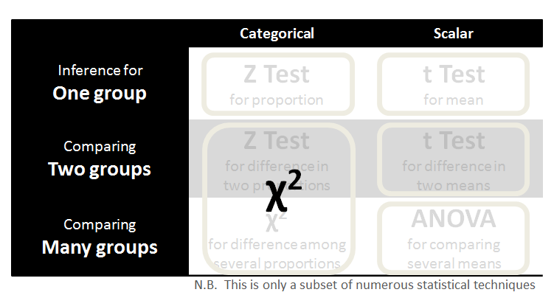
Week 8 Linear Regression
 | Categorical | Scalar
Relating Two groups | χ² test for independence | Correlation Linear Regression
Relating Many groups | Logistic Regression | Multiple Regression
N.B. This is only a subset of numerous statistical techniques

Slide 3
Regression Line
So, how to calculate the line that best fits the given data points?
Even if a straight line relationship were true, we do not get all points precisely on the line due to measurement errors.

Slide 4
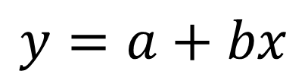






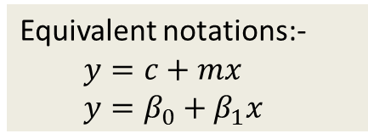
What is a line?
Equivalent notations:-
  $$y=c+mx$$
  $$y=β_{0}+β_{1}x$$
Algebraic Form
Graphical Form
dependent
variable
$$y$$
gradient or
slope
$$b=∆y/∆x$$
$$∆y$$
$$y=a+bx$$
$$∆x$$
$$a$$
Marginal effect of x on y - a measure of how much y tends to change when you increment in x
constant or
intercept
independent
variable
$$x$$

Slide 5



Regression Line
NB: True relationship may be more complicated than a straight line
Because of these issues we add an error to the model
$$y=a+bx+e$$
$$y=a+bx$$
Which line best fits the given data points?
$$x$$

Slide 6


Regression Line
$$y=a+bx+e$$
$$e_{i}$$
$$x$$

Slide 7
Regression Line
$$y=a+bx+e$$
$$e_{i}$$
$$x$$

Slide 8

Regression Line
We have data points x and y
We don’t know a and b
Minimize the sum of squared error from given points!
$$y=a+bx+e$$
We have data points x and y
We have data points x and y
$$e_{i}$$
This is known as the method of least squares
$$x$$

Slide 9




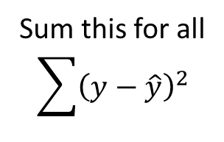
Method of Least Squares
$$y=a+bx+e$$
$$y= \hat{y} +e$$
Residual error
$$e=y−\hat{y}$$
$$e_{i}$$
$$e^{2}={\left(y−\hat{y}\right)}^{2}$$
Sum this for all
$$\sum{{\left(y−\hat{y}\right)}^{2}}$$
We try to minimize this

Slide 10
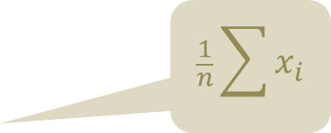
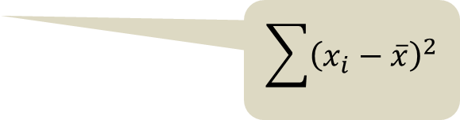
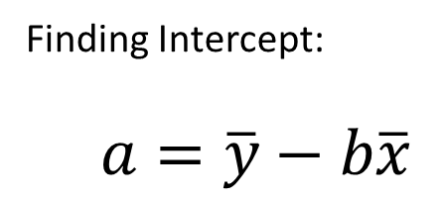
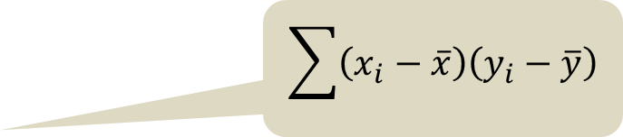
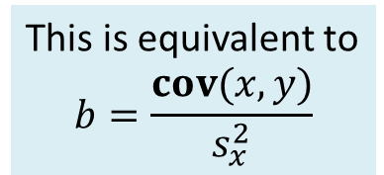
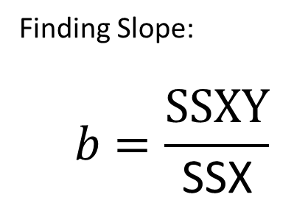
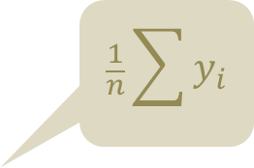
Method of Least Squares
Finding Slope:
  $$b=\frac{SSXY}{\text{SSX}}$$
$$\sum{\left(x_{i}−\overline{x}\right)\left(y_{i}−\overline{y}\right)}$$
This is equivalent to
$$b=\frac{cov(x,y)}{s_{x}^{2}}$$
$$\sum{{\left(x_{i}−\overline{x}\right)}^{2}}$$
$$\frac{1}{n}\sum{y_{i}}$$
Finding Intercept:
  $$a=\overline{y}−b\overline{x}$$
$$\frac{1}{n}\sum{x_{i}}$$

Slide 11
Linear Regression
Now that we have the regression line, we can use it to predict values of y
but:
Is there really a relationship between x and y?
How good a model is it of the relationship?
In a univariate regression (i.e. one independent variable) the significance of the relationship is the same as the significance of the correlation coefficient

Slide 12
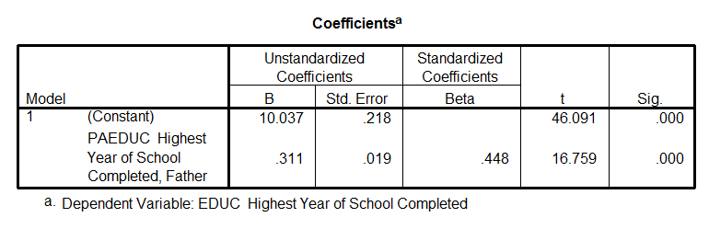
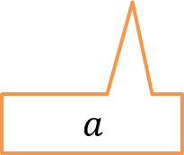

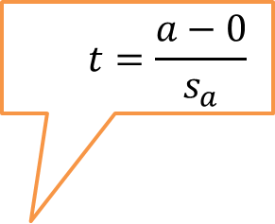
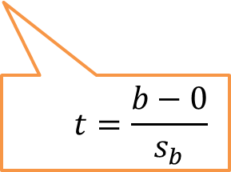
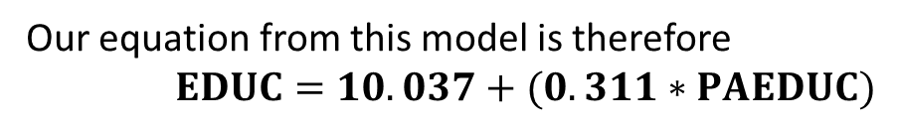
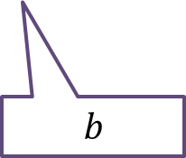
Linear Regression in SPSS
  $$t=\frac{a−0}{s_{a}}$$
  $$p−values$$
  $$t=\frac{b−0}{s_{b}}$$
Our equation from this model is therefore
$EDUC=10.037+(0.311∗PAEDUC)$
  $$a$$
  $$b$$

Slide 13
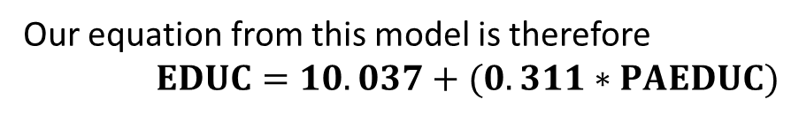
Question 1
Our equation from this model is therefore
$EDUC=10.037+(0.311∗PAEDUC)$
(1) According to the regression model, what is the appropriate way to increase the students' highest years of schooling completed? Should we increase or decrease their fathers' highest years of schooling completed?
(2) What is the null hypothesis for the red areas?
(3) What conclusions can we draw from the red areas?

Slide 14
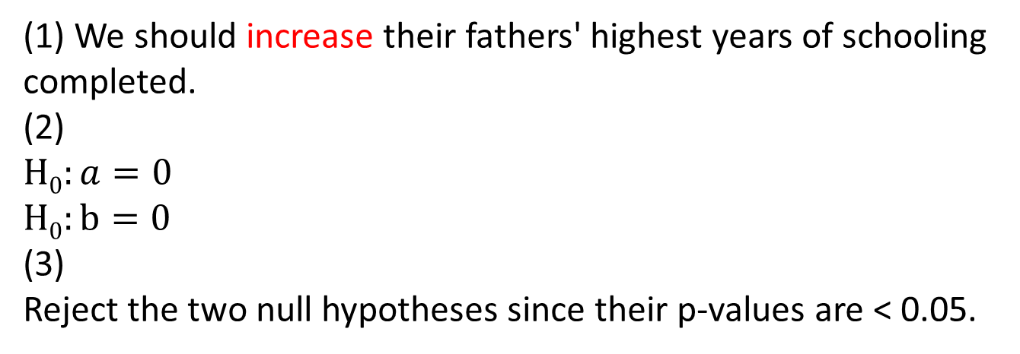
Question 1
Our equation from this model is therefore
$EDUC=10.037+(0.311∗PAEDUC)$
(1) We should increase their fathers' highest years of schooling completed.
(2)
$H0:a=0$
$H0:b=0$
(3)
Reject the two null hypotheses since their p-values are < 0.05.

Slide 15
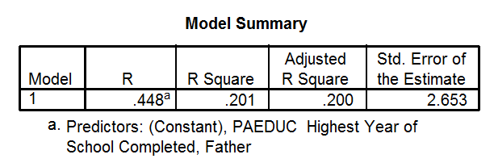
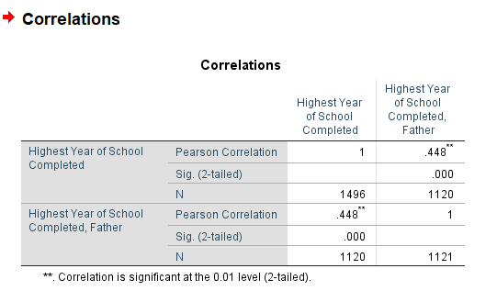
Linear Regression
R² provides a measure of how much of the variability in y is explained by the model
Please note that R here is the correlation coefficient, $r$

Slide 16






Linear Regression
y
Variance unexplained
Residual error
$$y_{i}$$
Total Variance
$$y_{i}−{\hat{y}}_{i}$$
$$y_{i}−\overline{y}$$
$${\hat{y}}_{i}$$
Variation explained through Regression
$${\hat{y}}_{i}−\overline{y}$$
$$\overline{y}$$
x

Slide 17
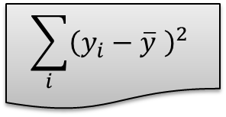
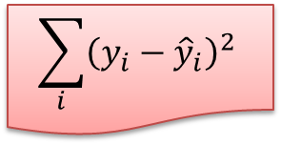
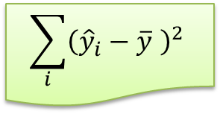
Linear Regression
y
ESS – Errors sum of squares
$$y_{i}$$
$$\sum_{i}{{\left(y_{i}−{\hat{y}}_{i}\right)}^{2}}$$
TSS - Total sum of Squares
$$y_{i}−{\hat{y}}_{i}$$
$$\sum_{i}{{\left(y_{i}−\overline{y} \right)}^{2}}$$
$$y_{i}−\overline{y}$$
$${\hat{y}}_{i}$$
RSS - Regression sum of squares
$${\hat{y}}_{i}−\overline{y}$$
$$\overline{y}$$
$$\sum_{i}{{\left({\hat{y}}_{i}−\overline{y} \right)}^{2}}$$
x

Slide 18
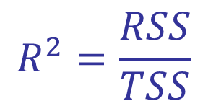
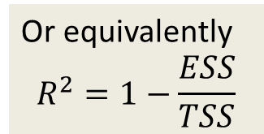

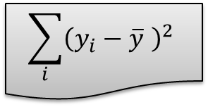
Measure of fit
R² is a measure of fit
(i.e. how well does the regression line fit the data points)
$$\sum_{i}{{\left({\hat{y}}_{i}−\overline{y} \right)}^{2}}$$
$$R^{2}=\frac{RSS}{TSS}$$
Or equivalently
$$R^{2}=1−\frac{ESS}{TSS}$$
$$\sum_{i}{{\left(y_{i}−\overline{y} \right)}^{2}}$$
NB: For only one independent variable, R² is equal to the squared correlation coefficient between x and y

Slide 19
Properties of R²
  Bigger values of R² imply more explanatory power for y
  0≤ R²≤1
  R²=1 means perfect fit.
  All data points exactly on regression line (i.e. ESS=0)
  R²=0 means no relation
  The model does not have any explanatory power for y whatsoever

Slide 20
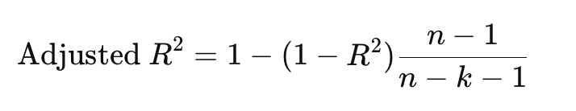
Adjusted R²
  While R² always increases (or stays the same) when you add more independent variables—even if those independent variables are useless …
  Adjusted R² is a modified version of R² that accounts for the number of independent variables in the model.

Slide 21
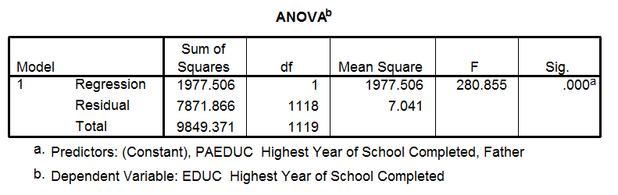
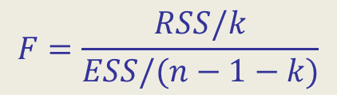
F Test for regression model
$$F=\frac{RSS/k}{ESS/(n−1−k)}$$
k is number of parameters (excluding the constant)
n is the number of observations

Slide 22
Non-linearity
Either x or y can be transformed by a variety of functions, for example. ln(y), x² ,1/x.
Theory might suggest a non-linear relationship
Observing an X-Y plot or the residual plots from the regression might suggest the relationship is non-linear.
Marks scored
Hours studied for exams
Hours studied for exams

Slide 23
10 Minutes Break

Slide 24
Multivariate Analysis
 | Categorical | Scalar
Relating Two groups | χ² test for independence | Correlation Linear Regression
Relating Many groups | Logistic Regression | Multiple Regression
N.B. This is only a subset of numerous statistical techniques

Slide 25
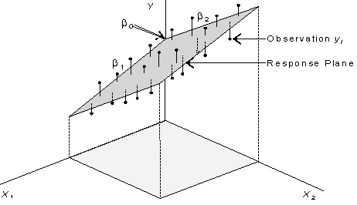

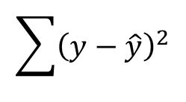
Multiple Regression
As with simple one variable regression, we want to minimise:-
$$\sum{{\left(y−\hat{y}\right)}^{2}}$$
Again estimated using least squares, using same principles as for one variable. Equation from the regression is
$$\hat{y}=β_{0}+β_{1}x_{1}+β_{2}x_{2}+…$$
Each independent variable is weighted to maximise prediction from the set of independent variables
Each independent variable is weighted to maximise prediction from the set of independent variables
Each independent variable is weighted to maximise prediction from the set of independent variables
Image source: http://www.sjsu.edu/faculty/gerstman/EpiInfo/cont-mult1.jpg

Slide 26
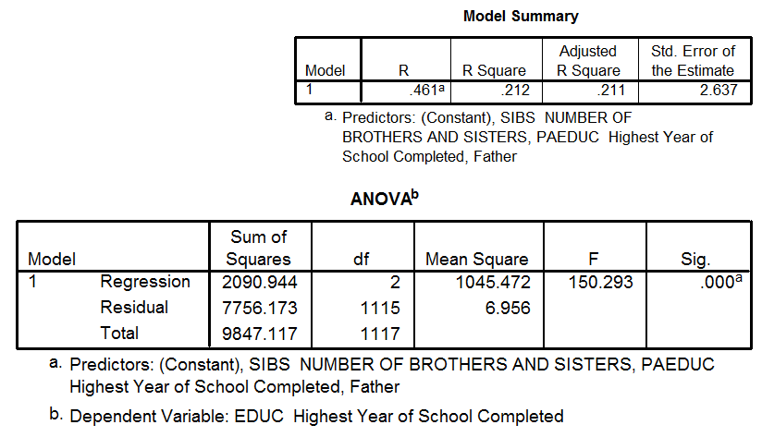

Multiple Regression
$$H_{0}:β_{1}=β_{2}= … =0$$

Slide 27
Question 2
$$H_{0}:β_{1}=β_{2}= … =0$$
What conclusions can we draw from the F-statistic?

Slide 28
Question 2
$$H_{0}:β_{1}=β_{2}= … =0$$
The regression model is statistically significant.

Slide 29
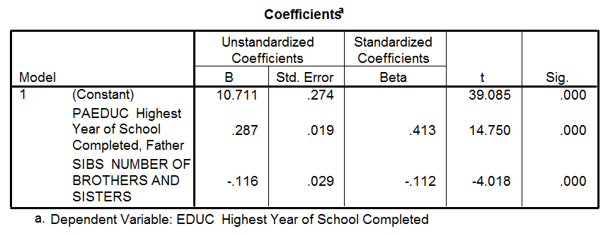
Question 3
Please write down our equation from this model
EDUC = ? + ( ? ∗ PAEDUC) + ( ? ∗SIBS)
Predict educ for someone for whom the father has 7 years of educations and who has 3 brothers and sisters
What is the null hypothesis for the red areas?
What conclusions can we draw from the red areas?

Slide 30
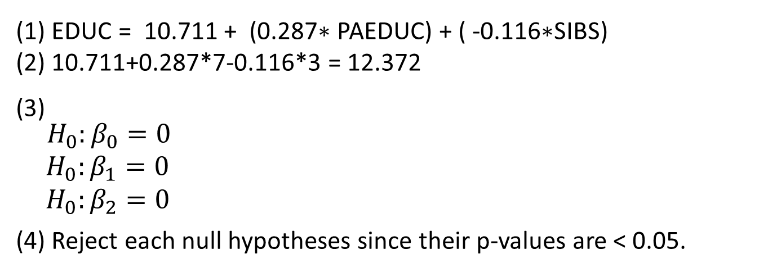
Question 3
(1) EDUC = 10.711 + (0.287∗ PAEDUC) + ( -0.116∗SIBS)
(2) 10.711+0.287*7-0.116*3 = 12.372
₍₃₎
$${ H}_{0}:β_{0}=0$$
$H_{0}:β_{1}=0$
$H_{0}:β_{2}=0$
(4) Reject each null hypotheses since their p-values are < 0.05.

Slide 31
Creating dummy variables
Some variables may be categorical. A common example would be gender, another example would be store location (e.g. Leeds, Manchester, and London)
Dummy variables are represented by dummy or indicator variables, which are set to 1 to represent one value (say “Leeds”) and 0 for all others
 | Dummy for Manchester | Dummy for Leeds
Manchester | 1 | 0
Leeds | 0 | 1
London | 0 | 0
There is a dummy variable for every value except for the baseline value (not given a variable acts as a baseline)
Optional Flipped Learning: Dummy Variable
Week 4 of LUBS5308M Business Analytics and Decision Science

Slide 32
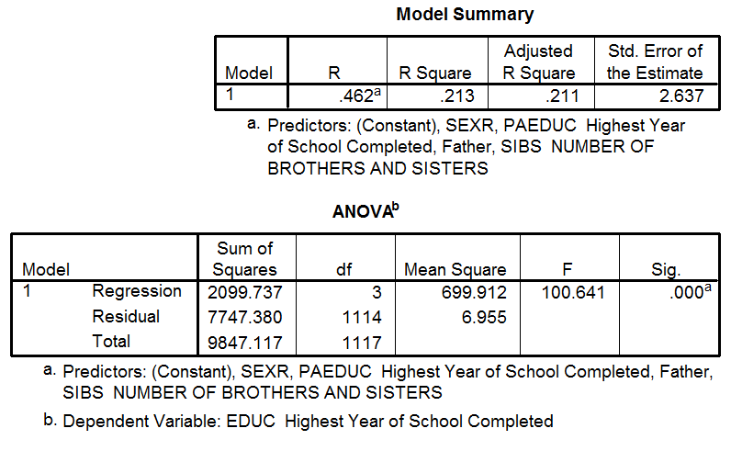
Creating dummy variables

Slide 33
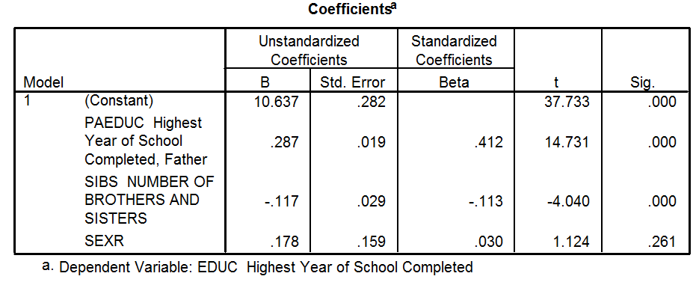
Creating dummy variables

Slide 34
Question 4
(1) Equation from this model is…
EDUC = + ( ∗ PAEDUC) + ( ∗SIBS) + ( ∗SEXR)
(2) What conclusions can we draw from the above t tests

Slide 35
Question 4
(1) Equation from this model is…
EDUC = 10.637 + ( 0.287 ∗ PAEDUC) + ( -0.117 ∗SIBS) + ( 0.178 ∗SEXR)
(2) The “SEXR" variable does not have a statistically significant effect on the dependent variable
Other variables have a statistically significant effect on the dependent variable

Slide 36
Creating interaction variables
The effect one independent variable has on the dependent variable might be affected by the value of a second independent variable
In this situation, we set up an interaction term
  Set up a variable which is the product of the two interacting variables and include this in the model
  If the interaction term is significant this indicates the interaction between the variables is present in the data

Slide 37
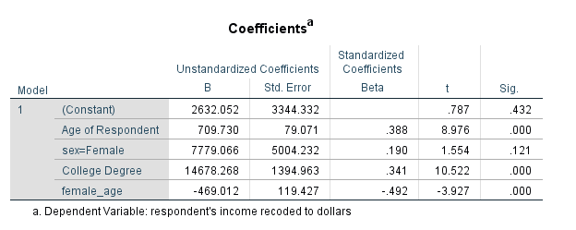
Example interaction variable
Predict the salary of a 45 years old woman WITH a college degree
SALARY F_45 = CONSTANT + AGE x 45 + FEMALE x 1 + DEGREE x 1 + FEMALE_AGE x 1 x 45=
35921.696
Predict the salary of a 45 years old man WITH a college degree
SALARY M_45 = CONSTANT + AGE x 45 + FEMALE x 0 + DEGREE x 1 + FEMALE_AGE x 0 x 45=
49248.17

Slide 38
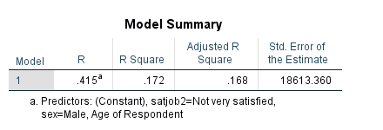
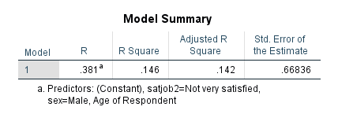
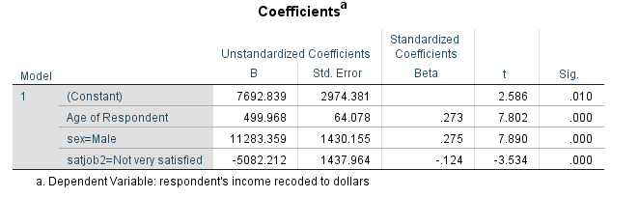
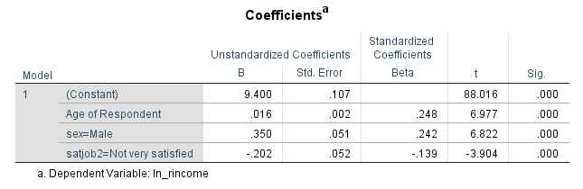
GSS full time – rincomdol & log(rincomdol) ~ gender age satjob

Slide 39
GSS full time – rincomdol & log(rincomdol) ~ gender age satjob
Interpretation
When age increase by 1, income increases by 1.6% all else being equal
Men are paid 35% more than women all else being equal
People who aren’t satisfied with their job are paid 20% less all else being equal

Slide 40
It is NOT all about R2
A very high R2 can be suspicious too!
Overfitting?
Presence of outliers?
Out-of-sample prediction?

Slide 41
What about using a dummy as a dependent variable in a linear regression
I would strongly advise against this
Can predict probabilities > 1
Can predict negative probabilities
Makes no sense
Better to use a logistic regression (logit or probit model)
Happy to assist with these models

Slide 42
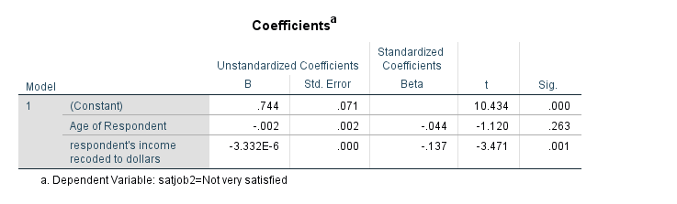
But let’s do it anyway (but this is stupid)
Equation from this model is…
SATJOB2 = 0.744 – 0.002 x AGE -0.000003332 x rincom
The probability that someone who is 40 years old and earns 200,000$ per year is not very satisfied with their job is -0.0024
NOPE, DOESN’T MAKE SENSE

Slide 43
Summary
 | Categorical | Scalar
Relating Two groups | χ² test for independence | Correlation Linear Regression
Relating Many groups | Logistic Regression | Multiple Regression
N.B. This is only a subset of numerous statistical techniques

Slide 44
Reading…
Berenson et al. (2015)
Chapter 14, Introduction to multiple regression
Sections 14.1 -14.2
Section 14.6
LUBS5308M
Flipped Learning Materials and Workshop in Week 4

Slide 45
Module Overview
Descriptive
Statistics
Probability
Distributions
Hypothesis
Testing 1
Probability
Sampling
Week
1
Week
2
Week
3
Week
4
Week
5
Week
6
Week
7
Week
8
Week
9
Week
10
Hypothesis
Testing 2
Testing
Relationship
Regression
Conditional
Probability
Factor
Analysis
Week
11
Revision

