Slide 1
Module Overview
Descriptive
Statistics
Probability
Distributions
Hypothesis
Testing 1
Probability
Sampling
Week
1
Week
2
Week
3
Week
4
Week
5
Week
6
Week
7
Week
8
Week
9
Week
10
Hypothesis
Testing 2
Testing
Relationship
Regression
Conditional
Probability
Factor
Analysis
Week
11
Revision

Slide 2
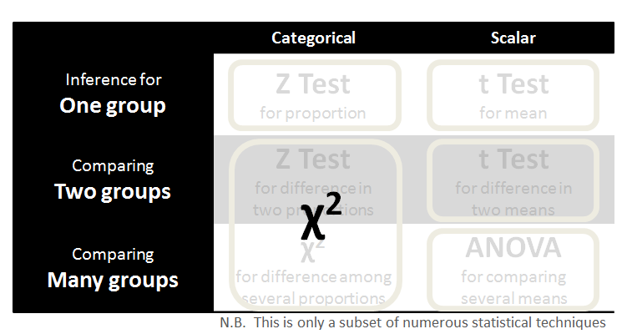
Hypothesis Testing
So far, looking for differences…
 | Categorical | Scalar
Relating Two groups | χ² test for independence | Correlation t Test Linear Regression
Relating Many groups | Logistic Regression | Multiple Regression
N.B. This is only a subset of numerous statistical techniques

Slide 3
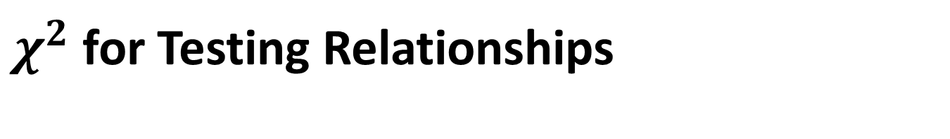
$χ^{2}$ for Testing Relationships
Row SUM
Is there a relationship between gender and product choice?
 | A | B | C
Number of MALES responded | 160 | 140 | 150
Number of FEMALES responded | 110 | 146 | 191
A+B+C
450
447
Number of customers responded
MALES+FEMALES | 270 | 286 | 341
897
Column SUM

Slide 4
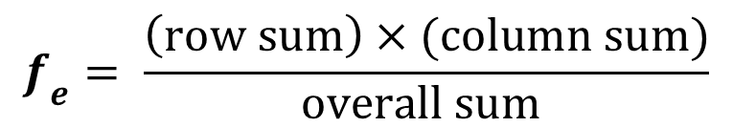
$χ^{2}$ for Testing Relationships
The Null Hypothesis is that…
There is no association between
gender and product preference
To generate the expected frequencies under the null hypothesis we use the formula
$$f_{e}= \frac{\left(row sum\right)×(column sum)}{overall sum }$$

Slide 5

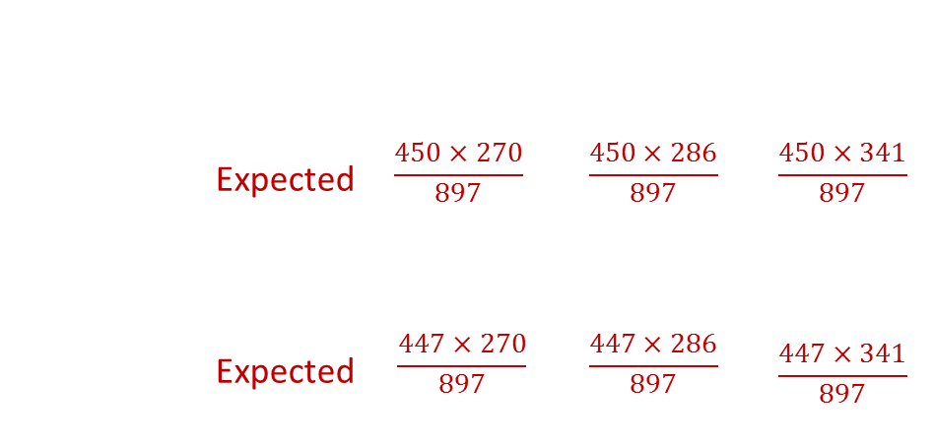
$χ^{2}$ for Testing Relationships
Is there a relationship between gender and product choice?
 | A | B | C
MALES Observed | 160 | 140 | 150
FEMALES Observed | 110 | 146 | 191
A+B+C
450
447
Expected | $$\frac{450×270}{897}$$ | $$\frac{450×286}{897}$$ | $$\frac{450×341}{897}$$
Expected | $$\frac{447×270}{897}$$ | $$\frac{447×286}{897}$$ | $$\frac{447×341}{897}$$
 |  | $$\frac{450×286}{897}$$
Number of customers responded
MALES+FEMALES | 270 | 286 | 341
897

Slide 6
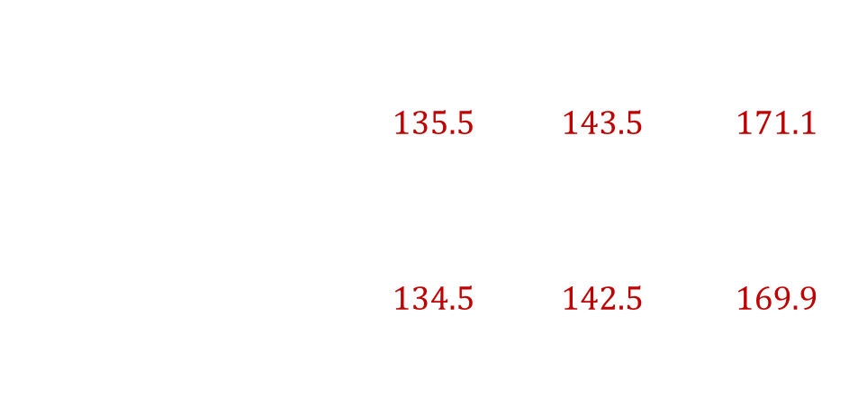
$χ^{2}$ for Testing Relationships
Is there a relationship between gender and product choice?
 | A | B | C
MALES Observed Expected | 160 | 140 | 150
FEMALES Observed Expected | 110 | 146 | 191
A+B+C
450
447
 | $$135.5$$ | $$143.5$$ | $$171.1$$
 | $$134.5$$ | $$142.5$$ | $$169.9$$
Number of customers responded
MALES+FEMALES | 270 | 286 | 341
897

Slide 7
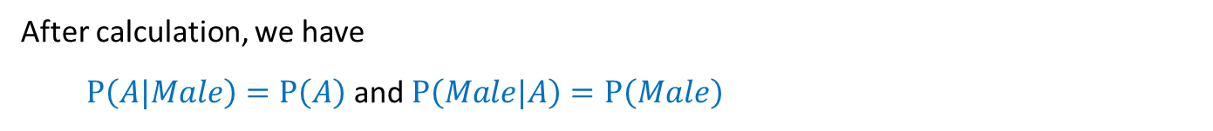
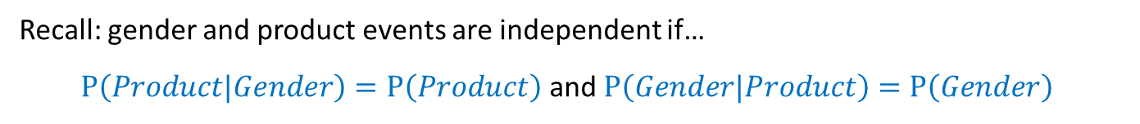
$χ^{2}$ for Testing Relationships
Expected values | A | B | C | A + B + C
Males | 135.5 | 143.5 | 171.1 | 450
Females | 134.5 | 142.5 | 169.9 | 447
Males + Females | 270 | 286 | 341 | 897
Recall: gender and product events are independent if…
  $P\left(Product|Gender\right)=P\left(Product\right)$ and $P\left(Gender|Product\right)=P\left(Gender\right)$
After calculation, we have
  $P\left(A|Male\right)=P\left(A\right)$ and $P\left(Male|A\right)=P\left(Male\right)$
  $P\left(A|Female\right)=P\left(A\right)$ and $P\left(Female|A\right)=P\left(Female\right)$
  $P\left(B|Male\right)=P\left(B\right)$ and $P\left(Male|B\right)=P\left(Male\right)$
  $$……$$

Slide 8
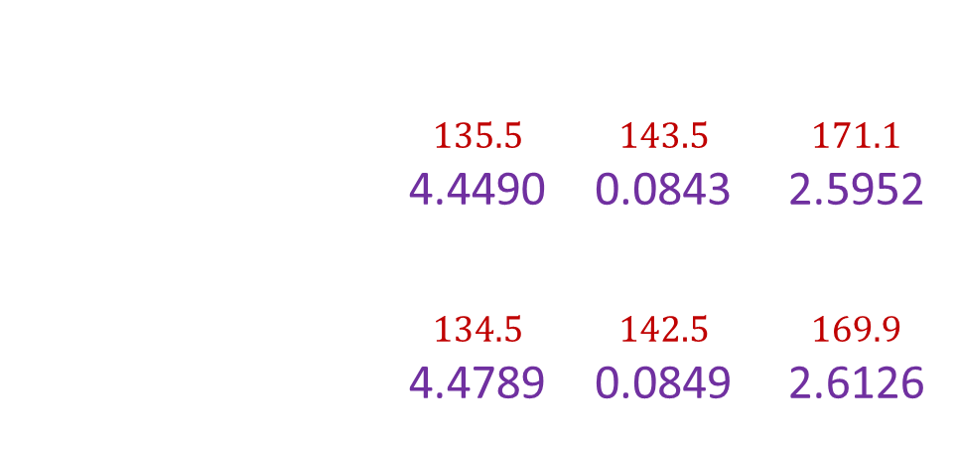
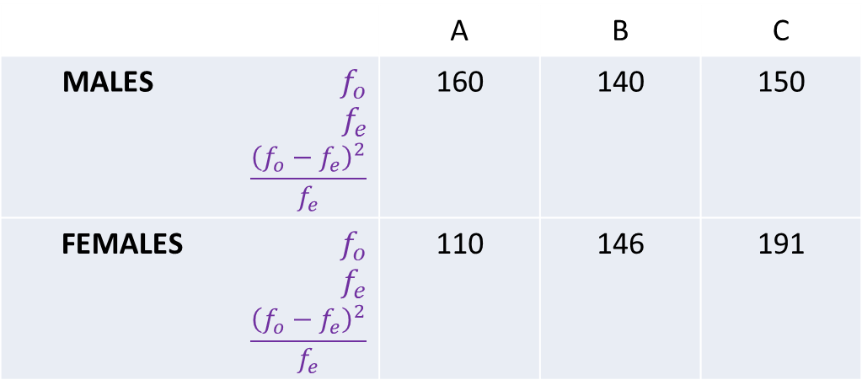
$χ^{2}$ for Testing Relationships
Is there a relationship between gender and product choice?
 | A | B | C
MALES $f_{o}$ $f_{e}$ $$\frac{{\left(f_{o}−f_{e}\right)}^{2}}{f_{e}}$$ | 160 | 140 | 150
FEMALES $f_{o}$ $$f_{e}$$ $$\frac{{\left(f_{o}−f_{e}\right)}^{2}}{f_{e}}$$ | 110 | 146 | 191
A+B+C
450
447
 | $$135.5$$ 4.4490 | $$143.5$$ 0.0843 | $$171.1$$ 2.5952
 | $$134.5$$ 4.4789 | $$142.5$$ 0.0849 | $$169.9$$ 2.6126
Number of customers responded
MALES+FEMALES | 270 | 286 | 341
897

Slide 9
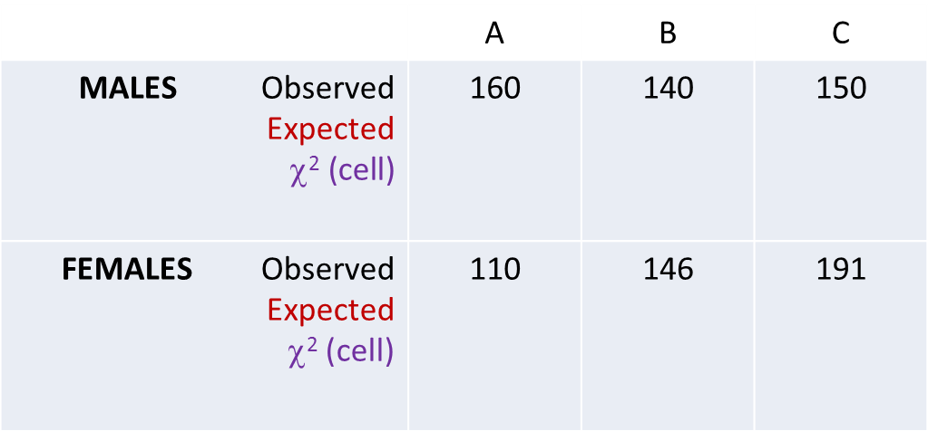
$χ^{2}$ for Testing Relationships
Is there a relationship between gender and product choice?
 | A | B | C
MALES Observed Expected $$\text{}\text{2} \text{(}\text{cell}\text{)}$$ | 160 | 140 | 150
FEMALES Observed Expected χ² (cell) | 110 | 146 | 191
A+B+C
450
447
 | $$135.5$$ 4.4490 | $$143.5$$ 0.0843 | $$171.1$$ 2.5952
 | $$134.5$$ 4.4789 | $$142.5$$ 0.0849 | $$169.9$$ 2.6126
Number of customers responded
MALES+FEMALES | 270 | 286 | 341
897

Slide 10



Recall $χ^{2}$
$$χ^{2}=\sum{\frac{{\left(f_{o}−f_{e}\right)}^{2}}{f_{e}}}$$
14.3049
α
0
$$χ^{2}$$

Slide 11
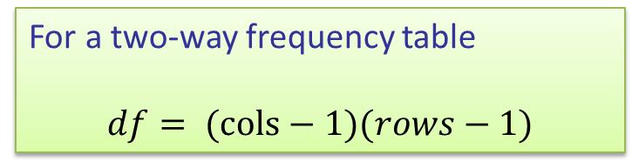



Recall $χ^{2}$
Reject if $χ^{2}{>χ}_{crit}^{2}$
$$χ^{2}=\sum{\frac{{\left(f_{o}−f_{e}\right)}^{2}}{f_{e}}}$$
14.3049
Lookup table provides the critical value
For a two-way frequency table
$$df= (cols−1)(rows−1)$$
α
What is $df$?
0
$$χ_{crit}^{2}$$
$$χ^{2}$$

Slide 12

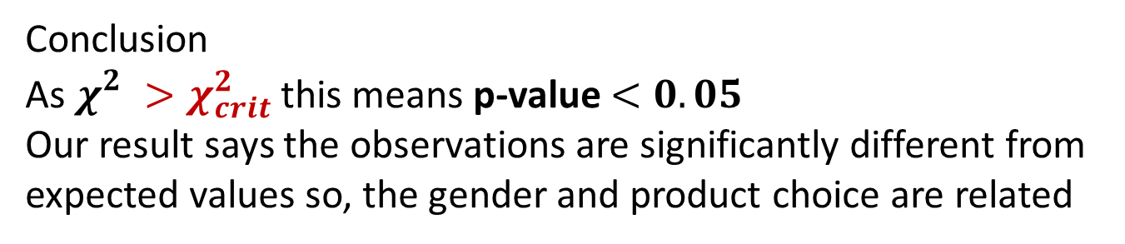

Chi Squared (χ²)
Summary
Step 1
H₀: There is no association between gender and product preference
Step 2
The calculated value of $χ_{}^{2}$= 14.3049
Step 3
We have the degrees of freedom, $df=2$
The lookup table gives the critical value, $χ_{crit}^{2}=5.991$
Conclusion
As$χ_{}^{2}>χ_{crit}^{2}$ this means p-value $<0.05$
Our result says the observations are significantly different from expected values so, the gender and product choice are related

Slide 13
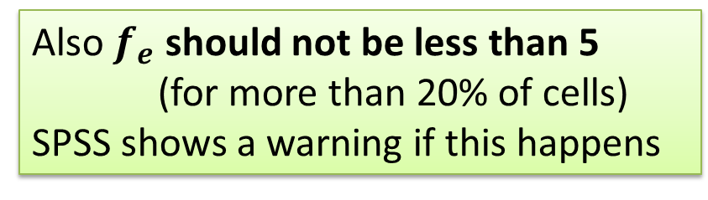
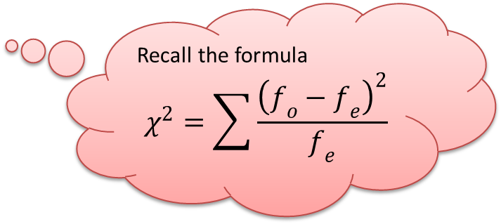
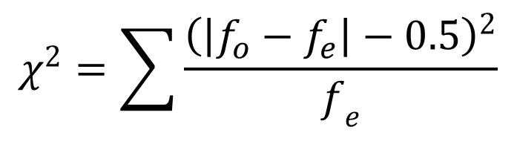
Yate’s correction for χ²
Note that for 2 x 2 tables the formula for χ² (calc) is calculated using a slightly different formula
$$χ^{2}=\sum{\frac{{\left(\left|f_{o}−f_{e}\right|−0.5\right)}^{2}}{f_{e}}}$$
Recall the formula
$$χ^{2}=\sum{\frac{{\left(f_{o}−f_{e}\right)}^{2}}{f_{e}}}$$
Also $f_{e}$ should not be less than 5
(for more than 20% of cells)
SPSS shows a warning if this happens

Slide 14
χ² with two variables in SPSS
This is the p-value i.e. probability of the result given the null hypothesis

Slide 15




Exercise 1
 | CYCLING | NOT CYCLING | ROW SUM
FEMALE | 18 | 19
MALE | 13 | 7
COLUMN SUM |  |  | TOTAL

Slide 16
18 | 19
13 | 7
20 | 17
11 | 9
0.1309 | 0.156
0.2421 | 0.2887

Slide 17
Parametric v Non-parametric Tests
Parametric
Non-parametric
Parametric were developed first
These assume you have either interval or ratio data
They make assumptions about the distribution (normality, variances)
These make less assumptions about the data
They are also known as “distribution free” statistics
Kruskal-Wallis Test
t test
Friedman Test
Fisher Exact test
Z test
Chi square
ANOVA
Spearman's Rho
Pearson’s r
Kendall's Tau
Wilcoxon Signed-Rank

Slide 18
Why do we still use parametric statistics?
Generally tests making less assumptions are less powerful in detecting effects
The sophistication of the tests available is greater and a wider range of tests are available in statistics software
Parametric statistics can, in practice, be quite robust to violations of their assumptions

Slide 19
10 Minutes Break

Slide 20
Summary so far…
We looked at measuring differences…
 | Categorical | Scalar
Relating Two groups | χ² test for independence | Correlation t Test Linear Regression
Relating Many groups | Logistic Regression | Multiple Regression
N.B. This is only a subset of numerous statistical techniques

Slide 21
EXTREMELY STRONG
RELATIVELY WEAKER
NEGATIVELY
RELATED
ALMOST NO RELATIONSHIP

Slide 22
A POSITIVE
RELATION
A POSITIVE
RELATION
EXTREMELY STRONG
RELATIVELY WEAKER
HOW TO QUANTIFY?
A NEGATIVE
RELATION
ALMOST NO
RELATION
NEGATIVELY
RELATED
ALMOST NO RELATIONSHIP

Slide 23

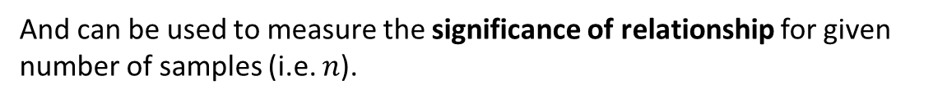


The Correlation Coefficient
$$r>0$$
$$r≅0$$
$$r<0$$
The correlation coefficient lets us measure the sign and strength of the relationship
And can be used to measure the significance of relationship for given number of samples (i.e. $n$).

Slide 24


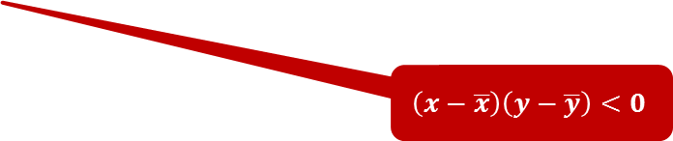

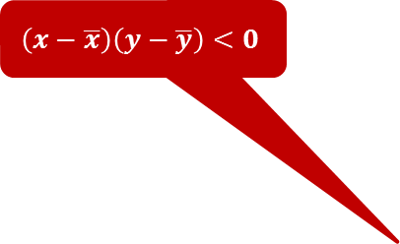

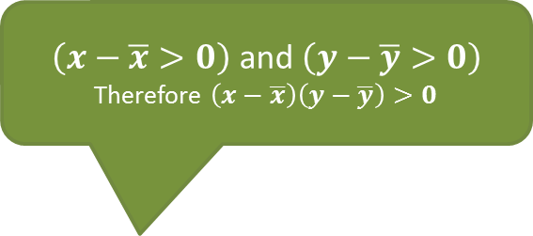
The Correlation Coefficient
How to calculate?
$\left(x−\overline{x}>0\right)$ and $\left(y−\overline{y}>0\right)$
Therefore $\left(x−\overline{x}\right)\left(y−\overline{y}\right)>0$
$$\left(x−\overline{x}\right)\left(y−\overline{y}\right)<0$$
$$\left(\overline{x},\overline{y}\right)$$
$$\overline{y}$$
$$\left(x−\overline{x}\right)\left(y−\overline{y}\right)<0$$
$\left(x−\overline{x}<0\right)$ and $\left(y−\overline{y}<0\right)$
Therefore $\left(x−\overline{x}\right)\left(y−\overline{y}\right)>0$
$$\overline{x}$$

Slide 25



Question 2
$$(a)$$
$$(b)$$
$$(c)$$
(1) If (x₁ - x₂) (y₁ - y₂) > 0, which of the above best describes the relationship between the two points (x_{1,} y₁) and (x_{2,} y₂)?
(2) If (x₁ - x₂) (y₁ - y₂) < 0, which of the above best describes the relationship between the two points (x_{1,} y₁) and (x_{2,} y₂)?
(3) If (x₁ - x₂) (y₁ - y₂) = 0, which of the above best describes the relationship between the two points (x_{1,} y₁) and (x_{2,} y₂)?

Slide 26
Question 2
$$(a)$$
$$(b)$$
$$(c)$$
(1) If (x₁ - x₂) (y₁ - y₂) > 0, which of the above best describes the relationship between the two points (x_{1,} y₁) and (x_{2,} y₂)? (a)
(2) If (x₁ - x₂) (y₁ - y₂) < 0, which of the above best describes the relationship between the two points (x_{1,} y₁) and (x_{2,} y₂)? (c)
(3) If (x₁ - x₂) (y₁ - y₂) = 0, which of the above best describes the relationship between the two points (x_{1,} y₁) and (x_{2,} y₂)? (b)

Slide 27


The Covariance
Lets do it for all points…
$$\frac{1}{n−1}\sum_{i}{\left(x_{i}−\overline{x}\right)\left(y_{i}−\overline{y}\right)}$$
This is the covariance of x and y
[ written as cov(x,y) ]
$$\left(\overline{x},\overline{y}\right)$$

Slide 28
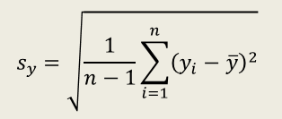
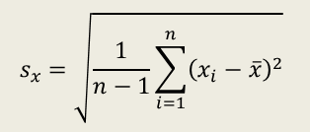
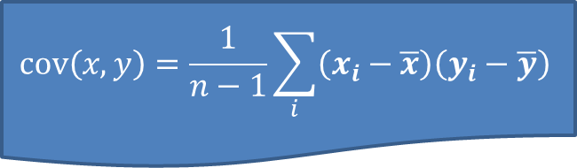
The Correlation Coefficient
$$cov\left(x,y\right)=\frac{1}{n−1}\sum_{i}{\left(x_{i}−\overline{x}\right)\left(y_{i}−\overline{y}\right)}$$
$$\left(\overline{x},\overline{y}\right)$$
$$s_{y}=\sqrt{\frac{1}{n−1}\sum_{i=1}^{n}{{\left(y_{i}−\overline{y}\right)}^{2}}}$$
Recall?
$$s_{x}=\sqrt{\frac{1}{n−1}\sum_{i=1}^{n}{{\left(x_{i}−\overline{x}\right)}^{2}}}$$

Slide 29


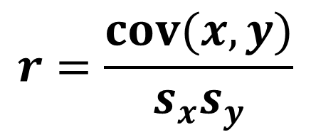
The Correlation Coefficient
So, the correlation coefficient, $r$, is calculated as
$$r=\frac{cov(x,y)}{s_{x}s_{y}}$$
What does 0 imply?
$r$ has values between -1 and +1
-1
0
+1

Slide 30

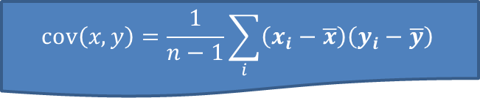
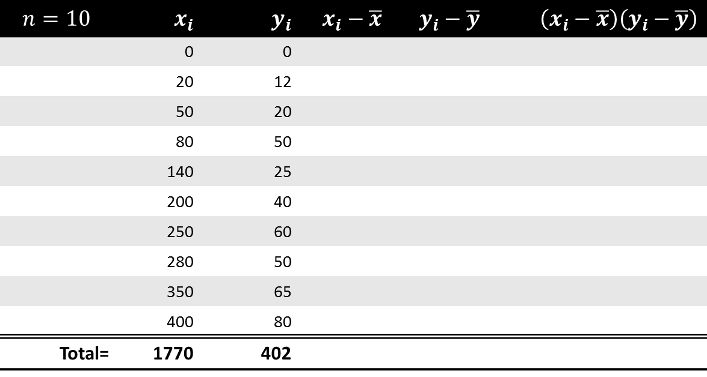
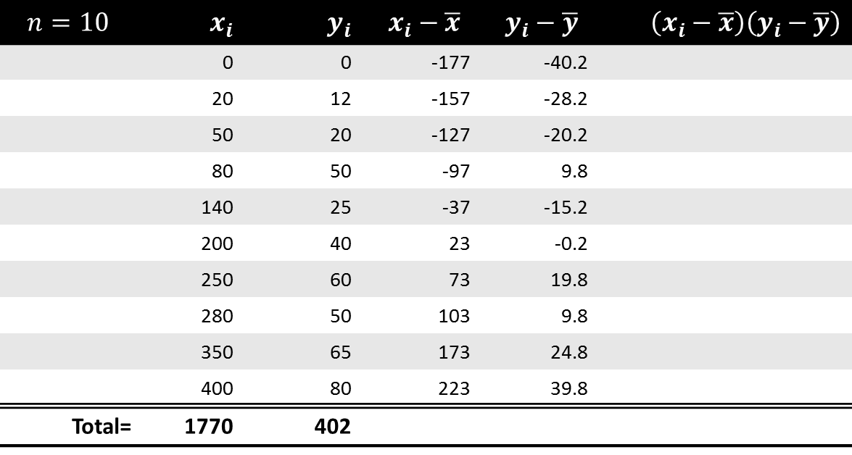
Example
$$cov\left(x,y\right)=\frac{1}{n−1}\sum_{i}{\left(x_{i}−\overline{x}\right)\left(y_{i}−\overline{y}\right)}$$
$$r=\frac{cov(x,y)}{s_{x}s_{y}}$$
$$n=10$$ | $$x_{i}$$ | $$y_{i}$$ | $$x_{i}−\overline{x}$$ | $$y_{i}−\overline{y}$$ | $$\left(x_{i}−\overline{x}\right)\left(y_{i}−\overline{y}\right)$$
 | 0 | 0 | -177 | -40.2
 | 20 | 12 | -157 | -28.2
 | 50 | 20 | -127 | -20.2
 | 80 | 50 | -97 | 9.8
 | 140 | 25 | -37 | -15.2
 | 200 | 40 | 23 | -0.2
 | 250 | 60 | 73 | 19.8
 | 280 | 50 | 103 | 9.8
 | 350 | 65 | 173 | 24.8
 | 400 | 80 | 223 | 39.8
Total= | 1770 | 402
$$n=10$$ | $$x_{i}$$ | $$y_{i}$$ | $$x_{i}−\overline{x}$$ | $$y_{i}−\overline{y}$$ | $$\left(x_{i}−\overline{x}\right)\left(y_{i}−\overline{y}\right)$$
 | 0 | 0
 | 20 | 12
 | 50 | 20
 | 80 | 50
 | 140 | 25
 | 200 | 40
 | 250 | 60
 | 280 | 50
 | 350 | 65
 | 400 | 80
Total= | 1770 | 402
Mean= | 177.0 | 40.2
SD= | 141.03 | 25.46

Slide 31
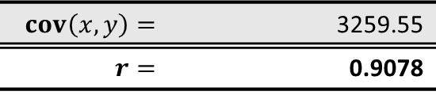
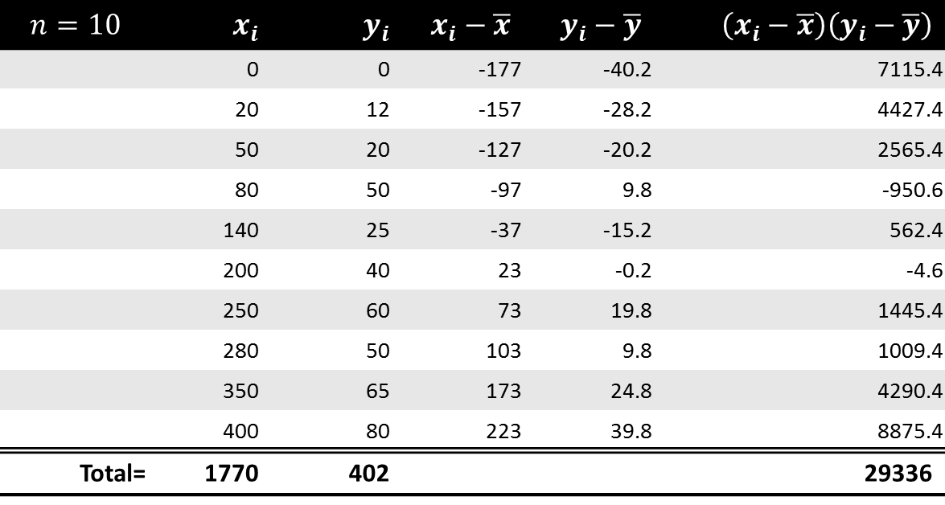
Example
$$cov\left(x,y\right)=\frac{1}{n−1}\sum_{i}{\left(x_{i}−\overline{x}\right)\left(y_{i}−\overline{y}\right)}$$
$$r=\frac{cov(x,y)}{s_{x}s_{y}}$$
$$n=10$$ | $$x_{i}$$ | $$y_{i}$$ | $$x_{i}−\overline{x}$$ | $$y_{i}−\overline{y}$$ | $$\left(x_{i}−\overline{x}\right)\left(y_{i}−\overline{y}\right)$$
 | 0 | 0 | -177 | -40.2 | 7115.4
 | 20 | 12 | -157 | -28.2 | 4427.4
 | 50 | 20 | -127 | -20.2 | 2565.4
 | 80 | 50 | -97 | 9.8 | -950.6
 | 140 | 25 | -37 | -15.2 | 562.4
 | 200 | 40 | 23 | -0.2 | -4.6
 | 250 | 60 | 73 | 19.8 | 1445.4
 | 280 | 50 | 103 | 9.8 | 1009.4
 | 350 | 65 | 173 | 24.8 | 4290.4
 | 400 | 80 | 223 | 39.8 | 8875.4
Total= | 1770 | 402 |  |  | 29336
$$n=10$$ | $$x_{i}$$ | $$y_{i}$$ | $$x_{i}−\overline{x}$$ | $$y_{i}−\overline{y}$$ | $$\left(x_{i}−\overline{x}\right)\left(y_{i}−\overline{y}\right)$$
 | 0 | 0
 | 20 | 12
 | 50 | 20
 | 80 | 50
 | 140 | 25
 | 200 | 40
 | 250 | 60
 | 280 | 50
 | 350 | 65
 | 400 | 80
Total= | 1770 | 402
Mean= | 177.0 | 40.2
SD= | 141.03 | 25.46
$$cov\left(x,y\right)=$$ | 3259.55
$$r=$$ | 0.9078

Slide 32
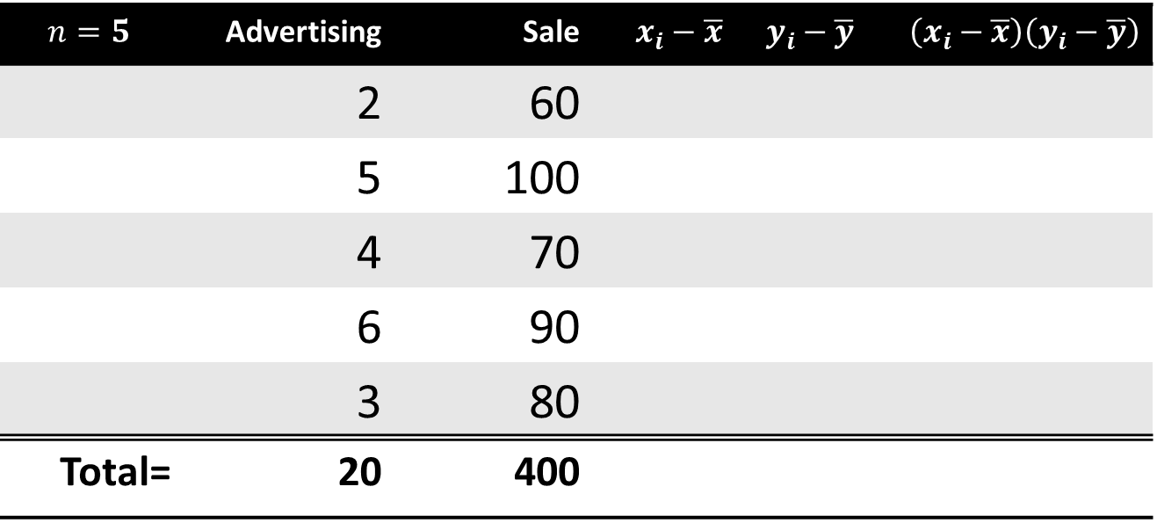
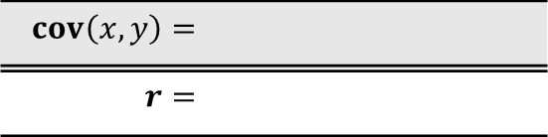
Exercise 3
$$cov\left(x,y\right)=\frac{1}{n−1}\sum_{i}{\left(x_{i}−\overline{x}\right)\left(y_{i}−\overline{y}\right)}$$
$$r=\frac{cov(x,y)}{s_{x}s_{y}}$$
$$n=5$$ | Advertising | Sale | $$x_{i}−\overline{x}$$ | $$y_{i}−\overline{y}$$ | $$\left(x_{i}−\overline{x}\right)\left(y_{i}−\overline{y}\right)$$
 | 2 | 60
 | 5 | 100
 | 4 | 70
 | 6 | 90
 | 3 | 80
Total= | 20 | 400
Mean= | 4 | 80
SD= | 1.581 | 15.811
$$cov\left(x,y\right)=$$
$$r=$$

Slide 33
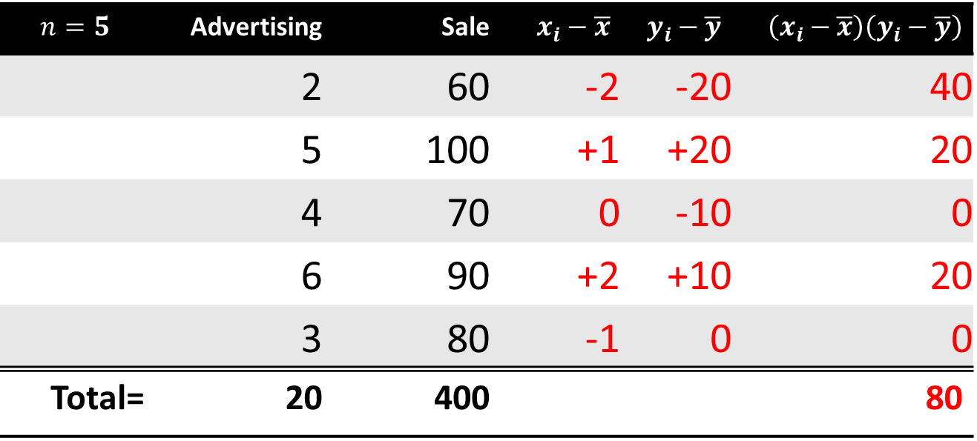
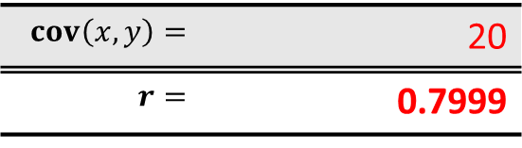
Exercise 3
$$cov\left(x,y\right)=\frac{1}{n−1}\sum_{i}{\left(x_{i}−\overline{x}\right)\left(y_{i}−\overline{y}\right)}$$
$$r=\frac{cov(x,y)}{s_{x}s_{y}}$$
$$n=5$$ | Advertising | Sale | $$x_{i}−\overline{x}$$ | $$y_{i}−\overline{y}$$ | $$\left(x_{i}−\overline{x}\right)\left(y_{i}−\overline{y}\right)$$
 | 2 | 60 | -2 | -20 | 40
 | 5 | 100 | +1 | +20 | 20
 | 4 | 70 | 0 | -10 | 0
 | 6 | 90 | +2 | +10 | 20
 | 3 | 80 | -1 | 0 | 0
Total= | 20 | 400 |  |  | 80
Mean= | 4 | 80
SD= | 1.581 | 15.811
$$cov\left(x,y\right)=$$ | 20
$$r=$$ | 0.7999

Slide 34
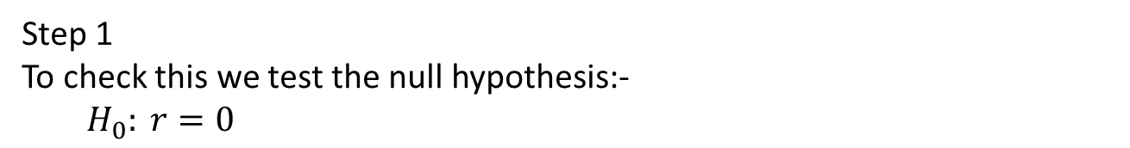
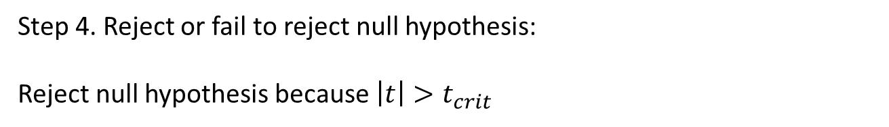
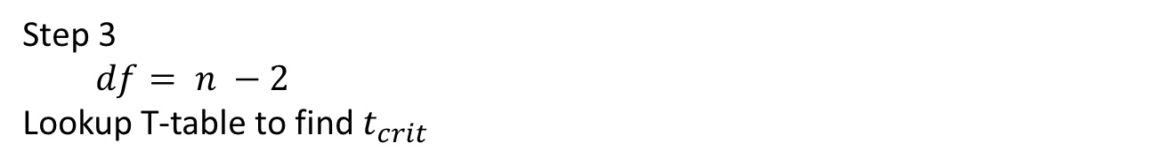
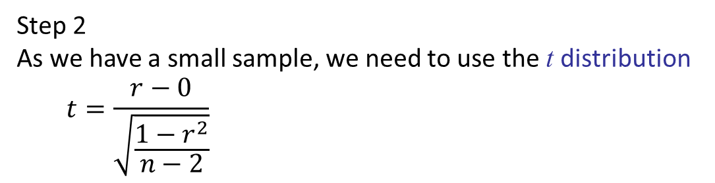
Significance of relation
Step 1
To check this we test the null hypothesis:-
  $$H_{0}: r=0$$
Step 2
As we have a small sample, we need to use the t distribution
  $$t=\frac{r−0}{\sqrt{\frac{1−r^{2}}{n−2}}}$$
Step 3
$$df= n −2$$
Lookup T-table to find $t_{crit}$
Step 4. Reject or fail to reject null hypothesis:
Reject null hypothesis because $\left|t\right|>t_{crit}$

Slide 35
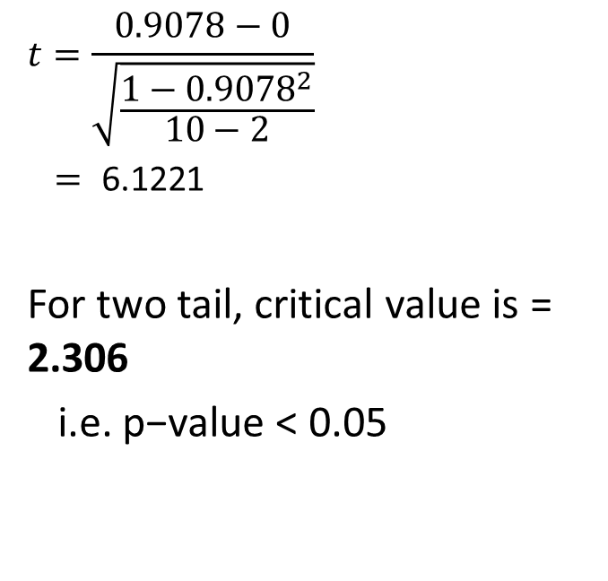
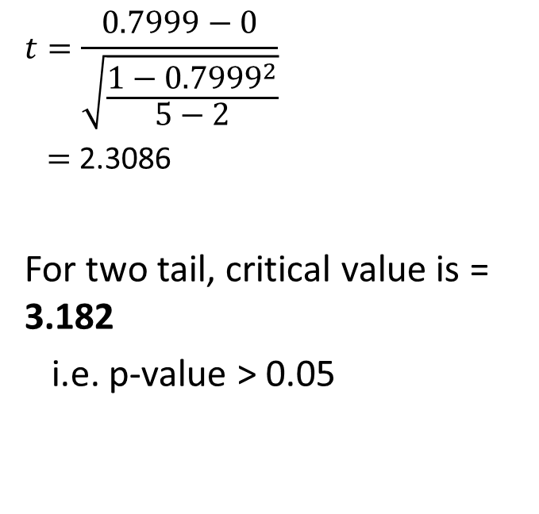
Significance of relation
Ads & Sales
Library & Drinks
  $$t=\frac{0.7999−0}{\sqrt{\frac{1−{0.7999}^{2}}{5−2}}}$$
  $=$ 2.3086
For two tail, critical value is = 3.182
i.e. p-value > 0.05
  $$t=\frac{0.9078−0}{\sqrt{\frac{1−{0.9078}^{2}}{10−2}}}$$
  $= \text{6}\text{.}\text{122}$1
For two tail, critical value is = 2.306
i.e. p−value < 0.05
NOT significant at 5% level
Significant at 5% level

Slide 36
Causality
You need to show that:
  X and Y vary together
  X occurs before Y
  eliminate potential “third variables”
Correlation ≠ Causation
Source: Franz H. Messerli, M.D., Chocolate Consumption, Cognitive Function, and Nobel Laureates, N Engl J Med 2012; 367:1562-1564

Slide 37
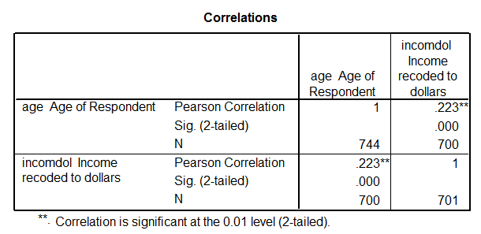
Correlation Coefficient in SPSS
This is the probability of the result given the null hypothesis

Slide 38
Question 4
This is the probability of the result given the null hypothesis
1) What is the null hypothesis for this test?
2) What is the result of the test?

Slide 39
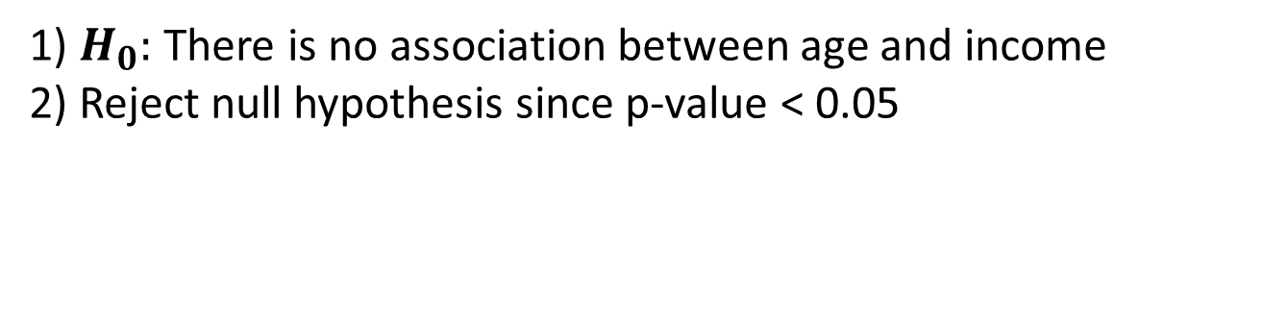
Question 4
This is the probability of the result given the null hypothesis
1) $H_{0}:$ There is no association between age and income
2) Reject null hypothesis since p-value < 0.05

Slide 40
Reading…
Berenson et al. (2015)
Chapter 12, Sections 12.1 – 12.3
These all discuss the two-way chi squared test
Chapter 3, Section 3.6
The covariance and the coefficient of correlation
Chapter 13, Simple linear regression
Subsection “t test for the correlation coefficient”

Slide 41
Module Overview
Descriptive
Statistics
Probability
Distributions
Hypothesis
Testing 1
Probability
Sampling
Week
1
Week
2
Week
3
Week
4
Week
5
Week
6
Week
7
Week
8
Week
9
Week
10
Hypothesis
Testing 2
Testing
Relationship
Regression
Conditional
Probability
Factor
Analysis
Week
11
Revision

