Slide 1
Module Overview
Descriptive
Statistics
Probability
Distributions
Hypothesis
Testing 1
Probability
Sampling
Week
1
Week
2
Week
3
Week
4
Week
5
Week
6
Week
7
Week
8
Week
9
Week
10
Hypothesis
Testing 2
Testing
Relationship
Regression
Conditional
Probability
Factor
Analysis
Week
11
Revision

Slide 2
A bit of housekeeping…
The exam is going to be a MULTIPLE CHOICE QUESTIONNAIRE
Don’t worry about:
Excel rounding errors (unless the question is about rounding, i.e. it is expected from you to round up)
Remembering equations by heart: don’t! Remember WHICH ONE to use
“Worry” about:
Interpretations
  Of the test results
  Of the regression results (more to come on this!)
Calculator:
  Casio fx-82 series
  Casio fx-83 series
  Casio fx-85 series
  Casio fx-350 series
  Sharp EL – 531 series

Slide 3
Consider this information…
A newspaper reported that 15% of trains do not depart on time from the train station. When observing 50 trains randomly, we found 10% departed late.
Is the newspaper lying about the problem?
Would you consider your observation to be statistically significantly different from what newspaper has reported?
How should we test this?
We can use a process called…
Hypothesis testing
Notes:
Hypothesis testing is a general word for techniques that we can use for this purpose. They tell us how we should interpret the results, and whether there really is something going on
In this module I am going to cover the main tests you might come across in research papers. This should allow you to understand statistical results and be able to critically evaluate quantitative evidence.

Slide 4

Hypothesis testing
H₀ - Null Hypothesis
H₁ - Alternative Hypothesis
Nothing is going on…
  i.e. there is no difference.
There is a difference.
We assume the original finding is truth unless we can provide evidence that there is
Notes:
The start of hypothesis testing is to generate the null hypothesis
THERE IS NOTHING GOING ON
this is a bit like the presumption of innocence in court proceedings - you have to prove that this is unlikely to be the case and therefore infer something is going on.

Slide 5




Hypothesis testing
p = 10%
n = 50
Is there really a difference?
$π$ = 15%
H₀ - Null Hypothesis
H₁ - Alternative Hypothesis
The proportion of late trains is equal to 15% which is reported by newspaper.
The proportion of late trains is not equal to 15% which is reported by newspaper.
$π$ = 15%
$π$ $≠$ 15%

Slide 6
Hypothesis testing
p = 10%
n = 50
Is there really a difference?
$π$ = 15%
H₀ - Null Hypothesis
H₁ - Alternative Hypothesis
Says: This difference is BY CHANCE
Probability of occurrence
Proportion of late trains
10%
15%

Slide 7
Hypothesis testing
p = 10%
n = 50
Is there really a difference?
$π$ = 15%
H₀ - Null Hypothesis
H₁ - Alternative Hypothesis
Says: This difference is BY CHANCE
Says: This chance is very unlikely, so we treat it as DIFFERENT
Probability of occurrence
Proportion of late trains
10%
15%

Slide 8
HYPOTHESIS TESTING
 | Categorical | Scalar
Inference for One group | Z Test for proportion | t Test for mean
Comparing Two groups | Z Test for difference in two proportions | t Test for difference in two means
Comparing Many groups | χ² for difference among several proportions | ANOVA for comparing several means
N.B. This is only a subset of the used statistical techniques

Slide 9



Z Test for Proportion
1
1
  State your null hypothesis (H₀)
  State your null hypothesis (H₀)
2
  Calculate test statistic from data (stat.)
On average, 15% of trains do not depart on time from Leeds station.
When observing 50 trains randomly, we found 10% departed late.
Would you consider this a significant improvement in the train service?
Null Hypothesis: There is no difference between what we observed and what is reported.
Alternative Hypothesis: There is a statistically significant difference between what is observed and what is reported.
3
  Choose a level of significance (α)
4
  Lookup the critical value or the p-value
5
  Reject H₀ or Fail to Reject
$$H_{0}: π=0.15$$
$$H_{1}: π≠0.15$$

Slide 10
Z Test for Proportion
1
1
1
  State your null hypothesis (H₀)
  State your null hypothesis (H₀)
  State your null hypothesis (H₀)
The probability distribution that’s relevant here is the sampling distribution of proportions (or percentages)
2
  Calculate test statistic from data (stat.)
3
  Choose a level of significance (α)
approx. normal distribution
4
  Lookup the critical value or the p-value
Standard deviation from population proportion
5
  Reject H₀ or Fail to Reject
0
0.15
1
This is true in a vast majority of cases although not always.
Notes:
This is produced by taking all possible samples of size n from a population and plotting the percentage of a particular characteristic in each sample as a distribution.
For large samples (>30 approximately)
the distribution is close to the normal distribution
it has a mean of the population percentage
its standard deviation is known as STEP

Slide 11
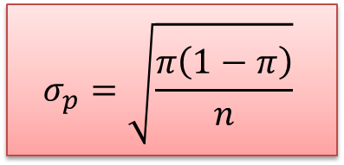
Z Test for Proportion
1
1
  State your null hypothesis (H₀)
  State your null hypothesis (H₀)
Standard error of the proportion (STEP)
2
  Calculate test statistic from data (stat.)
3
  Choose a level of significance (α)
4
  Lookup the critical value or the p-value
Standard error of the proportion (STEP)
5
  Reject H₀ or Fail to Reject
Standard deviation from population proportion
$$σ_{p}=\sqrt{\frac{π\left(1−π\right)}{n}}$$
0
0.15
1
Remember: The standard error of a proportion is a statistic indicating how greatly a particular sample proportion is likely to differ from the proportion in the population proportion.

Slide 12
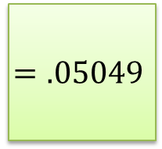
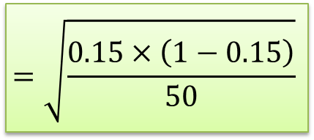
Z Test for Proportion
1
1
  State your null hypothesis (H₀)
  State your null hypothesis (H₀)
Standard error of the proportion (STEP)
2
  Calculate test statistic from data (stat.)
3
  Choose a level of significance (α)
4
  Lookup the critical value or the p-value
Standard error of the proportion (STEP)
5
  Reject H₀ or Fail to Reject
$$σ_{p}=\sqrt{\frac{π\left(1−π\right)}{n}}$$
$$=\sqrt{\frac{0.15×\left(1−0.15\right)}{50}}$$
$$=.05049$$
0
0.15
1

Slide 13
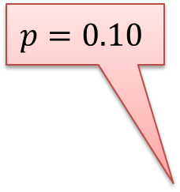
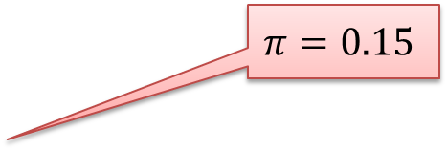
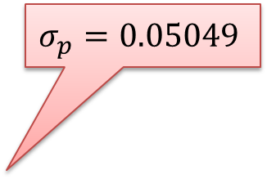
Z Test for Proportion
1
1
  State your null hypothesis (H₀)
  State your null hypothesis (H₀)
  Calculating test statistic called Z value
2
  Calculate test statistic from data (stat.)
3
  Choose a level of significance (α)
4
  Lookup the critical value or the p-value
$$σ_{p}=0.05049$$
5
  Reject H₀ or Fail to Reject
$$p=0.10$$
$$π=0.15$$
0
0.10
0.15
1

Slide 14

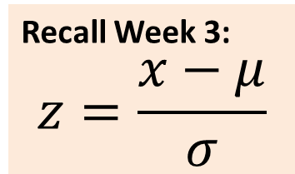
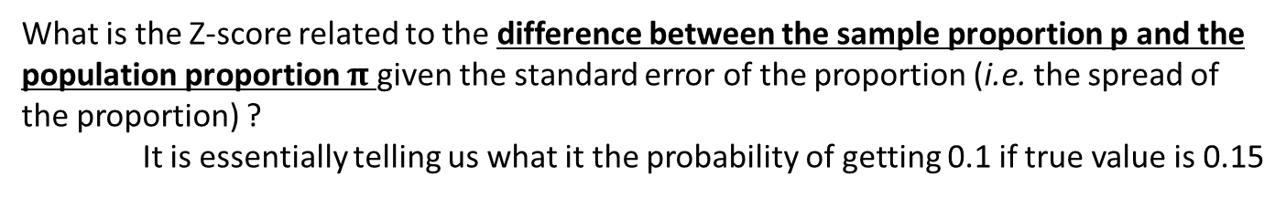
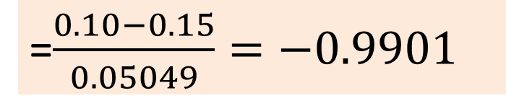
Z Test for Proportion
1
1
  State your null hypothesis (H₀)
  State your null hypothesis (H₀)
  Calculating test statistic called Z value
2
  Calculate test statistic from data (stat.)
3
  Choose a level of significance (α)
$$Z=\frac{p−π}{σ_{p}}$$
4
  Lookup the critical value or the p-value
=$\frac{0.10−0.15}{0.05049}=−0.9901$
$$σ_{p}=0.05049$$
5
  Reject H₀ or Fail to Reject
$$p=0.10$$
$$π=0.15$$
Recall Week 3:
$$z=\frac{x−μ}{σ}$$
0
0.10
0.15
1
  What is the Z-score related to the difference between the sample proportion p and the population proportion $π$ given the standard error of the proportion (i.e. the spread of the proportion) ?
  It is essentially telling us what it the probability of getting 0.1 if true value is 0.15

Slide 15
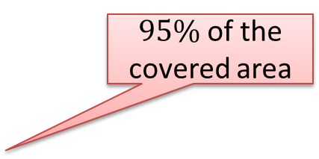
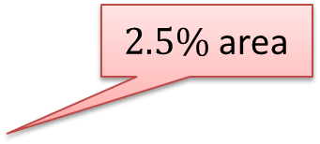

Z Test for Proportion
1
1
  State your null hypothesis (H₀)
  State your null hypothesis (H₀)
CHOOSING A LEVEL OF SIGNIFICANCE!
2
  Calculate test statistic from data (stat.)
3
  Choose a level of significance (α)
4
  Lookup the critical value or the p-value
$95\%$ of the covered area
5
  Reject H₀ or Fail to Reject
$2.5\%$ area
This is known as a two-tail test
0
$$π$$
1

Slide 16
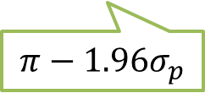
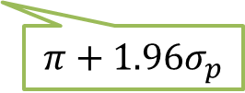
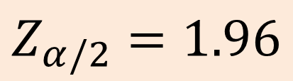
Z Test for Proportion
1
1
  State your null hypothesis (H₀)
  State your null hypothesis (H₀)
Finding critical value
2
  Calculate test statistic from data (stat.)
3
  Choose a level of significance (α)
4
  Lookup the critical value or the p-value
$95\%$ of the covered area
5
  Reject H₀ or Fail to Reject
$2.5\%$ area
$$Z_{α/2}=1.96$$
0
$$π$$
1
$$π−1.96σ_{p}$$
$$π+1.96σ_{p}$$
  “Is p comprised in the confidence interval of $π$ at the chosen level of confidence?”
Notes:
So the probability of result can be found by calculating how many standard deviations the percentage value for his sample is from the mean or population value.
The standard deviation of the sampling distribution of percentages is called the standard error of percentages or standard error of the proportion (STEP)

Slide 17

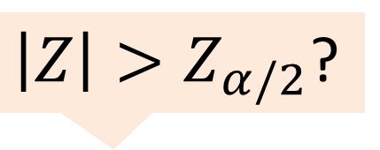

Z Test for Proportion
1
1
  State your null hypothesis (H₀)
  State your null hypothesis (H₀)
APPROACH 1 – Using C.I.
2
  Calculate test statistic from data (stat.)
$\left|Z\right|>Z_{α/2}$?
3
  Choose a level of significance (α)
$π$-0.9901 $σ_{p}$
4
  Lookup the critical value or the p-value
$95\%$ of the covered area
5
  Reject H₀ or Fail to Reject
$2.5\%$ area
$$Z_{α/2}=1.96$$
0
$$π$$
1
$$π−1.96σ_{p}$$
$$π+1.96σ_{p}$$
Given how accurately the sample proportion represents the population proportion and given the level of significance chosen, do we accept or reject H0 ?
Notes:
So the probability of result can be found by calculating how many standard deviations the percentage value for his sample is from the mean or population value.
The standard deviation of the sampling distribution of percentages is called the standard error of percentages or standard error of the proportion (STEP)

Slide 18
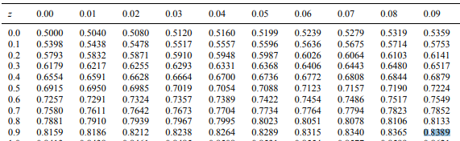
Z Test for Proportion
1
  State your null hypothesis (H₀)
APPROACH 2 – Using p-value
2
  Calculate test statistic from data (stat.)
3
  Choose a level of significance (α)
P-value = 1 – 0.8389
= 0.1611
4
  Lookup the critical value or the p-value
$π$-0.9901 $σ_{p}$
5
  Reject H₀ or Fail to Reject
Is this value
< 0.025 ?
0
p
$$π$$
1
P(Z<-0.9901) = P(Z>0.9901) = 1 – P(Z<0.9901) = 0.1611

Slide 19
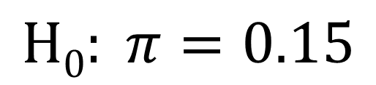
NOT ENOUGH EVIDENCE TO REJECT THIS STATEMENT
$$H0: π=0.15$$
In other words, we cannot say that the percentage of trains departing late has significantly changed.

Slide 20
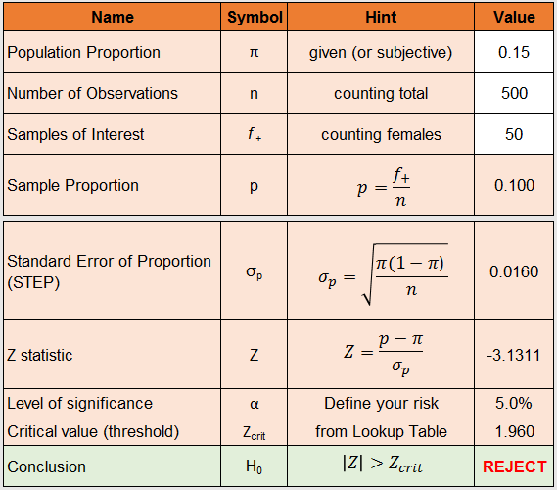
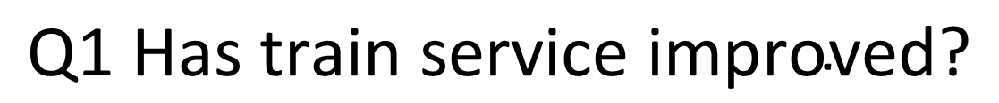
What if we observe 500 trains and 10% of them depart late?
$$\text{Q}\text{1 }\text{Has} \text{train} \text{service} \text{improved}\text{?}$$

Slide 21
What if we observe 500 trains and 10% of them depart late?
Q1 Has train service improved?
WE REJECT NULL HYPOTHESIS
THEREFORE, OUR ANSWER IS
YES, IT HAS IMPROVED

Slide 22
10 Minutes Break

Slide 23
HYPOTHESIS TESTING
 | Categorical | Scalar
Inference for One group | Z Test for proportion | t Test for mean
Comparing Two groups | Z Test for difference in two proportions | t Test for difference in two means
Comparing Many groups | χ² for difference among several proportions | ANOVA for comparing several means
N.B. This is only a subset of numerous statistical techniques

Slide 24



Example
The average number of hours worked by employees in the Telecom sector is 40 hours per week… But the managers tend to work more on average.
A survey of 200 managers showed that they were working 50 hours per week with standard deviation of 5 hours.
40
50
$$μ$$
$$\overline{x}$$

Slide 25


Testing for mean
1
  State your null hypothesis (H₀)
$$H_{0}: μ=40$$
$$H_{1}: μ≠40$$
40
$$μ$$

Slide 26
Testing for mean
1
  State your null hypothesis (H₀)
2
  Calculate test statistic from data (stat.)
The actual population may not possibly follow normal distribution but…
Population
distribution
40
$$μ$$

Slide 27
Testing for mean
1
  State your null hypothesis (H₀)
2
  Calculate test statistic from data (stat.)
Distribution for sample means
n=50
The actual population may not possibly follow normal distribution but…
Distribution for sample means
n=10
The probability distribution that’s relevant here is called the sampling distribution of means
Population
distribution
The sampling distribution of means is approximately normal for large samples (n>30)
40
$$μ$$

Slide 28
Sampling distribution: recall!
A sampling distribution of the sample mean is a probability distribution of all possible sample means from all possible samples (n).
In plain English, the sampling distribution is what you would get if you took a bunch of distinct samples, and plotted their respective means (mean from sample 1, mean from sample 2, etc.) and looked at the distribution…
…Except a “bunch of” samples is really ALL samples, and this distribution can be used to infer the probability you got a specific mean from any sample.

Slide 29
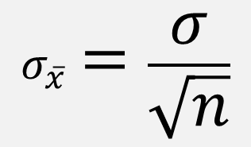
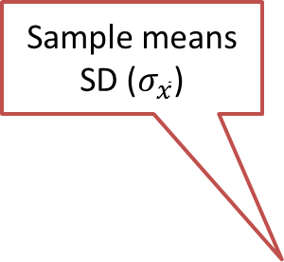
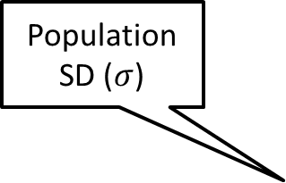
Testing for mean
1
  State your null hypothesis (H₀)
2
  Calculate test statistic from data (stat.)
The standard deviation of the distribution of sample means is called standard error of the mean (STEM)
Sample means
SD ($σ_{\overline{x}}$)
Population
SD ($σ$)
$$σ_{\overline{x}}=\frac{σ}{\sqrt{n}}$$
40
$$μ$$

Slide 30
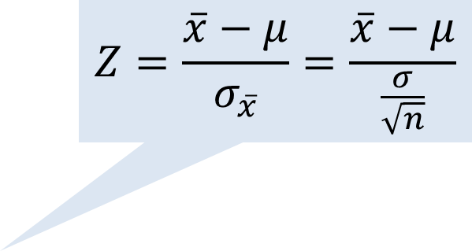
Testing for mean
1
  State your null hypothesis (H₀)
The statistic can be found by calculating how many standard deviations the mean of this sample is from the population value
2
  Calculate test statistic from data (stat.)
Sample means
SD ($σ_{\overline{x}}$)
$$Z=\frac{\overline{x}−μ}{σ_{\overline{x}}}=\frac{\overline{x}−μ}{\frac{σ}{\sqrt{n}}}$$
Do we know population SD?
40
50
$$μ$$
$$\overline{x}$$

Slide 31

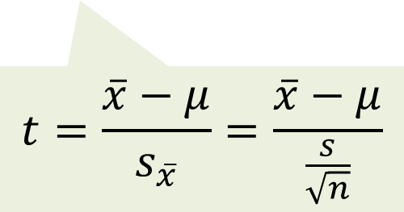
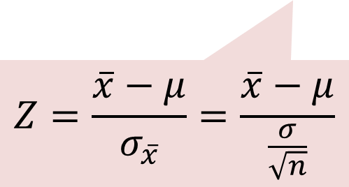

Testing for mean
Z Test
t Test
If we know the population standard deviation ($σ$)
Else, use the sample standard deviation ($s$) to estimate $σ$
$$Z=\frac{\overline{x}−μ}{σ_{\overline{x}}}=\frac{\overline{x}−μ}{\frac{σ}{\sqrt{n}}}$$
$$t=\frac{\overline{x}−μ}{s_{\overline{x}}}=\frac{\overline{x}−μ}{\frac{s}{\sqrt{n}}}$$
Use the normal distribution
For n>30
Use the Student’s t distribution
Notes:
The reason for using the t distribution is the lack of a population sd.
The t distribution is named after a guy called Student
Statistical software takes care of this issue for you

Slide 32
The Difference Between a T Distribution and a Normal Distribution
Normal distributions are used when the population distribution is assumed to be normal.
The T distribution is similar to the normal distribution, just with fatter tails.
The probability of getting values very far from the mean is larger with a T distribution than a normal distribution.

Slide 33

Testing for mean
1
  State your null hypothesis (H₀)
2
  Calculate test statistic from data (stat.)
Sample means
SD ($σ_{\overline{x}}$)
$$t=\frac{\overline{x}−μ}{s_{\overline{x}}}=\frac{\overline{x}−μ}{\frac{s}{\sqrt{n}}}$$
We know sample SD = 5 hours so we use t-distribution
40
50
$$μ$$
$$\overline{x}$$

Slide 34
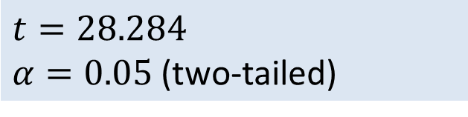
Testing for mean
1
  State your null hypothesis (H₀)
2
  Calculate test statistic from data (stat.)
3
  Choose a level of significance (α)
Sample means
SD ($σ_{\overline{x}}$)
$$t=28.284$$
$α=0.05$ (two-tailed)
40
50
$$μ$$
$$\overline{x}$$

Slide 35

Testing for mean
1
1
  State your null hypothesis (H₀)
  State your null hypothesis (H₀)
2
  Calculate test statistic from data (stat.)
3
  Choose a level of significance (α)
n>30 so we can comfortably use normal distribution
Sample means
SD ($σ_{\overline{x}}$)
4
  Lookup for the critical value
$$t=28.284$$
$α=0.05$ (two-tailed)
$$df= n−1 (199)$$
$tcrit=1.972$ (or Z_{crit}=1.96)
40
50
$$μ$$
$$\overline{x}$$

Slide 36
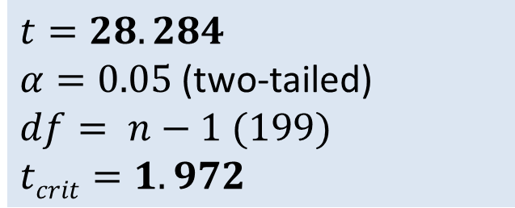
Testing for mean
1
1
  State your null hypothesis (H₀)
  State your null hypothesis (H₀)
2
  Calculate test statistic from data (stat.)
3
  Choose a level of significance (α)
Sample means
SD ($σ_{\overline{x}}$)
Do you think this is significant?
4
  Lookup the critical value or the p-value
5
  Reject H₀ or Fail to Reject
$$t=28.284$$
$α=0.05$ (two-tailed)
$$df= n−1 (199)$$
$tcrit=1.972$
40
50
$$μ$$
$$\overline{x}$$

Slide 37

Q2 Exercise Problem
The average value of houses when valued five years ago, was £120,000.
A recent survey of property prices for recent sales among local estate agents found that for a sample of 50 properties the average sale price was £124,000, with a standard deviation of £15,000.
Can we conclude that there has been
a significant change in house prices?

Slide 38
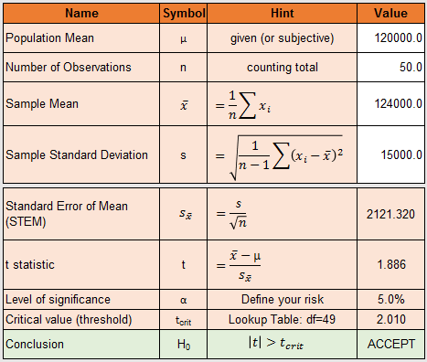
Q#2 Change in house prices?
The average value of houses when valued five years ago, was £120,000.
A recent survey of property prices for recent sales among local estate agents found that for a sample of 50 properties the average sale price was £124,000, with a standard deviation of £15,000.
Can we conclude that there has been
a significant change in house prices?
CANNOT REJECT NULL HYPOTHESIS
THEREFORE, WE CANNOT CLAIM A
SIGNIFICANT CHANGE

Slide 39
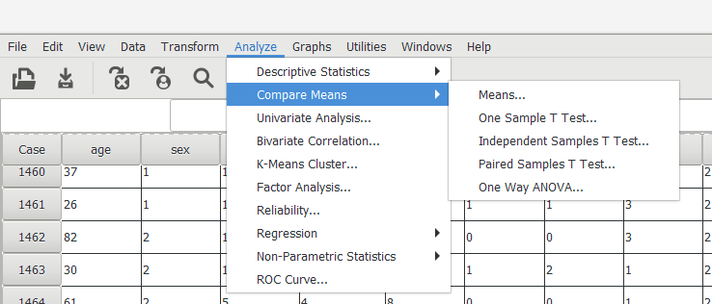
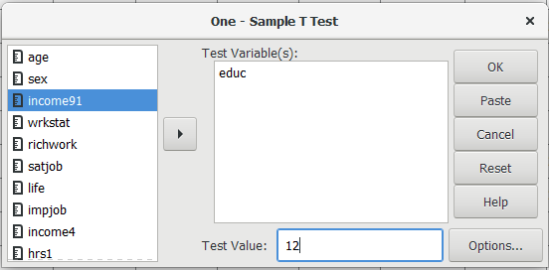
Hypothesis testing in SPSS/PSPP
Is the highest year of school completed in the GSS.SAV sample
different to the population average of 12?
1
2

Slide 40
Hypothesis testing in SPSS
Is the highest year of school completed in this sample
different to the population average of 12?
YES, there is strong evidence that it’s different

Slide 41
This is about “EVIDENCE” not “PROOF”
Possible Outcomes
 | ‘Statistical Test’: Failed to reject null hypothesis. | ‘Statistical Test’: Reject null hypothesis.
Reality: Null Hypothesis is true | GOOD CONCLUSION
Reality: Alternative Hypothesis is true |  | GOOD CONCLUSION
Notes:
The level of significance is, effectively, the chances of a Type I error.

Slide 42
This is about “EVIDENCE” not “PROOF”
Possible Outcomes
 | ‘Statistical Test’: Failed to reject null hypothesis. | ‘Statistical Test’: Reject null hypothesis.
Reality: Null Hypothesis is true | GOOD CONCLUSION | Type I Error/False Positive
Reality: Alternative Hypothesis is true |  | GOOD CONCLUSION
Notes:
The level of significance is, effectively, the chances of a Type I error.

Slide 43
This is about “EVIDENCE” not “PROOF”
Possible Outcomes
 | ‘Statistical Test’: Failed to reject null hypothesis. | ‘Statistical Test’: Reject null hypothesis.
Reality: Null Hypothesis is true | GOOD CONCLUSION | Type I Error/False Positive
Reality: Alternative Hypothesis is true | Type II Error/False Negative | GOOD CONCLUSION
Notes:
The level of significance is, effectively, the chances of a Type I error.

Slide 44
Reading…
Berenson et al. (2015)
Chapter 7 Section 7.4
Sampling Distribution of the Mean
Chapter 7 Section 7.5
Sampling Distribution of the Proportion
Chapter 9
Fundamentals of Hypothesis Testing

Slide 45
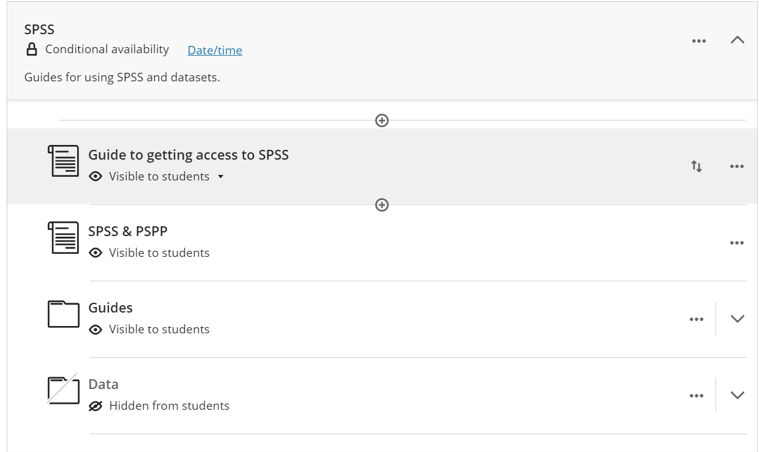
Seminar
The bit to do in class are the non-SPSS exercises
Information about SPSS can be found on Minerva:
Try to do the exercises based on SPSS on your own (this is not the core of this module) and email me if you have any questions or issues with using the software.

Slide 46
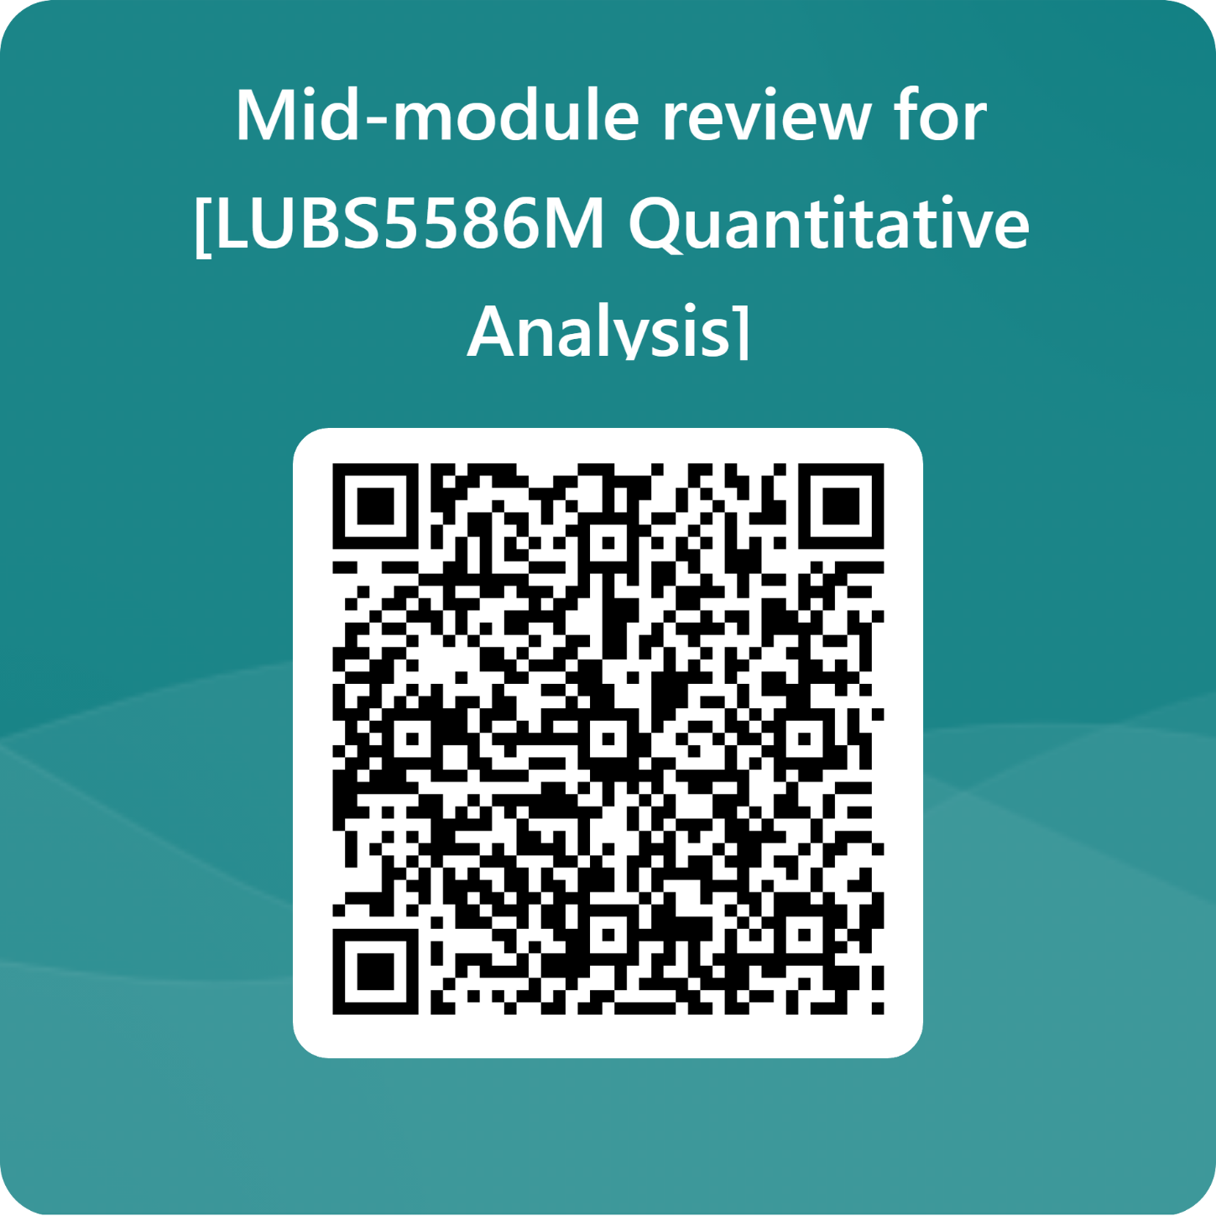

Slide 47
Module Overview
Descriptive
Statistics
Probability
Distributions
Hypothesis
Testing 1
Probability
Sampling
Week
1
Week
2
Week
3
Week
4
Week
5
Week
6
Week
7
Week
8
Week
9
Week
10
Hypothesis
Testing 2
Testing
Relationship
Regression
Conditional
Probability
Factor
Analysis
Week
11
Revision

