Slide 1
Module Overview
Descriptive
Statistics
Probability
Distributions
Hypothesis
Testing 1
Probability
Sampling
Week
1
Week
2
Week
3
Week
4
Week
5
Week
6
Week
7
Week
8
Week
9
Week
10
Hypothesis
Testing 2
Testing
Relationship
Regression
Conditional
Probability
Factor
Analysis
Week
11
Revision

Slide 2




Information from Samples
A population is all of some specified group
For example:
all of the people in England, or
all children in Leeds, or
all bottles produced in a factory, or
all students in LUBS5586M module
Essentially, this is a true data of the group.

Slide 3
Information from Samples
If we have complete data on a population (i.e. census)
then we can calculate descriptive statistic such as averages and proportions with certainty.
For example,
average heights of all people in England
proportion of defective bottles in factory
These values can be called parameters of the population.

Slide 4



Information from Samples
Often a census of the population is impractical so…
General Social Survey (GSS)
We take a sample from the population and make inferences about the population
To make inferences, we need to take a random or probability sample

Slide 5


Types of sampling
Probabilistic
Non-probabilistic
Simple Random
Systematic
Stratified
  Etc.
Convenience
Judgment
Snowball
  Etc.
Not good for inferring
about population
Notes:
In research and the commercial world you will come across two sorts of samples
Basically probability samples allow statistical inference to be used to estimate the characteristics of the population from which the sample is drawn and non-probability samples don’t. You need probability samples for statistical analysis
For probability samples the chance of any case being included is known and usually equal
For non probability samples the probability of a case being included is not known, so you can’t generalise on statistical grounds
Non probability samples include, for example self selected samples (where you advertise and collect data from whoever turns up), quota samples (where you approach people until you have, say, enough people in each age group), snowball samples where you get an initial contact to recommend others, and judgmental samples where you choose cases for a particular reason (e.g. because they are typical or extreme etc)

Slide 6
More on sampling before we stop, but we will also see that in the dissertation and research methods module
SYSTEMATIC
STRATIFED
Sample members from a larger population are selected according to a random starting point but with a fixed, periodic interval. This interval, called the sampling interval, is calculated by dividing the population size by the desired sample size.
E.g. One out of every five from population
Stratified random sampling is a method of sampling that involves the division of a population into smaller sub-groups known as strata. In stratified random sampling, or stratification, the strata are formed based on members' shared attributes or characteristics such as income or educational attainment.
E.g. Half of the sample as female and half as male.

Slide 7
Procedure for sampling
Identify sampling frame
n=?
Decide on sample size
Decide on sampling technique
Simple Random, Systematic, Stratified, Etc.
Check sample is representative
Notes:
Sampling frame - a complete list of cases in the population. If you build your own frame, take care it is unbiased, current & accurate. Phone books, eg, can be a problem as some people are ex-directory. Some can be straightforward to obtain if you have access, eg employees in a firm from the personnel department
Sample size –
Look at cartridges (mixed colors)
We want to know what percentage there is of each color
If we take a sample of a particular size, will we get the population figure?
if we take 2 samples of a particular size will we get the same result?
What happens as the sample size changes?
the size you need depends on the accuracy and confidence you want to have in the results. Size affects the potential errors involved when generalising to the population. This is the size you want in the sample, so if doing a survey you need to take account of response rate, and numbers in sub-categories of interest too. Response rates can be under 10% for business, under 3% for consumer if you don’t do follow-up
sampling technique - several available, discussed next
representativeness check - test the sample versus the population, respondents vs non-respondents on variables of interest (as we know weird things happen, they are just unlikely)

Slide 8



Statistical Inference
We infer population parameters from sample statistics
We cannot expect sample means, standard deviations or percentages to be an exact match of the population figures.
Generally, small samples provide less accurate estimates. There will always be uncertainty due to sampling variation.
35 | 27 | 22 | 35 | 35 | 23 | 21 | 21
34 | 37 | 29 | 29 | 36 | 38 | 39 | 22
$$μ=30.19$$
$$\tilde{x}=29.88$$

Slide 9
Statistical Inference
Sample suggests 43% male
Sample statistics give point estimates of the population parameters
We describe the uncertainty in our estimate using a confidence interval
Actual population is ??% male
The actual population parameter lies within the confidence interval with a particular probability

Slide 10
Proportions
Statistical inference about

Slide 11
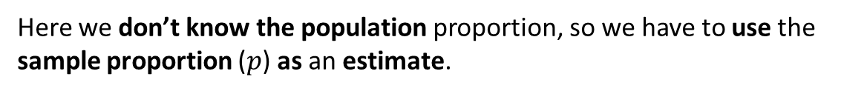
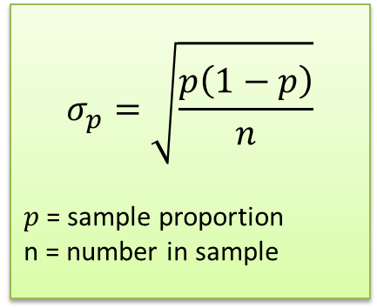
Statistical inferences about proportions
Proportion is defined as number of event of interest out of total number of observation. For Example:
Number of students that take French as a second language out of all students.
Percentage of defect products from factory.
In some situation, you might get this ‘proportion’ from the sample and want to infer to the population.
$$σ_{p}=\sqrt{\frac{p\left(1−p\right)}{n}}$$
$p$= sample proportion
n = number in sample
STANDARD ERROR OF THE PROPORTION!
Here we don’t know the population proportion, so we have to use the sample proportion ($p$) as an estimate.
Notes:
As you’ll recall from when we tested hypotheses about percentages….

Slide 12
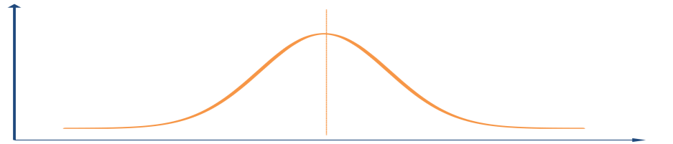
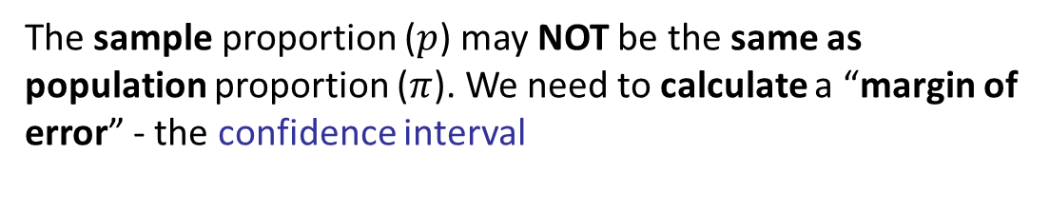
Confidence Interval for proportions
The sample proportion ($p$) may NOT be the same as population proportion ($π$). We need to calculate a “margin of error” - the confidence interval
An interval around the sample proportion in which we are confident that the population proportion lies
Conventionally we use the 95% or 99% confidence intervals
0%
p
100%
Notes:
As you’ll recall from when we tested hypotheses about percentages….

Slide 13
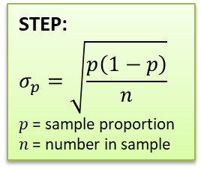
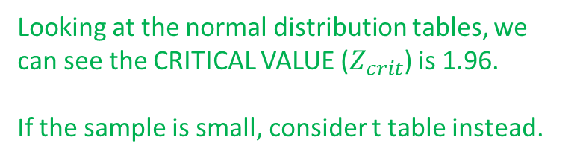
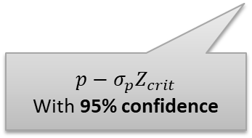
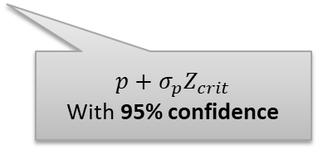
Confidence Interval for proportions
How far from the mean does a value have to be for there to be only a 2.5% probability of that happening (i.e. 5% for both tails of higher and lower)?
Looking at the normal distribution tables, we can see the CRITICAL VALUE ($Z_{crit}$) is 1.96.
If the sample is small, consider t table instead.
STEP:
$$σ_{p}=\sqrt{\frac{p\left(1−p\right)}{n}}$$
$p$= sample proportion
$n$ = number in sample
0%
p
100%
What would the 95% confidence interval be?
$$p+σ_{p}Z_{crit}$$
With 95% confidence
$$p−σ_{p}Z_{crit}$$
With 95% confidence
Notes:
Define a range as $σ_{p}Z_{crit}$on either side of the mean. Now, the probability of a value being in it is 0.95, or 95%

Slide 14
Example Problem 1
You survey a sample of 200 employees in a large organisation and discover that 40% of respondents feel their home life is adversely affected by stress at work.
How would you report these results using a 95% confidence interval?

Slide 15
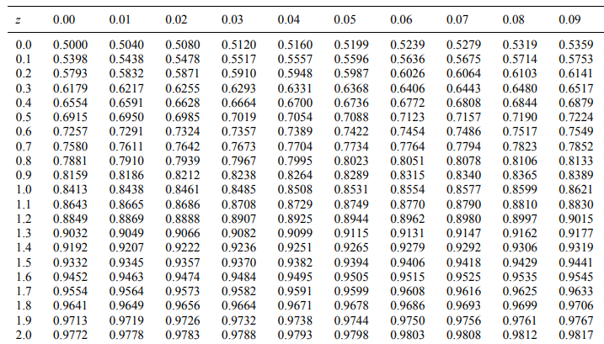
Example Problem 1
You survey a sample of 200 employees in a large organisation and discover that 40% of respondents feel their home life is adversely affected by stress at work.
How would you report these results using a 95% confidence interval?

Slide 16
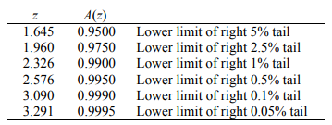
Example Problem 1
You survey a sample of 200 employees in a large organisation and discover that 40% of respondents feel their home life is adversely affected by stress at work.
How would you report these results using a 95% confidence interval?

Slide 17
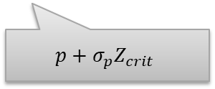
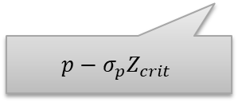
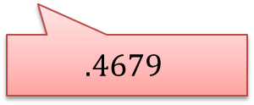

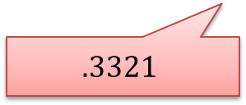

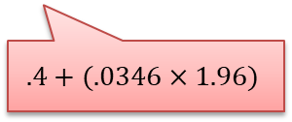

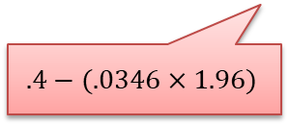
Example Problem 1
You survey a sample of 200 employees in a large organisation and discover that 40% of respondents feel their home life is adversely affected by stress at work.
How would you report these results using a 95% confidence interval?
Lookup table: $Z_{crit}=1.96$ for $α=0.05$
33% - 47%
STEP:
$$σ_{p}=\sqrt{\frac{p\left(1−p\right)}{n}}$$
$p$= sample proportion
$n$ = number in sample
STEP:
$$σ_{p}=\sqrt{\frac{.4\left(1−.4\right)}{200}}$$
= .03464
0%
p
100%
$$.3321$$
$$.4679$$
$$.4−(.0346×1.96)$$
$$.4+(.0346×1.96)$$
$$p−σ_{p}Z_{crit}$$
$$p+σ_{p}Z_{crit}$$

Slide 18
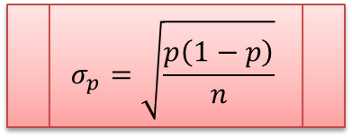




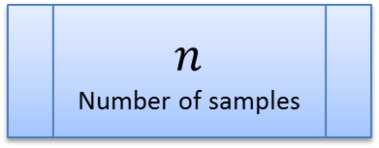
Sample size for target confidence level
We can also determine sample sizes for estimates of a given accuracy and confidence level
0%
$${{−σ}_{p}Z}_{crit}$$
$$p$$
$${σ_{p}Z}_{crit}$$
100%
$±σ_{p}Z_{crit}$
Confidence Interval
$$σ_{p}=\sqrt{\frac{p\left(1−p\right)}{n}}$$
$n$
Number of samples
Notes:
If we know how accurately we need to know the population percentage, we can then calculate STEP
e.g. if we want to know the percentage within 5%
either way this means 0.05=1.96*STEP
i.e. STEP = 0.05/1.96 = 0.025510
We can then put this value in the STEP formula and rearrange to calculate n

Slide 19
Example Problem 2
If the female population in the IT industry is roughly 40%, and we want to collect a sample that is within 5% of this population percentage, what sample size would we require?
$±σ_{p}Z_{crit}$
Confidence Interval
$$σ_{p}=\sqrt{\frac{p\left(1−p\right)}{n}}$$
$n$
Number of samples

Slide 20
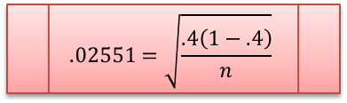
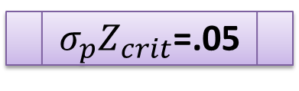
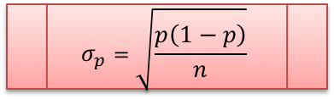
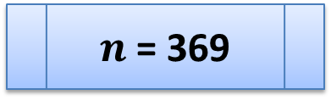
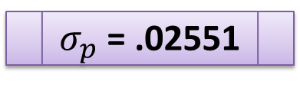
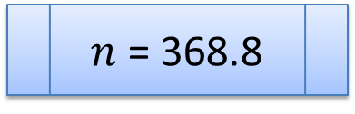
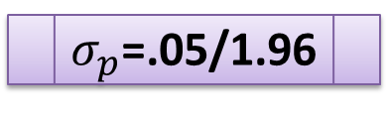
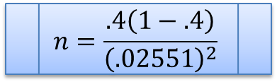
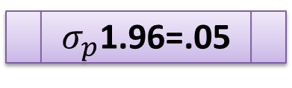
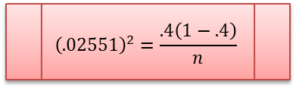
Example Problem 2
If the female population in the IT industry is roughly 40%, and we want to collect a sample that is within 5% of this population percentage, what sample size would we require?
$σ_{p}Z_{crit}$=.05
$$σ_{p}=\sqrt{\frac{p\left(1−p\right)}{n}}$$
$$n=\frac{.4\left(1−.4\right)}{{\left(.02551\right)}^{2}}$$
$σ_{p}$1.96=.05
$$.02551=\sqrt{\frac{.4\left(1−.4\right)}{n}}$$
$n$ = 368.8
$σ_{p}$=.05/1.96
$${\left(.02551\right)}^{2}=\frac{.4\left(1−.4\right)}{n}$$
$n$ = 369
$σ_{p}$ = .02551

Slide 21
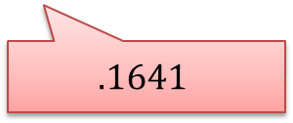
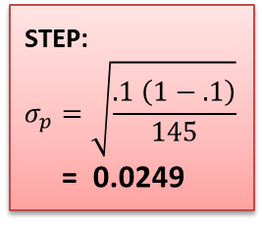
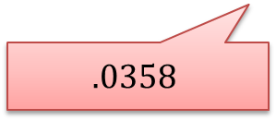
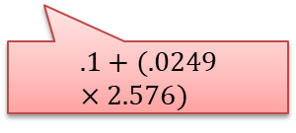
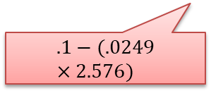

Exercise Problem 1
You survey a sample of 145 Phone from a production line and discover that 10% of them is defective.
How would you report these results using a 99% confidence interval?
Lookup table: $Z_{crit}=2.576$ for $α=0.01$
STEP:
$$σ_{p}=\sqrt{\frac{.1 \left(1−.1\right)}{145}}$$
= 0.0249
3% - 16%
$$.1−(.0249×2.576)$$
$$.1+(.0249×2.576)$$
$$.0358$$
$$.1641$$

Slide 22
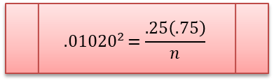
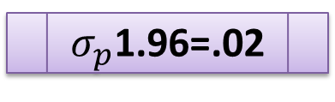
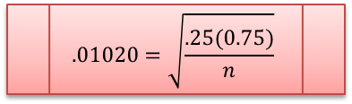
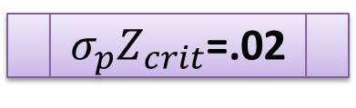

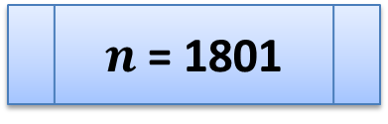
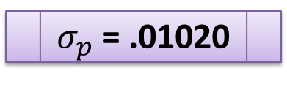
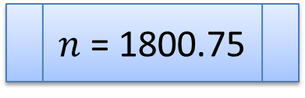
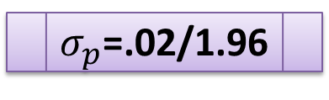
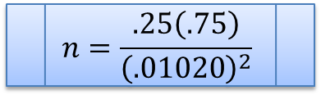
Exercise Problem 2
If the percentage of those who prefer rice over noodle is roughly 25%, and we want to collect a sample that is within 2% of this population percentage, what sample size would we require? (95% Confidence Interval)
$σ_{p}Z_{crit}$=.02
$$σ_{p}=\sqrt{\frac{p\left(1−p\right)}{n}}$$
$$n=\frac{.25\left(.75\right)}{{\left(.01020\right)}^{2}}$$
$σ_{p}$1.96=.02
$$.01020=\sqrt{\frac{.25(0.75)}{n}}$$
$n$ = 1800.75
$σ_{p}$=.02/1.96
$${.01020}^{2}=\frac{.25\left(.75\right)}{n}$$
$n$ = 1801
$σ_{p}$ = .01020

Slide 23
10 Minutes Break

Slide 24
Means
Statistical inference about
The standard error is a statistical term that measures the accuracy with which a sample distribution represents a population by using standard deviation. In statistics, a sample mean deviates from the actual mean of a population; this deviation is the standard error of the mean.

Slide 25
But what is the difference between standard error and standard deviation?
The standard deviation (SD) measures the amount of variability, or dispersion, from the individual data values to the mean, while the standard error of the mean (STEM) measures how far the sample mean (average) of the data is likely to be from the true population mean.
The standard deviation is about spread. You want to show the shape of the data
The standard error is about precision. You want to covered all potential answer.

Slide 26
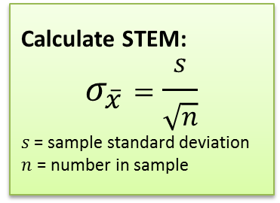

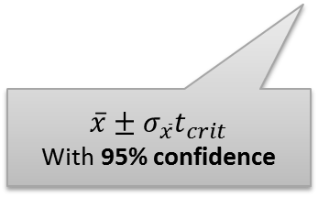
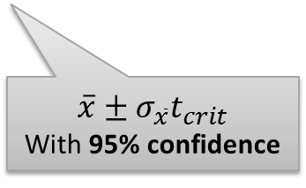

Statistical inferences about means
The confidence interval for the population mean is calculated in a similar way to the confidence interval for the population proportions…
Look at the t Distribution Table, we can see the CRITICAL VALUE ($t_{crit}$) for mean
Calculate STEM:
$$σ_{\overline{x}}=\frac{s}{\sqrt{n}}$$
$s$= sample standard deviation
$n$ = number in sample
$$\overline{x}$$
$$\overline{x}±σ_{\overline{x}}t_{crit}$$
With 95% confidence
$$\overline{x}±σ_{\overline{x}}t_{crit}$$
With 95% confidence
When a sample has more than 30 observations, the normal distribution can be used in place of the t distribution.

Slide 27
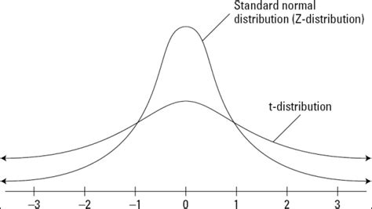
Z-Score vs T-Score
Z-Score
T-Score
The population’s standard deviation is known.
Or the sample size is large enough.
The population standard deviation is unknown. You make an estimate by using your sample.
And the sample size is small.

Slide 28
Example Problem 3
A company wanting to look at the efficiency of it’s order processing system. It takes a sample of 65 orders, and finds that the mean order processing time is 18.1077 days and the s.d of the sample is 3.9612.
What is the 95% confidence interval for the population mean?

Slide 29

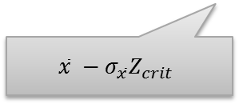




Example Problem 3
A company wanting to look at the efficiency of it’s order processing system. It takes a sample of 65 orders, and finds that the mean order processing time is 18.1077 days and the s.d of the sample is 3.9612.
What is the 95% confidence interval for the population mean?
Calculate STEM:
$$σ_{\overline{x}}=\frac{s}{\sqrt{n}}$$
$s$= sample standard deviation
$n$ = number in sample
Calculate STEM:
$$σ_{\overline{x}}=\frac{3.9612}{\sqrt{65}}$$
$s$= sample standard deviation
$n$ = number in sample
$$\text{= }\text{0.4913}$$
=
0.963
0.963
$$\overline{x}$$
$$\overline{x} −σ_{\overline{x}}Z_{crit}$$
$$\overline{x}+σ_{\overline{x}}Z_{crit}$$
$$18.107−(.4913)(1.96)$$
$$18.107+(.4913)(1.96)$$
17.1447
19.0707
Notes:
If you want the mean within +/- 5% you’d need to calculate 5% in units

Slide 30

Example Problem 4
A company wanting to look at the efficiency of it’s order processing system.
The mean order processing time is 18.1077 days and the s.d of the sample is 3.9612.
The same company wants to estimate the mean processing time with a confidence interval of half a day either side.
What is the size of the sample of orders that would be needed?
Calculate STEM:
$$σ_{\overline{x}}=\frac{s}{\sqrt{n}}$$
$s$= sample standard deviation
$n$ = number in sample

Slide 31










Example Problem 4
The same company wants to estimate the mean processing time with a confidence interval of half a day either side.
What is the size of the sample of orders that would be needed?
$σ_{\overline{x}}Z_{crit}$=0.5
$$σ_{\overline{x}}=\frac{s}{\sqrt{n}}$$
$$n={15.528}^{2}$$
$σ_{\overline{x}}$1.96=0.5
$$0.2551=\frac{3.9612}{\sqrt{n}}$$
$n$ = 241.12
Number of samples
$σ_{\overline{x}}$=0.5/1.96
$$\sqrt{n}=\frac{3.9612}{0.2551}$$
$n$ = 242
Number of samples
$σ_{\overline{x}}$ = 0.2551

Slide 32







Exercise Problem 3
A school is studying the final year student’s IQ to try to gauge their level of intellectual capability. It takes a sample of 135 students, and finds that the average IQ is 103.457 and the s.d of the sample is 7.323.
What is the 99% confidence interval for the population mean?
Calculate STEM:
$$σ_{\overline{x}}=\frac{s}{\sqrt{n}}$$
$s$= sample standard deviation
$n$ = number in sample
Calculate STEM:
$$σ_{\overline{x}}=\frac{\text{7.323}}{\sqrt{135}}$$
$s$= sample standard deviation
$n$ = number in sample
$$\text{= }\text{0.6302}$$
=
1.623
1.623
$$\overline{x}$$
$$\overline{x} −σ_{\overline{x}}Z_{crit}$$
$$\overline{x}+σ_{\overline{x}}Z_{crit}$$
$$103.457−(.6302)(2.576)$$
$$103.457+(.6302)(2.576)$$
101.83
105.08

Slide 33



Finite population!
What happens when population is finite? (not assumed infinity!)
In such a case, our estimates from the sample are more accurate than the conventional STEP and STEM calculations.
The values of STEP and STEM should be adjusted by multiplying with the finite population correction (fpc) factor:
$$\sqrt{\frac{N−n}{N−1}}$$
Adjusted STEM:
$$σ_{\overline{x}}=\frac{s}{\sqrt{n}}×\sqrt{\frac{N−n}{N−1}}$$
$s$= sample standard deviation
$n$ = number in sample
N = population count
Adjusted STEP:
$$σ_{p}=\sqrt{\frac{p\left(1−p\right)}{n}}×\sqrt{\frac{N−n}{N−1}}$$
$p$= sample proportion
$n$ = number in sample
N = population count
Notes:
Calculating population parameters from a sample value with a particular confidence interval is fairly straightforward, and software such as SPSS can do this for you. Wanting to know that you will get values with a certain value from the population mean (say +/- 5%) needs more forethought to calculate a sample size before data is collected. You also need some idea of the population values (perhaps from a pilot study). The variable with the most variation is the one to calculate on.
For many projects getting a big enough sample can be an issue.

Slide 34


Reading…
Berenson et al. (2015)
Chapter 7
  Types of Sampling Method
  Evaluating Survey Worthiness
  Sampling Distributions
Chapter 8, Sections 8.1-8.4 & 8.6
  Confidence Interval Estimation for the Mean ($σ$ known)
  Confidence Interval Estimation for the Mean ($σ$ unknown)
  Confidence Interval Estimation for the Proportion
  Determining Sample Size
  Confidence Interval Estimation and Ethical Issues

Slide 35
Module Overview
Descriptive
Statistics
Probability
Distributions
Hypothesis
Testing 1
Probability
Sampling
Week
1
Week
2
Week
3
Week
4
Week
5
Week
6
Week
7
Week
8
Week
9
Week
10
Hypothesis
Testing 2
Testing
Relationship
Regression
Conditional
Probability
Factor
Analysis
Week
11
Revision

