Slide 1
Module Overview
Descriptive
Statistics
Probability
Distributions
Hypothesis
Testing 1
Probability
Sampling
Week
1
Week
2
Week
3
Week
4
Week
5
Week
6
Week
7
Week
8
Week
9
Week
10
Hypothesis
Testing 2
Testing
Relationship
Regression
Conditional
Probability
Factor
Analysis
Week
11

Slide 2
Examination Update
120 Mins Exam
60 MCQ
14/01/2026
14:00 PM
Location: To be confirm, check University Website.
Calculator:
  Casio fx-82 series
  Casio fx-83 series
  Casio fx-85 series
  Casio fx-350 series
  Sharp EL – 531 series
Get the calculator approved at the Maurice Keyworth reception desk

Slide 3

Recall Week 2: The probability scale
Absolute
certainty
1.0
e.g. Will it snow tomorrow? Definitely
$$0≤p\left(X\right)≤1$$
0.5
Absolute
impossibility
e.g. Will it snow tomorrow? Impossible
0.0

Slide 4

Recall Week 2: Combining Events
Probability of A and B happening simultaneously…
For events that are not independent:
$$p\left(A∩B\right)=p\left(A\right)×p\left(B|A\right)$$

Slide 5


Recall Week 2
 | Male | Female | Total
Smokers |  |  | 30%
Non-smokers
Total |  | 50% | 100%
The company example:-
  50% of employees are female
  20% of female employees smoke
  30% of employees smoke
50% are females
20% females are smokers
20% females are smokers
30% of employee are smokers

Slide 6




Combining Events
Probability of A and B happening simultaneously…
For events that are not independent:
Consider a company where:-
  20% of female employees smoke
  50% of employees are female
  30% of employees smoke
If an employee is chosen at random…
  what is the chance it will be a woman who smokes?
Chances of both events $X_{smoke}$ and $X_{female}$ together:-
$p\left(X_{female}∩X_{smoke}\right)=p\left(X_{female}\right)×p\left(X_{smoke}\right)$
$p\left(X_{female}∩X_{smoke}\right)=0.50×0.30=0.15$

Slide 7

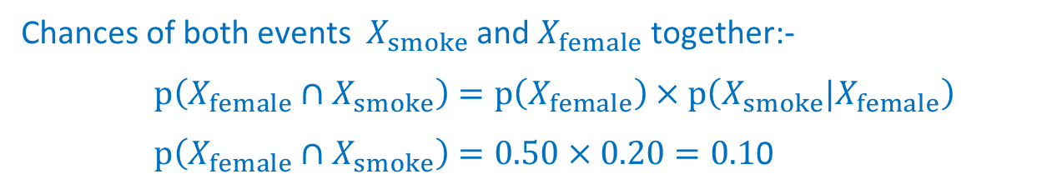
Combining Events
Probability of A and B happening simultaneously…
For events that are not independent:
Consider a company where:-
  20% of female employees smoke
  50% of employees are female
  30% of employees smoke
If an employee is chosen at random…
  what is the chance it will be a woman who smokes?
Chances of both events $X_{smoke}$ and $X_{female}$ together:-
$p\left(X_{female}∩X_{smoke}\right)=p\left(X_{female}\right)×p\left(X_{smoke}|X_{female}\right)$
$p\left(X_{female}∩X_{smoke}\right)=0.50×0.20=0.1$0

Slide 8
Conditional Probabilities
p(smoker if female) is the conditional probability i.e.
the worker smokes given that the worker is female
This can be written as…
p(smoker | female)
Conditional probabilities can be important:
  They give information about subgroups with different propensities
e.g. different propensities to default on loans or purchase products
Notes:
example in book shows that purchasing a plasma TV indicates an increased chance of purchasing a DVDR

Slide 9
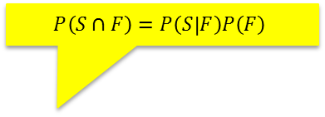
Example
 | Male | Female | Total
Smokers |  |  | 30%
Non-smokers
Total |  | 50% | 100%
10%
50% are females
P(F) = 0.5
$$P\left(S∩F\right)=P\left(S | F\right)P\left(F\right)$$
20% females are smokers
P(S|F) = 0.2
20% females are smokers
30% of employee are smokers
20% females are smokers
P(S) = 0.3

Slide 10



Bayes Theorem
Probability of A and B happening simultaneously…
For events that are not independent:
$$p\left(A∩B\right)=p\left(A\right)×p\left(B|A\right)$$
$$p\left(A∩B\right)=p\left(B\right)×p\left(A|B\right)$$
Bayes Theorem
Therefore
$$p\left(A\right)×p\left(B|A\right)=p\left(B\right)×p\left(A|B\right)$$
$$p\left(A|B\right)= p\left(A\right)×p\left(B|A\right)/p\left(B\right)$$

Slide 11
Question 1
 | Male | Female | Total
Smokers |  |  | 30%
Non-smokers
Total |  | 50% | 100%
10%
50% are females
P(F) = 0.5
$$P\left(S∩F\right)=P\left(S | F\right)P\left(F\right)$$
20% females are smokers
P(S|F) = 0.2
20% females are smokers
30% of employee are smokers
20% females are smokers
P(F|S) = ?
P(S) = 0.3

Slide 12
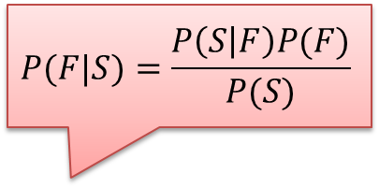
Question 1
 | Male | Female | Total
Smokers |  | 10% | 30%
Non-smokers
Total |  | 50% | 100%
$$P(F|S)=\frac{P\left(S | F\right)P(F)}{P(S)}$$
50% are females
P(F) = 0.5
20% females are smokers
P(S|F) = 0.2
20% females are smokers
30% of employee are smokers
20% females are smokers
P(S) = 0.3
  P(F|S) = 0.2 x 0.5 / 0.3 = 1/3

Slide 13
Law of total probability
B1, B2, … and Bn are mutually exclusive and collectively exhaustive events
For any event A:
$p\left(A\right)= p\left(A∩B1\right)+$ $p\left(A∩B2\right)+ …$ $+ p\left(A∩Bn\right)$
$= p\left(A|B1\right)p\left(B1\right)+$ $p\left(A|B2\right)p\left(B2\right)+ …$

Slide 14
Probability Exercise 2
  Box 1 contains 7 red and 3 white balls.
  Box 2 contains 2 red and 6 white balls.
  First a box is selected at random (each box is as likely to be selected as the other) and then a ball is drawn from the box.
  Please calculate p(B1), p(B2), p(red|B1), p(red|B2), and p(red)

Slide 15
Exercise 2
  P(B1) = 1/2
  P(B2) = 1/2
  P(red|B1) = 7/10
  P(red|B2) = 2/8 = 1/4
  P(red) = P(red|B1)P(B1) + P(red|B2)P(B2)
  = (7/10) * (1/2) + (1/4) * (1/2)
  = 0.475

Slide 16
Probability Exercise 3
  Box 1 contains 7 red and 3 white balls.
  Box 2 contains 2 red and 6 white balls.
  First a box is selected at random (each box is as likely to be selected as the other) and then a ball is drawn from the box.
  If a red ball is drawn, what is the probability that it came from Box 1?

Slide 17
Exercise 3
  P(B1|Red)
  = P(Red|B1) * P(B1) / P(Red)
  = (7/10)*(1/2)/0.475
  = 0.737

Slide 18
  10 Minutes Break

Slide 19
Probability Exercise 4
  You need to determine if an athlete at the Olympics is using drugs by interpreting the results of a test.
  Suppose that 5% of athletes at the Olympics are drug users.
  A test is 96% accurate, which we'll say means that if a person is a drug user, the result is positive 96% of the time and if the person is not a drug user, the result is negative 96% of the time.
  A randomly chosen athlete at the Olympics tests positive.
    What is the probability that the person is a drug user?

Slide 20
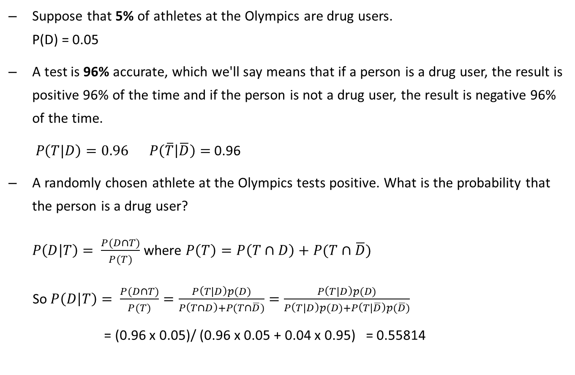
Exercise 4
  Suppose that 5% of athletes at the Olympics are drug users.
  P(D) = 0.05
  A test is 96% accurate, which we'll say means that if a person is a drug user, the result is positive 96% of the time and if the person is not a drug user, the result is negative 96% of the time.
  $P\left(T|D\right)=0.96$ $P\left(\overline{T} | \overline{D}\right)=$ 0.96
  A randomly chosen athlete at the Olympics tests positive. What is the probability that the person is a drug user?
  $P\left(D | T\right)= \frac{P(D∩T)}{P(T)}$ where $P\left(T\right)=P\left(T∩D\right)+P(T∩\overline{D})$
  So $P\left(D | T\right)= \frac{P(D∩T)}{P(T)}=\frac{P\left(T|D\right)p(D)}{P\left(T∩D\right)+P(T∩\overline{D})}=\frac{P\left(T|D\right)p(D)}{P\left(T|D\right)p(D)+P\left(T|\overline{D}\right)p(\overline{D})}$
  = (0.96 x 0.05)/ (0.96 x 0.05 + 0.04 x 0.95) = 0.55814

Slide 21
Exercise 4
  Now what if 40% of the group are drug users?
  P(D|T) = (0.96x0.4)/(0.96x0.4 + 0.04x0.6)= 0.941176

Slide 22
Probability Exercise 5
  The university buys computers from three different manufacturers:
    30% from manufacturer A
    45% from manufacturer B
    25% from manufacturer C
  Past experience has shown that the defective rates for these manufacturers are 3%, 1%, and 4% respectively.
  If a computer is returned to the manufacturer by the university because it was found to be defective, what is the probability that it came from manufacturer C?

Slide 23
Probability Exercise 5
  Three different manufacturers:
    30% from manufacturer A: P(A) = 0.3
    45% from manufacturer B: P(B) = 0.45
    25% from manufacturer C: P(C) = 0.25
  Defective rates for these manufacturers are 3%, 1%, and 4% respectively.
  P(D|A) = 0.03 P(D|B) = 0.01 P(D|C) = 0.04
  If a computer is returned to the manufacturer by the university because it was found to be defective, what is the probability that it came from manufacturer C?
  P(C|D) = P(D|C)P(C)/P(D)
  = P(D|C)P(C)/(P(D|A)P(A) + P(D|B)P(B) + P(D|C)P(C))
  = (0.04*0.25)/(0.03x0.3+0.01x0.45+0.04x0.25) = 0.425532

Slide 24
Natural frequencies method
The company example:-
  50% of employees are female
  20% of female employees smoke
  30% of employees smoke
Smoke
200
Male
500
Don’t
300
Employee
1000
Smoke
100
Female
500
Don’t
400

Slide 25
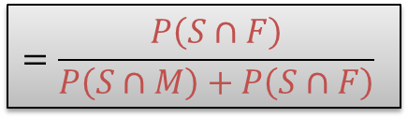
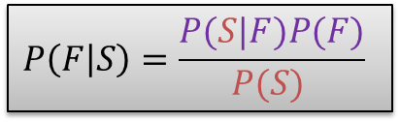
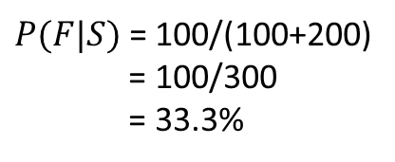
Natural frequencies method
$$P\left(F | S\right)=\frac{P(S|F)P(F)}{P(S) }$$
$$=\frac{P\left(S∩F\right)}{P\left(S∩M\right)+P\left(S∩F\right)}$$
Smoke
200
Male
500
Don’t
300
$P(F|S)$ = 100/(100+200)
= 100/300
= 33.3%
Employee
1000
Smoke
100
Female
500
Don’t
400

Slide 26
Probability exercise 6
Eight out of every thousand women have breast cancer (who had no symptoms prior to the screening test)
  Of these eight women, Seven will have a positive test result.
  Of the other 992 women, who do not have breast cancer, around 70 will have a positive test result.
What is the probability a woman with a positive test result actually has breast cancer?
Solve this using:
  Bayes rule
  Natural frequencies

Slide 27

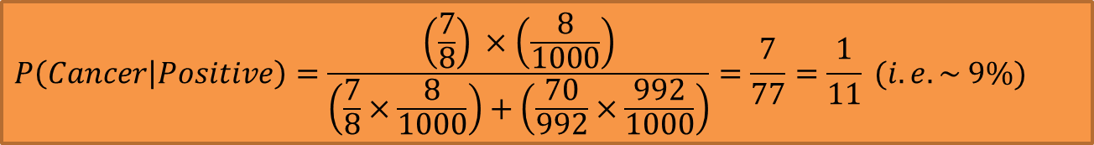


Exercise 6
Eight out of every thousand women have breast cancer (who had no symptoms prior to the screening test)
  Of these eight women, Seven will have a positive test result.
  Of the other 992 women, who do not have breast cancer, around 70 will have a positive test result.
What is the probability a woman with a positive test result actually has breast cancer?
$$P\left(Cancer | Positive\right)=\frac{P(Positive|Cancer)P(Cancer)}{P(Positive) }$$
$$P\left(Cancer | Positive\right)=\frac{\left(\frac{7}{8}\right) ×\left(\frac{8}{1000}\right)}{\left(\frac{7}{8}×\frac{8}{1000}\right)+\left(\frac{70}{992}×\frac{992}{1000}\right)}=\frac{7}{77}=\frac{1}{11} (i.e. \sim 9\%)$$
$$P\left(Cancer | Positive\right)=\frac{\left(\frac{7}{8}\right) ×\left(\frac{8}{1000}\right)}{\left(\frac{7}{8}×\frac{8}{1000}\right)+\left(\frac{70}{992}×\frac{992}{1000}\right)}$$
$$P\left(Cancer | Positive\right)\frac{P(S|F)P(F)}{P(S) }$$

Slide 28
Exercise 6
This method is referred to as using natural frequencies.
1000 women
8 have cancer
992 are clear
7
1
70
922
7 in 77 have cancer (1 in 11, or around 9%)

Slide 29
Reading…
Berenson et al. (2015)
Chapter 4
Section 4.3 - “Bayes Theorem”

Slide 30
When preparing for the exam
Tips:
Understand the concepts covered in the lecture slides.
Practice the 100+ questions in the lecture slides and seminar worksheets at least three times.
Complete 30+ mock questions within one hour.
Please book a meeting and talk to me!
Available in person on Wednesday and Friday
Available online on Monday, Tuesday and Thursday
Please send me an email or teams message if you have any questions. I will try to check email/message from time-to-time, and do my best to address your questions as quickly as possible.

Slide 31
Module Overview
Descriptive
Statistics
Probability
Distributions
Hypothesis
Testing 1
Probability
Sampling
Week
1
Week
2
Week
3
Week
4
Week
5
Week
6
Week
7
Week
8
Week
9
Week
10
Hypothesis
Testing 2
Testing
Relationship
Regression
Conditional
Probability
Factor
Analysis
Week
11
Revision

