Slide 1

Feedback from your mid-module reviews

Slide 2

Your feedback makes the difference
Provide additional examples and questions (7/40)
I have included more examples and questions in the lecture
Additional examples and questions can be found in the book
A bank of mock questions will be provided in Week 10 for revision
The pace of the lecture is fast (5/40)
I will try my best to slow down
Please ask me to repeat if anything is unclear
You can rewatch lectures on Minerva with subtitles at 0.5x speed
Please consider using a microphone (3/40)
I will do this 😊

Slide 3
Your feedback makes the difference
Give a real example of the main concept (3/40)
I will explain why we need to learn the topic, its outcomes, and its real-world applications
More online and offline resources, and reading tasks (2/40)
Khan Academy – Statistics and Probability
Doubts regarding when to use each formula (2/40)
I will spend more time on key formulas
If you still have doubts, please feel free to contact me

Slide 4
Your feedback makes the difference
Give brief summaries after each section and practice (2/40)
I will do this 😊
More seminars or longer seminars (1/40)
Unfortunately, the number and length of seminars are fixed in the timetable, so we can’t extend them officially. However, you’re very welcome to study with your classmates outside class.
If you have any questions, please feel free to contact me. I’ll be very happy to help.
Repeat other students’ questions (1/40)
I will do this 😊

Slide 5
Your feedback makes the difference
Add graded assignments (1/40)
The assessment format for this module has been set for this academic year, so we are sorry that we cannot add graded assignments this time.
A bank of mock test questions will be provided in Week 10 for revision
Pause longer for questions (1/40)
I will do this 😊
Would appreciate whiteboard explanations (1/40)
During the lecture, I’ll use the pen tool on the slides to explain key concepts clearly.
I can also use the whiteboard to go through things in more detail with you after the lecture if you’d like.

Slide 6
Your feedback makes the difference
Could future seminar sessions adopt a different teaching method? We could do the exercises at home first, and then you could give the explanations during the seminar (1/40)
Asking students to complete all the exercises before the seminar might be a bit overwhelming for many students, as there’s only one day between the lecture and seminar.
However, if you’d like more explanations or guidance on the exercises, please feel free to reach out to me—I’ll be happy to help.
Use tools like Excel to explore the application of each module in more depth (1/40)
The use of Excel for quantitative analysis will be briefly covered in the seminar in Week 7.
The use of SPSS will be covered in the seminars in Weeks 6, 8, and 10.
More examples of using Excel will be covered in LUBS5308M.

Slide 7
Your feedback makes the difference
If you are struggling with this module, …
Please reach out after class or during the seminar
Please send me an email if you have any questions
Please send me a MS Teams message if you have any questions
Please come to the seminar to do the exercises
Send me an email to book a meeting with me
  Monday: available all day
  Tuesday: available all day
  Wednesday: available after our class
  Thursday: available all day
If you want to come to classes prepared, …
I will update Minerva on Monday

Slide 8
Your feedback makes the difference
How you are going to be assessed?
60 questions in 2 hours
Formula sheet and lookup tables will be provided
Please bring a calculator
If you need help understanding this module or would like get feedback on the learning, …
Please feel free to reach out to me
Please send me an email or Teams message if you have any questions
Please send me an email to book a meeting with me
You can rewatch the lectures on Minerva
Tips for passing the exam
Please come to the seminar to do the exercises. Simply listening to the lecture is not enough. 19%–25% of students in previous years failed this module.

Slide 9
Module Overview
Descriptive
Statistics
Probability
Distributions
Hypothesis
Testing 1
Probability
Sampling
Week
1
Week
2
Week
3
Week
4
Week
5
Week
6
Week
7
Week
8
Week
9
Week
10
Hypothesis
Testing 2
Testing
Relationship
Regression
Conditional
Probability
Factor
Analysis
Week
11
Revision

Slide 10
HYPOTHESIS TESTING
 | Categorical | Scalar
Inference for One group | Z Test for proportion | t Test for mean
Comparing Two groups | Z Test for difference in two proportions | t Test for difference in two means
Comparing Many groups | χ² for difference among several proportions | ANOVA for comparing several means
N.B. This is only a subset of numerous statistical techniques

Slide 11
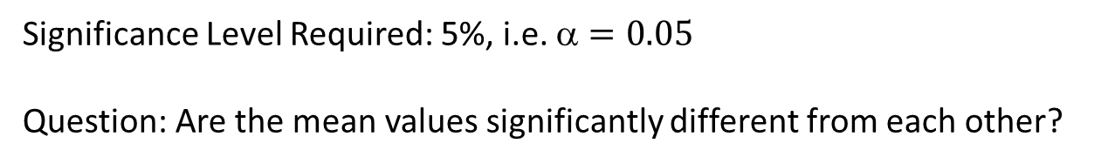
Comparing two means
We have data on wages of two samples of workers, both from large populations:-
 | Mean | SD | N
Production | £120 | £10 | 30
2. Maintenance | £130 | £12 | 50
Significance Level Required: 5%, i.e. $=0.05$
Question: Are the mean values significantly different from each other?
Scenario taken from Morris

Slide 12
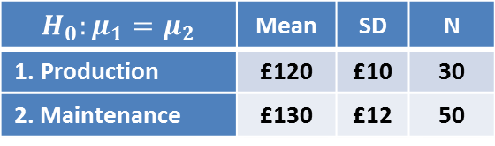
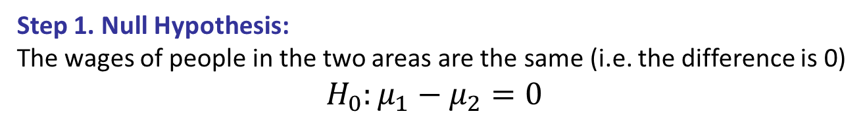
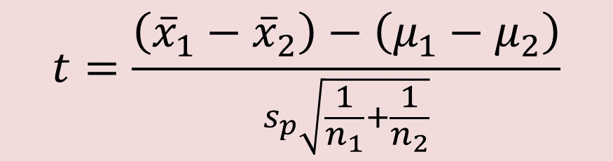


Comparing two means
$$H_{0}:μ_{1}=μ_{2}$$ | Mean | SD | N
Production | £120 | £10 | 30
2. Maintenance | £130 | £12 | 50
Step 1. Null Hypothesis:
The wages of people in the two areas are the same (i.e. the difference is 0)
$$H_{0}:μ_{1}−μ_{2}=0$$
Step 2. Test Statistic:
The number of standard errors by which the difference of sample mean differs from difference in population mean known as standard error of difference in sample means (STEDM)
$$Z=\frac{\overline{x}−μ}{\frac{σ}{\sqrt{n}}}$$
$$t=\frac{\overline{x}−μ}{\frac{s}{\sqrt{n}}}$$
$$t=\frac{\left({\overline{x}}_{1}−{\overline{x}}_{2}\right)−\left(μ_{1}−μ_{2}\right)}{s_{p}\sqrt{\frac{1}{n_{1}}+\frac{1}{n_{2}}}}$$
STEDM

Slide 13
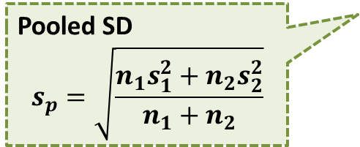
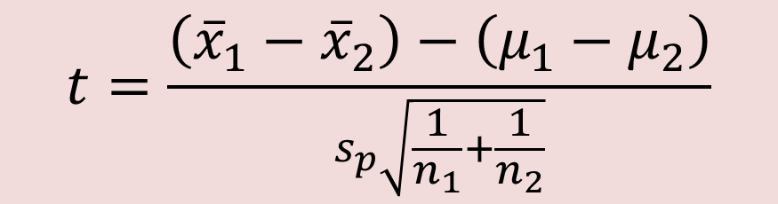


Comparing two means
$$H_{0}:μ_{1}=μ_{2}$$ | Mean | SD | N
Production | £120 | £10 | 30
2. Maintenance | £130 | £12 | 50
Step 2. Test Statistic:
The number of standard errors by which the difference of sample mean differs from difference in population mean known as standard error of difference in sample means (STEDM)
$$Z=\frac{\overline{x}−μ}{\frac{σ}{\sqrt{n}}}$$
$$t=\frac{\overline{x}−μ}{\frac{s}{\sqrt{n}}}$$
$$t=\frac{\left({\overline{x}}_{1}−{\overline{x}}_{2}\right)−\left(μ_{1}−μ_{2}\right)}{s_{p}\sqrt{\frac{1}{n_{1}}+\frac{1}{n_{2}}}}$$
Pooled SD
$$s_{p}=\sqrt{\frac{n_{1}s_{1}^{2}+n_{2}s_{2}^{2}}{n_{1}+n_{2}}}$$
STEDM
Assuming that the sampling distribution is normal for both samples

Slide 14
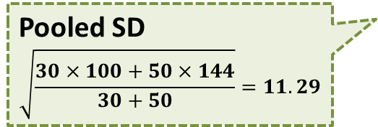
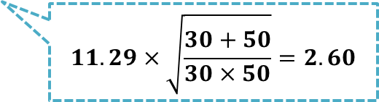
Comparing two means
$$H_{0}:μ_{1}=μ_{2}$$ | Mean | SD | N
Production | £120 | £10 | 30
2. Maintenance | £130 | £12 | 50
Step 2. Test Statistic:
The number of standard errors by which the difference of sample mean differs from difference in population mean known as standard error of difference in sample means (STEDM)
$$Z=\frac{\overline{x}−μ}{\frac{σ}{\sqrt{n}}}$$
$$t=\frac{\overline{x}−μ}{\frac{s}{\sqrt{n}}}$$
$$t=\frac{\left({\overline{x}}_{1}−{\overline{x}}_{2}\right)−\left(μ_{1}−μ_{2}\right)}{s_{p}\sqrt{\frac{1}{n_{1}}+\frac{1}{n_{2}}}}$$
Pooled SD
$$\sqrt{\frac{30×100+50×144}{30+50}}=11.29$$
$$11.29×\sqrt{\frac{30+50}{30×50}}=2.60$$
Assuming that the sampling distribution is normal for both samples
Assuming equal variances between both populations

Slide 15
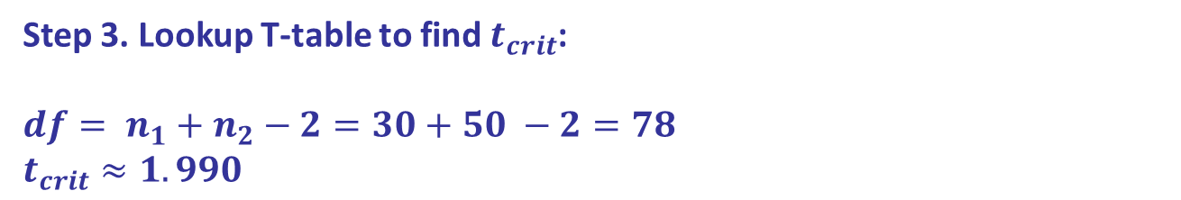

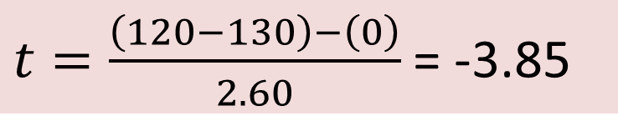

Comparing two means
$$H_{0}:μ_{1}=μ_{2}$$ | Mean | SD | N
Production | £120 | £10 | 30
2. Maintenance | £130 | £12 | 50
Step 2. Test Statistic:
The number of standard errors by which the difference of sample mean differs from difference in population mean known as standard error of difference in sample means (STEDM)
Is this significant?
$t=\frac{\left(120−130\right)−\left(0\right)}{2.60}$ = -3.85
Step 3. Lookup T-table to find $t_{crit}$:
$${df= n}_{1}+n_{2}−2=30+50 −2=78$$
$$t_{crit}≈1.990$$
Step 4. Reject or fail to reject null hypothesis:
Reject null hypothesis because $\left|t\right|>t_{crit}$
$$1.990$$

Slide 16
Levene’s test for equality of variances
Remember that assumption about equal variances between both populations?
You can check if that is true!
Is the highest year of school completed different for men and women?
 | Mean | SD | N
Male | 13.19 | 3.349 | 639
2. Female | 12.92 | 2.849 | 857
Step 1.
H₀: σ₁² - σ₂² = 0 ("the population variances of group 1 and 2 are equal")
H₁: σ₁² - σ₂² ≠ 0 ("the population variances of group 1 and 2 are not equal")
Notes:
Levines!!

Slide 17
Levene’s test for equality of variances
Step 1.
H₀: σ₁² - σ₂² = 0 ("the population variances of group 1 and 2 are equal")
H₁: σ₁² - σ₂² ≠ 0 ("the population variances of group 1 and 2 are not equal")
Levene’s Test tests the null hypothesis that the variances in the two samples are equal
Step 2. P-value < 0.05
We have sufficient evidence that population variances are different
Notes:
Levines!!

Slide 18
Levene’s test for equality of variances
Step 1.
H₀: σ₁² - σ₂² = 0 ("the population variances of group 1 and 2 are equal")
H₁: σ₁² - σ₂² ≠ 0 ("the population variances of group 1 and 2 are not equal")
Step 2.
P-value < 5%
We have sufficient evidence that population variances are different.
Note: The output in the Independent Samples Test table includes two rows: Equal variances assumed and Equal variances not assumed.
If Levene’s test indicates that the variances are equal across the two groups (i.e., p-value large), you will rely on the first row of output, Equal variances assumed.
If Levene’s test indicates that the variances are not equal across the two groups (i.e., p-value small), you will need to rely on the second row of output, Equal variances not assumed.
Notes:
Levines!!

Slide 19
Comparing two means in SPSS
Step 1.
H₀: σ₁² - σ₂² = 0 ("the population variances of group 1 and 2 are equal")
H₁: σ₁² - σ₂² ≠ 0 ("the population variances of group 1 and 2 are not equal")
Step 2.
P-value < 0.05
We have sufficient evidence that population variances are different.
Step 3. P-value > 0.05
We do not have sufficient evidence that population means are different.
Notes:
Levines!!

Slide 20
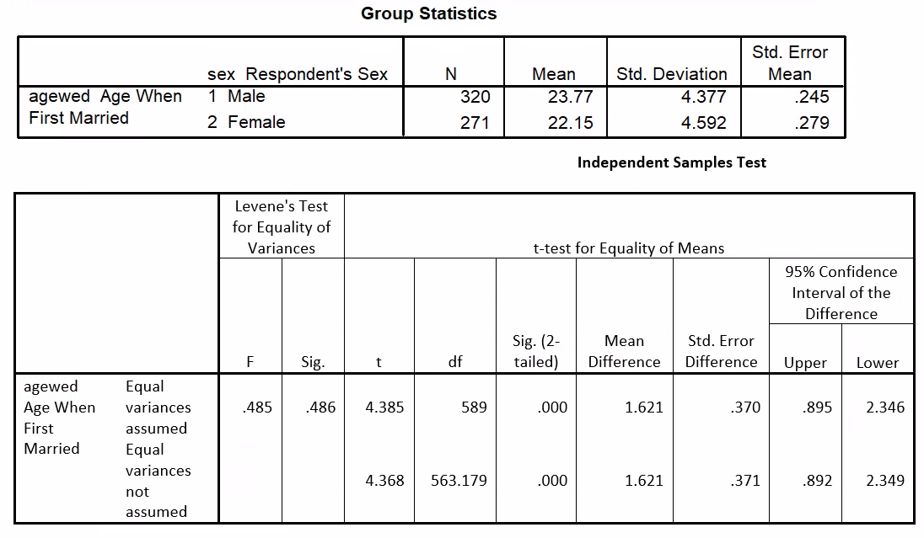
Question 1
1) What is the null hypothesis for Levene’s test?
2) What is the result of this Levene’s test?
3) How do we use Levene’s test?
4) What is the null hypothesis for this test?
5) What is the result of the test?
Notes:
Levines!!

Slide 21
Question 1
1) What is the null hypothesis for Levene’s test?
The null hypothesis for Levene’s test is that the variances of the samples of men and women are equal.
2) What is the result of this Levene’s test?
On this test p>0.05, so we accept the null hypothesis.
3) How do we use Levene’s test?
The result from Levene’s test tells us whether to read the results for “equal variances assumed” (if the null hypothesis is accepted) or those for “equal variances not assumed” (in this case the results happen to be the same).
Notes:
Levines!!

Slide 22
Question 1
4) What is the null hypothesis for this test?
The null hypothesis is that the age at which men and women first marry is equal, or that there is no difference in the age at which men and women first marry
5) What is the result of the test?
The null hypothesis is rejected at the 5% level (and indeed at the 1% level), we can say that there is a significant difference in the ages at which men and women first marry, on average.
Notes:
Levines!!

Slide 23
5 Minutes Break
Notes:
Levines!!

Slide 24
HYPOTHESIS TESTING
 | Categorical | Scalar
Inference for One group | Z Test for proportion | t Test for mean
Comparing Two groups | Z Test for difference in two proportions | t Test for difference in two means
Comparing Many groups | χ² for difference among several proportions | ANOVA for comparing several means
N.B. This is only a subset of numerous statistical techniques

Slide 25
Comparing more than two means
Have students scored differently in the three modules they have studied this semester?
 | Module 1 | Module 2 | Module 3
Student 1 | 52 | 41 | 43
Student 2 | 48 | 50 | 32
Student 3 | 46 | 44 | 40
Student 4 | 41 | 37 | 35
Mean | 46.75 | 43.00 | 37.50
Standard Deviation | 4.573 | 5.477 | 4.932

Slide 26
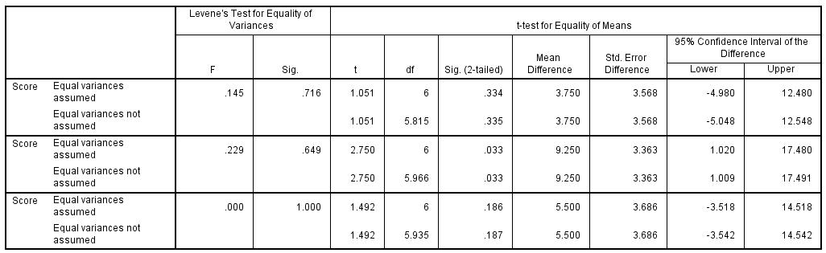



Comparing more than two means
t_{critical} = 2.447
d.f. = 6
Why not pair-wise t-Tests?
$$μ_{1}{:μ}_{2}$$
$$μ_{1}{:μ}_{3}$$
$$μ_{2}{:μ}_{3}$$
Notes:
Could compare, for

Slide 27
Comparing more than two means
Reason for choosing better analysis than pairwise t-Tests
The level of significance is 5% in each t-test. This means we have a 5% chance of a Type I error (reject the null hypothesis when it’s true)
In other words, 95% chance of not having a Type I error
For example, if we have three groups, we do three pairwise t tests, so
p(no Type I error) = 0.95 x 0.95 x 0.95
= 0.857
So the more tests, the more chance of a Type-I error

Slide 28
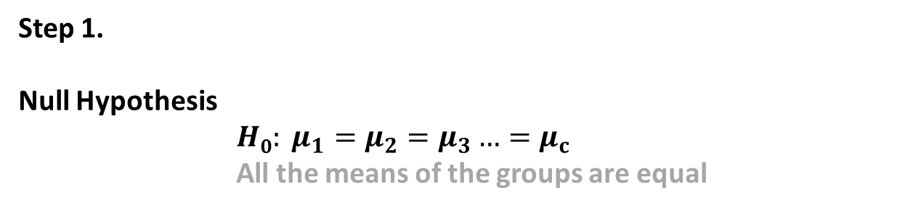

One-way ANOVA
ANOVA compares the variation within groups to that between groups
Step 1.
Null Hypothesis
$H0: μ_{1}=μ_{2}=μ_{3}…=μ_{c}$
All the means of the groups are equal
Alternative Hypothesis
$H1: μ_{i}≠μ_{j}$ for at least one pair (i,j)
Not all the means of the groups are equal
Step 2. Test Statistic

Slide 29
One-way ANOVA
ANOVA compares the variation within groups to that between groups
Between groups variability large compared to within groups variability
Within groups variability large compared to between groups variability

Slide 30
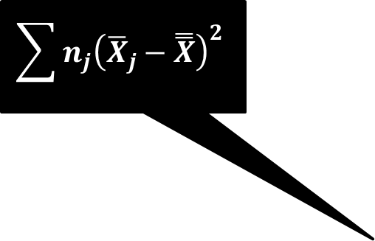

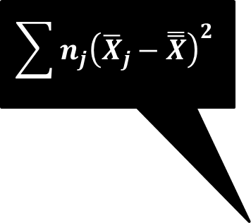



One-way ANOVA
$$\sum{n_{j}{\left({\overline{X}}_{j}−\overset{̿}{X}\right)}^{2}}$$
SUM OF SQUARES BETWEEN
$$\sum{n_{j}{\left({\overline{X}}_{j}−\overset{̿}{X}\right)}^{2}}$$
SSW
SSB
$$\overset{̿}{X}$$
SUM OF SQUARES WITH-IN
$${\overline{X}}_{1}$$
$${\overline{X}}_{2}$$
$${\overline{X}}_{3}$$

Slide 31

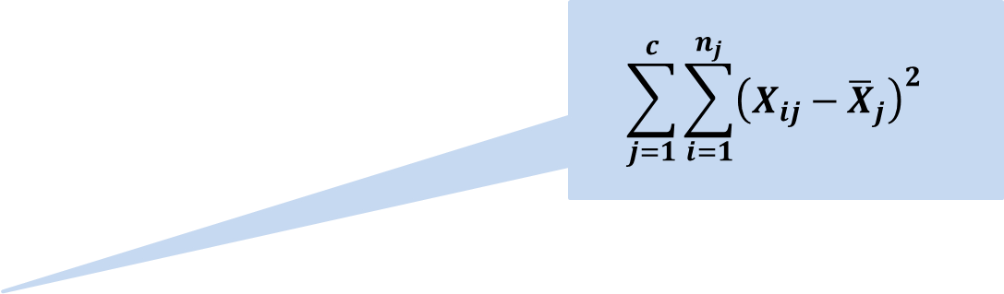
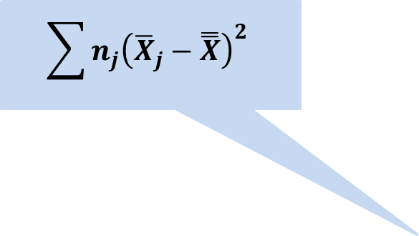
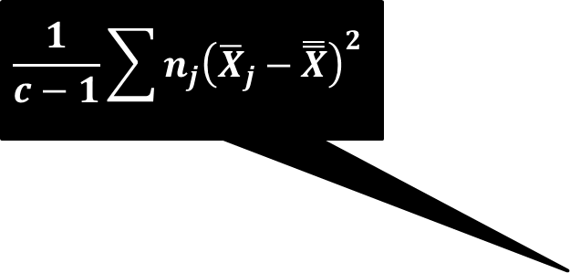
One-way ANOVA
$$\frac{1}{c−1}\sum{n_{j}{\left({\overline{X}}_{j}−\overset{̿}{X}\right)}^{2}}$$
$$\frac{1}{c−1}\sum{n_{j}{\left({\overline{X}}_{j}−\overset{̿}{X}\right)}^{2}}$$
$$\sum{n_{j}{\left({\overline{X}}_{j}−\overset{̿}{X}\right)}^{2}}$$
SSW
SSB
$$\overset{̿}{X}$$
$$\sum_{j=1}^{c}{\sum_{i=1}^{n_{j}}{{\left({X_{ij}−\overline{X}}_{j}\right)}^{2}} }$$
$${\overline{X}}_{1}$$
$${\overline{X}}_{2}$$
$${\overline{X}}_{3}$$

Slide 32


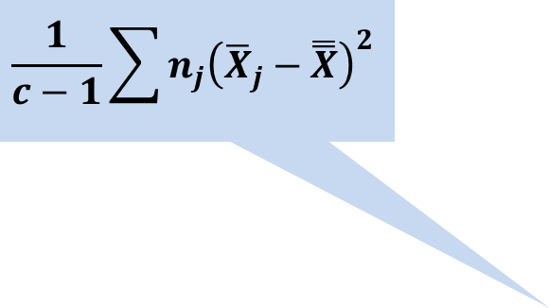
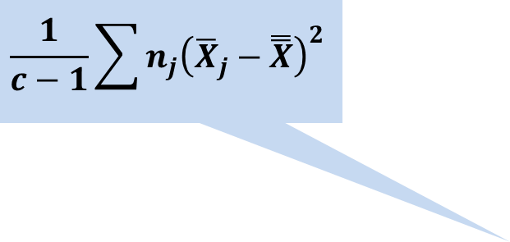
One-way ANOVA
$$\frac{1}{c−1}\sum{n_{j}{\left({\overline{X}}_{j}−\overset{̿}{X}\right)}^{2}}$$
$$\frac{1}{c−1}\sum{n_{j}{\left({\overline{X}}_{j}−\overset{̿}{X}\right)}^{2}}$$
$$\frac{1}{c−1}\sum{n_{j}{\left({\overline{X}}_{j}−\overset{̿}{X}\right)}^{2}}$$
MSW
MSB
$$\overset{̿}{X}$$
$$\frac{1}{n−c}\sum_{j=1}^{c}{\sum_{i=1}^{n_{j}}{{\left({X_{ij}−\overline{X}}_{j}\right)}^{2}} }$$
$${\overline{X}}_{1}$$
$${\overline{X}}_{2}$$
$${\overline{X}}_{3}$$

Slide 33
Question 2
$$\frac{1}{c−1}\sum{n_{j}{\left({\overline{X}}_{j}−\overset{̿}{X}\right)}^{2}}$$
$$\frac{1}{c−1}\sum{n_{j}{\left({\overline{X}}_{j}−\overset{̿}{X}\right)}^{2}}$$
$$\frac{1}{c−1}\sum{n_{j}{\left({\overline{X}}_{j}−\overset{̿}{X}\right)}^{2}}$$
MSW
MSB
$$\overset{̿}{X}$$
$$\frac{1}{n−c}\sum_{j=1}^{c}{\sum_{i=1}^{n_{j}}{{\left({X_{ij}−\overline{X}}_{j}\right)}^{2}} }$$
$${\overline{X}}_{1}$$
$${\overline{X}}_{2}$$
$${\overline{X}}_{3}$$
If the variance between groups (i.e., MSB) is very large, are the means of these three groups more likely to be equal?
If the variance within each group (i.e., MSW) is very large, are the means of these three groups more likely to be equal?
If we increase the sample size in each group, are the means of these three groups more likely to be equal?

Slide 34
Question 2
$$\frac{1}{c−1}\sum{n_{j}{\left({\overline{X}}_{j}−\overset{̿}{X}\right)}^{2}}$$
$$\frac{1}{c−1}\sum{n_{j}{\left({\overline{X}}_{j}−\overset{̿}{X}\right)}^{2}}$$
$$\frac{1}{c−1}\sum{n_{j}{\left({\overline{X}}_{j}−\overset{̿}{X}\right)}^{2}}$$
MSW
MSB
$$\overset{̿}{X}$$
$$\frac{1}{n−c}\sum_{j=1}^{c}{\sum_{i=1}^{n_{j}}{{\left({X_{ij}−\overline{X}}_{j}\right)}^{2}} }$$
$${\overline{X}}_{1}$$
$${\overline{X}}_{2}$$
$${\overline{X}}_{3}$$
If the variance between groups (i.e., MSB) is very large, are the means of these three groups more likely to be equal? No
If the variance within each group (i.e., MSW) is very large, are the means of these three groups more likely to be equal? Yes
If we increase the sample size in each group, are the means of these three groups more likely to be equal? No

Slide 35
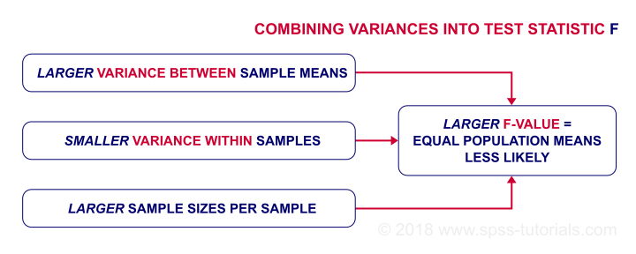

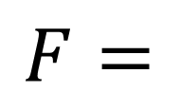

One-way ANOVA
Step 2. Test Statistic
$$\frac{1}{c−1}\sum{n_{j}{\left({\overline{X}}_{j}−\overset{̿}{X}\right)}^{2}}$$
MSB
$$F=$$
$$\frac{1}{n−c}\sum_{j=1}^{k}{\sum_{i=1}^{n_{j}}{{\left({X_{ij}−\overline{X}}_{j}\right)}^{2}} }$$
MSW

Slide 36

One-way ANOVA
Step 2. Test Statistic
$$\frac{1}{c−1}\sum{n_{j}{\left({\overline{X}}_{j}−\overset{̿}{X}\right)}^{2}}$$
MSB
$$F=$$
$$\frac{1}{n−c}\sum_{j=1}^{k}{\sum_{i=1}^{n_{j}}{{\left({X_{ij}−\overline{X}}_{j}\right)}^{2}} }$$
MSW
Step 3. Lookup F-table to find $F_{a}$
Step 4. Reject or fail to reject null hypothesis:
Reject null hypothesis if $F >F_{a}$ (or p-value < 0.05)

Slide 37
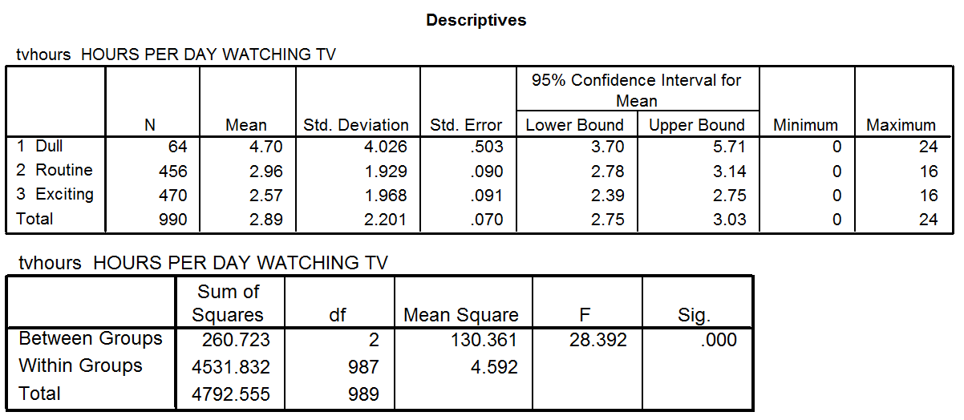
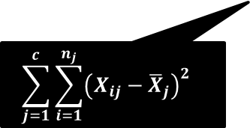
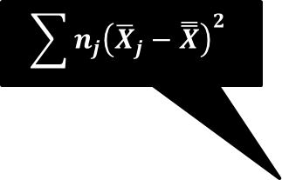

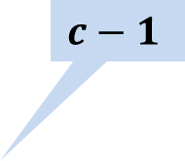
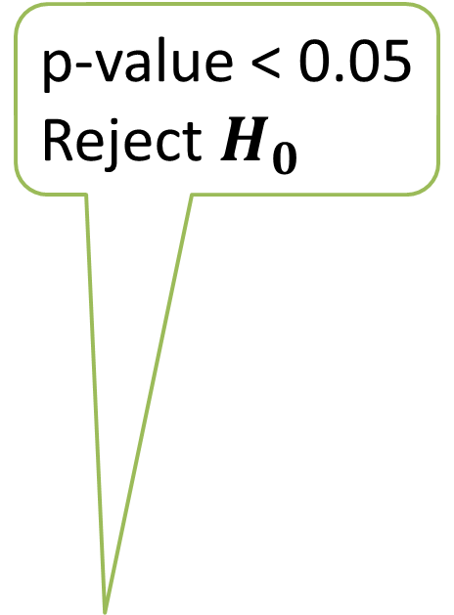
ANOVA Example 1
p-value < 0.05
Reject $H_{0}$
$$\sum{n_{j}{\left({\overline{X}}_{j}−\overset{̿}{X}\right)}^{2}}$$
$$c−1$$
$$\sum_{j=1}^{c}{\sum_{i=1}^{n_{j}}{{\left({X_{ij}−\overline{X}}_{j}\right)}^{2}} }$$
$$n−c$$

Slide 38
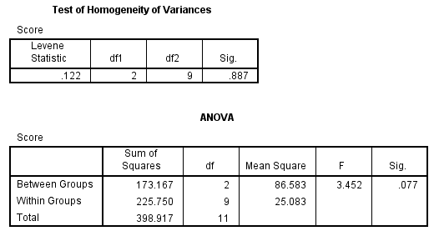
Question 3
1) What is the null hypothesis for Levene’s test?
2) What is the result of this Levene’s test?
3) What is the null hypothesis for this test?
4) What is the result of the test?

Slide 39
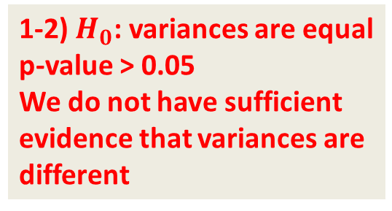
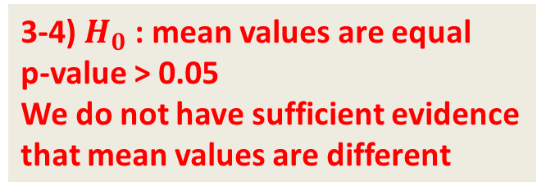
Question 3
1-2) $H_{0}$: variances are equal
p-value > 0.05
We do not have sufficient evidence that variances are different
$$\sum{n_{j}{\left({\overline{X}}_{j}−\overset{̿}{X}\right)}^{2}}$$
$$c−1$$
$$\sum_{j=1}^{c}{\sum_{i=1}^{n_{j}}{{\left({X_{ij}−\overline{X}}_{j}\right)}^{2}} }$$
$$n−c$$
3-4) $H_{0}$: mean values are equal
p-value > 0.05
We do not have sufficient evidence that mean values are different

Slide 40
Recall
We use Levene’s test to decide which multiple comparisons to use. If the result of the test is not significant (we cannot reject the null hypothesis that the variances in the groups are equal) we use Bonferroni, if it is significant we use Games-Howell
Check the course textbook for “Levene test for homogeneity of variance”

Slide 41
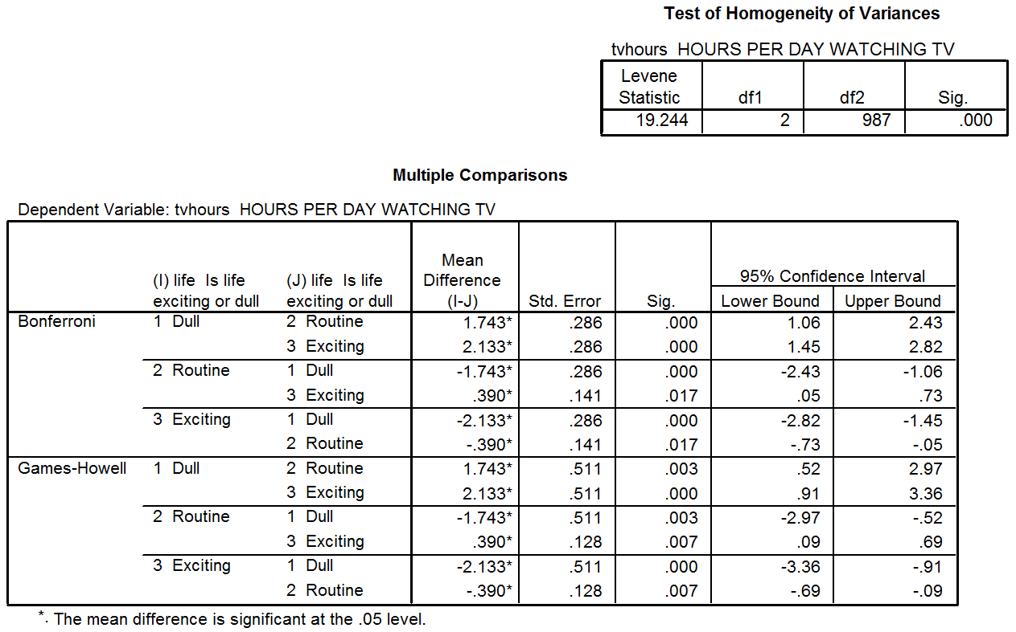
ANOVA Example 3
Equal variances assumed
p-value < 0.05
variances are different
Equal variances not assumed

Slide 42
Question 4
What can we conclude from the red areas?

Slide 43
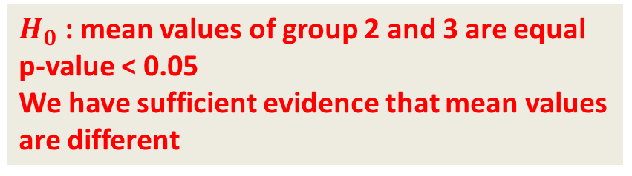

Question 4
$H_{0}$: mean values of group 1 and 2 are equal
p-value < 0.05
We have sufficient evidence that mean values are different
$H_{0}$: mean values of group 2 and 3 are equal
p-value < 0.05
We have sufficient evidence that mean values are different

Slide 44
HYPOTHESIS TESTING
 | Categorical | Scalar
Inference for One group | Z Test for proportion | t Test for mean
Comparing Two groups | Z Test for difference in two proportions | t Test for difference in two means
Comparing Many groups | χ² for difference among several proportions | ANOVA for comparing several means
N.B. This is only a subset of numerous statistical techniques

Slide 45
Chi Squared (χ²)
It is a non-parametric technique
To test whether distributions across categories are different to what is expected

Slide 46
Parametric v Non-parametric Tests
Parametric
Non-parametric
Parametric were developed first
These assume you have either interval or ratio data
They make assumptions about the distribution (normality, variances)
These make less assumptions about the data
They are also known as “distribution free” statistics
Kruskal-Wallis Test
t test
Friedman Test
Fisher Exact test
Z test
Chi square
ANOVA
Spearman's Rho
Pearson’s r
Kendall's Tau
Wilcoxon Signed-Rank

Slide 47
Why do we still use parametric statistics?
Generally tests making less assumptions are less powerful in detecting affects
The sophistication of the tests available is greater and a wider range of tests are available in statistics software
Parametric statistics can, in practice, be quite robust to violations of their assumptions
Notes:
It might seem that it would be easier just to use non-parametric statistics all the time, but it’s not that easy.
The above being said, there are non-parametric equivalents to things like t-tests and correlation coefficients, although we won’t cover them here.

Slide 48
Chi Squared (χ²) – ONE WAY
In a market research survey customers were asked which of three potential new products they preferred
 |  | A | B | C
 | Number of customers responded | 270 | 286 | 341
 |  |  | TOTAL | 897
Are the three products equally attractive?
What is the Null Hypothesis?
ANSWER: All products are equally attractive

Slide 49
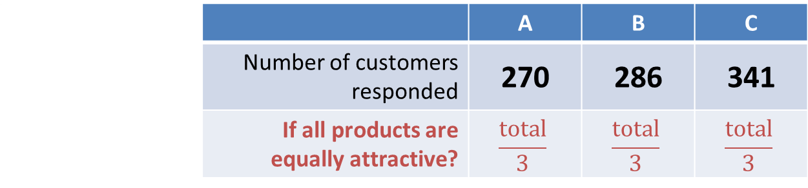
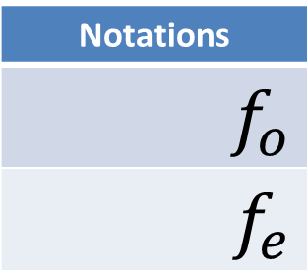
Chi Squared (χ²)
Are the three products equally attractive?
 |  | A | B | C
 | Number of customers responded | 270 | 286 | 341
 | If all products are equally attractive? | $$\frac{total}{3}$$ | $$\frac{total}{3}$$ | $$\frac{total}{3}$$
 |  | A | B | C
 | Number of customers responded | 270 | 286 | 341
 | Expected number of customers responded | 299 | 299 | 299
Notations
$$f_{o}$$
$$f_{e}$$
 | Observed - Expected | -29 | -13 | 42
 | (Observed – Expected)² | 841 | 169 | 1764

Slide 50

Chi Squared (χ²)
Are the three products equally attractive?
 |  | A | B | C
 | Number of customers responded | 270 | 286 | 341
 | If all products are equally attractive? | $$\frac{total}{3}$$ | $$\frac{total}{3}$$ | $$\frac{total}{3}$$
 |  | A | B | C
 | Number of customers responded | 270 | 286 | 341
 | Expected number of customers responded | 299 | 299 | 299
Notations
$$f_{o}$$
$$f_{e}$$
$$f_{o}−f_{e}$$ | Observed - Expected | -29 | -13 | 42
$${\left(f_{o}−f_{e} \right)}^{2}$$ | (Observed – Expected)² | 841 | 169 | 1764
$$\frac{{\left(f_{o}−f_{e}\right)}^{2}}{f_{e}}$$ | (Observed – Expected)² Expected | 2.8127 | 0.5652 | 5.8997
 | $$χ_{}^{2}=$$ | 9.2776

Slide 51
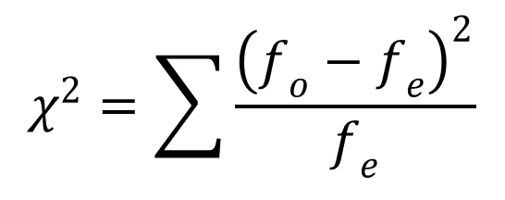

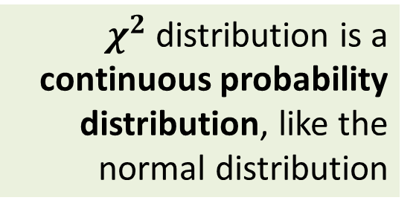
Chi Squared (χ²)
$$χ^{2}=\sum{\frac{{\left(f_{o}−f_{e}\right)}^{2}}{f_{e}}}$$
$χ^{2}$ distribution is a continuous probability distribution, like the normal distribution
α
0
$$χ^{2}$$

Slide 52


Chi Squared (χ²)
Reject if $χ^{2}{>χ}_{crit}^{2}$
We then need to find the probability of this value (p-value)
$$χ^{2}=\sum{\frac{{\left(f_{o}−f_{e}\right)}^{2}}{f_{e}}}$$
9.2776
Lookup table provides the critical value
$χ^{2}$ distribution is a continuous probability distribution, like the normal distribution
α
0
$$χ_{crit}^{2}$$
$$χ^{2}$$

Slide 53

Chi Squared (χ²)
Reject if $χ^{2}{>χ}_{crit}^{2}$
We then need to find the probability of this value (p-value)
$$χ^{2}=\sum{\frac{{\left(f_{o}−f_{e}\right)}^{2}}{f_{e}}}$$
9.2776
Lookup table provides the critical value
$χ^{2}$ distribution is a continuous probability distribution, like the normal distribution
α
The degrees of freedom
$$df=cols−1$$
0
$$χ_{crit}^{2}$$
$$χ^{2}$$
= 5.991

Slide 54


Chi Squared (χ²) - Summary
Step 1.
H₀ : All products are equally attractive
Step 2.
The calculated value of χ² = 9.2776
Step 3.
We have the degrees of freedom, $df=2$
The lookup table gives the critical value, $χ_{crit}^{2}=5.991$
Step 4.
As$χ_{}^{2}>χ_{crit}^{2}$ this means p-value $<0.05$
Our result says the observations are significantly different so,
The three products are NOT equally attractive

Slide 55
Question 5
This is the p-value
i.e. probability of the result given the null hypothesis
1) What is the null hypothesis for this test?
2) What is the result of the test?

Slide 56
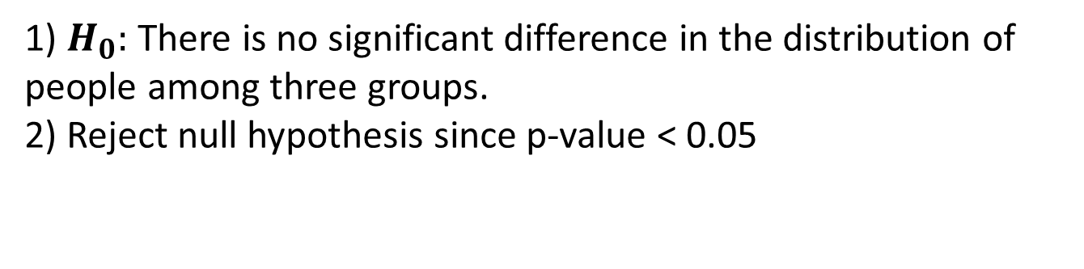
Question 5
This is the p-value
i.e. probability of the result given the null hypothesis
1) $H_{0}:$ There is no significant difference in the distribution of people among three groups.
2) Reject null hypothesis since p-value < 0.05

Slide 57
Hypothesis Testing
 | Categorical | Scalar
Inference for One group | Z Test for proportion | t Test for mean
Comparing Two groups | Z Test for difference in two proportions | t Test for difference in two means
Comparing Many groups | χ² for difference among several proportions | ANOVA for comparing several means
 | Categorical | Scalar
Inference for One group | Z Test for proportion | t Test for mean
Comparing Two groups | Z Test for difference in two proportions | t Test for difference in two means
Comparing Many groups | χ² for difference among several proportions | ANOVA for comparing several means
χ²
N.B. This is only a subset of numerous statistical techniques
N.B. This is only a subset of numerous statistical techniques

Slide 58
Reading…
Berenson et al. (2015)
Chapter 10 Section 10.1
Comparing the Means of Two Independent Populations
Chapter 11, Section 11.1
The Completely Randomized Design: One-Way Analysis of Variance

Slide 59
Module Overview
Descriptive
Statistics
Probability
Distributions
Hypothesis
Testing 1
Probability
Sampling
Week
1
Week
2
Week
3
Week
4
Week
5
Week
6
Week
7
Week
8
Week
9
Week
10
Hypothesis
Testing 2
Testing
Relationship
Regression
Conditional
Probability
Factor
Analysis
Week
11
Revision

