Slide 1
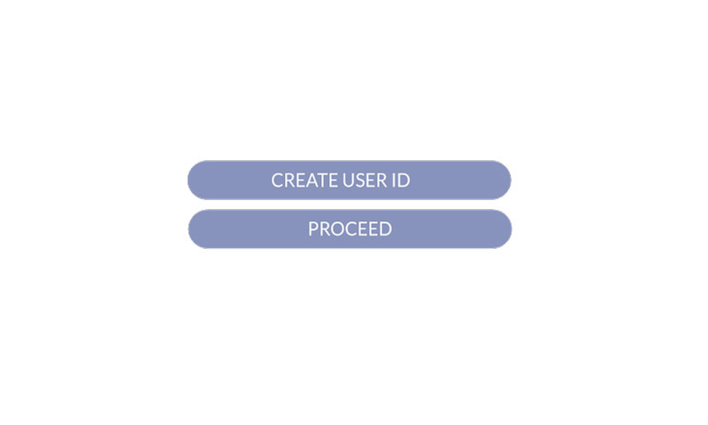

Slide 2
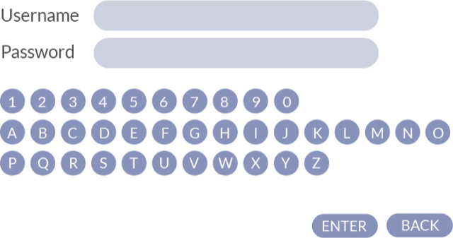

Slide 3
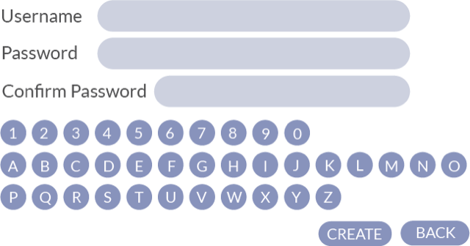

Slide 4
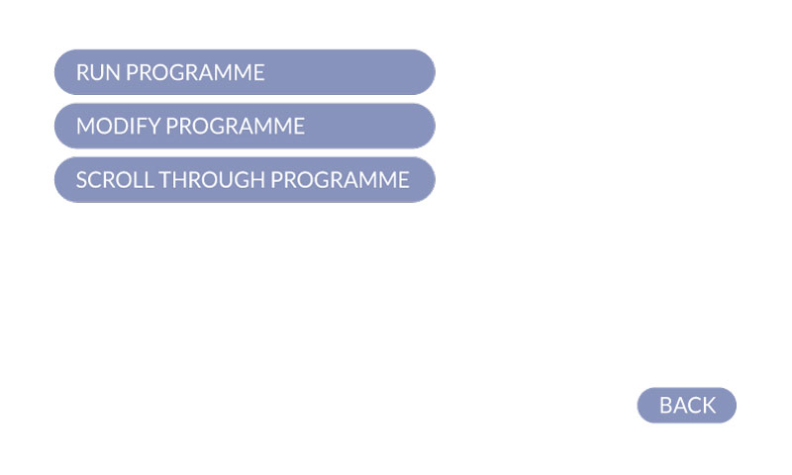

Slide 5
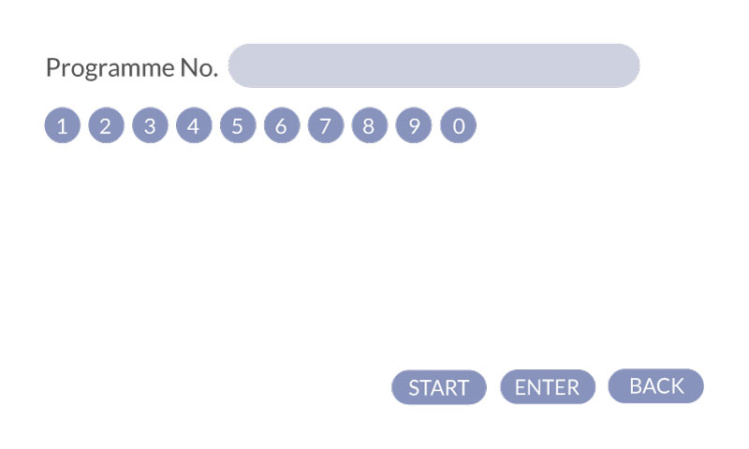
1
2
3
4
5
6
7
8
9
10
START
BACK

Slide 6

Modify Programme no.
1
2
3
4
5
6
7
8
9
10
START
BACK

Slide 7
Modify Program
Step
Well No.
Parameter Shake Step
Action
Duration
Description
WAIT 1
Wait after reaching well (Sec)
WAIT 2
Wait after move to bottom(Sec)
SHAKE
Shake time(Sec)
WAIT 4
Wait after shaking (Sec)
WAIT 5
Wait after move to top(sec)
APPLY
BACK

Slide 8
Modify Program
Step
Well No.
Parameter Washing Step
Action
Duration
Description
WAIT 1
FILL
WAIT 2
SHAKE
WAIT 4
DRAIN
WAIT 5
Wait after reaching well (Sec)
Enable fill washing solution by pump 1 (1-on,0 off)
Wait after move to bottom(Sec)
Shake time(Sec)
Wait after shaking (Sec)
Enable drain washing solution by pump2 (1-on,0 off)
Wait after move to top(sec)
APPLY
BACK

Slide 9
Modify Program
Step
Well No.
Parameter Drying Step
Action
Duration
Description
HEATER ON |  | Switch ON the heater
WAIT1 |  | Wait for drying
HEATER OFF |  | Switch OFF the heater
APPLY
BACK

Slide 10
Programme in process
Step
Well No.
Parameter Shake Step
Action
Duration
Description
WAIT 1
Wait after reaching well (Sec)
WAIT 2
Wait after move to bottom(Sec)
SHAKE
Shake time(Sec)
WAIT 4
Wait after shaking (Sec)
WAIT 5
Wait after move to top(sec)
STOP

Slide 11
Programme in process
Step
Well No.
Parameter Washing Step
Action
Duration
Description
WAIT 1
FILL
WAIT 2
SHAKE
WAIT 4
DRAIN
WAIT 5
Wait after reaching well (Sec)
Enable fill washing solution by pump 1 (1-on,0 off)
Wait after move to bottom(Sec)
Shake time(Sec)
Wait after shaking (Sec)
Enable drain washing solution by pump2 (1-on,0 off)
Wait after move to top(sec)
STOP

Slide 12
Programme in process
Step
Well No.
Parameter Drying Step
Action
Duration
Description
HEATER ON |  | Switch ON the heater
WAIT1 |  | Wait for drying
HEATER OFF |  | Switch OFF the heater
STOP

Slide 13
Modify Program
Step
Well No.
Action
Duration
Description
1
2
3
OK
4
5
6
7
8
9
Esc
0
.
APPLY
BACK

Slide 14


Slide 15


Manual Control
NBs_STEP
X :
<<
>>
Z :
<<
>>
HOME X
HOME Z

