Slide 1

Installation PelvicFloor module to Slicer
Install / run Slicer
Adding shortcuts to Slicer
Move file .slicerrc.py to Slicer directory

Slide 2
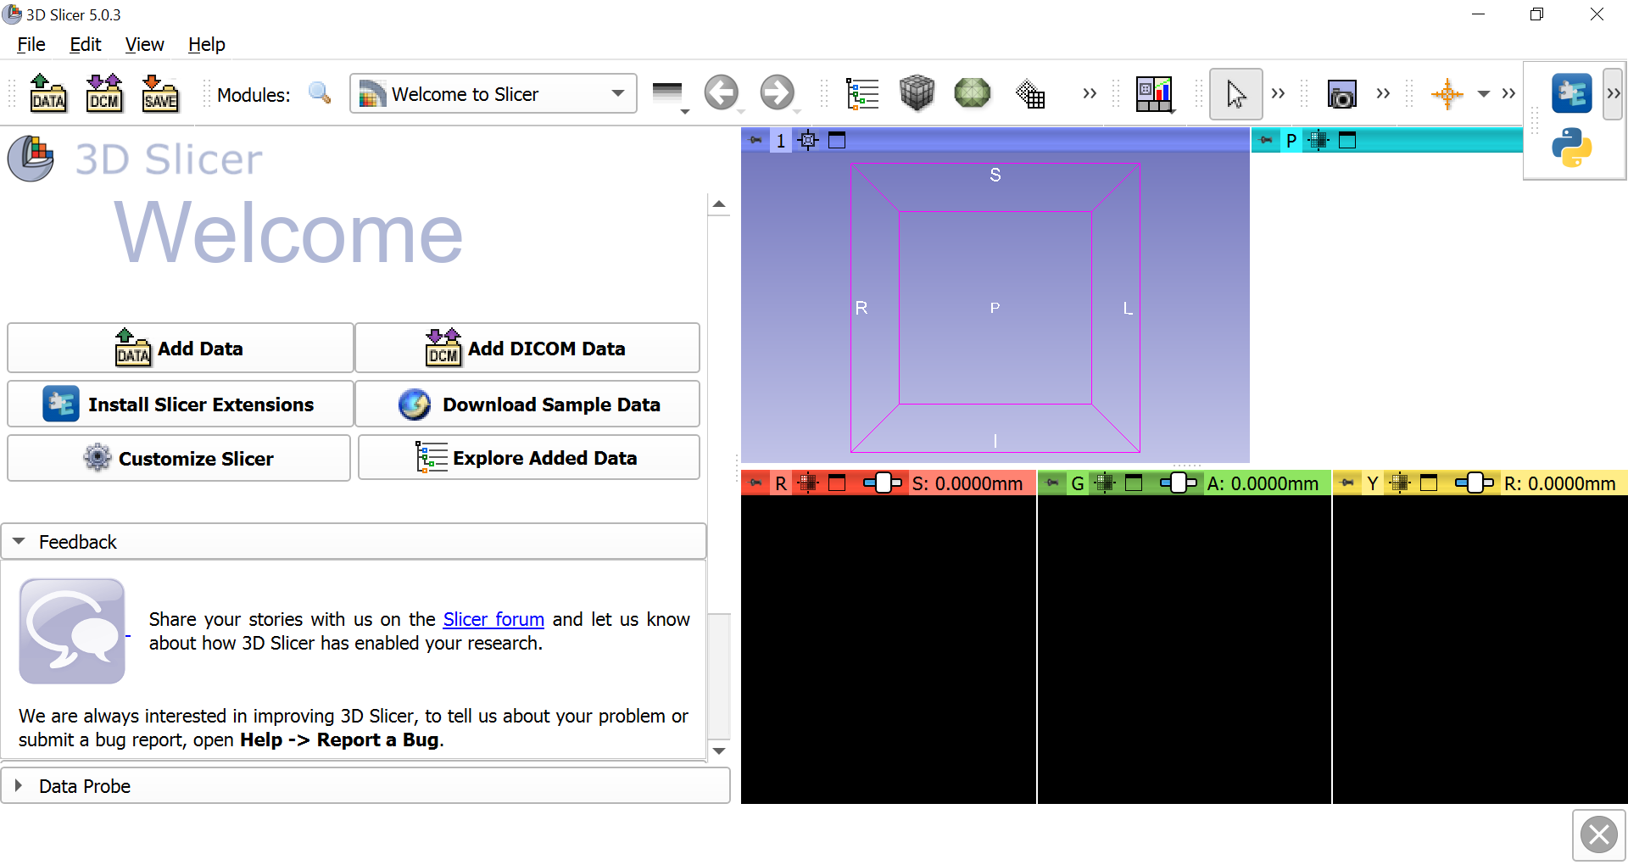
Run Python CLI (Command Line Interactor)

Slide 3
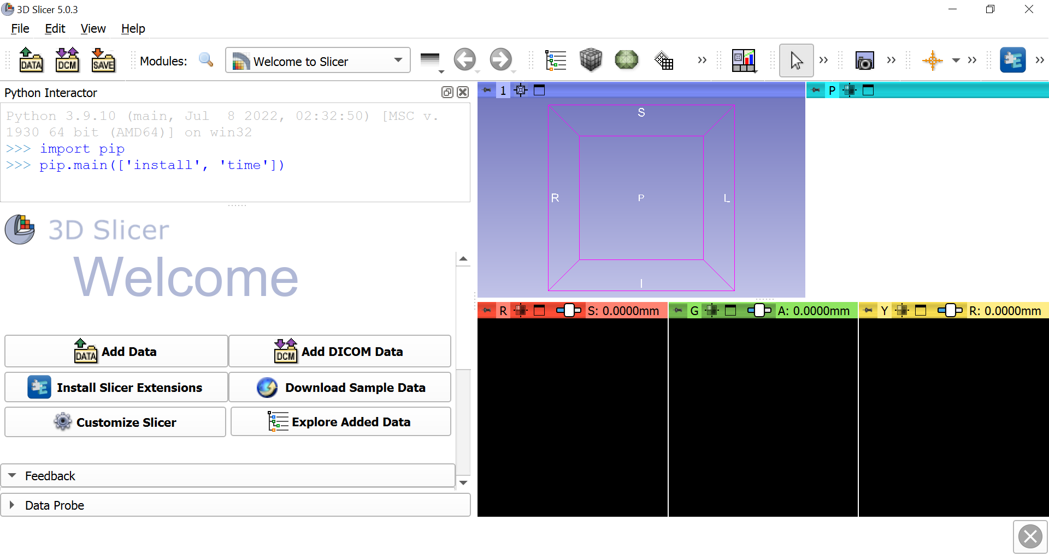
Import pip and install necessary Python modules
import pip
pip.main(['install', 'time'])

Slide 4
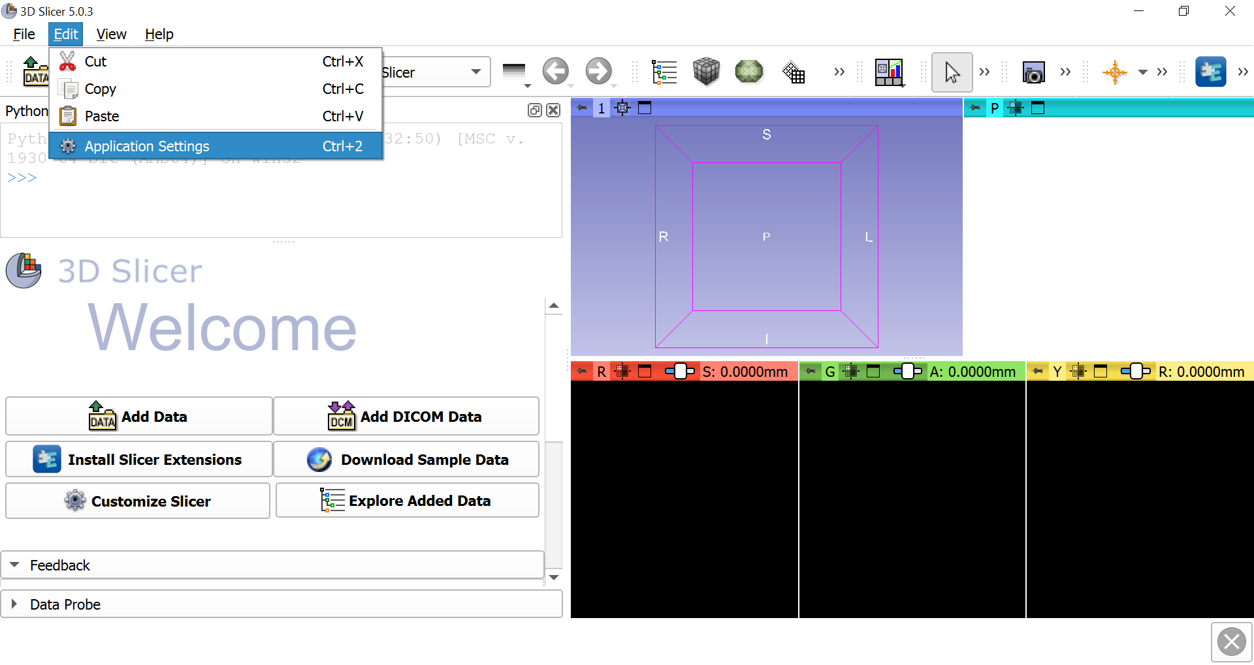
Go to Edit and Application Settings

Slide 5
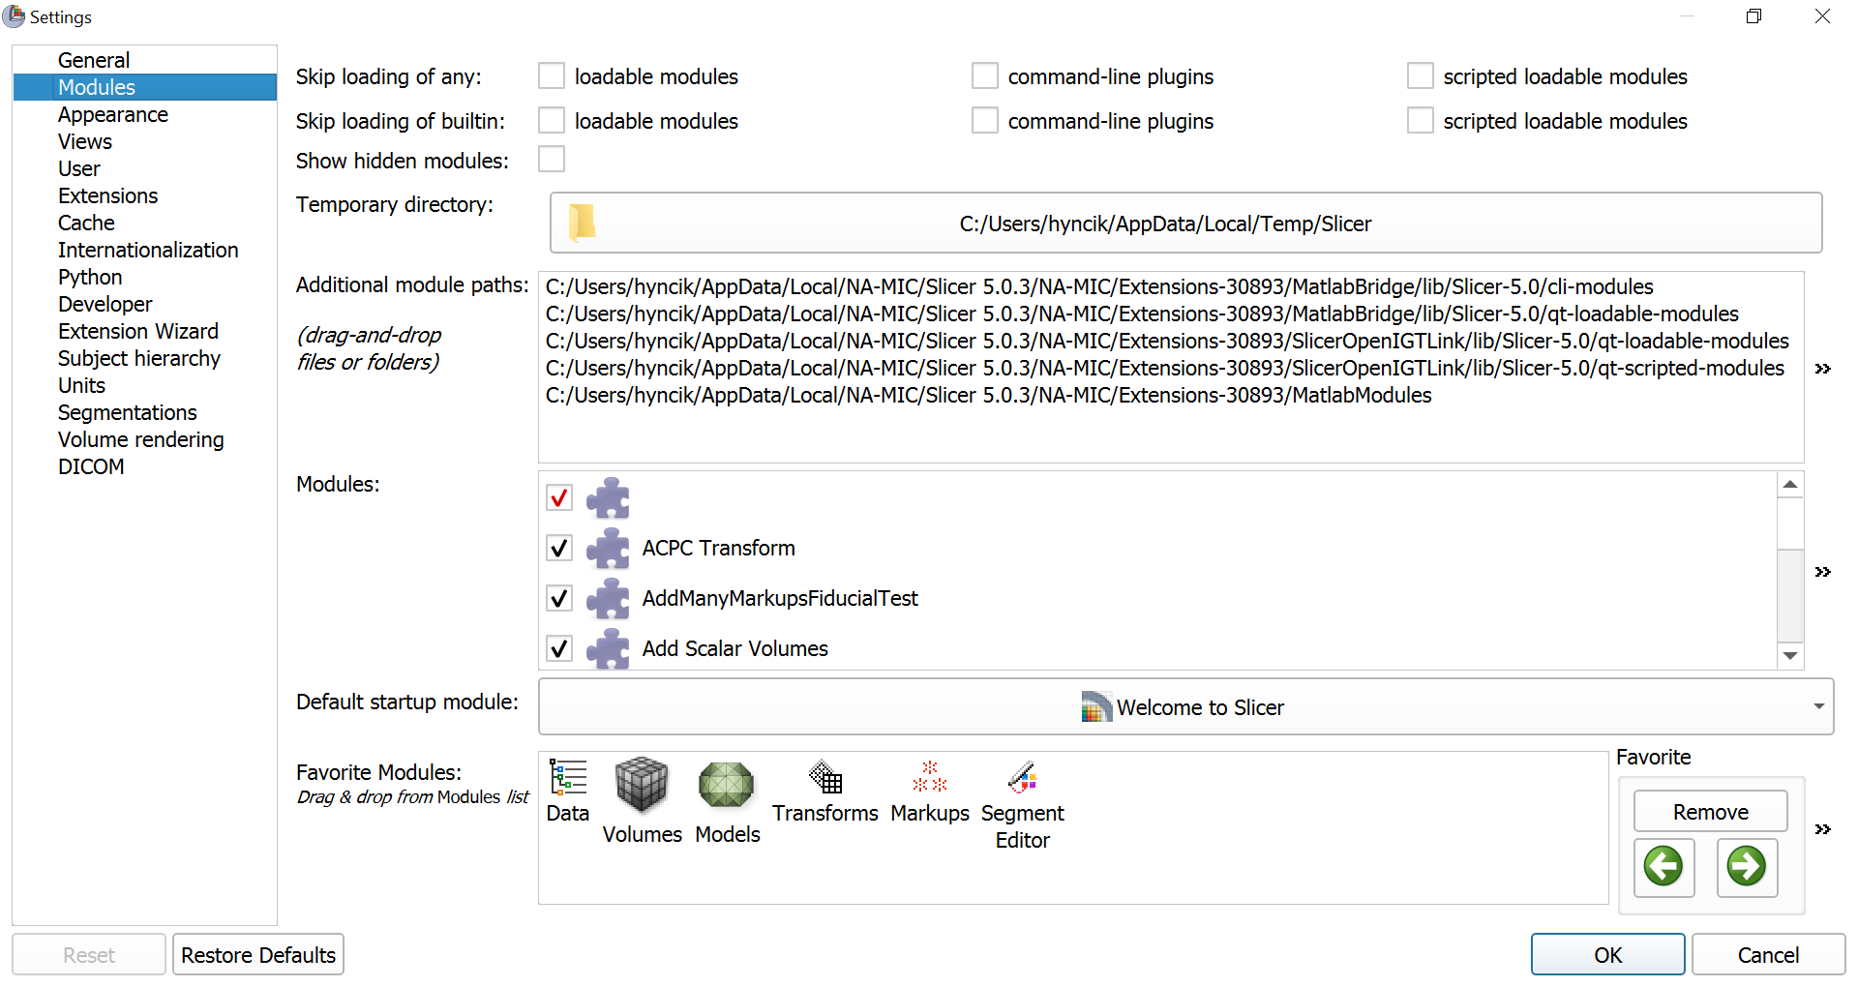
Open Modules and expand the window
1.
2.

Slide 6
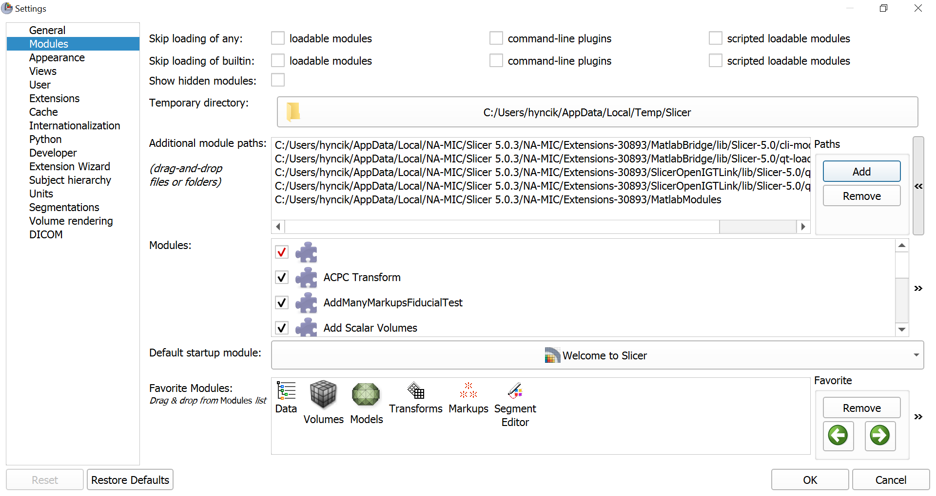
Click on Add

Slide 7
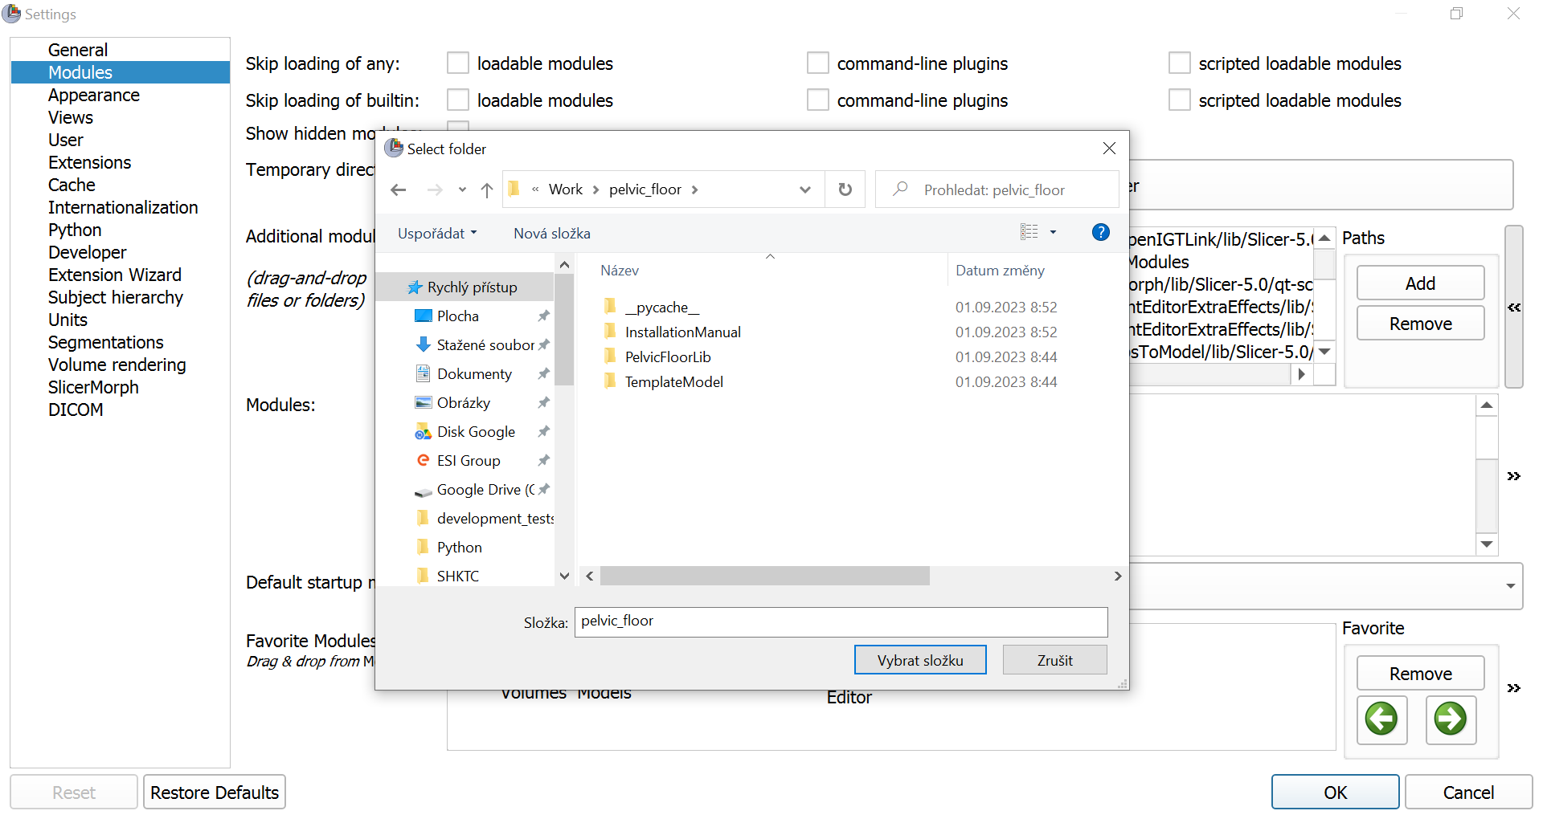
Go inside directory pelvic_floor, choose the folder and press OK
2.
1.

Slide 8
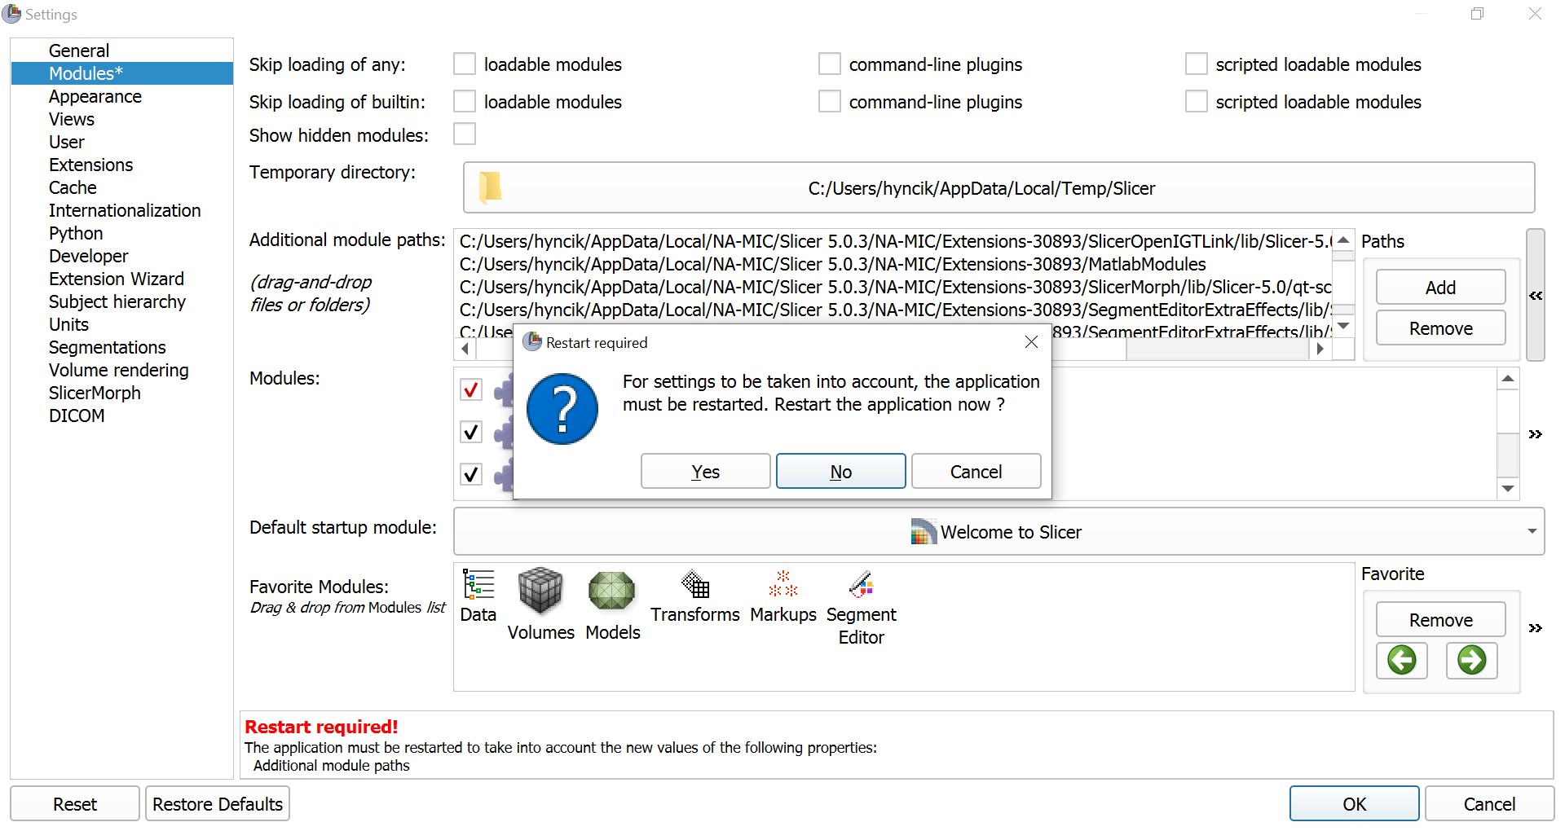
Restarting Slicer is required, so press Yes

Slide 9
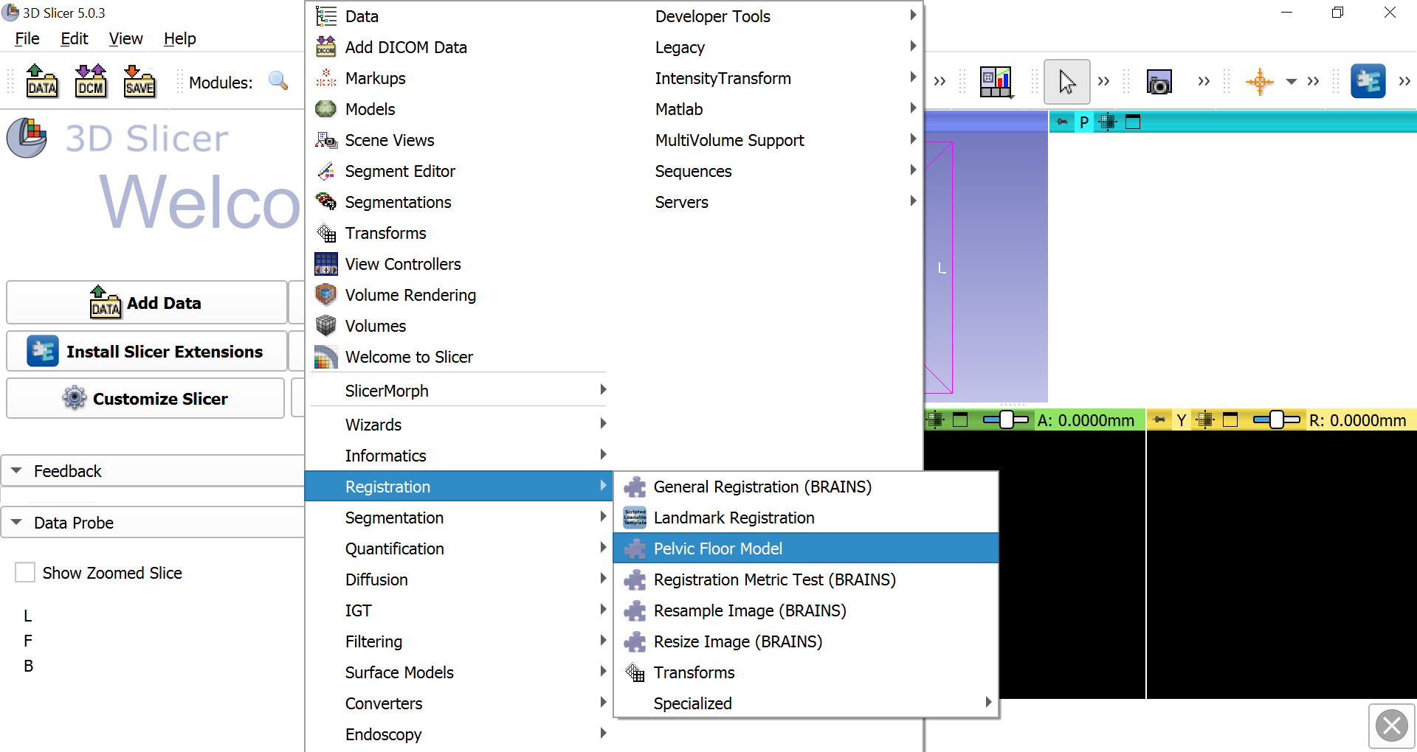
Go to Modules, submenu Registration and choose Pelvic Floor Model

Slide 10
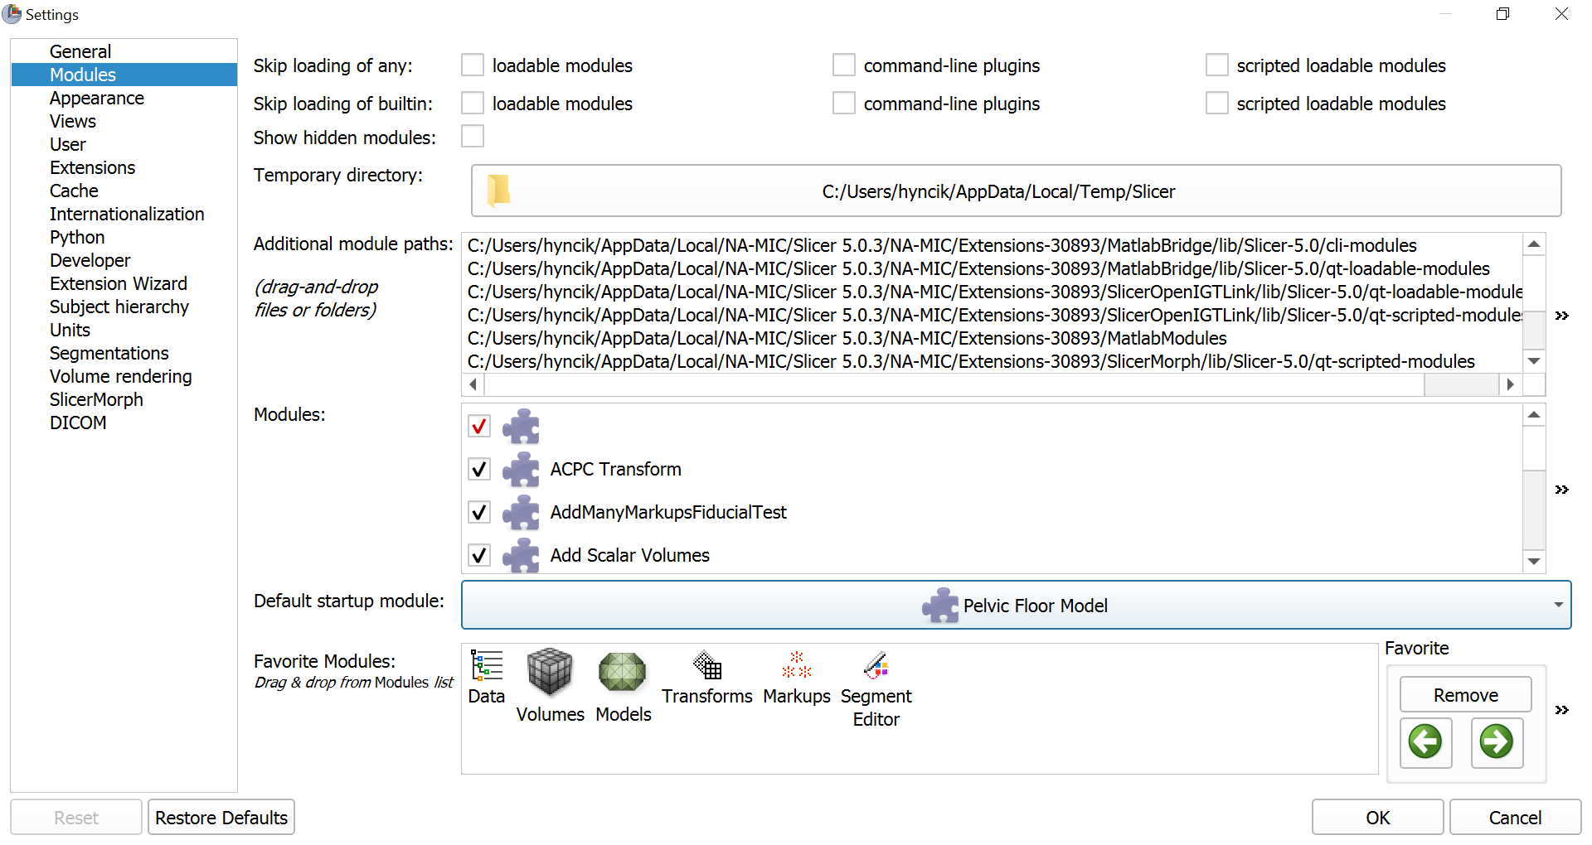
Make Pelvic Floor Model default startup module

