Slide 1

Atlas
Alexander Pela & Tristan Knott

Slide 2

What is Atlas?
“
”
A web-based Learning Management Software crafted to meet the training program needs of small-to medium-sized organizations.

Slide 3
Milestone 1
The discovery and drafting phase:
Figuring out what the LMS was
Layout
Site Flow

Slide 4
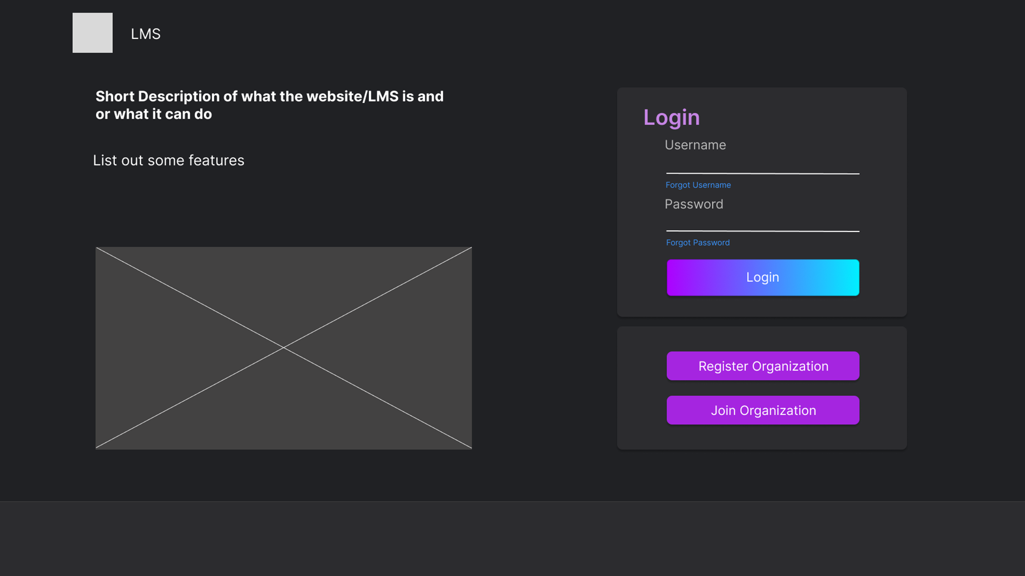
Login Page

Slide 5
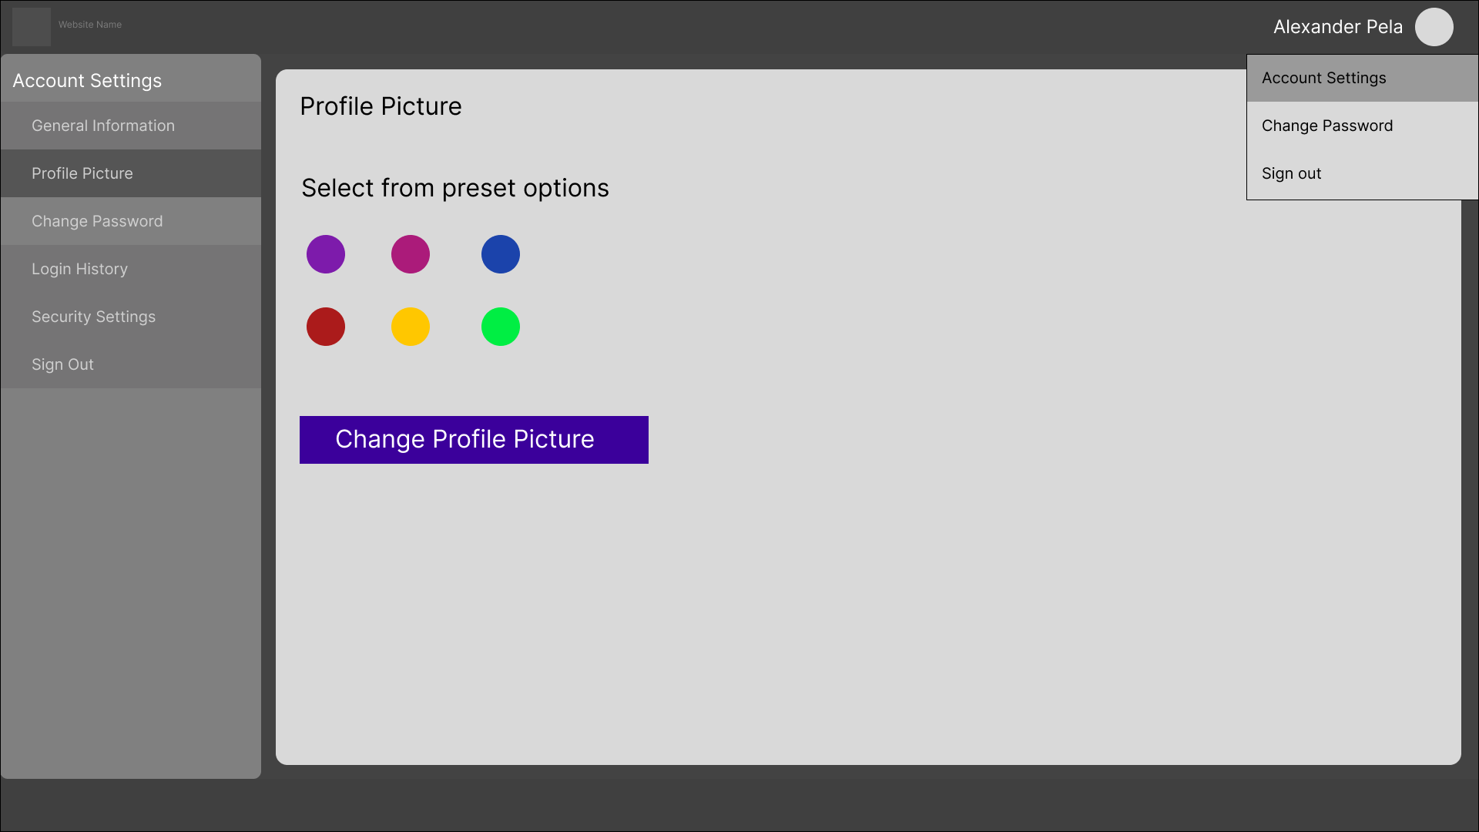
Account Settings (Profile Picture)

Slide 6
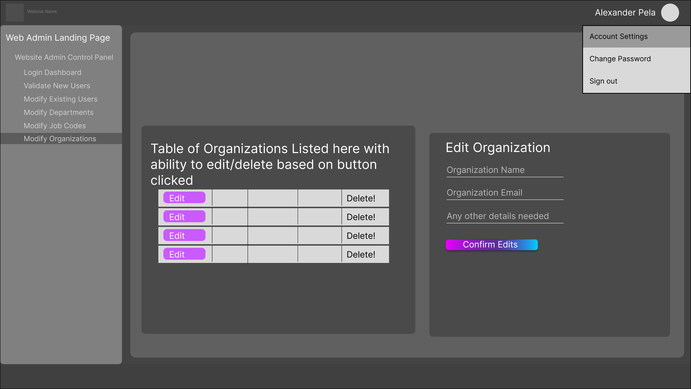
Organization CRUD

Slide 7
Milestone 2
Checking in on visual design and layout and acknowledging feedback:
Improve visuals
Change layout of all pages.
Finalized assets (fonts, colors, etc).
Workflow of each form/page

Slide 8
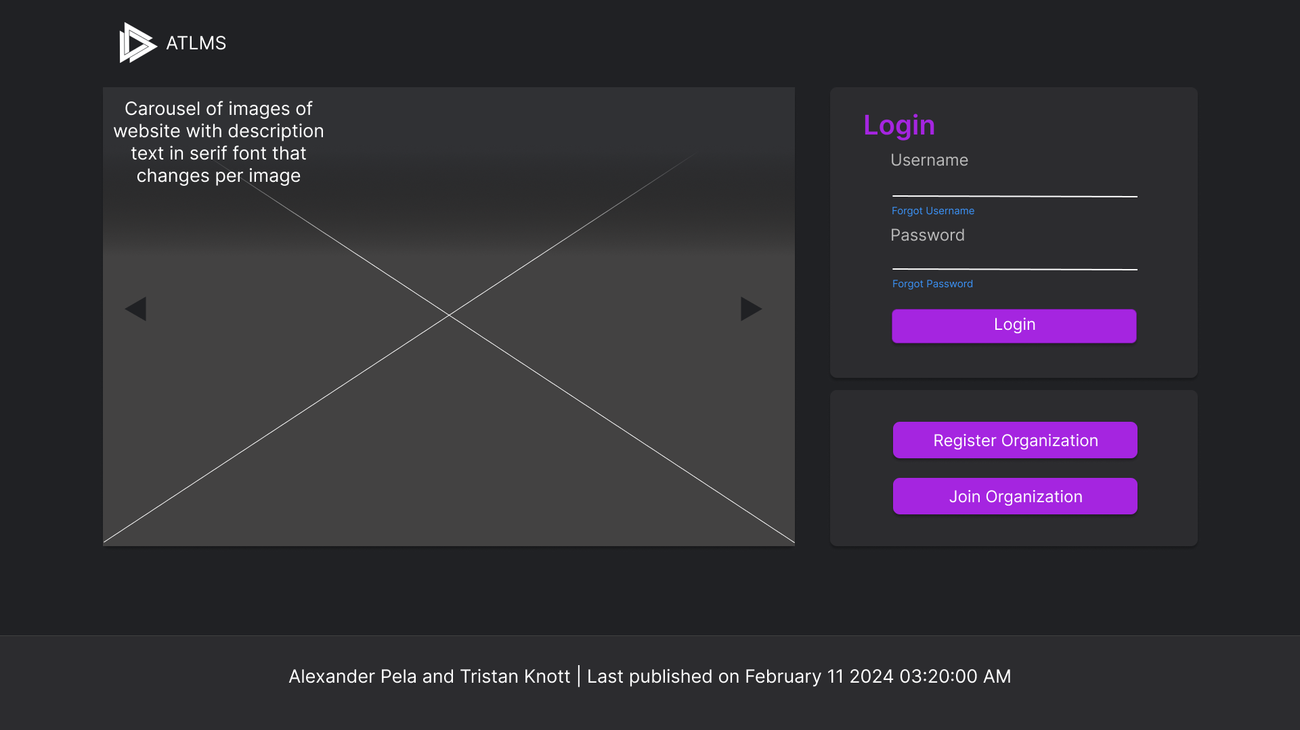
Login Page

Slide 9
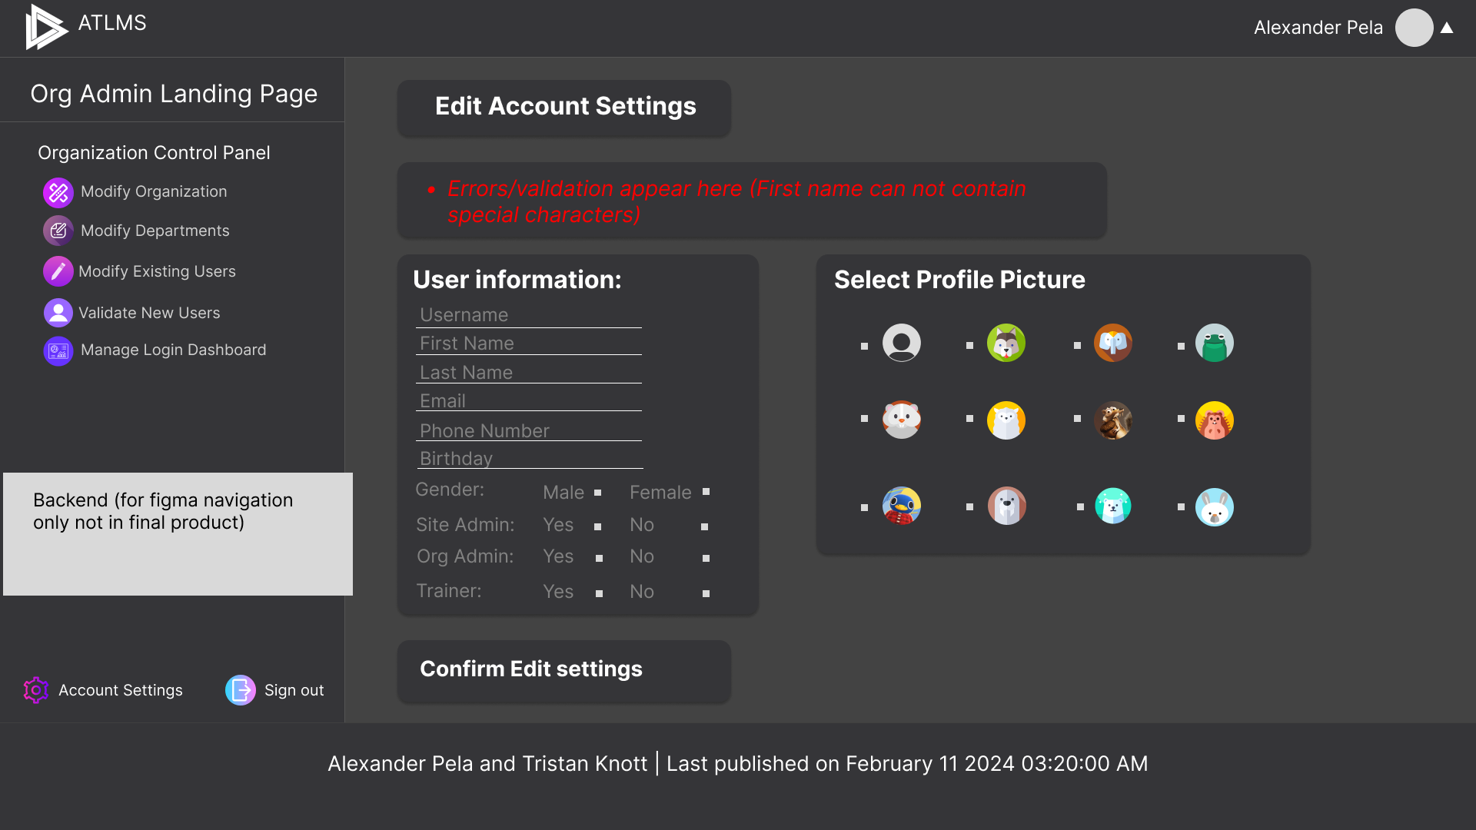
Account Settings

Slide 10
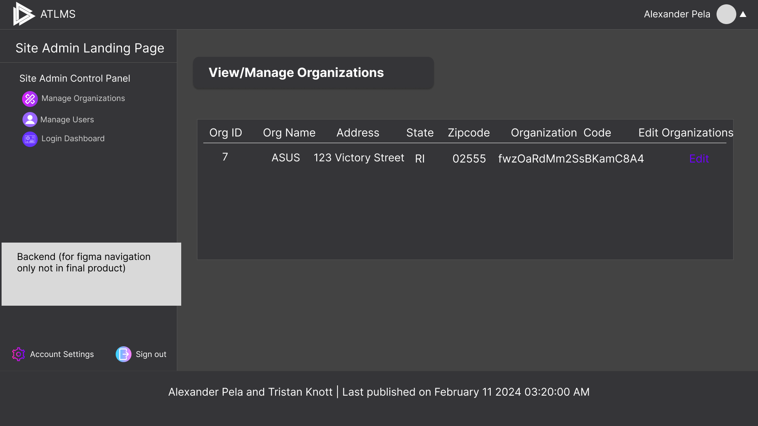
View Organizations

Slide 11
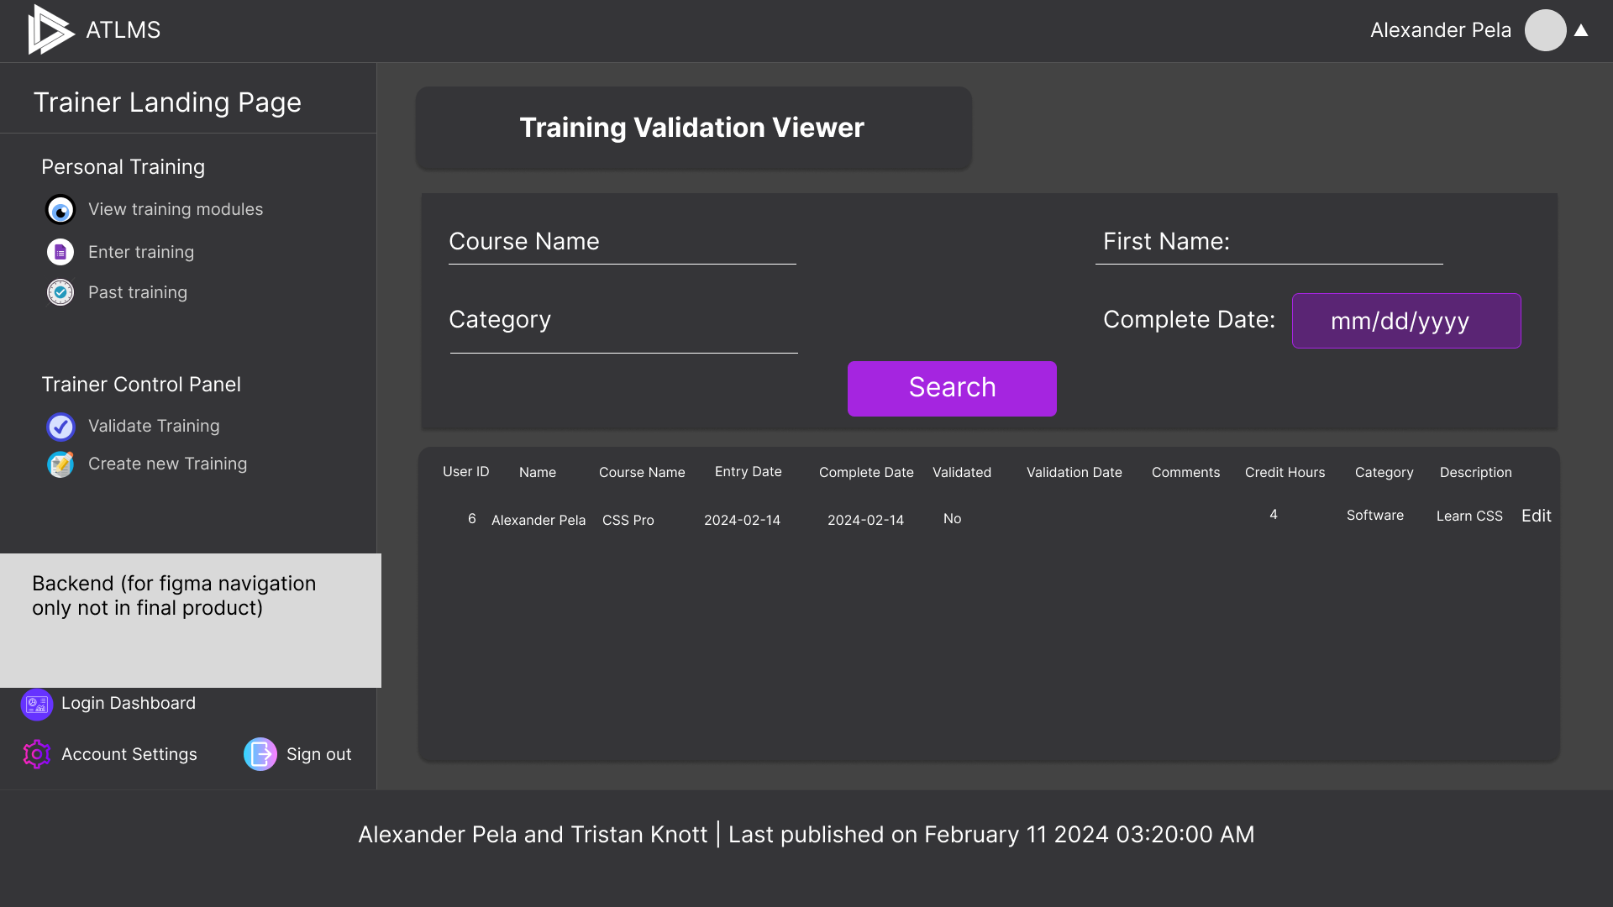
Training Validation Viewer

Slide 12
The Final Product
Addressing user feedback and the final visual changes.
Change error validation to be on client and appear next to each input
Improve search visuals.
Changing input types.

Slide 13
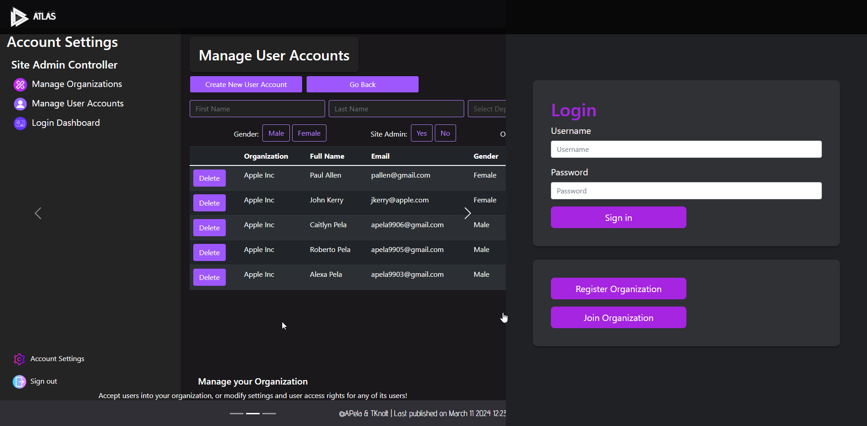
Login Page

Slide 14
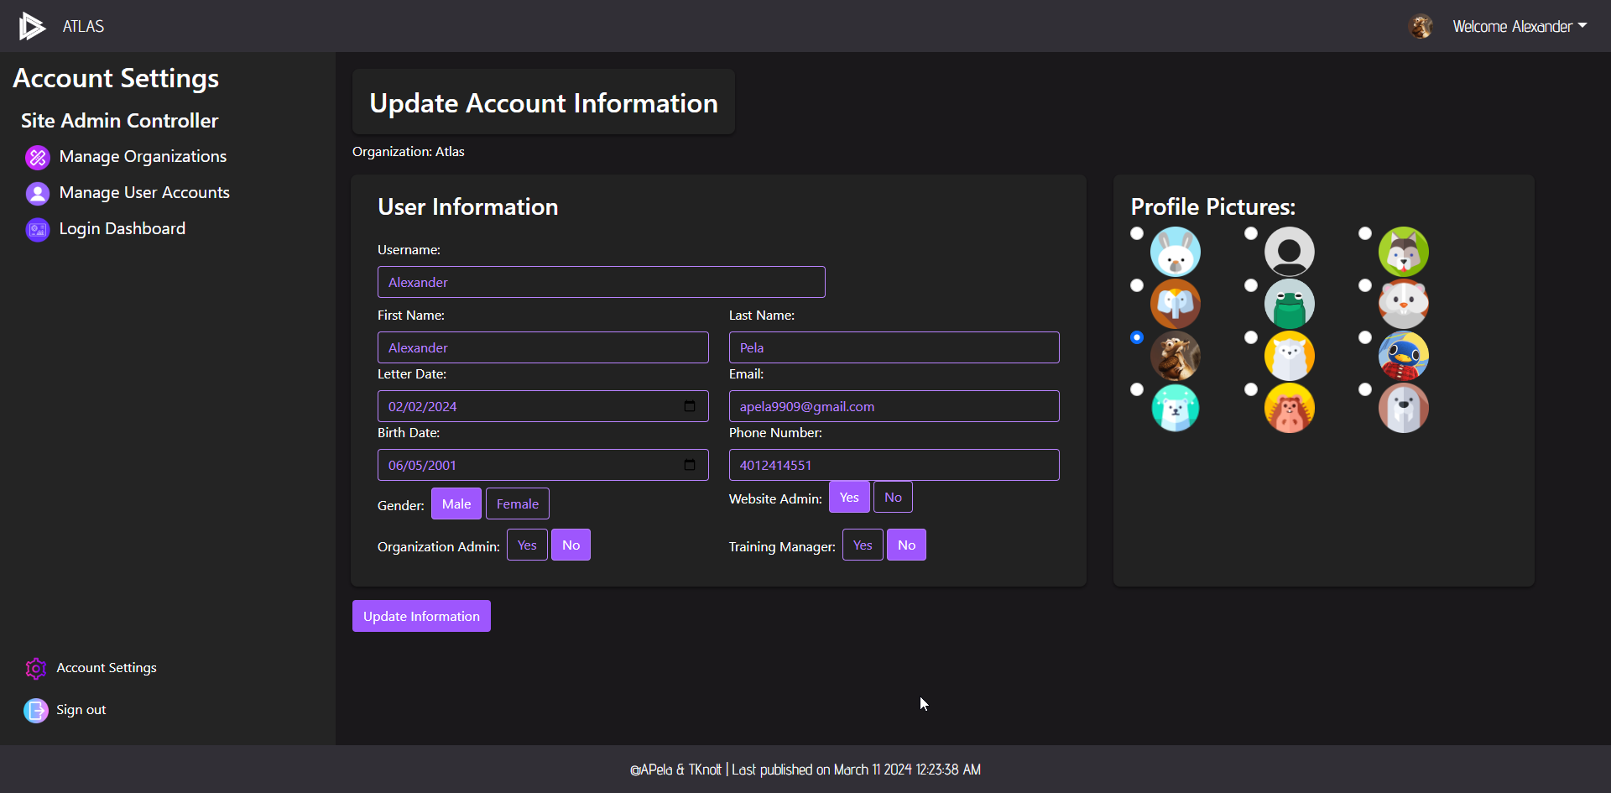
Update Account Information (Settings)

Slide 15
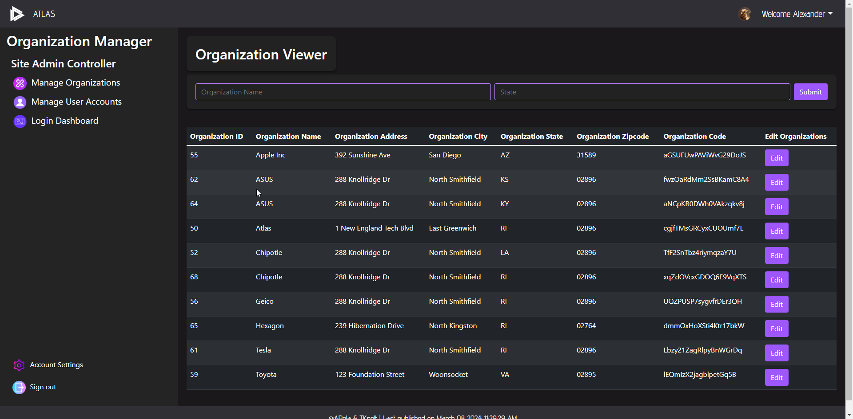
Organization Viewer

Slide 16
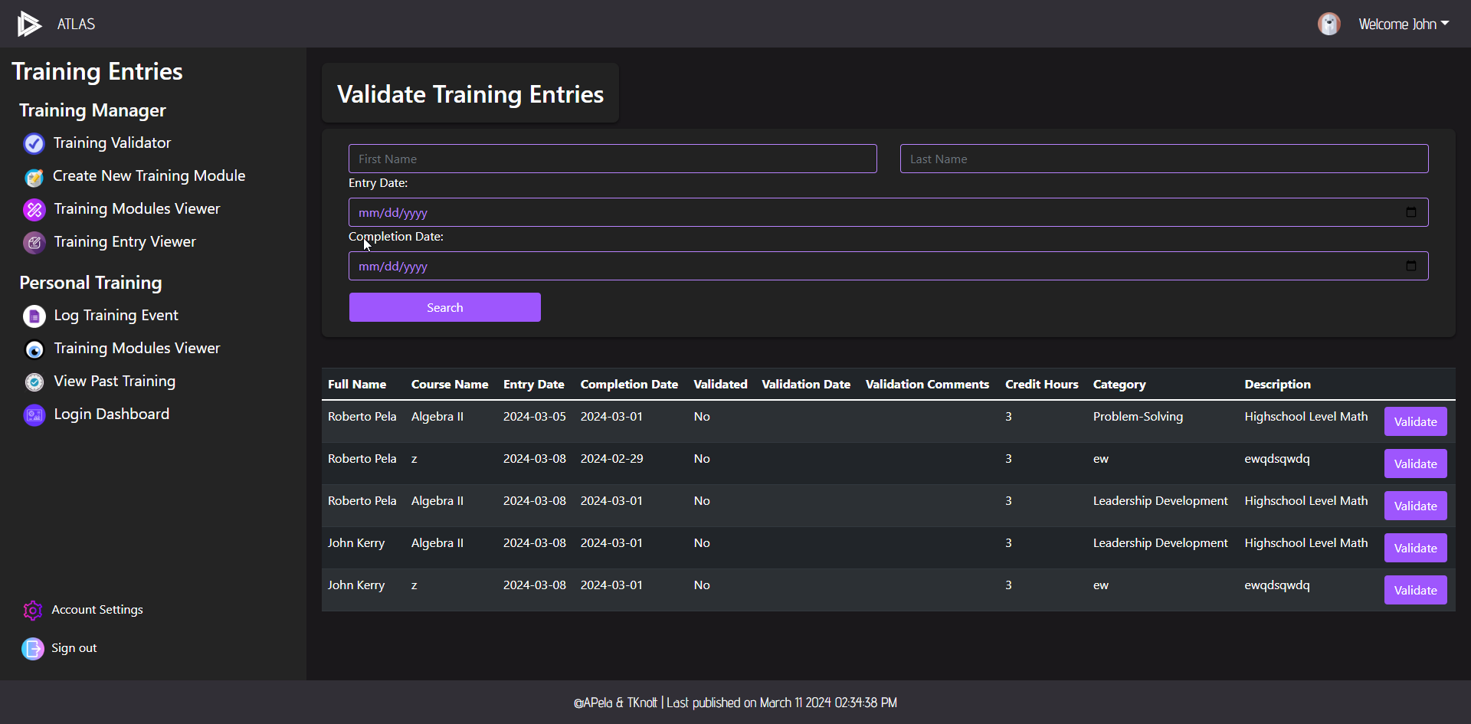
Training Validation Viewer

Slide 17
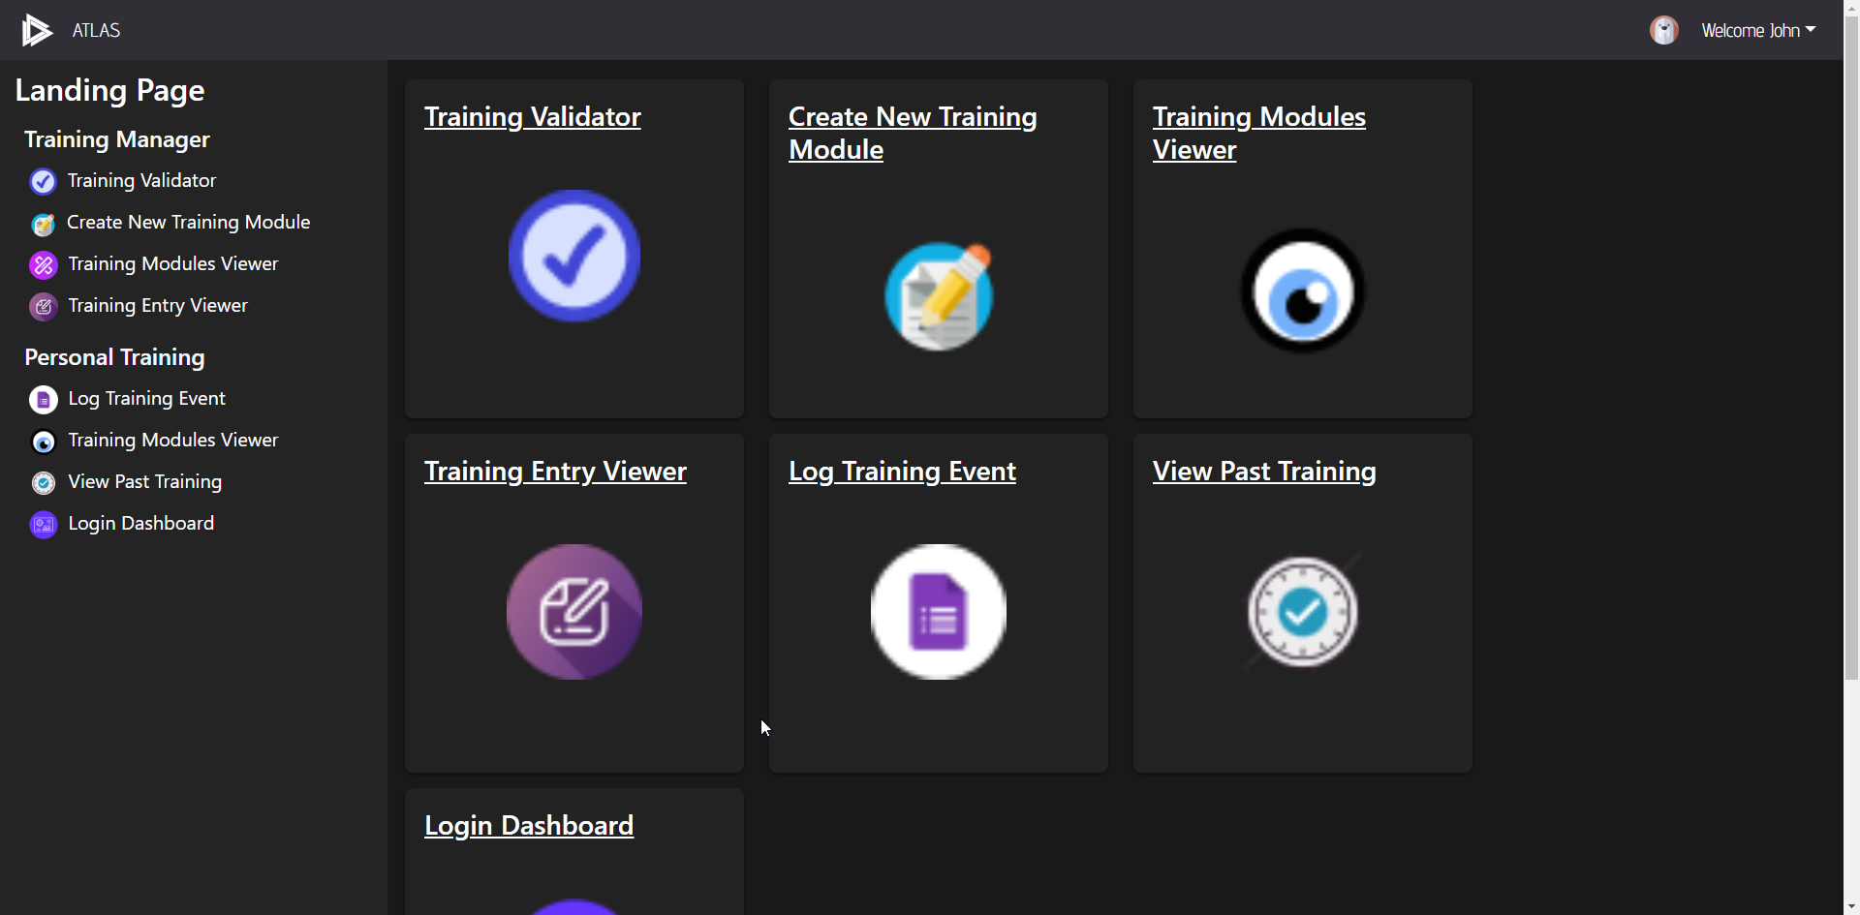
Landing Page

Slide 18
Alex’s Three Lessons
The importance of design and prototyping
Mastery of Bootstrap/CSS
Choosing colors for a project

Slide 19
Tristan’s Three Lessons
Organizing bootstrap/css settings early on
Setting up a code structuring pattern for sites with similar designs
Coding to match prototype

Slide 21
The end ☺
Remember that you are trying to show me that you followed the design process and that you can translate a design comp into a working front-end.
Keep it concise. I need you to highlight the design and implementation of that design.
Show me how you grew and gained new knowledge this quarter.

