Slide 1

Atlas
Alexander Pela & Tristan Knott

Slide 2

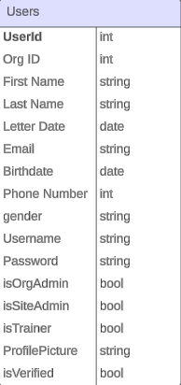
What is Atlas?
“
”
A web-based Learning Management Software crafted to meet the training program needs of small-to medium-sized organizations.

Slide 3
Run Code
Examples
Show Organization Join and Create:
Personalize Account Settings/Enter Trainings on training manager. (ATLAS_JKerry1963, TestTrainer2!)
Site Manager show managing an organization (Alexander, AlexanderPela)

Slide 4
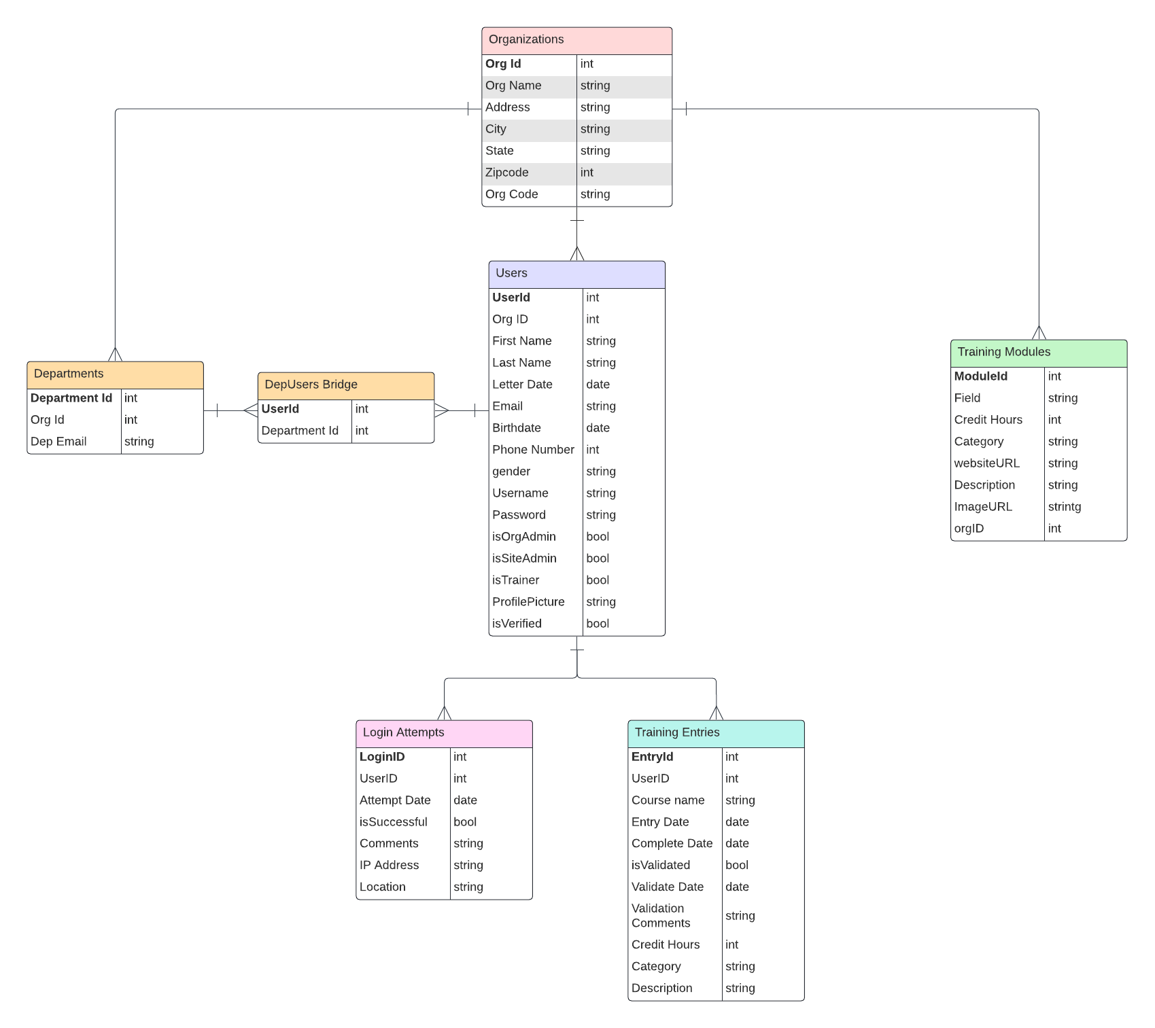
ERD

Slide 5
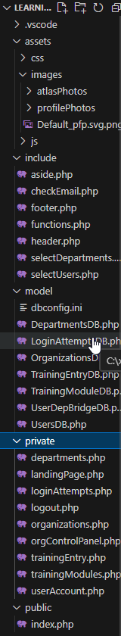
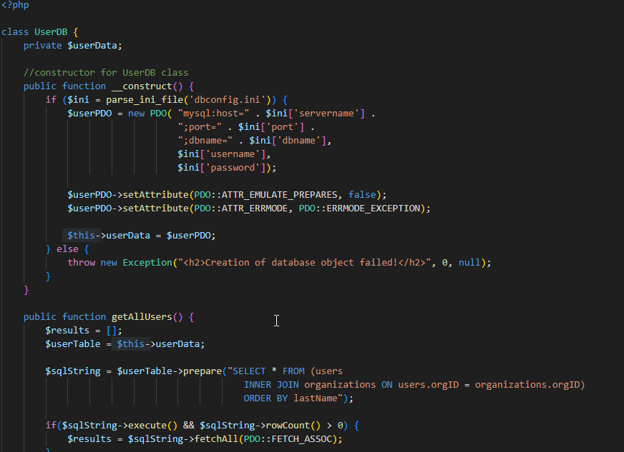
File Structure (UserDB)

Slide 6
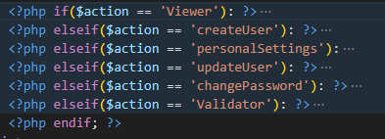
Action

Slide 7

isSiteAdmin/OrgAdmin/Trainer/Verified

Slide 8
Alex’s Successes, Failures, Impediments
Successes:
Understanding the “flow of code” (Pseudo coding with comments).
Creation of full-stack software.
Failures:
Job Codes feature was cut. (Too many levels of users and views).
Impediments:
Maintaining a healthy balance between project, other classes, work, etc.

Slide 9
Tristan’s Successes, Failures, Impediments
Successes:
1
2
Failures:
3
Impediments:
4

Slide 10
What would you do differently
Design and Documentation time.
Prioritize getting functionality coded first and then working on visual code.

Slide 11
Future Growth
Project:
Make trainings be assigned by departments in an organization.
Make Power BI like dashboards for users.
Reintroduce Job Codes.
Personal:
Work on website projects for other people to improve as Software Engineers.

