Slide 1

LINQ QUERIES
By Salami Oluwapelumi and Oyinbo John

Slide 2
AGENDA
What is LINQ Why should we use LINQ , what are the benefits of using LINQ,
LINQ on the whiteboard
C# Enhancement Features
Extension methods, Lambda Expression,
Implicit Typing.
LINQ QUERIES
Different ways of writing LINQ queries,Fluent Syntax,
Query Expression.
LINQ OPERATORS
Deferred Execution, LINQ Operators, Filtering
Projecting, Ordering, Joining
Questions

Slide 3
WHAT IS LINQ?
LINQ stands for Language Integrated Query
LINQ was introduced in C# 3.0 and Framework 3.5.
LINQ is a set of language and framework features for writing structured type-safe queries over local object collections and remote data sources.
LINQ enables you to query any collection implementing IEnumerable<T>

Slide 4
Advantages of LINQ
Familiar language: Developers don’t have to learn a new query language for each type of data source or data format.
Less coding: It reduces the amount of code to be written as compared with a more traditional approach.
Readable code: LINQ makes the code more readable so other developers can easily understand and maintain it.

Slide 5
Advantages of LINQ
Standardized way of querying multiple data sources: The same LINQ syntax can be used to query multiple data sources.
Compile time safety of queries: It provides type checking of objects at compile time.
IntelliSense Support: LINQ provides IntelliSense for generic collections.
Shaping data: You can retrieve data in different shapes.

Slide 6
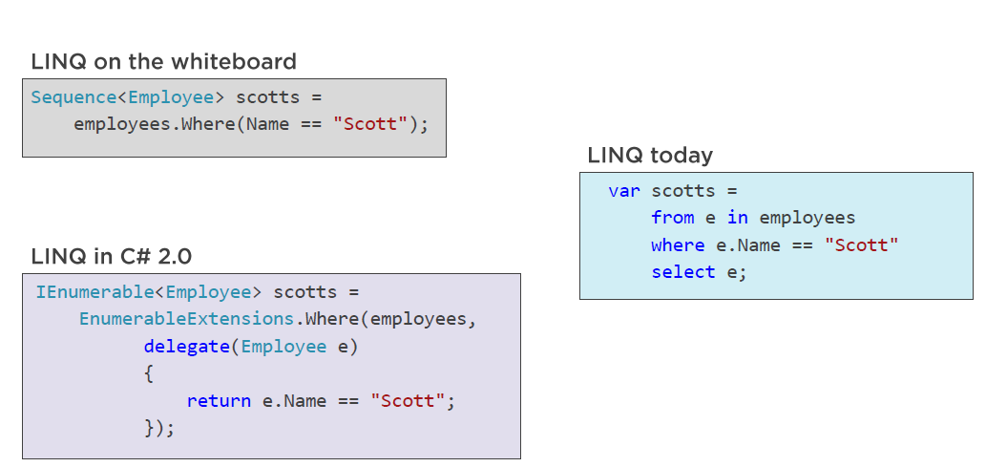

Slide 7
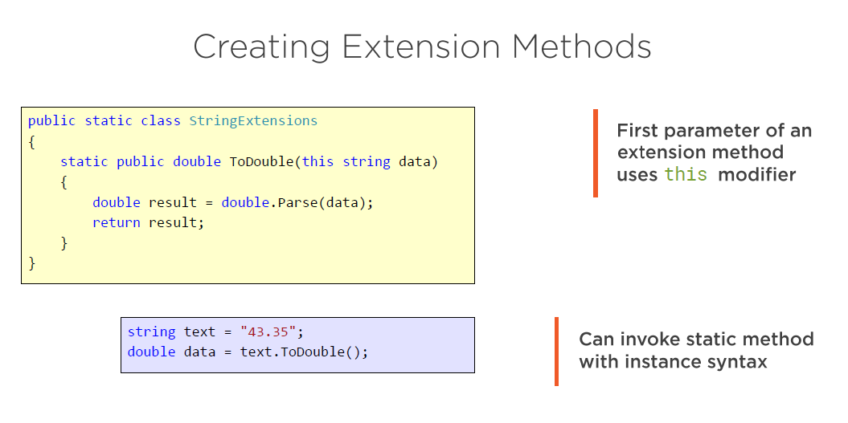
C# Enhancement Features: Extension Methods

Slide 8
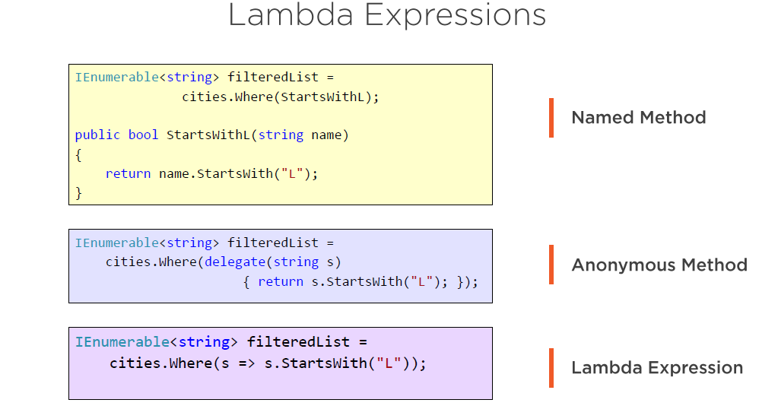
C# Enhancement Features: Lambda Expressions

Slide 9
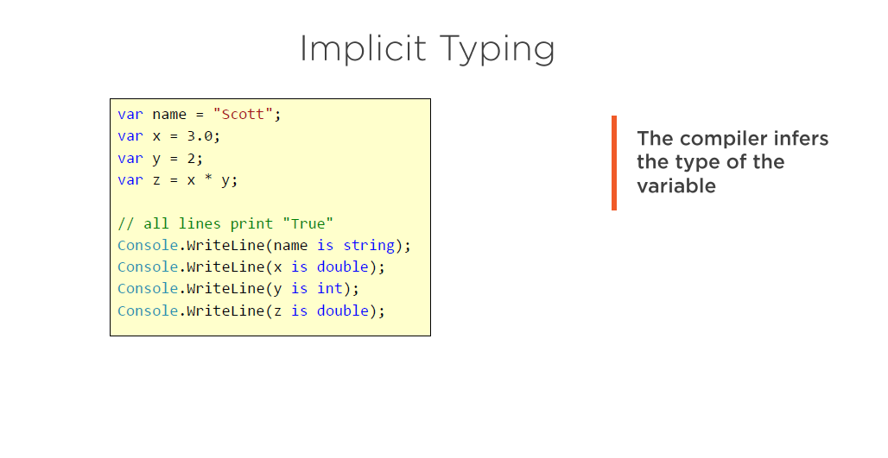
C# Enhancement Features: Implicit Typing

Slide 10
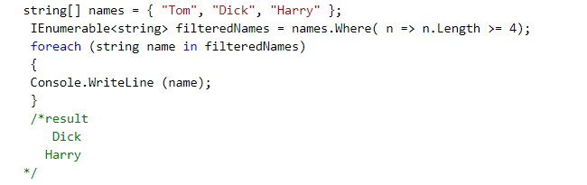
WHAT IS A QUERY?
A query is an expression that, when enumerated, transforms sequences with query operators.
The simplest query comprises one input sequence and one operator.
There are two kinds of ways of writing queries in C# namely;
Fluent Syntax. And;
Querry Expression.

Slide 11
LINQ QUERIES
To write LINQ queries we use the LINQ Standard Query Operators. The following are a few Examples of Standard Query Operators select, from, where, orderby, join, groupby.
The Standard Query Operators are implemented as extension methods on IEnumerable<T> interface
From a performance perspective there is no difference between the two. Which one to use depends on your personal preference.
NB: But keep in mind, behind the scene, LINQ queries written using SQL like query expressions are translated into their lambda expressions before they are compiled.

Slide 12
FLUENT SYNTAX
Fluent syntax is the most flexible and fundamental way to query a data store.
It allows operator chaining.
Extension Methods and Lambda expressions are quite important to this process.
The example in the next slide is a fluent syntax

Slide 13
QUERY EXPRESSIONS
C# provides a syntactic shortcut for writing LINQ queries, called query expressions.
Query expressions always start with a from clause and end with either a select or group clause.
The from clause declares a range variable.
A range variable refers to the current element in the sequence that the operation is to be performed on.
The compiler processes a query expression by translating it into fluent syntax.

Slide 14
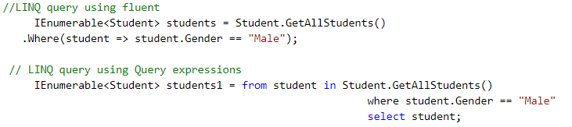
FLUENT SYNTAX VS QUERY EXPRESSIONS DEMO

Slide 15
DEFERRED EXECUTION
LINQ operators can be broadly classified into 2 categories based on the behavior of query execution 1. Deferred or Lazy Operators - These query operators use deferred execution. Examples - select, where, Take, Skip etc.
An important feature of most query operators is that they execute not when constructed, but when enumerated.EXECUTION
2. Immediate or Greedy Operators - These query operators use immediate execution. Examples - count, average, min, max, ToList etc.
All standard query operators provide deferred execution, with the following exceptions:
Operators that return a single element or scalar value, such as First or Count.
The following conversion operators:
ToArray, ToList, ToDictionary, ToLookup.

Slide 16
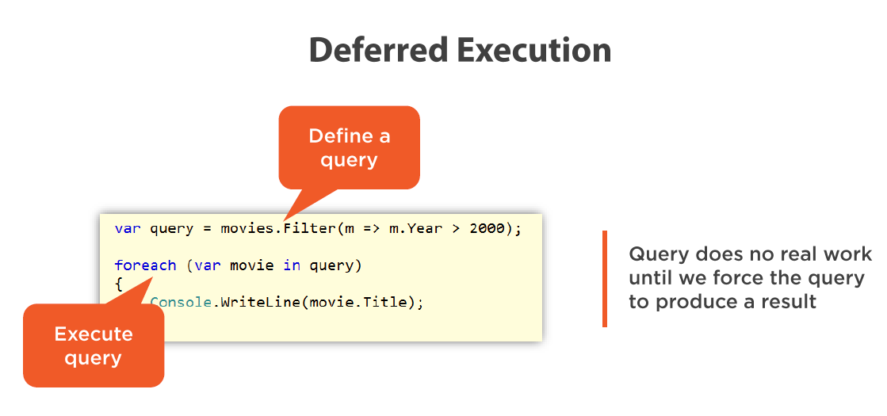
DEFERRED EXECUTION DEMO

Slide 17
LINQ OPERATORS
The standard query operators fall into three categories:
Sequence in, sequence out (sequence-to-sequence).E.g filtering, projecting and joining.
Sequence in, single element or scalar value out. E.g aggregation methods and quantifiers.
Nothing in, sequence out (generation methods). E.g generation methods like Empty, Range, Repeat.

Slide 18
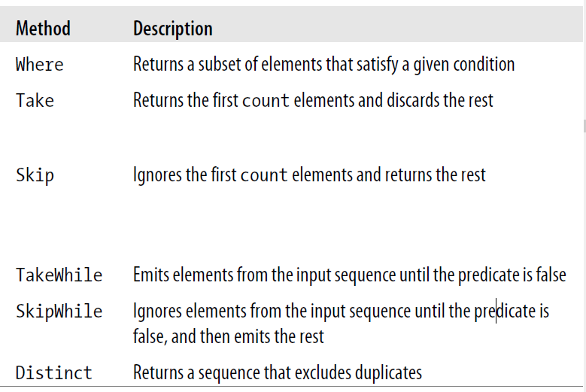
FILTERING

Slide 19
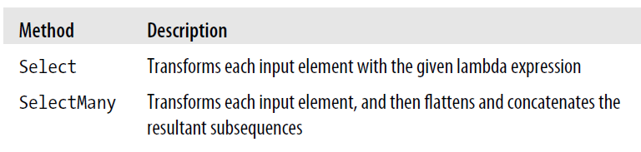
PROJECTING

Slide 20
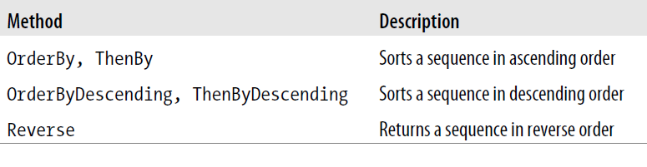
ORDERING

Slide 21
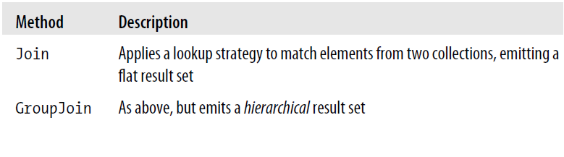
JOINING

Slide 22
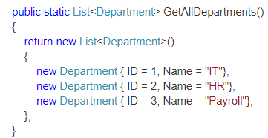
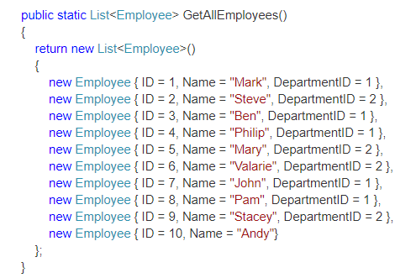
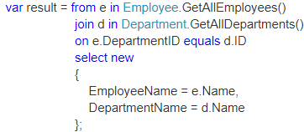
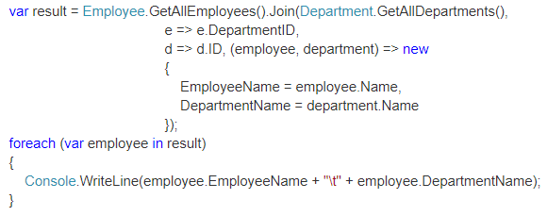
Joining Demo

Slide 23
QUESTIONS???
THANKS.

