Slide 1

FOOTBALL PLAYERS VALUE PREDICTION
Peleg Levy & Koral Tayeb
DS Final Project

Slide 2

TABLE OF CONTENTS
01
Introduction
02
Web Scraping & Data Cleaning
03
Exploratory Data Analysis
04
Building a Model & Evaluating Model’s Result
05
Results & Conclusion
Define The Problem &
Research lead question
Resources, Crewing process, Final data to analyze structure
Discovering patterns & recognizing anomalies in our data
How market value is defined?

Slide 3
Introduction
Football clubs spend a huge amount of money every year to buy professional football players, during the transfer window. The case we are trying to build is that there seems to be evidence of a player’s market value being correlated with the player statistics. This is interesting because ability and performance are notoriously difficult to quantify in football. It varies with the playing qualities, position, the league, the ability of his own teammates, and so on.
Consequently, valuing a player is very hard to predict. In this project, we have constructed a dataset using 2912 players from 98 teams playing in Top 5 European leagues, and we have estimated players’ market value using linear regression analysis & machine learning tactics.

Slide 4

Research Lead Question
Can the value of a football player be predicted from their playing attributes and metadata?

Slide 5
Web Scraping & Data Cleaning
Resources
Web Scrapping using Crawling
Data Cleaning
Results
II.
I.
Transfermarket.us
Fbref.com
Using Crawling to get our players data statistics
Using Crawling to get the real market value of each player.
III.
IV.
Drop NaN (empty) values.
Check Duplicated values.
Drop unnecessary columns.
Unreadable characters or spaces.
Replace players value to $m resolution.
One dataframe which is built from 6 DF of a football player characteristics:
Stats, shooting, passing, creation, defense, miscellaneous.
Get the real market value for each player of our DF.

Slide 6
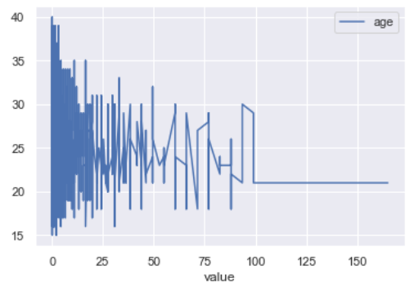
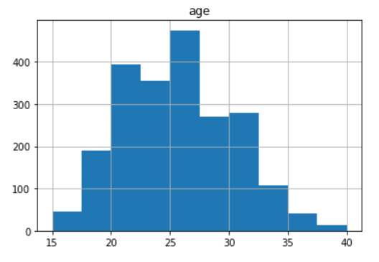
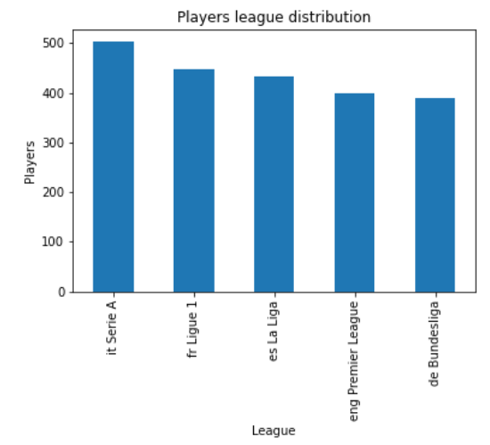
Exploratory Data Analysis (EDA)
Exploratory Data Analysis refers to the critical process of performing initial investigations on data so as to discover patterns, to recognize anomalies & check assumptions with the help of summary statistics and graphical representations.
In our project we were looking for the correlations between a player’s statistics compared to his position, age, and real market value.

Slide 7

Building Linear Regression Model How market value is defined?
Ability
Position
Age
The main aim is to see whether market value can be determined using his performance statistics. A player’s market value can be represented by:
Unique abilities to each position
+
Defender, Attacker, Forward
+
Our players are 18-40 years old

Slide 8
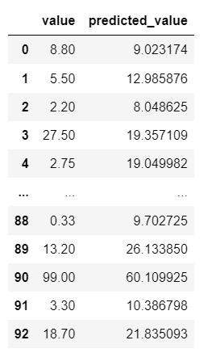
RESULTS & CONCLUSIONS
Popularity has a big influence on a player market value.
Football team sees part of their players as a economic property, who can raise the clubs financial profits.
Team members may affect each other's statistics.
Players with long-term injuries may have far fewer hits, simply because they haven’t been playing.
Player popularity in his country
The economic strength and prestige of the club
New signings may get more attention, even beyond the transfer season.
We tried a Linear Regression on all of our players divided to positions with parameters that are necessary to each positions.
Finally we did not find out a high fit with part of the players’ real value by our model.
When we noticed the big space error in part of our predictions, we had a research and found several reasons of data enrichment options & challenges:

Slide 9
THANKS

