Slide 1
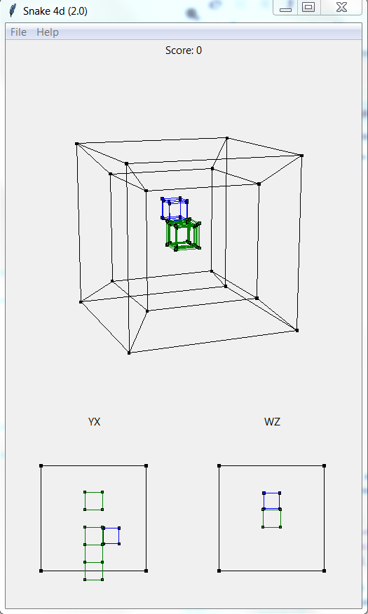
Perspective projection
Flat projection
W
S
I
K
A D
J L

