Slide 1
License Plate recognizer
Pelle Reyniers

Slide 2
Presentation content
Introduction
Problem Breakdown
Components
Conclusion
Demo
Q&A

Slide 3
Presentation content
Introduction
Problem Breakdown
Components
Conclusion
Demo
Q&A

Slide 4
Introduction
Objectives
Possible Extensions
Information
Practical usage

Slide 5

Information
Input of the system: graphic image or moving images
Output of the system: License plate in ASCII or string form
Digital system

Slide 6

Objectives
Creating a script that manipulates the images so the license plate becomes clear.
Creating a script that returns the license plate when (in string format) when a picture is given as input.
Use Matlab to execute all scripts.

Slide 7

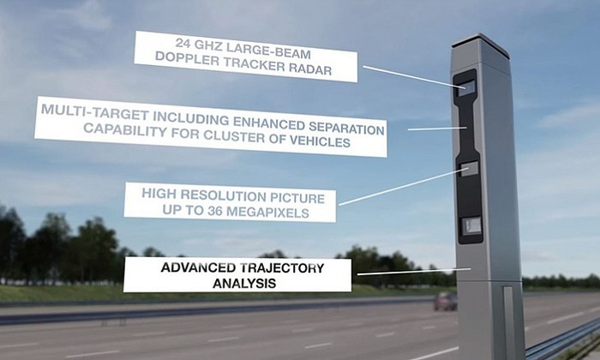
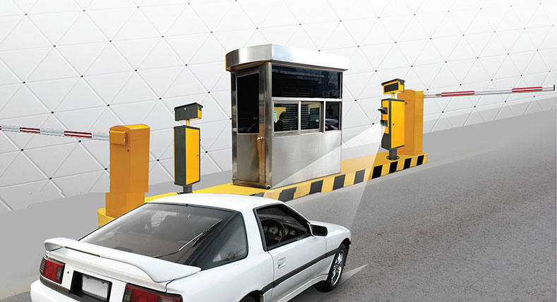
Practical usage

Slide 8

Possible Extensions
Investigate the use of parallel programming CUDA
Moving Images instead of static

Slide 9
Presentation content
Introduction
Problem Breakdown
Components
Conclusion
Demo
Q&A

Slide 10
Problem Breakdown
Image Manipulation
The Search
Evaluation

Slide 11
Presentation content
Introduction
Problem Breakdown
Components
Conclusion
Demo
Q&A

Slide 12

Image Manipulation
Re-scale and grey scale
Noise reduction
Edge detection
Clear edges
Fill regions

Slide 13
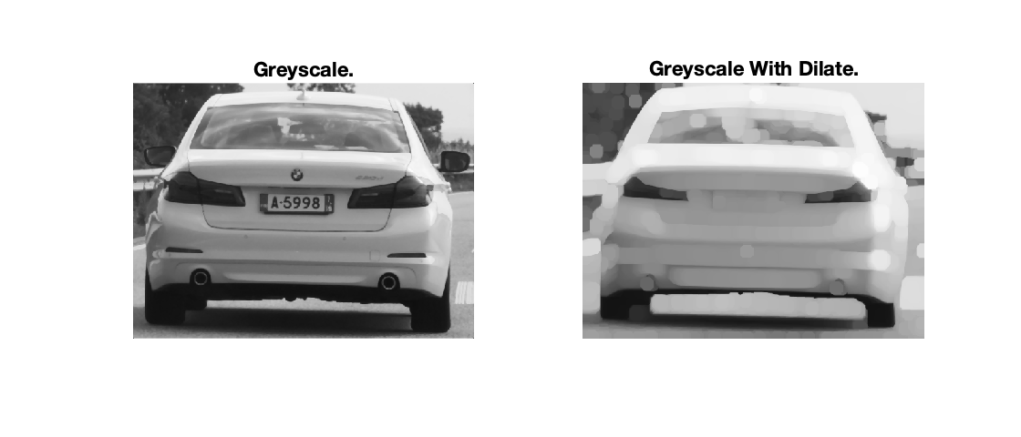
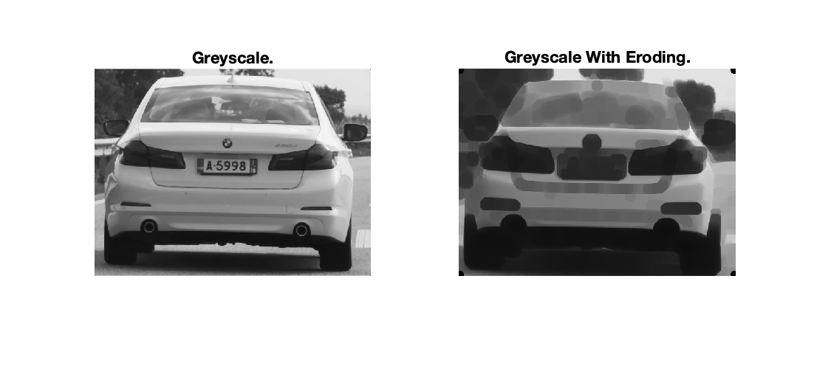
Image Manipulation

Slide 14
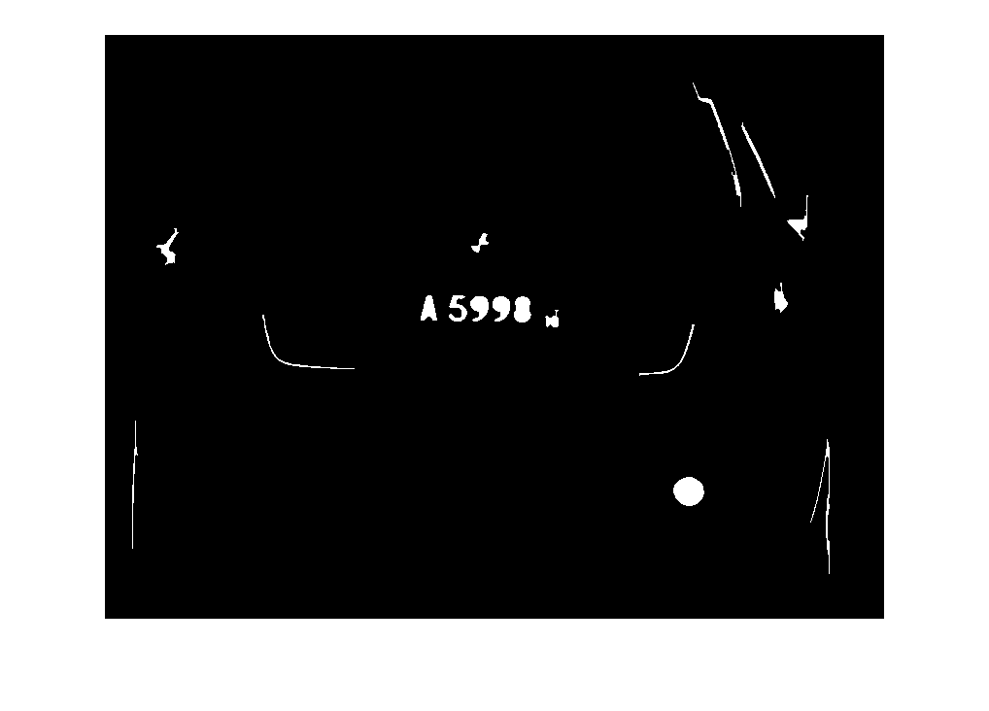
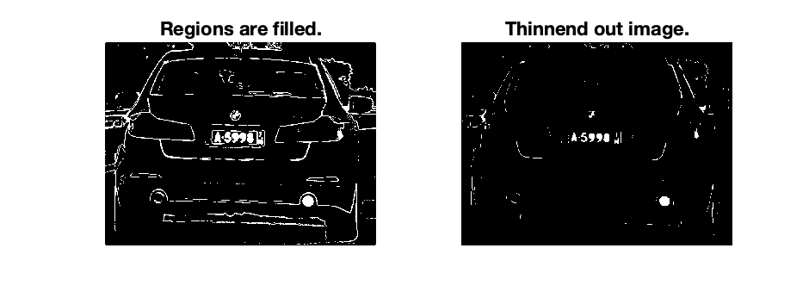
Image Manipulation

Slide 15

The Search
overall
Find Candidates
Find candidates
Test
Choice
Search for regions
Selection

Slide 16
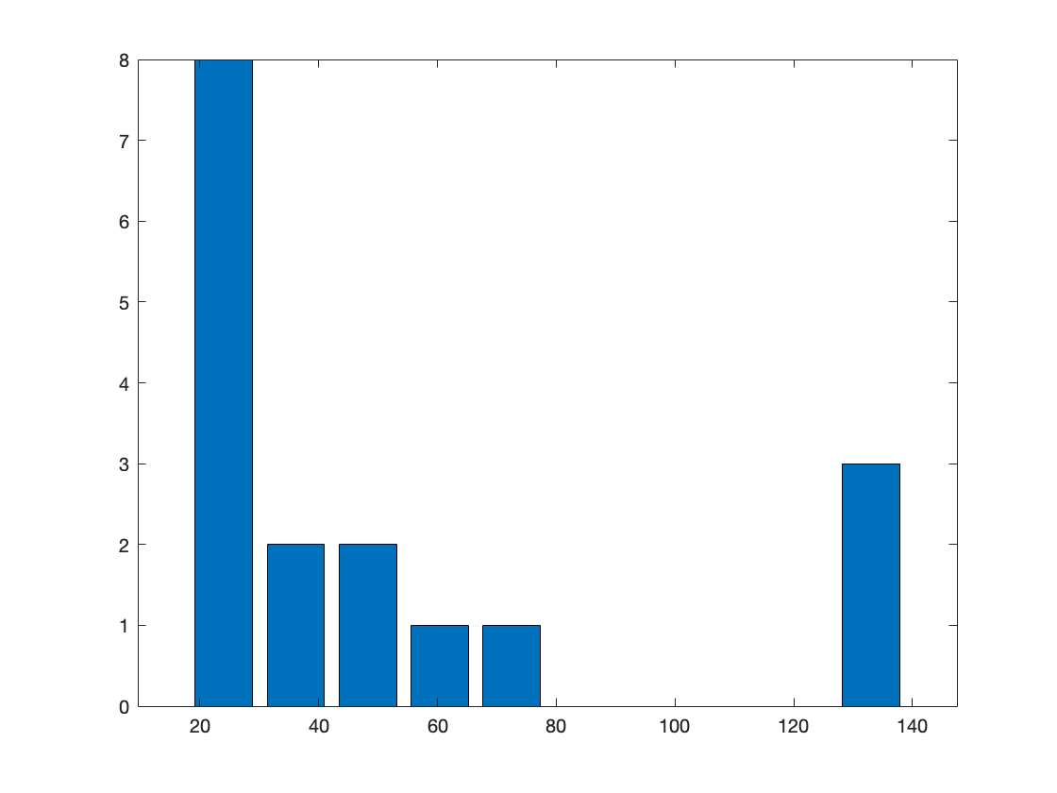
Find candidates
histogram
Iterate regions
Iterate and correlations
Selection

Slide 17
Presentation content
Introduction
Problem Breakdown
Components
Conclusion
Demo
Q&A

Slide 18
Conclusion
Working
Selection Problems
Selection Solutions
Other strategies

Slide 19
Presentation content
Introduction
Problem Breakdown
Components
Conclusion
Demo
Q&A

Slide 20
Demo

Slide 21
Presentation content
Introduction
Problem Breakdown
Components
Conclusion
Demo
Q&A

Slide 22


