Slide 1
License Plate recognizer
Pelle Reyniers

Slide 2
Presentation content
Introduction
Problem Breakdown
Components
Conclusion
Demo
Q&A

Slide 3
Presentation content
Introduction
Problem Breakdown
Components
Conclusion
Demo
Q&A

Slide 4
Introduction
Objectives
Possible Extensions
Information
Practical usage

Slide 5

Information
Input of the system: graphic image or moving images
Output of the system: License plate in ASCII or string form
Digital system

Slide 6

Objectives
Creating a script that manipulates the images so the license plate becomes clear.
Creating a script that returns the license plate when (in string format) when a picture is given as input.
Use Matlab to execute all scripts.

Slide 7

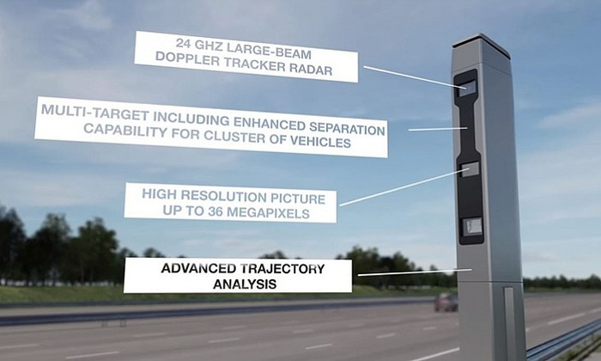
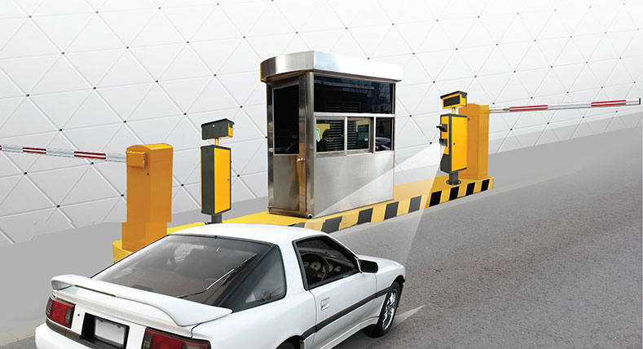
Practical usage

Slide 8

Possible Extensions
Investigate the use of parallel programming CUDA
Moving Images instead of static

Slide 9
Presentation content
Introduction
Problem Breakdown
Components
Conclusion
Demo
Q&A

Slide 10
Problem Breakdown
Image Manipulation
The Search
Evaluation

Slide 11
Presentation content
Introduction
Problem Breakdown
Components
Conclusion
Demo
Q&A

Slide 12
Image manipulation

Slide 13
The Search

Slide 14
Evaluation

Slide 15
Presentation content
Introduction
Problem Breakdown
Components
Conclusion
Demo
Q&A

Slide 17
Presentation content
Introduction
Problem Breakdown
Components
Conclusion
Demo
Q&A

Slide 18
Demo

Slide 19
Presentation content
Introduction
Problem Breakdown
Components
Conclusion
Demo
Q&A

Slide 20
